Slide 1
Evaluation of machine learning algorithms for medical devices at the FDA
Aria Pezeshk, Nicholas Petrick, Berkman Sahiner
Division of Imaging, Diagnostics, and Software Reliability
Office of Science and Engineering Laboratories
Center for Devices and Radiological Health

Slide 2
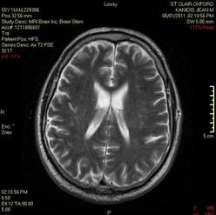
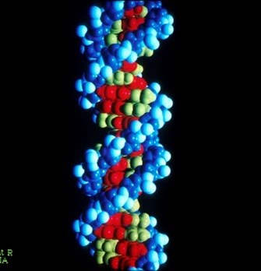

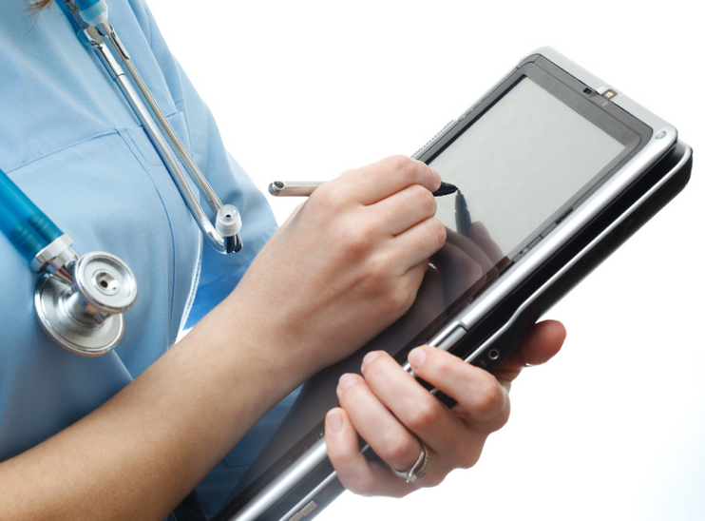
AI/ML Have Numerous Gateways into Medical Devices
Data Source
Imaging
Omics, lab tests on specimens
Biomedical signals
Other health records
In-vivo
  Radiology
  Nuc. Med.
  Optical
In-vitro
  Cytopathology
  Histopathology
ECG
EEG
EMG
Oxygenation
Evoked potentials
Continuous BP, resp. signals
Wearables
Demographics
Medical history
Clinical text
Laboratory results
Vital signs
Billing data
Data from wellness devices
Chatbots, speech-based assistants
Sequencing
  DNA
  RNA
  Protein
Microarray gene expression
ML application examples
Filtering
Segmentation
CADe
CADx
Quantification
Image reconstruction
Artifact reduction
Protein structure prediction
Gene expression regulation
Protein classification
Anomaly classification
Patient monitoring
Alarms
Anomaly detection
Anomaly classification
Quantification

Slide 3
AI/ML Has Numerous Gateways into Medical Devices
Data Source
Imaging
Omics, lab tests on specimens
Biomedical signals
Other health records
In-vivo
  Radiology
  Nuc. Med.
  Optical
In-vitro
  Cytopathology
  Histopathology
Demographics
Medical history
Clinical text
Laboratory results
Vital signs
Billing data
Data from wellness devices
Chatbots, speech-based assistants
Sequencing
  DNA
  RNA
  Protein
Microarray gene expression
ECG
EEG
EMG
Oxygenation
Evoked potentials
Continuous BP, resp. signals
Wearables
ML application examples
Tailoring treatment
Prediction of patient outcome
Patient stratification, triage
Population-wide health research and outcomes
ML/AI-guided development of new drugs, devices, and treatments

Slide 4
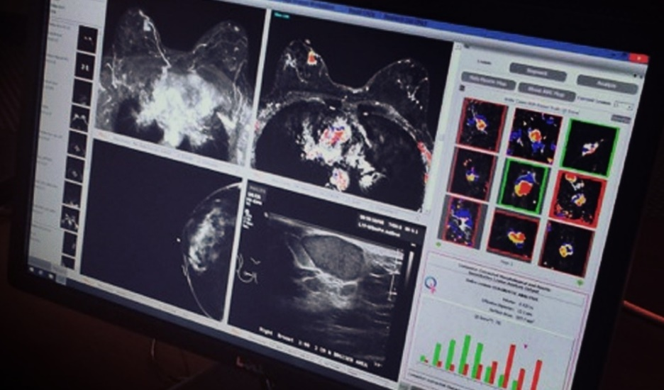
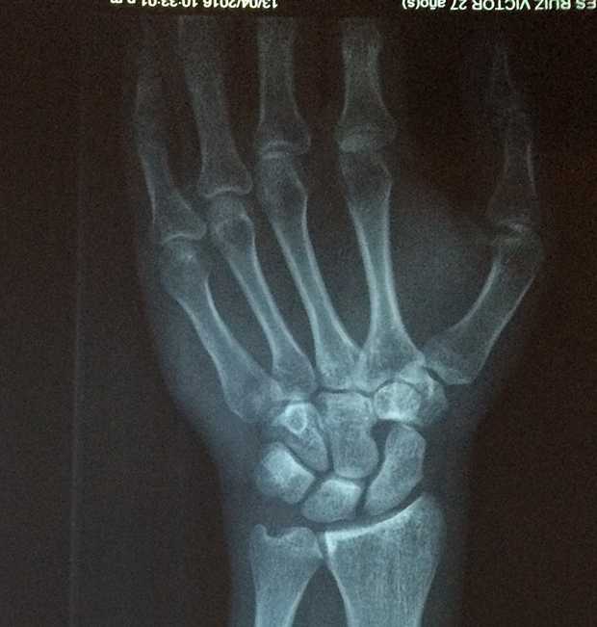
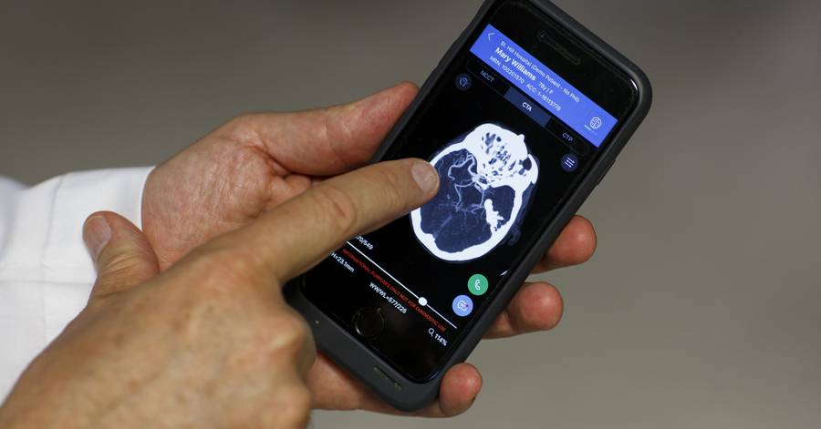
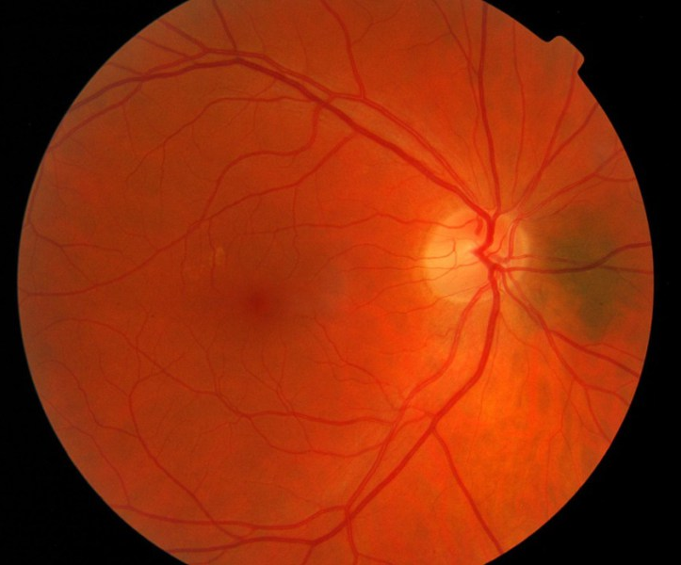
Many New DeNovo Devices Incorporating AI/ML in Medical Imaging in the Past 2 Years
Computer-Aided Classification of Breast Lesions on Magnetic Resonance Imaging:
Computer-Aided Diagnosis (CADx)
Computer-Aided Detection and Diagnosis of Fractures on Radiographs:
CADe + CADx
Notification of Specialists for Suspicion of Stroke on Computerized Tomography Images:
Radiological Computer Aided Triage
Detection of Diabetic Retinopathy on Retina Fundus Images:
Retinal Diagnostic Software

Slide 5
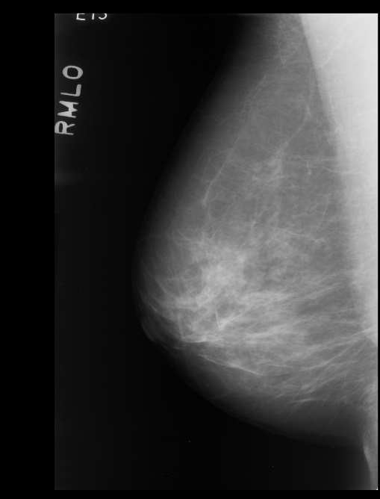
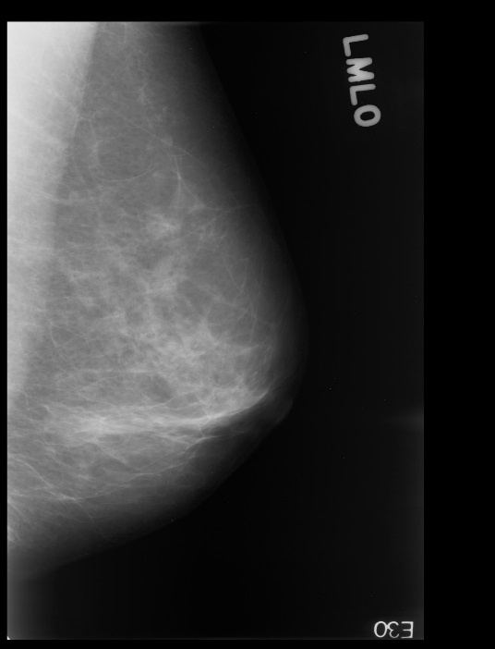
Assessment of Computer-Aided Detection Devices
ML-based disease prompting devices
Aimed at improving the performance of clinicians in disease detection
Two FDA guidances released in 2012
  Served as an example on how to assess newer types of devices
    Computer-aided classification
    Triage
    Combined image analysis

Slide 6
Device Description
Device & algorithm descriptions
  Device usage (mode of operation, patient population, …)
  Algorithm design and function
    Including structure of traditional ML or deep learning networks
    Inputs
      Type and range of signals/data
    Outputs
  Training process
  Training/test database
  Reference standard
  …
Needed for
  Understanding scope of a change in a modified CADe algorithm
  Comparing two devices
  May reduce performance testing requirements
Better description increases confidence in the device

Slide 7

Data
ML algorithms are data-driven
  Versus, for example, physics or biology based
ML algorithm development is now facilitated by standardized ML platforms
  Brings ML to a wider array of users
  The good
    Design of novel ML applications is streamlined for groups with access to high-quality data
  The bad
    Garbage in - garbage out
Clinical Data
Feature Extraction
ML Training
Trained Model
Training Data
Output

Slide 8

Performance Testing
Performance of ML algorithm on an independent, representative data
Firewall
Independent Test Data
Training Data
Learning Process
Training Set
Tuning Set
Learned Model (Fixed)
Learned Models
Selected Model
Test
Performance

Slide 9
Performance assessment
Standalone Performance
Clinical reader performance
Performance of algorithm alone
Assesses robustness and generalizability of algorithm
Assessment of clinical aids
Clinicians’ performance utilizing device
  Multi-reader multi-case designs
  Compare clinician’s performance with the ML SaMD aid to without the aid
Test Dataset
Apply
ML Alg.
Statistical
Analysis
Standalone
Performance
Clinical
w/o Aid Interp.
Test Dataset
Statistical Analysis
Reader
Performance
(Difference)
Apply
ML Alg.
Clinical
Aided Interp.

Slide 10
Some Key Characteristics / Unique Aspects in the Design / Evaluation of Machine Learning Algorithms
Data Driven:
  Need for large, representative, high-quality data sets with annotations / ground truth
  Potential for algorithmic bias
  Generalizability
Often aimed at helping clinicians:
  Explainability may be an issue
Open to evolving in time:
  Challenges of providing oversight to an AI-based product that is changing

Slide 11
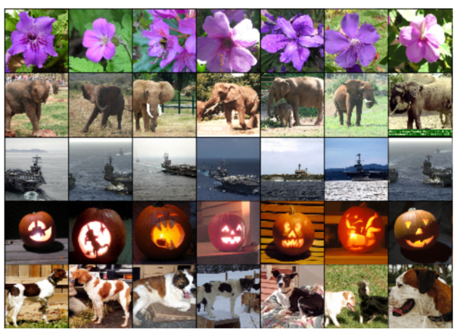
Many Well-Known ML Applications Rely on Large Data Sets for Training
ImageNet classification task
  1000 categories
  Training: 1.28M images with ground truth
  Test: 100k images, predict 5 (out of 1000) classes
Data augmentation is crucial:
  Baidu Automated Speech Recognition trained on 7,000h of labeled speech + 100,000h of synthetic speech
  Synthetic speech created by adding different types of background noise to their labeled speech dataset

Slide 12
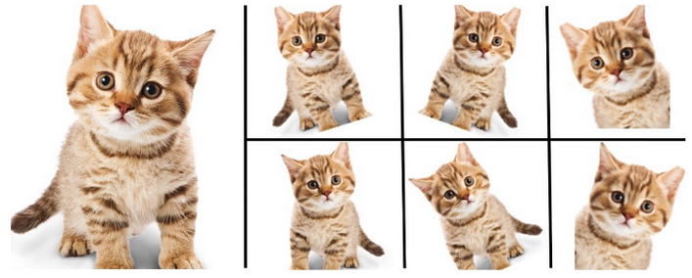
Data Augmentation
Typical augmentation methods in medical imaging include
  Shifts, flips, rotations, and sometimes scalings of regions of interest (ROIs)
  Other affine transformations
  Color transformations

Slide 13
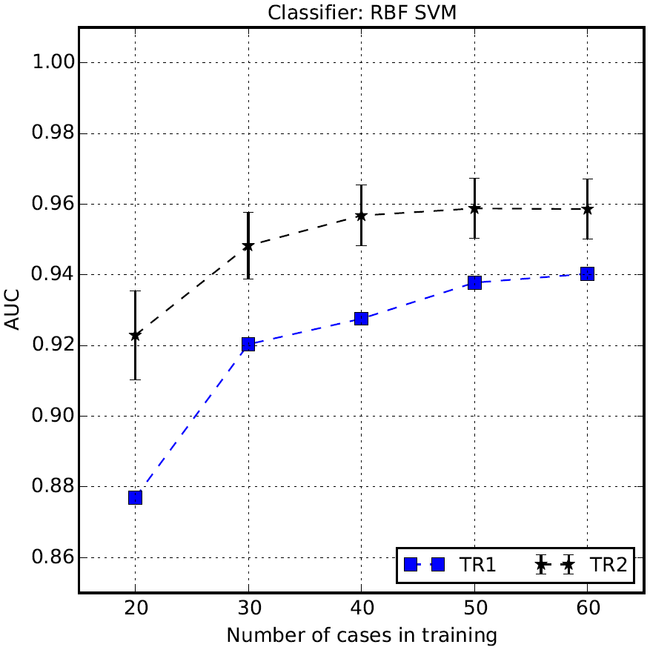
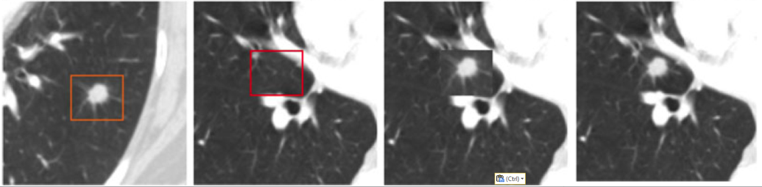
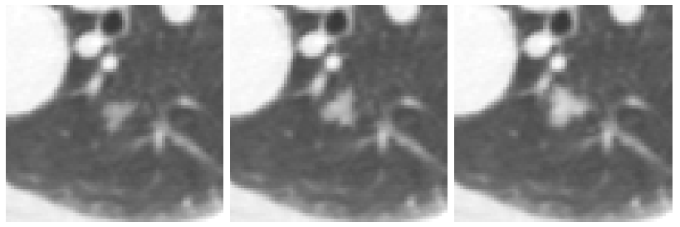
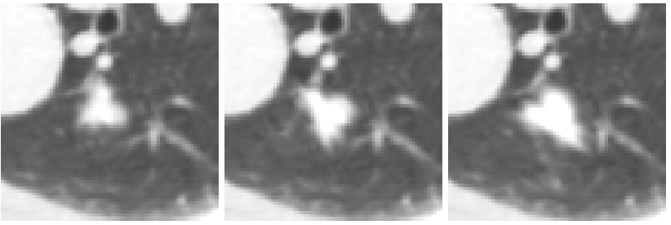
Computational Lesion Insertion for Training
Pezeshk et al.
IEEE TBME 2016
IEEE TMI 2017
Source
Target
Cut & Paste
Seamless Insertion

Slide 14
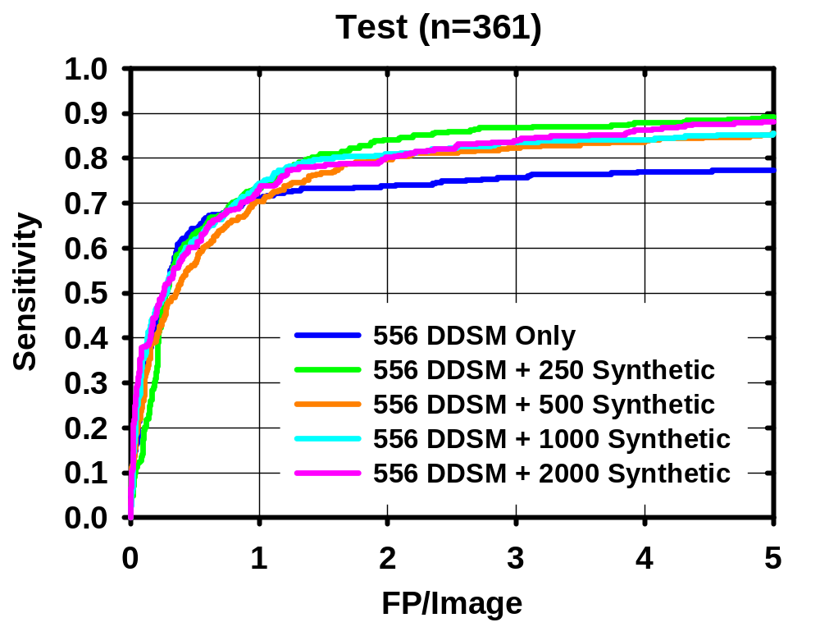
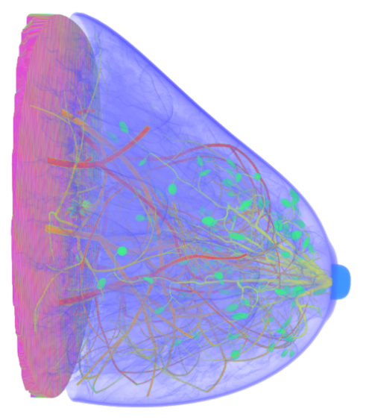
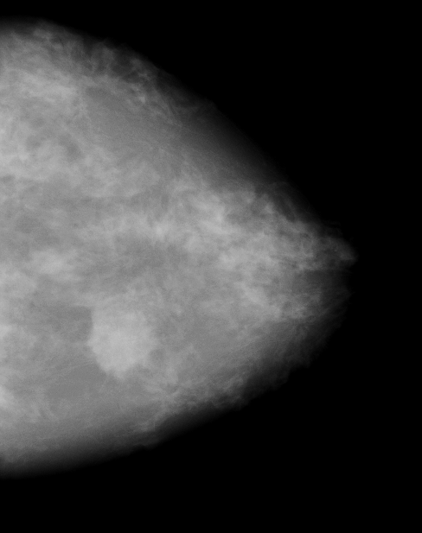
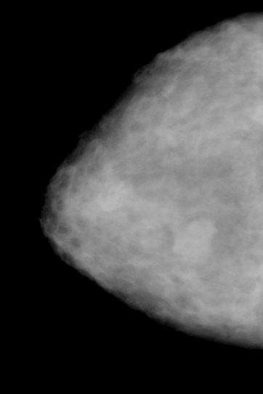
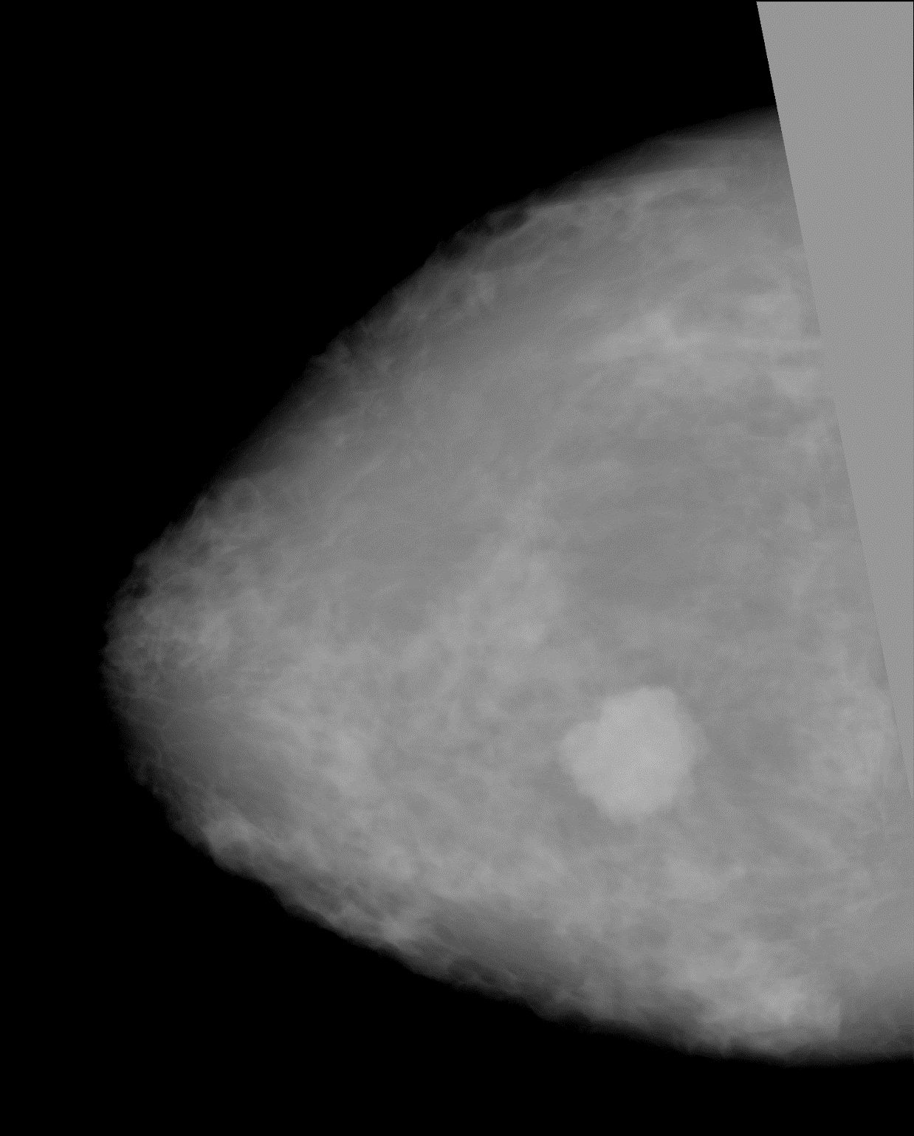
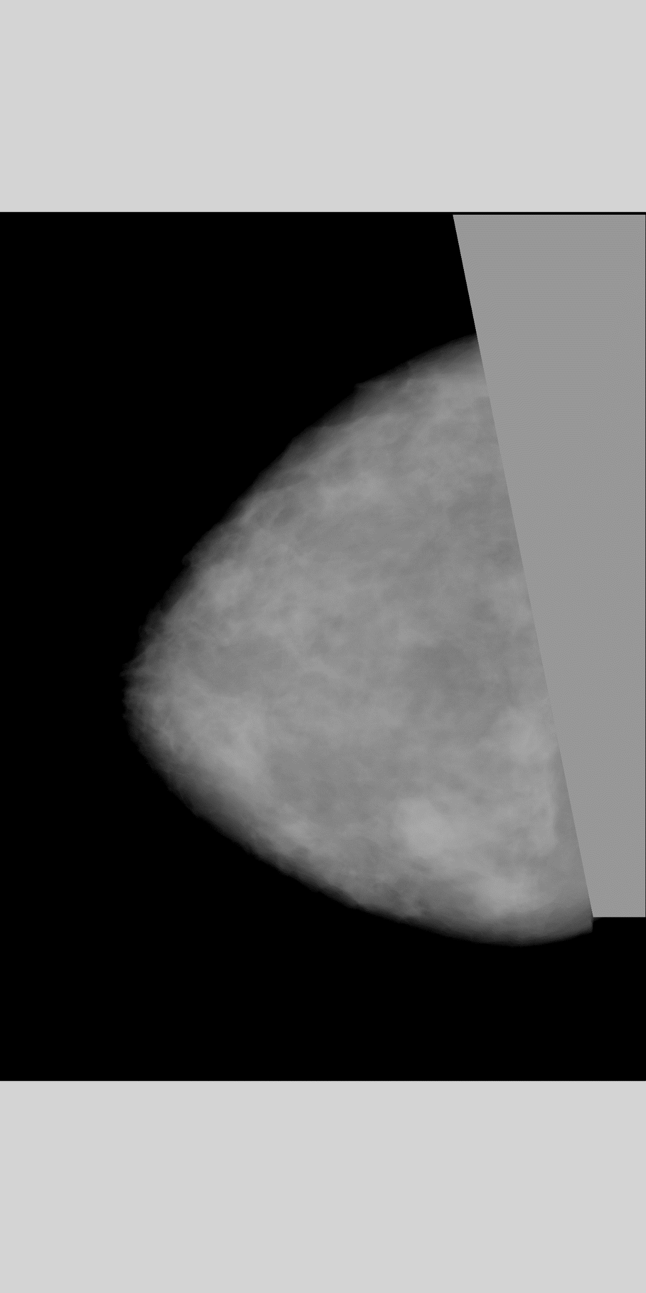
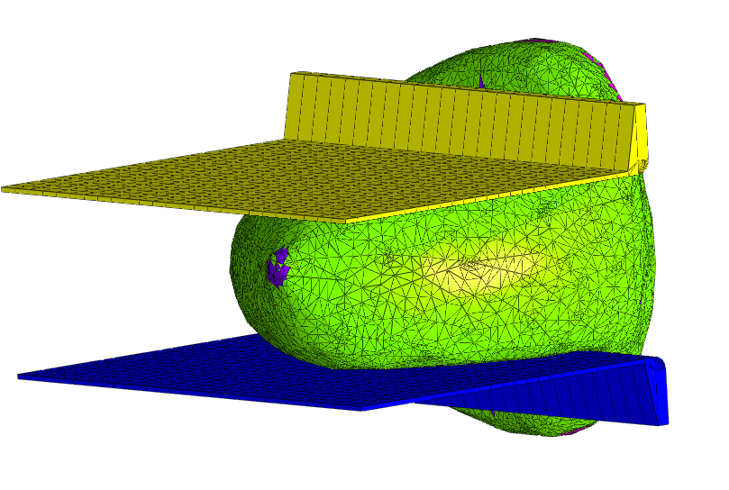
Synthetic Images for Algorithm Training
Increase training set size for ML by using synthetic mammograms with lesions
Cha et al.
RSNA 2018
SPIE Medical Imaging 2019
JMI 2019 (Accepted)

Slide 15
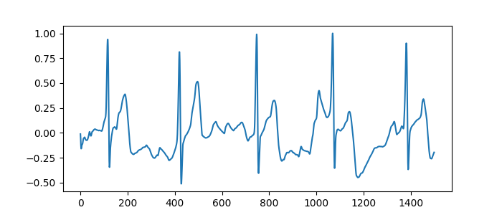
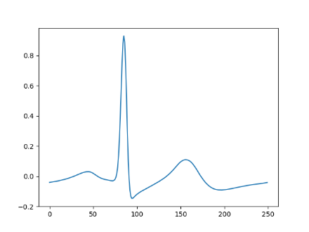
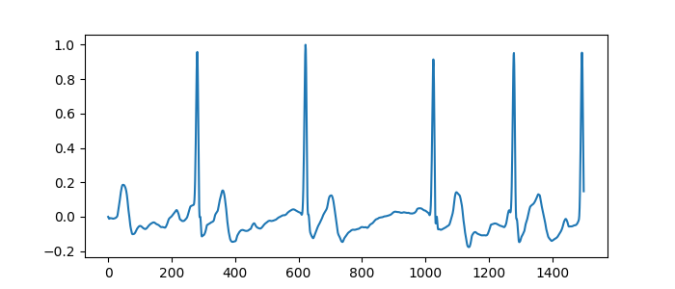
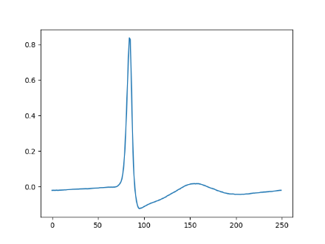
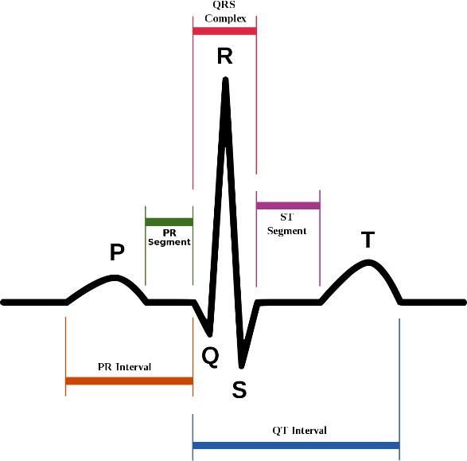
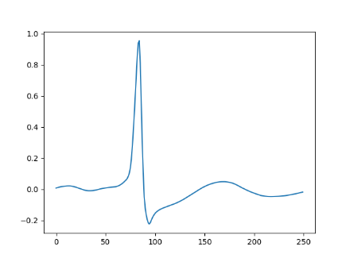
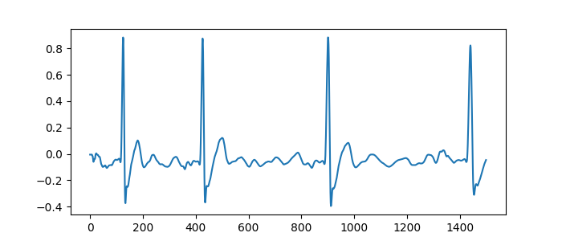
Synthesis of ECG Signals with Atrial Fibrillation using Generative Adversarial Networks
Real AF ECG
Normal ECG
Median Beats
Heart rate irregular
Normal
Generative adversarial network (GAN)
with style transfer and signal warping
Real
AF
Suppressed,
more fibrillatory
Suppressed
Synthetic AF ECG
Synthetic
AF
Wang, Cha, Sahiner and Scully, 2019

Slide 16
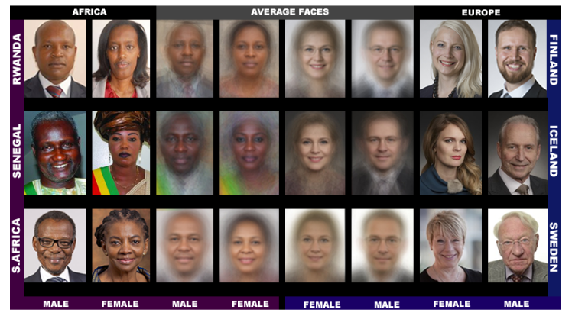
Algorithm Bias Due to Training Data Set Selection
Non-representative training set may result in biased algorithm design
Example:
  If a certain identifiable sub-population proportionally misrepresented in training, the algorithm may perform poorly for that sub-population
  Facial recognition: ML algorithms from Facebook, IBM, Microsoft tested*
    Classifiers performed:
      Best for lighter individuals and males
      Worst for darker females
*proceedings.mlr.press/v81/buolamwini18a/buolamwini18a.pdf

Slide 17
Training Data Set Selection
Limiting your training cases to one institution may result in a biased classifier
What is different between institutions?
  When differences can be identified, it can be more direct to look at sub-populations than differences between institutions
AUROC for classifying chest X-ray as normal or abnormal | DenseNet Trained on RIH Chest X-ray | DenseNet Trained on NIH Chest X-ray | Difference
Test on RIH chest X-ray | 0.960 | 0.924 | 0.036 (0.026, 0.046)
Test on NIH chest X-ray | 0.855 | 0.900 | 0.045 (0.041, 0.049)
Ian Pan et al., Journal of Digital Imaging 2019

Slide 18
Automation Bias
The use of automation as a heuristic replacement for vigilant information seeking and processing
  Investigation started in airline industry*
Documented in Healthcare
  When algorithm intended as a second reader is used instead in concurrent reader mode**
    Second reader: Clinician first completes the interpretation of the case without computer aid, then the computer results are displayed
    Concurrent reader: Computer results are displayed at the moment the case is opened for interpretation
*LJ Skitka et al, Int. J. of Aviation Psychology, 2000
**Alberdi et al., Academic Radiology 2004

Slide 19
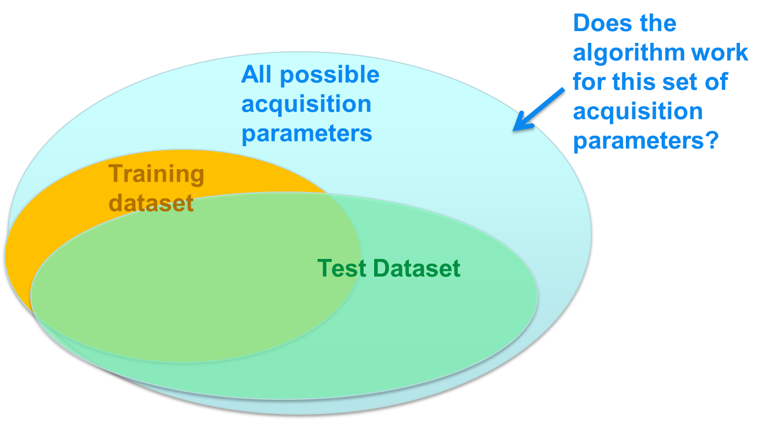
Generalizability
Machine learning algorithms are trained and tested with particular data
  Patient subsets, data acquisition parameters, data acquisition systems

Slide 20
Generalizability
Domain knowledge from clinicians, scientists and engineers should help in deciding what types of factors are important in generalizability
Example:
  Image acquisition x-ray beam spectrum variation should not be a major factor for a segmentation algorithm generalizability
  Image acquisition dose could be a major factor if the algorithm is designed at tested at regular dose, when generalizability to ultra-low does is being discussed

Slide 21
Explainability
An explanation is typically an answer to a why-question*
  Why did the AI system diagnose this case with pneumonia?
Why-questions are typically contrastive, even when not explicitly so
  Why did the AI system diagnose this case with pneumonia and not pleural effusion?
  Why did the AI system diagnose this case with pneumonia but not the previous case?
FDA has no requirements for explainability for devices incorporating AI/ML
  It may be expected that sponsors in the future may choose to incorporate explainability components because it may help increase the trust in the device
*Miller T, “Explanation in AI: Insights from the Social Sciences,” arXiv 1706.07269

Slide 22
Levels of Explanation
When asked to provide an explanation, people provide different levels of explanation depending on
  Who is asking
    Is it my 5-yr old niece or a graduate student?
  What they believe are the most relevant causes
    The chain of causes needs to be truncated at some level: Depth of explanation
In health AI, we have different “users” and different needs for “depth of explanation”
  Patients, caregivers, insurance, regulators, scientific community

Slide 23
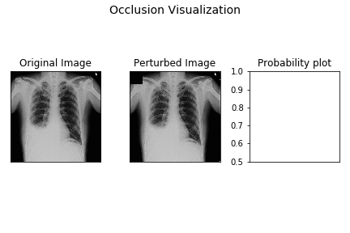
Occlusion Visualization
When the right costophrenic angle and accumulated fluid region is occluded to the network, the probability of the pleural effusion drops
http://blog.qure.ai/notes/visualizing_deep_learning

Slide 24

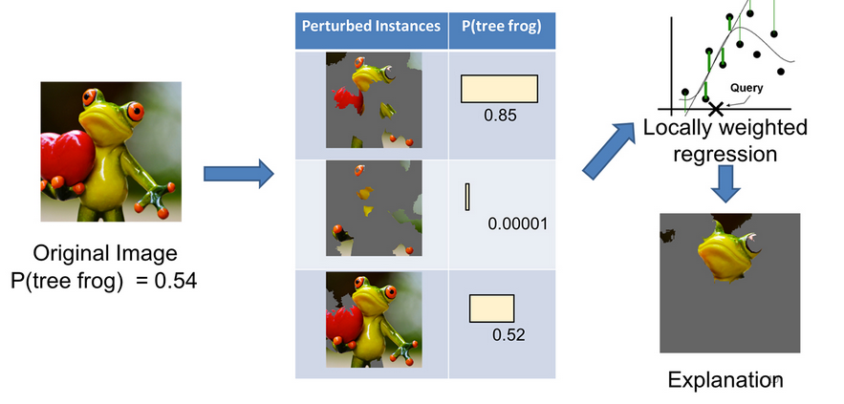
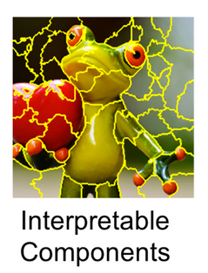
Linear Proxy Model: LIME (Local Interpretable Model-Agnostic Explanations)
Ribeiro MT et al, “Why Should I Trust You? Explaining the Predictions of Any Classifier,” arXiv 1602.04938

Slide 25
Evaluating Explanations*
Application-grounded: Real users, real tasks
  Evaluate the quality of an explanation in the context of its end-task, e.g., whether it results in better identification/reduction of errors
Human-grounded: Real humans, simplified tasks
  Example: Humans are presented with pairs of explanations, and must choose the one that they find of higher quality
Functionally-grounded: No humans, proxy tasks
  Example: Show that one's method performs better with respect to certain regularizers, e.g., is more sparse/distangled compared to other baselines
*Doshi-Velez F and Kim B, “Towards A Rigorous Science of Interpretable Machine Learning,” arXiv 1702.08608
When you can measure what you are speaking about, you know something about it. – Lord Kelvin

Slide 26
A New Regulatory Challenge
Traditionally, algorithm changes that significantly affect the device’s performance would require a new submission to the FDA, as per the Software Modifications Guidance
In the future, it is anticipated that devices incorporating ML keep learning after release
  Ever enlarging data sets for algorithm training
  New types of input
  New architectures/models
How can the FDA provide oversight to adapting devices in a manner that is aligned with the technology’s lifecycle?

Slide 27
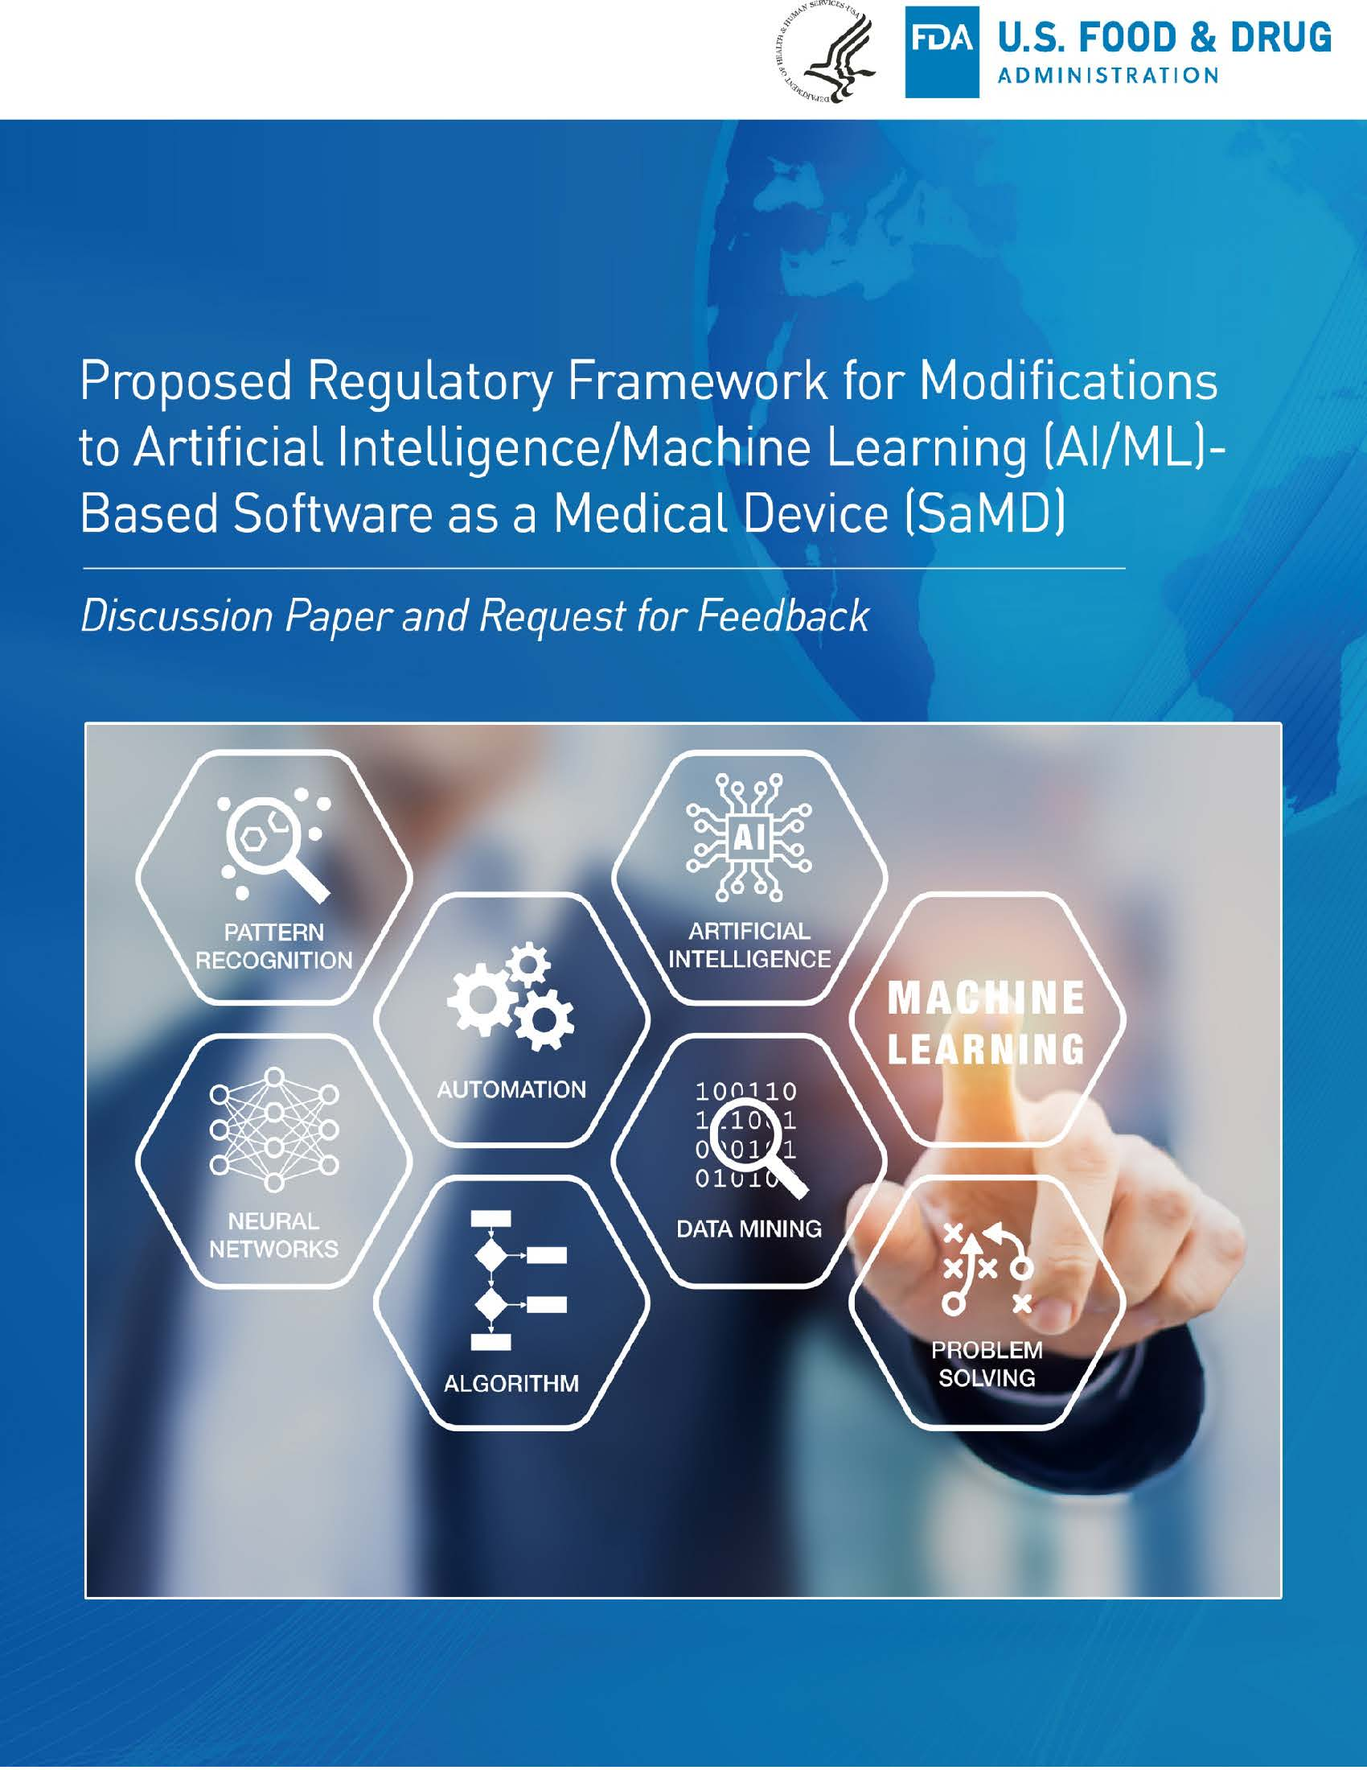
Proposed Regulatory Framework for Modifications to AI/ML Algorithms
An option to submit a plan for modifications during the initial premarket review of an AI/ML-based software as a medical device
Reviewed during initial premarket phase
  Pre-Specifications (SPS)
  Algorithm Change Protocol (ACP)
  Performance monitoring
Comment period ended in early summer
  Currently working on response to comments

Slide 28
SPS & ACP: A Pre-Determined Change Control Plan
SaMD Pre-Specifications (SPS):
Delineates the proposed types of modifications to the SaMD
(i.e., what types of changes the sponsor plans to achieve)
Draws a virtual “region of potential changes” around the initial specifications and labeling of the original device
Algorithm Change Protocol (ACP):
Describes the methods for performing and validating the changes pre-specified in SPS
(i.e. how the sponsor intends to achieve the changes)
Typically specific to the device and type of change
Expected to contain a step-by-step delineation of the procedures to be followed
Good ML Practices (GMLP):
Accepted practices in ML/AI algorithm design, development, training, and testing that facilitate the quality development and assessment of ML/AI-based algorithms
Based on concepts from quality systems, software reliability, machine learning, and data analysis, etc

Slide 29
Algorithm Change Protocol (ACP)
Data Management | For new training & test data: Collection protocols Quality assurance Reference standard determination Auditing and sequestration of training and test sets
Re-training | Re-training objectives Changes related to: ML methods, including architecture and parameters Data pre-processing Criteria to initiate performance evaluation
Performance Evaluation | Assessment metrics Statistical analysis plans Frequency and triggers for evaluation Performance targets Methods for testing with “clinicians in the loop” when necessary
Update Procedures | Software verification and validation When and how updates will be implemented Plans for global and local updates Communication and transparency to users

Slide 30
Test Data Reuse for Continuous Learning
High-quality test data sets with reference truth are often limited in medicine
If you get to interrogate the test set many times, your so-called “test” set becomes part of training
Performance seems to improve for the so-called “test” set as the device adapts, but
  If you collect a fresh sample from the true population, you may find that performance has actually declined
Possible mitigation strategy: Thresholdout (Dwork et al., Science 2015)
In essence, add noise to reported performance each time you access the test set
Differential privacy from cryptography yields statistical guarantees

Slide 31
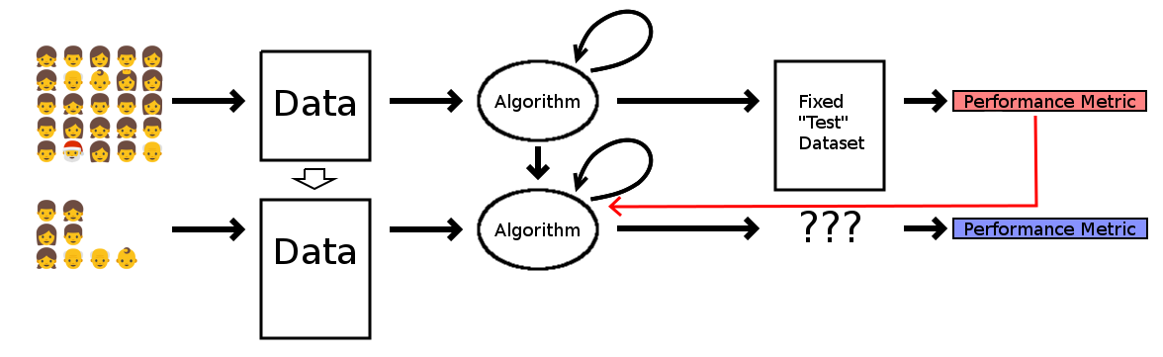
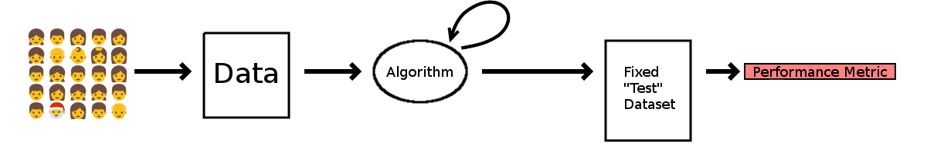
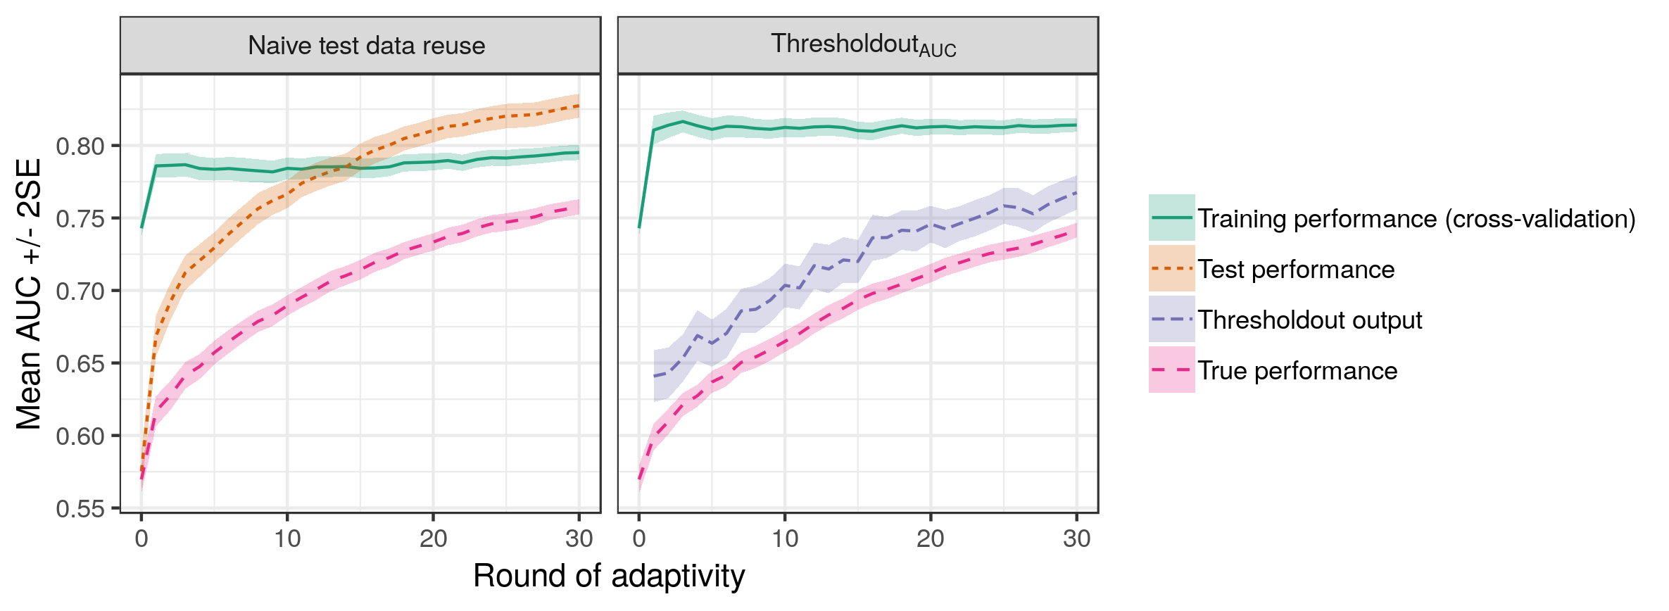
Test data Reuse for Continuous Learning
Gossmann et al.
SPIE 2018

Slide 32
Use of imperfect reference standard for AI/ML system monitoring
Ground truth data to monitor the performance of an AI/ML system is often difficult and/or expensive to collect.
How can an imperfect reference standard, such as clinicians’ assessment, be used instead of the ground truth?
Initial approach: Develop a new technique to estimate lower bounds on various performance metrics
  Model-free
  Rigorous statistical guarantees

Slide 33
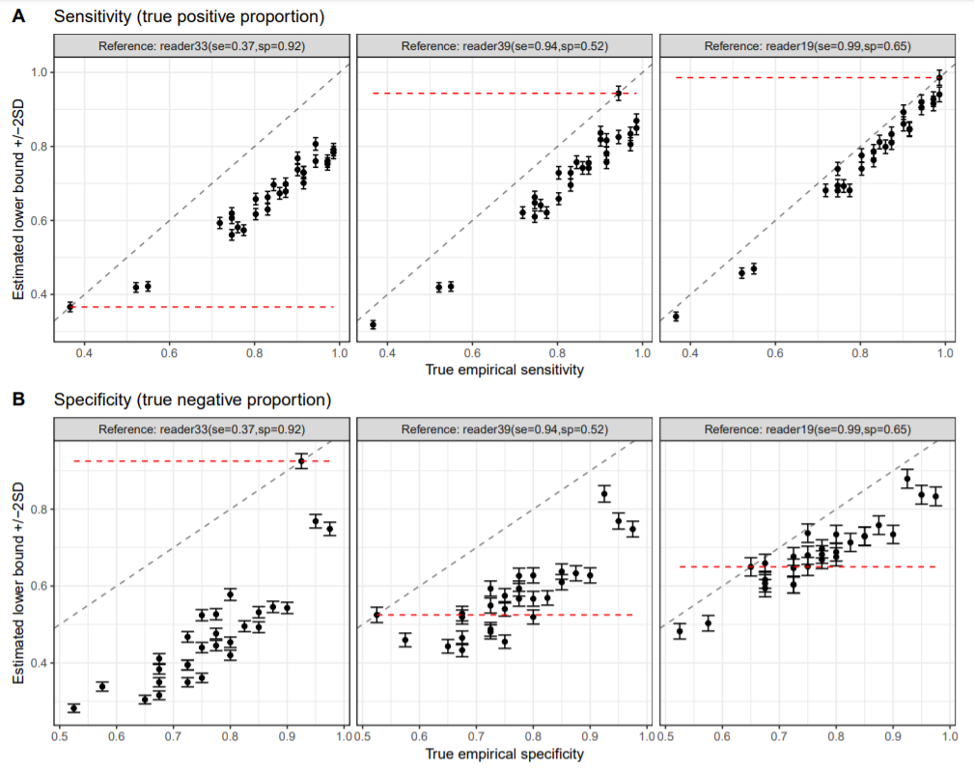
Use of imperfect reference standard for AI/ML system monitoring
Gossmann et al.
JSM 2019

Slide 34
Summary
A number of devices incorporating AI/ML have been approved/cleared recently
  Guidance for CAD in radiology has worked as a model for other devices
A regulatory framework has been proposed for modifications of AI/ML-based software as a medical device
There exist unique research issues, including those related to data sets, generalizability, explainability, and evolving algorithms
FDA researchers are active in the design of tools and methods related to machine learning in medicine

