Slide 1
Real World Data and Evidence Projects at FDA
Diqiong (Joan) Xie, Ph.D.
Division of Biometrics V
Office of Biostatistics
Center for Drug Evaluation and Research
FDA

Slide 2
Disclaimer and Disclosure
The views expressed herein are those of the authors and should not be construed as FDA’s views or policies
The mention of commercial products, their sources, or their use in connection with material reported herein is not to be construed as either an actual or implied endorsement of such products by the Department of Health and Human Services
Some products or programs mentioned are not sponsored by FDA but are noted as illustrations of RWD/RWE efforts in the public domain
No conflicts of interest to disclose

Slide 3
Outline
Background
Infrastructure
Non-Interventional Studies
RWE in Pre-Marketing Studies
Looking forward

Slide 4
Background

Slide 5
RWE: What Are the Goals?
Maximize the opportunities to have regulatory decisions incorporate data/evidence from settings that more closely reflect clinical practice
  Increase the diversity of populations
  Improve efficiency with existing data
Maintain Current Evidentiary Standards

Slide 6
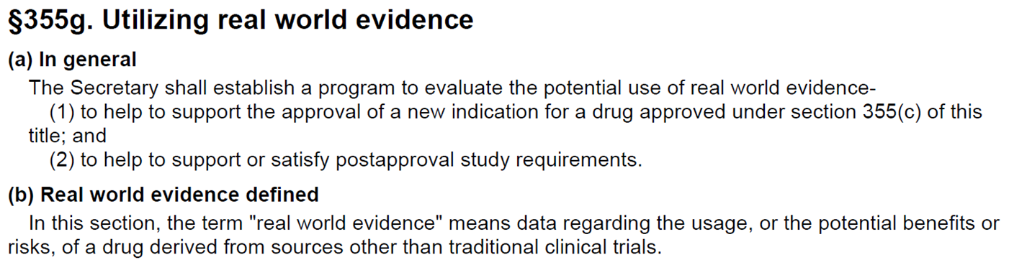
21st Century Cures Act

Slide 7
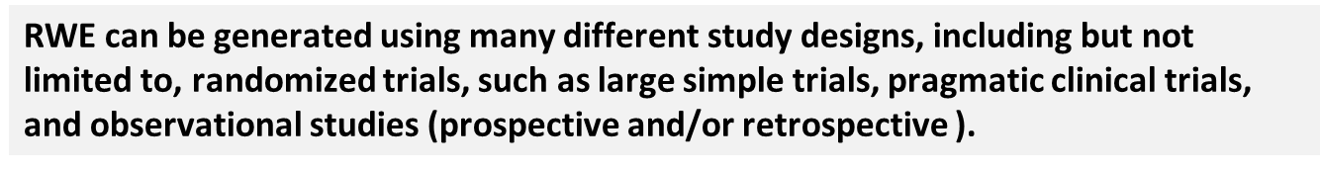
FDA CDER Definitions
Real World Data are data relating to patient health status and/or the delivery of health care routinely collected from a variety of sources.
Real World Evidence is the clinical evidence regarding the usage and potential benefits or risks of a medical product derived from analysis of RWD.
RWD include data derived from electronic health records (EHRs), claims and billing data, data from product and disease registries, patient-generated data including in home-use settings, and data gathered from other sources that can inform on health status, such as mobile devices.

Slide 8
The Current State
Considerable experience with claims and pharmacy data
  Evidence about safety of products
Limited use of RWD in efficacy determinations
  Rare diseases and cancers
Current system provides substantial evidence of efficacy in the population studied but may leave a number of questions unanswered
Can RWE fill in the gaps?

Slide 9
infrastructure to support REAL world studies

Slide 10
FDA-Catalyst
FDA-Catalyst
Contact with health plan members and providers
Collect primary data
Answer a wider range of questions
Sentinel
Claims data
Diagnosis
Procedures
Pharmacy dispensings

Slide 11
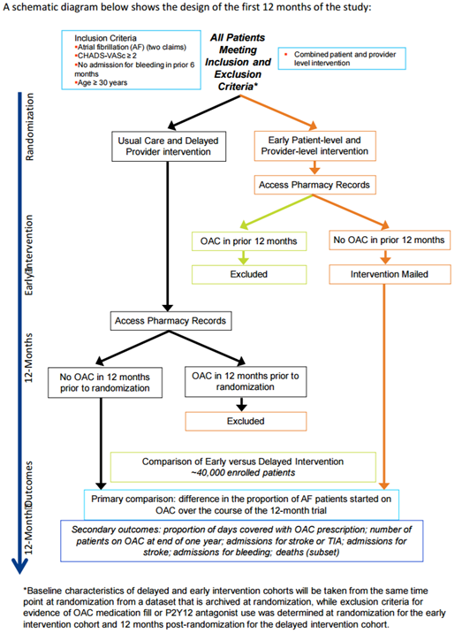
FDA-Catalyst Example: Impact Afib
A randomized controlled trial within the FDA-Catalyst distributed database environment
Evaluation of a practice and patient level educational intervention for individuals with atrial fibrillation and an increased risk of stroke

Slide 12
RWD Depth and Breadth
Perspective:
Difficulty breathing
Heart rate increase
Functional status:
Joint pain
Emotional symptoms
Life style change:
Healthy diet
Routine exercise
1/1/2018
Encounter
Emergency Department Procedure:
Appendectomy
Inpatient stay
Encounter
Office visit diagnosis:
Anxiety
Encounter
Office visit diagnosis:
Influenza with pneumonia
Dispensings
Prescription:
Antibiotic
1/1/2019
Hosptial Records
Heart rate
Blood pressures
Pain level
Lab results
Drugs taken
Clinic electronic records
Height
Weight
Body temperature
Heart rate
Blood pressures
Spirometry results
Pulse oximetry results
Claims data: breadth, consistency
Electronic Health Records: depth, only certain occations
Data not captured: how to fill the gap?

Slide 13
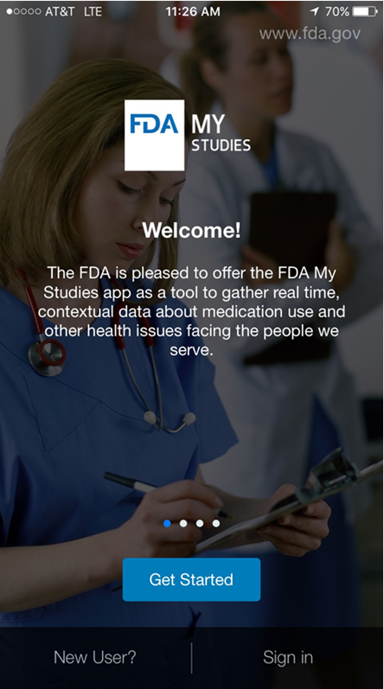
FDA My Studies
Mobile App
  Standard frameworks - ResearchKit (iOS), ResearchStack (Android)
  Gateway capability
Web-based configuration portal
Secure Storage Environment
  Federal Information Security Management Act compliance
  Partitioned for distributed research
  Responses can be downloaded in broadly compatible formats (e.g., SAS, Excel, etc.)

Slide 14
Non-interventional studies

Slide 15
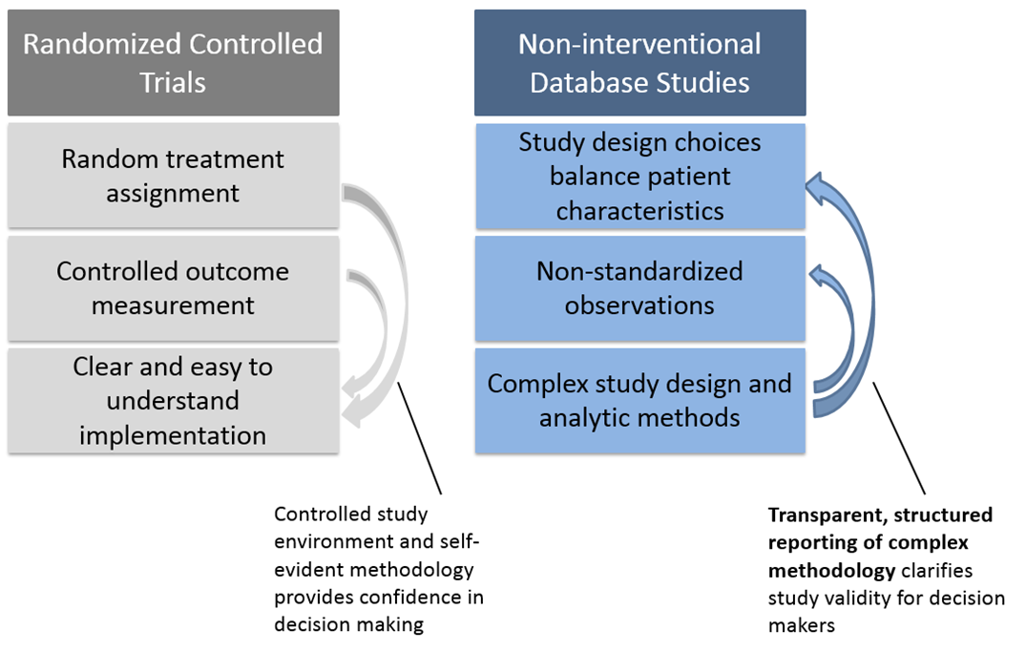
Special Considerations for Non-Interventional Studies
“Big” Real World Data holders often license data to investigators who may not be able to share it directly with regulators
Concerns about “p-hacking”

Slide 16
Replication of Clinical Trials with Non-Interventional Database Studies
FDA/Harvard Medical School/Brigham and Women’s Hospital Collaboration
Goal: Identify an area where observational methods lead to the same conclusion as clinical trials
  therapeutic areas/indications
  trial designs
  regulatory questions and outcomes
RWD source: Medicare and commercial claims
Thirty trials with a range of characteristics
  Superiority and non-inferiority designs
  Statistically significant and null findings

Slide 17
RWE in pre-marketing studies

Slide 18
RWD in Pre-Marketing Studies
Maintain Current Evidentiary Standards
No application with RWE as the sole support
RWD can provide supporting evidence for efficacy
  When a randomized trial is unethical
  Rare disease
  Therapeutic areas with no alternative care

Slide 19
RWD in Pre-Marketing Studies
Consider the differences among data sources:
Patients’ demographics and disease status
Outcome assessment method and schedule
Few analytical methods adjust for unmeasured confounders
Matching
Compare clinical outcomes
Data Source 1
Drug 1
N1
Matched Drug 1
n2
Drug 1 vs Drug 2
Data Source 2
Drug 2
N2
Matched Drug 2
n2

Slide 20
Looking Forward
Continued engagement with stakeholders to identify the key questions that FDA needs to answer to facilitate sponsor use of RWD and RWE for regulatory decisions
Identification of knowledge gaps and support for appropriate demonstration projects to facilitate development of RWE for regulatory decisions
Provision of guidance(s)

Slide 21
Special Thanks to
Dr. David Martin, FDA
Dr. Mark Levenson, FDA
Dr. Erik Bloomquist, FDA
Dr. Shenghui Tang, FDA
Dr. Thomas Gwise, FDA
Dr. Rajeshwari Sridhara, FDA

