Slide 1
Meta-Analyses of Randomized Clinical Trials for Safety Outcomes
September 25, 2019
Eugenio Andraca-Carrera
Division of Biometrics 7
Office of Biostatistics
Office of Translational Sciences
Center for Drug Evaluation and Research
U.S. Food and Drug Administration

Slide 2
Motivating Example
Is there a difference in risk between Drug A and Control?
Study | Drug A | Control
1 | 8/100 (8.0%) | 4/100 (4.0%)
2 | 7/100 (7.0%) | 6/100 (6.0%)
3 | 1/100 (1.0%) | 1/100 (1.0%)
4 | 1/100 (1.0%) | 2/100 (2.0%)
5 | 105/500 (21.0%) | 50/250 (20.0%)
6 | 8/200 (4.0%) | 10/200 (5.0%)
Crude Pooling Results
Relative Risk: 1.38
95% CI: (1.05, 1.81)
Meta-Analysis Results
Relative Risk: 1.06
95% CI: (0.81, 1.38)
Crude Pooling: 130/1100 (11.8%) 73/850 (8.6%)

Slide 3
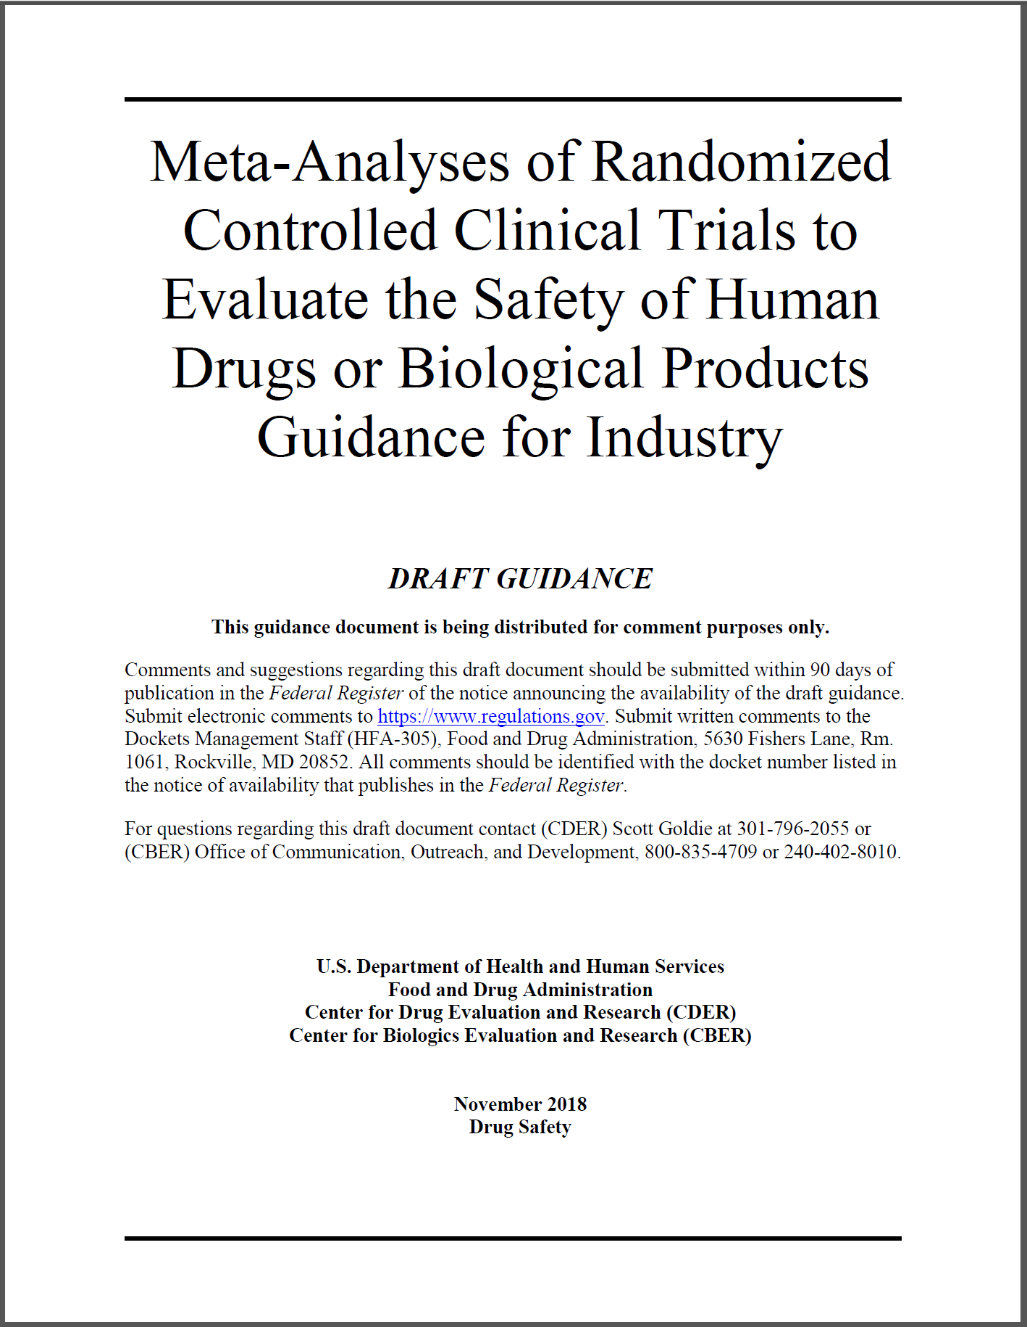
Meta-Analysis Guidance
Use of meta-analyses of randomized controlled clinical trials to evaluate safety within the framework of regulatory decision-making.
Describes factors FDA intends to consider when evaluating the strength of evidence provided by a meta-analysis for studying safety of drugs.
Focus is on evaluating a pre-defined hypothesis about a suspected risk; not exploratory safety meta-analysis

Slide 4
Outline
Basic Principles
Pre-Specification and Transparency
Statistical Methods
Examples
Conclusions

Slide 5
Basic Principles
Main message: quality over quantity
  Meta-analysis increases precision
  Meta-analysis does not correct for potential biases

Slide 6
Trial Selection
Controlled and adequately designed
Inclusion criteria is relevant for the population of interest
Trials are relevant to current medical practice
Quality and completeness of safety outcome ascertainment
Appropriateness of exposure and follow-up periods
Appropriateness of comparator and dose of test drug
Availability of subject-level data

Slide 7
Trial Selection
Controlled and adequately designed
Inclusion criteria is relevant for the population of interest
Trials are relevant to current medical practice
Quality and completeness of safety outcome ascertainment
Appropriateness of exposure and follow-up periods
Appropriateness of comparator and dose of test drug
Availability of subject-level data

Slide 8
Outcome Ascertainment
Ideal scenario:
  Outcome variable is uniformly defined and ascertained prospectively in all trials
  Outcome is objective and/or is adjudicated based on pre-specified criteria
Oftentimes safety outcome is identified retrospectively
  Use of “hard outcomes” minimizes potential biases
  A pre-specified and uniform outcome definition across trials reduces heterogeneity and increases interpretability
  Identification of potential outcomes and adjudication should be blind to treatment
  Retrospective adjudication is recommended if possible

Slide 9
Exposure and Follow-Up
Consider the period in which the safety outcome is measured
  Example: risk of allergic reactions may be evaluated with an
  on-treatment analysis
  Example: risk of malignancies may require long follow-up and understanding of treatment and study discontinuation patterns
Analysis methods should account for differences in exposure and follow-up time between trials
Evaluate the potential impact of informative censoring

Slide 10
Dosing and Comparators
Multiple doses can provide useful information
  Include trials in MA with dose greater than the approved dose to rule out associations
  Explore dose response
Suitability of comparator drugs should be considered in MA trial inclusion criteria
  Placebo provides context as it cannot cause the safety outcome
  Active comparator should be assessed to determine if it is associated with the safety outcome a priori

Slide 11
Availability of Subject-Level Data
Subject-level data improves the quality of the MA
  Explore relationship between exposure and outcome
  Assess informative censoring
  Assess definition of outcome
  Subgroup analyses
Subject-level data is often needed to re-purpose trials that were originally designed to meet efficacy objectives

Slide 12
Outline
Basic Principles
Pre-Specification and Transparency
Statistical Methods
Examples
Conclusions

Slide 13
Pre-Specifying the Meta-Analysis Protocol
The MA protocol should document the motivation and objectives of the MA
If safety signal originates from a specific trial:
  A meta-analysis that excludes the trial may be preferable for confirming the signal
  Inclusion of the trial in MA may be acceptable to summarize existing information

Slide 14
Meta-Analysis Protocol Best Practices
The protocol should contain
  Detailed description of information available prior to MA design
  Potential problems anticipated and methods to manage the problem
Finalize the protocol prior to selecting the component trials and conducting the MA
Make the protocol available through advanced publication or other method for distribution

Slide 15
Reporting Results
Report the trial selection process including the pre-specified trial selection criteria
Summarize individual trial design features, durations of exposure and follow-up, and subject populations
  If subject-level data is available, include more thorough summaries (e.g. baseline risk factors)
Report departures from planned analyses
Include point estimates and measures of uncertainty

Slide 16
Outline
Basic Principles
Pre-Specification and Transparency
Statistical Methods
Examples
Conclusions

Slide 17
Fixed Effects vs. Random Effects
Guidance thinking on this topic:
  Fixed effects models estimate the average effect across trials. This interpretation is often useful even if trials do not have a common treatment effect
  Random effects models estimate the average effect for some hypothetical population of trials. This interpretation is not as intuitive
  Random effects models may produce confidence intervals with better coverage and a better characterization of the two sources of variance (within trials and between trials)

Slide 18
Example Revisited
Study | Drug A | Control
1 | 8/100 (8.0%) | 4/100 (4.0%)
2 | 7/100 (7.0%) | 6/100 (6.0%)
3 | 1/100 (1.0%) | 1/100 (1.0%)
4 | 1/100 (1.0%) | 2/100 (2.0%)
5 | 105/500 (21.0%) | 50/250 (20.0%)
6 | 8/200 (4.0%) | 10/200 (5.0%)
Fixed Effects
Relative Risk: 1.06
95% CI: (0.81, 1.38)
Crude Pooling: 130/1100 (11.8%) 73/850 (8.6%)
These suggest different conclusions. Need to also change how pooled proportions are reported.

Slide 19
Example Revisited
Study | Drug A | Control
1 | 8/100 (8.0%) | 4/100 (4.0%)
2 | 7/100 (7.0%) | 6/100 (6.0%)
3 | 1/100 (1.0%) | 1/100 (1.0%)
4 | 1/100 (1.0%) | 2/100 (2.0%)
5 | 105/500 (21.0%) | 50/250 (20.0%)
6 | 8/200 (4.0%) | 10/200 (5.0%)
With crude pooling, Study 5 is weighted twice as much to estimate the proportion of events in Drug A than in the Control arm
Crude Pooling: 11.8% 8.6%

Slide 20
Example Revisited
Study | Drug A | Control
1 | 8/100 (8.0%) | 4/100 (4.0%)
2 | 7/100 (7.0%) | 6/100 (6.0%)
3 | 1/100 (1.0%) | 1/100 (1.0%)
4 | 1/100 (1.0%) | 2/100 (2.0%)
5 | 105/500 (21.0%) | 50/250 (20.0%)
6 | 8/200 (4.0%) | 10/200 (5.0%)
Study-size adjusted percentages assign equal weight to these two quantities (proportional to the size of Study 5)
Crude Pooling: 11.8% 8.6%
Study-size adjusted 10.6% 10.1%
percentages**
** Crowe et al. (2016). Reporting adverse drug reactions in product labels. Therapeutic Innovation & Regulatory Science, 50(4), 455-463.

Slide 21
Example Revisited
Study | Drug A | Control
1 | 8/100 (8.0%) | 4/100 (4.0%)
2 | 7/100 (7.0%) | 6/100 (6.0%)
3 | 1/100 (1.0%) | 1/100 (1.0%)
4 | 1/100 (1.0%) | 2/100 (2.0%)
5 | 105/500 (21.0%) | 50/250 (20.0%)
6 | 8/200 (4.0%) | 10/200 (5.0%)
Fixed Effects
Relative Risk: 1.06
95% CI: (0.81, 1.38)
Crude Pooling: 11.8% 8.6%
Study-size adjusted 10.6% 10.1%
percentages**
Percentages and Relative Risk are now consistent

Slide 22
Outline
Basic Principles
Pre-Specification and Transparency
Statistical Methods
Example
    Prospective Subject-level Meta-Analysis
Conclusions

Slide 23
LABAs and Risk of Serious Asthma-Related Adverse Events
Long-Acting Beta-Agonists (LABAs) have been available to treat asthma since the 1990s
In 2003 a Boxed Warning described a potential risk of asthma-related hospitalization, intubation, or death associated with LABAs
In 2006 the SMART trial (N=26,355) observed an imbalance in respiratory-related deaths with salmeterol vs placebo (24 vs 11)
In 2008, a patient-level meta-analysis evaluated the risk of asthma-related hospitalization, intubation, or death, comparing LABA to non-LABA treatments (Levenson 2008)
110 trials for 4 products were considered: Advair (salmeterol, fluticasone), Foradil (formoterol), Serevent (salmeterol), and Symbicort (formoterol, budesonide)

Slide 24
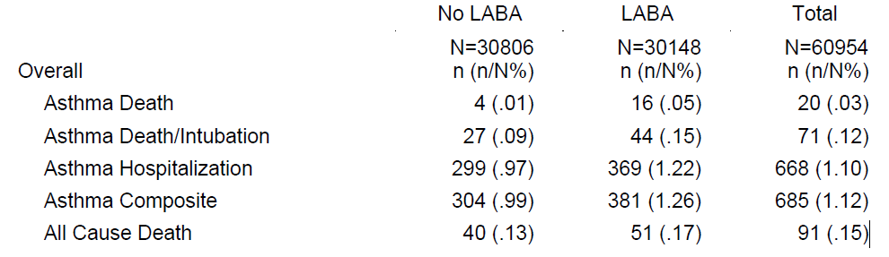
Results of 2008 Meta-Analysis
*
*The No LABA comparator group included: ICS, short-acting beta-agonists, placebo, combination of treatments.

Slide 25
Results of 2008 Meta-Analysis
The estimated risk difference of the composite event differed by whether LABAs were administered in addition of ICS:
  LABA without ICS vs non-LABA, RD (95% CI): 3.63 (1.51, 5.75) per 1000
  LABA + ICS vs ICS alone, RD (95% CI): 0.25 (-1.69, 2.18) per 1000
In 2010, the label of LABAs was modified to contraindicate the use of LABAs without ICS
A post-marketing requirement was issued in 2010. The manufacturers of 4 LABAs agreed to conduct separate trials with a common protocol and joint steering committee and adjudication committee

Slide 26
Prospectively Designed Trials
4 adult trials conducted for Symbicort (AstraZeneca), Advair Diskus (GSK), Dulera (Merck), and Foradil (Novartis)
Primary Endpoint: composite of asthma related hospitalizations, asthma related intubations, or asthma related death
Common design: 26 weeks treatment duration, ~11,700 subjects randomized 1:1 to LABA + ICS or ICS alone
Each trial was designed to collect 87 events and have 90% power to rule out a risk margin (hazard ratio) greater than 2.0 associated with each of the LABAs
A meta-analysis of these analyses was agreed upon in advance

Slide 27
Summary of the
3 Completed Trials
Trial | Treatment Arms | N | Composite events | Hospitalization | Intubation | Death
AUSTRI | Advair | 5834 | 34 | 34 | - | -
 | ICS | 5845 | 33 | 33 | 2 | -
D5896C00027 | Symbicort | 5838 | 43 | 42 | 1 | 2
 | ICS | 5843 | 40 | 40 | - | -
SPIRO | Dulera | 5865 | 39 | 39 | - | -
 | ICS | 5864 | 32 | 32 | - | -

Slide 28
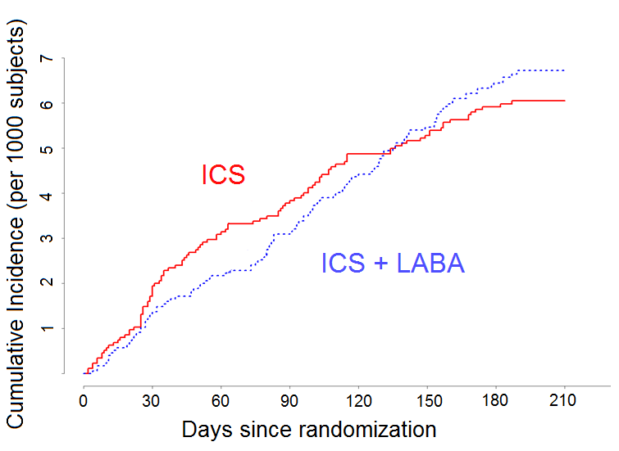
Pooled Kaplan-Meier Cumulative Incidence of Composite Event

Slide 29
Results of the Prospective
Meta-Analysis
Trial (Product) | Events/N | Events/N | HR (95% CI)
 | LABA+ICS | ICS
Advair | 34/5834 | 33/5845 | 1.03 (0.64, 1.66)
Symbicort | 43/5838 | 40/5843 | 1.07 (0.70, 1.65)
Dulera | 39/5865 | 32/5864 | 1.22 (0.76, 1.94)
Meta-analysis | 116/17537 | 105/17552 | 1.10 (0.85, 1.44)

Slide 30
Analysis Summary
Upper bound of 95% CI met the margin of 2.0 for each of the 3 trials
The meta-analysis estimated a HR of 1.10 (0.85, 1.44) associated with LABA + ICS compared to ICS alone
The majority of the composite events were hospitalizations. Few deaths and intubations were observed
Boxed Warning was removed

Slide 31
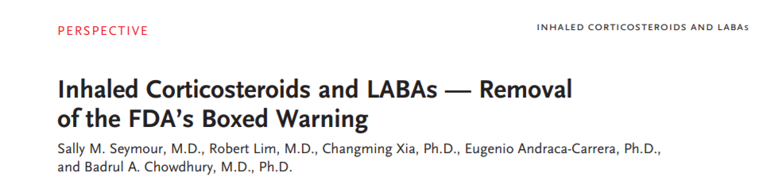
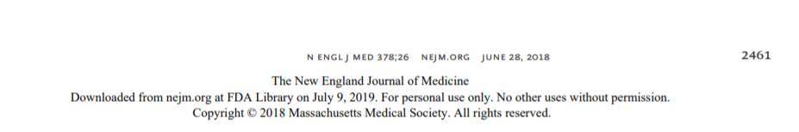

Slide 32
Outline
Basic Principles
Pre-Specification and Transparency
Statistical Methods
Examples
Conclusions

Slide 33
Conclusions (1)
Reasons for meta-analysis:
  Statistically correct method to combine data from multiple trials
  Add precision to an estimate
  Investigate the risk of rare events
  Evaluate effect in subgroups

Slide 34
Conclusions (2)
Focus on improving the quality and transparency of the MA
Pre-specify the MA protocol and trial inclusion criteria
Preference is to conduct MA based upon subject-level data
  Improves the quality of the MA versus a MA based on summary-level data
  Allows one to evaluate outcome definition, relationship of outcome to exposure, informative censoring, subgroups, etc.

Slide 35
Strength of Evidence and Regulatory Decisions
Factors FDA considers in determining strength of evidence for safety-related regulatory decision
  Quality of the individual trials
  Pre-specification and documentation
  Appropriateness of statistical methods
Magnitude of risk
Precision of the estimated risk
Robustness to sensitivity analyses
Consistency across trials

Slide 36
References
FDA Draft Guidance for Industry (2018): Meta-Analyses of Randomized Controlled Clinical Trials to Evaluate the Safety of Human Drugs or Biological Products
  https://www.fda.gov/media/117976/download
White Paper for November 25, 2013 Public Meeting on Meta-analyses of Randomized Controlled Trials for the Evaluation of Risk to Support Regulatory Decisions: http://www.fda.gov/downloads/Drugs/NewsEvents/UCM372069.pdf
Crowe et al. (2016). Reporting adverse drug reactions in product labels. Therapeutic Innovation & Regulatory Science, 50(4), 455-463.
S.M. Seymour, R. Lim, C. Xia, E. Andraca-Carrera, B.A. Chowdhury (2018). Inhaled corticosteroids and LABAs: removal of the FDA’s boxed warning. N Engl J Med, 378, pp. 2461-2463
Levenson, Mark 2008. Long-Acting Beta-Agonists and Adverse Asthma Events Meta-Analysis. Joint Meeting of the Pulmonary-Allergy Drugs Advisory Committee, Drug Safety and Risk Management Advisory Committee and Pediatric Advisory Committee:
https://wayback.archive-it.org/7993/20170405035612/https:/www.fda.gov/ohrms/dockets/ac/08/briefing/2008-4398b1-01-FDA.pdf

