Slide 1

Imputed transcriptome-wide association studies of blood cell traits in European ancestry cohorts
Amanda L. Tapia
Department of Biostatistics
University of North Carolina at Chapel Hill
October 3, 2019

Slide 2



Background
Blood cell traits (BCTs) clinically important
  Complete blood count values
    acute and chronic disease risk
    insight into inflammation, oxygen transport, blood clotting
Genome-wide association studies (GWAS) identified >2,700 variants for BCTs¹
  limited in identifying causal genes and pathways
Transcriptome-wide association study (TWAS)
  Transcriptome = gene expression
  Advantages beyond GWAS
    Better understand biological mechanism of associations
    Reduced multiple testing burden
    Potentially identify novel loci missed by GWAS
Amanda L. Tapia
of 14

Slide 3

Goals
Instead of GWAS
relates genetic variation directly to blood cells
(~ millions of SNPs)
SNP₁
ATGTC…
Blood cells
..…
SNP_{N}
CTGAC…
We want TWAS
relates genetically regulated gene expression to blood cells (~ 10,000 genes)
SNP₁
ATGTC…
Blood cells
Gene expression
..…
SNP_{N}
CTGAC…
not in study population
Amanda L. Tapia
of 14

Slide 4




TWAS Method
nearby SNPs
Observed gene expression
$${\hat{β}}_{1}$$
Reference panel model training
SNP₁: ATGTC…
…
1
…
SNP_{N}: CTGAC…
$${\hat{β}}_{N}$$
Predict gene expression in study population
nearby SNPs
$${\hat{β}}_{1}$$
Predicted gene expression
SNP₁: ATATC…
2
…
SNP_{N}: CTGAT…
$${\hat{β}}_{N}$$
Associate predicted gene expression with blood cell traits
Blood cells
Predicted gene expression
3
Amanda L. Tapia
of 14

Slide 5
TWAS Application
Reference panel
Study population
Depression Genes and Networks whole blood²
  N = 922
  # genes = 11,538
PredictDB weights from PrediXcan³
Genetic Epidemiology Research on Adult Health and Aging (GERA)⁴
European ancestry (N = 54,542)
10 blood cell traits
  Hematocrit, hemoglobin, lymphocytes, monocytes, MCV, neutrophils, WBC, platelets, RBC, red cell distribution width
Amanda L. Tapia

Slide 6
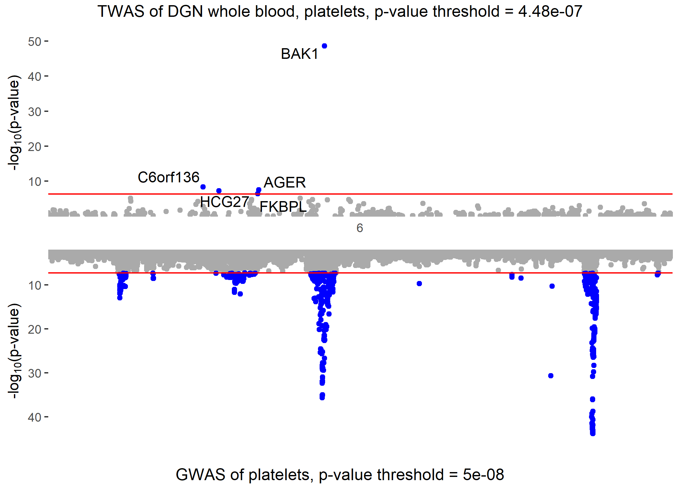
Results
Overall results
Mirror plot of TWAS (top) and GWAS (bottom) Platelet results on chr. 6
111,510
associations tested
TWAS signal driven by GWAS?
268
statistically significant associations*
111,242
associations not statistically significant*
Condition on GWAS signal
* Bonferroni corrected p-value < 4.48E-7
Amanda L. Tapia

Slide 7
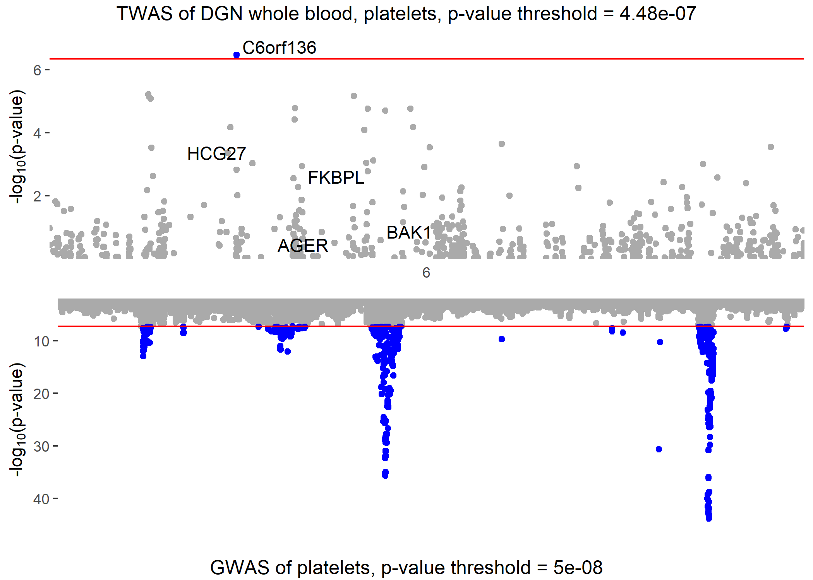
Results - Conditional Analysis
Mirror plot of TWAS (top) and GWAS (bottom) Platelet results on chromosome 6
Before conditional analysis
After conditional analysis
TWAS signal driven by GWAS?
Conditionally non-significant
Condition on GWAS signal
Amanda L. Tapia

Slide 8
Results - Conditional Analyses
268
statistically significant associations*
Condition on known risk SNPs within ± 500kb of the gene
215 conditionally
non-significant associations*
Condition on known SNP plus most significant GWAS SNP within ± 500kb of the gene
34
conditionally significant associations*
20
conditionally non-significant associations*
19 associations from single-SNP models excluded
14 conditionally significant associations*
Replication!
* Bonferroni corrected p-value < 4.48E-7
Amanda L. Tapia

Slide 9
Replication
Reference panel
Study population
Depression Genes and Networks whole blood²
  N = 922
  # genes = 11,538
PredictDB weights from PrediXcan³
Atherosclerosis Risk in Communities Study (ARIC)⁵
European ancestry (N = 9,345)
  Lower powered sample
10 Blood cell traits
  Hematocrit, hemoglobin, lymphocytes, monocytes, MCV, neutrophils, WBC, platelets, RBC, red cell distribution width
Amanda L. Tapia
Notes:
Add reference to ARIC

Slide 10
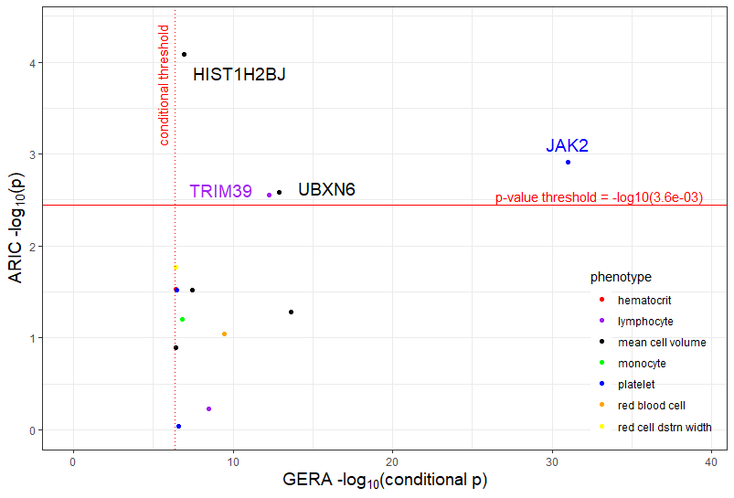
Replication Results
Conditionally significant GERA associations versus ARIC associations
ARIC replicate genes
Gene | Chr | Trait
HIST1H2BJ | 6 | mean cell vol
JAK2 | 9 | platelet
TRIM39 | 6 | lymphocyte
UBXN6 | 19 | mean cell vol
Amanda L. Tapia

Slide 11
Replication Results
ARIC replicate genes
Gene | Chr | Trait | Syndrome | GWAS/Enhancer associations *
HIST1H2BJ | 6 | mean cell volume (MCV) |  | None known for BCTs
JAK2 | 9 | platelet | Abnormal platelet morphology, etc. | GWAS: platelet, eosinophil Enhancer: MCV, RDW
TRIM39 | 6 | lymphocyte |  | Enhancer: other WBCs – basophil, eosinophil, monocyte
UBXN6 | 19 | mean cell volume (MCV) |  | Enhancer: MCV and mean cell hemoglobin
* GWAS = trait-gene associations; Enhancer = genetic variants in enhancer regions of gene associated with the trait
Syndrome and select known associations very briefly summarized from GeneCards Human Gene Database ⁶
Amanda L. Tapia
Notes:
Genetic variants in the enhancer regions of the gene are associated with WBCs

Slide 12
Conclusion & Future Directions
Conclusion
Future directions
Advantages of TWAS beyond GWAS
TWAS applied to GERA Europeans
  268 overall significant associations
  14 conditionally significant associations
Replication in ARIC
  4 significant associations, 4 unique genes
HIST1H2BJ and TRIM39 may represent novel discoveries
Refine conditional analysis
Further investigation into gene function
Application of TWAS in UK Biobank
  ~ 500,000 Europeans
  Meta-analysis with and/or replication in GERA and ARIC
Amanda L. Tapia

Slide 13
References & Acknowledgements
References
Acknowledgements
Astle, Cell 2016
DGN: http://dags.stanford.edu/dgn/
Gamazon, Nature Genetics 2015
GERA: https://www.ncbi.nlm.nih.gov/projects/gap/cgi-bin/study.cgi?study_id=phs000674.v2.p2
ARIC: https://www.nhlbi.nih.gov/science/atherosclerosis-risk-communities-aric-study
GeneCards: https://www.genecards.org/
Yun Li, PhD and Li lab members
Laura Raffield, PhD
GERA investigators
ARIC investigators
Amanda L. Tapia

Slide 14
Thank you!
Amanda L. Tapia
Department of Biostatistics
University of North Carolina at Chapel Hill
altapia@live.unc.edu
of 14

