Slide 1
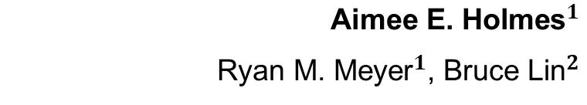
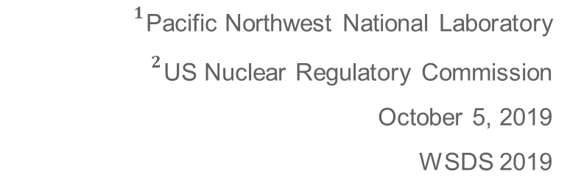
Analysis Approaches to Estimating Probability of Detection from Multiple Data Sources
PNNL-SA-148009
${\text{Aimee} \text{E}\text{. }\text{Holmes}}^{1}$
${\text{Ryan} \text{M}\text{. }\text{Meyer}}^{1}$, ${\text{Bruce} \text{Lin}}^{2}$
${}^{1}$Pacific Northwest National Laboratory
${}^{2}$US Nuclear Regulatory Commission
October 5, 2019
WSDS 2019
Notes:
About the Image: PNNL Aerial Photo
Aerial photo of the Pacific Northwest National Laboratory campus from the west.
https://www.flickr.com/photos/pnnl/42712951642/in/album-72157670058514908/

Slide 2
Work Sponsored By
This work was sponsored by the U.S. Nuclear Regulatory Commission’s Office of Research, under work agreement NRC-HQ-60-17-D-0010; Carol Nove – NRC COR.
PNNL is a multi-program national laboratory operated by Battelle Memorial Institute for the U.S. DOE under DE-AC06-76RLO 1830.

Slide 3
The Problem
Periodic nondestructive examination (NDE) is conducted on nuclear power plant (NPP) components to ensure structural integrity and safe operations
  Effective flaw detection in these materials can prevent component leakage or ruptures before they become critical
NDE flaw detection performance can be measured using probability of detection (POD) estimates
Multiple sources of data were used in this study
  Variability across data sources was considered in the analysis
  An assessment of data from multiple sources, including how to combine these data to generate accurate POD estimates, is presented.

Slide 4
What is Probability of Detection (POD)?
POD is the de facto metric used in quantifying the performance of an inspection for detecting structural defects (usually cracks). POD reflects the stochastic nature of detection and has a value often expressed as a percentage (range from 0% to 100%) or fraction (range from 0 to 1).
POD is typically represented as a function of flaw size (t) in this context.
The ideal POD curve is a step function with perfect (POD = 1) detection of all flaws of t>0 and no detection (POD = 0) of flaws of t=0 (or t ≤ pre-defined minimum flaw size).

Slide 5
Focus
Analysis techniques for deriving POD for qualified ultrasonic examinations (UT) in U.S. NPPs
POD is derived from empirical UT studies performed in laboratory-like environments on specimens that simulate realistic and relevant NPP component geometries

Slide 6
Three Sources of Empirical NDE Performance Data
Program for Inspection of Nickel Alloy Components (PINC)
  Blind international round robin test; PINC final report NUREG/CR-7019 (available at www.nrc.gov) [ML17159A466]
Program to Assess the Reliability of Emerging Nondestructive Techniques (PARENT)
  Open and blind international round robin testing; PARENT final reports NUREG/CRs 7235 (Blind) & 7236 (Open) (available at www.nrc.gov) [Blind - ML17159A466; Open - ML17223A700]
EPRI (Electric Power Research Institute) Performance Demonstration Initiative (PDI)
  Developed from EPRI PDI data; POD analysis of PDI data is summarized in EPRI report: 3002010988 [MRP-262 Rev. 3]

Slide 7
Variation Among Data Sources
Flaw size distribution and manufacturing technique for flaws
Test format and objectives
  PDI intent is to determine if performance is “good enough,” not meant to fully characterize performance
  PARENT and PINC results more likely to represent performance that is possible
Period of time for data collection
  PINC and PARENT data each collected over 1-2 year time frame
  PDI data accumulated over 20 years (estimated performance represents an average over this period)
Variation in the procedures/techniques represented in each dataset and the relative distribution of procedures
Variation in how data analysis is performed (i.e. how are false call data utilized?)

Slide 8
Objective
Consider combining results from the three data sources (where appropriate) to empirically estimate the overall POD
Determine if/where models can be combined (through-wall regions)

Slide 9
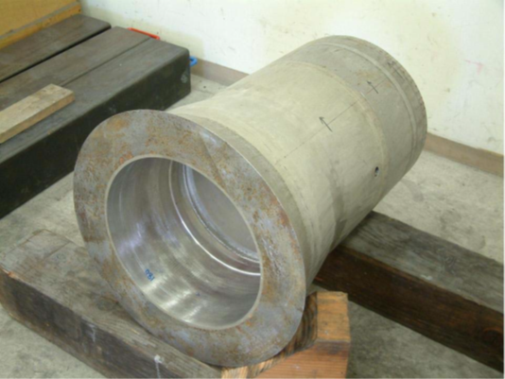
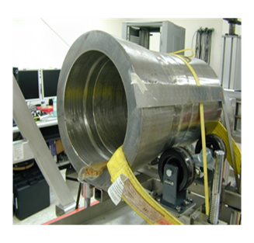
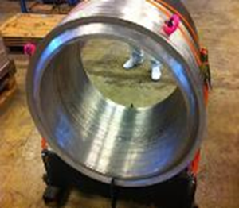
Specimens
PINC - SBDMW
PARENT - SBDMW
Type:
  LBDMW - large-bore dissimilar metal welds
  SBDMW - small-bore dissimilar metal welds
PARENT - LBDMW

Slide 10
Detection Data
2-D view of a block:
There are true detections, false calls, and missed detections
flawed grading unit
flaw indication
Distribution: Bernoulli/Binomial
1 if a crack was detected in a grading unit (gu), 0 otherwise
Two types of grading units:
  Blank
  Flawed
weld

Slide 11
Data – Four Linked Tables
Inspection Table – Identifies inspector, date of inspection, which block (id) was inspected, the procedure, inspection type (detection, length sizing, depth sizing), location of the inspected region, type of access (OD or ID), etc.
Indication Table – the inspection id, where the inspector saw indications (position, length, depth)
Block Table – type of block (SBDMW or LBDMW), size/dimensions of the block, if the weld was ground, location of the weld, inner and outer radius, etc.
Flaws Table – location of each flaw, depth, length, etc.

Slide 12
Score Results
Detection Table – Each row contains the result of a flawed grading unit inspection.
False Call Table – For each inspection, it provides the number of false calls (indications that do not overlap a flawed grading unit) of a single inspection. It also contains the length of blank material inspected.
Regression Table – Contains the detection table and converts the false call table to a number of detections (false calls) out of the number of unflawed grading units contained in the inspection region.
Inspection.id | Flaw.id | Detection? | Indication | Comment
11 | 23 | 0 | NA | Missed flaw.
11 | 27 | 1 | 38 | Detected flaw.
Insp.id | Block.id | Flaw.id | Ind.id | ndet | Nobs | gu
11 | P35 | 27 | 38 | 1 | 1 | flaw
96 | P40 | NA | NA | 4 | 74 | blank

Slide 13
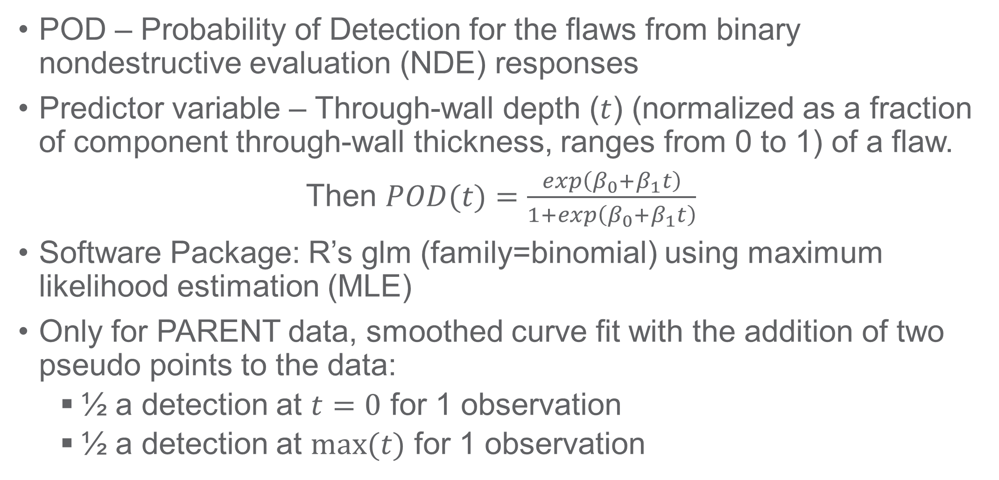
Methodology – Logistic Regression
POD – Probability of Detection for the flaws from binary nondestructive evaluation (NDE) responses
Predictor variable – Through-wall depth ($t$) (normalized as a fraction of component through-wall thickness, ranges from 0 to 1) of a flaw.
Then $POD(t)=\frac{exp\left(β_{0}+β_{1}t\right)}{1+exp\left(β_{0}+β_{1}t\right)}$
Software Package: R’s glm (family=binomial) using maximum likelihood estimation (MLE)
Only for PARENT data, smoothed curve fit with the addition of two pseudo points to the data:
  ½ a detection at $t=0$ for 1 observation
  ½ a detection at $max⁡(t)$ for 1 observation

Slide 14
Data Partitions Determined by:
Specimen Type
  LBDMW – large-bore dissimilar metal welds
  SBDMW – small-bore dissimilar metal welds
Access
  ID – Inner Diameter
  OD – Outer Diameter
Flaw Orientation
  C – Circumferential
  A – Axial

Slide 15
Detection Data
2-D view of a block:
There are true detections, false calls, and missed detections
flawed grading unit
flaw indication
Distribution: Bernoulli/Binomial
1 if a crack was detected in a grading unit (gu), 0 otherwise
Two types of grading units:
  Blank
  Flawed
weld

Slide 16
Summary of Test Block Dimensions
Data Source | PDI |  | PINC | PARENT
Specimen Type | SBDMW | LBDMW | SBDMW | SBDMW | LBDMW
Outer Diameter (mm) | 305-356 | 686-787 | 386–390 | 289 and 815 | 852–895
Wall Thickness (mm) | 30-58 | 64-76 | 42–46 | 35 and 39.5 | 68-78
Access | OD | ID | ID and OD | OD | ID and OD
Result: 8 data partitions (bold >1 data sources):
SBDMW OD C SBDMW OD A SBDMW ID C SBDMW ID A
LBDMW OD C LBDMW OD A LBDMW ID C LBDMW ID A

Slide 17
Number of Observations for Model Building
Data Partition | PDI Blank gu | PDI Flawed gu | PINC Blank gu | PINC Flawed gu | PARENT Blank gu | PARENT Flawed gu
SBDMW OD C | 5020 | 1675 | 422 | 183 | 844 | 167
SBDMW OD A | 5020 | 611 | 422 | 127 | 844 | 45
LBDMW ID C | 1467 | 553 | NA | NA | 404 | 38
LBDMW ID A | 1467 | 288 | NA | NA | 404 | 34
gu = grading unit
NA = Not Applicable
Only presenting those cases that had multiple data sources for the same data partition.

Slide 18
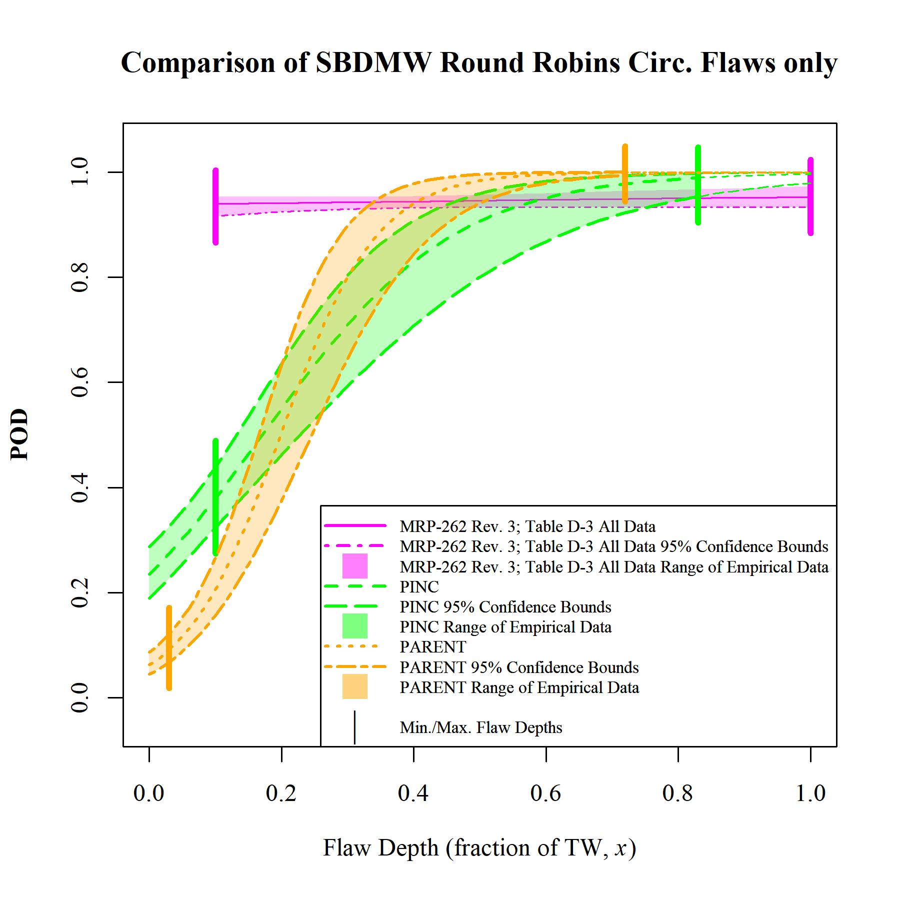
Plot:
SBDMW OD C
PDI = MRP-262 Rev. 3 data
Shading below “Min” flaw size to indicate that false call data is used in the logistic curve fit for PINC and PARENT
“Analysis of Empirical Probability of Detection Data for Dissimilar Metal Welds,” PNNL-28090 [ML19204A260].

Slide 19
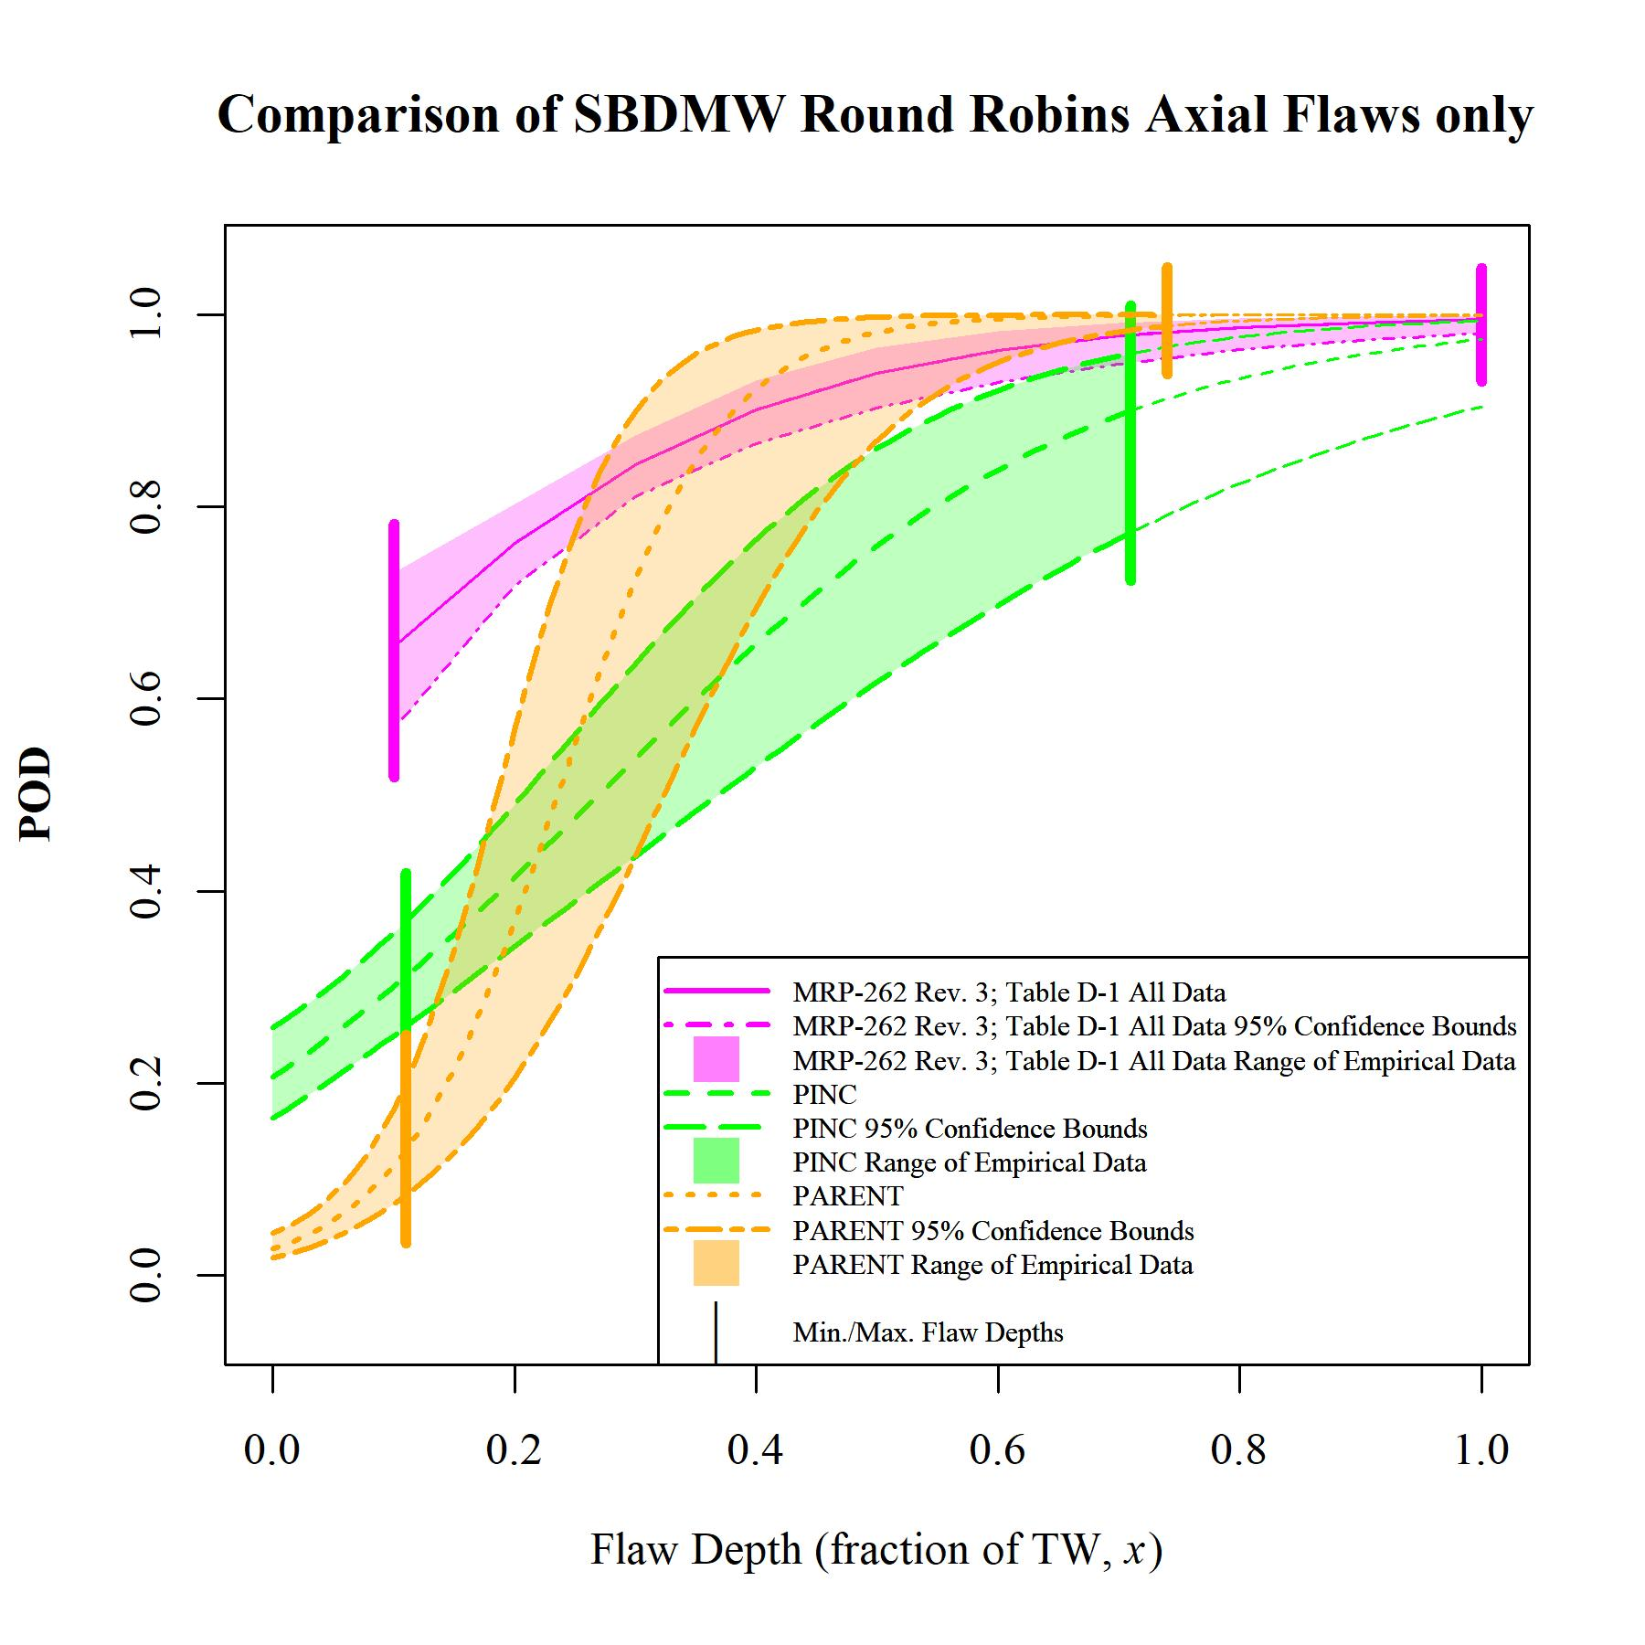
Plot:
SBDMW OD A
PDI = MRP-262 Rev. 3 data
“Analysis of Empirical Probability of Detection Data for Dissimilar Metal Welds,” PNNL-28090 [ML19204A260].

Slide 20
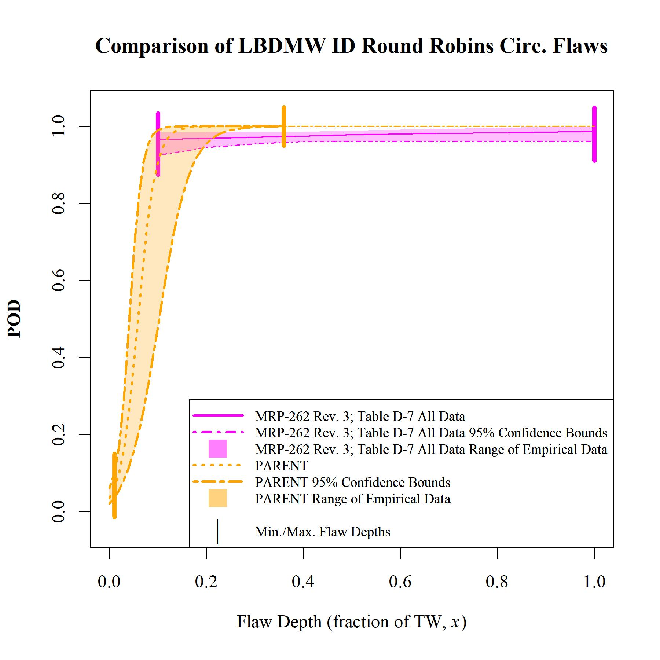
Plot:
LBDMW ID C
PDI = MRP-262 Rev. 3 data
“Analysis of Empirical Probability of Detection Data for Dissimilar Metal Welds,” PNNL-28090 [ML19204A260].

Slide 21
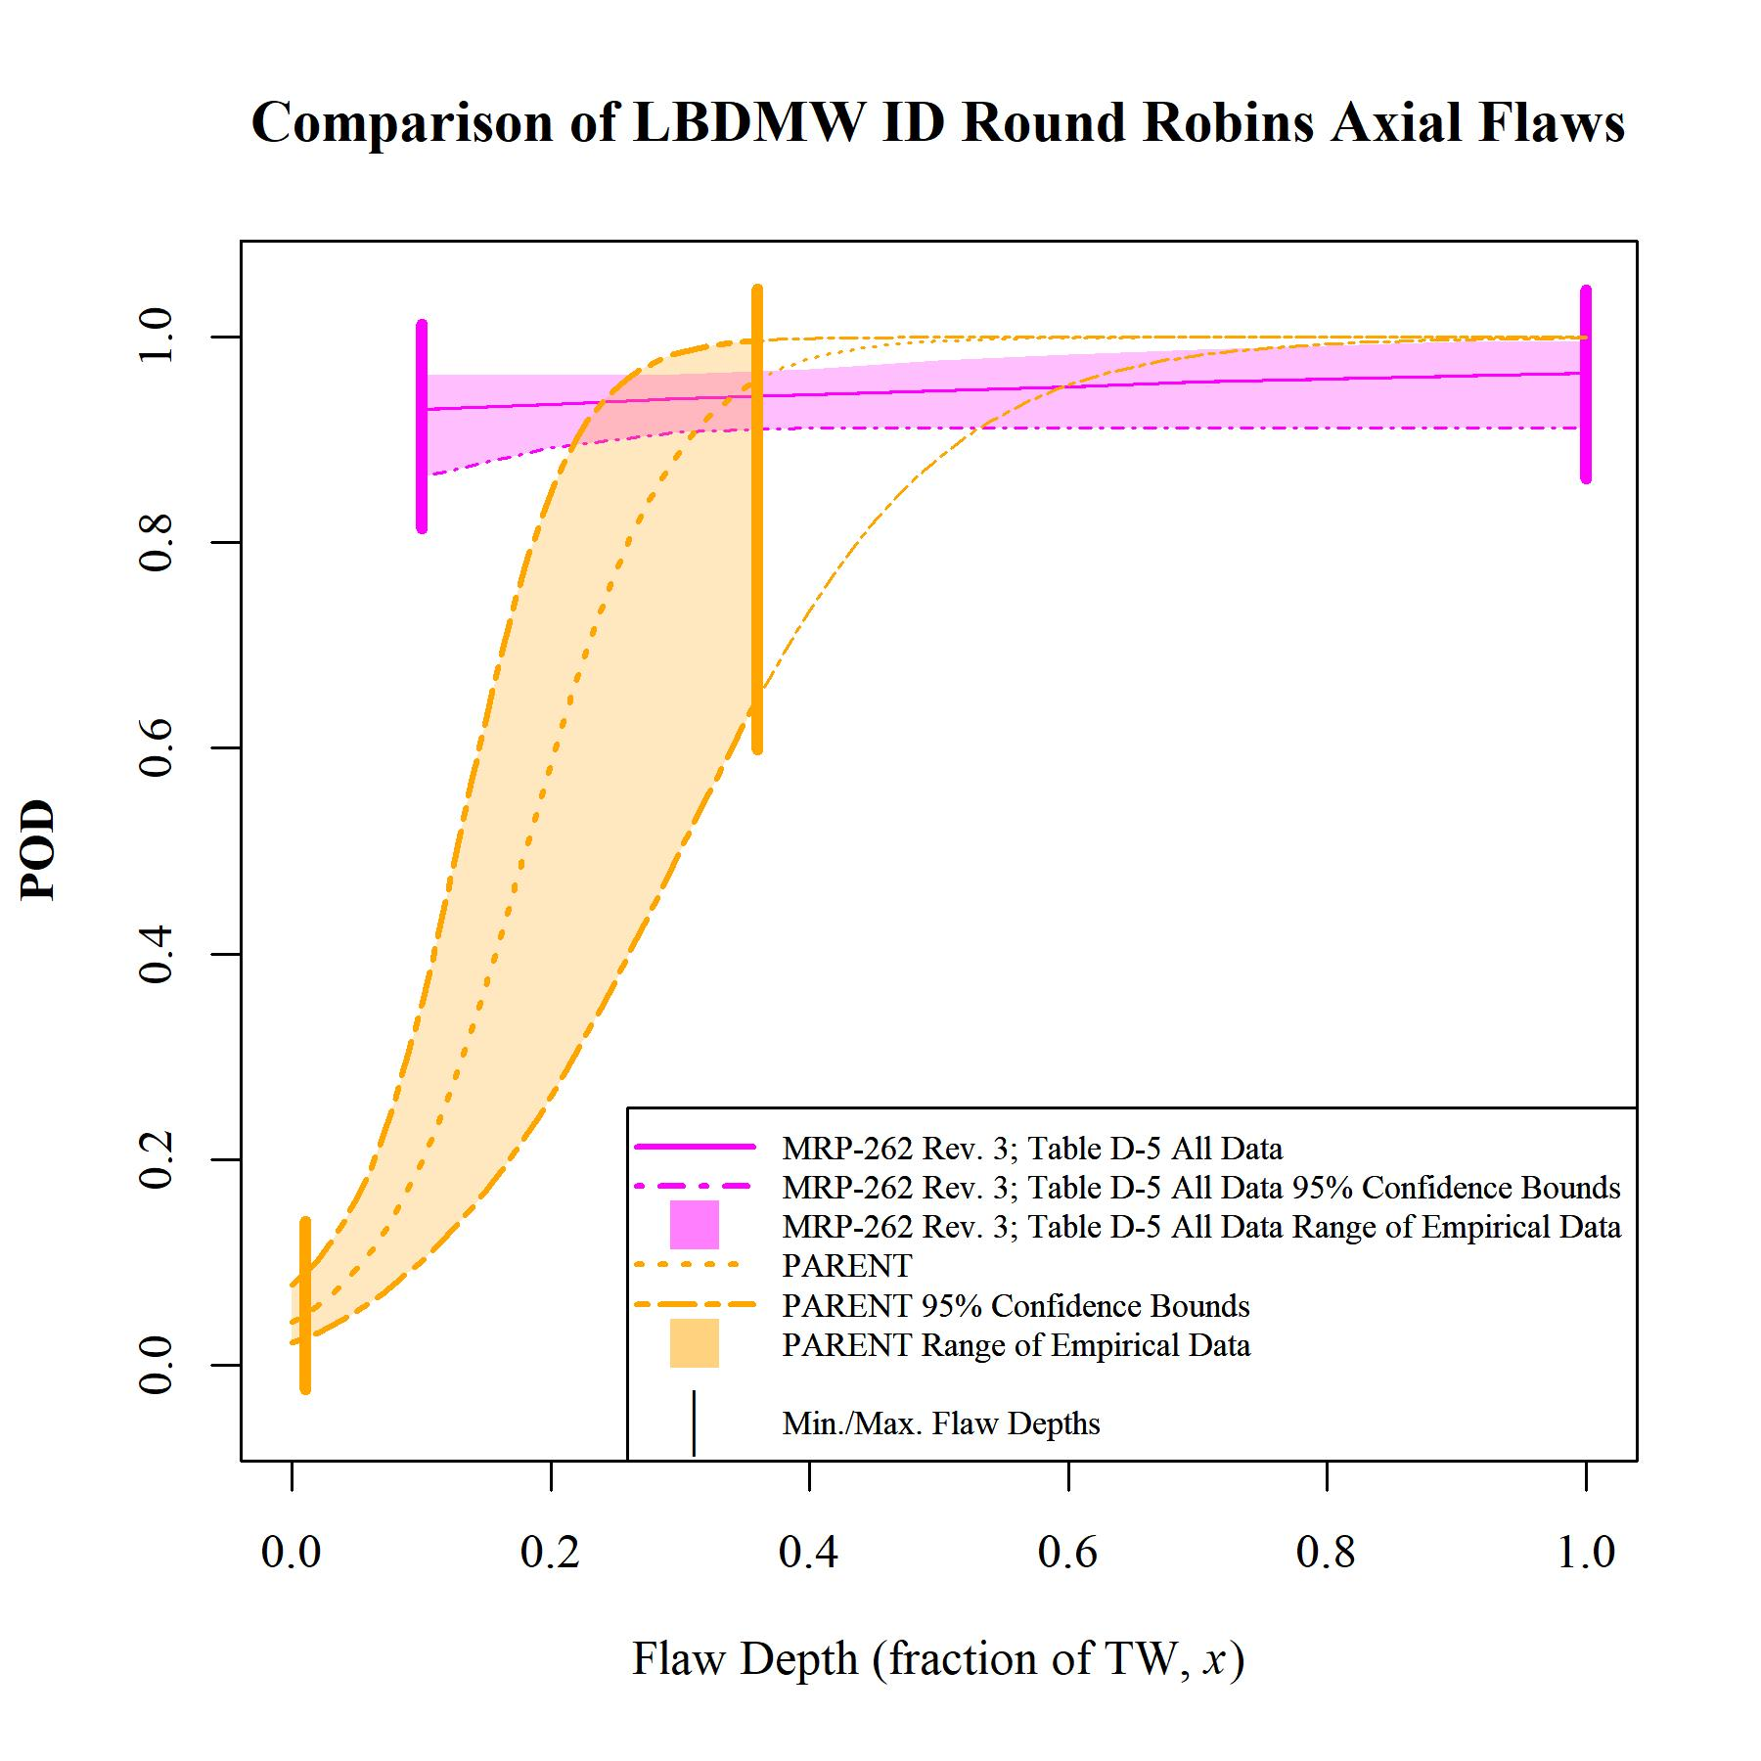
Plot:
LBDMW ID A
PDI = MRP-262 Rev. 3 data
“Analysis of Empirical Probability of Detection Data for Dissimilar Metal Welds,” PNNL-28090 [ML19204A260].

Slide 22
Summary of Model Parameters
Category | Flaw Orientation | Data Source | β₀ | β₁ | sd(β₀) | sd(β₁) | ρ | Min. Flaw Depth, x | Max. Flaw Depth, x
SBDMW (OD Access) | Circumferential | PDI – Category A (MRP-262 Rev. 3; Table 6-8) | 2.71 | 0.31 | 0.21 | 0.45 | −0.86 | 0.10 | 1.00
 |  | PINC | −1.18 | 6.9 | 0.14 | 1.0 | −0.49 | 0.10 | 0.83
 |  | PARENT | −2.71 | 13.7 | 0.18 | 1.5 | −0.48 | 0.03 | 0.72
SBDMW (OD Access) | Axial | PDI – Category A (MRP-262 Rev. 3; Table 6-5) | 0.12 | 5.24 | 0.27 | 1.02 | −0.91 | 0.10 | 1.00
 |  | PINC | −1.34 | 4.99 | 0.15 | 0.77 | −0.46 | 0.11 | 0.71
 |  | PARENT | −3.56 | 15.1 | 0.23 | 2.3 | −0.43 | 0.11 | 0.74
LBDMW (ID Access) | Circumferential | PDI – Category B2 (MRP-262 Rev. 3; Table 6-14) | 3.24 | 1.06 | 0.55 | 1.32 | −0.87 | 0.10 | 1.00
 |  | PARENT | −3.31 | 56 | 0.29 | 13 | −0.33 | 0.01 | 0.36
LBDMW (ID Access) | Axial | PDI – Category B1 (MRP-262 Rev. 3; Table 6-11) | 2.50 | 0.82 | 0.51 | 1.40 | −0.87 | 0.10 | 1.00
 |  | PARENT | −3.14 | 17.4 | 0.35 | 3.9 | −0.40 | 0.01 | 0.36

Slide 23
Some Sources of Variation Among Studies
Type and size of flaws
Test format and objectives
  Blind vs. Open
  PDI Intent: Passing inspection teams/procedures/equipment
  PARENT and PINC: performance that is possible
Period of time for data collection
  PINC: Data collected 2007-2008
  PARENT: Data collected 2012-2014
  PDI data accumulated over 20 years (April 2009 and earlier)
  Important because detection procedures/equipment have changed through time
Variation in the procedures/techniques and their frequency represented in each dataset
Variation in how data analysis is performed (i.e. how is false call data utilized?)

Slide 24
Discussion
Expensive to construct specimens resulting in a small number of flaws being inspected in Round Robin studies. This leads to wider 95% Confidence Bounds for the models.
There are likely other significant predictor variables. Other flaw-specific parameters (tilt, aspect ratio, etc.) or flaw-specific characteristics could be impacting the results.
Sometimes a small number of inspections (could be as small as 2) per flaw.
Data limitation – don’t have access to PDI detection data, have access to the regression models

Slide 25
Conclusions/Recommendations
Consider exploring down-weighting the false call data (same rate, but include fewer observations).
Would recommend including false call data in all models.
Would recommend appropriately partitioning the datasets and clearly defining the range of data that should be included in the combined models. Determining what percentage of the partitioned datasets should be included (with appropriate weightings) in the final models.
Determine if any important data gaps exist.
Consider a Bayesian approach with the PDI model informing the prior, and PINC and PARENT detection data informing the likelihood.

Slide 26
Questions?

