Slide 1

Using Technology to Assess the Impact of Alcohol Use on HIV Medication Adherence
Enbal Shacham, PhDª; Daphne Lew, MPHª; Julia Lόpez, PhD^{b}; Steve Scroggins, MPHª; Rachel Presti, MD^{b}; Tim Trull, PhD^{c}
ª College for Public Health and Social Justice, Saint Louis University, 3545 Lafayette Avenue, St. Louis, MO 63104
^{b} Washington University School of Medicine, 660 S. Euclid Avenue, St. Louis, MO 63110
^{c} Department of Psychological Sciences, University of Missouri, 210 McAlester Hall, Columbia, MO 65211

Slide 2
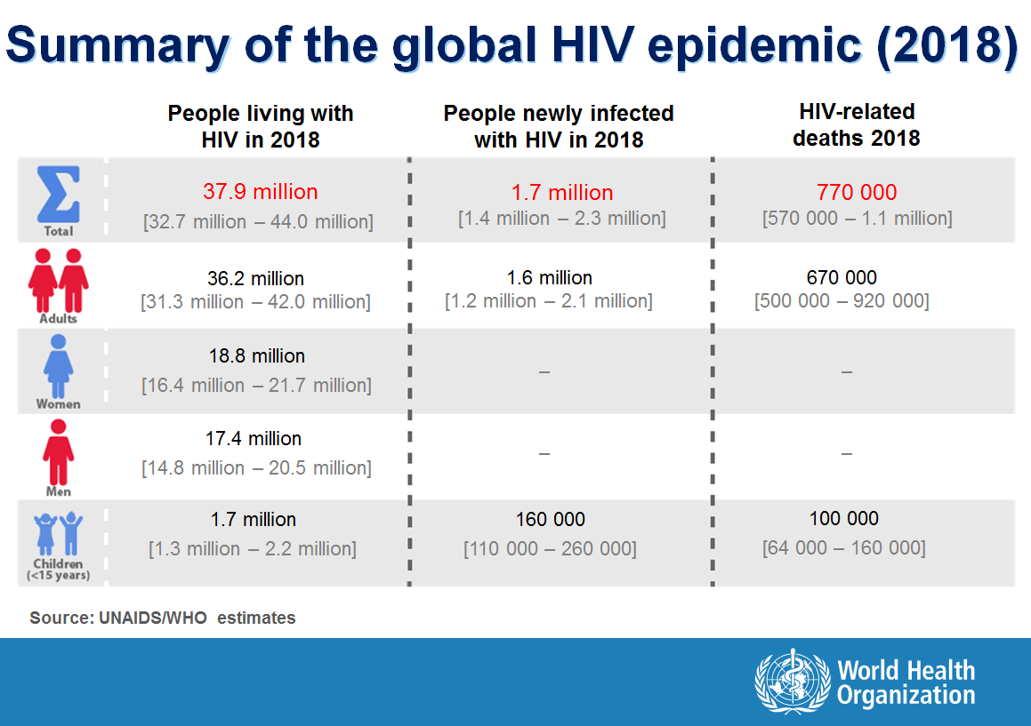
Global and Local Burden of HIV
Approximately 1.2 million people in the United States (US) are living with HIV¹
Nearly 40,000 new cases of HIV infections are diagnosed each year in the US¹
It is estimated that about 15% of individuals living with HIV in the US do not know that they are infected²
In the St. Louis region, approximately 6,200 individuals are living with HIV³
https://www.who.int/hiv/data/2018_summary-global-hiv-epi.png?ua=1

Slide 3


Disease Management for People Living with HIV
Among people living with HIV (PLWH), consistent medication adherence is important for proper infection control and viral suppression⁴
Only 51% of PLWH in the US have achieved viral suppression⁵
Heavy drinkers are known to be less likely to adhere to antiretroviral treatment (ART), and PLWH are known to have higher rates of alcohol use^{6,7}
Other barriers to medication adherence include psychiatric disorders, stigma, and difficulties with health services⁸
https://www.cdc.gov/hiv/images/risk/art/NoTransmission-Opt1.jpg
https://www.cdc.gov/hiv/images/risk/art/BecomeUndetectable.jpg

Slide 4
Ecological Momentary Assessments
Ecological momentary assessment (EMA) is a class of research methods that allows for data collection in real-time and in real-world settings⁹
Ecological
Data is collected in real-world environments, while the subject is engaging in their normal daily activities
Momentary
Assessments focus on the current state of the subject, as opposed to asking subjects to recall feelings or experiences over a wide range of time
Assessments
Moments for assessment are selected based on particular occurrences, random sampling, or some other pre-specified sampling scheme
Recent advances in smartphone technology have made implementation of EMA much more feasible through the use of specifically-designed smartphone applications
EMA has been used to better understand patterns associated with substance use, tobacco cessation, pain management, and aspects of clinical treatment¹⁰

Slide 5
Ecological Momentary Assessments among PLWH
Retrospective recall is known to be prone to systematic bias and error, and this is particularly true regarding recall of substance use^{9,11}
Recent studies have shown that EMA can successfully be used to understand patterns of substance use and mood among PLWH^{10,12,13}
One study of PLWH showed that self-reported methamphetamine and alcohol use was more accurately recorded using EMA than retrospective recall¹²
A short-term study using EMA among older PLWH showed that subjects experienced high rates of time alone, particularly when their pain levels were higher, which in turn was associated with lower overall happiness¹⁴

Slide 6
Gaps Addressed in the Current Study
Consistent alcohol use is known to be associated with lower ART adherence overall, but little has been done to look at the relationship between intraday alcohol consumption and medication adherence
Studies using EMA with PLWH have examined relationships between daily mood and alcohol use, but have not related these constructs to ART adherence
The use of technology to assess substance use, mood, and ART adherence of PLWH in real-time and over an extended period of time can help better characterize intraday patterns that may be beneficial or detrimental to proper disease management

Slide 7
Participant Recruitment
Participants were recruited from the Washington University HIV Clinic in St. Louis, MO
 | n/N (%)
Under 35 years of age | 7/34 (20.6)
African-American/Black/Latinx Race | 26/34 (73.5)
Male gender | 26/34 (76.5)
Transgender: Male to Female | 1/34 (2.9)
Highest education level: Some high school | 2/34 (5.9)
Highest education level: High school diploma or equivalent | 11/34 (32.4)
Highest education level: Bachelor’s degree or higher | 6/34 (17.6)
Annual income less than $10,000 | 19/34 (55.9)
Annual income $10,000-$29,999 | 12/34 (35.3)
Married or Partnered | 5/34 (14.7)
Never married | 23/34 (67.6)
Unemployed/disability/student | 19/34 (55.9)
Consider self homeless | 1/34 (2.9)
Eligibility criteria:
Greater than 21 years of age
HIV positive
Have consumed alcohol in the past 30 days
Lived in St. Louis Metropolitan region
Received ART for 6 months prior to the start of the study, with no intention of changing
Exclusion criteria:
Unable to give informed consent
Had active psychosis or other uncontrolled mental illness
Incarcerated
Table 1: Select demographic characteristics of the study sample

Slide 8
Data and Measures
Subjects completed a baseline interview to gather information about sociodemographic characteristics, substance use, sexual behaviors, and psychological distress
Clinical biomarkers reflecting the impact of alcohol use on liver function and HIV viral loads were collected from electronic medical records
A smartphone application was developed to collect real-time EMA data prospectively over 28 days
Subjects reported information about alcohol consumption, mood, and sexual activities
  Types of surveys included random prompts (3 times throughout the day), morning reports, alcoholic drink reports (initial drink and follow-up), and mood dysregulation
  Mood was measured using the Positive and Negative Affect Schedule – Short Form (PANAS-SF)¹⁵
Of the 34 subjects enrolled in the study, 28 completed the full 28-day follow-up

Slide 9
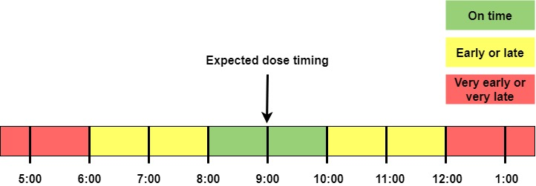
Data and Measures: Medication Adherence
Medication adherence was measured using a Medication Event Monitoring System (MEMSCap) pill bottle, which recorded the date and time when the bottle was opened
Three subjects were on twice-daily ART regimens while 25 were on once-a-day regimens
Overall medication adherence was calculated as:
$$Adherence \%=\left(\frac{Recorded bottle openings}{Expected bottle openings based on ART regimen}\right)∗100$$
Figure 1: Image showing how timing of doses throughout the study was determined

Slide 10
Data and Measures
Figure 2: Example of mood, alcohol use, and medication adherence data for one study participant

Slide 11
Analytic Methods
Descriptive statistics for all variables of interest
Spearman correlations were used to look at relationships between baseline biomarkers, medication adherence, alcohol use, and mood variability
Three multilevel logistic regression models to examine the joint impact of alcohol use and mood on daily medication adherence throughout the study
  Outcomes of interest included daily adherence, early or very early doses, and late or very late doses
  All models controlled for gender, race, age, and baseline depression score
  Affect scores and alcohol use variables were person-mean centered and grand-mean centered to determine the between- and within-person effects

Slide 12
Results: Medication Adherence
Once-a-day medication regimen overall adherence: 93.88%
Twice-a-day medication regimen overall adherence: 95.52%
Figure 3: Proportions of dose timings among non-missed doses

Slide 13
Results: Alcohol Use and Mood Variability
 | Mean +/- SD | Median | IQR
Real-time alcohol use
Number of days with drinks per person | 7.75 +/- 5.58 | 7 | (3.75, 11.25)
Number of episodes per person | 8.11 +/- 5.74 | 7 | (4.00, 12.25)
Alcohol episodes
Number of drinks per episode | 4.84 +/- 5.11 | 3 | (1.00, 6.00)
Episode duration (minutes) | 112.30 +/- 131.17 | 43 | (30.00, 146.50)
Mood variability
MSSD: PANAS Positive | 46.85 +/- 35.43 | 42.25 | (20.47, 68.83)
MSSD: PANAS Negative | 7.15 +/- 14.11 | 2.96 | (0.66, 4.79)
PAC: PANAS Positive | 0.19 +/- 0.12 | 0.22 | (0.10, 0.27)
PAC: PANAS Negative | 0.03 +/- 0.04 | 0.02 | (0.00, 0.04)
Table 3. Descriptive statistics of real-time alcohol use for all participants (n = 28), characteristics of alcohol episodes (n = 227), and measures of mood variability for all participants (n = 28)
MSSD: mean square of successive differences; PAC: proportion of acute change

Slide 14
Results: Spearman Correlations
Significant association between MSSD for negative mood and total number of alcohol episodes throughout the study period (ρ = 0.374, p < 0.05)
Higher mean corpuscular volume (MCV) at baseline was significantly associated with lower overall adherence and higher number of late doses (ρ = -0.382 and ρ = 0.387, respectively, both p < 0.05)
  MCV is a biomarker that can be used to reflect the physiological impact of alcohol use, where higher values are associated with long-term impact of alcohol use on liver function¹⁶
Other significant associations were found between variables that were similar in nature, such as associations between positive PAC and negative PAC

Slide 15
Results: Multivariate Models
Alcohol use, mood, and the combination of both variables did not significantly predict daily medication adherence
Individuals with a higher number of alcohol episodes throughout the study had decreased odds of medication adherence, though the relationship was non-significant
  This association was observed in models predicting early and late doses as well
On days when individuals reported higher negative affect (worse mood), odds of taking their medication dose late were significantly increased (aOR: 1.10; 95% CI: [1.01, 1.19])
  This association persisted even after also controlling for alcohol use

Slide 16
Summary of Findings
Medication adherence in the sample was high compared to other studies of PLWH
Individuals with once-a-day regimens reported higher proportions of on-time doses, while those with twice-a-day regimens reported higher proportions of very early or very late doses
The sample experienced very low levels of negative mood variability, particularly when compared to positive mood variability
Negative mood variability was associated with a higher number of alcohol episodes throughout the study
On days when individuals reported higher negative affect (worse mood) they were more likely to take their dose late or very late

Slide 17
Conclusions
Participants in the study were established patients in the Washington University HIV Clinic, so it is not surprising that their overall medication adherence was high
The finding that alcohol use did not significantly impact medication adherence may point to the fact that these subjects have found ways to incorporate medication adherence into their daily lives
The association between mood variability and both alcohol use and dose timing highlights the need for appropriate mental health services for PLWH
Collection of intra-day measures of mood, alcohol use, and medication adherence using EMA was highly successful with this population of PLWH

Slide 18

Implications and Future Directions
A larger study involving subjects that are younger, have less-managed HIV, or are newly receiving care may provide further insights into the relationship between alcohol use, mood variability, and medication adherence
Using technology to implement EMA among PLWH can provide important insights into the characteristics of daily living that help promote or prevent proper disease management
https://aidsinfo.nih.gov/understanding-hiv-aids/infographics/32/the-path-to-a-longer--healthier-life-with-hiv

Slide 19

Questions?
Thank you!
For additional information, feel free to contact me at daphne.lew@slu.edu
https://www.researchgate.net/profile/Daphne_Lew

Slide 20
References
CDC. Trends in U.S. HIV diagnoses, 2005–2014. 2016; https://www.cdc.gov/nchhstp/newsroom/docs/factsheets/hiv-data-trends-fact-sheet-508.pdf.
CDC. HIV Basics: Overview, Data and Trends, U.S. Statistics. 2019; https://www.hiv.gov/hiv-basics/overview/data-and-trends/statistics.
Missouri Department of Health and Senior Services. 2017 Epidemiologic Profiles of HIV, STD, and Hepatitis in Missouri. 2017; https://health.mo.gov/data/hivstdaids/pdf/SLHIVSTD2017.pdf.
CDC. HIV Viral Suppression and an Undetectable Viral Load: The Health and Prevention Benefits. 2018; https://files.hiv.gov/s3fs-public/Viral-Suppression-Sheet.pdf
CDC, National Center for HIV/AIDS, Viral Hepatitis, STD, and TB Prevention. HIV in the United States and Dependent Areas. 2019; https://www.cdc.gov/hiv/pdf/statistics/overview/cdc-hiv-us-ataglance.pdf
NIH, National Institute on Alcohol Abuse and Alcoholism. Alcohol and HIV/AIDS. Alcohol Alert. 2002; 57. https://pubs.niaaa.nih.gov/publications/aa57.htm
Azar MM, Springer SA, Meyer JP, Altice FL. A systematic review of the impact of alcohol use disorders on HIV treatment outcomes, adherence to antiretroviral therapy and health care utilization. Drug and Alcohol Dependence. 2010; 112(3): 178-193.
Shubber Z, Mills EJ, Nachega JB, Vreeman R, Freitas M, Bock P, Nsanzimana S, Penazzato M, Appolo T, Doherty M, Ford N. Patient-Reported Barriers to Adherence to Antiretroviral Therapy: A Systematic Review and Meta-Analysis. PLoS Medicine. 2016; 13(11): 1-14. doi: 10.1371/journal.pmed.1002183
Shiffman S, Stone AA, Hufford M. Ecological Momentary Assessment. Annual Review of Clinical Psychology. 2008; 4(1): 1-32.doi: 10.1146/annurev.clinpsy.3.022806.091415
Shacham E, Lew D, Xiao T, Lopez J, Trull T, Schootman M, Presti R. Testing the Feasibility of Using Ecological Momentary Assessment to Collect Real-Time Behavior and Mood to Predict Technology-Measured HIV Medication Adherence. AIDS and Behavior. 2019; 23(8): 2176-2184. doi: 10.1007/s10461-018-2378-9
Gmel G, Daeppen JB. Recall Bias for Seven-Day Recall Measurement of Alcohol Consumption Among Emergency Department Patients: Implications for Case-Crossover Designs. Journal of Studies on Alcohol and Drugs. 2007; 68(2): 303-310. doi: 10.15288/jsad.2007.68.303
Rowe C, Hern J, DeMartini A, Jennings D, Sommers M, Walker J, Santos GM. Concordance of Text Message Ecological Momentary Assessment and Retrospective Survey Data Among Substance-Using Men Who Have Sex With Men: A Secondary Analysis of a Randomized Controlled Trial. JMIR mHealth and uHealth. 2016; 4(2): e44. doi: 10.2196/mhealth.5368.
Yang C, Linas B, Kirk G, Bollinger R, Chang L, Chander G, Siconolfi D, Braxton S, Rudolph A, Latkin C. Feasibility and Acceptability of Smartphone-Based Ecological Momentary Assessment of Alcohol Use Among African American Men Who Have Sex With Men in Baltimor. JMIR mHealth and uHealth. 2015; 3(2): e67. doi: 10.2196/mhealth.4344.
Paolillo EW, Tang B, Depp CA, Rooney AS, Vaida F, Kaufmann CN, Mausbach BT, Moore DJ, Moore RC. Temporal Associations Between Social Activity and Mood, Fatigue, and Pain in Older Adults With HIV: An Ecological Momentary Assessment Study. JMIR Mental Health. 2018; 5(2): e38. doi: 10.2196/mental.9802.
Karim J, Weisz R, Rehman SU. International positive and negative affect schedule short-form (I-PANAS-SF): testing for factorial invariance across cultures. Procedia Social and Behavioral Sciences. 2011;15:2016-2022.
Agarwal S, Fulgoni VL, Lieberman HR. Assessing alcohol intake & its dose-dependent effects on liver enzymes by 24-h recall and questionnaire using NHANES 2001-2010 data. Nutrition Journal. 2016;15:62.

Slide 21
Results: Multivariate Models
 | Model 1 |  | Model 2 |  | Model 3
 | aOR | 95% CI | aOR | 95% CI | aOR | 95% CI
Within-person effects
Positive affect | 0.99 | (0.95, 1.03) | -- | -- | 0.99 | (0.95, 1.03)
Negative affect | 1.03 | (0.95, 1.12) | -- | -- | 1.03 | (0.95, 1.12)
Number of alcoholic drinks | -- | -- | 1.03 | (0.96, 1.11) | 1.03 | (0.96, 1.11)
Alcohol episodes | -- | -- | 1.25 | (0.67, 2.31) | 1.26 | (0.68, 2.35)
Between-person effects
Positive affect | 1.00 | (0.96, 1.05) | -- | -- | 1.02 | (0.97, 1.07)
Negative affect | 0.92 | (0.75, 1.15) | -- | -- | 0.91 | (0.74, 1.12)
Number of alcoholic drinks | -- | -- | 1.05 | (0.80, 1.37) | 1.09 | (0.82, 1.46)
Alcohol episodes | -- | -- | 0.18 | (0.01, 3.79) | 0.10 | (0.003, 3.17)

Slide 22
Results: Multivariate Models
 | Model 1 |  | Model 2 |  | Model 3
 | aOR | 95% CI | aOR | 95% CI | aOR | 95% CI
Predicting early or very early doses
Within-person effects
Positive affect | 0.99 | (0.95, 1.02) | -- | -- | 0.98 | (0.95, 1.02)
Negative affect | 0.97 | (0.90, 1.05) | -- | -- | 0.98 | (0.90, 1.06)
Number of alcoholic drinks | -- | -- | 1.02 | (0.96, 1.09) | 1.03 | (0.97, 1.09)
Alcohol episodes | -- | -- | 1.12 | (0.64, 1.96) | 1.09 | (0.62, 1.91)
Between-person effects
Positive affect | 1.00 | (0.96, 1.05) | -- | -- | 1.01 | (0.96, 1.06)
Negative affect | 1.14 | (0.91, 1.43) | -- | -- | 1.11 | (0.88, 1.39)
Number of alcoholic drinks | -- | -- | 1.19 | (0.90, 1.56) | 1.21 | (0.90, 1.64)
Alcohol episodes | -- | -- | 0.50 | (0.02, 11.43) | 0.36 | (0.01, 13.11)

Slide 23
Results: Multivariate Models
 | Model 1 |  | Model 2 |  | Model 3
 | aOR | 95% CI | aOR | 95% CI | aOR | 95% CI
Predicting late or very late doses
Within-person effects
Positive affect | 1.00 | (0.97, 1.04) | -- | -- | 1.00 | (0.97, 1.04)
Negative affect | 1.10* | (1.01, 1.19) | -- | -- | 1.10* | (1.01, 1.19)
Number of alcoholic drinks | -- | -- | 1.01 | (0.95, 1.07) | 1.01 | (0.95, 1.07)
Alcohol episodes | -- | -- | 0.92 | (0.53, 1.58) | 0.96 | (0.56, 1.66)
Between-person effects
Positive affect | 1.02 | (0.98, 1.06) | -- | -- | 1.02 | (0.98, 1.07)
Negative affect | 0.88 | (0.73, 1.07) | -- | -- | 0.87 | (0.71, 1.06)
Number of alcoholic drinks | -- | -- | 1.01 | (0.81, 1.27) | 1.10 | (0.85, 1.41)
Alcohol episodes | -- | -- | 2.06 | (0.15, 27.94) | 0.73 | (0.03, 15.48)

