Slide 1
Defining New Staging Criteria for Metastatic Breast Cancer Using Recursive Partitioning
Samantha M. Thomas, MS^{1,2} and Jennifer K. Plichta, MD, MS^{2,3}
¹Department of Biostatistics & Bioinformatics, ²Duke Cancer Institute, ³Department of Surgery
Duke University, Durham NC

Slide 2
Background and Motivation
American Joint Commission on Cancer (AJCC) develops staging criteria for many cancer types.
  Primarily uses T-stage (tumor), N-stage (nodal status), and M-stage (metastasis) for most cancers
8th Edition (most recent) AJCC staging criteria for breast cancer incorporated additional clinical factors:
  Tumor grade
  ER/PR/HER2 receptor status
  Multigene assay score
However, this only applied to non-metastatic breast cancer. All patients with metastatic breast cancer (MBC), regardless of clinical factors, remained stage IV (similar to all previous edition)
But, there is evidence that the prognosis of MBC patients can vary significantly

Slide 3
Objective
Determine if distinct prognostic groups exist among de novo MBC patients

Slide 4
Data and Methods
Patients age 18+ diagnosed 2010-2013 with de novo MBC were selected from the National Cancer Database (N=16187)
Recursive partitioning analysis (RPA) with splitting criteria of p=0.10 was used to group patients with similar overall survival (OS) based on clinical characteristics:
  T/N Stage,
  Tumor Grade,
  ER/PR/HER2 Receptor Status,
  # of Metastatic Sites
  Presence of Bone-Only Metastases
After RPA, 3-year OS rates were estimated for each terminal node and nodes were amalgamated into 3 groups based on 3-year OS:
  (A) >50%
  (B) 30-50%
  (C) <30%

Slide 5
Methods, cont.
Bootstrapping with 1000 iterations was then conducted around the RPA to better approximate the population distribution.
Characteristic profiles were then assigned to final groupings based on the substage (A, B, or C) to which they were assigned most often.
Kaplan-Meier analyses and log-rank tests were used to estimate differences in OS.
Validated in a single-institution sample (N=131)

Slide 6
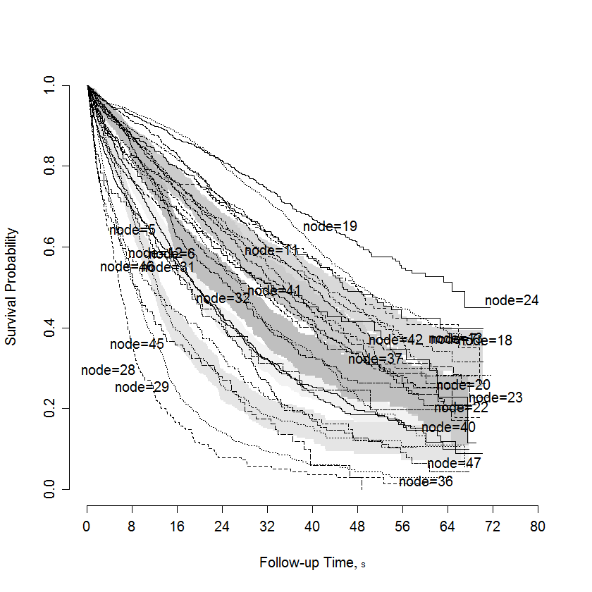
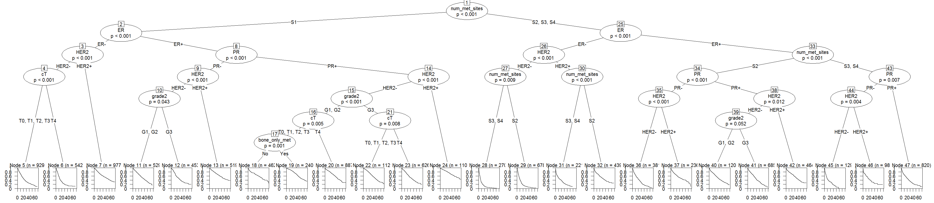
Results
There were 1123 possible combinations of the included variables and RPA on the original data resulted in 24 terminal nodes

Slide 7
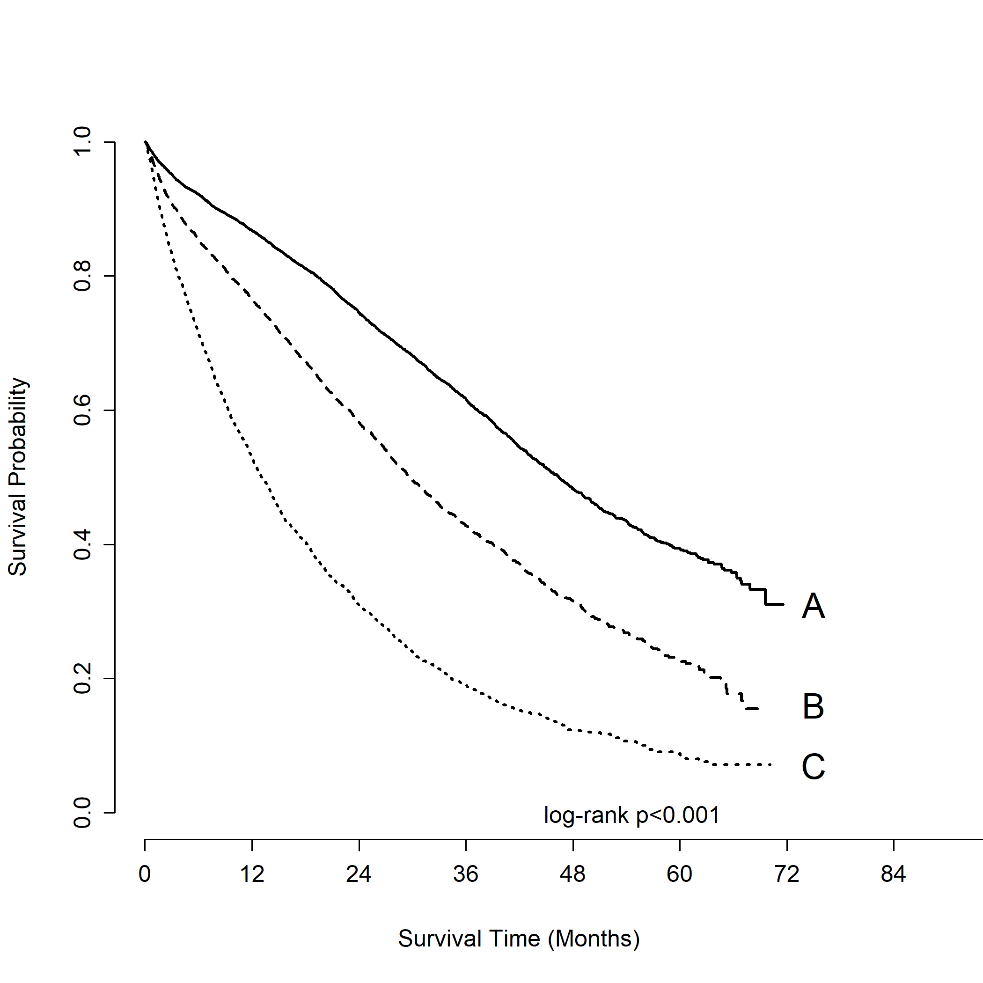
Results, cont.
After bootstrapping, distinct stage IVA, IVB, and IVC groupings were identified
Substage | N | 5-Year OS Rate (95% CI)
A | 7941 | 0.393 (0.374-0.411)
B | 4291 | 0.228 (0.206-0.250)
C | 3955 | 0.088 (0.074-0.105)
Distinct prognostic groups were maintained when the substaging was applied to the validation set

Slide 8
Conclusions
There are distinct prognostic groups among de novo MBC patients and these groupings can be used to improve prognostication and guide patient care.
These findings have motivated the AJCC to reevaluate the MBC staging guidelines.

