Slide 1
Forecasting Hierarchical Time Series
Seema Sangari* and Dr. Xinyan (Abby) Zhang
PhD Candidate- Analytics and Data Science
* https://www.linkedin.com/in/seemasangari/

Slide 2
Agenda
Introduction: Hierarchical Time Series
Motivation
High Level Algorithm
Data Generation
Proposed Approach
Forecasting
Results

Slide 3
Hierarchical Series
$$S=\sum_{i}{Y_{i}}= \sum_{i}{\sum_{j_{i}}{X_{ij_{i}}}}$$
𝑆=∑2_𝑖▒𝑌_𝑖 = ∑2_𝑖▒∑2_(𝑗_𝑖)▒𝑋_(𝑖𝑗_𝑖 )
$$Y_{1}= \sum_{j_{1}}{X_{1j_{1}}}$$
𝑌_1= ∑2_(𝑗_1)▒𝑋_(1𝑗_1 )
X₁₁
...
$$Y_{2}=\sum_{j_{2}}{X_{2j_{2}}}$$
𝑌_2=∑2_(𝑗_2)▒𝑋_(2𝑗_2 )
X₂₁
...
$$X_{2j_{2}}$$
𝑋_(2𝑗_2 )
...
$$Y_{i}= \sum_{j_{i}}{X_{ij_{i}}}$$
𝑌_𝑖= ∑2_(𝑗_𝑖)▒𝑋_(𝑖𝑗_𝑖 )
X_{i1}
...
$$X_{ij_{i}}$$
𝑋_(𝑖𝑗_𝑖 )
...
...
$$X_{1j_{1}}$$
𝑋_(1𝑗_1 )
Top Level
Mid Level
Bottom Level

Slide 4
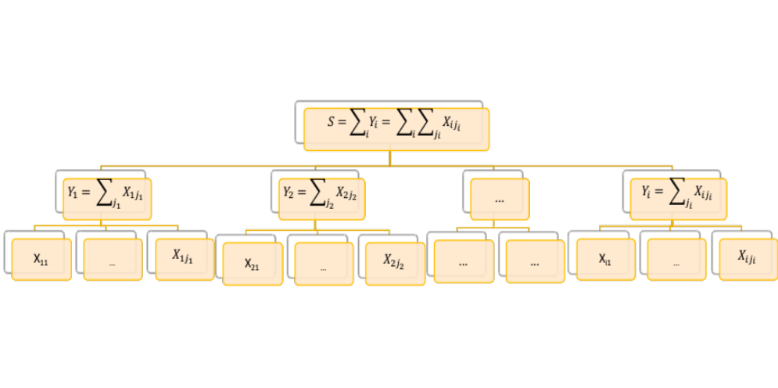
Hierarchical Time Series
Time Dimension
T₁:
T₂:
...
T_{k}:

Slide 5
US Tourism: Hierarchical Series
US
East
New York
New Jersey
Central
Ohio
…
West
California
Nevada
...
Texas
...

Slide 6
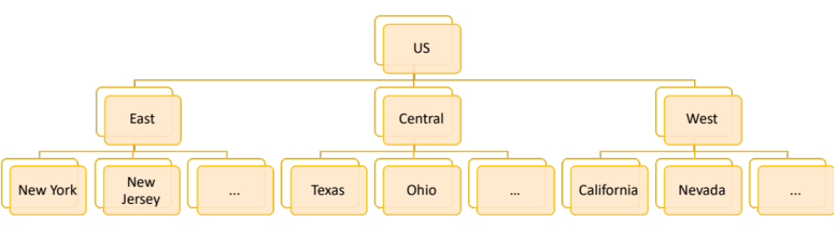
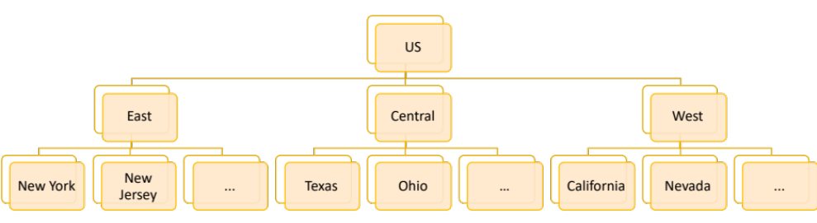
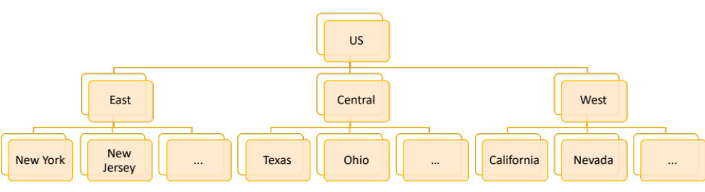
US Tourism: Hierarchical Time Series
Time Dimension
T₁:
T₂:
...
T_{k}:

Slide 7
Motivation
Top Down Approach
  Fails to capture dynamic of individual time series
  None of the trends captured
Bottom Approach
  Resolves above problems
  Noise at Bottom level data results in aggregated noise at upper levels

Slide 8
High Level Algorithm
Top Down Approach
  Captures dynamic of individual time series
  Trends captured
Vertically
  Captures summation of the corresponding series at sub level
Horizontal
  Captures linear relation among the respective time series

Slide 9
Algorithm: Hierarchical Data
Top Level : Predict with Time Series
US
East
NY
NJ
Central
Ohio
…
West
California
Nevada
...
Texas
...
Mid/Low-Level: Establish Linear relation with Odds predictions

Slide 10
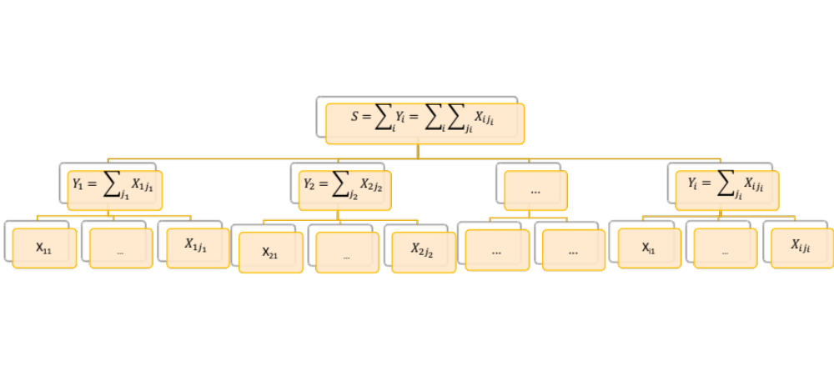
Research Concept: Longitudinal Hierarchical Data
Time Dimension
SUM
RELATION AMONG THE VARIABLES

Slide 11
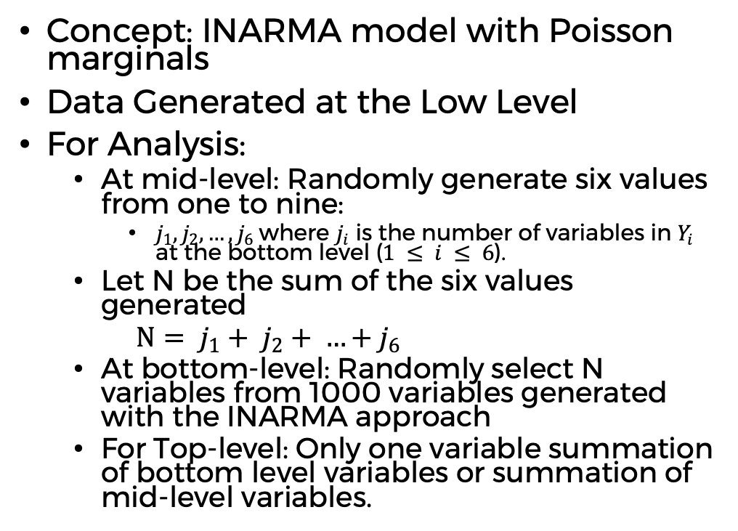
Data Generation
Concept: INARMA model with Poisson marginals
Data Generated at the Low Level
For Analysis:
  At mid-level: Randomly generate six values from one to nine:
    $j_{1}, j_{2}, …, j_{6}$where $j_{i}$ is the number of variables in $Y_{i}$ at the bottom level ($1 ≤ i ≤ 6$).
  Let N be the sum of the six values generated
  $N= j_{1}+ j_{2}+ …+j_{6}$
  At bottom-level: Randomly select N variables from 1000 variables generated with the INARMA approach
  For Top-level: Only one variable summation of bottom level variables or summation of mid-level variables.

Slide 12
Proposed Approach
Odds – Fixed Formula
Time Series Forecasting
Solving Linear Equations – Closed form solution

Slide 13
Odds: One Vs Rest
Tourists | East | West | Central
#Tourists | 40 | 60 | 100
Odds | 0.25 | 0.43 | 1
Central has same number of tourist when compared against rest (East + West) of the US
West has 43% of tourist when compared against rest (East + Central) of the US
East has 25% of tourist when compared against rest (West + Central) of the US
Notes:
One against the others

Slide 14


Research Concept – based on Odds
From/Region | East | West | Central | Total
Asia | 10 | 20 | 50 | 80
Europe | 30 | 40 | 50 | 120
Sum | 40 | 60 | 100 | 200
Odds defines the likelihood of visiting particular region in the US given the tourists from Asia/Europe
  Given Asians, likelihood visiting East to rest of US : Odds(East) = 10/(20+50) =0.143
  Given Europeans , likelihood of visiting East to rest of US : Odds(East) = 30/(40+50) = 0.333

Slide 15
Research Concept – based on Odds
Time/Industry | East | West | Central | Total
T1 | 10 | 20 | 50 | 80
T2 | 30 | 40 | 50 | 120
Sum | 40 | 60 | 100 | 200
Odds defines the likelihood of visiting particular region in the US at the given time
  At Time T1, likelihood of I1 to rest of industries : Odds(T1) = 10/(20+50) =0.143
  At Time T2, likelihood of I1 to rest of industries : Odds(T2) = 30/(40+50) = 0.333

Slide 16
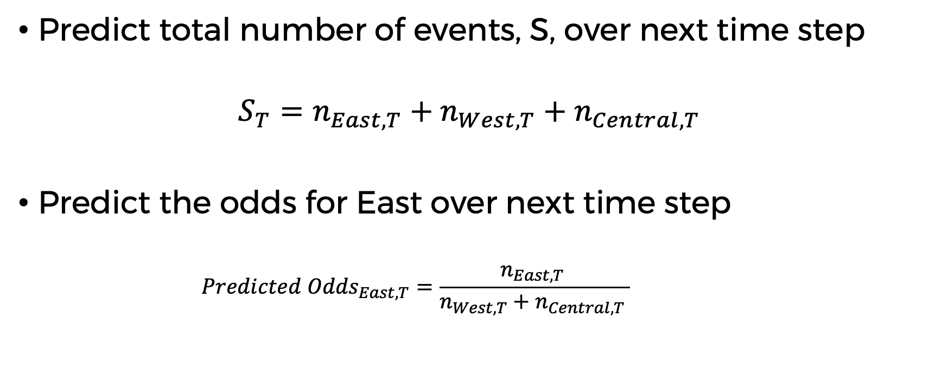
Forming Linear Equalities
Predict total number of events, S, over next time step
$$S_{T}=n_{East, T}+n_{West,T}+n_{Central,T}$$
Predict the odds for East over next time step
    $${Predicted Odds}_{East,T}=\frac{n_{East,T }}{n_{West,T}+n_{Central,T }}$$

Slide 17
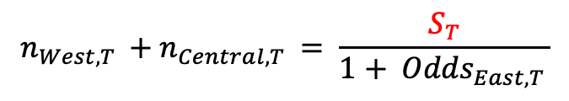
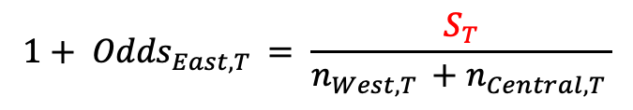
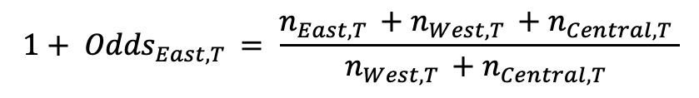
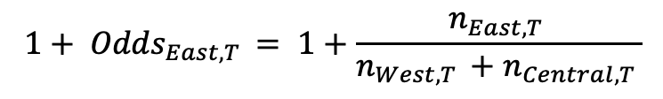
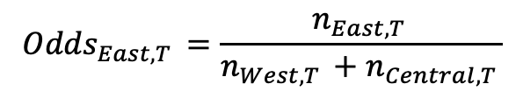
Odds lead to Linear equalities
$${Odds}_{East,T }=\frac{n_{East,T }}{n_{West,T }+n_{Central,T }}$$
$${1+ Odds}_{East,T }= 1+\frac{n_{East,T }}{n_{West,T }+n_{Central,T }}$$
$${1+ Odds}_{East,T }= \frac{n_{East,T }+n_{West,T }+n_{Central,T }}{n_{West,T }+n_{Central,T }}$$
$${1+ Odds}_{East,T }= \frac{S_{T}}{n_{West,T }+n_{Central,T }}$$
$$n_{West,T }+n_{Central,T }= \frac{S_{T}}{{1+ Odds}_{East,T }}$$

Slide 18
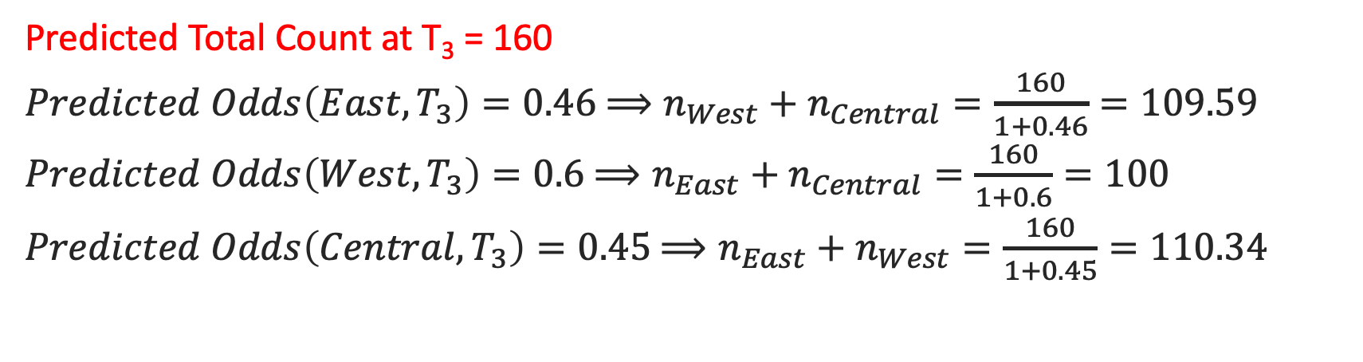
Forming Linear Equalities
Time/Industry | East | West | Central | Total
T1 | 10 | 20 | 50 | 80
T2 | 30 | 40 | 50 | 120
Sum | 40 | 60 | 100 | 200
Predicted Total Count at T₃ = 160
$Predicted Odds\left(East,T_{3}\right)=0.46$ $⟹n_{West}+n_{Central}=\frac{160}{1+0.46}=109.59$
$Predicted Odds\left(West,T_{3}\right)=0.6$ $⟹n_{East}+n_{Central}=\frac{160}{1+0.6}=100$
$Predicted Odds\left(Central,T_{3}\right)=0.45$ $⟹n_{East}+n_{West}=\frac{160}{1+0.45}=110.34$

Slide 19
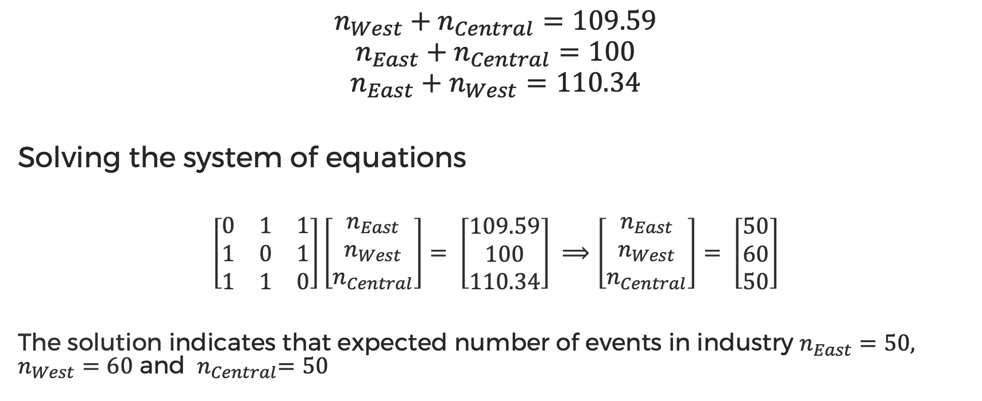
Solving Linear Equations
$$n_{West}+n_{Central}=109.59$$
$$n_{East}+n_{Central}=100$$
$$n_{East}+n_{West}=110.34$$
Solving the system of equations
$\left[\begin{matrix}0 & 1 & 1 \\ 1 & 0 & 1 \\ 1 & 1 & 0\end{matrix}\right]\left[\begin{matrix}n_{East} \\ n_{West} \\ n_{Central}\end{matrix}\right]= \left[\begin{matrix}109.59 \\ 100 \\ 110.34\end{matrix}\right] ⟹\left[\begin{matrix}n_{East} \\ n_{West} \\ n_{Central}\end{matrix}\right]= \left[\begin{matrix}50 \\ 60 \\ 50\end{matrix}\right]$
The solution indicates that expected number of events in industry $n_{East}=50, n_{West}=60$ and ${ n}_{Central}=50$

Slide 20
Forecasting Odds Time Series
ARIMA (Auto-Regressive Integrated Moving Average)
LSTM Variants:
  Vanilla
  Stacked
  BiDirectional
  CNN
  Convolutional

Slide 21
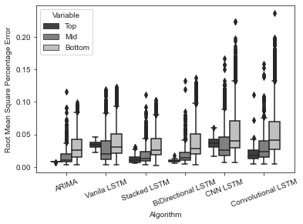
Results

Slide 22
Questions
Please reach out at SSangar1@students.Kennesaw.edu
https://www.linkedin.com/in/seemasangari/

