Slide 1
Building the Foundation for More Flexible A/B Testing: Applications of Interim Monitoring to Large-Scale Data
Wenru Zhouª, Miranda Kroehl^{b}, Maxene Meier^{b,} Alex Kaizerª
ªDepartment of Biostatistics & Informatics University of Colorado
^{b}Digital Platforms Organization Charter Communications
Notes:
Hi Everyone, my name is Wenru. I am glad to introduce you the application of interim monitoring to large-scale data. After this presentation, you will get an idea about how to choose the interim monitoring method for your own large data.

Slide 2
Outline
Introduction
Simulation Study
Application
Conclusions and Next Steps
Notes:
This is our outline. First, I am going to give you an introduction about AB testing and interim monitoring, and then I will show our simulation study. Then we are going to talk about the application of our findings to the real world problem. Last, we can talk about our conclusion and the next steps.

Slide 3
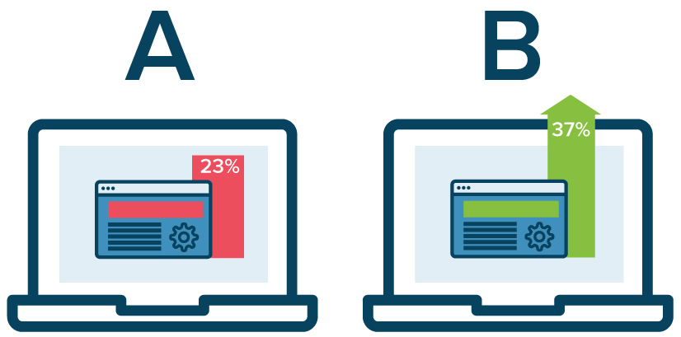
Introduction: A/B Testing in Industry
Key strategy used to inform the business on how changes to a product impact function or customer experience
Design, implementation, and analysis techniques for A/B tests are often standardized to meet the needs for high-volume experimentation
Speed is of the essence and on-going monitoring is often used to facilitate rapid data-driven decision making
Sophisticated approaches for experimental design with robust interim monitoring methodology are challenging to apply in a standardized or scalable manner
Notes:
Here is an introduction about A/B testing in industry. We have four points to mention.
1. AB testing is the Key strategy to tell us how changes to a product impact customer experience
2. We want the design, implementation, and analysis techniques for AB testing are standardized, since we might have hundreds of AB tests ongoing.
3. The speed of making a correct decision is very important. While we are waiting, we might loss the market oppurtunities
4. If the approaches for the design with interim monitoring is too sophisticated, we cannot apply it to hundreds of AB testing. Therefore, we want the approaches are simple, generalizable, and trustable.

Slide 4
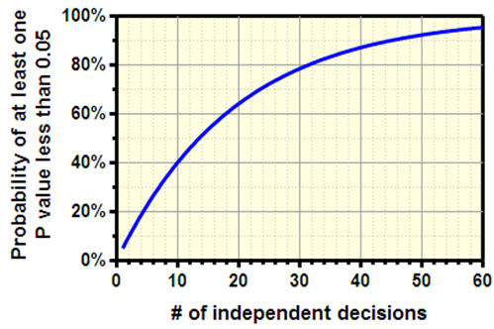
Introduction: Interim Monitoring
Interim monitoring allows us to analyze our data multiple without jeopardizing the Type I error rate
Looking at the data multiple times may allow us to end an experiment early if we have evidence to support a decision
Notes:
Now let’s talk about interim monitoring. Interim monitoring allows us to analyse our data multiple times without inflating the type I error rate.
As you can see from the figure, the x-axis is the number of independent decisions, and the y-axis is probability of at least one p-value less than 0.05. If we make one decision, the probability of falsely rejecting null is 5%. But if we make the decision for 10 times, the probability is around 40%. If we make the decision for 60 times, the probability jumps to 95%

Slide 5
Introduction: Interim Monitoring
General Approach: adjust the alpha value threshold for each interim look
  The threshold is a function of # of looks and reasons for stopping
Interim monitoring (IM) approaches are designed around the reason(s) for stopping
  Stopping for Futility: We have enough evidence to conclude the null cannot be rejected, and can stop the study early
  Stopping for Difference: We have enough evidence to conclude the null can be rejected, and can stop the study early
  Stopping for Both: We have evidence to either stop for futility or difference
Notes:
How to avoid the inflating type I error rate? We can decrease the alpha level threshold for each interim and final look. So, the overall type I error rate can still be maintained under a certain level. After that, we can early stop our study if the p-value from a interim or the final analysis is beyond the threshold.
We have three ways to early stop. Stopping for futility, which means that we stop the study since we have enough evidence to conclude the null cannot be rejected.
Stopping for Difference, which means that we stop the study since we have enough evidence to conclude the null can be rejected.
Stopping for Both, which means that we have enough evidence to either stop for futility or stop for difference.

Slide 6
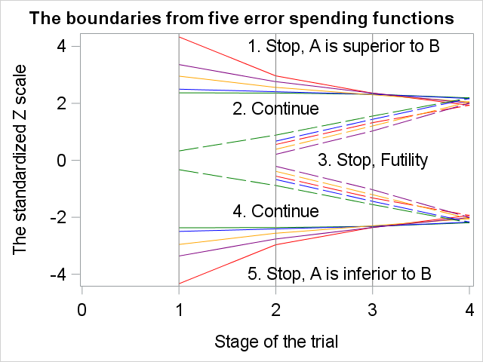
Introduction: Error Spending Functions
Example of Boundaries for 5 IM Approaches
Stop and Claim that A is significant superior to B
Stop and Claim that A is significant inferior to B
Conservation at early stage:
OBF>Power,ρ=3>2>1>Pocock
Assuming large Z prefers A
Conservation at later stage:
OBF<Power,ρ=3<2<1<Pocock
IM Methods
O′Brien-Fleming (OBF)
Power (ρ=3)
Power (ρ=2)
Power (ρ=1)
Pocock
Stop for Difference
Stop for Futility
Notes:
Here is an example of the interim monitoring approaches. In academic area we call it error spending function.
The y axis is the standard z statistics, we assume large Z prefers variate A or treatment A. The x axis is the interim analysis and the final analysis. You can see different colors of the boundaries. The red one is OBF, the purple, yellow, and blue ones are power boundaries with different parameters. The green one is the Pocock boundary.
Now, how can we use those boundaries in practice? Let see examples. After the first interim analysis, the standard z statistics is here, see the star above the first interim analysis. Since it is above all the boundaries, no matter which boundary you choose, you will reject the null hypothesis, and claim that A is superior to B.
Now, how about the z-statistics is here at the 1st interim analysis? Since it is at the continue region for all the boundaries, no matter what one you choose, you will continue to the second interim analysis. Now suppose it is also at the continues region, we will continue to the 3rd interim analysis. Now it may fall into the stop region, and so we can claim that A is inferior to B.
What if the z-statistics is here? Then your decision will depend on what boundary you choose. If you choose OBF as your boundary, the study will continue to the second interim analysis. But if you choose any one of other boundaries, you will stop the study and claim that A is inferior to B.
You will find that the conservative degree of each boundaries are different. It is the hardest to reject the null for the OBF boundary since it has the smallest reject region at early interim analysis. It is the easiest to reject the null for the Pocock boundary, since it has the largest reject region at early interim analysis. The order of hard rejection is like this. OBF, followed by power, parameter=3, 2, and1, and Pocock.
But at later interim analysis and final analysis, the order will be reversed. OBF tends to reject the null hypothesis most easily. The order of hard rejection is like this: Pocock, followed by Power, parameter=1, 2, and 3, and then OBF.
The conservative degree of each boundary are also different for stopping for futility or difference. By looking at the difference of stopping region, you can know which one is more conservative at the beginning or end of the study.

Slide 7
Introduction: Interim Monitoring in Industry
Benefits
Reduce the number of customers exposed to a product change before it becomes standard practice
Reduce the time it takes to run an A/B test
Get product improvements out to our customers more quickly
Drawbacks
If we do not have evidence to stop early, our maximum sample size will be larger than if we hadn’t looked at all
  Larger N = Longer Trial
Most companies don’t have the bandwidth to do individual complex designs for each A/B test, and there is no existing guidance on an “optimal” design out of the many approaches
There are many benefits to interim monitoring; however, lack proper guidance on an optimal and scalable approach prevent most companies from using these methods. Here, we set out to evaluate common approaches and determine if we could provide that guidance.
Notes:
Here are the benefits and drawbacks of interim monitoring methods. For the benefit, it gives us opportunity to reduce the sample size and time and get product improved more quickly. But the drawbacks are obvious. If we don’t have evidence to stop early, the maximum sample size will be larger than the sample size if we don’t have any interim look. In addition, many companies don’t know what is the optimal design for most of studies since there is lack of existing guidance of an optimal design out of many approaches.
Here we are going to evaluate common approaches and determine if we could provide that guidance.

Slide 8
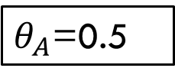
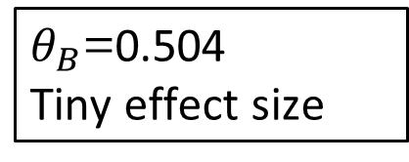
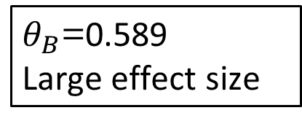
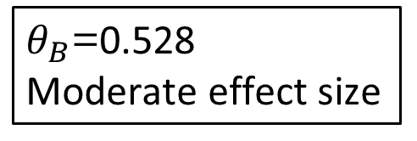
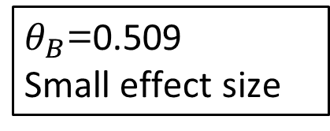
Simulation Study Design
We conducted a simulation study to compare different IM against a fixed sample approach under a set of scenarios common in A/B testing
500
per arm
$θ_{B}$=0.589
Large effect size
$θ_{A}$=0.5
5000
per arm
$θ_{B}$=0.528
Moderate effect size
Interim Monitoring Methods
O’Brien-Fleming (OBF)
Pocock
Power, rho = 1
Power, rho = 2
Power, rho = 3
Simulation Study Conditions
Control Response Rate = 0.5
Type I error = 0.05
Power = 0.80
Two-sample T-test
$θ_{B}$=0.509
Small effect size
50,000
per arm
250,000
per arm
$θ_{B}$=0.504
Tiny effect size
Notes:
This is our simulation design. We conducted a simulation study to compare different interim monitoring methods against a fixed sample approach under a set of scenarios common in A/B testing. Here is the process.
For a fixed sample design and range of sample sizes, we calculated the detectible effect size based on the control response rate, type I error, and Power
For each IM method, OBF, Power, and Pocock, and three kinds of early stopping rules, we calculated the maximum sample size (MSS) for 2, 4 and 20 total analyses
Data were simulated in R under both the null and alternative (10,000 replicates per condition)

Slide 9
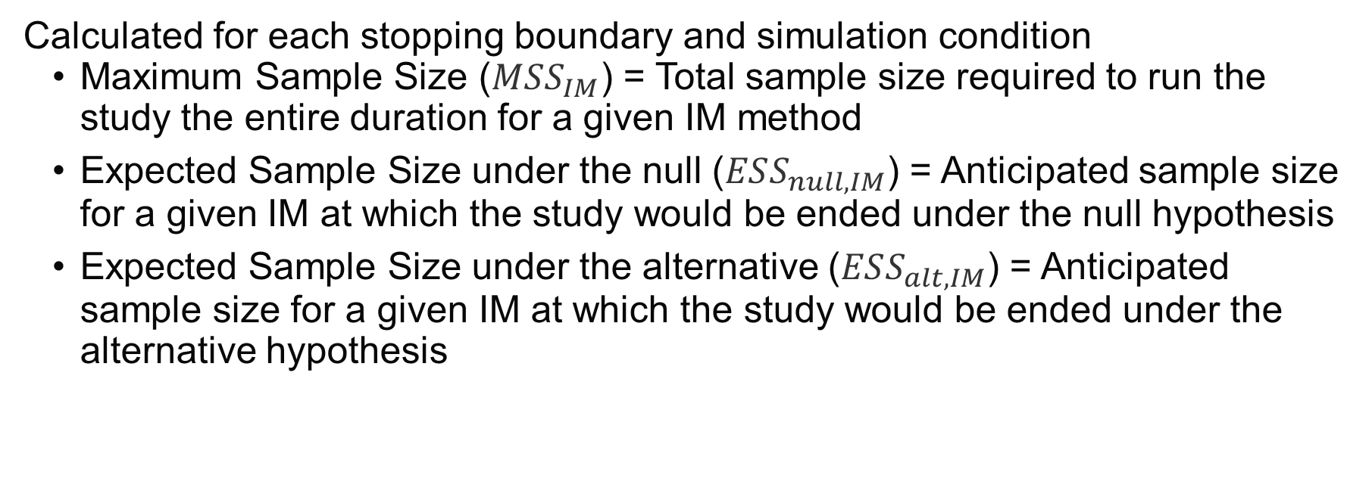
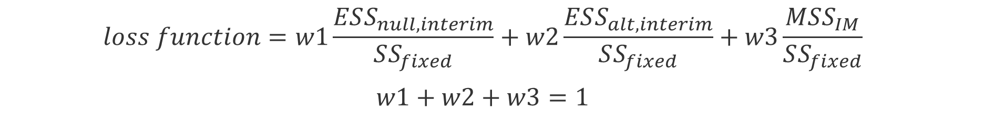
Simulation Study Evaluation
A total of 16 stopping boundaries were evaluated (5 IM approaches x 3+1)
Calculated for each stopping boundary and simulation condition
  Maximum Sample Size ($MSS_{IM}$) = Total sample size required to run the study the entire duration for a given IM method
  Expected Sample Size under the null ($ESS_{null,IM}$) = Anticipated sample size for a given IM at which the study would be ended under the null hypothesis
  Expected Sample Size under the alternative ($ESS_{alt,IM}$) = Anticipated sample size for a given IM at which the study would be ended under the alternative hypothesis
  $$loss function=w1\frac{ESS_{null,interim}}{SS_{fixed}}+w2\frac{ESS_{alt,interim}}{SS_{fixed}}+w3\frac{MSS_{IM}}{SS_{fixed}}$$
  $$w1+w2+w3=1$$
Notes:
After we get the simulation data, how are we going to evaluate the boundaries? We need a loss function. Here are three important concepts. Maximum sample size, expected sample size under null, and expected sample size under alternative. The maximum sample size is the total sample size we need if we do not stop at any interim analysis. The expected sample size under null is the anticipated sample size for a given interim method assuming the null hypothesis is true. The expected sample size under alternative is the anticipated sample size for a given interim method assuming the alternative hypothesis is true.
Our loss function contains these three terms, with three weights in front of them. The sum up of three weights is one. For each term, it is a ratio between a interim monitoring method and the fixed sample size design.

Slide 10

Simulation Study Evaluation
A total of 16 stopping boundaries were evaluated (5 IM approaches x 3+1)
A loss function was used to estimate the benefit of the IM approach compared to the Fixed design
  Smaller loss function value, smaller ESS, and smaller MSS is better
  $$loss function=w1\frac{ESS_{null,IM}}{SS_{fixed}}+w2\frac{ESS_{alt, IM}}{SS_{fixed}}+w3\frac{MSS_{IM}}{SS_{fixed}}$$
  $$w1+w2+w3=1$$
Notes:
We prefer boundaries with smaller loss functions, since smaller loss function indicates smaller sample size comparing to the fixed sample size design. We can change the weights of each term to focus on what we care about more. For example, if you care about the maximum sample size, you should increase the weight for maximum sample size.

Slide 11
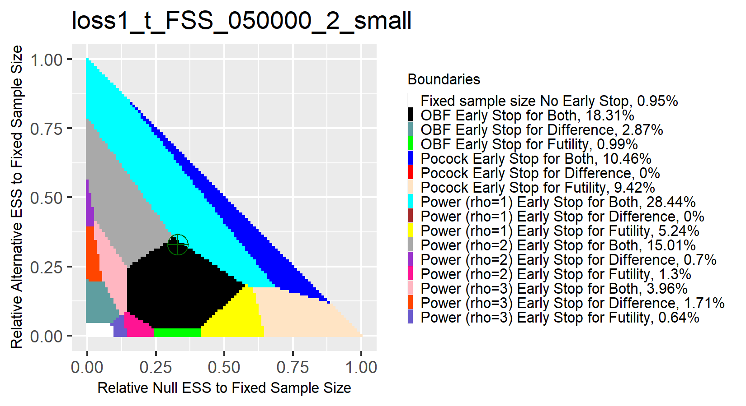
Simulation Study Results
Results comparing the fixed design ($θ_{B}$=0.509) with N=50,000 per arm to interim monitoring methods with 2 total analyses
Notes:
This is our simulation results with 2-total analysis for 50,000 sample size. The Y axis represents the weight of relative expected sample size under alternative hypothesis. The X axis is the weight of relative expected sample size under null hypothesis. The color in figure represents the boundary with the smallest loss function for the given combination of three weights. For example, if we set the weight of relative maximum sample size to be very large, we are reducing the weights of relative expected sample size under null and alternative hypothesis. The optimal boundary is white at the lower left size, representing fixed sample size design without any early stop.
The largest color regions are black, cyan, and grey. Black represents OBF early stop for both. Cyan represents Power with parameter=1, early stop for both, and grey represents Power with parameter=2 early stop for both. This means that they are the ideal choices for most combination of weights if your weights are not very extreme.
However, you might think that those color still looks complicated. Is there a simpler version? Yes we have.

Slide 12
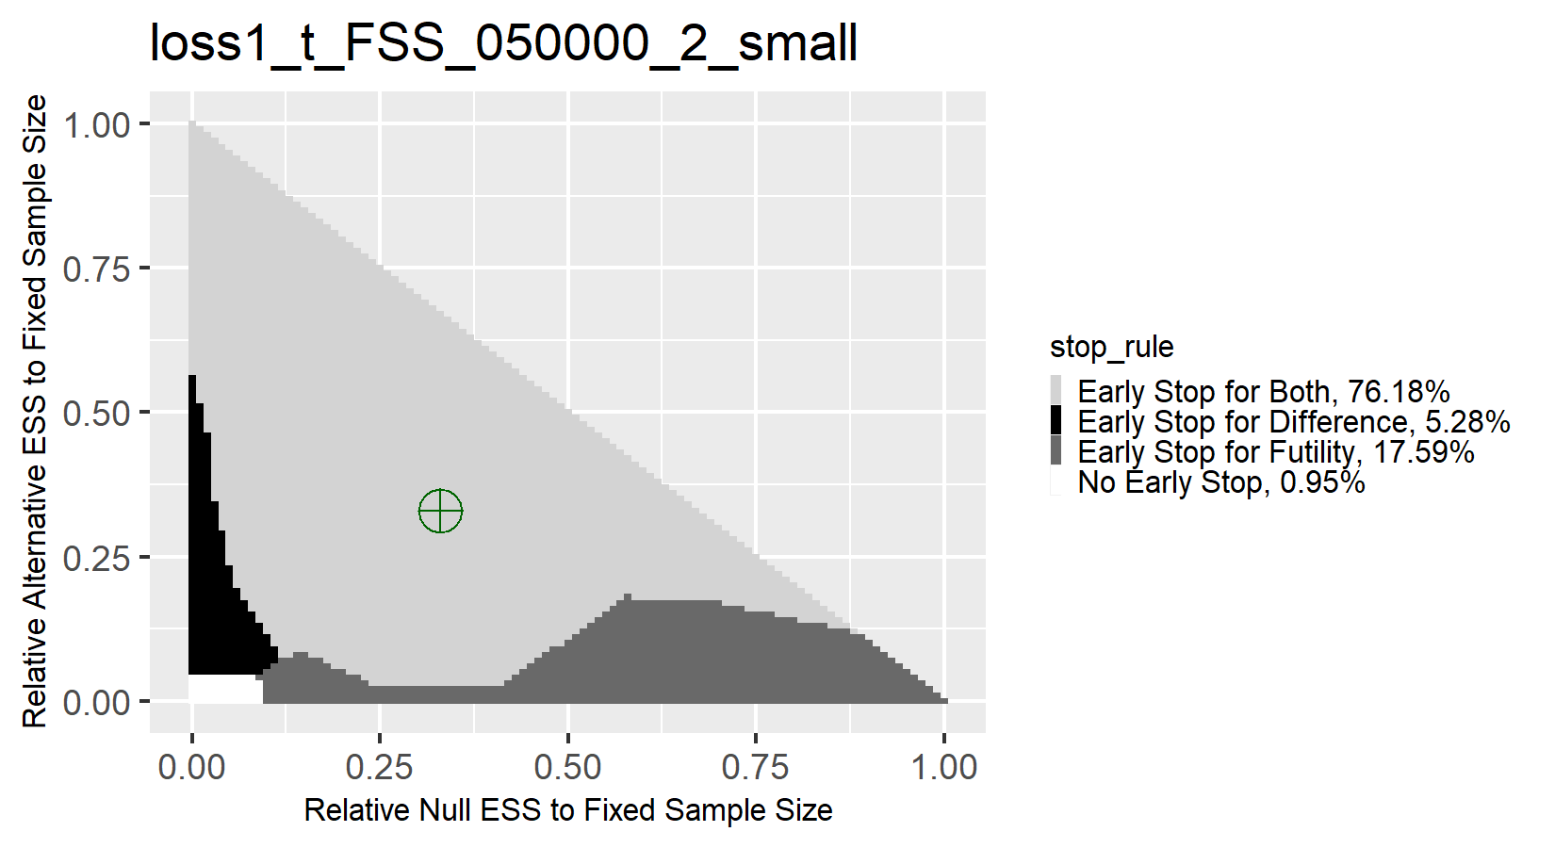
Simulation Study Results
Results comparing the fixed design ($θ_{B}$=0.509) with N=50,000 per arm to interim monitoring methods with 2 total analyses
Notes:
Now let’s compress all boundaries just based on the stopping rule. No matter what boundary it is, we combined them by stopping rule. Now we only have four options: Early stop for both, for difference, for futility, and no early stop. This is still our simulation results with 2-total analysis for 50,000 sample size. The color in figure represents the stopping rule with the smallest loss function for the given combination of three weights. For example, if we set the weight of relative maximum sample size to be very large, we are reducing the weights of relative expected sample size under null and alternative hypothesis. The optimal stopping rule is white at the lower left size, representing fixed sample size design without any early stop.

Slide 13
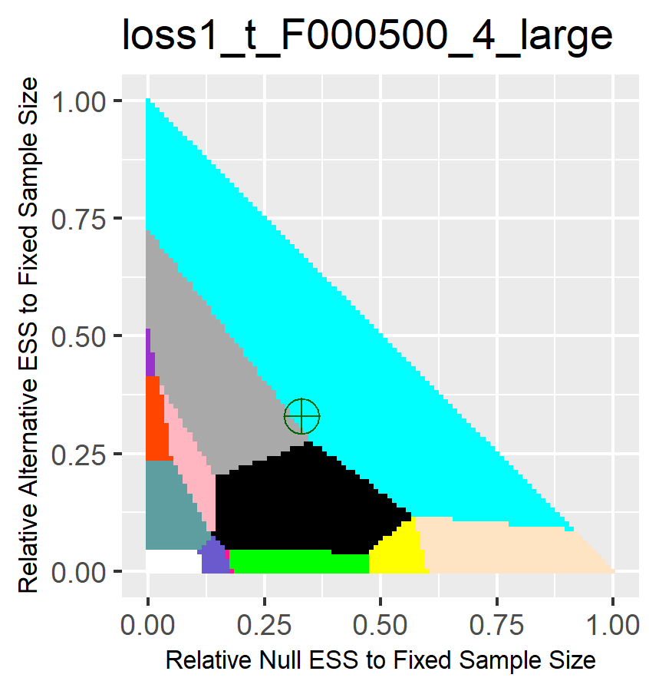
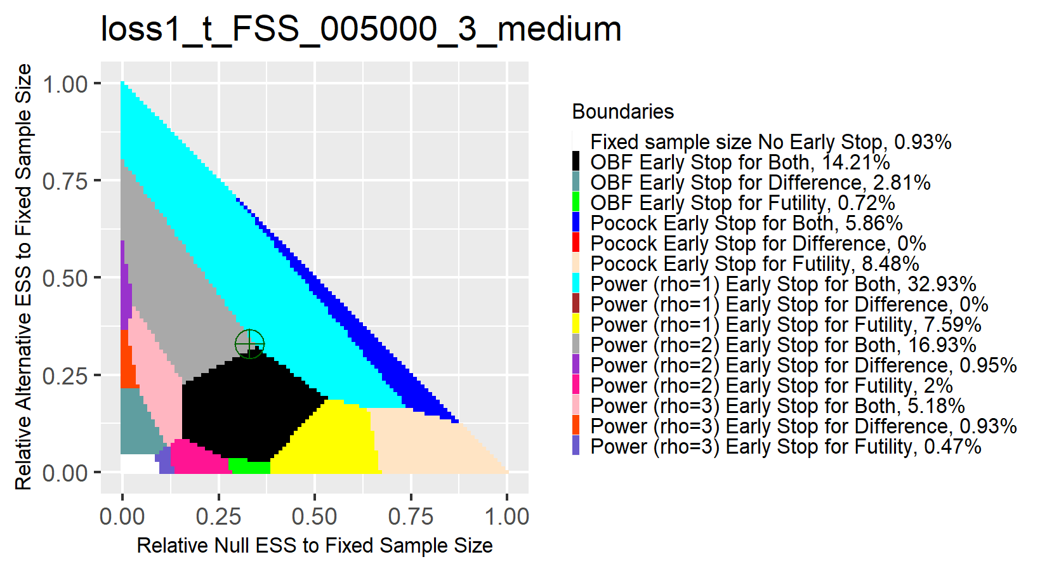
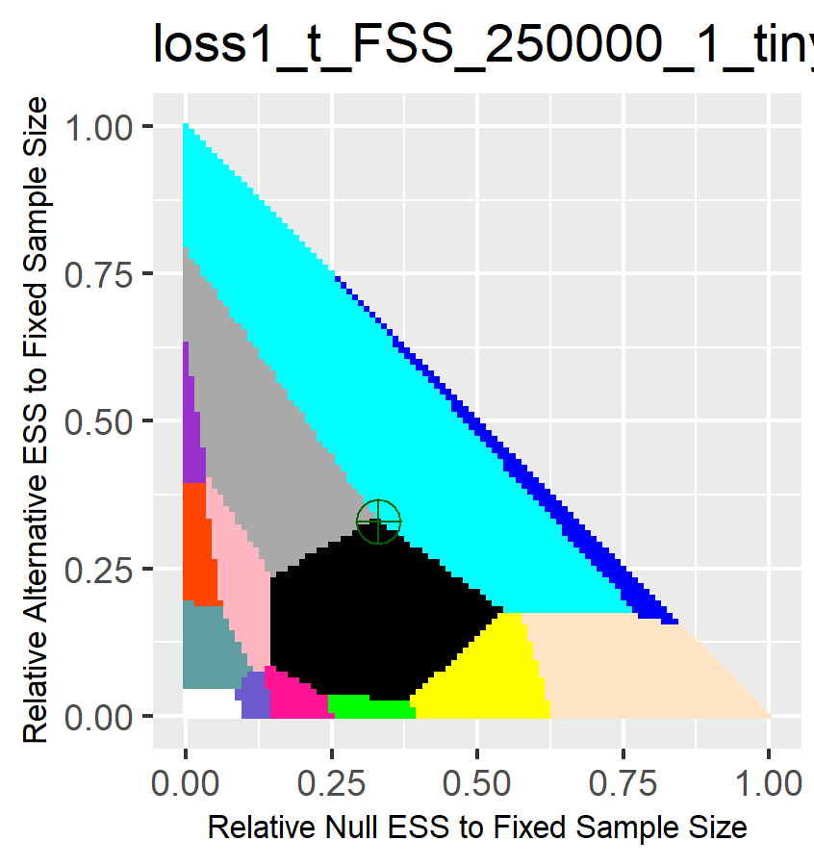
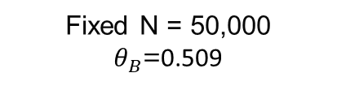
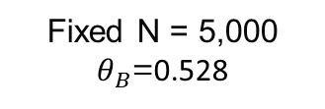
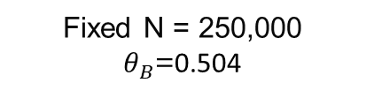
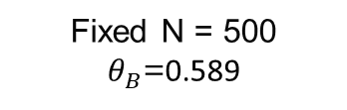
Simulation Study Results
We see similar patterns when looking at different sample and effect sizes
Clear Guidelines can be Established
Regardless of IM approach, Stopping for Both is optimal
OBF and Power (rho=1 or 2) are most ideal for a wide range of conditions
Fixed N = 500 $θ_{B}$=0.589
Fixed N = 5,000 $θ_{B}$=0.528
Fixed N = 50,000 $θ_{B}$=0.509
Fixed N = 250,000 $θ_{B}$=0.504
Notes:
Now let’s generalize the sample size by increasing and decreasing it. You will see the similar pattern. Regardless of IM approach, Stopping for Both is optimal. OBF and Power (parameter=1 or 2) are most ideal for a wide range of conditions. Again, this is for 2-total analysis.
Although the figure is not shown here, as number of interim analysis increase from 2 to 4 to 20, the pink area, which is Power with parameter=3 stop for both, and black area, which is still OBF stop for both will grow. The grey and cyan, which are power with parameter=1 and 2 will shrink. In sum, OBF stopping for both maintains its advantage across 2, 4, and 20 total analysis.

Slide 14
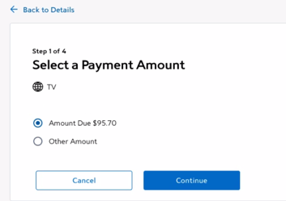
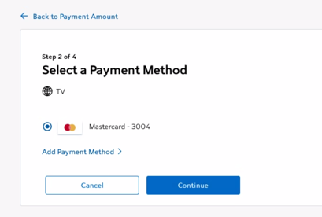
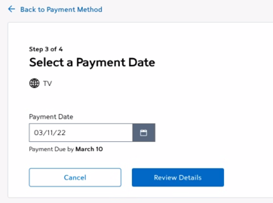
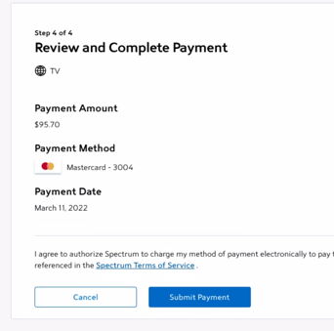
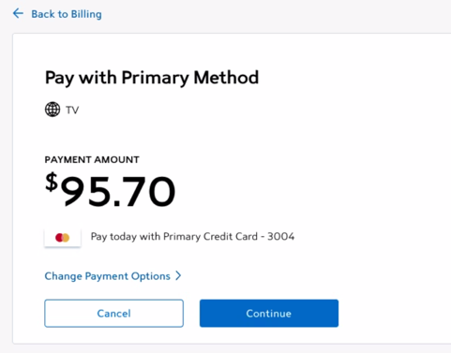
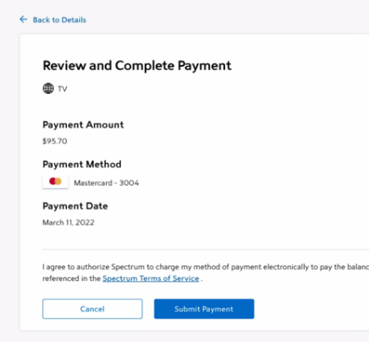
Application: Improving the One-Time-Payment Experience for Spectrum Customers
More than millions of Spectrum customers use the one-time-payment (OTP) feature each month. An improved “quick-pay” flow would reduce the number of steps through the payment process and is hypothesized to reduce errors and improve the customer experience
One-time-payment with standard payment flow
One-time-payment with improved “quick pay” flow
Notes:
Now we have known the theoretical result, let’s see the application of our findings (wait for 2 seconds, drink some water).
More than millions of Spectrum customers use the one-time-payment feature each month. An improved “quick-pay” flow would reduce the number of steps through the payment process and is hypothesized to reduce errors and improve the customer experience. The upper figures are the standard payment flow. The lower figures are the quick payment flow. They want to know if the new quick payment system will reduce the frequency of error comparing to the standard payment flow.

Slide 15
Application: Improving the One-Time-Payment Experience for Spectrum Customers
Using standardized design plans, this experiment would run for a month
Getting this out to customers more quickly could improve the customer experience for many, and an applying interim monitoring would be beneficial
Based on our work, we would recommend OBF stopping for both since it has good performance across different loss function weights for the various sample sizes
Notes:
If we use the study design without any early stop, this experiment will run for a month. But if we apply interim monitoring to this study, it would be beneficial since early stop is allowed. Because they want to equally split the weight, based on our work, we would recommend OBF stopping for both since it has good performance across different loss function weights for the various sample sizes

Slide 16
Conclusions
We can provide the following guidelines for A/B test designs
With our loss function, most weight combinations favor stopping for both difference and futility
  Stopping for difference is only optimal when strongly weighting one of the ESS weights
OBF stopping is ideal for the presented 2-total analyses, as well as the 4- and 20-total analysis
For intentionally under- and over-powered designs there are different recommendations
Notes:
Now let’s see the conclusions. We can provide the following guidelines for A/B test designs. First, we will recommend stopping for both, then stopping for futility. Stopping for difference is only optimal when we strongly weight one of the weights. If you don’t have a preference about how to split the weights, you can just give one third weight to each. More specifically, among boundaries with stopping for both, OBF is the most ideal one across difference sample sizes and different numbers of interim looks.
And this is the conclusion for studies that are adequately powered. For intentionally under- and over-powered designs there are different recommendations

Slide 17
Next Steps
Extend to continuous outcome
Extend to bivariate or multivariate space
Notes:
These are our next steps. Since we simulated using binary outcome, we plan to extend to continuous outcomes. And we plan to extend to bivariate or multivariate space since it is very common for a study having multiple endpoints.

Slide 18
Questions

Slide 19
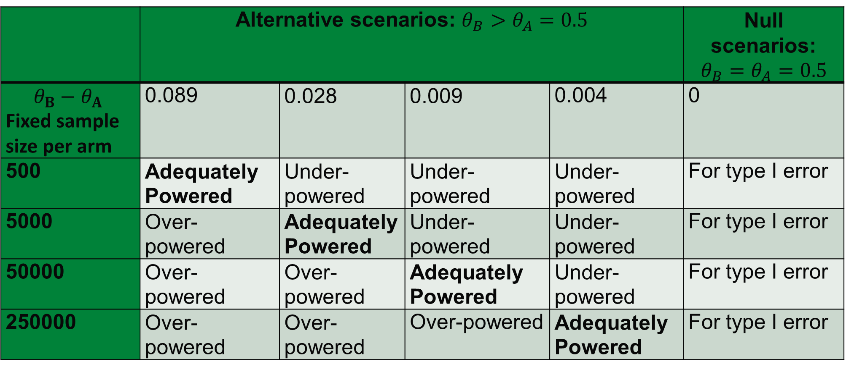
Simulation study – Design
 | Alternative scenarios: $θ_{B}>θ_{A}=0.5$ |  |  |  | Null scenarios: $θ_{B}=θ_{A}=0.5$
$$θ_{B}−θ_{A}$$ Fixed sample size per arm | 0.089 | 0.028 | 0.009 | 0.004 | 0
500 | Adequately Powered | Under-powered | Under-powered | Under-powered | For type I error
5000 | Over-powered | Adequately Powered | Under-powered | Under-powered | For type I error
50000 | Over-powered | Over-powered | Adequately Powered | Under-powered | For type I error
250000 | Over-powered | Over-powered | Over-powered | Adequately Powered | For type I error
Notes:
This is our study design. We set the effect size from 0.089 to 0.004 and set the sample size in fixed sample design from 500 to 250,000. By all possible combination of them, we have different adequately, over, and under powered design. By setting the null scenarios, we can calculate the type I error.

Slide 20
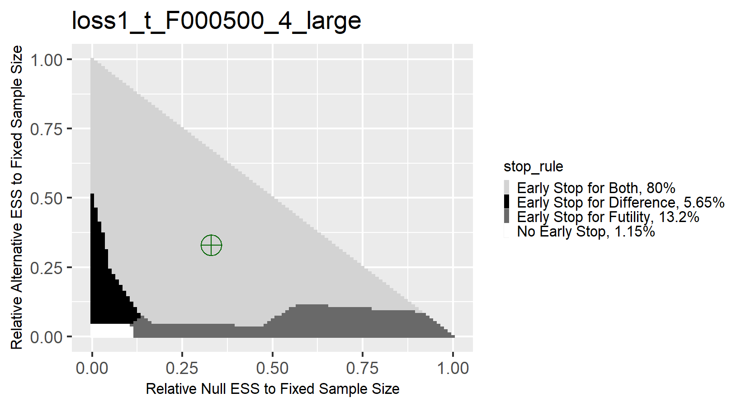

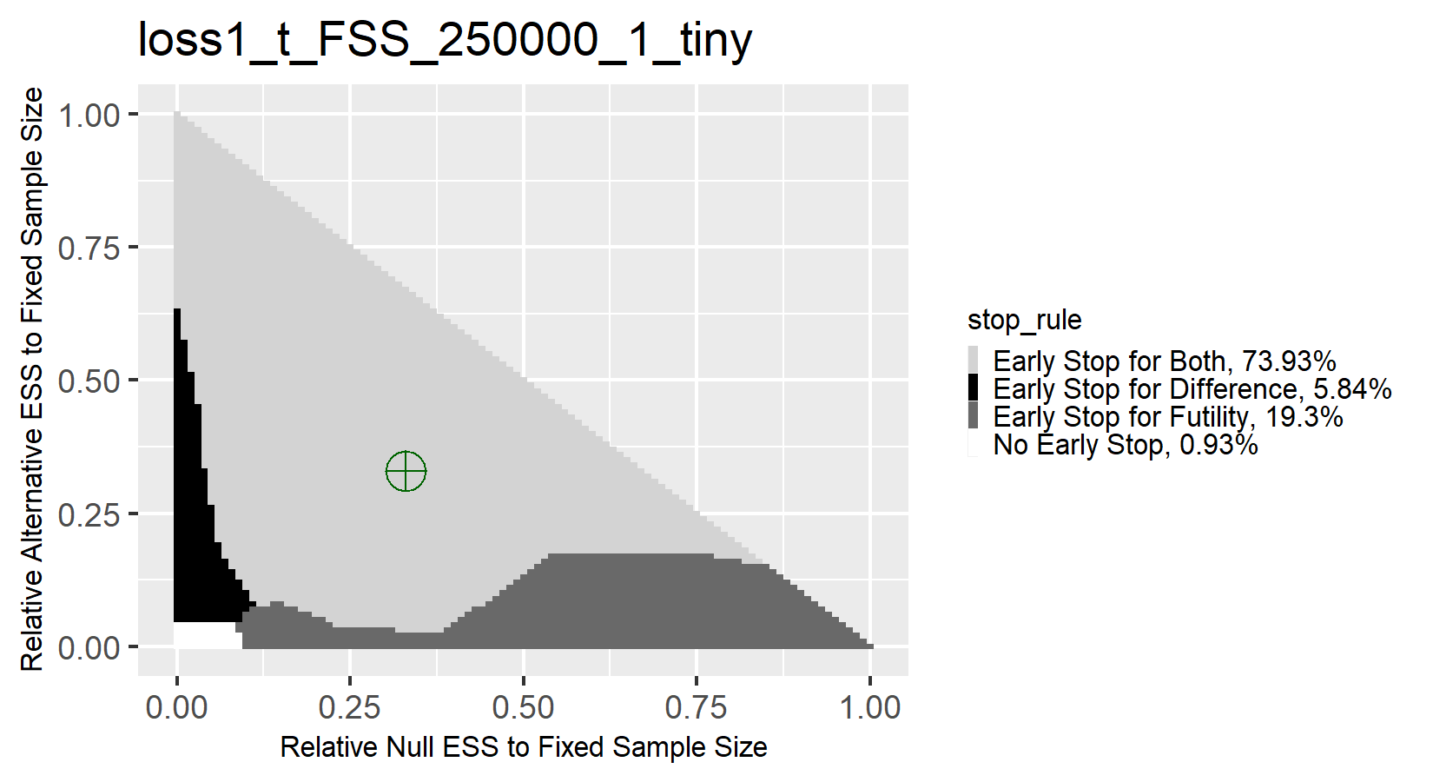
Simulation Study Results
We see similar patterns when looking at different sample and effect sizes
Clear Guidelines can be Established
Regardless of IM approach, Stopping for Both is optimal
Large
Moderate
Small
Tiny
Notes:
The sample size is generalized from 500 to 250,000 per arm, and the target is to find the optimal stopping rules for a 2-total analysis study. You will see the similar pattern. Regardless of IM approach, Stopping for Both is optimal. As number of interim analysis increase from 2 to 4 to 20, we have the same conclusion.

Slide 21
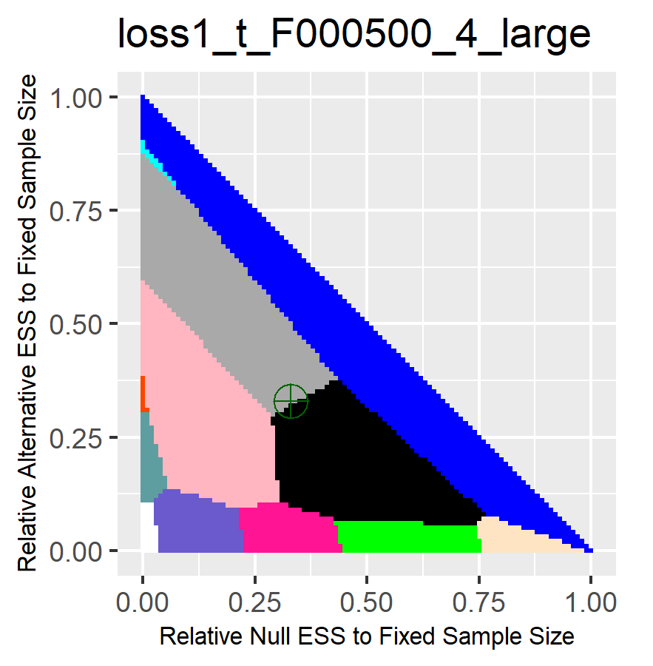
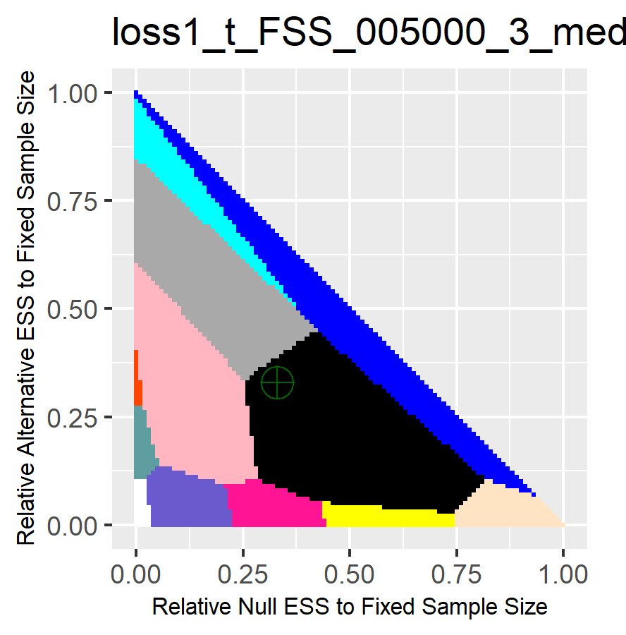
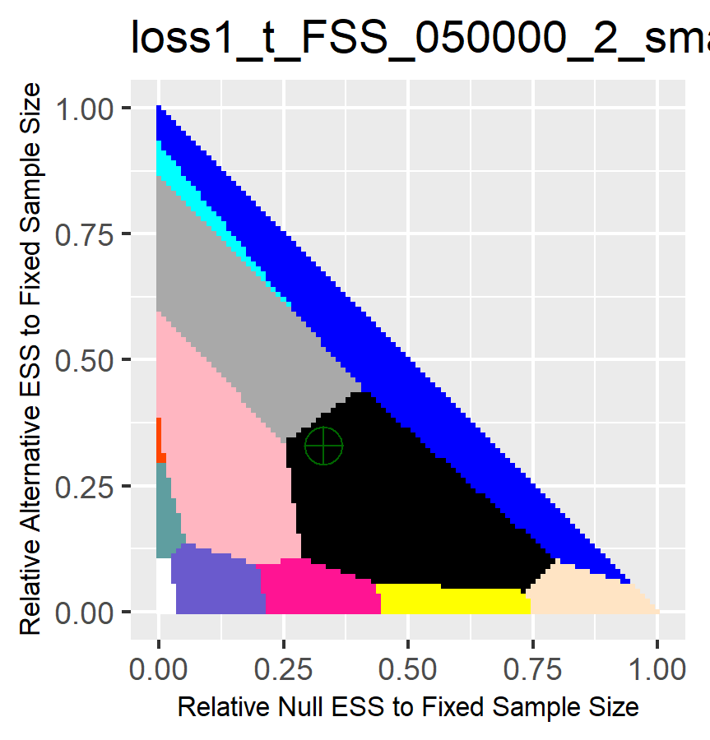
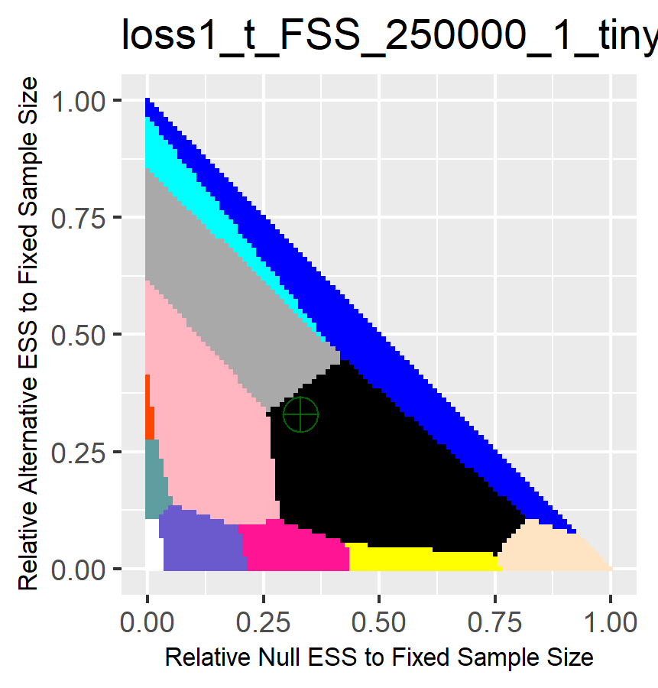
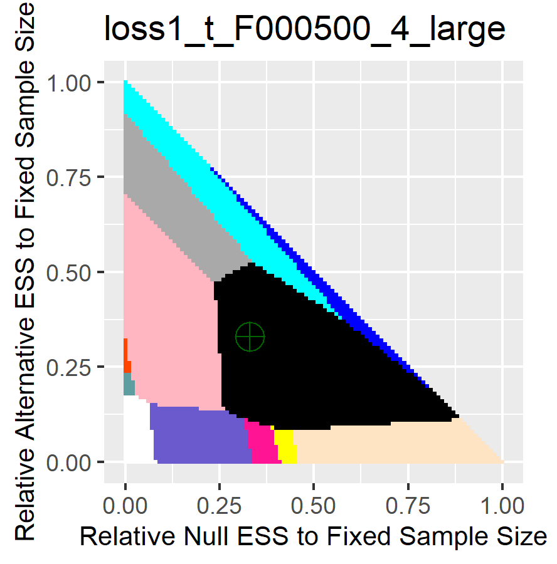
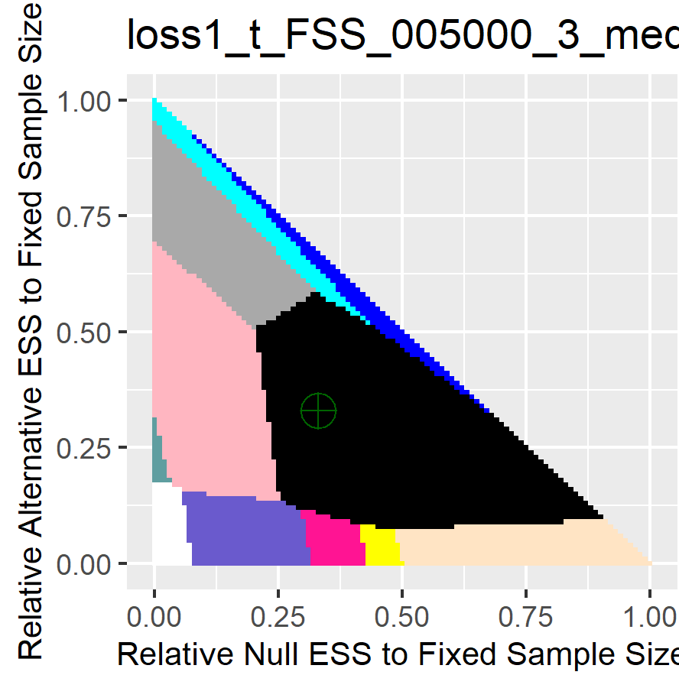
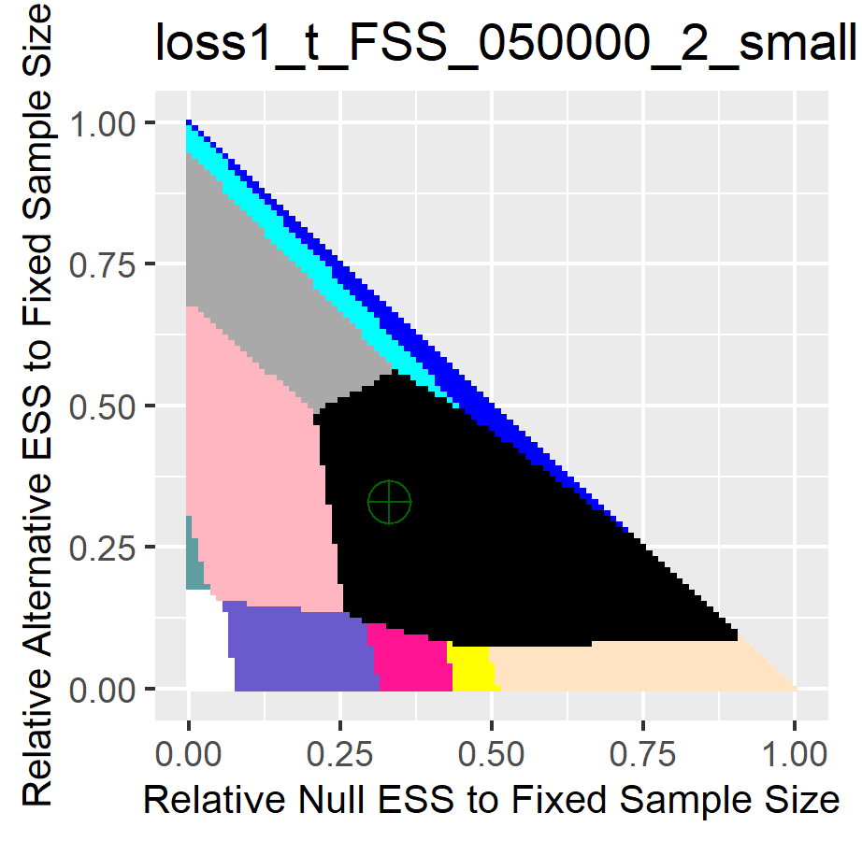
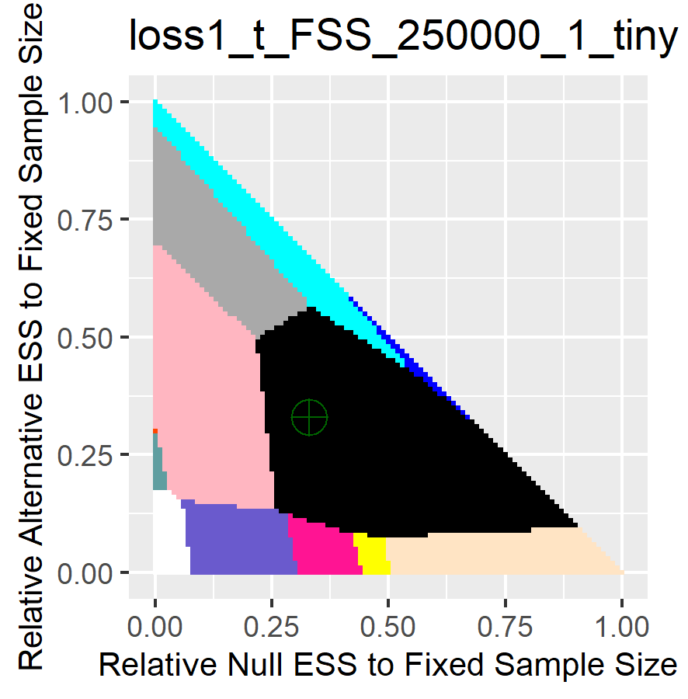
Further adequately powered results
OBF stop for both remains the best
large effect
moderate effect
small effect
tiny effect
4-total analysis
20-total analysis
Notes:
These are the simulation result for 4 and 20-total analysis. The star represents OBF stopping for both. You can find that it is ideal for most weight combinations across all number of total analysis and all sample size.

Slide 22
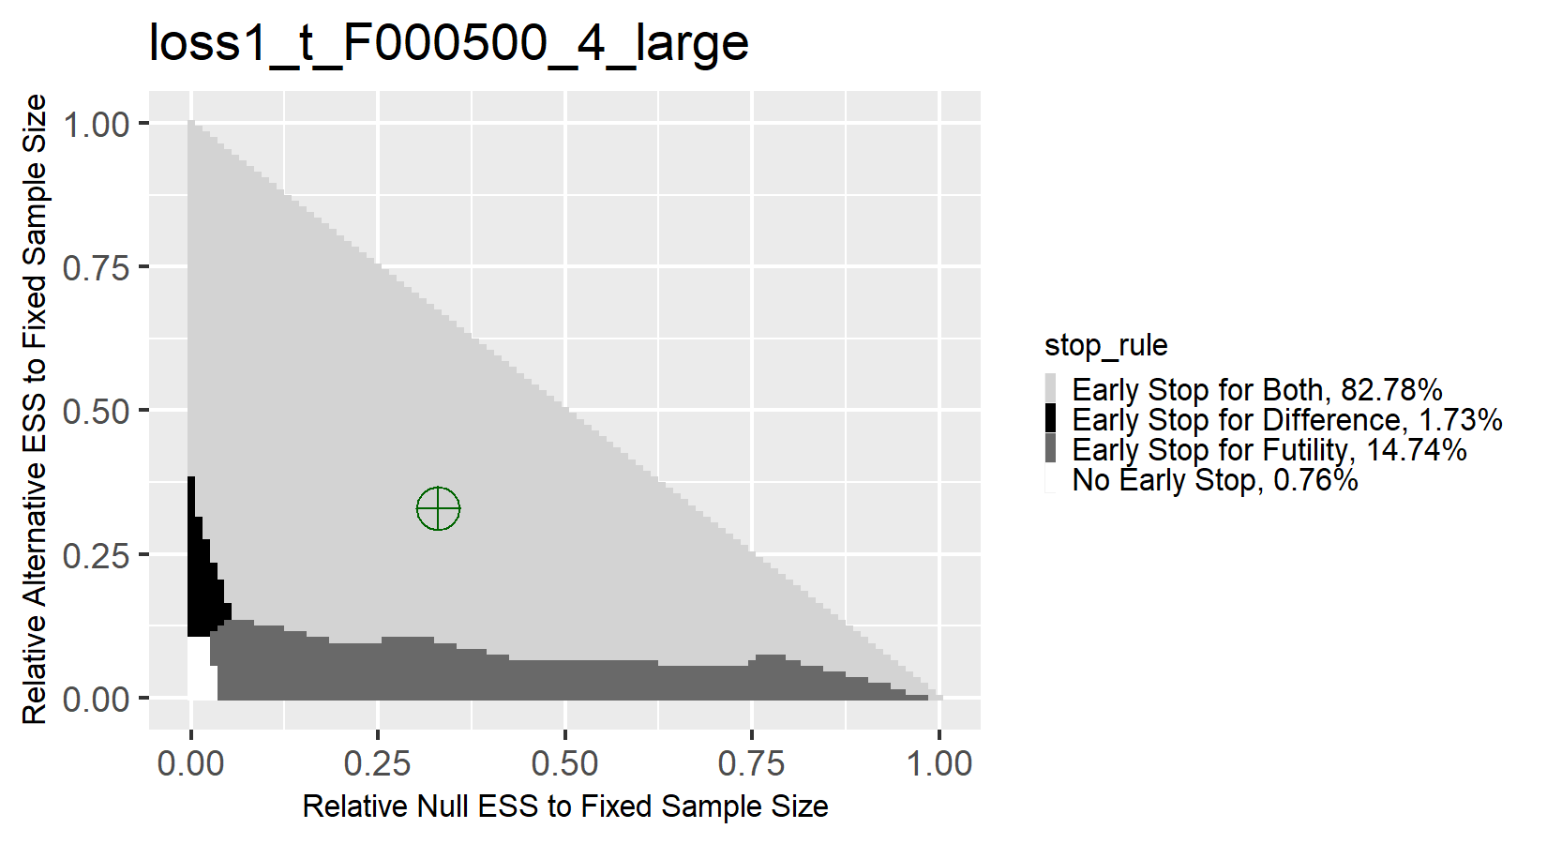
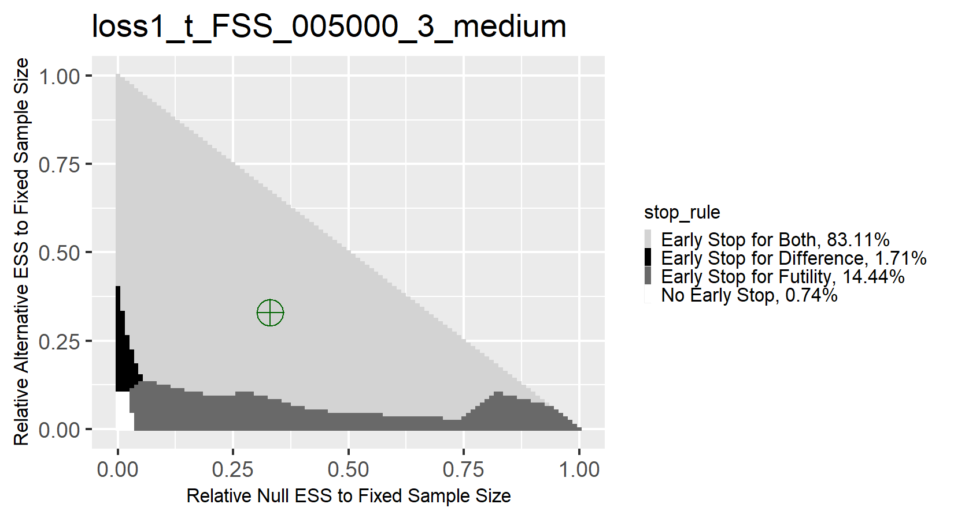
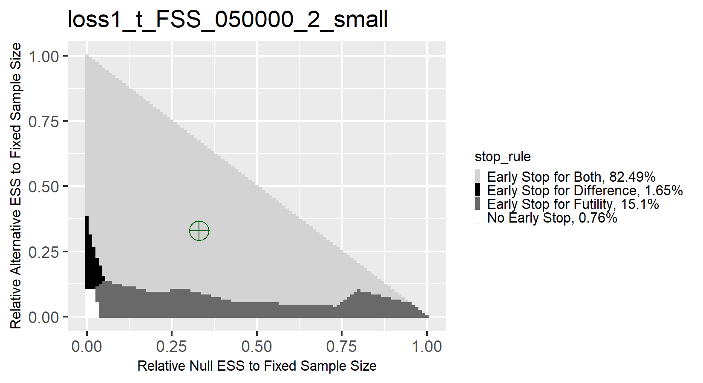
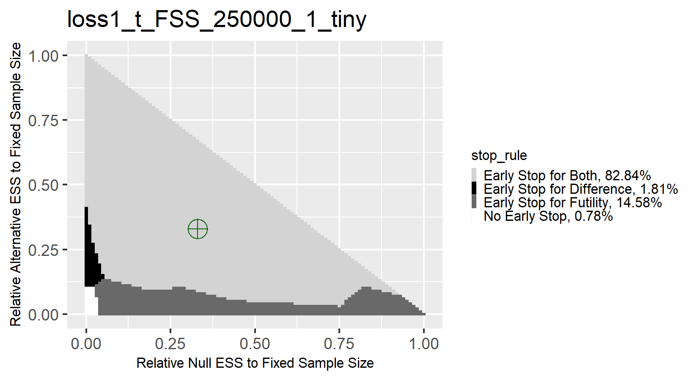
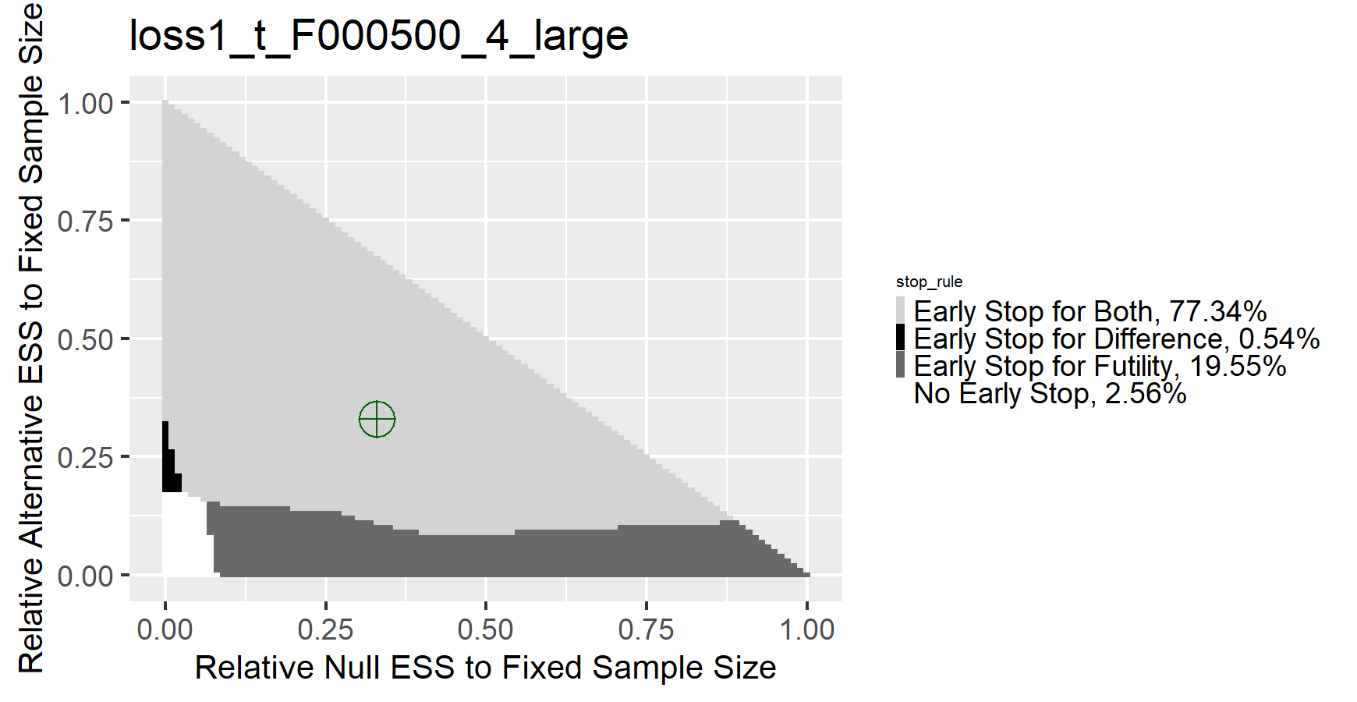
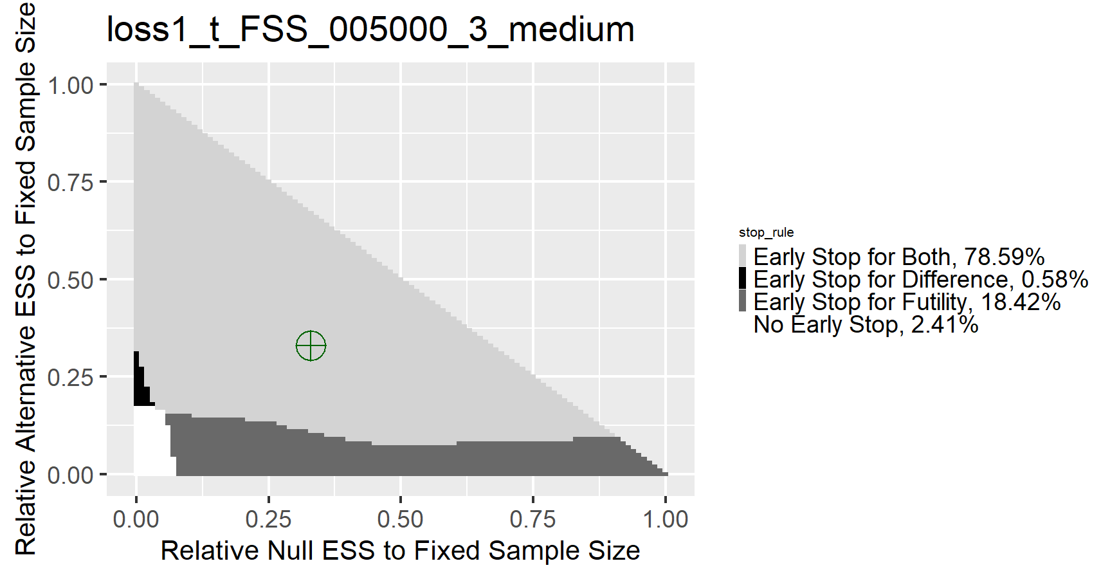
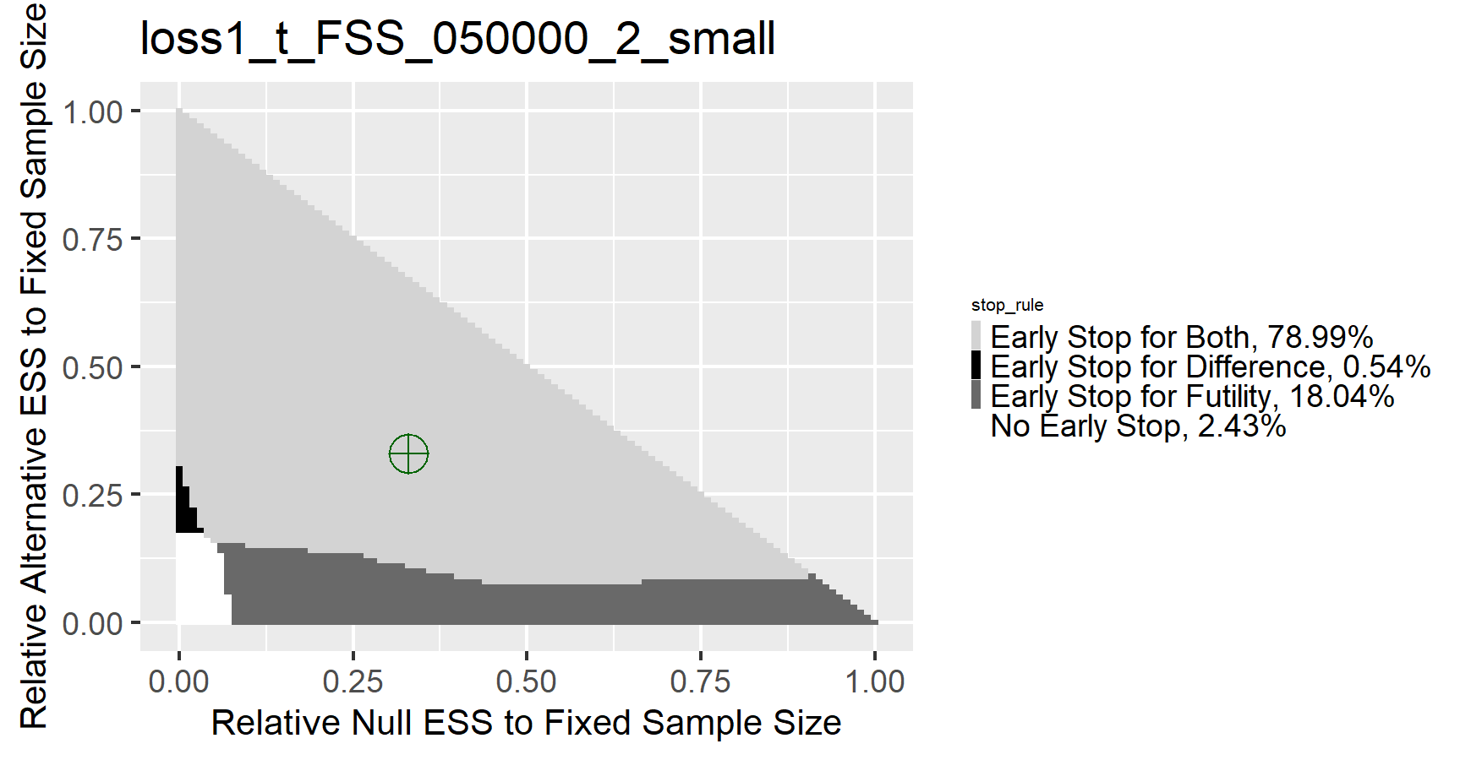
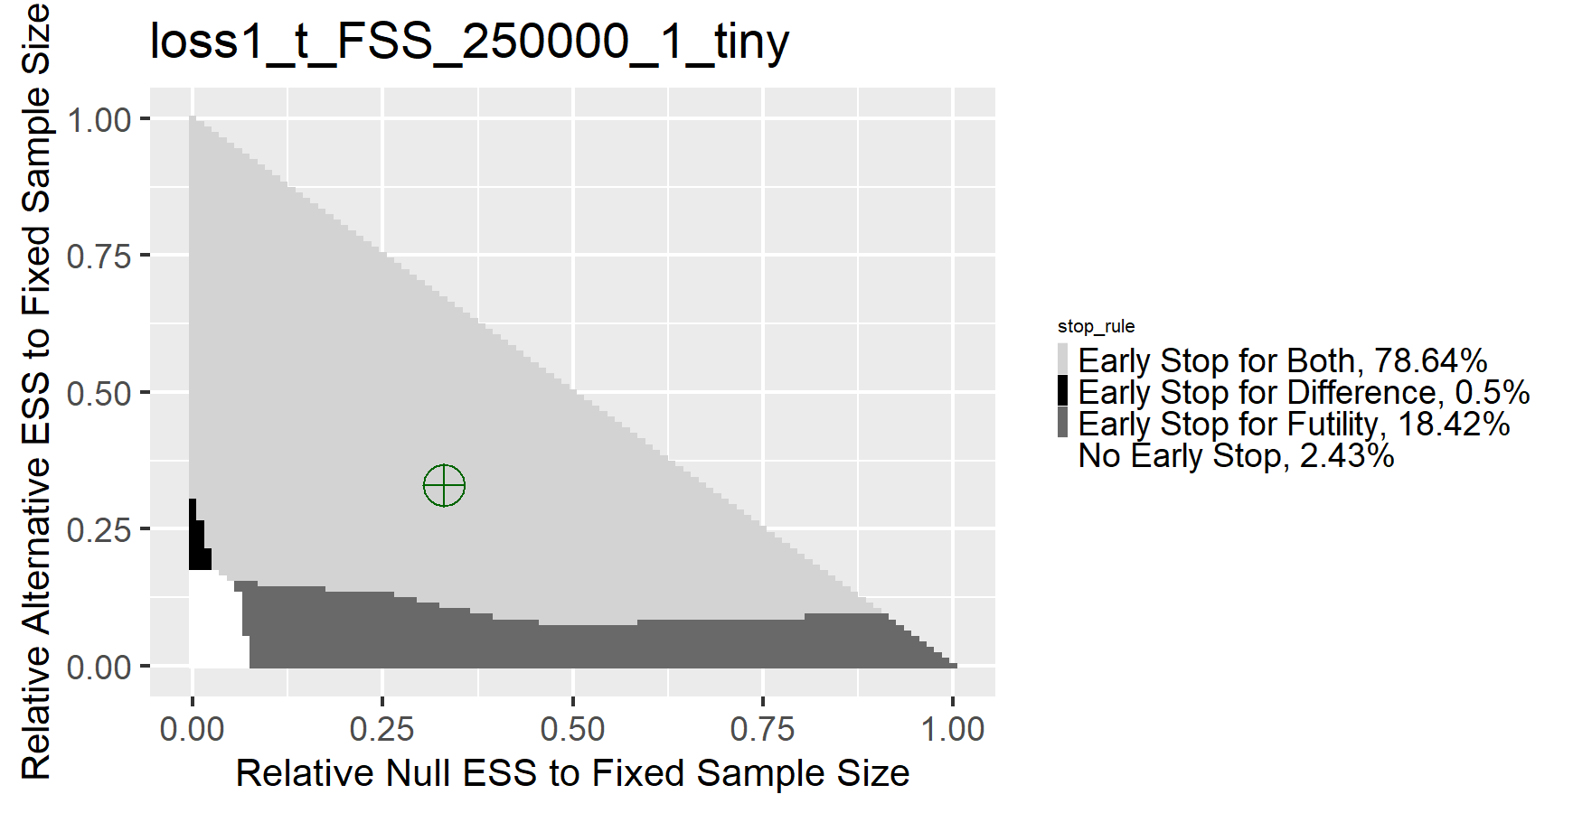
Further adequately powered results
Stop for both remains the best
large effect
moderate effect
small effect
tiny effect
4-total analysis
20-total analysis
Notes:
These are the simulation result for 4 and 20-total analysis. The light grey represents a general stopping for both. You can find that it is ideal for most of the weight combinations across all numbers of total analysis and all sample size.

Slide 23
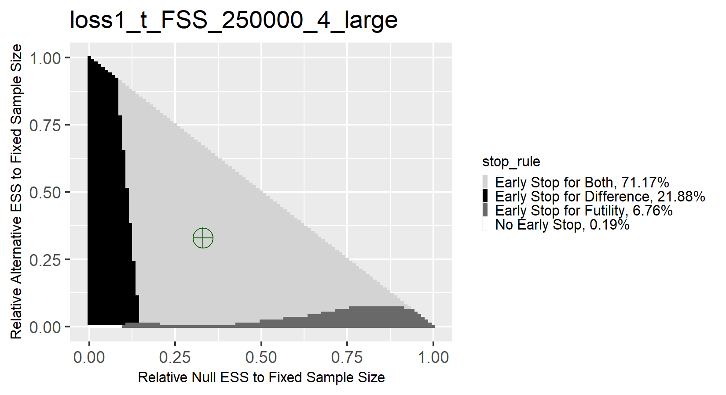
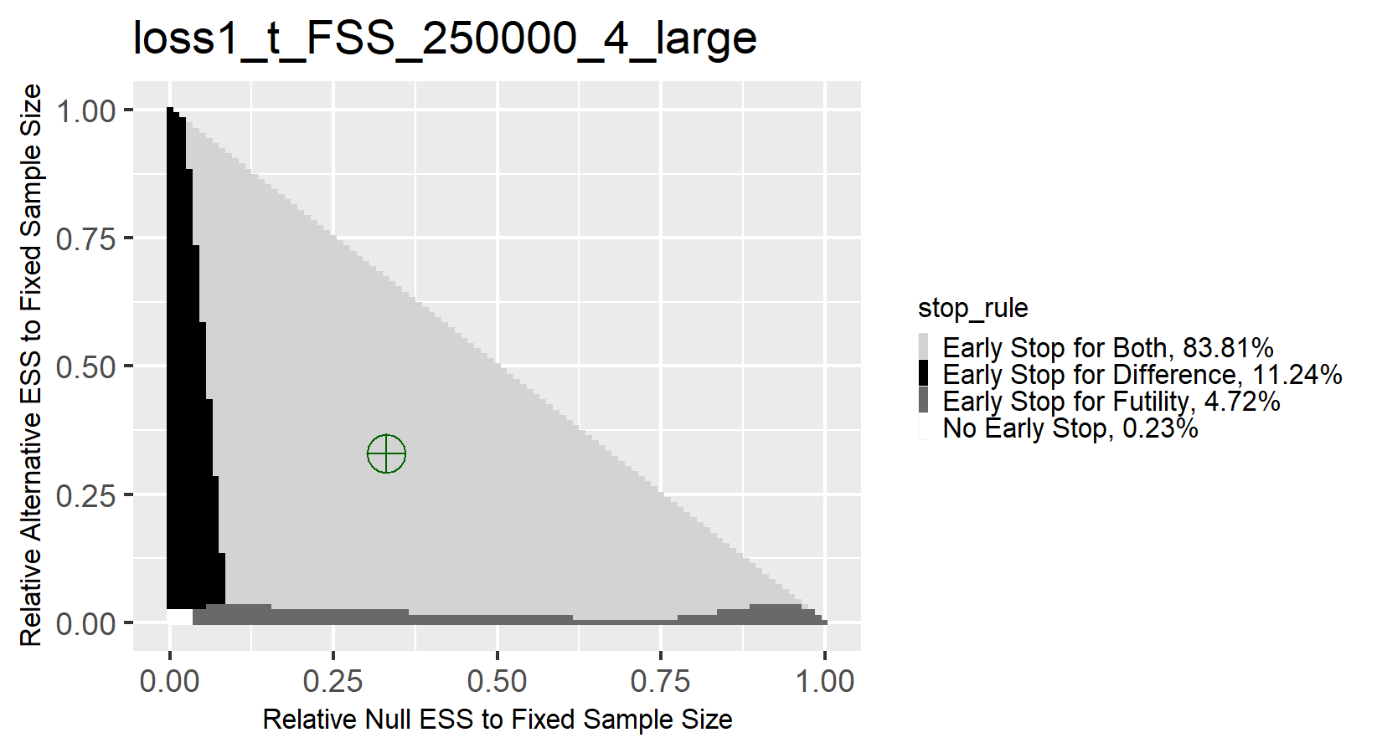
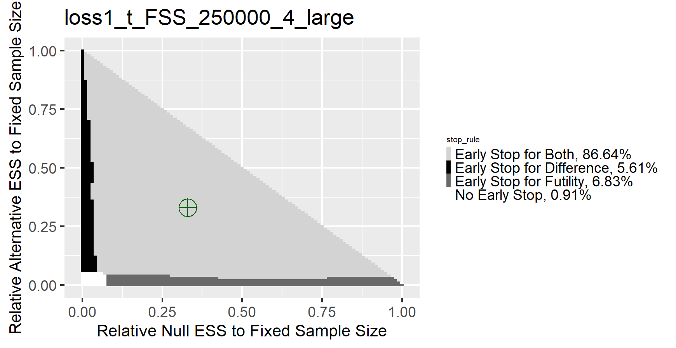
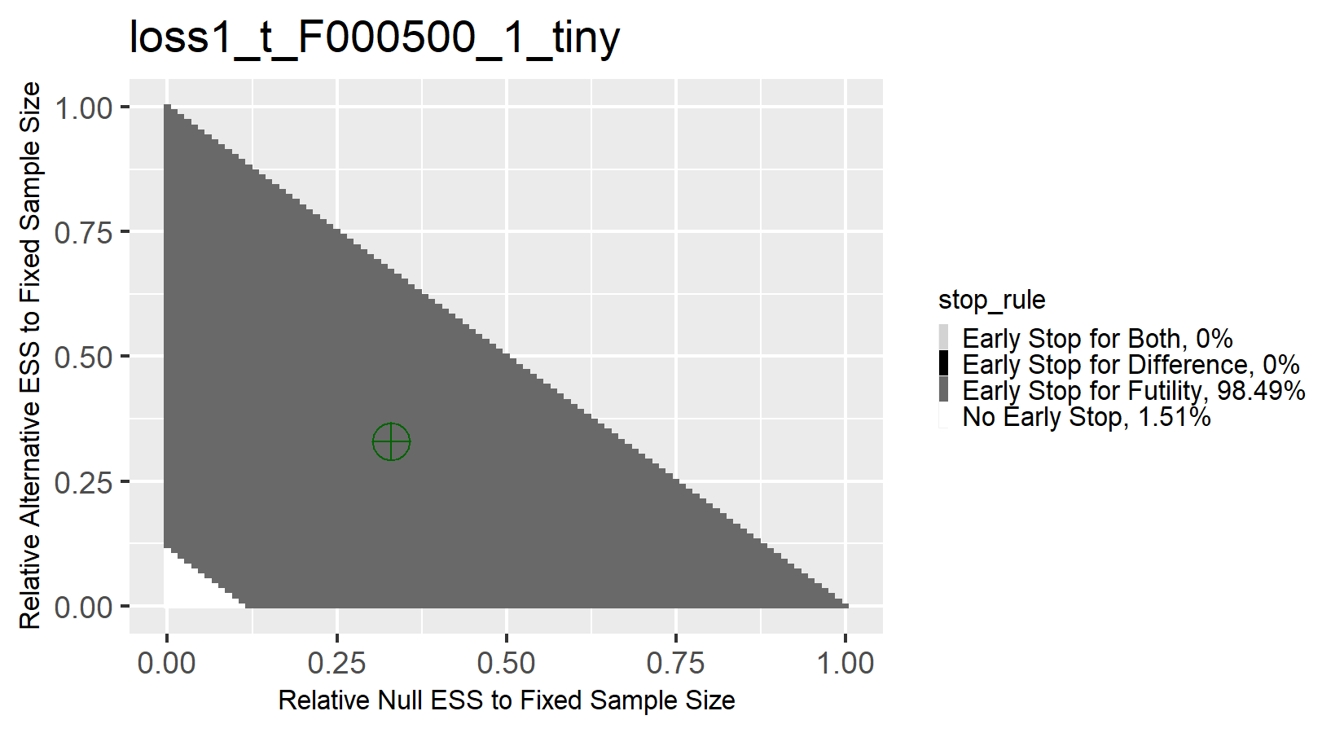
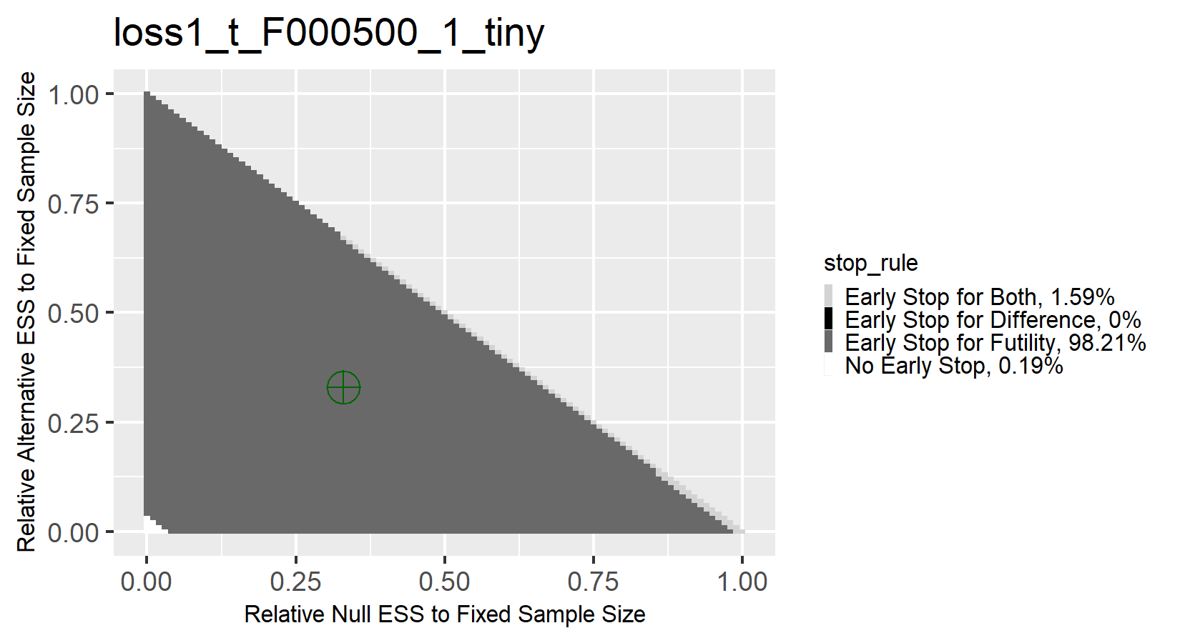
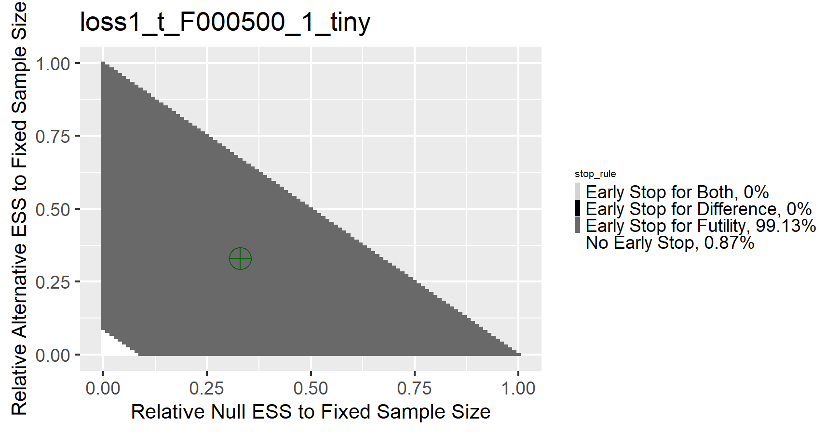
Over- & Under-powered results
2-total analysis
4-total analysis
20-total analysis
Severely overpowered
SS=250,000 per arm, large effect size,
Stopping for both is the optimal
2-total analysis
4-total analysis
20-total analysis
Severely under powered
SS=500 per arm,
tiny effect size,
Stopping for futility is the optimal
Notes:
This is the result for over and under-powered results. For the overpowered design, stopping for both is still the ideal, which is the same with adequately powered design. However, for under powered design, stopping for futility is the ideal design. This can be understood intuitively, since you are unlikely to detect a difference due to lack of power, you should stop for futility to save the resources. But in practice, if you are running a preliminary study, you should consider a fixed sample size design, since it guarantees you have as much information as possible.

