Slide 1
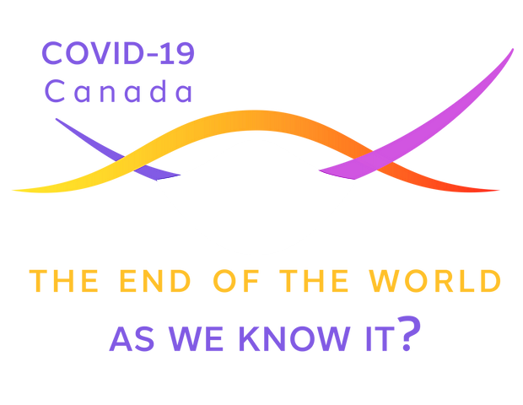
Understanding information about COVID-19: how reliability of favored sources and level of understanding influenced adherence to sanitary measures in Canada during the first year of the pandemic
Clémentine Courdi, University of Montreal
Sahar Ramazan Ali, University of Montreal

Slide 2
Introduction
Goal: Explore how understanding of information and sources’ reliability can influence adherence to health measures implemented by Canadian federal and provincial governments.
Context: COVID-19 pandemic and heterogeneity in adherence
Sanitary measures: social distancing, contacts’ limitation and mask wearing
Impacts of knowledge level and reliability of sources on adherence = not well explored in COVID-19 literature
Explore factors beyond conspiracy theories issues
What hinders adherence?

Slide 3
Survey
Longitudinal survey of the Canadian population during the COVID-19 pandemic
Launch of the canadian survey
(1st measurement time)
April 6th, 2020
April 2022
(12th measurement time)
3617 Canadians answered the first wave of the survey
Representativeness of the Canadian population has been established for age, gender identity, and province of residence for the first wave
For measurement times 2 to 11, the average participation rate is 57%.
(de la Sablonnière & al., 2020)

Slide 4
Methodology
Group-based trajectory models created for each sanitary measure
(social distancing, staying home, mask wearing)
  Software: SAS, PROC TRAJ package
Multinomial logistic regression for prediction
  Software: SAS, PROC TRAJ package, RISK argument
2 main predictors:
  Level of understanding (low, medium, high)
  Use of reliable sources (yes or no)
Control factors: level of education, age, gender, province of residence, immigration status, political identity
  Pre-treatment of data and visualization realized in R
(Nagin, 1999)

Slide 5
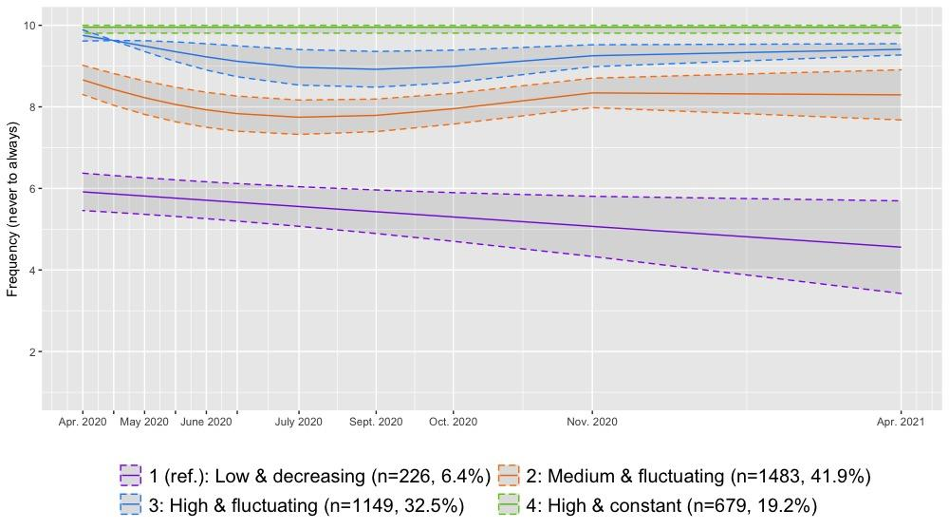
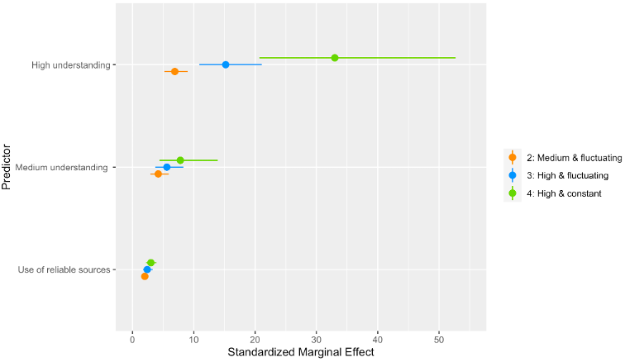
Results - Adherence to social distancing
Predictors of adherence trajectories
Adjusted Odds Ratio (95% CI)
Trajectories

Slide 6
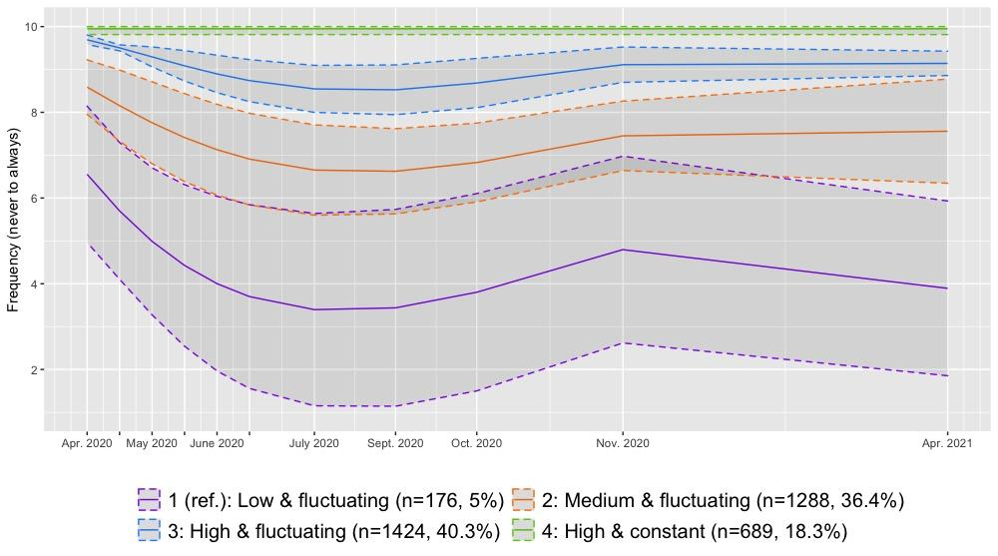
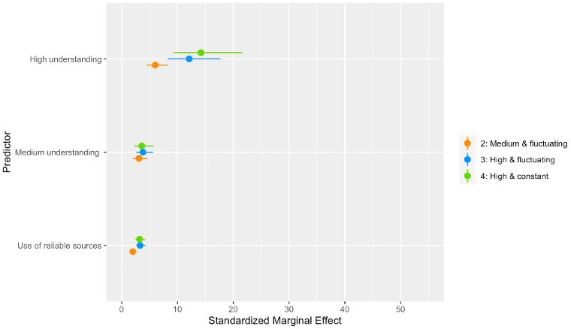
Results - Adherence to contacts limitation
Predictors of adherence trajectories
Adjusted Odds Ratio (95% CI)
Trajectories

Slide 7
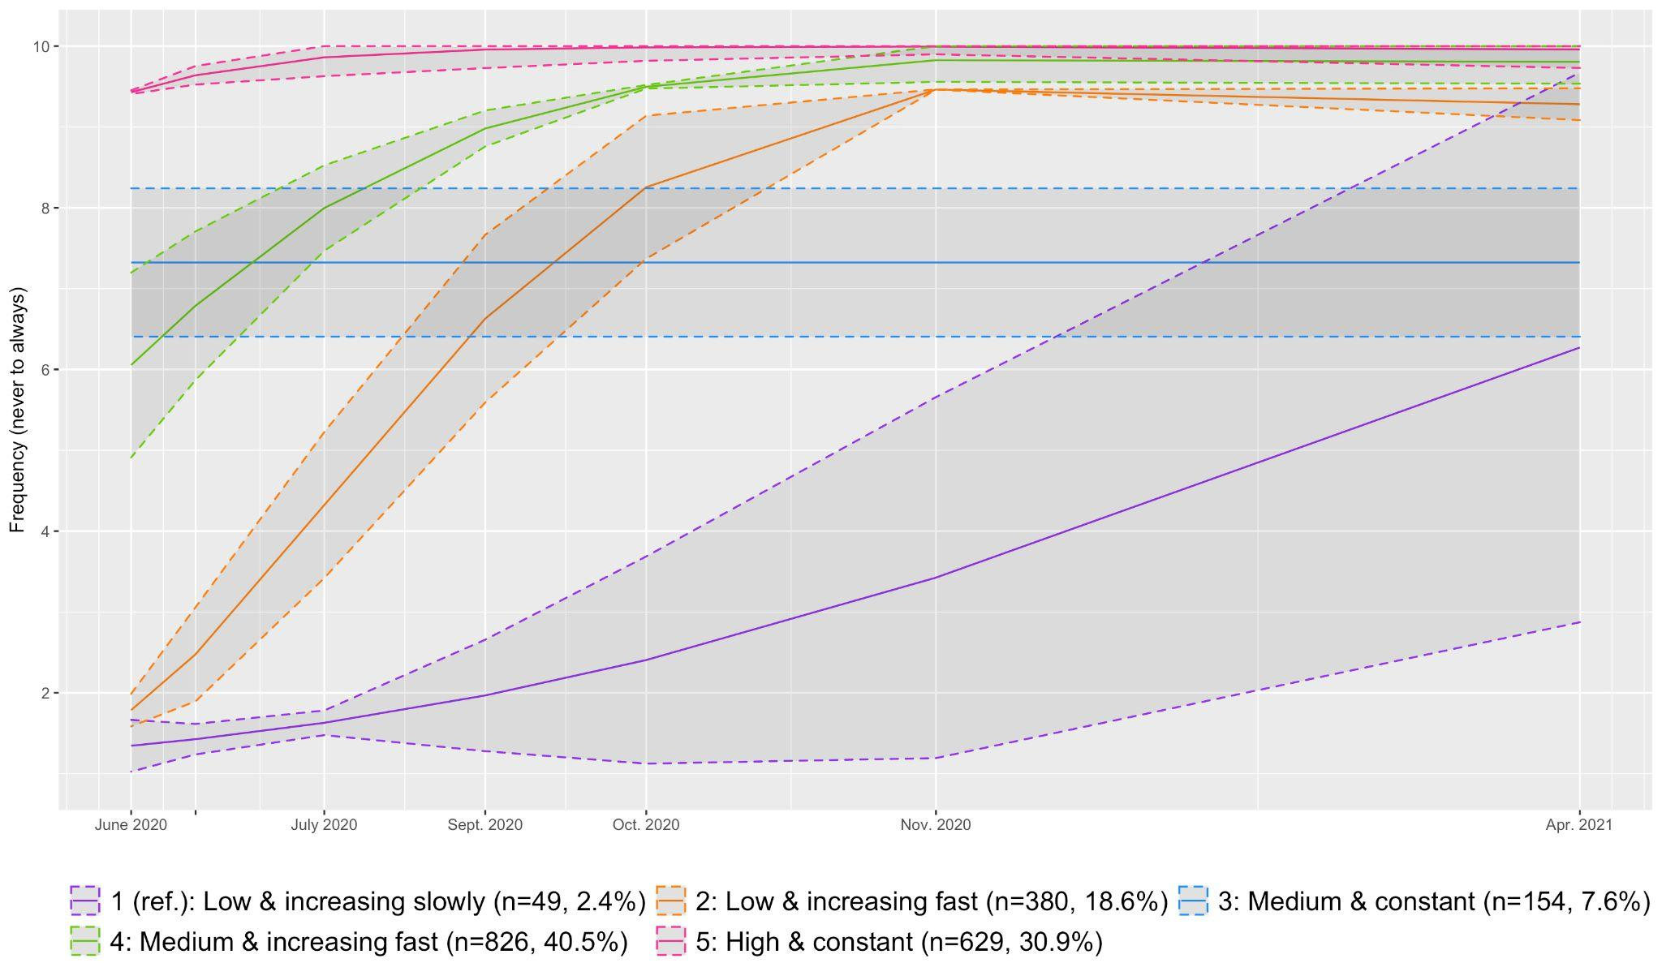
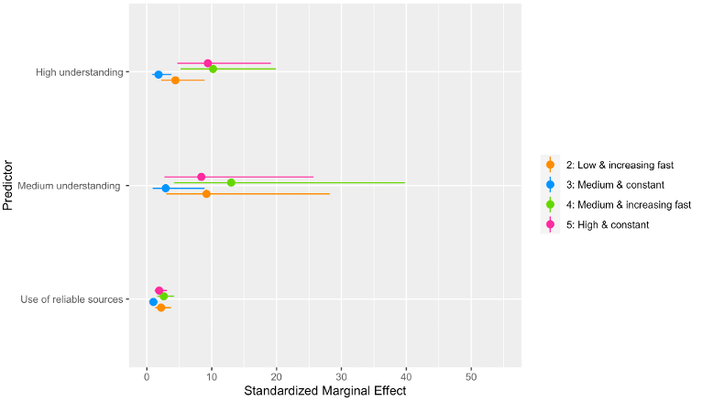
Results - Adherence to mask wearing
Predictors of adherence trajectories
Adjusted Odds Ratio (95% CI)
Trajectories

Slide 8
Key findings
The group with the lowest adherence represents around 5% of the population
Participants with a low level of understanding are 3 to 33 times more likely to follow a low adherence trajectory
Participants who use unreliable sources are 2 to 3 times more likely to follow a low adherence trajectory
Being a man, being younger, and being more to the right on the political spectrum increases the odds of following a low adherence trajectory
Adherence to mask wearing is less influenced by use of reliable sources and depends on province of residence

Slide 9
Conclusion
Confirms that beyond individual characteristics, adherence to sanitary measures is highly influenced by the knowledge of those measures
Understanding is the most important predictor of adherence, even when considering reliability of sources and education level
Promoting better health literacy (capacity to understand, access and use health-related information) should be a priority to increase adherence to sanitary measures in the event of another future global health crisis
(Abel & McQueen, 2020; Abdel-Latif, 2020; Agley et Xiao, 2021;
Enticott et al., 2021; Gerosa et al., 2021; Webster, 2020)
Notes:
beyond individual characteristics, adherence to measures is highly influenced by the knowledge of those measures, as it is impossible for individuals to follow guidelines they do not know

Slide 10
References & Acknowledgements
Researchers
Roxane de la Sablonnière (Professor, Psychology)
Éric Lacourse (Professor, Sociology)
Jean-Marc Lina (Professor, Electrical Engineering)
Dietlind Stolle (Professor, Political Sciences)
Anna Dorfman (Professor, Psychology)
Mathieu Pelletier-Dumas (Post-doctoral Fellow, Psychology)
Contact information
clementine.courdi@umontreal.ca
https://csdc-cecd.wixsite.com/covid19csi
References
Abdel-Latif, M. (2020). The enigma of health literacy and COVID-19 pandemic. Public Health, 185, 95-96. doi: 10.1016/j.puhe.2020.06.030
Abel, T. & McQueen, D. (2020). Critical health literacy and the COVID-19 crisis. Health Promotion International, 35(6), 1612-1613. doi: 10.1093/heapro/daaa040
Agley, J. & Xiao, Y. (2021). Misinformation about COVID-19: evidence for differential latent profiles and a strong association with trust in science. BMC Public Health, 21(1), 12 p. doi: 10.1186/s12889-020-10103-x
de la Sablonnière, R., Dorfman, A., Pelletier-Dumas, M., Lacourse, É., Lina, J. M., Stolle, D., Taylor, D. M., Benoit, Z., Boulanger, A., Caron-Diotte, M., Mérineau, S., & Nadeau, A. (2020). COVID-19 Canada : La fin du monde tel qu’on le connaît ? (Rapport technique N° 1). Présentation de l’enquête COVID-19. Université de Montréal.
Enticott, J., Slifirski, W., Lavoie, K. L., Bacon, S. L., Teede, H. J. & Boyle, J. A. (2021). Knowledge, Attitude, and Self-Reported Practice Towards Measures for Prevention of the Spread of COVID-19 Among Australians: A Nationwide Online Longitudinal Representative Survey. Frontiers in Public Health, 9, 17 p. doi: 10.3389/fpubh.2021.630189
Gerosa, T., Gui, M., Hargittai, E. & Nguyen, M. H. (2021). (Mis)informed During COVID-19: How Education Level and Information Sources Contribute to Knowledge Gaps. International Journal of Communication, 15, 2196-2217.
Nagin, D. S. (1999). Analyzing developmental trajectories: A semiparametric, group-based approach. Psychological Methods, 4(2), 139-157. doi:10.1037/1082-989X.4.2.139
Webster, R. K., Brooks, S. K., Smith, L. E., Woodland, L., Wessely, S., & Rubin, G. J. (2020). How to improve adherence with quarantine: Rapid review of the evidence. Public Health, 182, 163–169. https://doi.org/10.1016/j.puhe.2020.03.007

