Slide 1
Functional Integrative Bayesian Analysis of High-dimensional Multiplatform Genomic Data
CS17 - Data-driven Healthcare
ASA SDSS 2022
Rupam Bhattacharyya
June 9, 2022

Slide 2
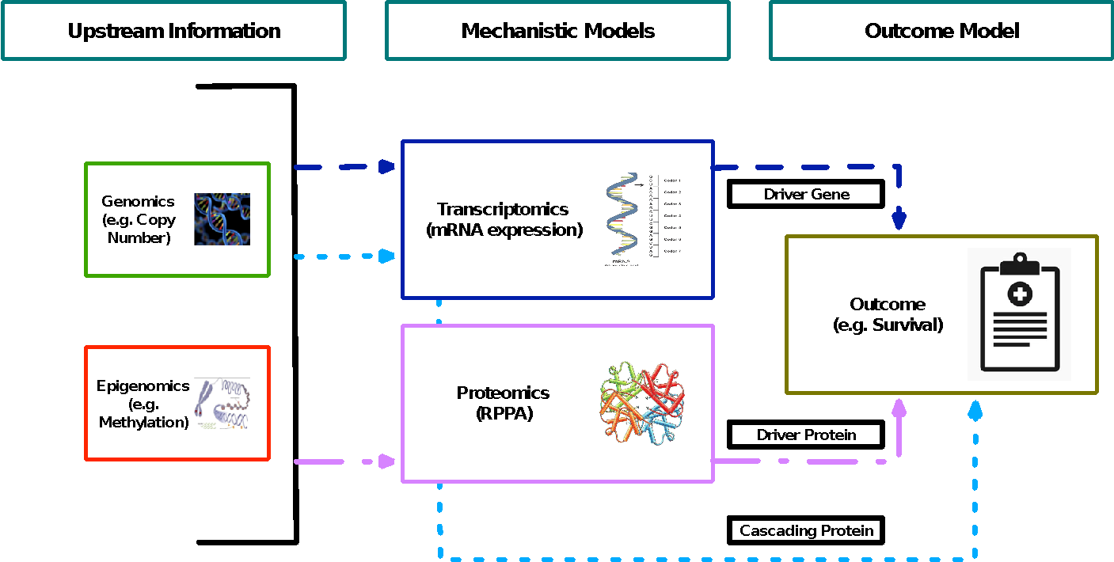
Biological Background

Slide 3
Modeling Idea
Multilevel modeling approach.
Mechanistic models that learn about ‘importance’ of genes/proteins.
An outcome model that incorporates such knowledge to improve selection.

Slide 4


Mechanistic Models
Notations: C - copy number alteration, M - DNA methylation, G - mRNA expression, P - proteomics.
Driver Gene
Driver Protein
Cascading Protein

Slide 5

Outcome Model
Evidences go into the priors for these parameters

Slide 6


Outcome Model
Comes from mechanistic models
Advantages:
  Allows the user to incorporate any form of evidence.
  Only requires some summary statistics.
  Can control the impact of evidence.

Slide 7
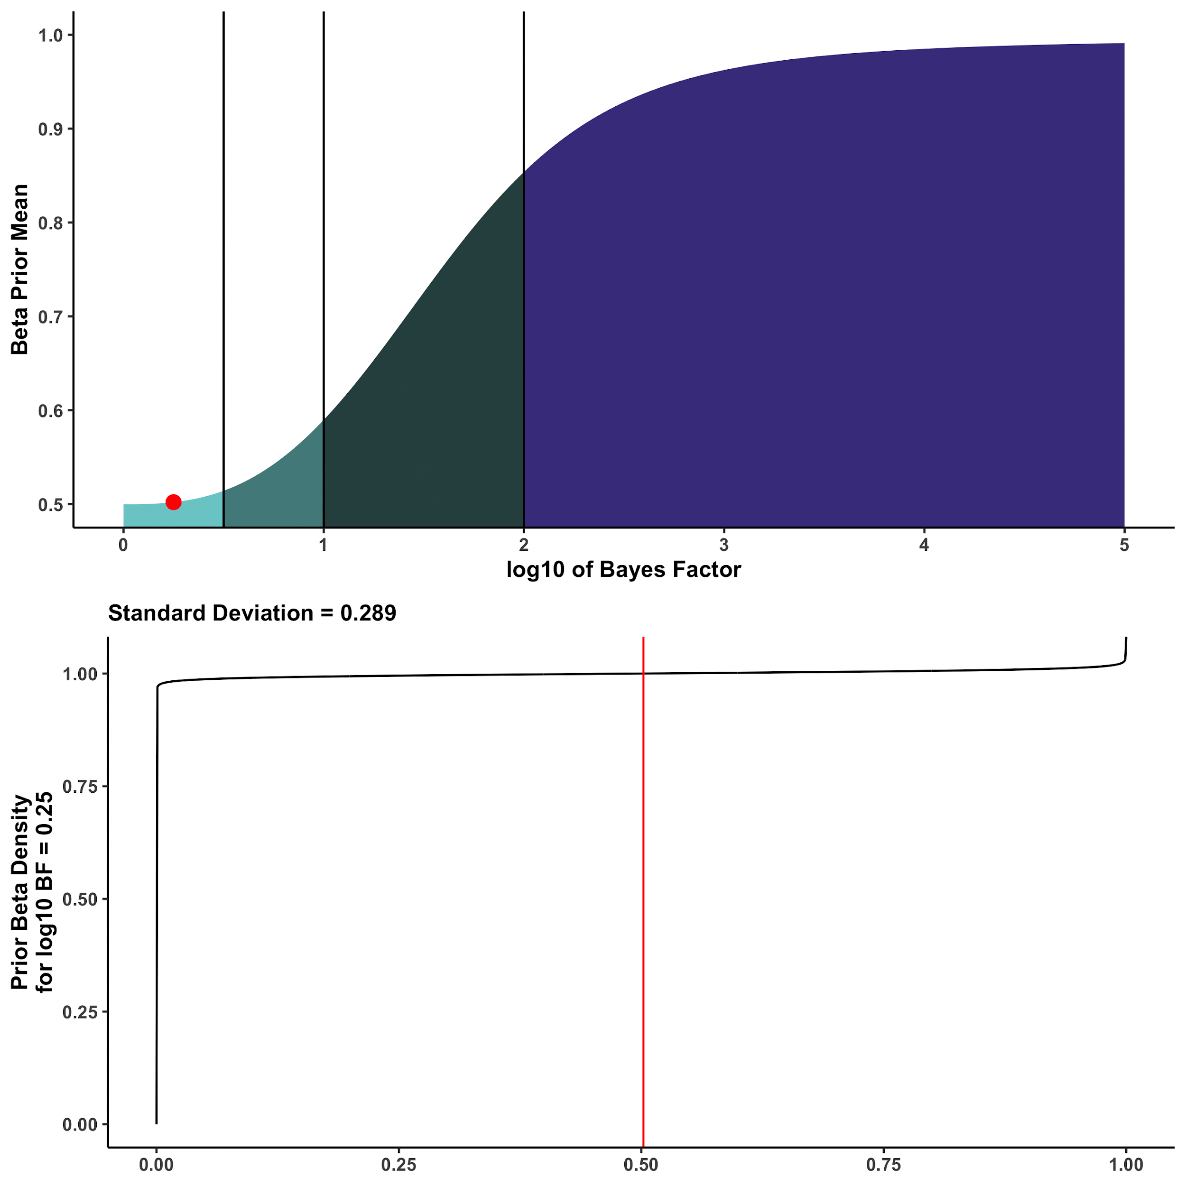
Calibration Map

Slide 8
Model Fitting
Full MCMC
Exact Posterior
Selection-only MCMC
Faster Computation
E-M based BVS

Slide 9
Simulation
Continuous outcome.
Selection-only MCMC version.
Covariates picked up from TCGA cancers.
  Fix a TCGA cancer.
  Fix covariate matrix from real data.
  Pick up effect sizes from an uncalibrated variable selection model.
  Generate outcome based on it.

Slide 10
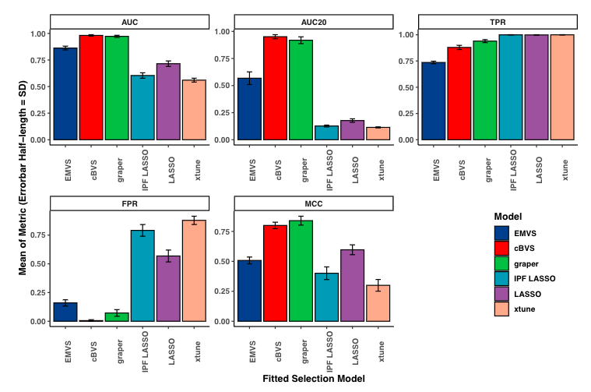
Simulation
Calibrated methods mostly do well.
cBVS does well across all metrics.
Performance preserved in other small-sample scenarios.

Slide 11
Pan-cancer Analysis
14 TCGA cancers classified into four groups.
Pan-gynae: breast invasive carcinoma (BRCA), cervical squamous cell carcinoma and endocervical adenocarcinoma (CESC), ovarian serous cystadenocarcinoma (OV), uterine corpus endometrial carcinoma (UCEC), uterine carcinosarcoma (UCS).
Pan-kidney: kidney chromophobe (KICH), kidney renal clear cell carcinoma (KIRC), kidney renal papillary cell carcinoma (KIRP).
Pan-squamous: esophageal carcinoma (ESCA, squamous), head and neck squamous cell carcinoma (HNSC), lung squamous cell carcinoma (LUSC).
Pan-GI: colon and rectum adenocarcinoma (CORE), esophageal carcinoma (ESCA, adeno), stomach adenocarcinoma (STAD).

Slide 12
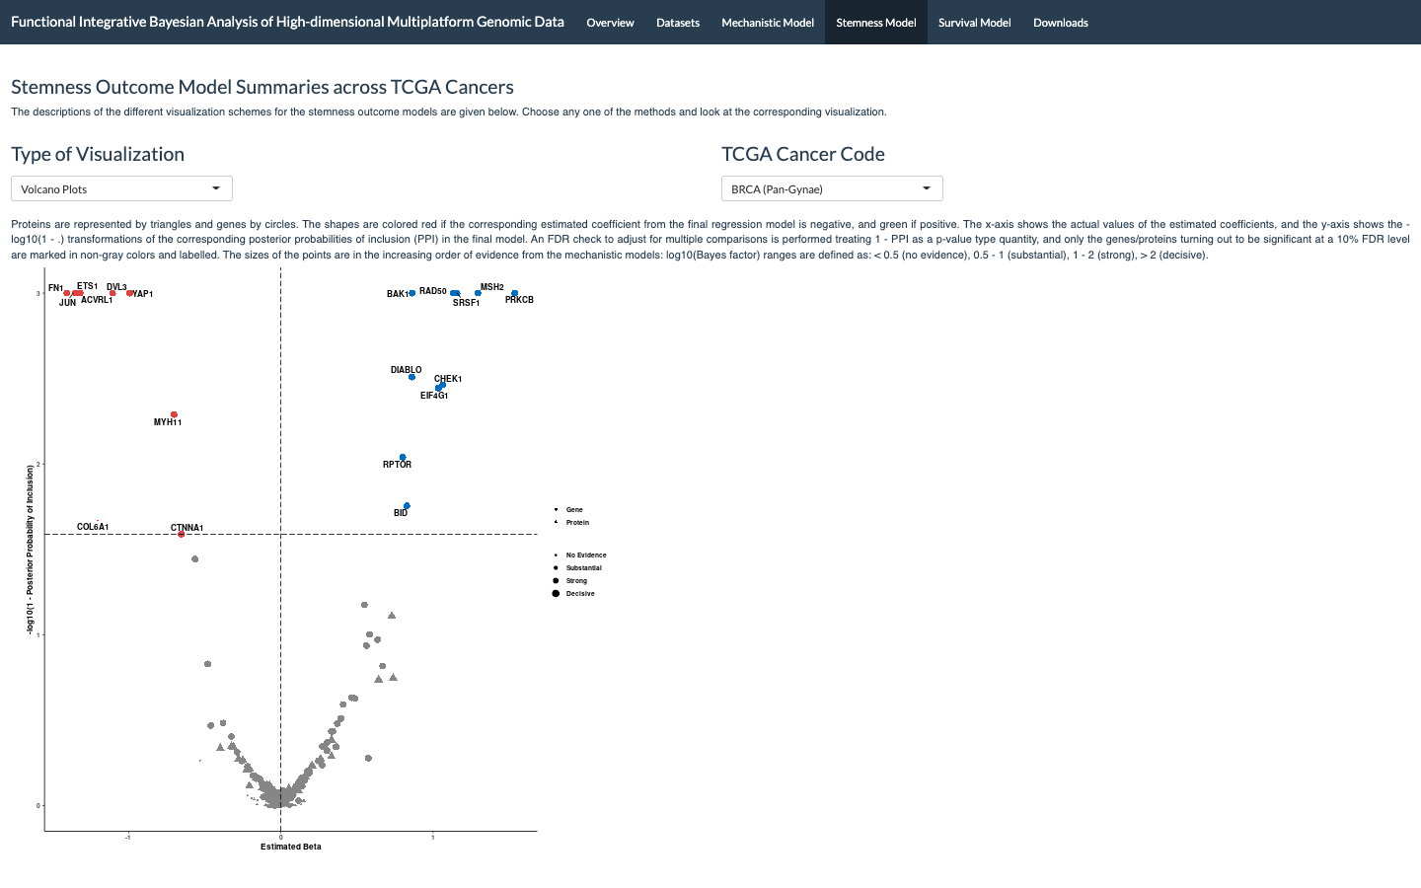
Shiny App
https://bayesrx.shinyapps.io/Functional_iBAG/

Slide 13
Wrap-up
Summary:
  Calibration has benefits.
  MCMC computation is the only bottleneck.
Future steps?
  Expand the proteomics panel.
    Clinical Proteomic Tumor Analysis Consortium (CPTAC).
  Incorporate tumor heterogeneity information.
    Varying-coefficient models?
      Hastie and Tibshirani, 1993.
  Precision oncology direction?
    Cell lines - drug response data in a third layer.

Slide 14
References
Gevaert, O., Villalobos, V., Sikic, B. I., & Plevritis, S. K. (2013). Identification of ovarian cancer driver genes by using module network integration of multi-omics data. Interface focus, 3(4), 20130013.
Hastie, T., & Tibshirani, R. (1993). Varying‐coefficient models. Journal of the Royal Statistical Society: Series B (Methodological), 55(4), 757-779.
Malta, T. M., Sokolov, A., Gentles, A. J., Burzykowski, T., Poisson, L., Weinstein, J. N., ... & Schumacher, S. E. (2018). Machine learning identifies stemness features associated with oncogenic dedifferentiation. Cell, 173(2), 338-354.
Ročková, V., & George, E. I. (2014). EMVS: The EM approach to Bayesian variable selection. Journal of the American Statistical Association, 109(506), 828-846.
Song, X., Ji, J., Gleason, K. J., Yang, F., Martignetti, J. A., Chen, L. S., & Wang, P. (2019). Insights into impact of DNA copy number alteration and methylation on the proteogenomic landscape of human ovarian cancer via a multi-omics integrative analysis. Molecular & Cellular Proteomics, 18(8), S52-S65.

Slide 15
Thanks for your attention!
Questions/Feedbacks/Comments?
Poster 3 | Allegheny I | 2:45 – 3:40 Today
www.rupamb.com | rupamb@umich.edu

