Slide 1
Comprehensive Evaluation of CNNs for Pollen Classification
Predrag Matavulj, Sanja Brdar, Marko Panić, Branko Šikoparija
BioSense Institute, Novi Sad, Serbia

Slide 2
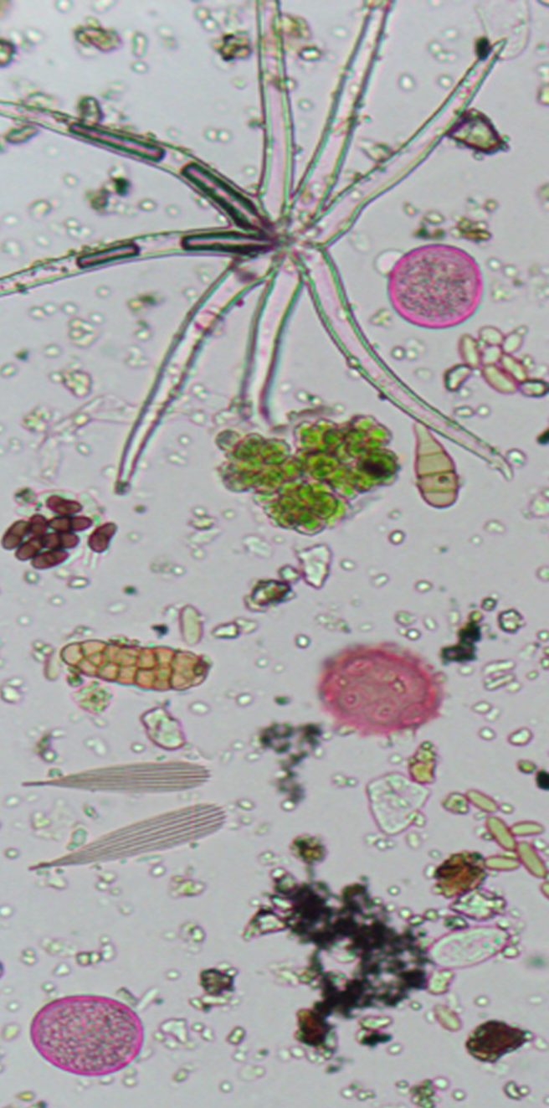
MOTIVATION

Slide 3
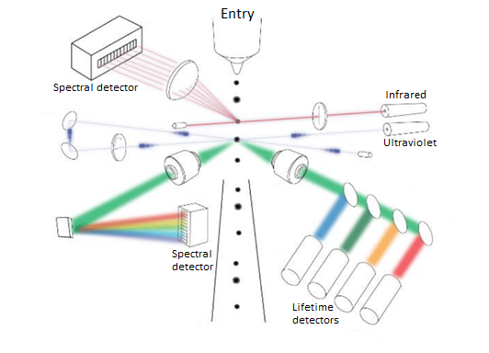
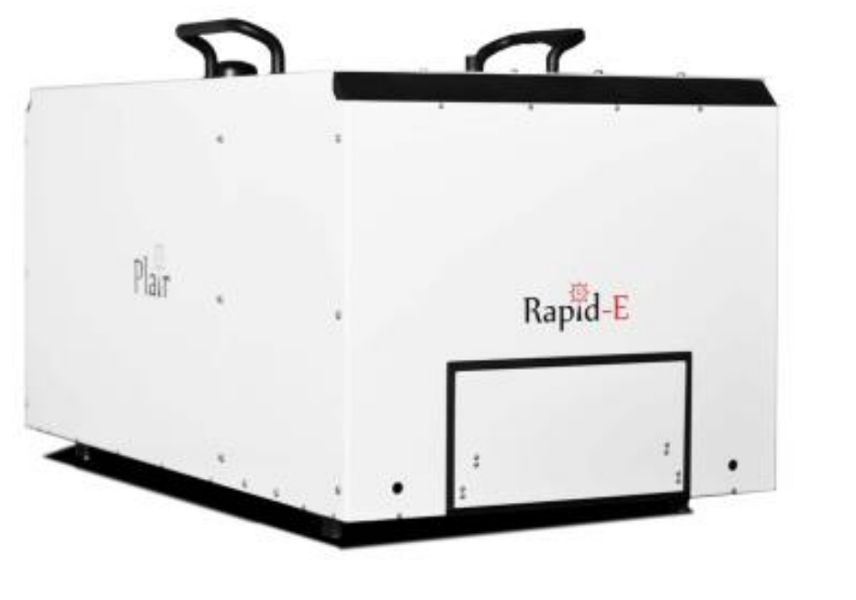
TECHNOLOGY
Angles
Time

Slide 4
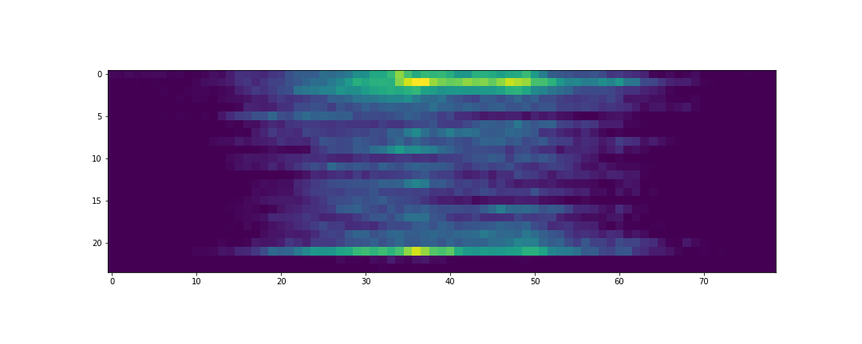
DATA
SCATTERED LIGHT IMAGE
Dimensions: 24xn, where n is the number of acquisitions – the width of the image is not fixed
Angles
Time

Slide 5
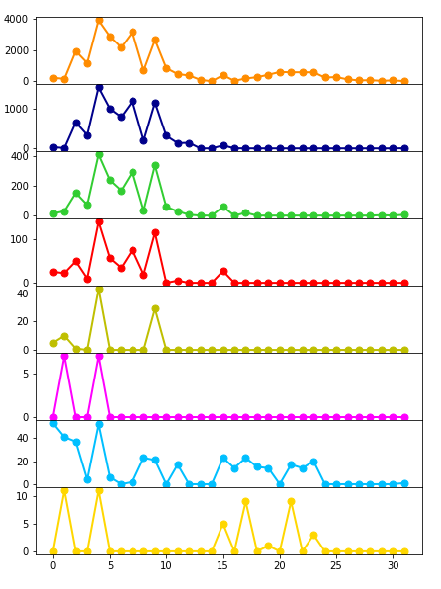

DATA
FLUORESCENCE SPECTRUM
Eight consecutive acquisitions distanced by 500 nanoseconds (ns) over 32 channels of the spectrometer unit.
preprocessing
Time
Time
Emission wavelength
Emission wavelength

Slide 6
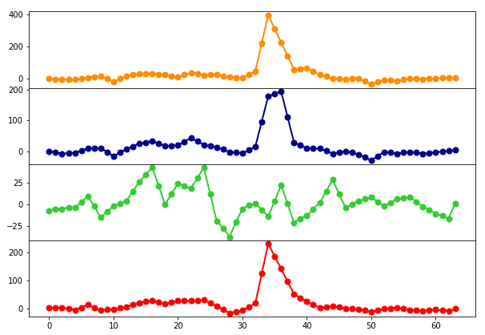
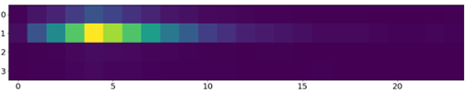
DATA
FLUORESCENCE LIFETIME
By simultaneous acquisition over four separated bands the fluorescence lifetime is measured.
Emission wavelength
Time
preprocessing
Emission wavelength
Time

Slide 7
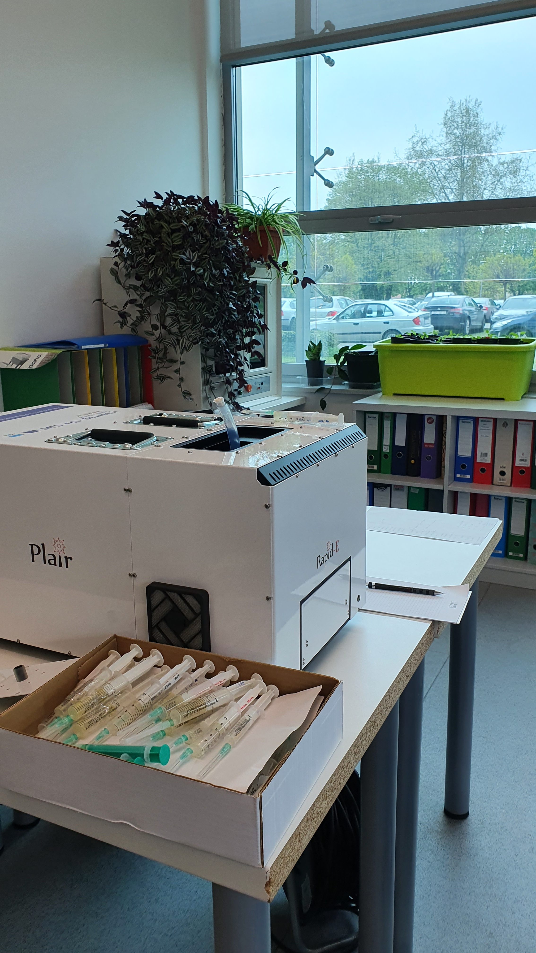
COLLECTING LABELED DATA
Collecting pollen samples
Calibration events: exposing the device with collected samples in a controlled environment

Slide 8
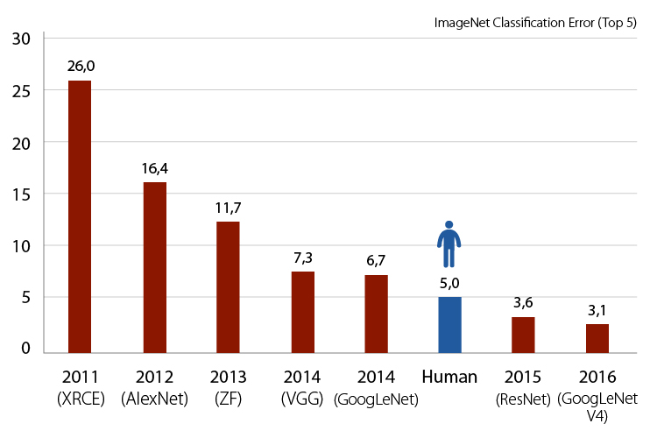
MODELS

Slide 9
VANILLA CNNS
Feature
extraction
Convolutional blocks
Convolution
Batch normalization
Padding
Dropout
Maxpool
ReLU
FC(x)
Classification

Slide 10
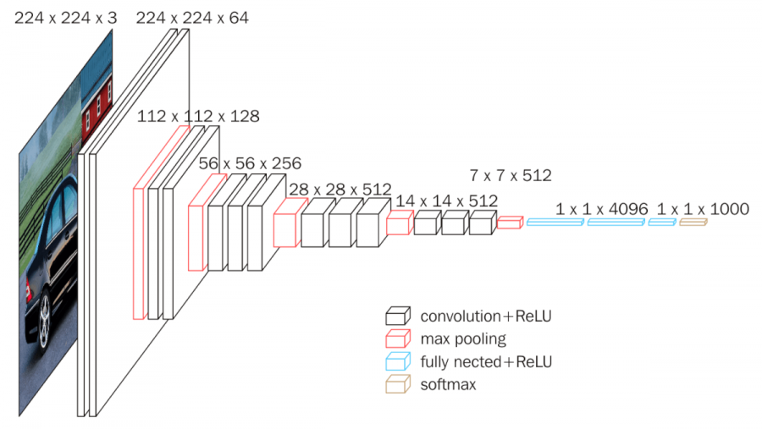
VGG

Slide 11
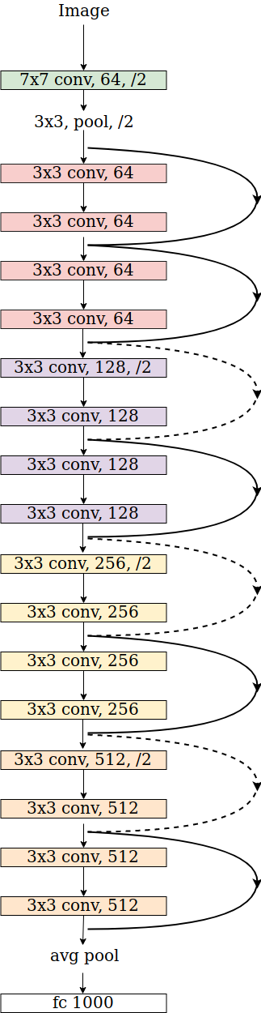
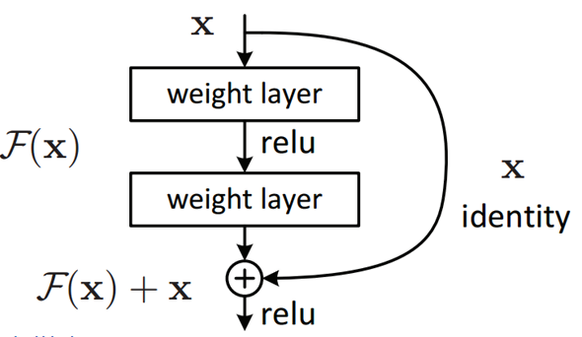
RESNET

Slide 12
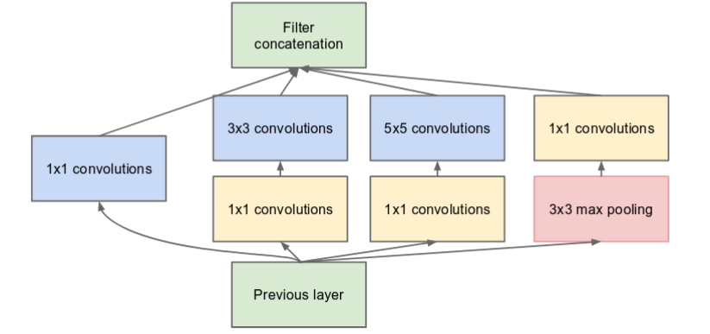
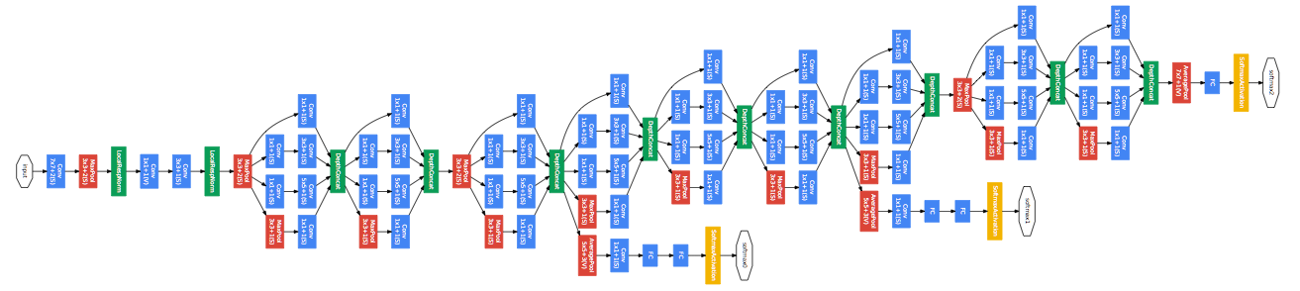
INCEPTION

Slide 13
RESULTS

Slide 14
CREATING MULTI-MODAL MODELS
Neural Network Framework 1
Neural Network Framework 2
Neural Network Framework 3
FC(x)
FC(x)
FC(x)
Concatenation
Classification

Slide 15
RESULTS

Slide 16
Thank you for your attention!
This research was funded by the BREATHE project from the Science Fund of the Republic of Serbia PROMIS program, under grant agreement no. 6039613

