Slide 1



Inter- and Intra-Institutional Efforts to Build Capacity for Data Science Education
DP Landsittel¹, H Hochheiser¹, G Cooper², RS Day¹, DN Boone¹, ES Wright¹, N Batmanghelich¹, NN Urban^{2,3}
University of Pittsburgh, Departments of Biomedical Informatics¹ and Neurobiology², and Office of the Provost³
INTRODUCTION
Data Science Efforts at the University of Pittsburgh
Data Science¹ represents an implicitly multidisciplinary field requiring a broad set of skills.
Our group sought to:
  Develop educational modules to enhance existing course
  Share resources within and across institutions
  Coordinate educational efforts across departments
Collaborations are being formed across schools, departments, training programs, CTSA-funded efforts, UPMC and Carnegie Mellon University
EDUCATIONAL MODULES
  Discovery of underlying causal relationships
  Implementation of propensity score-base methods
  Bias, variance, smoothing, and shrinking
  Machine learning for image segmentation and registration
  Text and natural language processing of social media data
  Bioinformatics analysis of TCGA data and the Human Microbiome Project
Department of Biostatistics and
Graduate School of Public Health
Department of Statistics and
School of Arts and Sciences
CONCLUSIONS AND FUTURE DIRECTIONS
The University of Pittsburgh has substantially increased capacity for data science research and education through an expanded department of Biomedical informatics and supplemental funding from NLM², a new School of Computing and Information (merging the Department of Computer Science and School of Information Science + new faculty and dean) and collaboration across schools led by the Office of the Provost.
REFERENCES
https://grants.nih.gov/grants/rfi/NIH-Strategic-Plan-for-Data-Science.pdf
http://www.dbmi.pitt.edu/training-programs/overview
https://www.ncbi.nlm.nih.gov/pmc/articles/PMC3758063/
Funding received from a Supplement to a T15 Training Grant from the National Libraries of Medicine: 3T15 LM007059-31S1
Slide 1 of 7

Slide 2
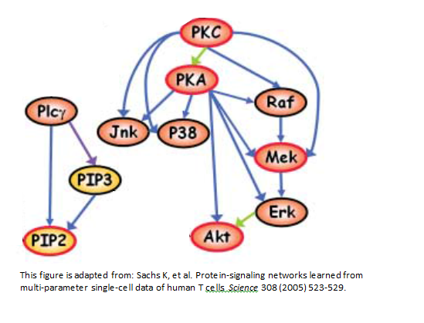
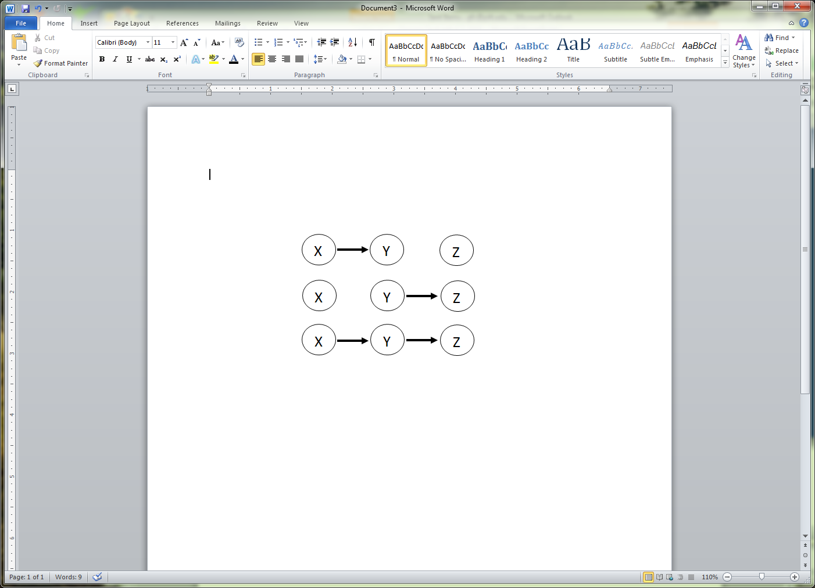
Inter- and Intra-Institutional Efforts to Build Capacity for Data Science Education
DP Landsittel¹, H Hochheiser¹, G Cooper², RS Day¹, DN Boone¹, ES Wright¹, N Batmanghelich¹, NN Urban^{2,3}
University of Pittsburgh, Departments of Biomedical Informatics¹ and Neurobiology², and Office of the Provost³
INTRODUCTION
MODELING AND DISCOVERY OF CAUSAL RELATIONSHIPS FROM DATA
Data Science¹ represents an implicitly multidisciplinary field requiring a broad set of skills.
Our group sought to:
  Develop educational modules to enhance existing course
  Share resources within and across institutions
  Coordinate educational efforts across departments
Causal modeling and discovery (CMD) from data are central to science. This
5-week course will provide an introduction to key CMD concepts and methods
using Causal Bayesian Networks as a representation. The planned topics are as follows:
Causal Bayesian Networks (CBNs)
A directed acyclic graph
Nodes represent variables
Arcs represent direct causation
A variable is modeled as independent of its non-effects, given its causal parents
Issues include: time, feedback, confounding, selection, and a variety types of data
Discovery of CBNs from Data
Components
  Representation
  Search
  Evaluation
Approaches
  Bayesian
  Constraint-based
Inference Using CBNs
Observational. Example: P(Y | observe(Z))
Interventional. P(Y | manipulate(X))
Both. P(Y | observe(Z), manipulate(X))
EDUCATIONAL MODULES
  Discovery of underlying causal relationships
  Implementation of propensity score-base methods
  Bias, variance, smoothing, and shrinking
  Machine learning for image segmentation and registration
  Text and natural language processing of social media data
  Bioinformatics analysis of TCGA data and the Human Microbiome Project
CONCLUSIONS AND FUTURE DIRECTIONS
Causal modeling and discovery (CMD) are important components of a data science education
Fundamental CMD concepts and basic methods can be taught in a 5-week course
We plan to offer such a course at the University of Pittsburgh in Fall 2018
The course teaching materials will be open source and freely available to all
REFERENCES
https://grants.nih.gov/grants/rfi/NIH-Strategic-Plan-for-Data-Science.pdf
http://www.dbmi.pitt.edu/training-programs/overview
https://www.ncbi.nlm.nih.gov/pmc/articles/PMC3758063/
Funding received from a Supplement to a T15 Training Grant from the National Libraries of Medicine: 3T15 LM007059-31S1
Slide 2 of 7

Slide 3
Inter- and Intra-Institutional Efforts to Build Capacity for Data Science Education
DP Landsittel¹, H Hochheiser¹, G Cooper², RS Day¹, DN Boone¹, ES Wright¹, N Batmanghelich¹, NN Urban^{2,3}
University of Pittsburgh, Departments of Biomedical Informatics¹ and Neurobiology², and Office of the Provost³
INTRODUCTION
Implementation of Propensity Score-Based (PS) Methods
Data Science¹ represents an implicitly multidisciplinary field requiring a broad set of skills.
Our group sought to:
  Develop educational modules to enhance existing course
  Share resources within and across institutions
  Coordinate educational efforts across departments
PS Methods and Assumptions
Formulating the Research Question
Model Assignment Mechanisms
Assess validity of Instrumental Variables
Adequacy of the Design and Data
Form the Pseudo Population
Estimate IV Effects
Assumptions
EDUCATIONAL MODULES
Causal Graphs
Fit the Outcomes Model
Interpret Causal Effects
  Discovery of underlying causal relationships
  Implementation of propensity score-base methods
  Bias, variance, smoothing, and shrinking
  Machine learning for image segmentation and registration
  Text and natural language processing of social media data
  Bioinformatics analysis of TCGA data and the Human Microbiome Project
Causal Question
Sensitivity Analysis
CONCLUSIONS AND FUTURE DIRECTIONS
This project leverages a previous contract from the Patient-Centered Outcomes Research Institute (PCORI) that developed a decision tool for causal inference specific to comparative effectiveness research³.
We are developing a publically available course using Google Drive with embedded links and videos.
REFERENCES
https://grants.nih.gov/grants/rfi/NIH-Strategic-Plan-for-Data-Science.pdf
http://www.dbmi.pitt.edu/training-programs/overview
https://www.pcori.org/research-results/2013/modeling-strategies-observational-comparative-effectiveness-research-what
https://www.ncbi.nlm.nih.gov/pmc/articles/PMC3758063/
Funding received from a Supplement to a T15 Training Grant from the National Libraries of Medicine: 3T15 LM007059-31S1
Slide 3 of 7

Slide 4
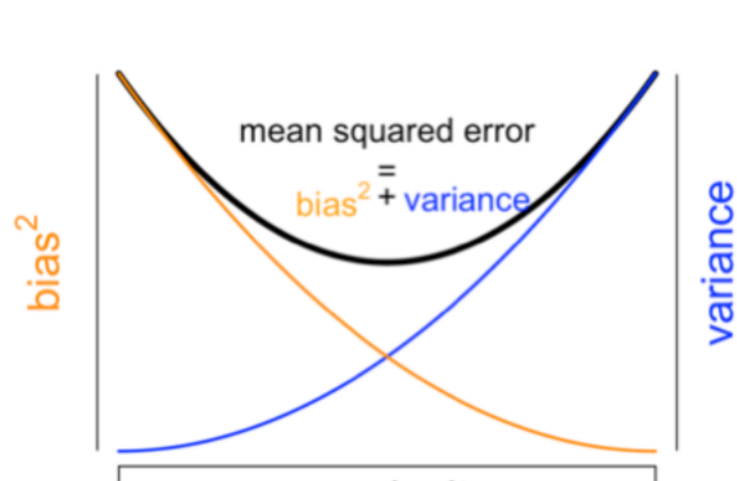
Inter- and Intra-Institutional Efforts to Build Capacity for Data Science Education
DP Landsittel¹, H Hochheiser¹, G Cooper², RS Day¹, DN Boone¹, ES Wright¹, N Batmanghelich¹, NN Urban^{2,3}
University of Pittsburgh, Departments of Biomedical Informatics¹ and Neurobiology², and Office of the Provost³
INTRODUCTION
Module: Bias, variance, smoothing, and shrinking
Data Science¹ represents an implicitly multidisciplinary field requiring a broad set of skills.
Our group sought to:
  Develop educational modules to enhance existing course
  Share resources within and across institutions
  Coordinate educational efforts across departments
The module begins with a two-by-two table counting the responding and nonresponding patients for two groups labeled D and L.
The response rate is very high in group D, very low in group L, but most of the patients are in L.
A dilemma: in deciding whether to pursue “personalized medicine” for group D, how should we use group L data? How should knowledge about this feature inform how to “borrow strength”?
Expansions of the motivating example open avenues to explore many techniques and issues, and a web of connected statistical concepts important for data scientists.
Analysts face tradeoffs in many forms between reliability (e.g. low variance) and validity (e.g. low bias). Choosing the optimal compromise point is a common challenge.
lump | ⬅ | model averaging | ➔ | split
simple | ⬅ | complexity | ➔ | complex
few | ⬅ | #parameters | ➔ | many
few | ⬅ | #components | ➔ | many
large | ⬅ | penalty | ➔ | small
heavy | ⬅ | prior weight | ➔ | Light
EDUCATIONAL MODULES
  Discovery of underlying causal relationships
  Implementation of propensity score-base methods
  Bias, variance, smoothing, and shrinking
  Machine learning for image segmentation and registration
  Text and natural language processing of social media data
  Bioinformatics analysis of TCGA data and the Human Microbiome Project
Software approach:
Rmarkdown with “shiny” interactive components, including embedded reusable components for capturing student’s reflective answers, and their own questions, and “aha”s, to save and e-mail.
CONCLUSIONS AND FUTURE DIRECTIONS
Some topics in the works include model averaging, cross-validation, penalized likelihood and regularization, empirical Bayes, hierarchical Bayes, smoothing and shrinking, multiple testing, decision theory, degrees of freedom and overfitting.
REFERENCES
https://grants.nih.gov/grants/rfi/NIH-Strategic-Plan-for-Data-Science.pdf
http://www.dbmi.pitt.edu/training-programs/overview
https://www.ncbi.nlm.nih.gov/pmc/articles/PMC3758063/
Funding received from a Supplement to a T15 Training Grant from the National Libraries of Medicine: 3T15 LM007059-31S1
Slide 4 of 7

Slide 5
Inter- and Intra-Institutional Efforts to Build Capacity for Data Science Education
DP Landsittel¹, H Hochheiser¹, G Cooper², RS Day¹, DN Boone¹, ES Wright¹, N Batmanghelich¹, NN Urban^{2,3}
University of Pittsburgh, Departments of Biomedical Informatics¹ and Neurobiology², and Office of the Provost³
INTRODUCTION
Social Media
Jupyter notebooks
  Didactic material
  Python Coding exercises
  Standalone deployment possible in multiple courses
Tools:
  Tweepy – Twitter API www.tweepy.org
  spaCy NLP spacy.io
  Scikit-learn scikit-learn.org
Four modules
Deploy on JupyterHub server
Eventual publication through GitHub
  Supports sharing and adaptation
Data Science¹ represents an implicitly multidisciplinary field requiring a broad set of skills.
Our group sought to:
  Develop educational modules to enhance existing course
  Share resources within and across institutions
  Coordinate educational efforts across departments
Twitter, Facebook
Useful data source on health-related behavior⁴
  Smoking
  Flu transmission
Data Science Challenges
  Acquisition
  Processing/management
  Description
  Annotation
  Natural Language Processing: Tokenization, parsing, part-of-speech
  Classification
Goals – demonstrate both techniques and practical approaches
EDUCATIONAL MODULES
  Discovery of underlying causal relationships
  Implementation of propensity score-base methods
  Bias, variance, smoothing, and shrinking
  Machine learning for image segmentation and registration
  Text and natural language processing of social media data
  Bioinformatics analysis of TCGA data and the Human Microbiome Project
CONCLUSIONS AND FUTURE DIRECTIONS
Planned deployment and evaluation – fall 2018
Appropriate tool selection helps-
  Python toolkits and Jupyter work well together.
REFERENCES
https://grants.nih.gov/grants/rfi/NIH-Strategic-Plan-for-Data-Science.pdf
http://www.dbmi.pitt.edu/training-programs/overview
https://www.ncbi.nlm.nih.gov/pmc/articles/PMC3758063/
Funding received from a Supplement to a T15 Training Grant from the National Libraries of Medicine: 3T15 LM007059-31S1
Slide 5 of 7

Slide 6
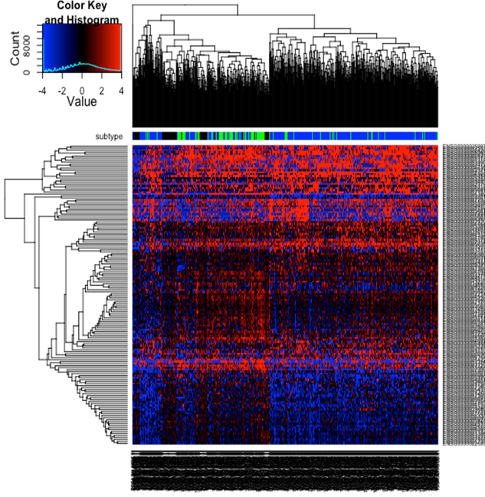
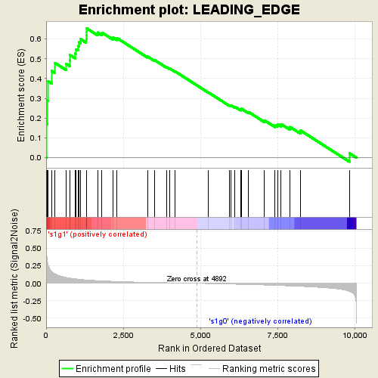
Inter- and Intra-Institutional Efforts to Build Capacity for Data Science Education
DP Landsittel¹, H Hochheiser¹, G Cooper², RS Day¹, DN Boone¹, ES Wright¹, N Batmanghelich¹, NN Urban^{2,3}
University of Pittsburgh, Departments of Biomedical Informatics¹ and Neurobiology², and Office of the Provost³
INTRODUCTION
Analysis of publically available RNAseq data with Bioconductor packages
Data Science¹ represents an implicitly multidisciplinary field requiring a broad set of skills.
Our group sought to:
  Develop educational modules to enhance existing course
  Share resources within and across institutions
  Coordinate educational efforts across departments
Download kallisto-generated TCGA transcript counts data and meta data from XENA browser
Download breast cancer clinical data and metadata from TCGA firehose
Base R
Data Wrangling
HER2+ BC transcript data
HER2- BC transcript data
Tximport
Collapse transcript counts to gene-level counts
HER2+ BC gene-level data
HER2- BC gene-level data
DESeq2
Perform Differential Expression Analysis
EDUCATIONAL MODULES
BiomaRt
Use metadata to inform converting gene name to Gene Symbol
  Discovery of underlying causal relationships
  Implementation of propensity score-base methods
  Bias, variance, smoothing, and shrinking
  Machine learning for image segmentation and registration
  Text and natural language processing of social media data
  Bioinformatics analysis of TCGA data and the Human Microbiome Project
Base R
Connect count data to DEG data
GSEA
DEG and count datatable
Heatmap3
CONCLUSIONS AND FUTURE DIRECTIONS
Learners will be introduced to publically-available RNAseq data sets, version control, metadata, data wrangling, naming conventions and conversions, and the Bioconductor and other packages necessary to perform an analysis on an authentic dataset.
Being built using R-kernal in Jupyter Notebook hosted on a local server
REFERENCES
https://grants.nih.gov/grants/rfi/NIH-Strategic-Plan-for-Data-Science.pdf
http://www.dbmi.pitt.edu/training-programs/overview
https://www.ncbi.nlm.nih.gov/pmc/articles/PMC3758063/
Funding received from a Supplement to a T15 Training Grant from the National Libraries of Medicine: 3T15 LM007059-31S1
Slide 6 of 7

Slide 7
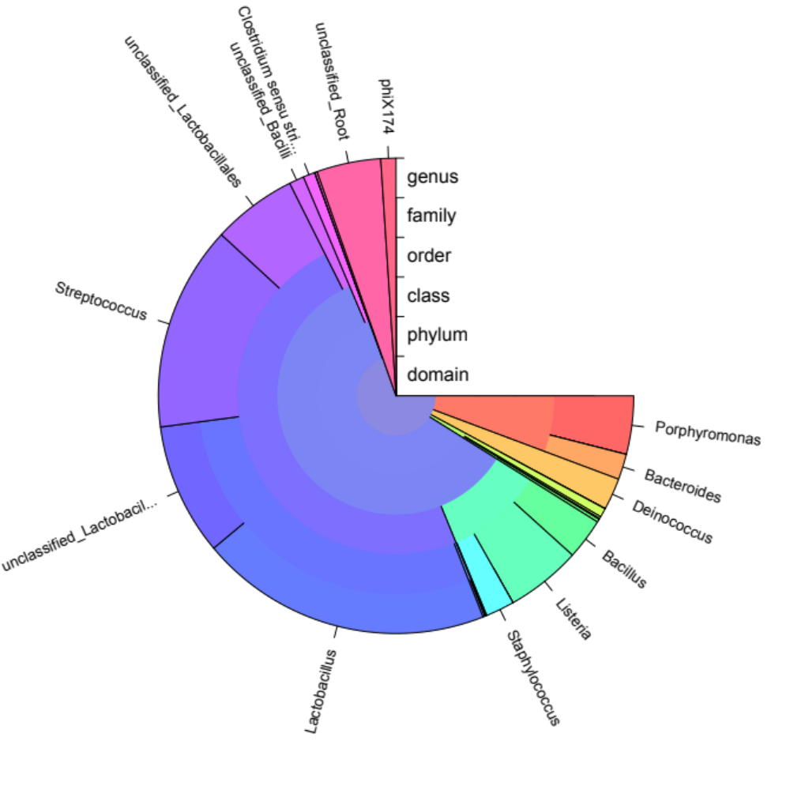
Inter- and Intra-Institutional Efforts to Build Capacity for Data Science Education
DP Landsittel¹, H Hochheiser¹, G Cooper², RS Day¹, DN Boone¹, ES Wright¹, N Batmanghelich¹, NN Urban^{2,3}
University of Pittsburgh, Departments of Biomedical Informatics¹ and Neurobiology², and Office of the Provost³
INTRODUCTION
Human microbiome module
Data Science¹ represents an implicitly multidisciplinary field requiring a broad set of skills.
Our group sought to:
  Develop educational modules to enhance existing course
  Share resources within and across institutions
  Coordinate educational efforts across departments
It has become increasingly clear that the microbiome, that is the community of microorganisms on and within us, is an important component of health and disease. Correlations between microbiome composition (see figure at left) and disease can be identified by analyzing large datasets of DNA sequences made publicly available as part of the Human Microbiome Project. Starting from this real data, students were challenged with (1) reduction of the raw data into a meaningful and manageable form, (2) using existing bioinformatics tools in a reproducible manner, (3) applying and comparing the results of a variety of analysis methods, (4) visualization of their results, and (5) identifying limitations of their conclusions.
EDUCATIONAL MODULES
  Discovery of underlying causal relationships
  Implementation of propensity score-base methods
  Bias, variance, smoothing, and shrinking
  Machine learning for image segmentation and registration
  Text and natural language processing of social media data
  Bioinformatics analysis of TCGA data and the Human Microbiome Project
CONCLUSIONS AND FUTURE DIRECTIONS
The module illustrated several universal principles of data science while focusing on microbiome analyses as a case study. These principles included: (i) subsampling data before scaling up, (ii) maximizing reproducibility through version control, (iii) making code extensible to increase reusability, and (iv) use of in-line notetaking tools such as R Markdown.
REFERENCES
https://grants.nih.gov/grants/rfi/NIH-Strategic-Plan-for-Data-Science.pdf
http://www.dbmi.pitt.edu/training-programs/overview
https://www.ncbi.nlm.nih.gov/pmc/articles/PMC3758063/
Funding received from a Supplement to a T15 Training Grant from the National Libraries of Medicine: 3T15 LM007059-31S1
Slide 7 of 7

