Slide 1
Visualization Using Open-Source Tools: some FDA perspectives
Paul Schuette
Scientiﬁc Computing Coordinator
Food and Drug Administration
Center for Drug Evaluation and Research
Oﬃce of Translational Sciences
Oﬃce of Biostatistics
Paul.Schuette@fda.hhs.gov

Slide 2
Disclaimer
This presentation reflects the views of the author and should not be construed to represent the FDA's views or policies.

Slide 3
What does the FDA do?
FDA is responsible for protecting the public health by assuring the safety, efficacy and security of human and veterinary drugs, biological products, medical devices, our nation’s food supply, cosmetics, and products that emit radiation.
See https://www.fda.gov/AboutFDA/WhatWeDo/
FDA regulated products comprise approximately 20% − 25% of consumer spending in the United States.

Slide 4
FDA Organization
The US FDA is organized by centers:
Center for Biologics Evaluation and Research (CBER)
Center for Drug Evaluation and Research (CDER)
Center for Devices and Radiological Health (CDRH)
Center for Food Safety and Applied Nutrition (CFSAN)
Center for Tobacco Products (CTP)
Center for Veterinary Medicine (CVM)
National Center for Toxicological Research (NCTR)
Office of Regulatory Affairs

Slide 5
What does CDER do?
Promote public health by ensuring the availability of safe and effective drugs
Conduct rigorous science-based premarket review to help ensure that drugs that will be marketed to the public are safe and effective
Identify and develop new scientific methods, models, and tools to improve the quality, safety, predictability and efficiency of new drug development
Promote patient and health professional awareness of drug benefits and risks through effective communication of drug information

Slide 6
CDER Responsibilities, post market
Protect public health by promoting the safe use of marketed drugs
Conduct post-market surveillance to enable early detection of new safety signals
Conduct rigorous studies to understand emerging drug safety signals and effectively manage those signals
Promote patient and health professional awareness of drug risks and safe use
Oversee drug promotion and marketing to help ensure that marketed drug labeling and advertising are truthful and not misleading

Slide 7
CDER Responsibilities, continued
Protect public health by ensuring the quality and integrity of marketed drug products
Secure the global supply chain to help ensure that drug integrity is maintained and that drugs are being manufactured and distributed to conform to established quality standards
Improve drug quality oversight capacity through expanded use of risk-based methods
Promote public and stakeholder awareness of drug quality and integrity issues through effective consumer communications
FDA Center for Drug Evaluation and Research (CDER) Strategic Plan 2013-2017

Slide 8
Graphics
Graphics are used across the entire medical product cycle:
  Premarket Review
  Postmarket Review
  Communications with patients and health care providers
  Research
R and Python are the principle open source software packages used.

Slide 9
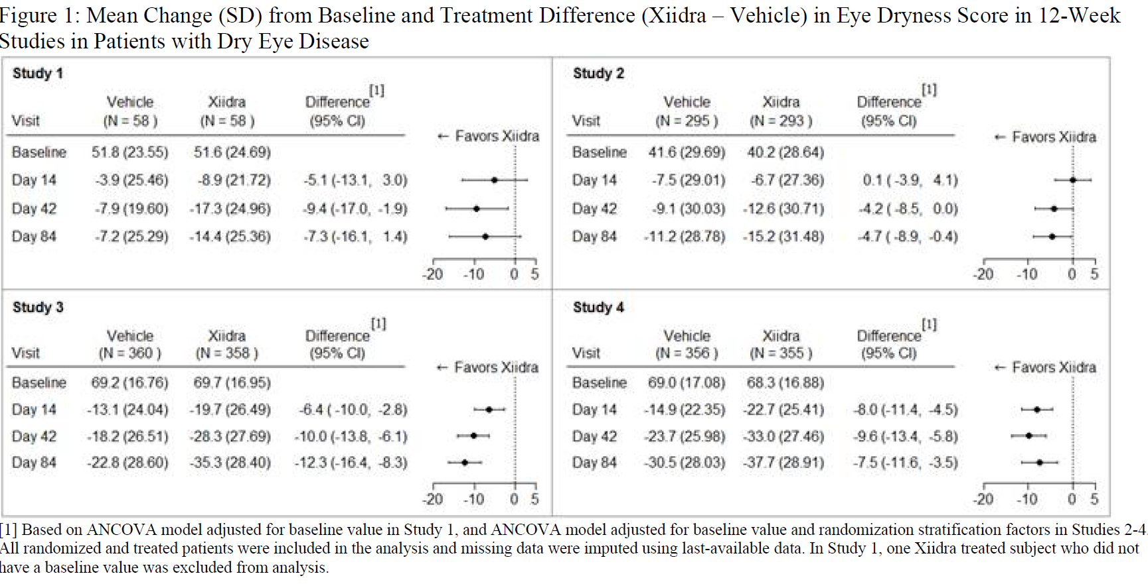
Product Label https://www.accessdata.fda.gov/drugsatfda_docs/label/2016/208073s000lbl.pdf

Slide 10
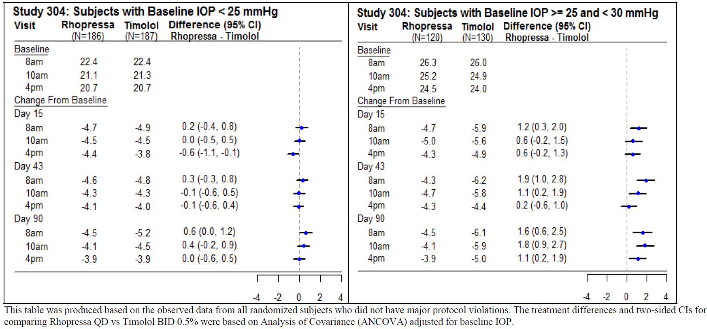
Another Product Label
R Graphic. Drug for the reduction of elevated intraocular pressure (IOP) in patients with open-angle glaucoma or ocular hypertension https://www.accessdata.fda.gov/drugsatfda_docs/label/2017/208254lbl.pdf

Slide 11
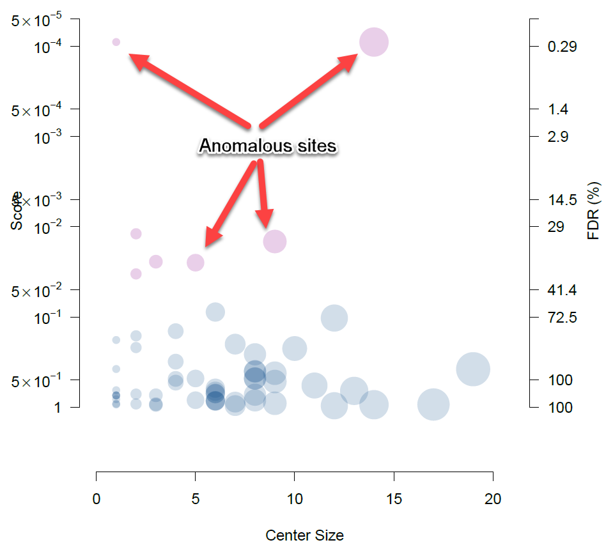
Data Anomaly Detection
Use open source software to detect potential data problems
Example of CRADA software output
Sage, Python tool for inspectors for PK/PD profiles
R Shiny app for data anomaly detection for PK/PD profiles
Cooperative Research and Development Agreement with CluePoints for detecting anomalous clinical trial sites.

Slide 12
R Shiny Apps
Internal to FDA
Waterfall Plot
Hepatotoxicity
Demographics
PRO
External to FDA (openFDA)
LRT app for Adverse Event analyses

Slide 13
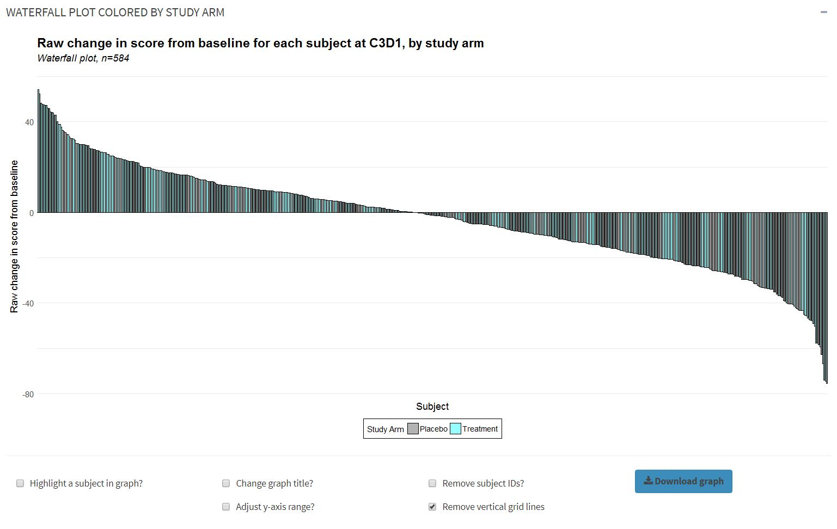
Waterfall Plot

Slide 14
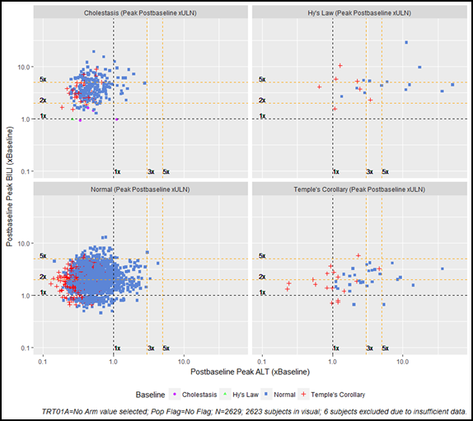
Hepatotoxicity
The Hepatotoxicity tool bolsters analysis of Drug Induced Liver Injury (DILI) through a composite visualization that includes both pre-treatment and on-treatment prevalence of ALT and BILI in terms of Hy’s Law candidate laboratory Upper Limit Normal (ULN) thresholds as well as the magnitude of these elevations normalized by respective baseline test results. This analysis is particularly useful for studies in which subjects have elevated liver enzyme test results at baseline (e.g., subjects with Chronic Hepatitis C).

Slide 15
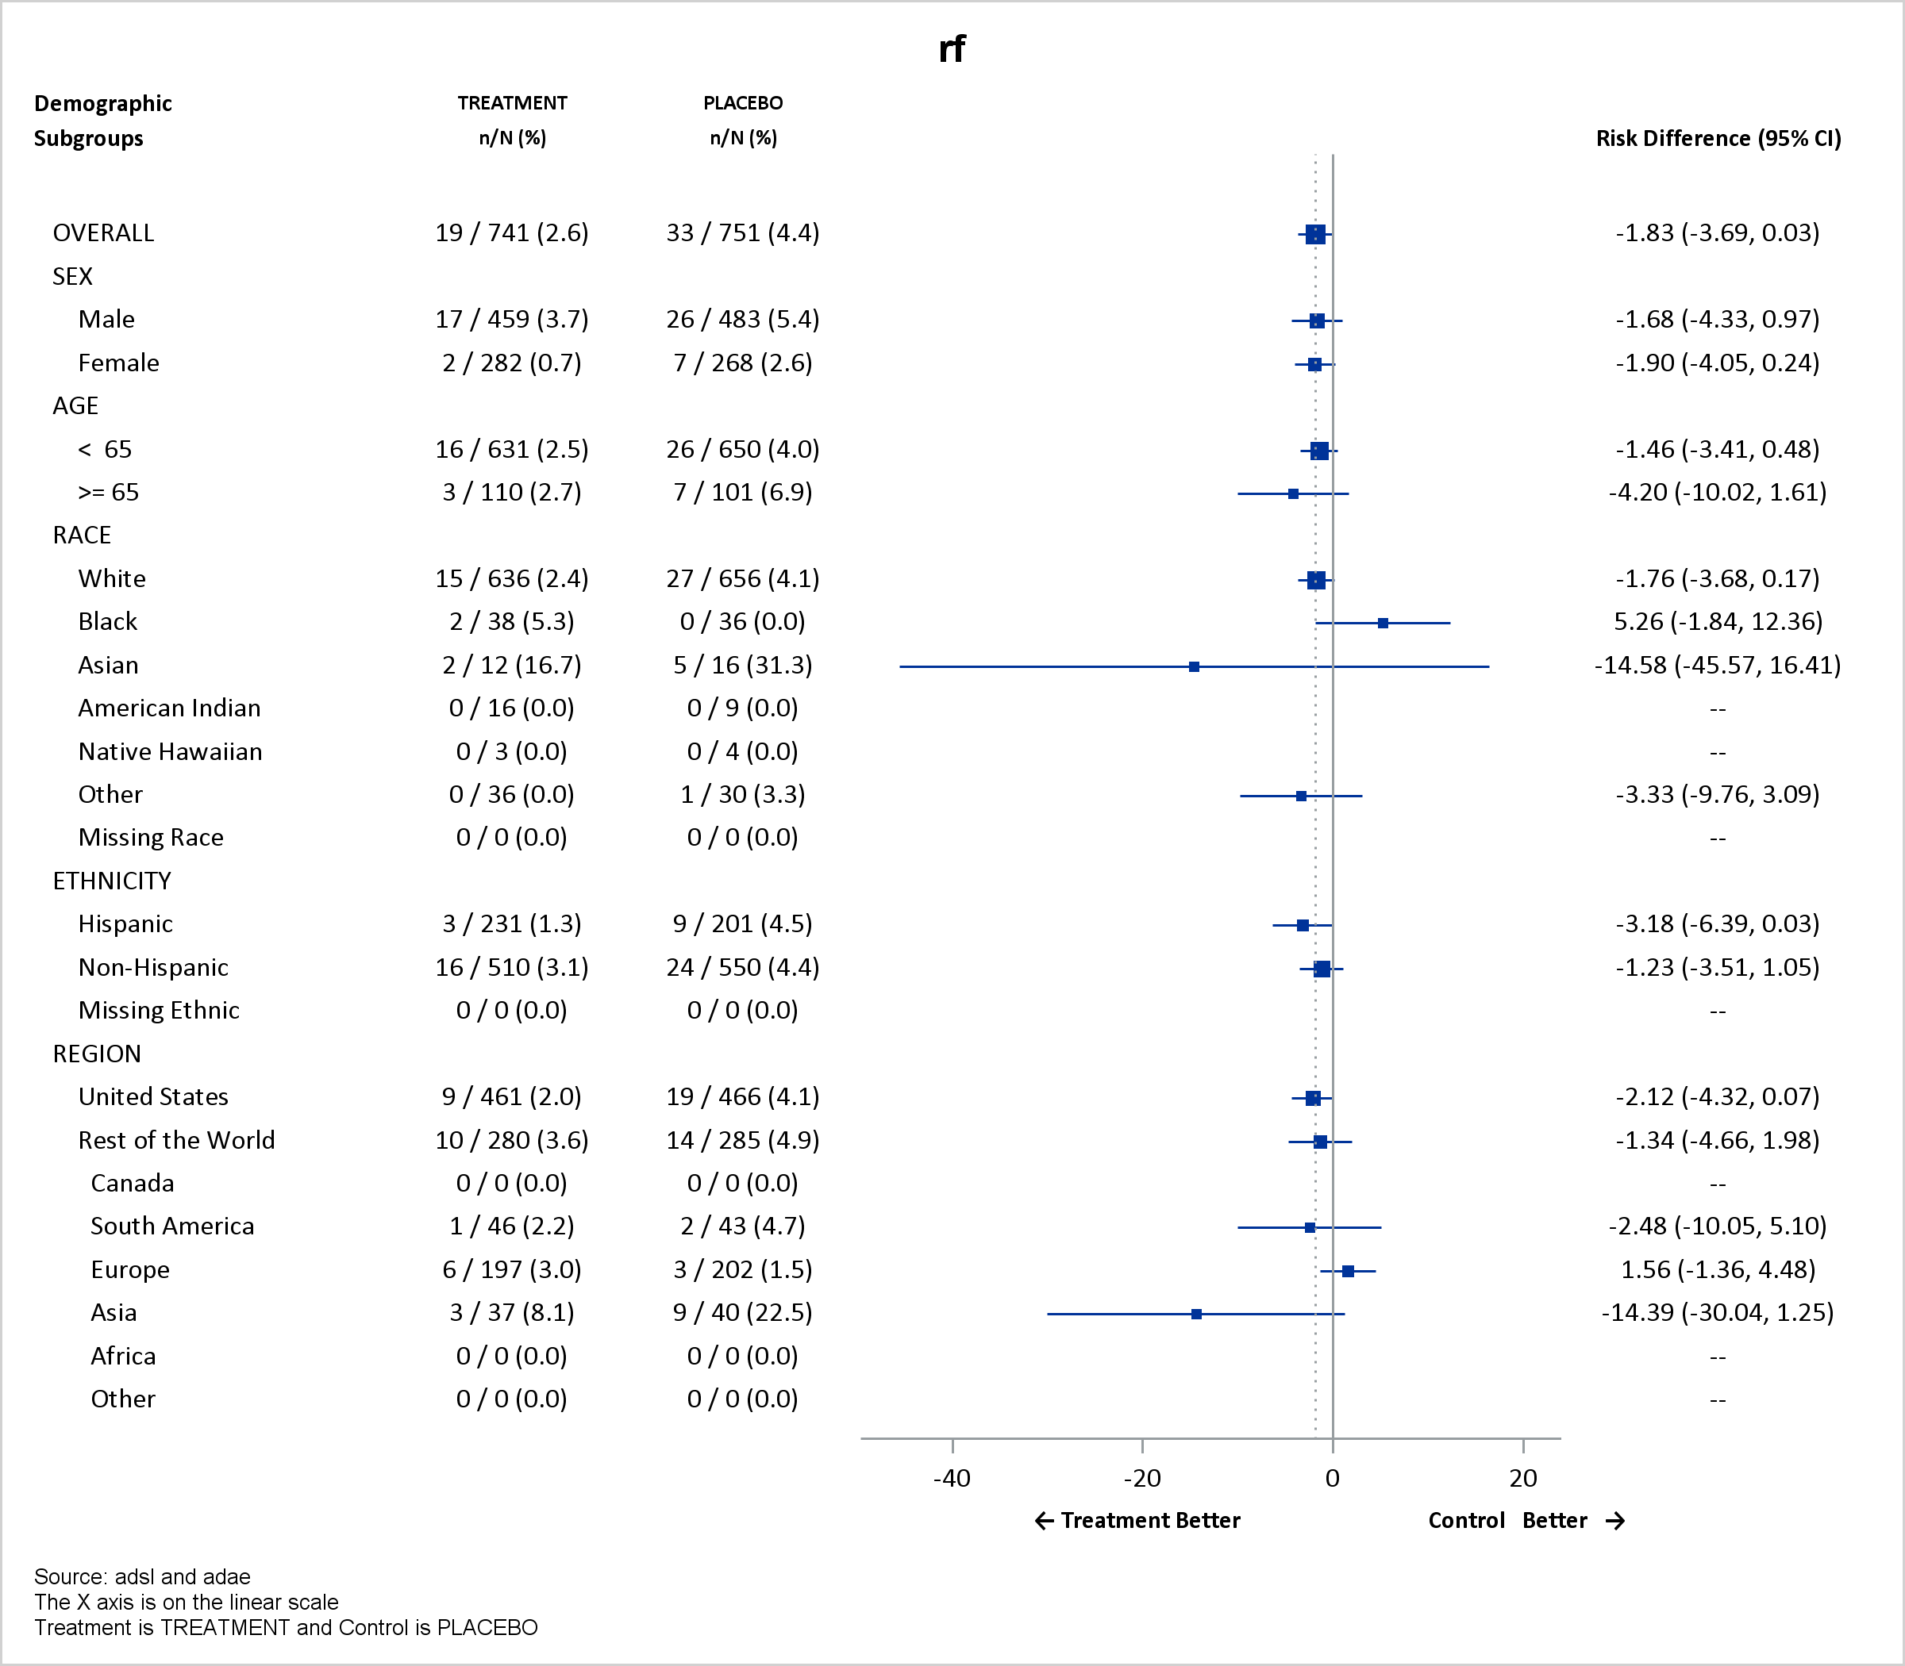
Demographic Tool
The Demographic Tool provides targeted descriptive statistics and safety endpoint analysis for demographic subgroups, including age, sex, race, and ethnicity. The tool has a simple user interface that dynamically walks end-users through the process of executing the analysis. The example deals with a safety endpoint analysis.

Slide 16
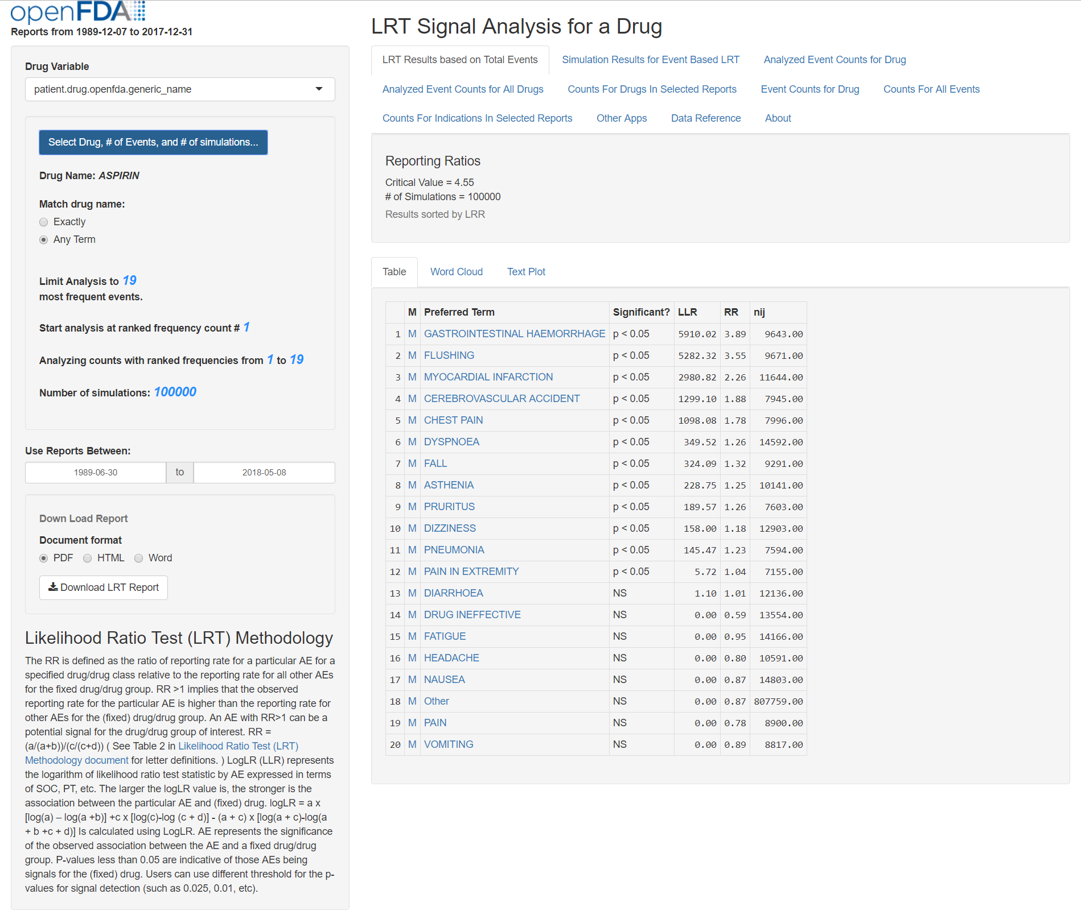
FAERS data, OpenFDA https://openfda.shinyapps.io/LRTest/

Slide 17
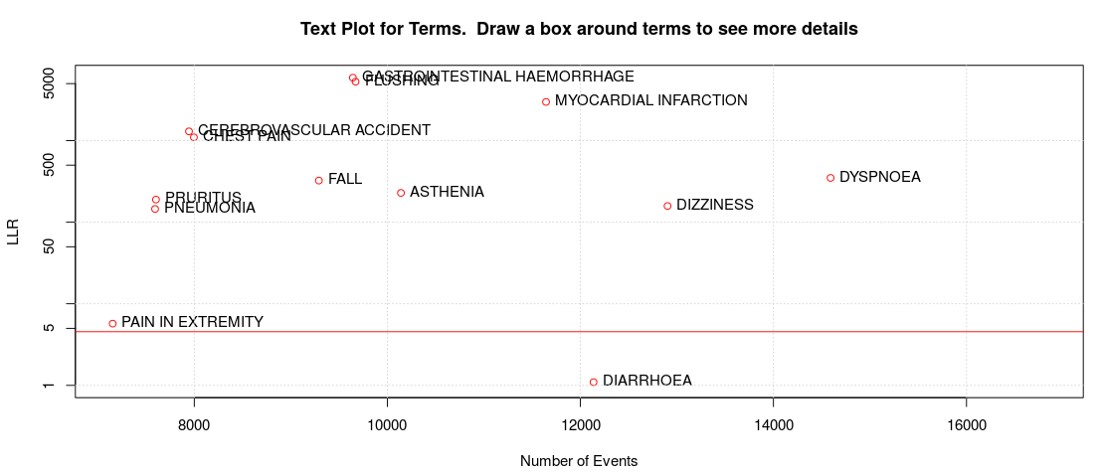
Text Plot from LRT app,
Drug: aspirin
Notes:
Potential confounding by indication?

Slide 18
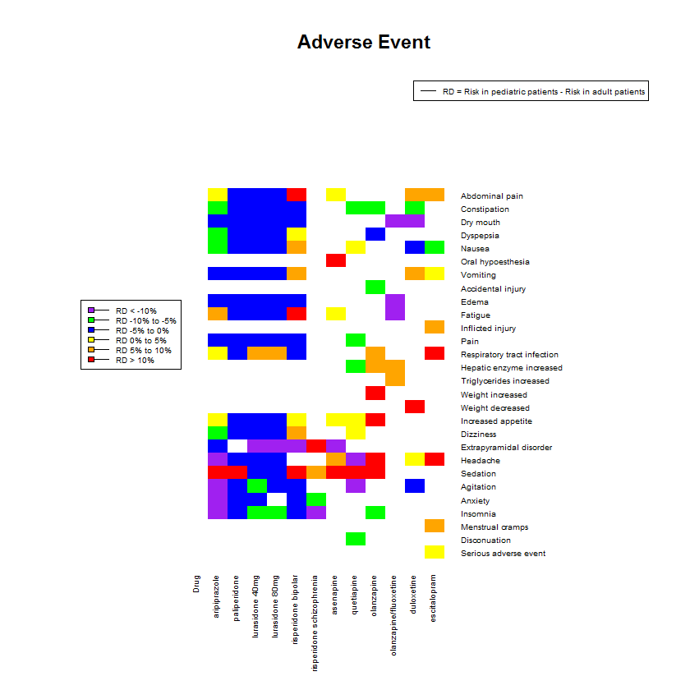
Research, Pediatric vs Adult ADRs

Slide 19
Conclusions
Open Source tools such as R offer cost effective ways for FDA to communicate with the public, health care providers and regulated industry.
Interactive tools such as R Shiny can enhance users’ experience and understanding.
However, we still need subject matter experts to help frame questions and draw appropriate conclusions.

Slide 20
Acknowledgements
Yan Wang
Jimmy Wong
Daniel Choi
Austin Taylor
Xiaomei Liu

Slide 22
Statistical Software Clarifying Statement
“FDA does not require use of any specific software for statistical analyses, and statistical software is not explicitly discussed in Title 21 of the Code of Federal Regulations [e.g., in 21CFR part 11]. However, the software package(s) used for statistical analyses should be fully documented in the submission, including version and build identification. …
Sponsors are encouraged to consult with FDA review teams and especially with FDA statisticians regarding the choice and suitability of statistical software packages at an early stage in the product development process”

