Slide 1

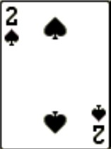
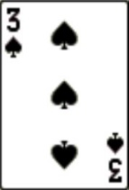
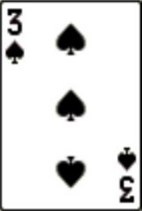
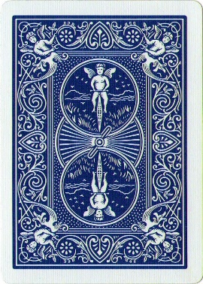
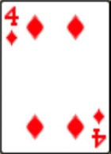
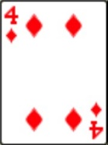
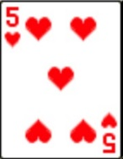
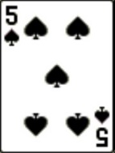

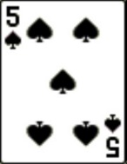
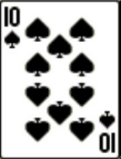
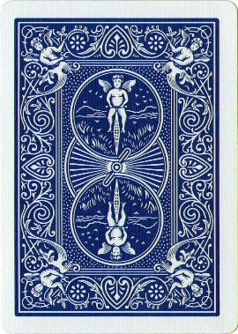
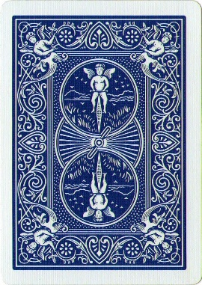
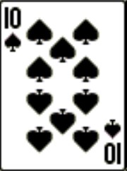
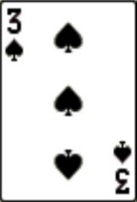
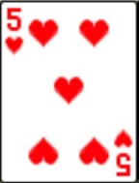
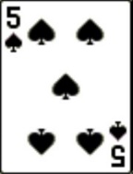
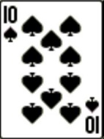
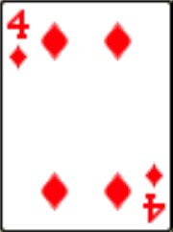
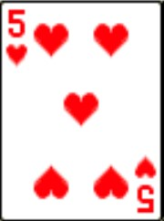
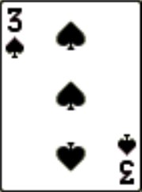
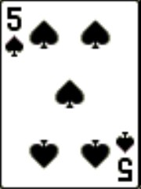
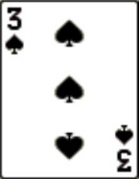
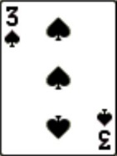




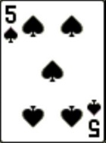
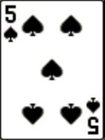
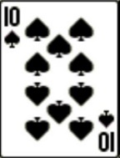
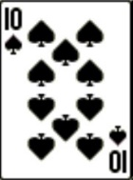
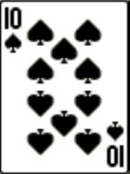
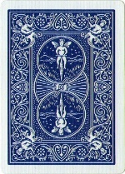
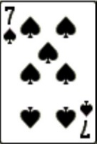
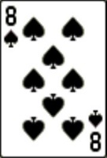
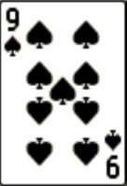
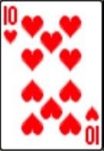
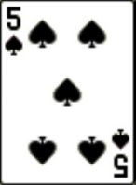
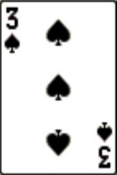

Penalized regression within the game Cribbage: A Machine Learning Application
Christopher Silberstein & Amanda K. Montoya
The Ohio State University, Department of Psychology
Symposium on Data Science & Statistics
May 16-19 2018, Reston, VA
Cribbage Components
Machine Learning Application
Choosing the Crib
Cribbage is a popular 2-4 player card game where players are attempting to score 121+ points by summing to 15 or 31 and creating pairs, runs, or nobs.
Choosing the 4 card Hand
Expected Value of each 4 card hand: Hand Score + Pegging Score
Opponent’s Hand
Players cycle between being the dealer, which they must deal both players a six-card hand.
Players must choose four cards to keep and two to throw into the “crib”.
A card is then flipped up from the deck and they take turns playing cards one at time within the “pegging” process.
After, the dealer looks at the four cards within the crib to score. If neither person is at 121+ points the game continues.
20.713
20.713
23.177
20.869
19.256
Crib
Your Hand
24.060
16.709
14.442
14.442
23.445
28.646
20.357
20.357
22.838
24.554
Synopsis
Pegging Process
Previous work on optimal cribbage play does not take into account information across the three stages of play. The goal of this project is to create a program which optimally plays cribbage and simultaneously balancing the importance of different cards in different stages of the game (hand, pegging, crib). We used data from 1000 games of cribbage provided by an online cribbage website. Predictions were generated using penalized regression.
Turn 1
Turn 2
Turn 3
Turn 4
Opponent’s Hand
Opponent’s Hand
Opponent’s Hand
Opponent’s Hand
0 pts
0 pts
0 pts
0 pts
Discussion
Previous attempts to develop algorithms to play cribbage have ignored different parts of the game, perhaps assuming that because the hand is the highest scoring section of the game, the other parts have little importance.
The importance of integrating across the stages of the game is important because all parts of the game produce points. This creates sections of the game that can be analyzed together and therefore produce a more optimal program.
Your Hand
0 pts
0 pts
0 pts
0 pts
Your Hand
Your Hand
Your Hand
Turn 5
Turn 6
Turn 7
Turn 8
Opponent’s Hand
Opponent’s Hand
Opponent’s Hand
Opponent’s Hand
Penalized Regression
0 pts
0 pts
0 pts
1 pt
Lasso was chosen as the penalized regression algorithm for this project over other algorithms, like Ridge, due to the necessity of being able to shrink the parameters to zero and selecting the variables automatically, which Lasso does really well.
2 pts
2 pts
2 pts
2 pts
Your Hand
Your Hand
Your Hand
Your Hand
Contact: Silberstein.10@osu.edu
Notes:
Synopsis: (this program focuses on 2 players) . Cribbage is a popular 2-4 player card game that currently does not contain much complete analysis of all its components.
Discussing where the data came from: from an online cribbage company that was given and through the collection of data as it plays more hands.

