Slide 1


Mixed Type Distribution Plots
Symposium on Data Science and Statistics
Reston, Virginia
May 19, 2018
Christopher Weld *
Department of Applied Science
College of William & Mary
Prof. Larry Leemis
Department of Mathematics
College of William & Mary
❖ DOI: 10.1177/1473871618756584 (Information Visualization, Feb 2018)
* Funded in part by the Omar Bradley Research Fellowship in Mathematics

Slide 2

Agenda
Mixed Type Distribution Plots
Introduce Example
Complications
Plot Heuristics
Questions & Comments
Applications
Software
Hidden Material
Notes:
Unearth interesting paradigm plotting MRV

Slide 3

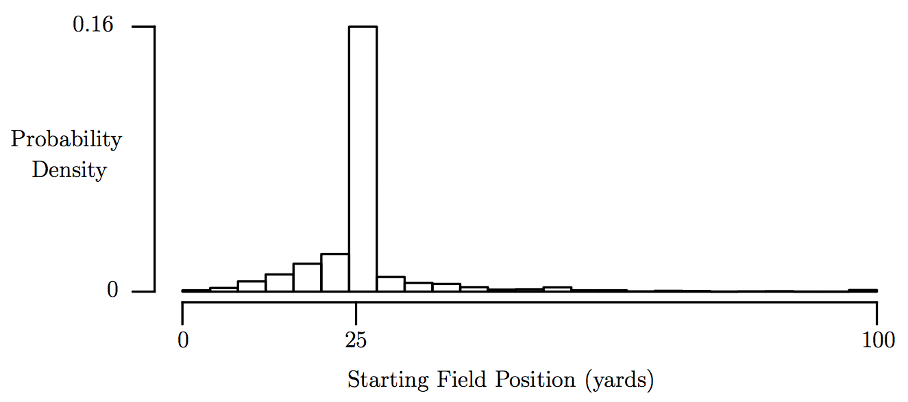
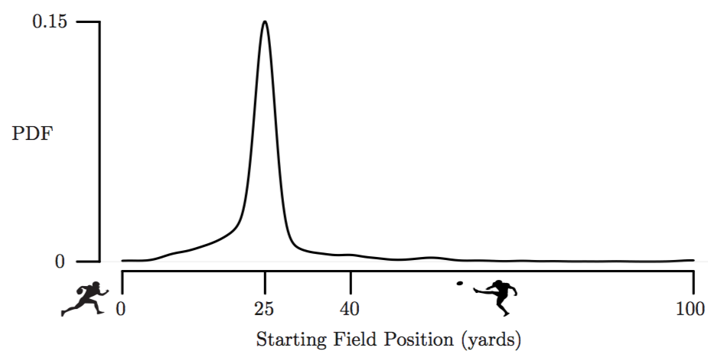


Mixed Type Distribution Plots
Plot Options: “Traditional” Approach
Starting Field Position
1 0
2 0
3 0
4 0
5 0
4 0
3 0
2 0
1 0
Notes:
Typical approach to plot data leads to:
Kernel Density Function
or Normalized Histogram
…both Distn approximations use data values to generate their respective plots
…lost in both illustrations are the distinction between C & D components
Reference notes:
Kernel used to ”smooth” plot (i.e. Gaussian kernel gives bell-curve at data points for summation in Kernel density fn)
BANDWIDTH: the standard deviation of the kernel used (BIGGER = SMOOTHER)

Slide 4
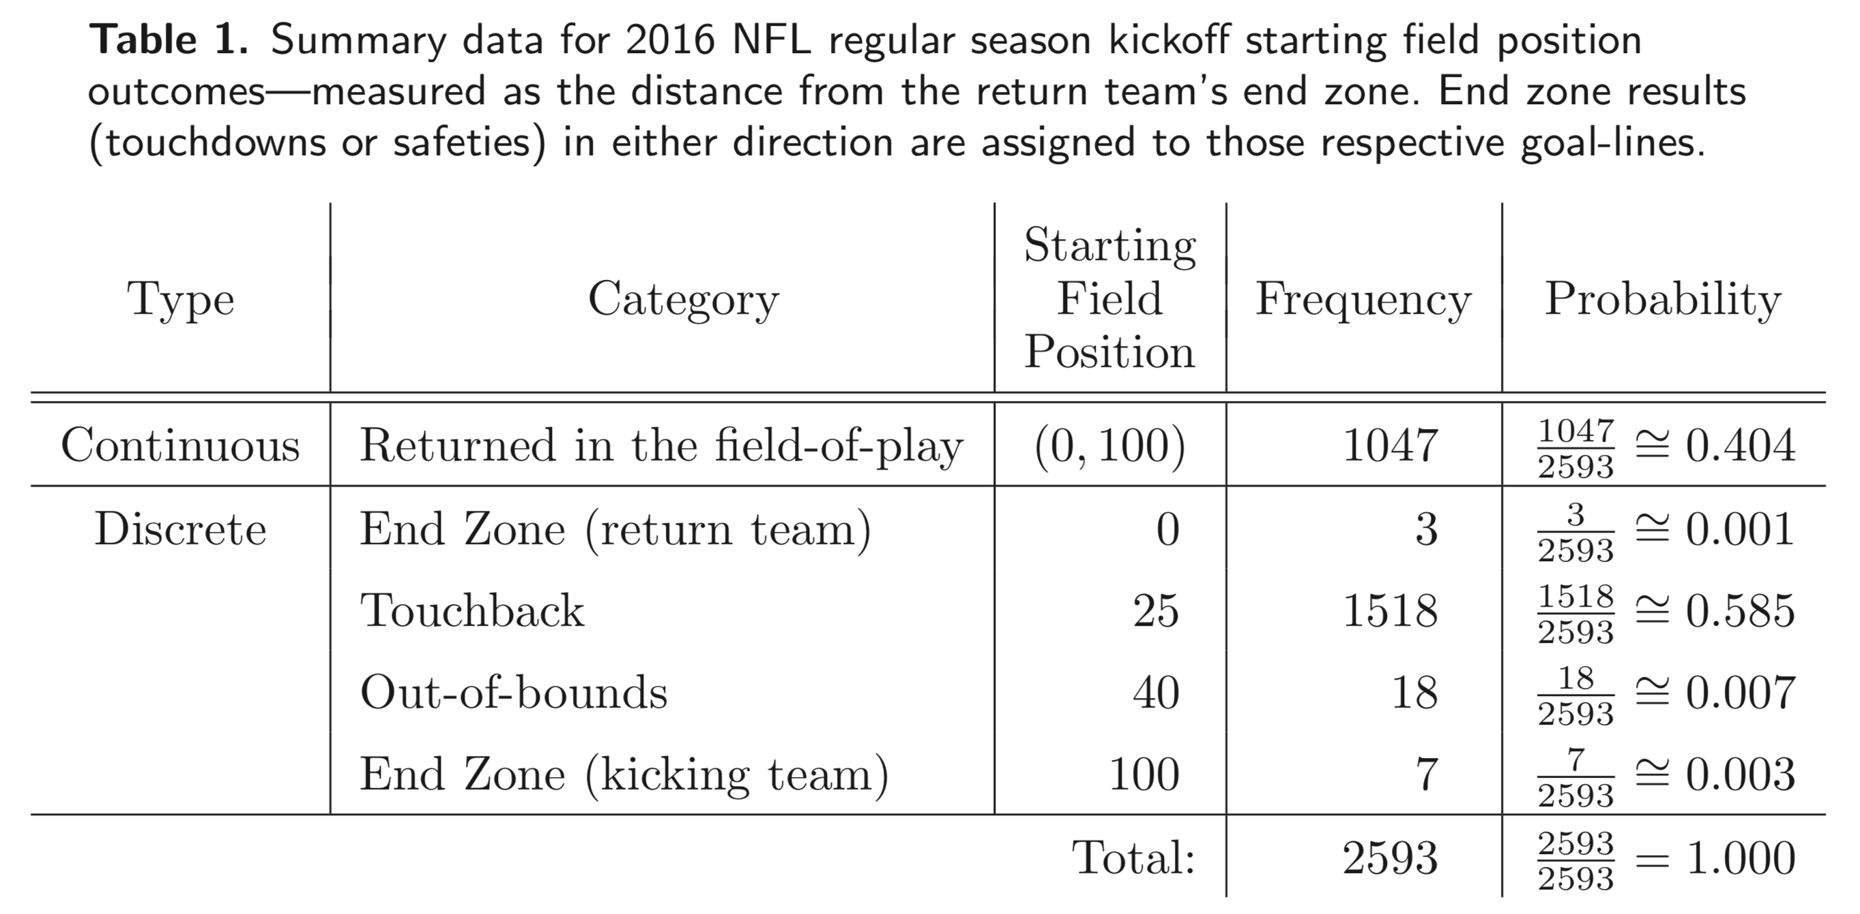
Mixed Type Distribution Plots
Example: Mixed Type Distribution
Starting Field Position
2016 NFL Regular Season Statistics (Horowitz, 2017)
1 0
2 0
3 0
4 0
5 0
4 0
3 0
2 0
1 0
Notes:
(starting field position discussion)
45,736 entries, 2,593 of which are kickoffs with implications to our model.
Separate into its continuous outcomes, and categorical outcomes (touchbacks, touchdowns, OB, safeties)
End-zone results (touchdowns or safeties) in either direction are assigned to those respective goal-lines.
Common starting point for analysis is to plot results…

Slide 5

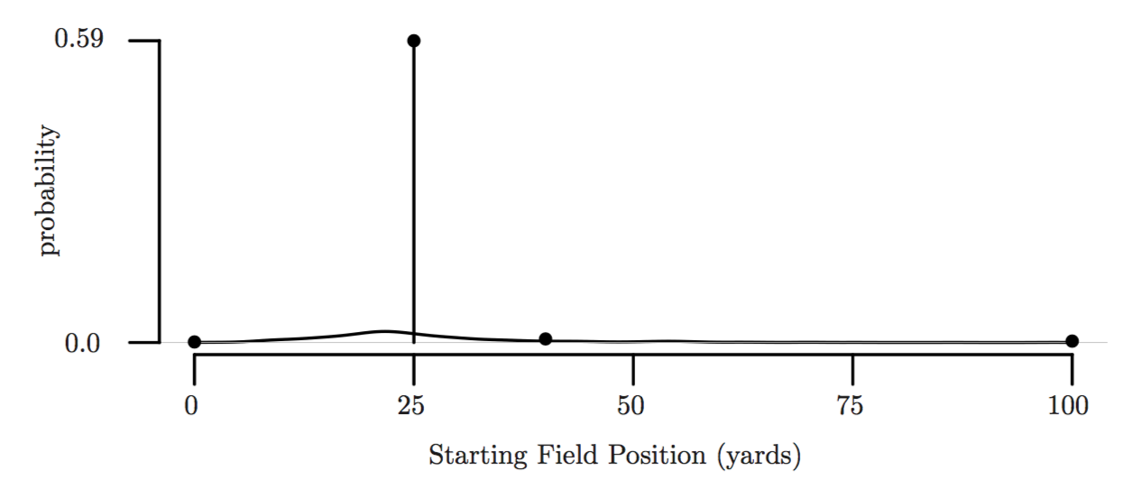
Mixed Type Distribution Plots
Example: Plot
Starting Field Position
1 0
2 0
3 0
4 0
5 0
4 0
3 0
2 0
1 0
Notes:
Mixed type random variables.
Seldom represented graphically;
few times seen, given simply as illustrated here
isolate continuous component to see what's going on...
...NOT often seen in print; (Joegerson Tweedie Models pg 142)

Slide 6
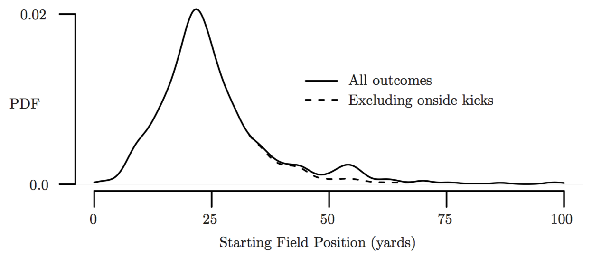
Mixed Type Distribution Plots
Continuous Portion Isolated
Starting Field Position
1 0
2 0
3 0
4 0
5 0
4 0
3 0
2 0
1 0
Notes:
Rich landscape of peaks and troughs

Slide 7
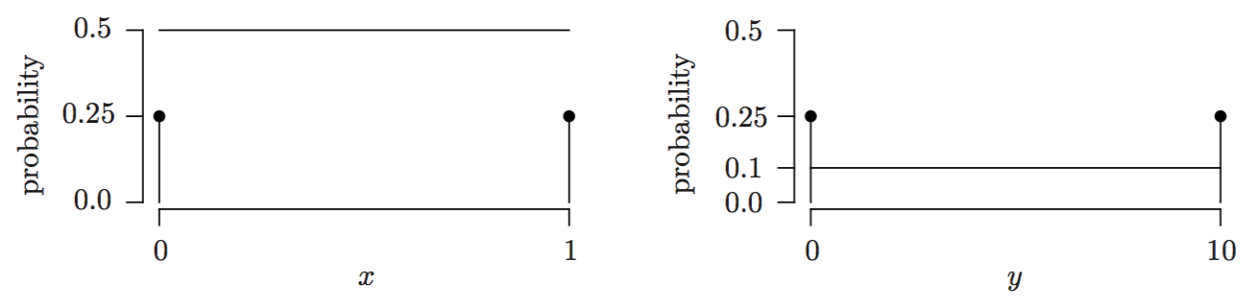
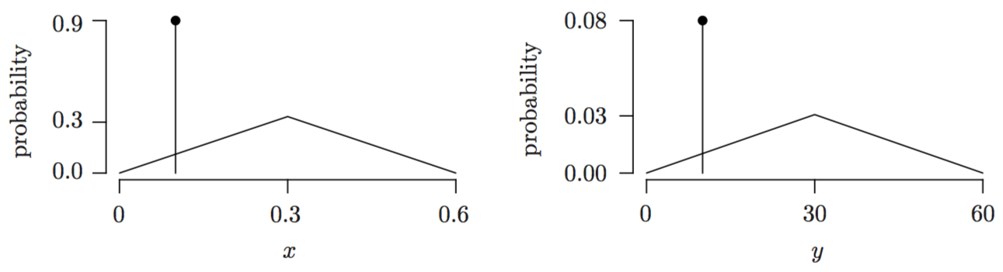

Mixed Type Distribution Plots
PDF & PMF Merger Complications
What is happening?
Consider $Y=g\left(X\right)=10X$
Another example:
Mixed Type Distribution Plots require careful inspection!
Notes:
give a simple, analogous distribution...
mixed type (D portion; C portion)
...when undergoes transformation Y = 10 X
continuous prob is diluted over greater distance, whereas probability mass at discrete locations remain identical (albeit with different spt)
- CAN DECEIVE: comparing 2: BOTH account for same C & D contribution (50% D, 50% C)
- Looking at another example... SEEMINGLY IDENTICAL plots represent VASTLY DIFFERENT CONTRIBUTIONS OF C & D distn

Slide 8
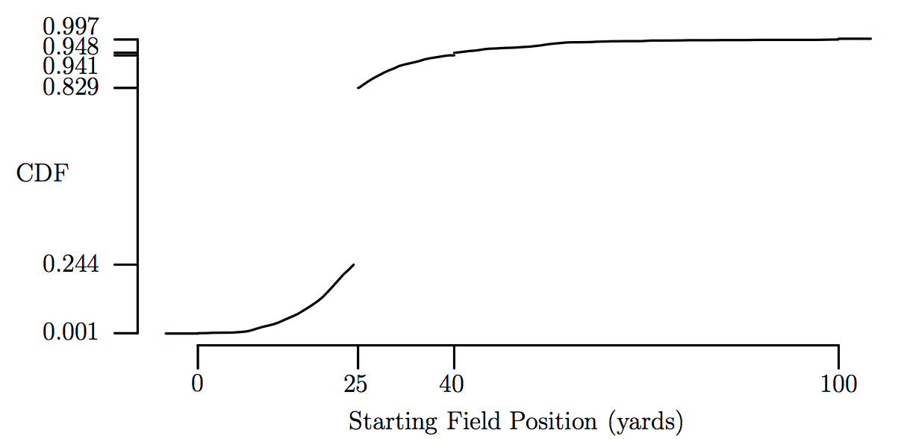
Mixed Type Distribution Plots
CDF Plot
Starting Field Position
1 0
2 0
3 0
4 0
5 0
4 0
3 0
2 0
1 0
Notes:
If probability plot deceives, how about another approach… CDF
…lacks insights and intuition of PDF
…smaller PMF points nearly indistinguishable

Slide 9

Mixed Type Distribution Plots
Developing a Consistent Plot Methodology
Starting Field Position
Heuristic for Plotting
Mixed Type Random Variables
1 0
2 0
3 0
4 0
5 0
4 0
3 0
2 0
1 0
Notes:
...what to do?
...develop CONSISTENT METHODOLOGY to better illustrate so that plot ALLIGNS W INTUITION

Slide 10
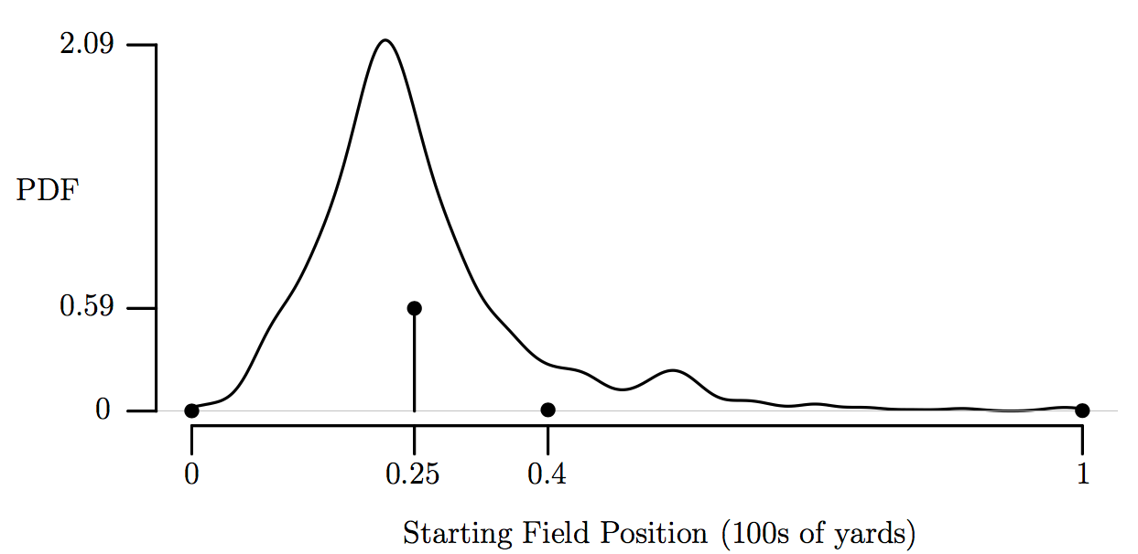

Mixed Type Distribution Plots
Option 1: Normalized Support Plot
Starting Field Position
1 0
2 0
3 0
4 0
5 0
4 0
3 0
2 0
1 0

Slide 11
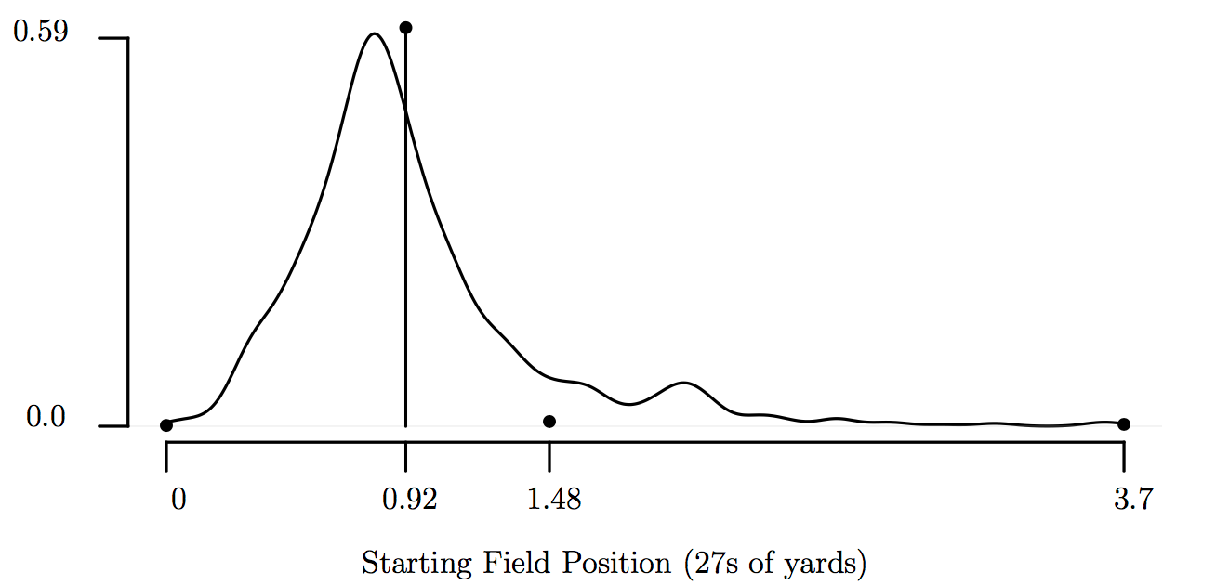
Mixed Type Distribution Plots
Option 2: Support Transformation to Align Heights
Starting Field Position
1 0
2 0
3 0
4 0
5 0
4 0
3 0
2 0
1 0

Slide 12
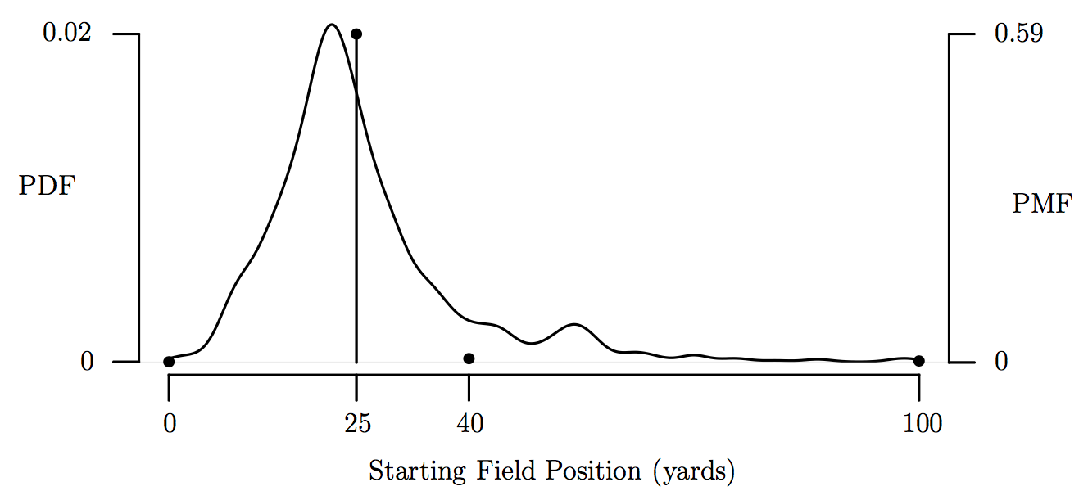
Mixed Type Distribution Plots
Option 3: Secondary Axis to Align Heights
Starting Field Position
1 0
2 0
3 0
4 0
5 0
4 0
3 0
2 0
1 0

Slide 13
Mixed Type Distribution Plots
Developing a Consistent Plot Methodology
Starting Field Position
Heuristic for Plotting
Mixed Type Random Variables
0.59 discrete spike
1
Identify its dominant plot component.
2
Insert secondary axis and calibrate axes scales relative to its dominant component.
0.40 continuous component
3
Assess relative cost and benefit to plot interpretation with secondary axes.
1 0
2 0
3 0
4 0
5 0
4 0
3 0
2 0
1 0
Notes:
...CONSISTENT METHODOLOGY to better illustrate so that plot ALLIGNS W INTUITION
Detailed heuristic included in Information Visualization publication

Slide 14
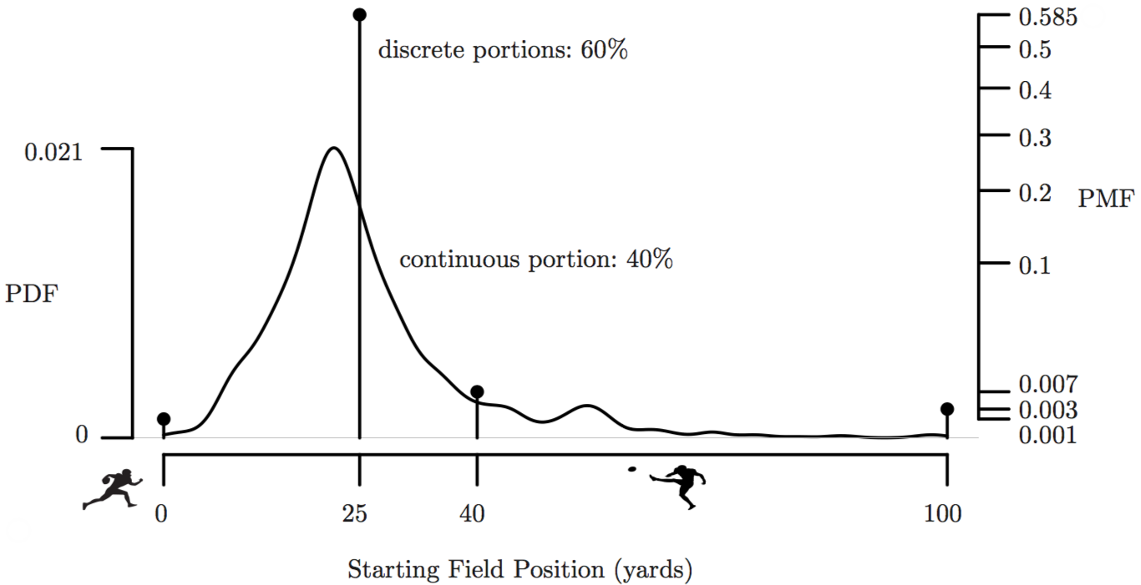
Mixed Type Distribution Plots
An Illustrative Example
Starting Field Position
Notes:
Mode of C curve 2/3 height of max D spike
Sq Rt scale to help distinguish between small D spikes

Slide 15
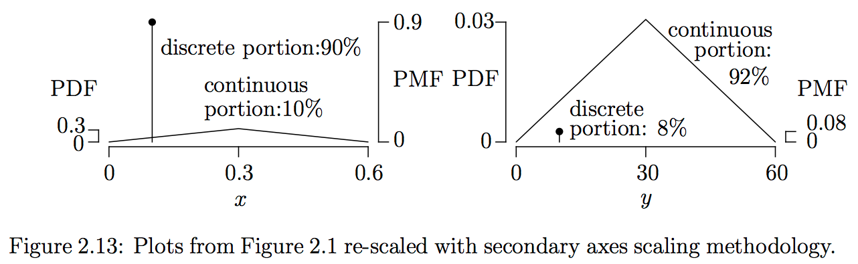
Mixed Type Distribution Plots
An Illustrative Example
Plot heuristic applied to additional example.
Notes:
Caveat: last step is to assess if:
1) intuition roughly aligns with plot (SUBJECTIVE)
2) introducing 2ndary axis worth its "price" (SUBJECTIVE)
Two SUBJECTIVE measures;
INEXACT science; none-the-less, BIG IMPROVEMENT
w Introduction Mixed RVs, revisit GOAL statement...

Slide 16
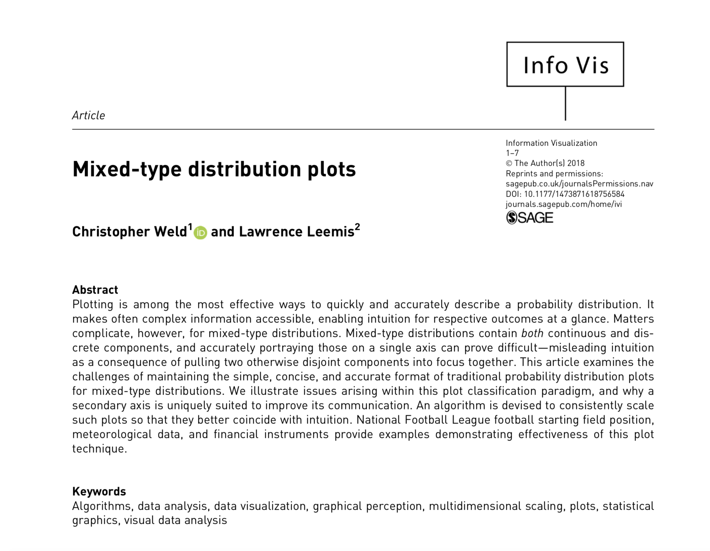
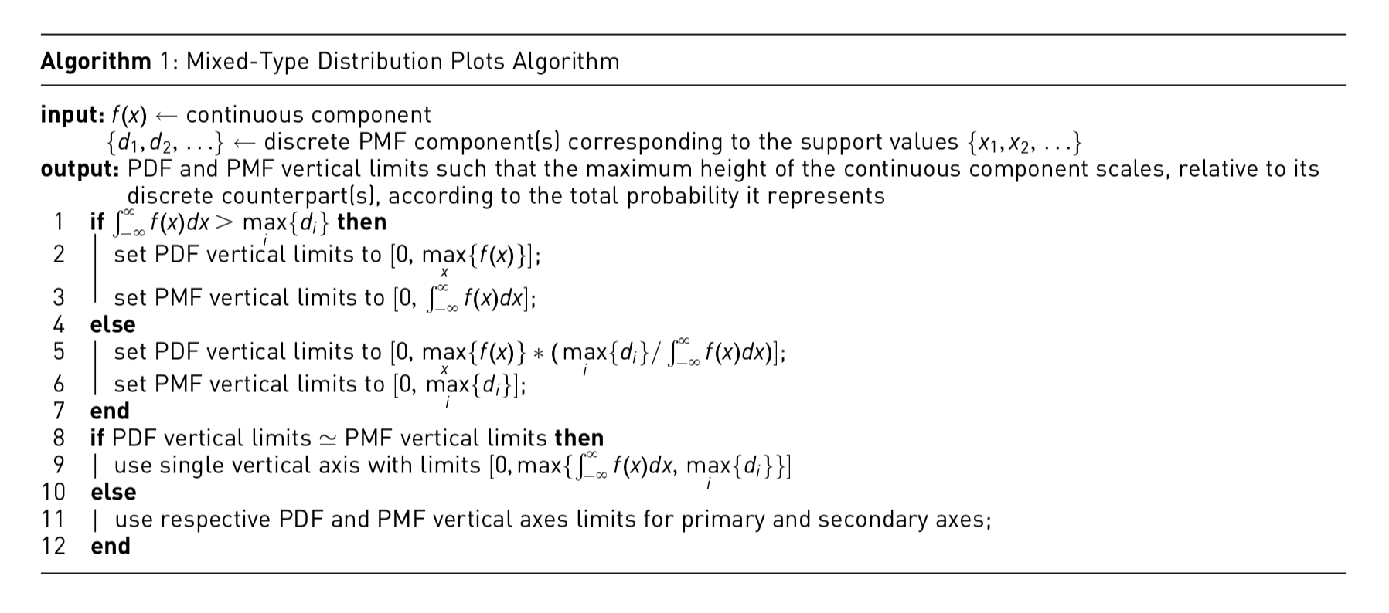
Questions & Comments?
Mixed Type Distribution Plots
Information Visualization, Feb 2018
DOI: 10.1177/1473871618756584

Slide 17
BACK-UP SLIDES
Past this point…
…only.

Slide 18
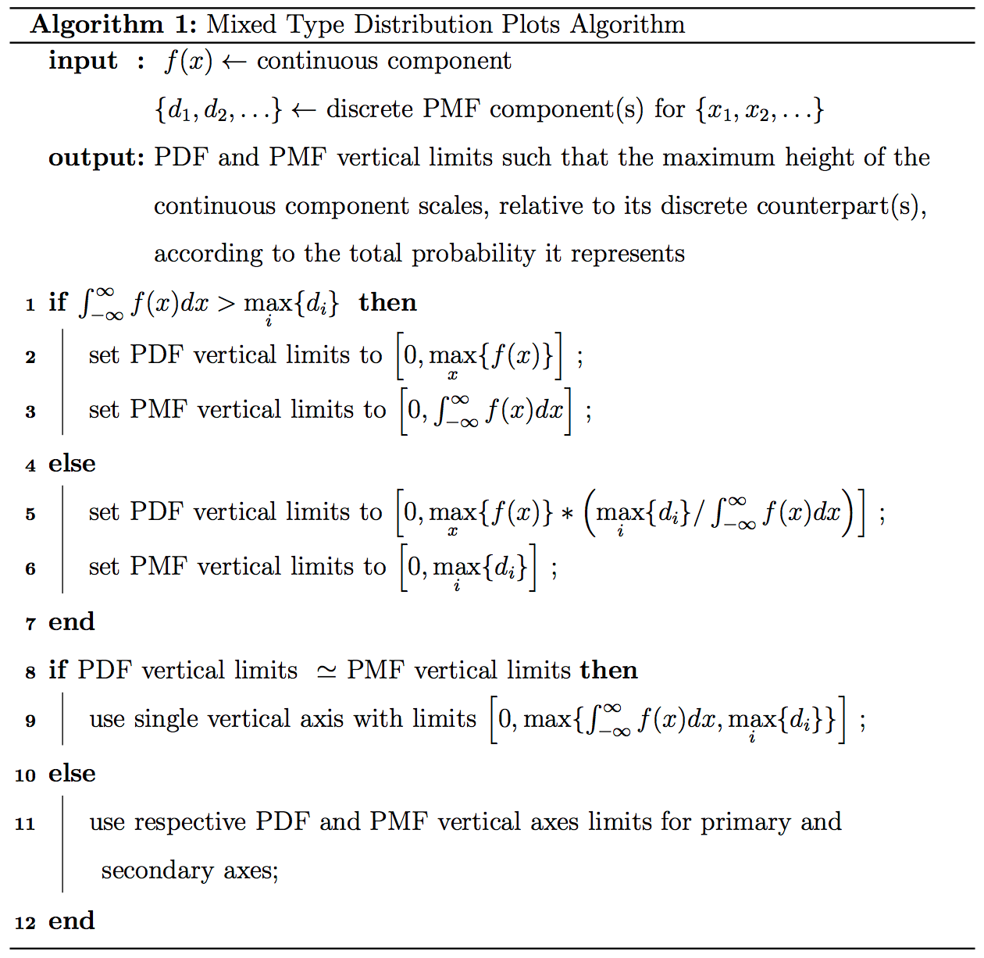
Identify the “dominant” plot component, and calibrate axes scales relative to it.
Introduce a secondary axis if its impact are worth its additional plot complexity.

Slide 19
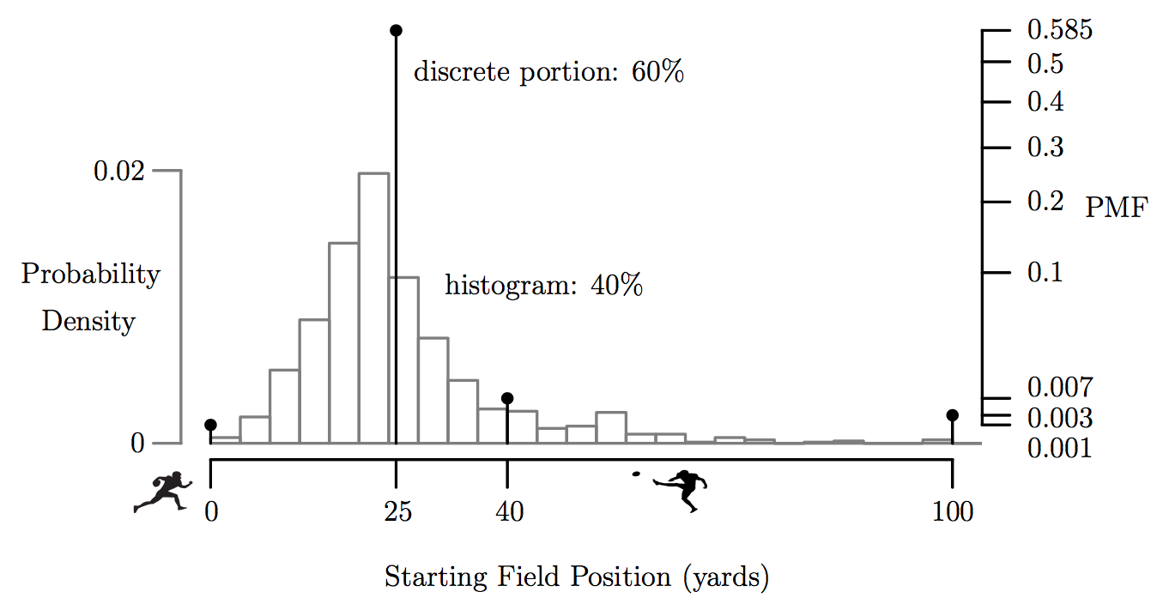
Mixed Type Distribution Plots
An Illustrative Example
Starting Field Position
Notes:
Mode of C curve 2/3 height of max D spike
Sq Rt scale to help distinguish between small D spikes

Slide 20
Mixed Type Distribution Plots
An Illustrative Example
Starting Field Position
Notes:
Mode of C curve 2/3 height of max D spike
Sq Rt scale to help distinguish between small D spikes

