Slide 1


Testing for Feature Relevance:
The HARVEST Algorithm
Herbert I. Weisberg
Victor P. Pontes
Mathis Thoma
CAUSALYTICS, LLC

Slide 2
Predictive Analytics: A Very Hard Problem
Huge number of features but few are relevant
Often a limited number of observations
Two contradictory challenges:
  Find the relevant features
  Construct a statistical model

Slide 3
Divide and Conquer: Two (Easier?) Problems
1) Screen out irrelevant features efficiently
2) Build model using mostly relevant features
We focus on task 1. If done well, then task 2 should be (relatively) easy.

Slide 4
Conceptual Framework
Prediction depends on Correlation not Causation
But no stable Correlation exists without Causation
Relevance = Correlation grounded in Causation

Slide 5
Rationale for HARVEST
A relevant feature cannot decrease model fit to data except by chance
An irrelevant feature cannot increase model fit except by chance
How can we identify features that don’t truly contribute to accuracy and eliminate them, while “sparing” relevant features?

Slide 6
Univariate “filtering” methods:
Poor trade-off between sensitivity and specificity
Insensitive to inter-relationships among features

Slide 7
HARVEST
Highly
Accurate &
Robust
Variable
Evaluation
Selection &
Testing

Slide 8
HARVEST
Step 1: Generate n random subsets of size k.
Step 2: For each random subset, train the corresponding predictive model.
Step 3: For each subset, calculate an estimate of accuracy A.

Slide 9
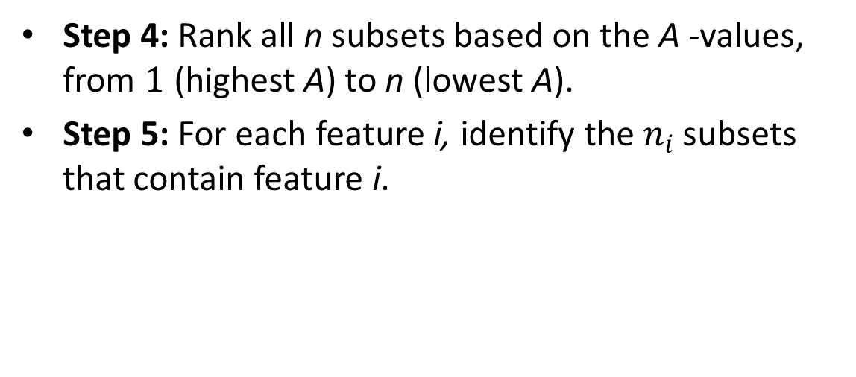
HARVEST
Step 4: Rank all n subsets based on the A -values, from $1$ (highest A) to n (lowest A).
Step 5: For each feature i, identify the $n_{i}$ subsets that contain feature i.

Slide 10
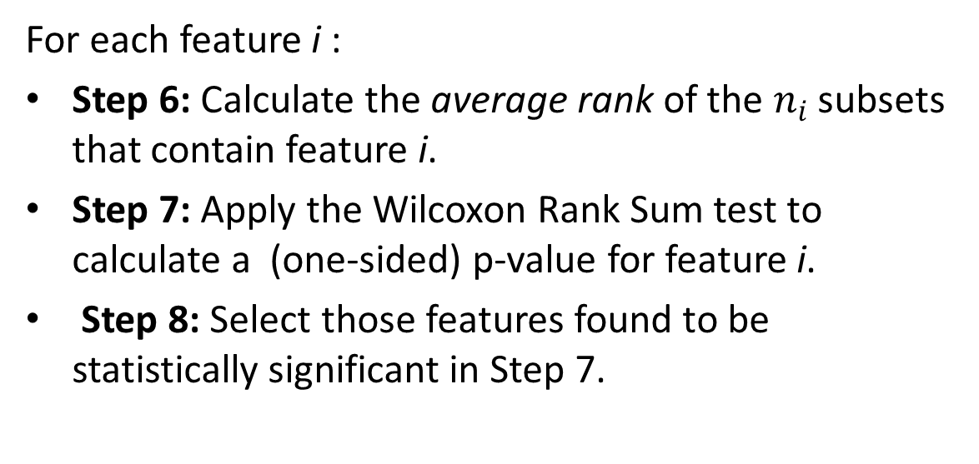
HARVEST
For each feature i :
Step 6: Calculate the average rank of the $n_{i}$ subsets that contain feature i.
Step 7: Apply the Wilcoxon Rank Sum test to calculate a (one-sided) p-value for feature i.
Step 8: Select those features found to be statistically significant in Step 7.

Slide 11
HARVEST “Parameters”
The general form of the learning machine (model)
The accuracy criterion: A
The total number of random subsets: n
The number of features included in each subset: k
The specification of a desired p-value

Slide 12
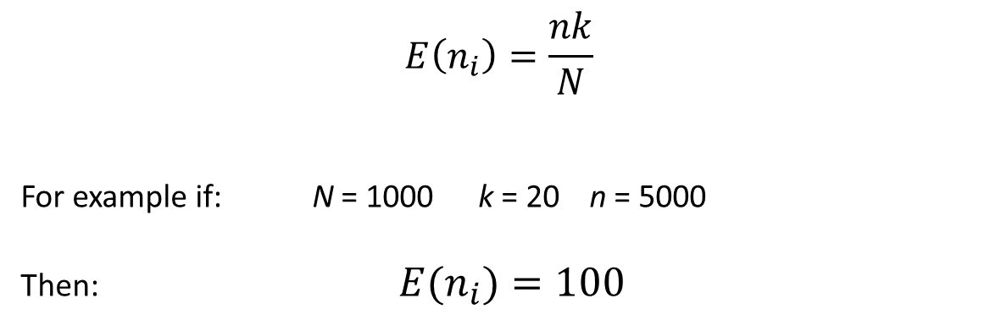
How Many Subsets?
$$E\left(n_{i}\right)=\frac{nk}{N}$$
For example if: N = 1000 k = 20 n = 5000
Then: ${E(n}_{i})=100$

Slide 13
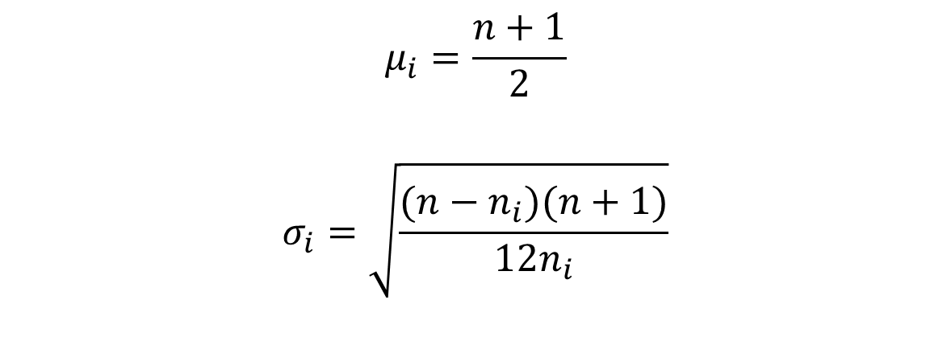
Wilcoxon Rank Sum Test
$$μ_{i}=\frac{n+1}{2}$$
$$σ_{i}=\sqrt{\frac{(n−n_{i})(n+1)}{12n_{i}}}$$

Slide 14
Using the “Harvested” Features
Create a model of the same form (e.g. GLM, logistic)
Refine the model (e.g. interactions, transformations)
Create a new model of a different form (e.g. CART)
Perform another round of HARVEST

Slide 15
A Genomics Example: The Study
Problem: predict cancer metastasis after tumor removal
Started with gene expressions for 6,000 genes
Applied HARVEST in three rounds to training data
Selected final 10 genes
Fit a logistic model to internal validation data
Validated in 5 external samples

Slide 16
A Genomics Example: The Results
Existing Model: Mean AUC for 5 samples = .75
(Best achieved previously)
Our Model: Mean AUC for 5 samples = .79

Slide 17
Simulation: HARVEST vs. Six Other Methods
Model from Wang et al.: Random Lasso (Ann Apl Stat, 2011)
Linear model: 6 relevant features out of 40 total
Number of observations = 50
Methods were Random Lasso, Lasso, and 4 others
Generated data and compared with published results

Slide 18
HARVEST Parameters
Model form: simple linear regression
The accuracy criterion: R-squared
The total number of random subsets: 4000
The number of features included in each subset: 15
Desired p-value: 0.05

Slide 19
Simulation Results: HARVEST vs. Six Other Methods
 | Sensitivity |  |  | Specificity
Method | Minimum | Median | Maximum | Minimum | Median | Maximum
Lasso | 11 | 70 | 77 | 75 | 83 | 88
Adaptive Lasso | 16 | 49 | 59 | 86 | 92 | 96
Elastic Net | 63 | 92 | 96 | 77 | 83 | 91
Relaxed Lasso | 4 | 63 | 70 | 91 | 96 | 100
VISA | 4 | 62 | 73 | 92 | 97 | 99
Random Lasso | 84 | 96 | 97 | 70 | 79 | 89
HARVEST | 93 | 95 | 98 | 84 | 91 | 96

Slide 20
Summary
Motivated by a clear conceptual definition of feature relevance.
Can efficiently identify and test features for relevance.
Early results of predictive models produced using HARVEST are very promising.
Needs additional testing to determine strengths and limitations.

