Slide 1
Embedding Approaches for Mining Heterogeneous Information Networks
Yizhou Sun
Department of Computer Science
University of California, Los Angeles
yzsun@cs.ucla.edu
May 17, 2018

Slide 2
Outline
Introduction
Unsupervised Network Embedding for Anomaly Detection
User-Guided Network Embedding for Link Prediction
Functional Embedding for Recommendation in Content-Rich Networks
Summary

Slide 3
Information Network Mining
Popular mining functions for information networks
  Clustering
  Classification
  Similarity Search
  Recommendation
  Link prediction
Key: similarity metric between nodes!

Slide 4
One Possible Solution
Define Link-based similarity
  SimRank [Jeh and Widom, 2002]
  Random Walk with Restart [Tong et al., 2006]
  PathSim [Sun et al., 2011]
  Limitations:
    Need to store pair-wised similarity
    computational expensive

Slide 5
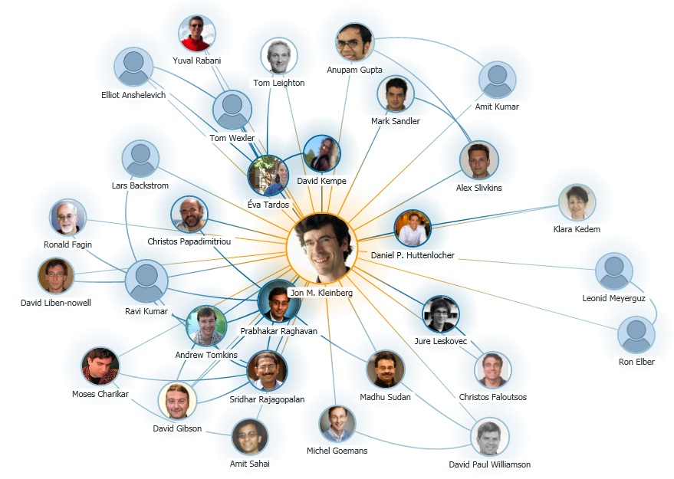
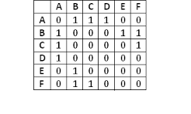
Another Possible Solution
Represent nodes with features
  A naïve solution:
  Limitations:
    Extremely High-dimensional
    No global structure information integrated
  A more recent trend: Network embedding (e.g., LINE by Tang et al.)
    General network embedding
    Homogeneous networks
Notes:
http://kalogriopoulosgen677s12.weebly.com/protein-interaction-network.html

Slide 6
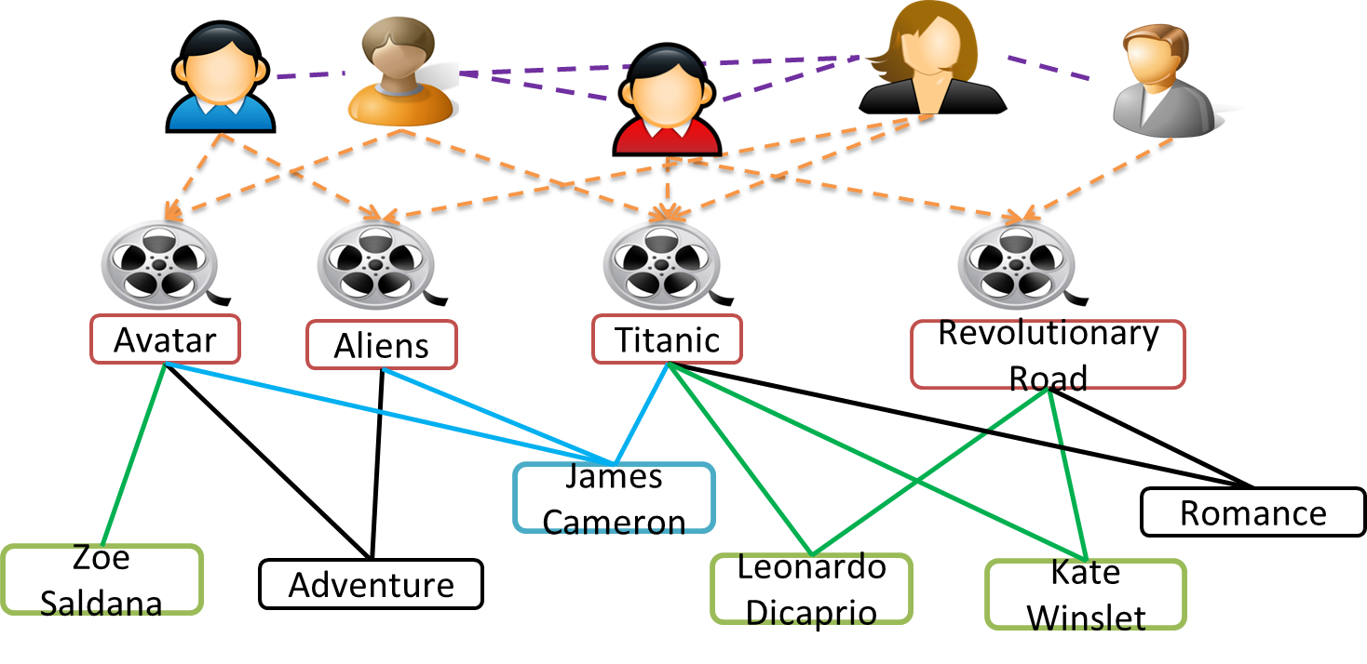
Challenges
How to utilize links belonging to different types with different semantic meanings?
How to leverage the guidance from the task?
How to utilize the rich content information associated with nodes, e.g., text and image?

Slide 7
Outline
Introduction
Unsupervised Network Embedding for Anomaly Detection
User-Guided Network Embedding for Link Prediction
Functional Embedding for Recommendation in Content-Rich Networks
Summary

Slide 8
Anomaly Detection
Entity Embedding-based Anomaly Detection for Heterogeneous Categorical Events [Chen et al., IJCAI’16]

Slide 9
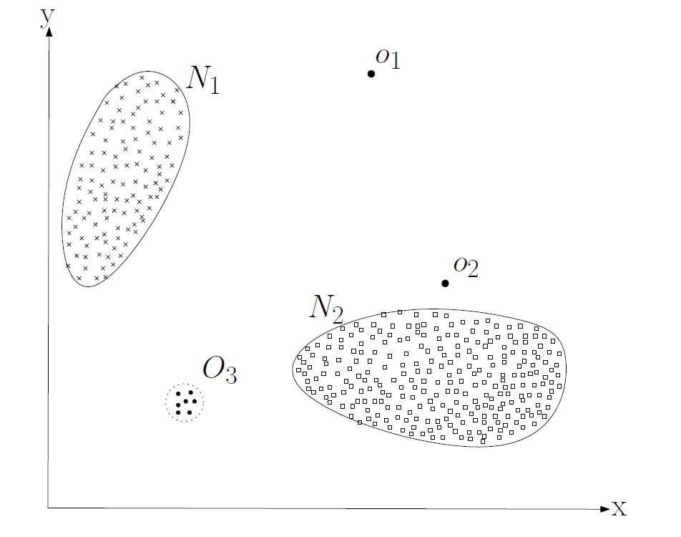
Unsupervised Anomaly Detection
Standard approach: find points with low density
  E.g., using clustering or KNN approach

Slide 10
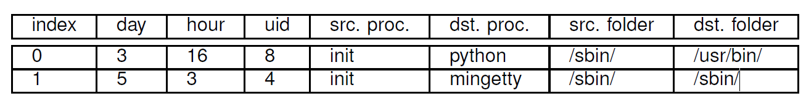
How about Categorical Events?
Example: Process-Process interaction events
  How to define distance between two events?
    How to define the distance between User 8 and User 4?
  Solution: define the probability of an event
    Challenge: Too many possible events while too few observations for each one!

Slide 11





The Network View of Categorical Events
D
Event
Explore Second-order interactions to capture entities’ similarity!
S
D
S

Slide 12
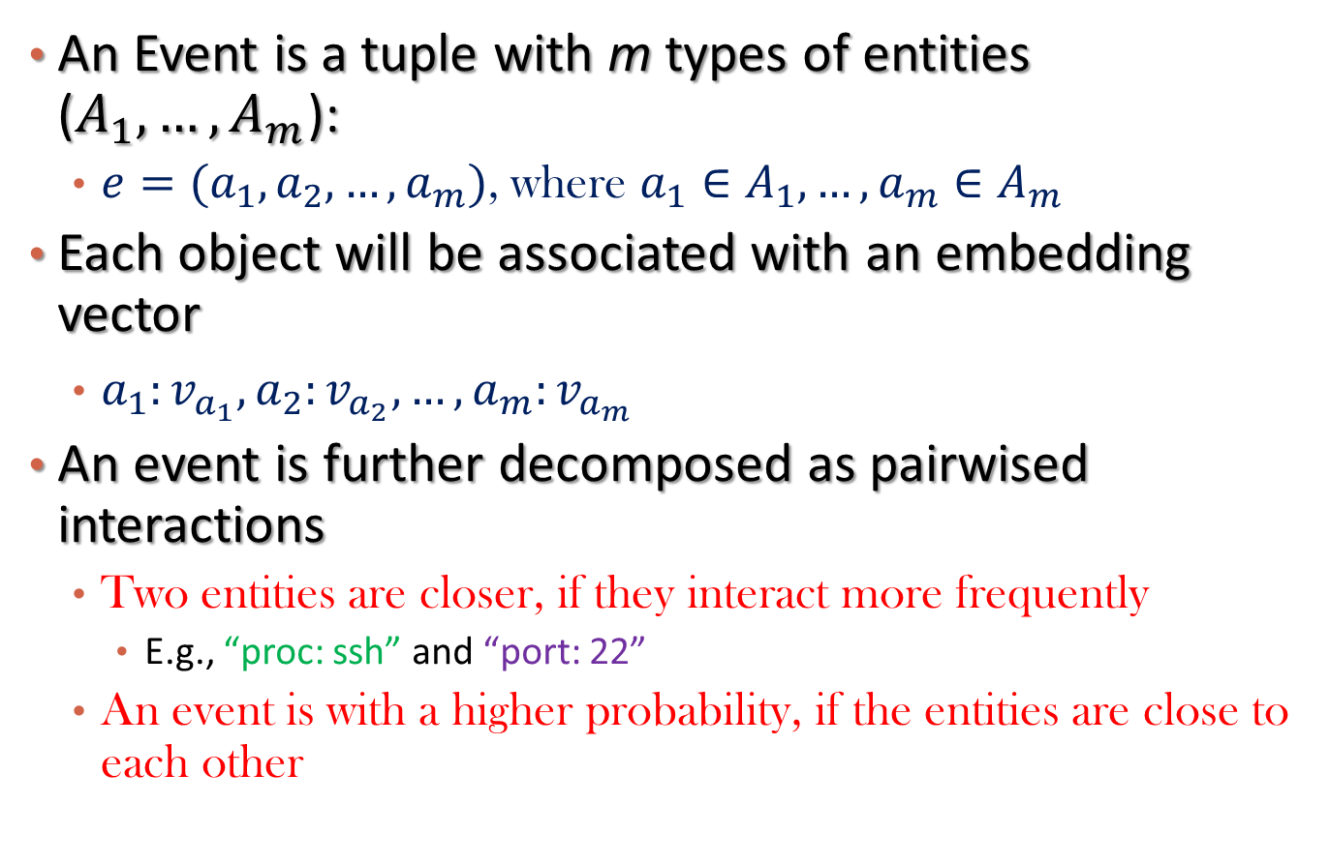
Embedding-based Probability Modeling for Events
An Event is a tuple with m types of entities ($A_{1},…,A_{m}$):
  $e=(a_{1},a_{2},…,a_{m})$, where $a_{1}∈A_{1},…,a_{m}∈A_{m}$
Each object will be associated with an embedding vector
  $a_{1}:v_{a_{1}}, a_{2}:v_{a_{2}},…,a_{m}:v_{a_{m}}$
An event is further decomposed as pairwised interactions
  Two entities are closer, if they interact more frequently
    E.g., “proc: ssh” and “port: 22”
  An event is with a higher probability, if the entities are close to each other

Slide 13
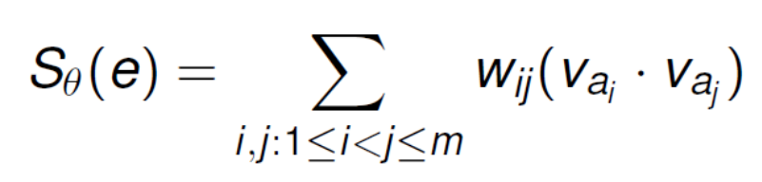
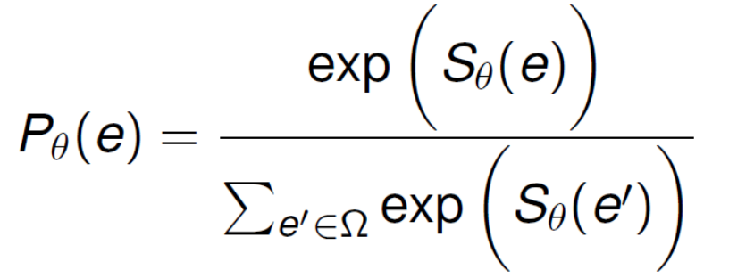
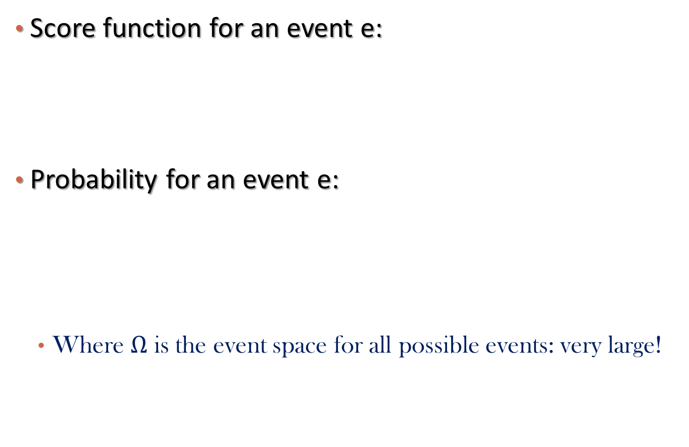
APE Model
How close are the two entities?
Score function for an event e:
Probability for an event e:
  Where $Ω$ is the event space for all possible events: very large!
How strong is this type of interaction?

Slide 14
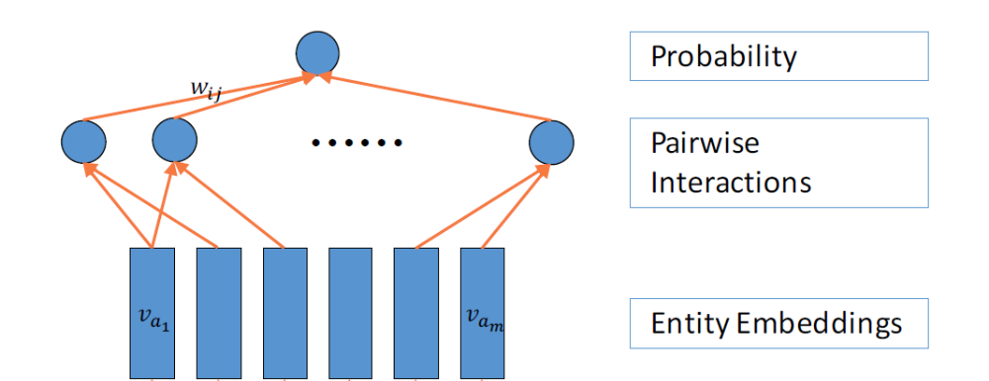
Graphical Illustration of APE Model

Slide 15
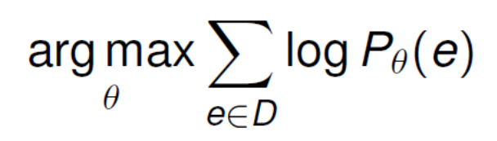
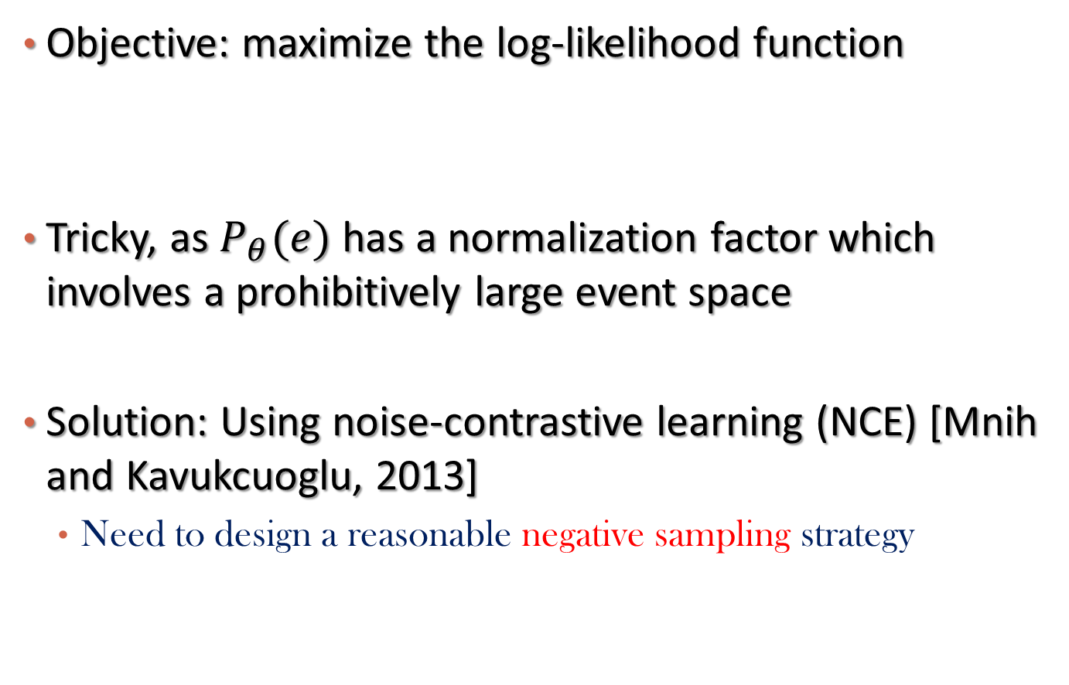
The Learning Algorithm
Objective: maximize the log-likelihood function
Tricky, as $P_{θ}(e)$ has a normalization factor which involves a prohibitively large event space
Solution: Using noise-contrastive learning (NCE) [Mnih and Kavukcuoglu, 2013]
  Need to design a reasonable negative sampling strategy

Slide 16
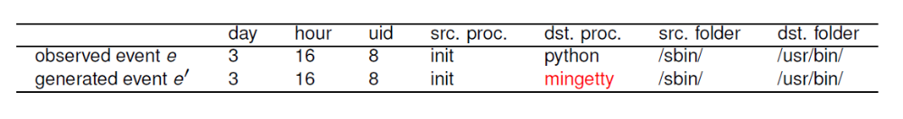
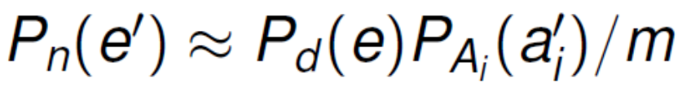
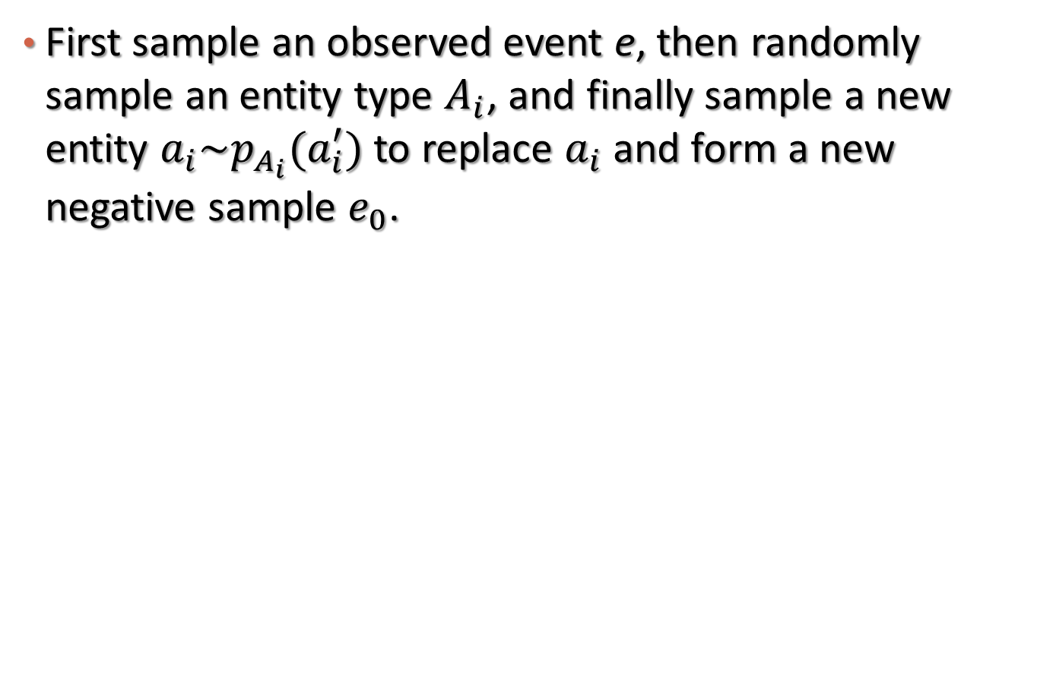
Generating Noise Distribution
First sample an observed event e, then randomly sample an entity type $A_{i}$, and finally sample a new entity $a_{i}\sim p_{A_{i}}(a_{i}^{′})$ to replace $a_{i}$ and form a new negative sample $e_{0}$.
m: # of attribute types

Slide 17
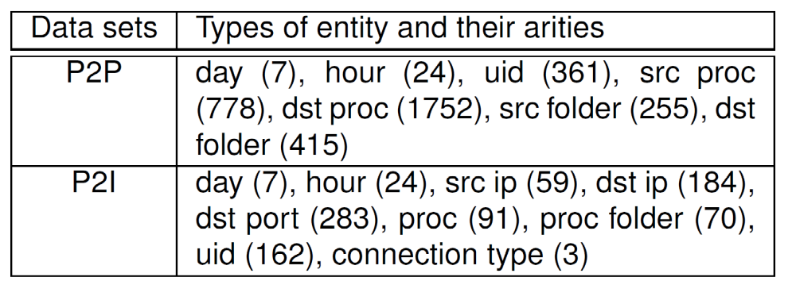
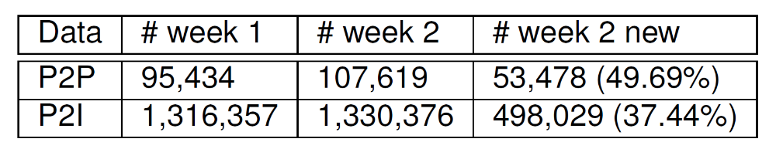
Datasets
Two Datasets: Process-Process Events (P2P) and Process-Internet Events (P2I)
# Week 1 for model learning, and # Week 2 new for evaluation

Slide 18
Evaluation: Baselines
Condition. This method is proposed in [Das and Schneider 2007].
CompreX. This method is proposed in [Akoglu et al. 2012].
APE. This is the proposed method. Note that we use the negative of its likelihood output as the abnormal score.
APE (no weight). This method is the same as APE, with equal weights for each type of interactions

Slide 19
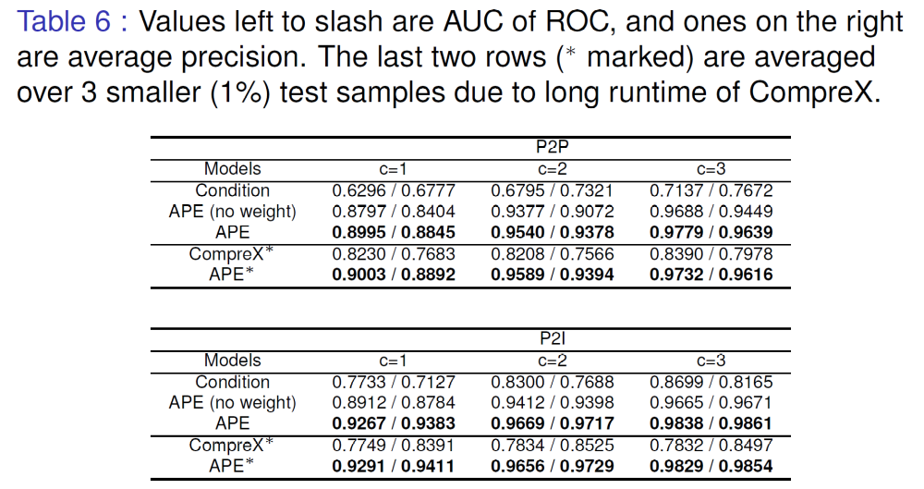
Evaluation: Results

Slide 20
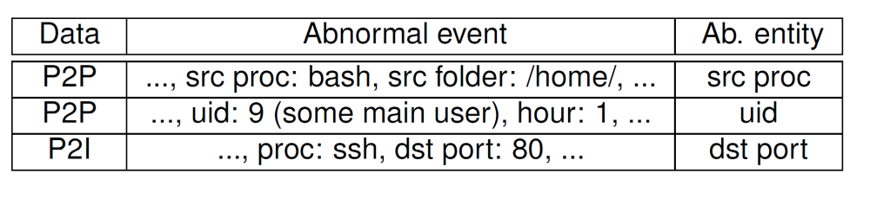
Case Studies
Anomaly detected

Slide 21
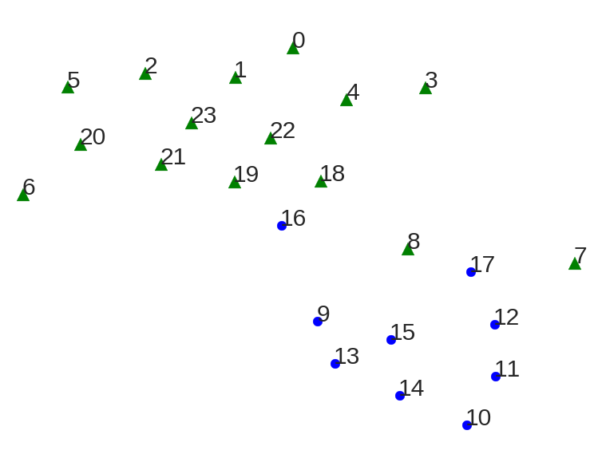
Embedding Detected
Entity Type: “Hour”
Non-working hours
Working hours

Slide 22
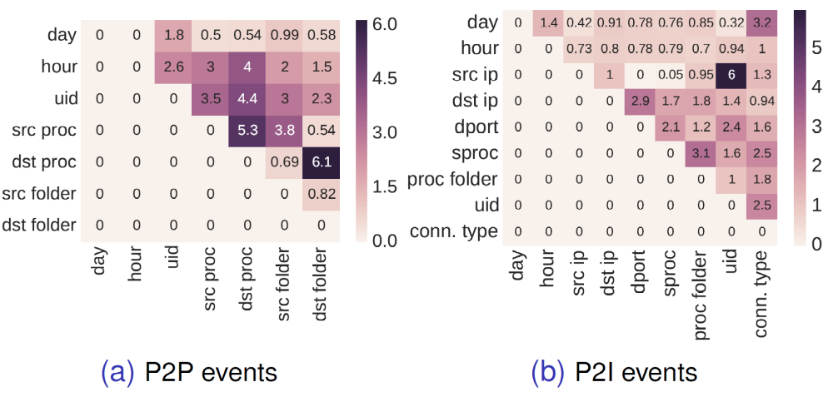
Interaction Weights Learned

Slide 23
Outline
Introduction
Unsupervised Network Embedding for Anomaly Detection
User-Guided Network Embedding for Link Prediction
Functional Embedding for Recommendation in Content-Rich Networks
Summary

Slide 24
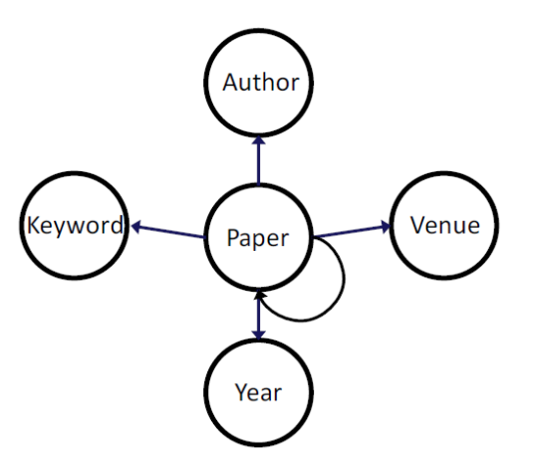
Author Identification
Task-guided and Path-augmented Heterogeneous Network Embedding for Author Identification [Chen and Sun, WSDM’17]
Given an anonymized paper, with
  Venue (e.g., WSDM)
  Year (e.g., 2017)
  Keywords (e.g., “heterogeneous network embedding”)
  References (e.g., [Chen et al., IJCAI’16] )
  Can we predict its authors?

Slide 25
Challenges
How to embed the network under the guidance of author identification task?
  Task guided embedding vs. general network embedding.
How to utilize and select the global information in the heterogeneous network?
  Meta-path-based augmentation.
  Meta-path: a concatenation of existing relations, e.g., author-paper->paper-author

Slide 26
Our Solution
Task-guided and path-augmented embedding: A Semi-Supervised framework
  Task-guided embedding takes care of supervised labels
    E.g., Author “Ting Chen” should be close to Keyword “Heterogeneous network embedding”
  Path-augmented embedding takes care of the global structure of networks
    E.g., Keyword “Heterogeneous network embedding” should be close to Keyword “node representation”
The Combined Model
  Joint training of two types of embedding
  Path selection is performed to pick most informative meta-paths for network embedding.

Slide 27
Task-Guided Embedding
The embedding architecture for author identification
Notes:
Advantage of weighted combination

Slide 28
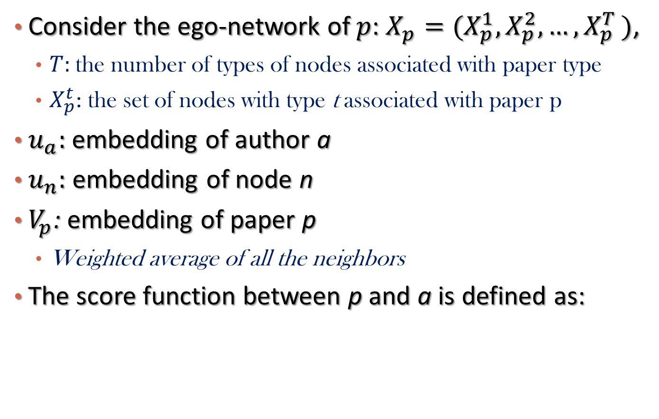
Formally
Consider the ego-network of $p$: $X_{p}=(X_{p}^{1},X_{p}^{2},…,X_{p}^{T })$,
  $T:$the number of types of nodes associated with paper type
  $X_{p}^{t}$: the set of nodes with type t associated with paper p
$u_{a}:$embedding of author a
$u_{n}:$ embedding of node n
$V_{p}$: embedding of paper p
  Weighted average of all the neighbors
The score function between p and a is defined as:

Slide 29
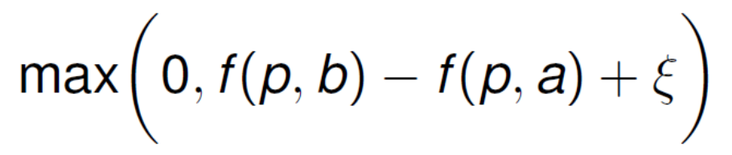
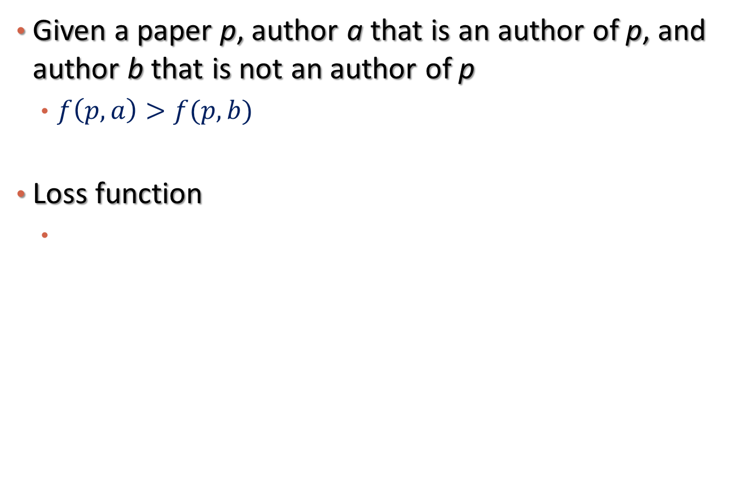
Ranking-based Objective
Given a paper p, author a that is an author of p, and author b that is not an author of p
  $f\left(p,a\right)>f(p,b)$
Loss function

Slide 30
Path-Augmented Embedding
Limitations of task-guided embedding
  Supervised labels expensive to obtain
  The rich structure information of heterogeneous information networks is not fully explored
Path-Augmented Embedding
  Prepare meta-paths that are potentially related to the task
  Apply general purpose embedding

Slide 31
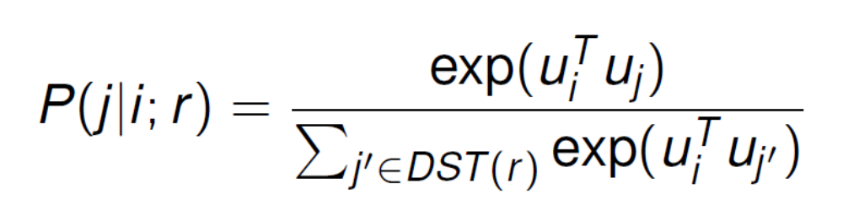
Formally
For each meta-path-based relation
  Define the probability of reaching node j from node i via meta-path r via their embeddings
  Use negative sampling to approximate the distribution
The goal is to maximize the likelihood of observing all the paths under each meta-path

Slide 32
The Joint Model
Objective function

Slide 33
How to select meta-paths?
A greedy strategy is used to select meta-paths
  Step 1: Rank single meta-path according to their performance
  Step 2: Greedily add the current best meta-path into current pool, stop until the performance deteriorates
Different meta-paths will be selected for different tasks

Slide 34
Experiments
Dataset:
  AMiner Citation data set.
  Papers before 2012 are used in training, and papers on and after 2012 are used as test.

Slide 35
Baselines
Supervised feature-based baselines (i.e. LR, SVM, RF, LambdaMart).
  Manually crafted features
Task-specific embedding.
Network-general embedding.
Pre-training + Task-specific embedding.
  Take general embedding as initialization of task-specific embedding

Slide 36
Which meta-paths are selected?
A-P-P: author write paper cite paper
A-P-W: author write paper contain keyword
P-A: paper written-by author

Slide 37
Comparison
Easy task: choose author candidate as true authors + negative authors

Slide 38
Performance over Different Groups of Authors

Slide 39
The Real Game
Treat all the authors (1M) as candidates

Slide 40
Case Study

Slide 41
Outline
Introduction
Unsupervised Network Embedding for Anomaly Detection
User-Guided Network Embedding for Link Prediction
Functional Embedding for Recommendation in Content-Rich Networks
Summary

Slide 42
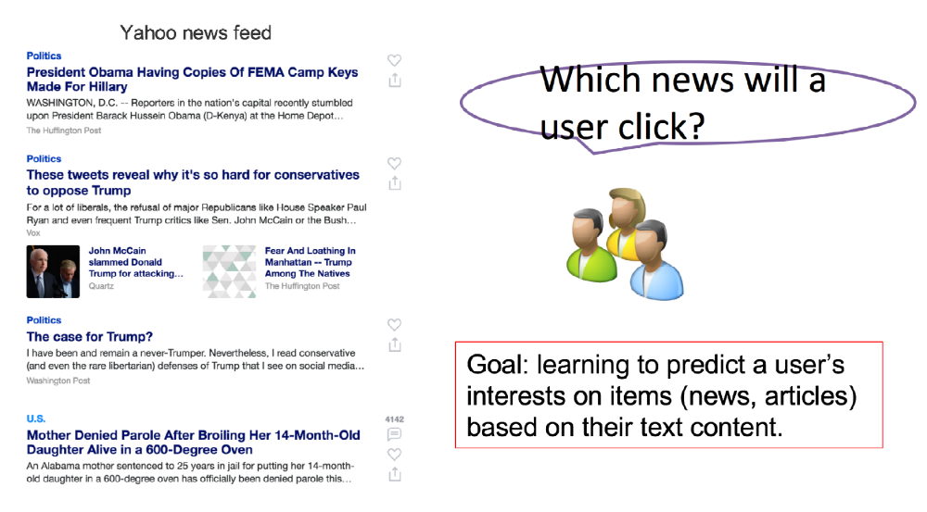
Text Recommendation
Chen et al., “On Sampling Strategies for Neural Network-based Collaborative Filtering,” KDD’17
Use the news recommendation as a running example

Slide 43
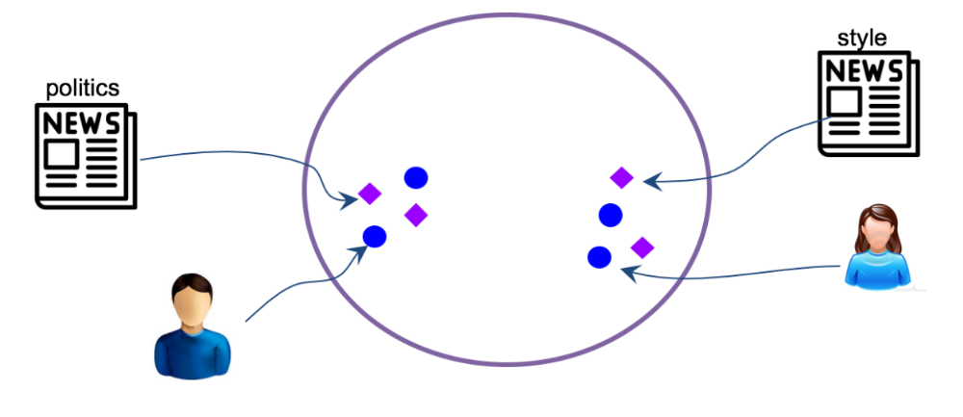
Solution
Neural Network-based Collaborative Filtering
Subsumes several existing work, e.g., Bansal et al., RecSys’16, Van den Oord et al., NIPS’13

Slide 44
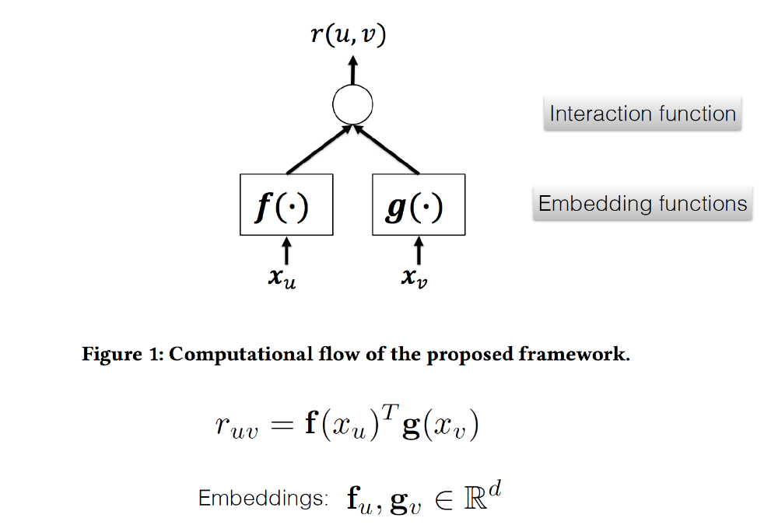
More Generally: Functional Embedding
Goal: Minimize the loss function between predicted and observed rating or ranking

Slide 45
Learning Algorithm
Loss function
  Pointwise loss:
    A link with higher score is more likely to be observed
  Pairwise loss
    A positive link should have a higher score than a negative link
Parameters:
  Parameters in the embedding function
Optimization: (Mini-Batch) Stochastic Gradient Descent
  Given a mini-batch of links, update parameters using stochastic gradient descent, until converge

Slide 46
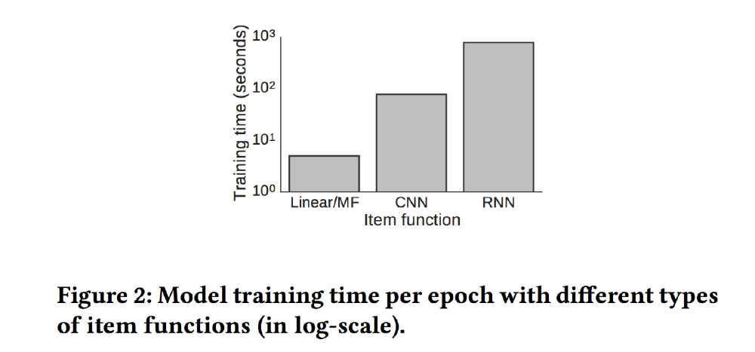
Challenge
Computational cost is very heavy when embedding functions are complex multi-layer non-linear transformations, such as RNN and CNN

Slide 47
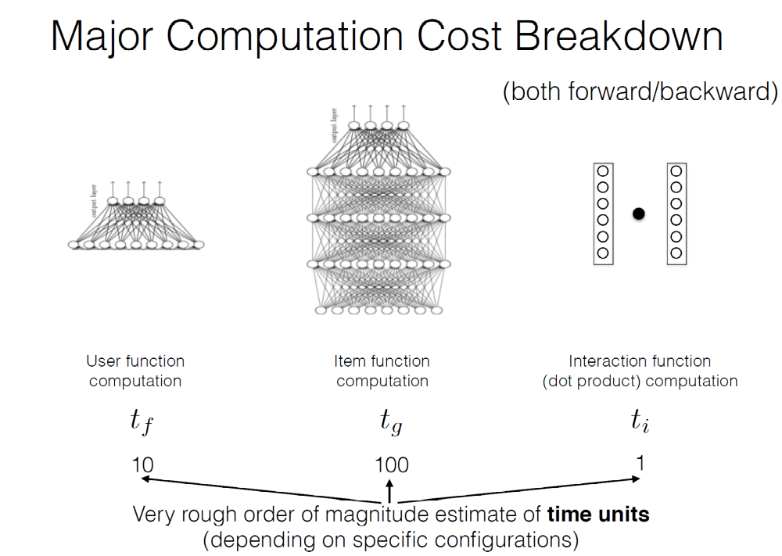
Three Types of Computations

Slide 48
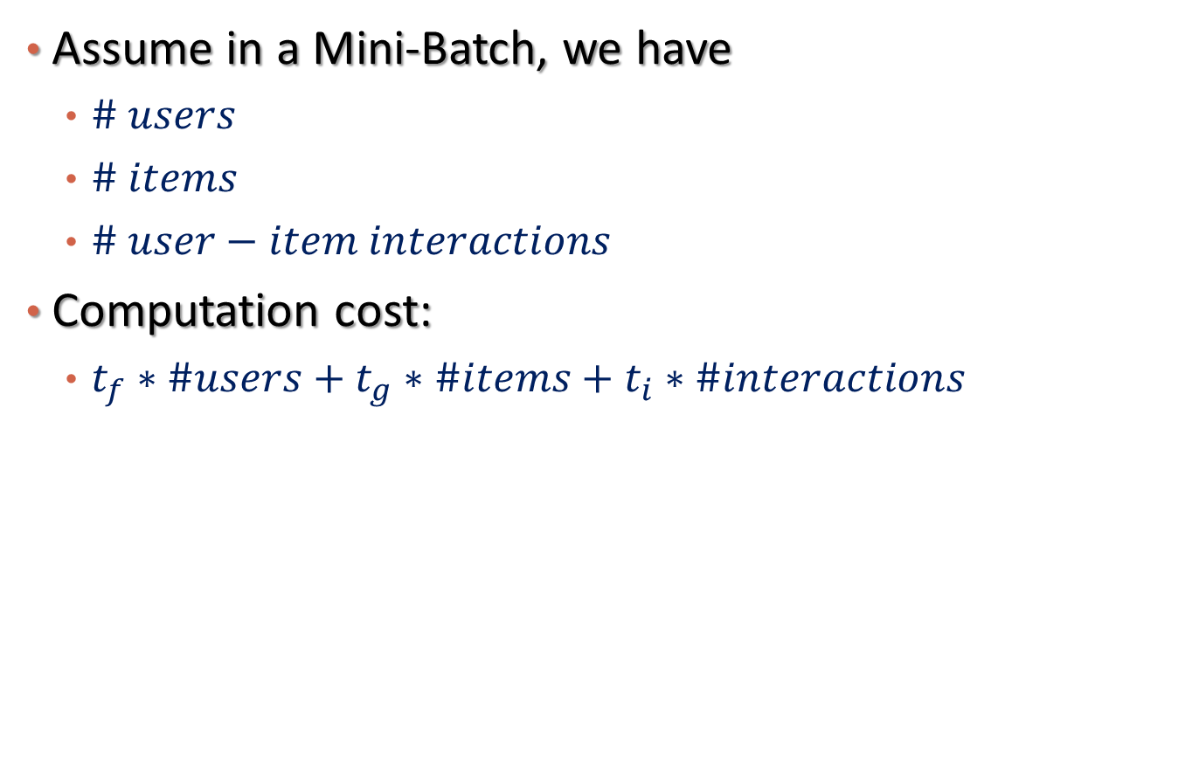
The Cost Model in a Mini-Batch
Assume in a Mini-Batch, we have
  $\# users$
  $\# items$
  $\# user−item interactions$
Computation cost:
  $t_{f}∗\#users+t_{g}∗\#items+t_{i}∗\#interactions$
Most expensive!

Slide 49
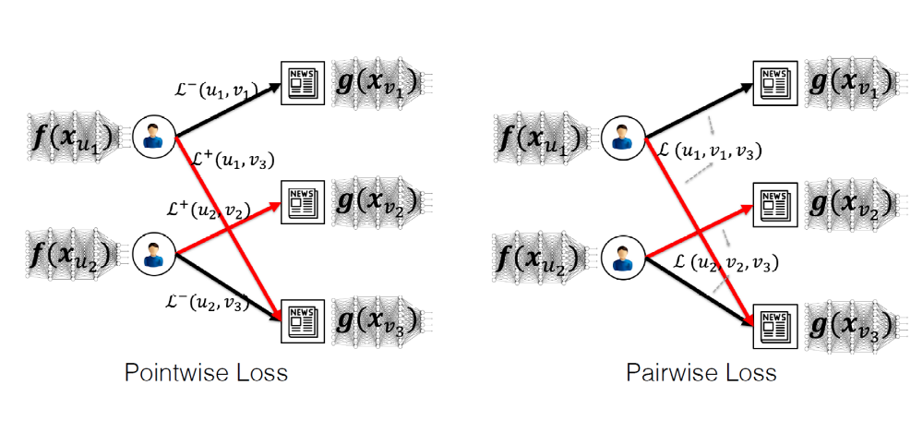
Solution to Speedup Computation
Design sampling strategies that can share the computational costs on the node type that are expensive
  Data to sample here: Links between users and items
  Major computational costs: on nodes, esp. on items that involves rich text

Slide 50
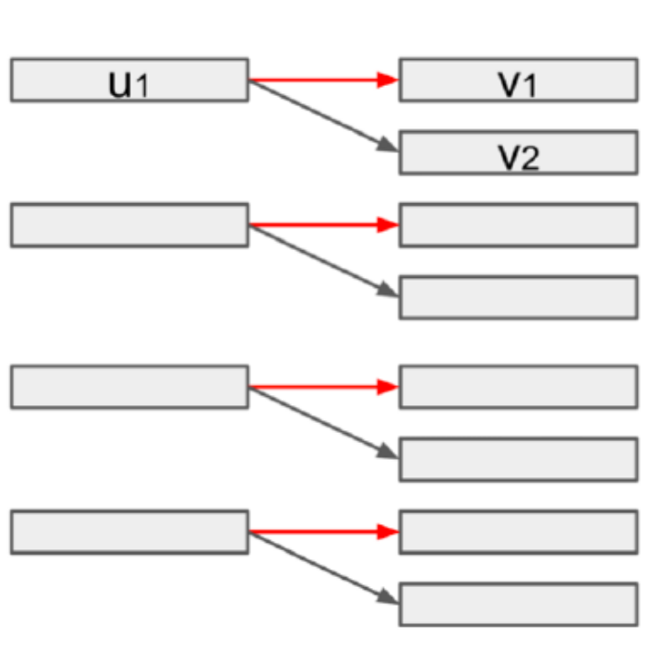
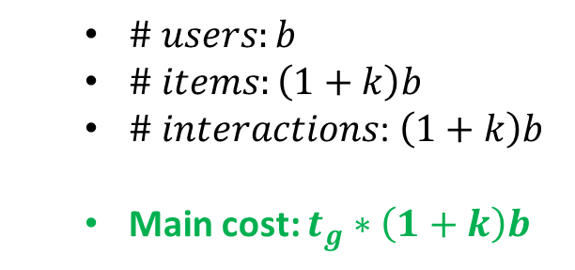
Existing Sampling Strategies
Negative Sampling: b positive links and k negative links for each positive link
  In each mini-batch: no items are shared!
  $\# users:b$
  $\# items:\left(1+k\right)b$
  $\# interactions$: $\left(1+k\right)b$
  Main cost: $t_{g}∗\left(1+k\right)b$

Slide 51
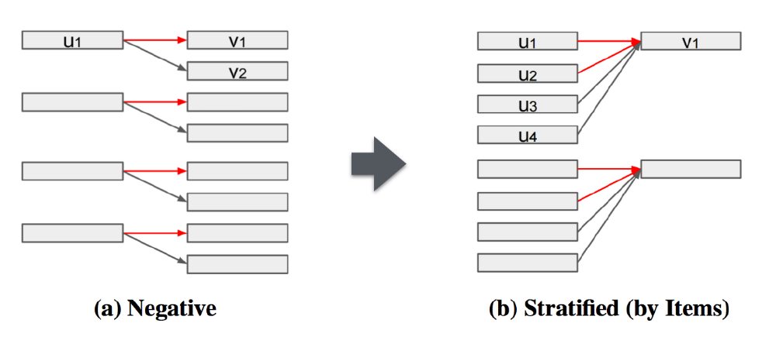
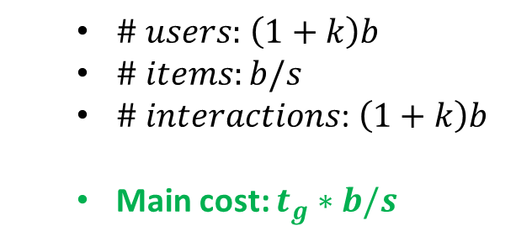

Proposed Strategy 1: Stratified Sampling
Share items: b positive links and k negative links for each positive link; # of positive link per item: s
  $\# users:b$
  $\# items:\left(1+k\right)b$
  $\# interactions$: $\left(1+k\right)b$
  Main cost: $t_{g}∗\left(1+k\right)b$
  $\# users:$ $\left(1+k\right)b$
  $\# items:b/s$
  $\# interactions$: $\left(1+k\right)b$
  Main cost: $t_{g}∗b/s$

Slide 52
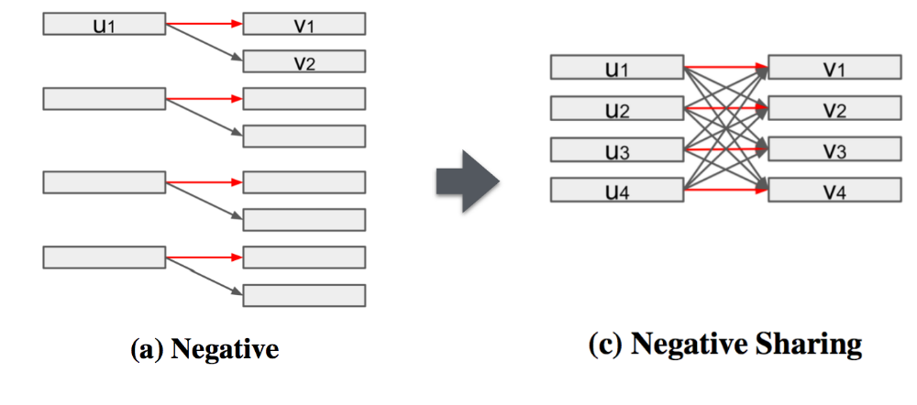
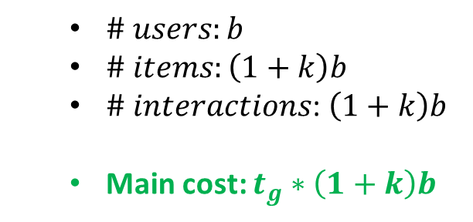
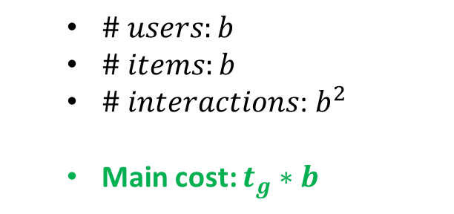
Proposed Strategy 2: Negative Sharing
Treat all the non-links as negative links, again share items: still b positive links
  $\# users:b$
  $\# items:\left(1+k\right)b$
  $\# interactions$: $\left(1+k\right)b$
  Main cost: $t_{g}∗\left(1+k\right)b$
  $\# users:b$
  $\# items:b$
  $\# interactions$: $b^{2}$
  Main cost: $t_{g}∗b$

Slide 53
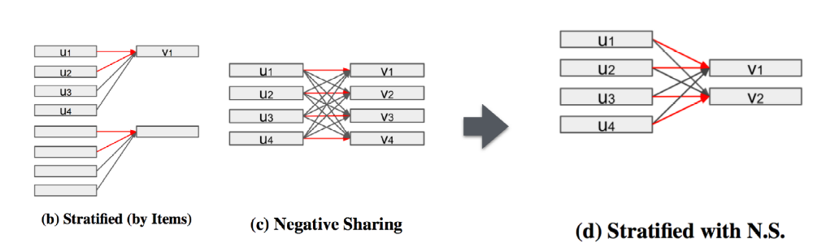
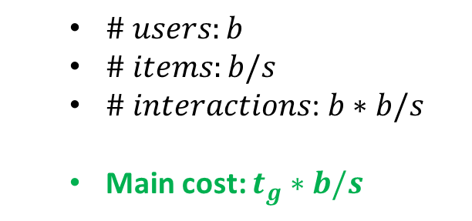
Combine Two Strategies
Stratified sampling only: Cannot deal with ranking-based loss functions
Negative sharing only: Too many negative links used, diminishing return
Still b positive links, s positive links per item
  $\# users:b$
  $\# items:b/s$
  $\# interactions$: $b∗b/s$
  Main cost: $t_{g}∗b/s$

Slide 54
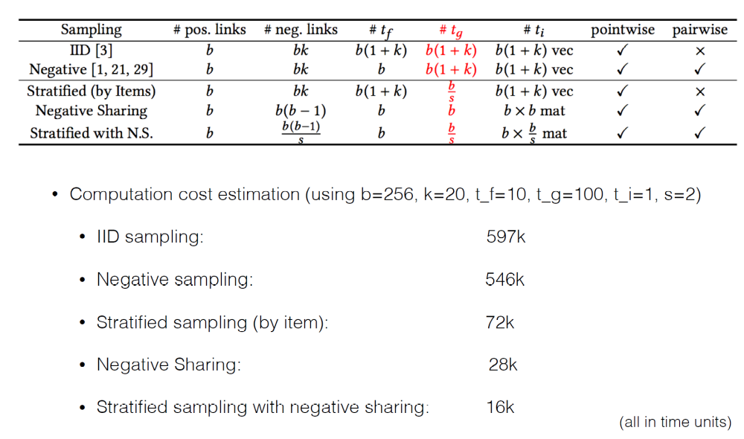
Cost Summary

Slide 55
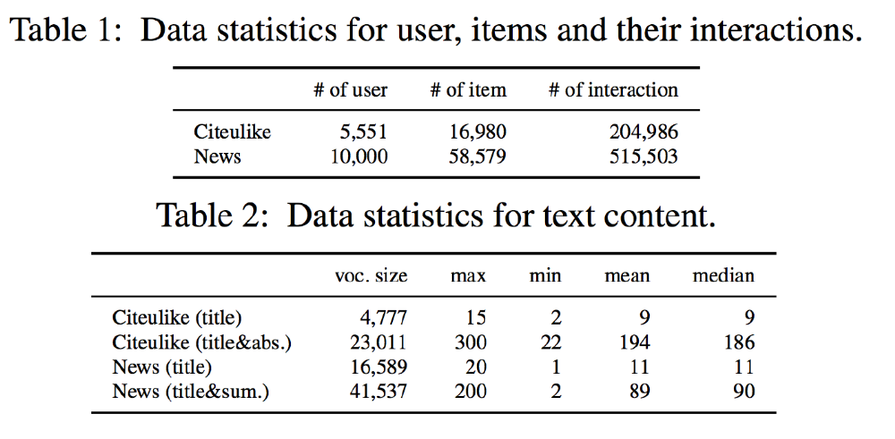
Experimental Results
Speedup up to 30 times with even performance improvement
Datasets

Slide 56
Running Time
Converge faster and fewer iterations are needed when more links are used!
Notes:
Iteration:

Slide 57
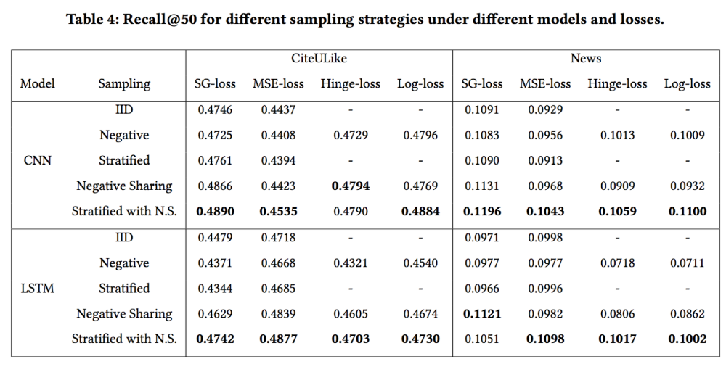
Effectiveness

Slide 58
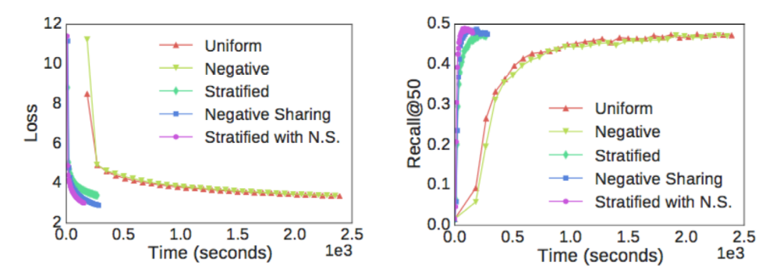
Convergence Curves
Convergence to a better place using much less time
training
test

Slide 59
Outline
Introduction
Unsupervised Network Embedding for Anomaly Detection
User-Guided Network Embedding for Link Prediction
Functional Embedding for Recommendation in Content-Rich Networks
Summary

Slide 60
Summary
Representing nodes by utilizing links in networks is an effective and efficient way of mining networks
  Different types of links have different importance scores
  Meta-path augmented general embedding helps
  Functional embedding can further leverage the content information in the networks
Applications
  Anomaly detection for heterogeneous categorical events
  Link prediction, e.g., drug recommendation, disease diagnosis
  Recommendation

Slide 61
Q & A
Thank you!

