Slide 1
Partnering for Data Science:
The Laboratory for Analytic Sciences
Alyson Wilson, Ph.D.
North Carolina State University
agwilso2@ncsu.edu
https://ncsu-las.org

Slide 2

Laboratory for Analytic Sciences
What is LAS?
LAS is an academic-industry-government translational research partnership that works at the intersection of technology and tradecraft.
https://ncsu-las.org/

Slide 3
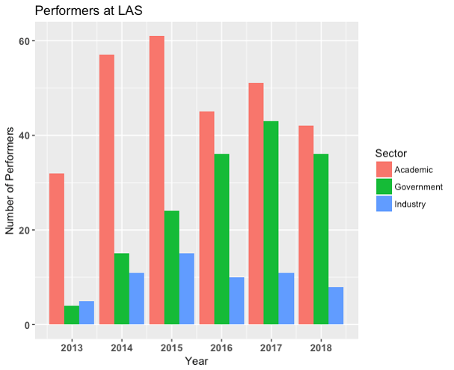
Participants
29 faculty at 9 universities
12 NCSU full-time staff
9 industry partners
~40 government staff, including other IC partners
60% STEM faculty
40% Humanities and Social Sciences faculty

Slide 4
LAS Model
  What we do
  How we do it
    Mostly unclassified
    Visible partnership
    Translational research
    Technology and tradecraft
  Establish a joint vision
  Team-based approach
  Immersive collaboration
  Little pieces of lots of people

Slide 5
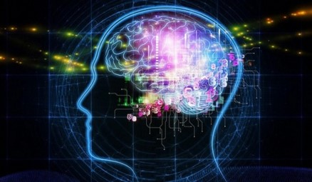

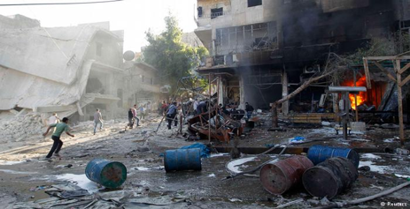
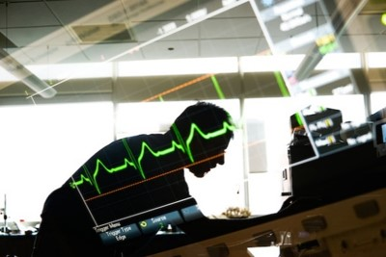
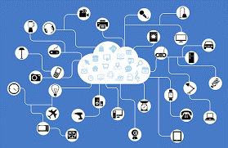
Projects
During 2017, LAS has about 70 projects. We group the projects into exemplars.

Slide 6
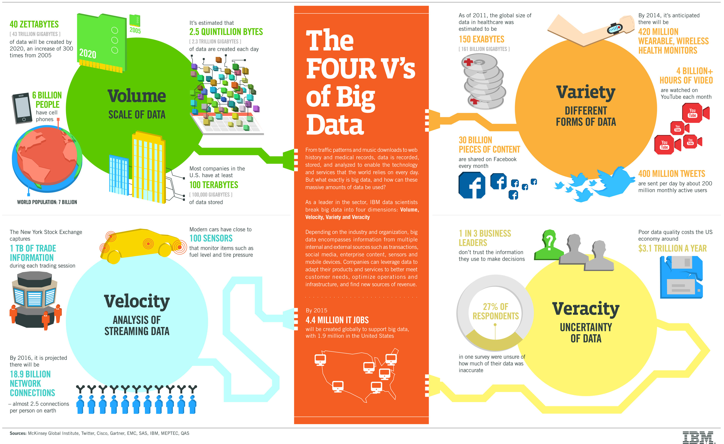
Data Science
Five Data Science Skills
Technical
Communication
Collaboration
Tools
Subject Matter Expertise

Slide 7
Anticipatory Thinking
The deliberately divergent exploration and analysis of relevant futures

Slide 8
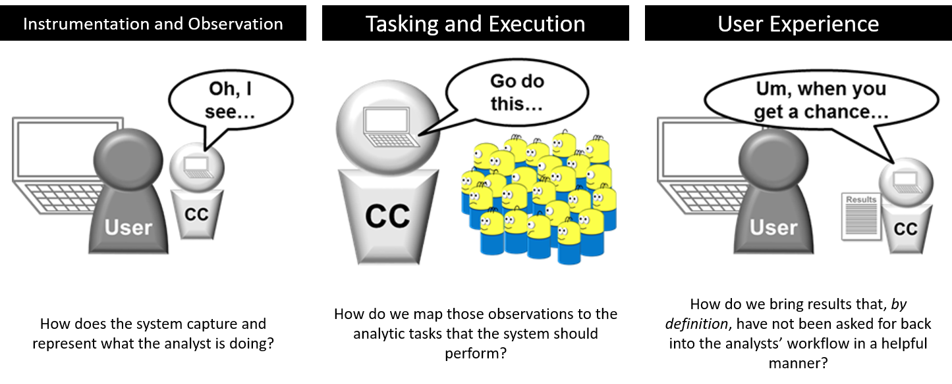
Collaborative Computing

Slide 9
Cybersecurity
Can we use anticipatory analytic tradecraft to anticipate or predict a cyber event or adversary action?
Can we move beyond anomaly detection?
Can we anticipate or predict notable events in noisy environments without reliance on hard signatures or pattern matching schemes?
Can we devise methods to steer adversarial actions away from their strength and toward ours?

Slide 10
Internet of Things
The IoT effort focuses on low power, wide area networks and industrial IoT devices.
IoT Lab with Software Defined Radio to collect data
Analytics development

Slide 11
Resisting Influence and Supporting Stability Campaign
Failing States Index
Radicalization
Machine Translation of North Korean Propaganda
Automatic Detection of Propaganda
Analytic Integrity for Machine Learning
Media Veracity

Slide 12
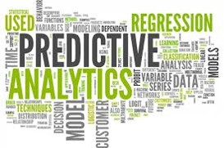
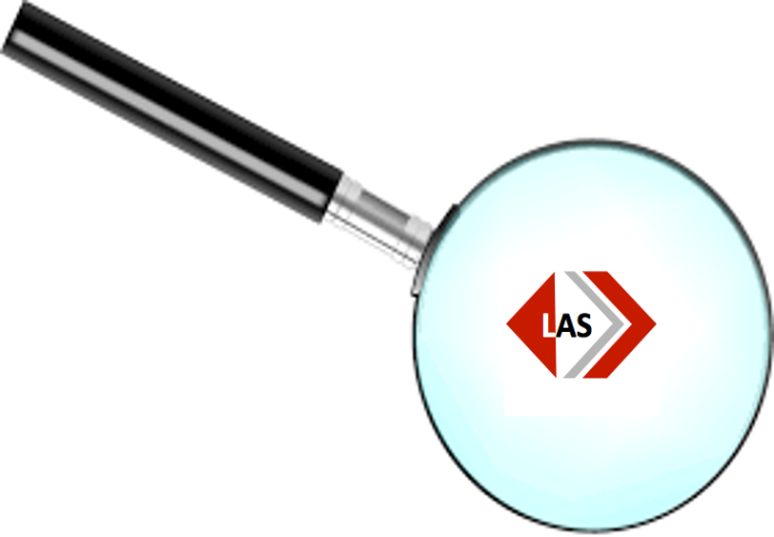
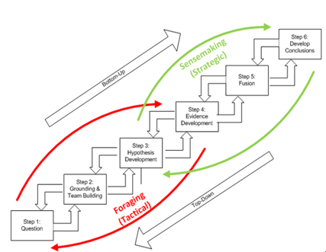
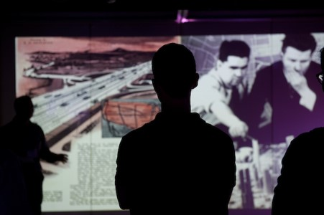
2019 Activities

Slide 13


