Slide 1
Practical Framework
Julia Lane

Slide 2
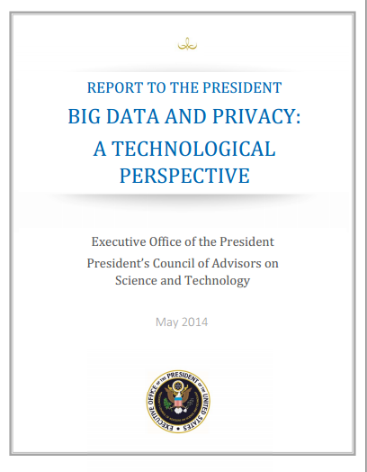
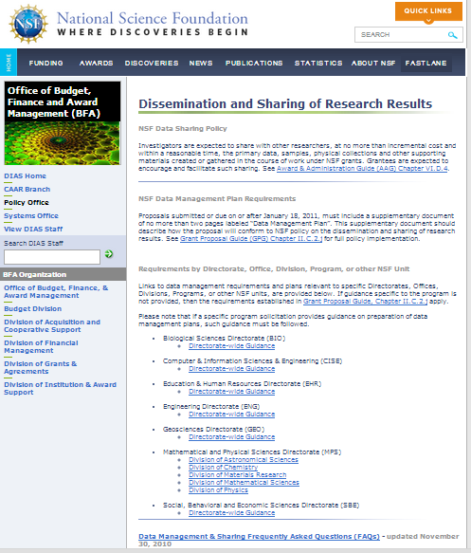
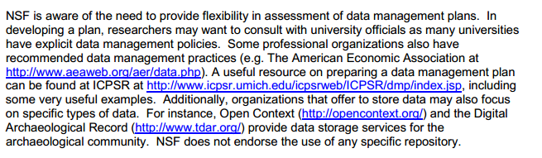
Motivation

Slide 3
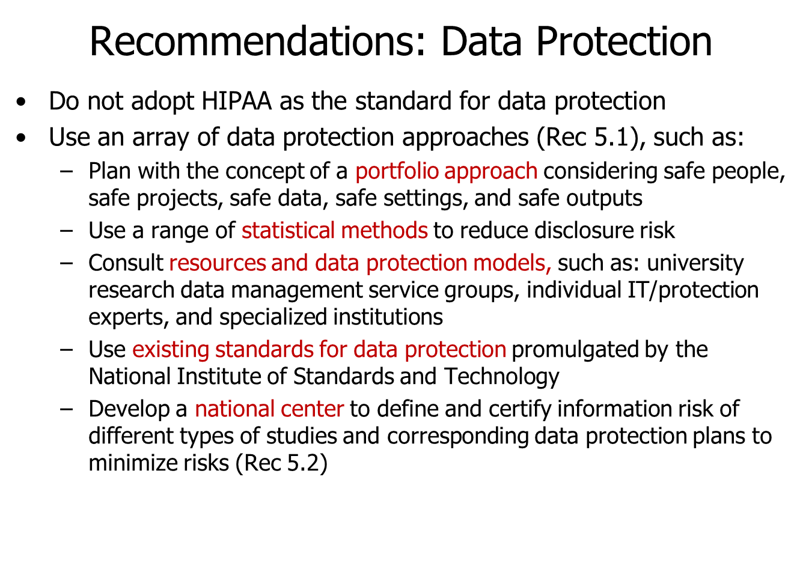

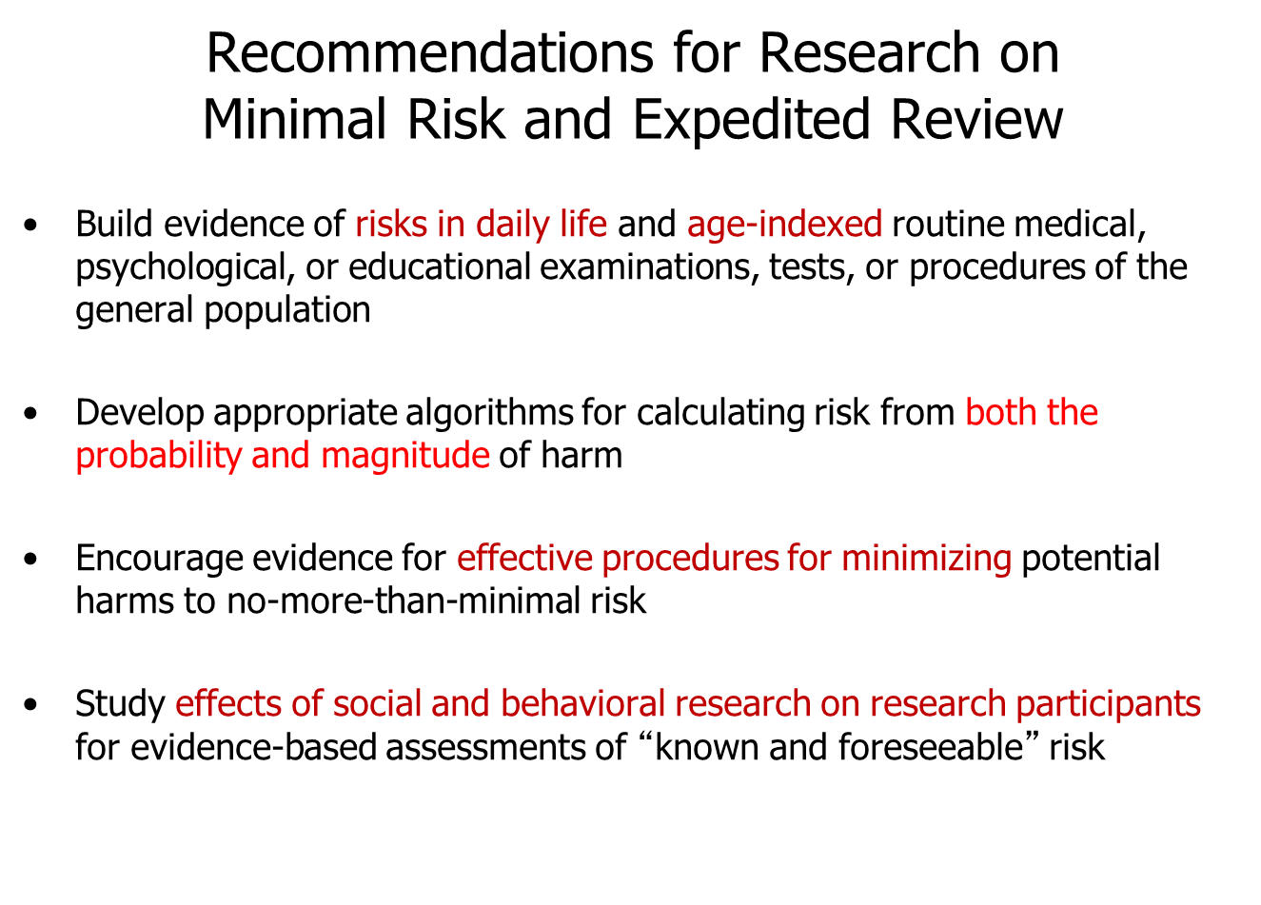
Motivation

Slide 4
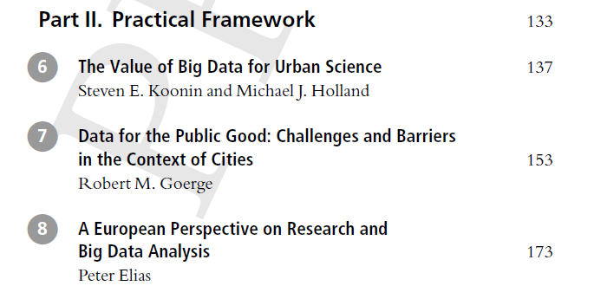
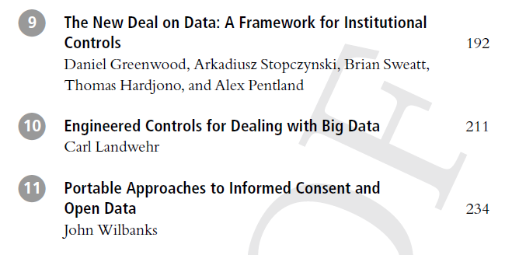

Slide 5
Key themes
1. Value of big data for public good
2. Practical access issues
3. European experience
4. Practical approaches
  Regulatory
  Technical
  Legal and technical

Slide 6
1. Value of big data for the public good
Koonin and Holland: cities
  city management
  reduced taxpayer cost and burden
  great transparency and less corruption
  greater economic growth, and
  addressing problems of epidemics, climate change and pollution

Slide 7
2. Practical access issues
Goerge: experience from building data warehouse
  What data to develop and access
  How to develop capacity in agencies
  How to present data in a useful way
  How to keep data secure
  How to build trust

Slide 8
3. European experience
Elias:
  harmonized approach to legislation designed to provide individuals and organizations with what has become known as the ‘right to privacy’.
  Creation of a research environment (the European Research Area or ‘ERA’) in which research interests are promoted via cross-border access to microdata free from legal constraints and other obstacles.
  The European Research Area is described by the European Commission as: ‘… a unified research area open to the world, based on the internal market, in which researchers, scientific knowledge and technology circulate freely’ (European Commission, 2012).

Slide 9
3. European experience: Data

Slide 10
3. European Experience: Key points
The importance of the legal status of those bodies holding data
The lack of agreed and common standards covering data security and the authentication of potential research users;
The need for public support for the use for research of de-identified personal information;
The need for a coordinated governance structure for all activities associated with access, linking and sharing personal information

Slide 11
4. (i) Regulatory Standards
Greenwood et al. “New Deal on Data” Data is the new oil - need to build interstate highways
  Business, Legal, Technical standards
  Build an open Personal Data Store (openPDS) personal cloud trust network and Living Informed Consent, where the user is entitled to know what data is being collected,by what entities and put in charge of sharing authorizations

Slide 12
4 (ii) Technical Approaches
Landwehr
  access must be allowed through controls engineered into the data infrastructure
  analysis on encrypted files
  build systems in which information flow, rather than access control is used to enforce policies
    delineate the characteristics of subjects, objects, and access modes

Slide 13
4.(iii) Legal and technical
Wilbanks: portable legal consent framework
  traditional frameworks to permit data reuse have been left behind by the mix of advanced techniques for re-identification and cheap technologies for the creation of data about individuals.
  Commons-based approach that can be used to recruit individuals who understand the risks and benefits of data analysis and use

Slide 14
Suggestions for future work
Need concerted national effort – build interstate highways.
  Make case for value of statistical research (not just for publications – but also to make sense of data)
  Identify barriers and trusted entities (like Europe)
  Develop standardised approaches for developing trust
    Business, legal, technical framework
    Certification for “trust” development
    Cybercontrols
  Make approaches practical, accessible and scalable

Slide 15
And a reminder of why

