Slide 1
The Art (& Sometimes Science) of Turning Precinct Results Into Data
“I can’t believe this isn’t already available!”
Derek Willis, OpenElections
SDSS 2020
https://tinyurl.com/openelex-sdss

Slide 2
About OpenElections
Volunteer, non-profit effort that started with two journalists
Total funding since 2013: about $250,000
Everything we do is public at https://github.com/openelections
Of course we are at @openelex

Slide 3
The Goals
Freely available official precinct-level election result data for the United States
General, primary and special elections
Ideally, broken out by vote type

Slide 4
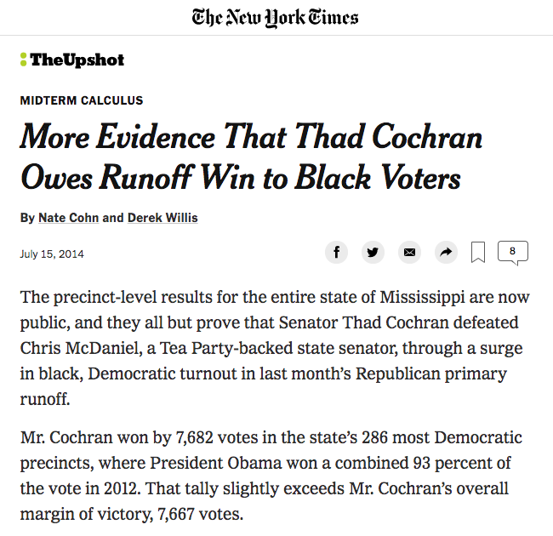
What Just Happened
Having data makes it possible for the public to understand how elections are won and lost.

Slide 5
The Basic Process
Check state or local jurisdiction website for official results that have been posted.
Email state or local election official requesting official results. This might involve a public records request.
If required, send formal request by mail, sometimes with payment.
If necessary, call state or local election official, or send a reminder by email.
Repeat 1-4 as needed.

Slide 6
State of the Nation
41 states (and D.C.) provide statewide precinct results as data.
6 states provide statewide precinct results in a non-machine readable format.
3 states do not provide statewide precinct results in any format.

Slide 7
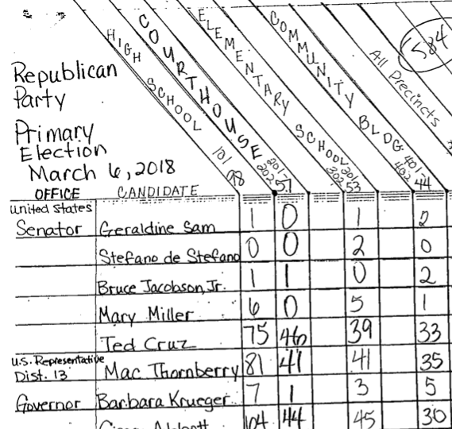
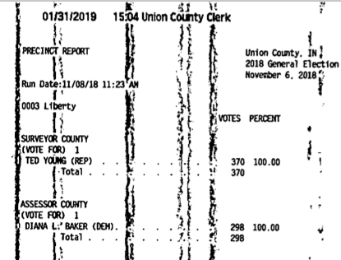
What We Get

Slide 8
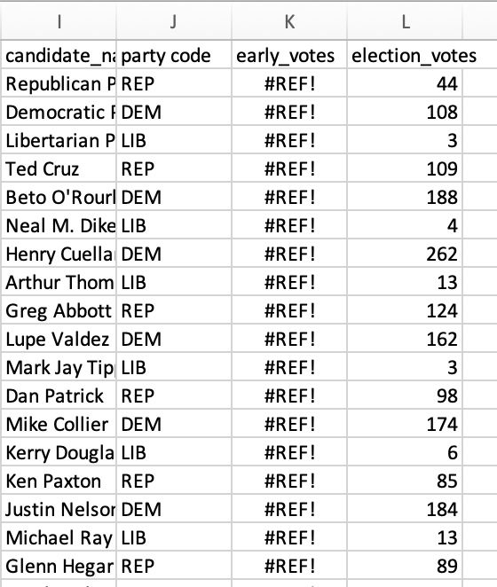
There’s More
If you want early voting results in Texas, you have to get results from all 254 counties.
Like this ---->

Slide 9
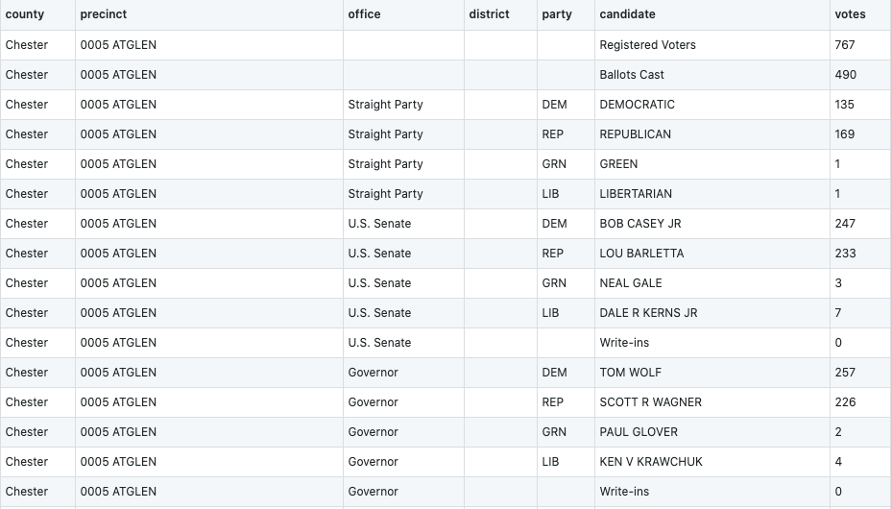
The Results Result
2018 general election results, Chester County, Pa.
https://github.com/openelections/openelections-data-pa/blob/master/2018/counties/20181106__pa__general__chester__precinct.csv

Slide 10
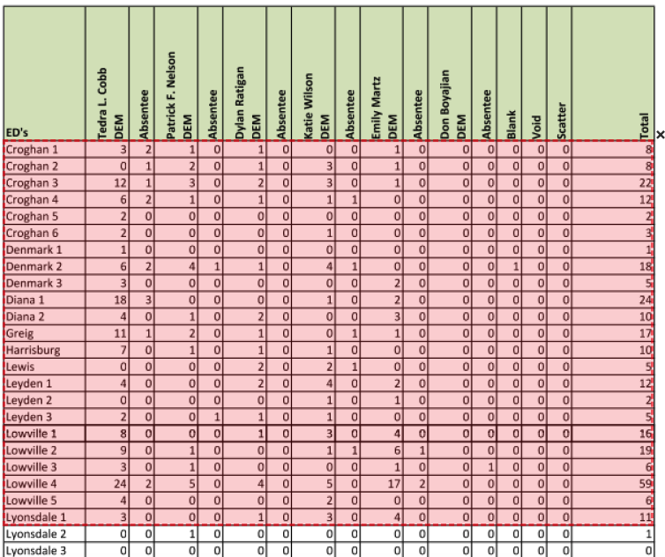

The Tools
Tabula
Python
R
Ruby
https://tabula.technology/

Slide 11
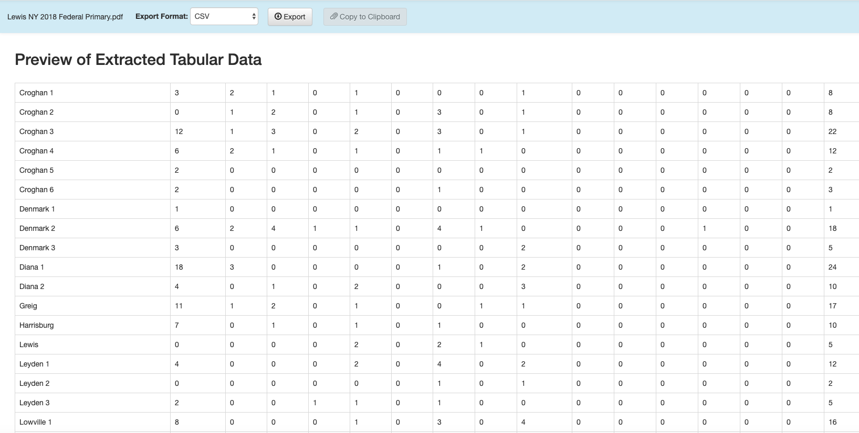
How Tabula Works

Slide 12
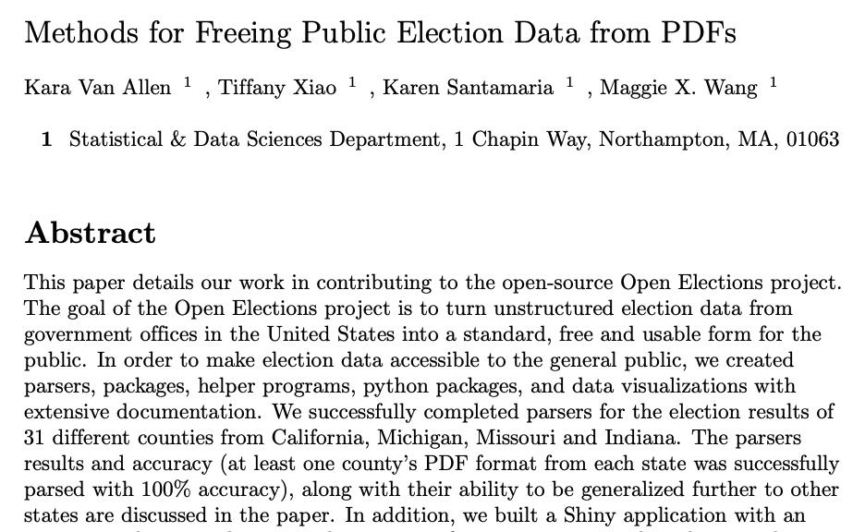
How Data Science Helps
https://sds-capstone.github.io/openelections/website/open_elections_paper.pdf

Slide 13
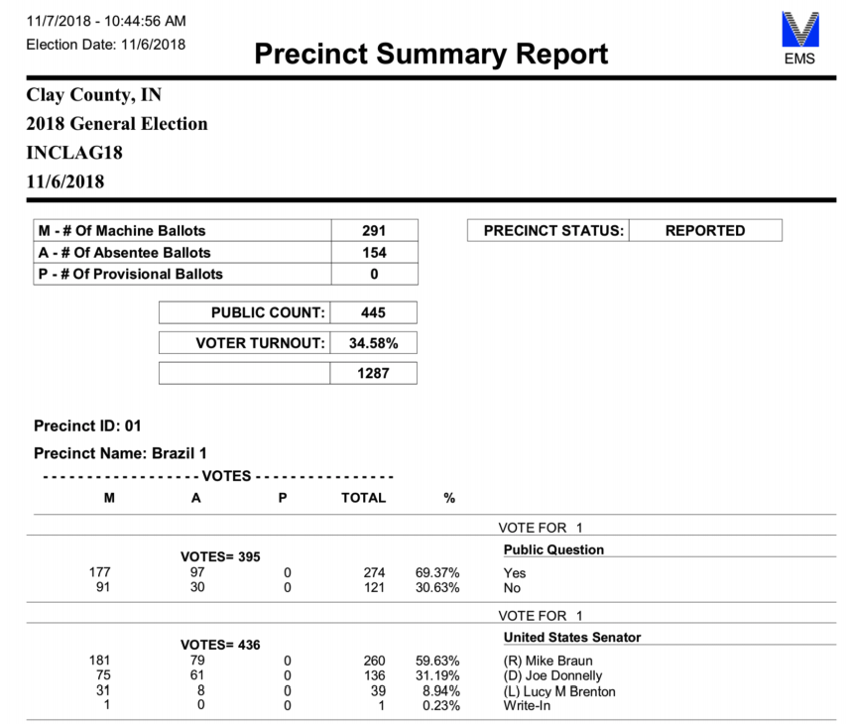
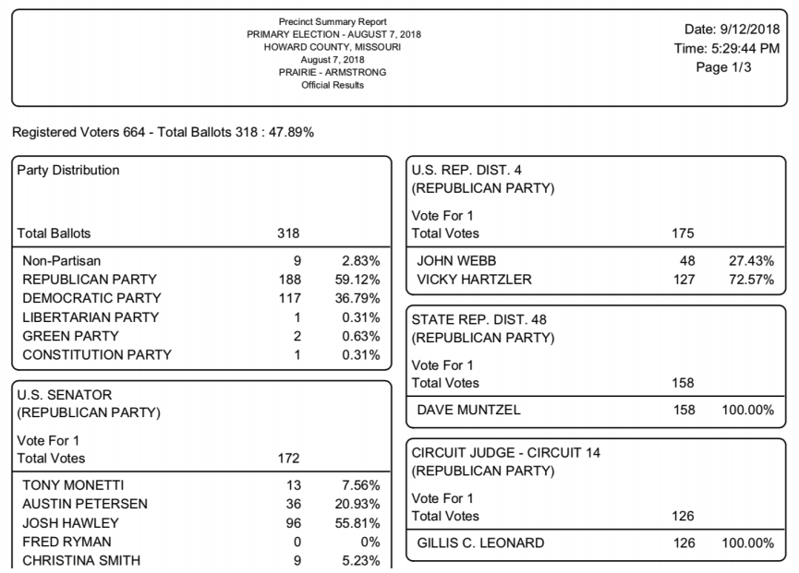
Handling Multiple Layouts

Slide 14
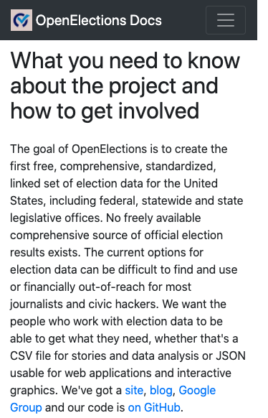
What We Could Use
A more robust approach to guided parsing that gets specialized knowledge out of a person’s head and into code.
Examples from other domains!
<cough>Volunteers</cough>

Slide 15
Thank You!
For more info:
http://docs.openelections.net/
https://github.com/openelections
https://twitter.com/openelex
openelections@gmail.com

