Slide 1




Data visualization techniques for the analysis of eczema-affected specific regions of the body as predictors of food allergy risk
Alyssa Ylescupidez¹, George du Toit², Katerina Salavoura², Helen Brough², Suzana Radulovic², Colin O’Rourke¹, Gideon Lack², Henry T Bahnson¹
¹Benaroya Research Institute and the Immune Tolerance Network, Seattle
²King’s College, Evelina, Guy’s and St. Thomas’ Hospital, London

Slide 2

Eczema and its role in food allergy
Eczema (also atopic dermatitis) characterized by itching, redness, scaly rashes
  Associated with food and environmental allergies
Dual Allergen Exposure Hypothesis: oral exposure prevents allergy, allergen exposure on the skin causes allergy
We needed a tool to visualize multivariable eczema data collected longitudinally
Asthma and Allergy Foundation of America. (n.d.). Retrieved from https://www.aafa.org/eczema/

Slide 3
SCORAD: “SCORing Atopic Dermatitis”
Objectively assess and score severity of eczema
Combines multiple metrics into a single summary metric
Known to correlate with allergy
Clinically useful but not best for testing hypotheses for causes of allergy
  Interested in more granular metrics and visualizing eczema on different regions of the body
SCORAD Index
Mild | Moderate | Severe
<15 | 15-40 | >40

Slide 4
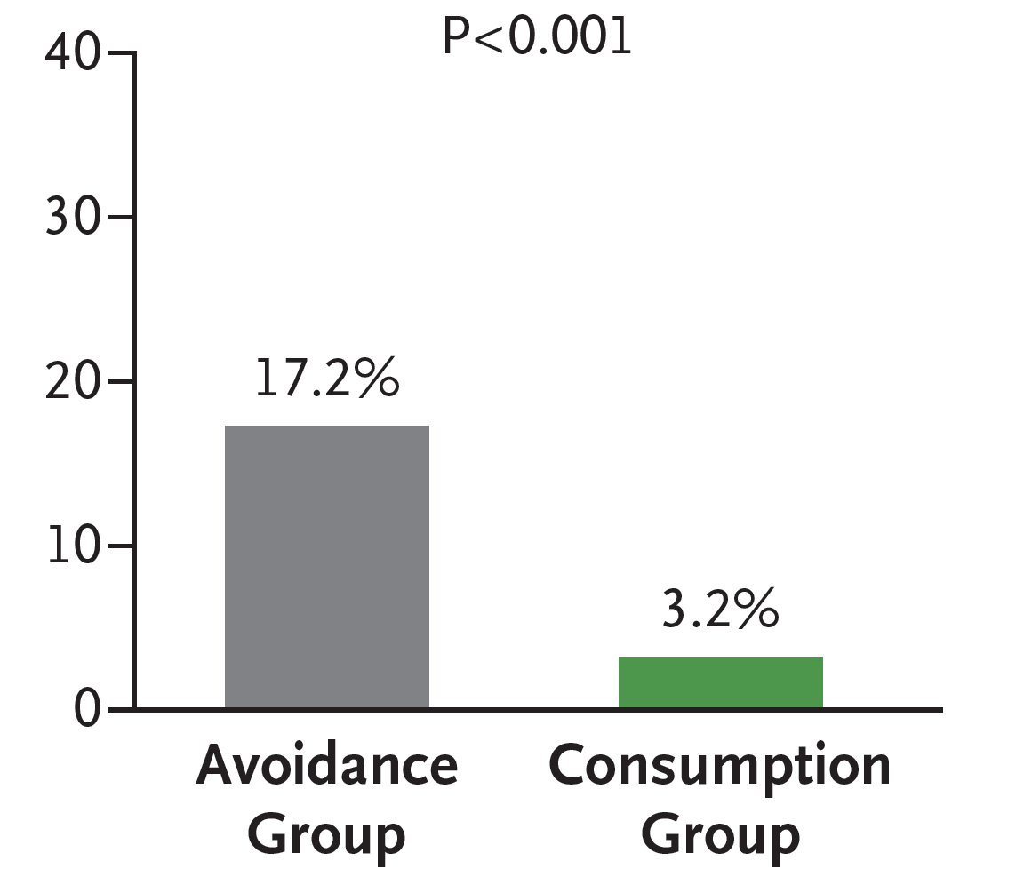
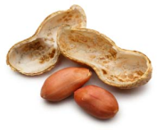

Background of the LEAP Study
Ancillary study to the LEAP (Learning Early About Peanut Allergy) Study
Investigate phenotypes of eczema
LEAP
60 Months
Consumption
Prevalence of Allergy
4 to < 11 Months
Avoidance
Diagnosis of Peanut Allergy
81% Relative Reduction

Slide 5
Study design
640 participants (healthy skin to severe eczema)
Assessed at each visit:
  Presence of eczema on specific regions of the body
    50 binary variables indicated presence of eczema assessed by a physician
  Overall severity of eczema (i.e., SCORAD, redness, sleeplessness)
Baseline Clinic Visit
Final
Clinic Visit
4-11 months of age
12 months of age
30 months of age
60 months of age

Slide 6
Visualizing patterns of eczema
Spatial data collected longitudinally
Wanted an automated process for visualizing data on a map of the body
  No templates for mapping to the human body
Created tools, using JMP Pro 14, to visualize patterns of eczema on the entire body over time
  34 shapes, each corresponding to a specific body region
  Mapped data to the human body using Cartesian X,Y coordinates

Slide 7
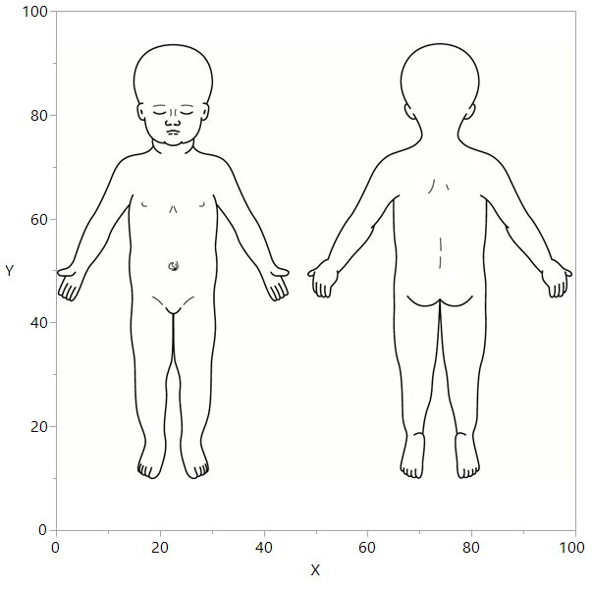
Creating polygons for each body region
Each body region is an individual shape
Outline of each shape made up of points

Slide 8
Creating polygons for each body region
Each body region is an individual shape
Outline of each shape made up of points
l

Slide 9
Creating polygons for each body region
Each body region is an individual shape
Outline of each shape made up of points
l
l

Slide 10
Creating polygons for each body region
Each body region is an individual shape
Outline of each shape made up of points
l
l
l

Slide 11
Creating polygons for each body region
Each body region is an individual shape
Outline of each shape made up of points
l
l
l
l
l
l
l

Slide 12
Creating polygons for each body region
Each body region is an individual shape
Outline of each shape made up of points
l
l
l
l
l
l
l
l
l
l
l
l
l
l
l
l
l
l
l
l
l
l
l
l
l
l
l
l
l

Slide 13
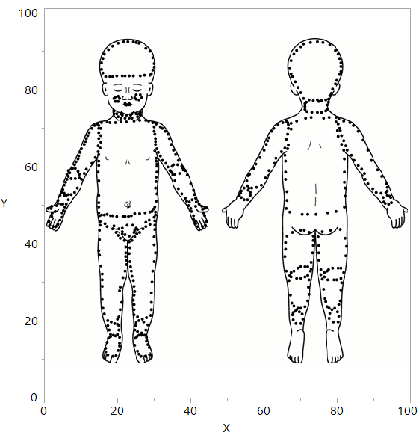
Completed outlines of all body regions

Slide 14
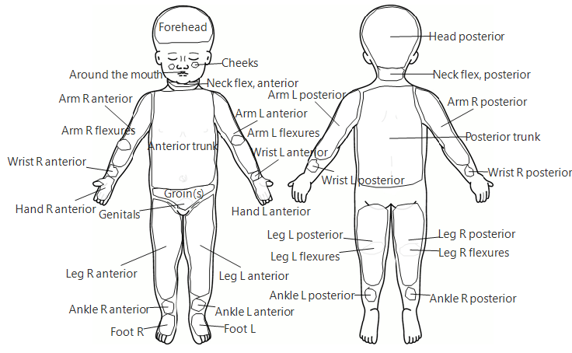
Regions assessed for presence of eczema

Slide 15

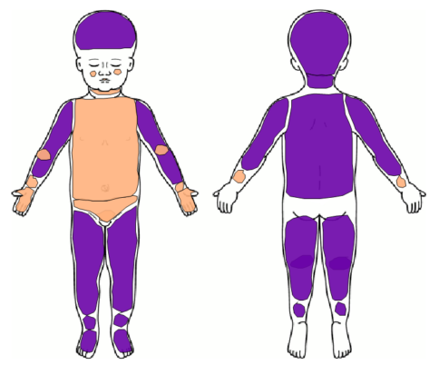
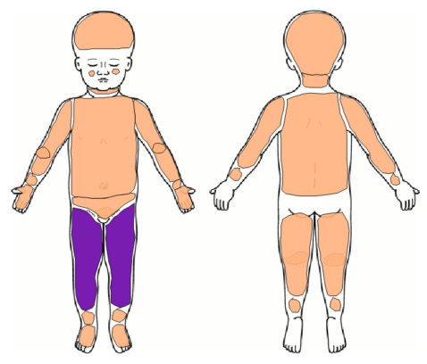
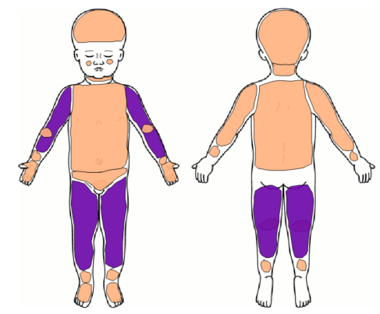
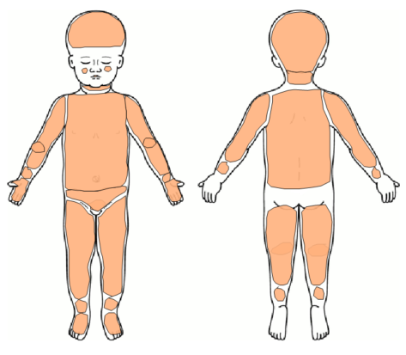
Visualizing eczema at multiple visits
Baseline
12 Months
Examine eczema trends over time for each participant
Eczema present at baseline is no longer present by 60 month visit
White areas were not assessed for eczema
30 Months
60 Months

Slide 16
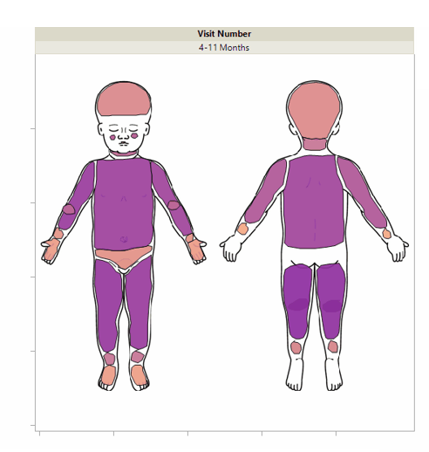
GIF animation displays eczema trends
Region Affected by Eczema
n
n
No
Yes
Eczema tends to improve over time

Slide 17
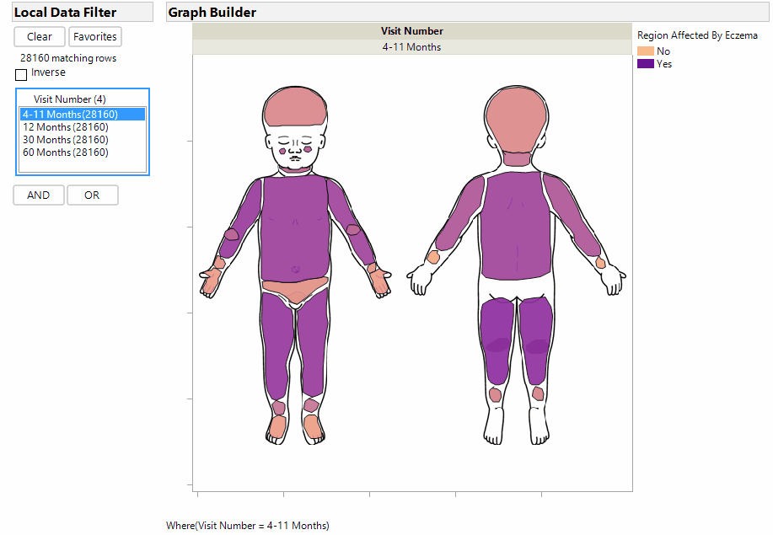
GIF animation displays eczema trends
Region Affected by Eczema
n
n
No
Yes
Eczema tends to improve over time

Slide 18
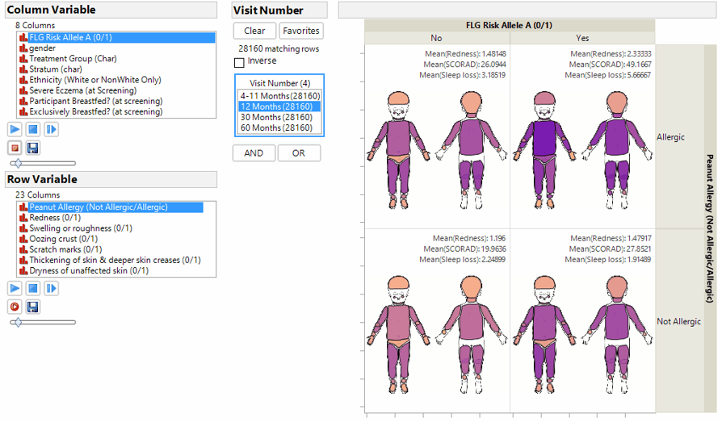
Utilizing column switchers for data exploration
Column Variable
Row Variable

Slide 19
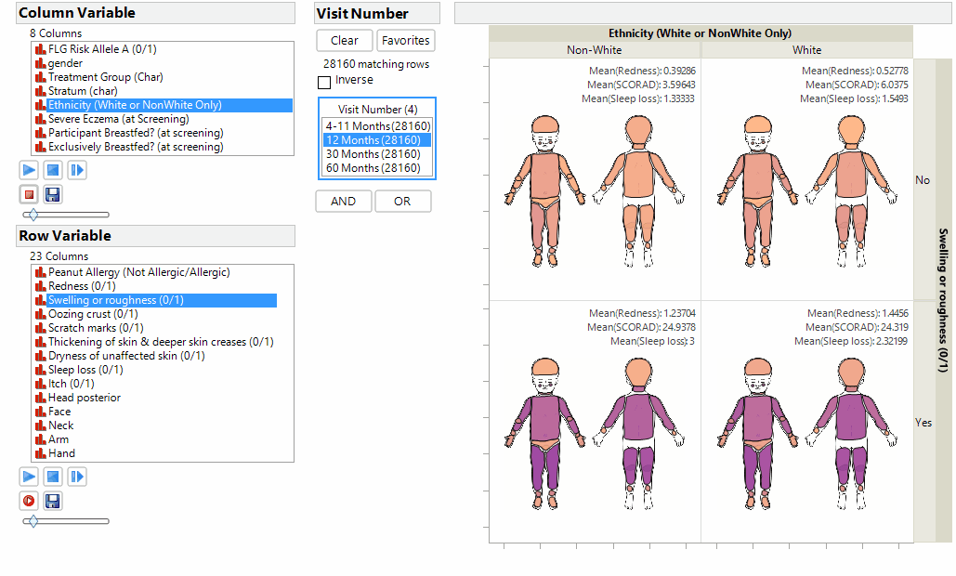
Utilizing column switchers for data exploration
In this example, we can cycle through 736 visualizations total

Slide 20
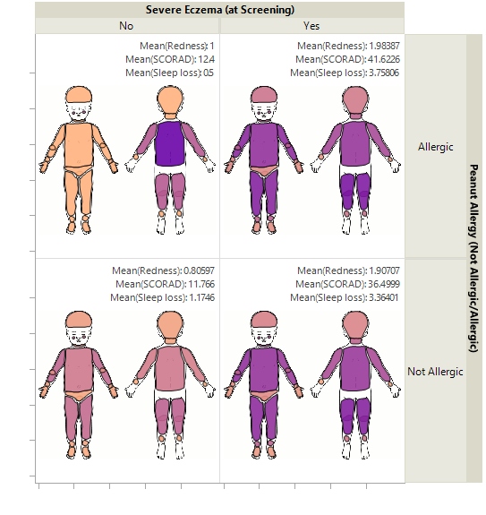
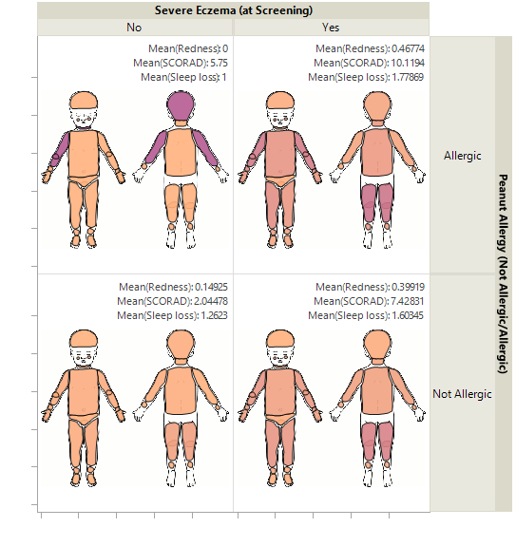
Identifying associations of interest
Age 4-11 Months
Age 60 Months
Region Affected by Eczema
n
n
No
Yes
Peanut allergic participants that had severe eczema at screening continue to have the most severe eczema at 60 months

Slide 21
Conclusions & future direction
Developed a visualization tool to map data to a custom created map
  Efficient use of spatial data
  Rapid visualization of data for spatial analyses
Created a reusable template for mapping data to the entire human body
This methodology can be used to draw and visualize any data or experiments involving visualization of spatial analyses
Tool could be utilized by doctors and clinicians to easily visualize data from databases

Slide 22
Acknowledgments
Henry T Bahnson
George du Toit
Katerina Salavoura
Helen Brough
Suzana Radulovic
Colin O’Rourke
Gideon Lack

Slide 23
Resources & Contact Info
JMP Custom Map Creator Add-In documentation: https://community.jmp.com/t5/JMP-Add-Ins/Custom-Map-Creator/ta-p/21479
JMP documentation for creating custom maps: https://www.jmp.com/support/help/14-2/custom-map-files.shtml
Contact email:
Alyssa Ylescupidez - aylescupidez@benaroyaresearch.org

