Slide 1
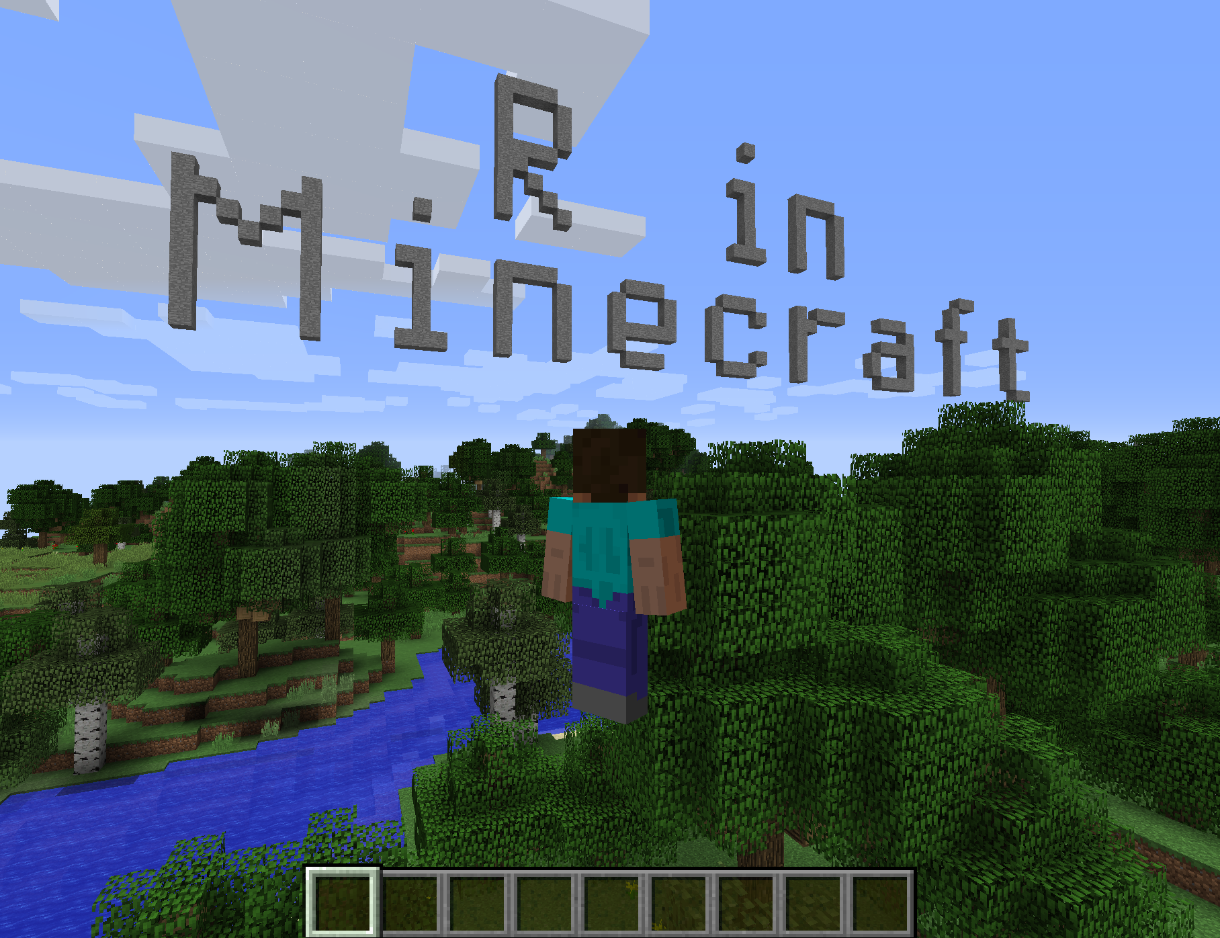
David Smith
@revodavid

Slide 2
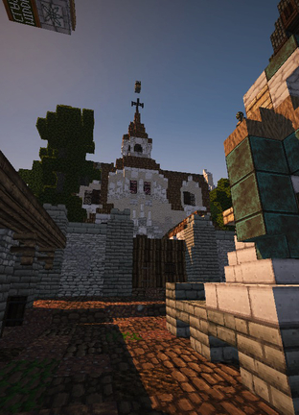
What is Minecraft?
A 3-D exploration and building game
  In “Survival” mode, the player crafts resources while defending against monster attacks
  In “Creative” mode, it’s more like an immersive virtual Lego session
Developed by Mojang
  Acquired by Microsoft in 2014
Hugely popular with under-15s
Notes:
Image source: https://minecraft.net/en-us/article/five-years-westeros

Slide 3
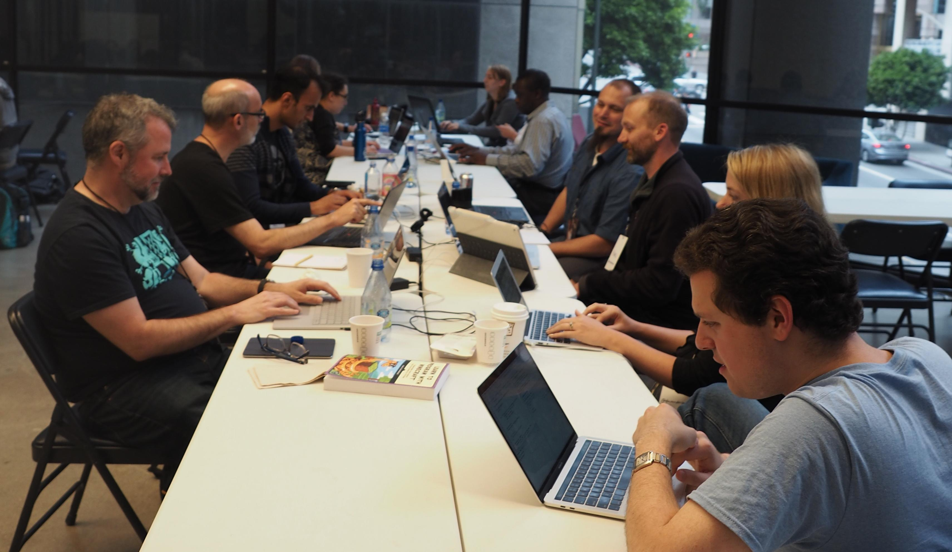

Slide 4
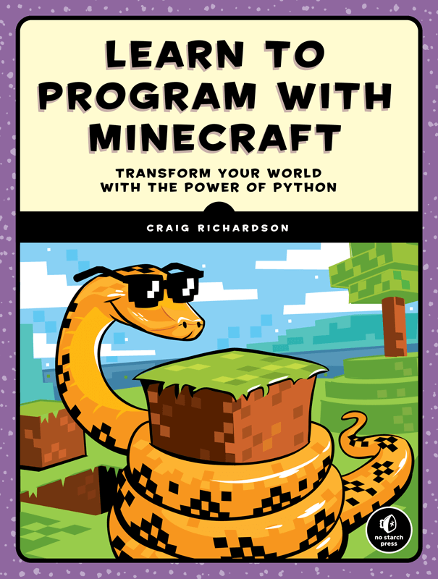
Why R in Minecraft?
Teach kids the R language
  motivated by automating tedious tasks in Minecraft
Extensible Client/Server architecture
  World can be modified via server extensions
  Language API provides a higher-level interface

Slide 5

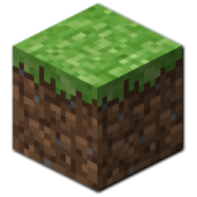

You Will Need:
Minecraft desktop (requires purchase)
  Java version NOT Windows Store or Xbox/Mobile version
Minecraft account (account.mojang.com)
Spigot Minecraft server (free)
  w/ RaspberryJuice plugin
Desktop client running R
  “miner” and “craft” packages

Slide 6
R packages
miner: Basic functions for interfacing with a Minecraft server:
  connect to Spigot server
  inspect / modify world area (by blocks)
  monitor player actions (movement, block interaction)
  github.com/ropenscilabs/miner
craft: Higher-level functions built on basic tools
  Render a message / image / maze in the world
  github.com/ropenscilabs/craft
  Accompanying book: ropenscilabs.github.io/miner_book

Slide 7
DIY Docker build with VM in Azure
Launch Ubuntu Data Science Virtual Machine
  open ports 4711,25565 in/out (in Networking)
git clone https://github.com/ropenscilabs/miner
cd miner/inst
docker build -t minecraft .
docker run -ti --rm -p 4711:4711 -p 25565:25565 minecraft
> defaultmode creative
> op [your_username]

Slide 8
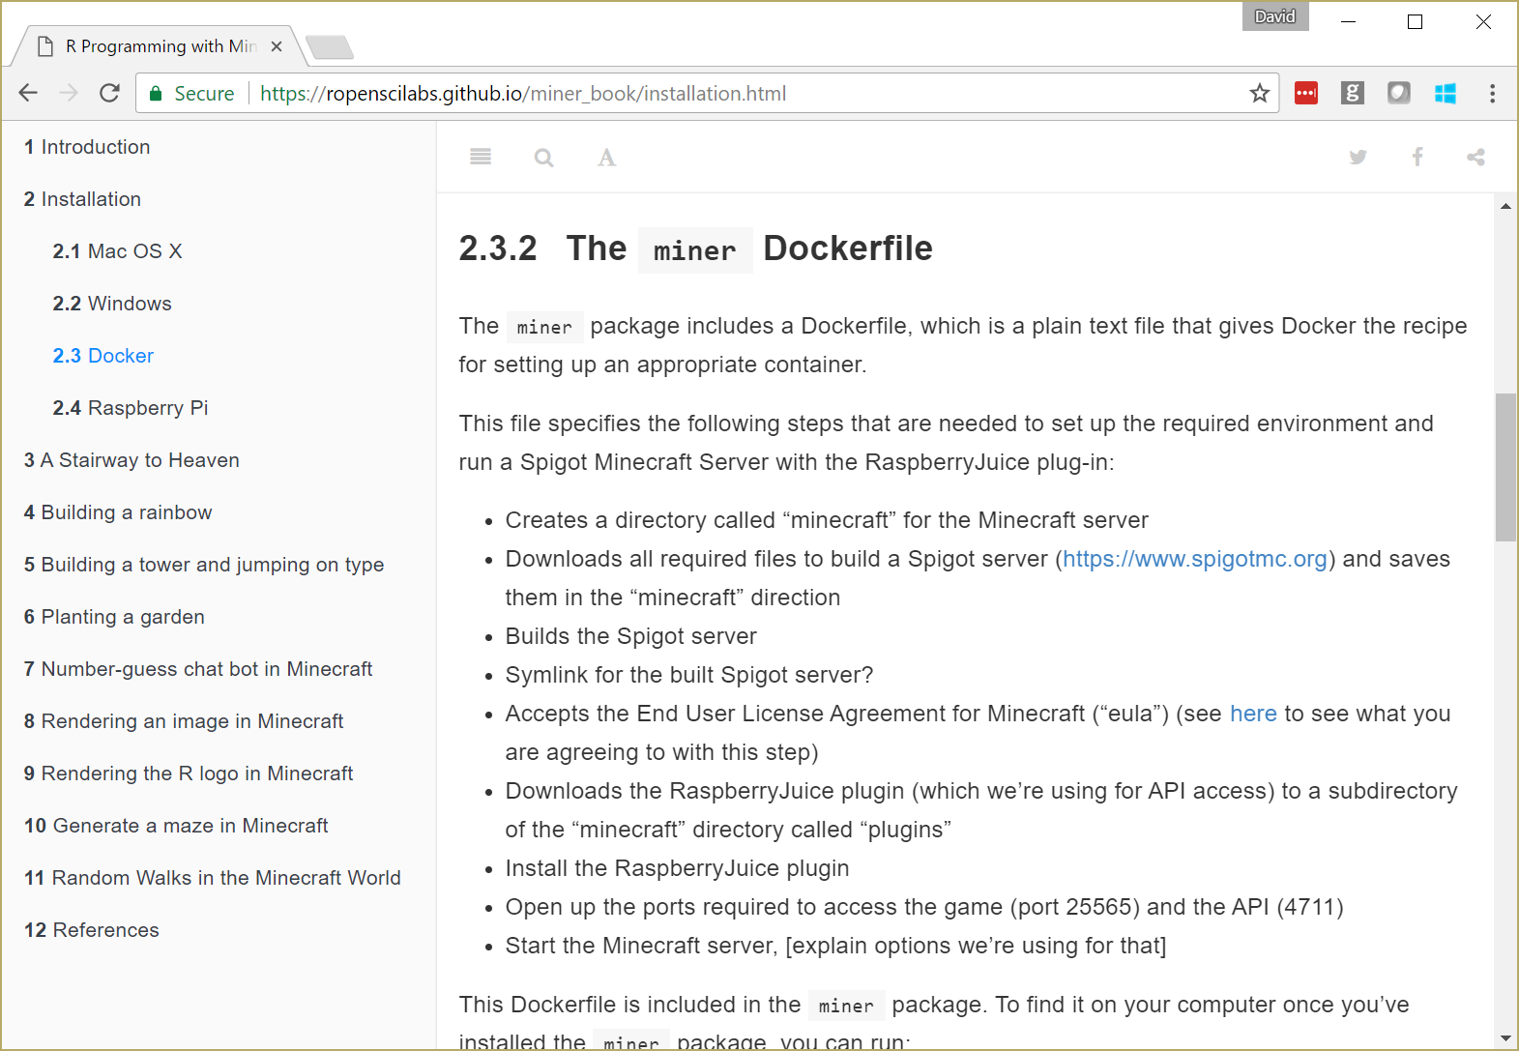

Slide 9
Docker pull
In any Ubuntu docker machine or VM
  (still need to open ports 4711,25565 in/out)
sudo docker run -ti --rm -p 4711:4711 -p 25565:25565 \
revodavid/minerserver:latest

Slide 10
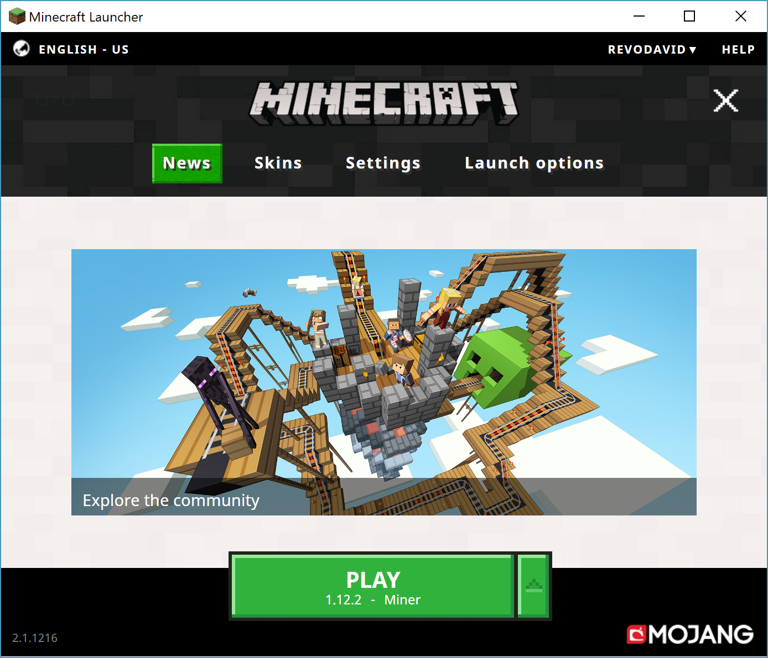
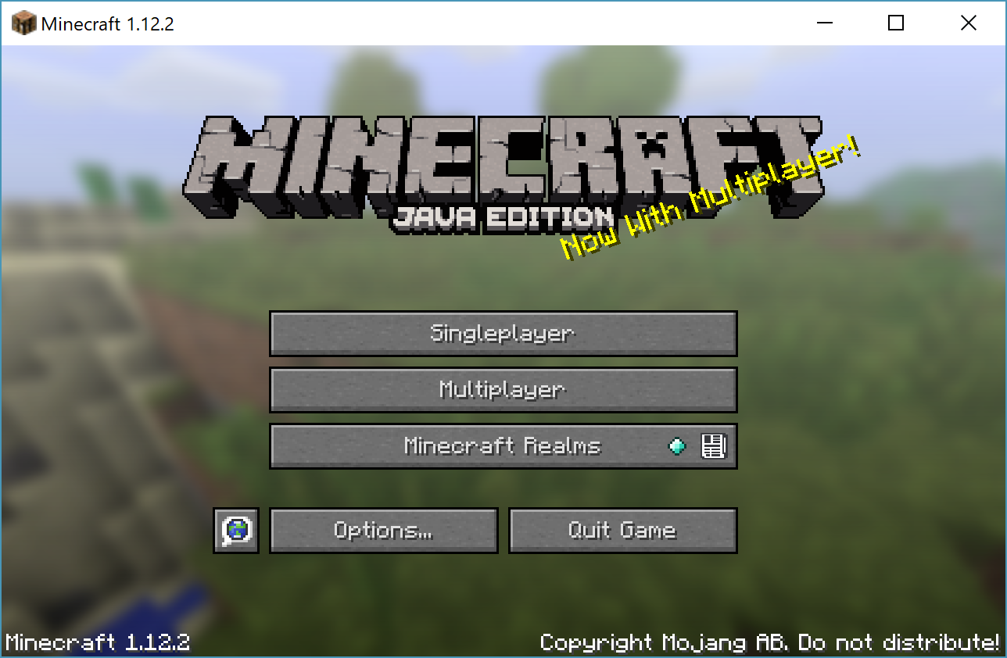


Launch Minecraft

Slide 11
Connect using miner package
In R:
library(devtools)
install_github("ropenscilabs/miner")
install_github("ropenscilabs/craft")
library(miner)
mc_connect("52.170.156.222")
chatPost("Connection Test")
Connections expire after about 10 mins, so reconnect as needed

Slide 12
Modifying the World
library(craft)
v <- getPlayerPos()
write_text("Welcome to" , v+c(0,12,0),
font="8x12", dir="west")
write_text(" SDSS2019" , v+c(0,1,0),
font="8x12", dir="west")

Slide 13
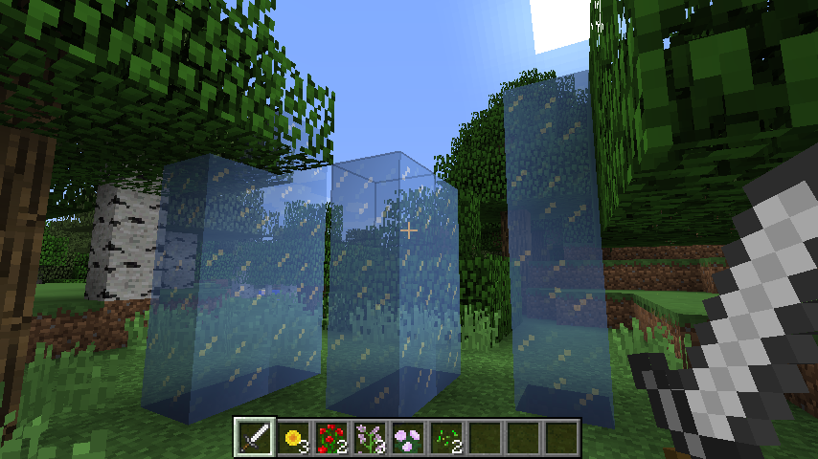
mc_connect()
getPlayerPosition()
setBlocks()
getBlockHits()

Slide 14
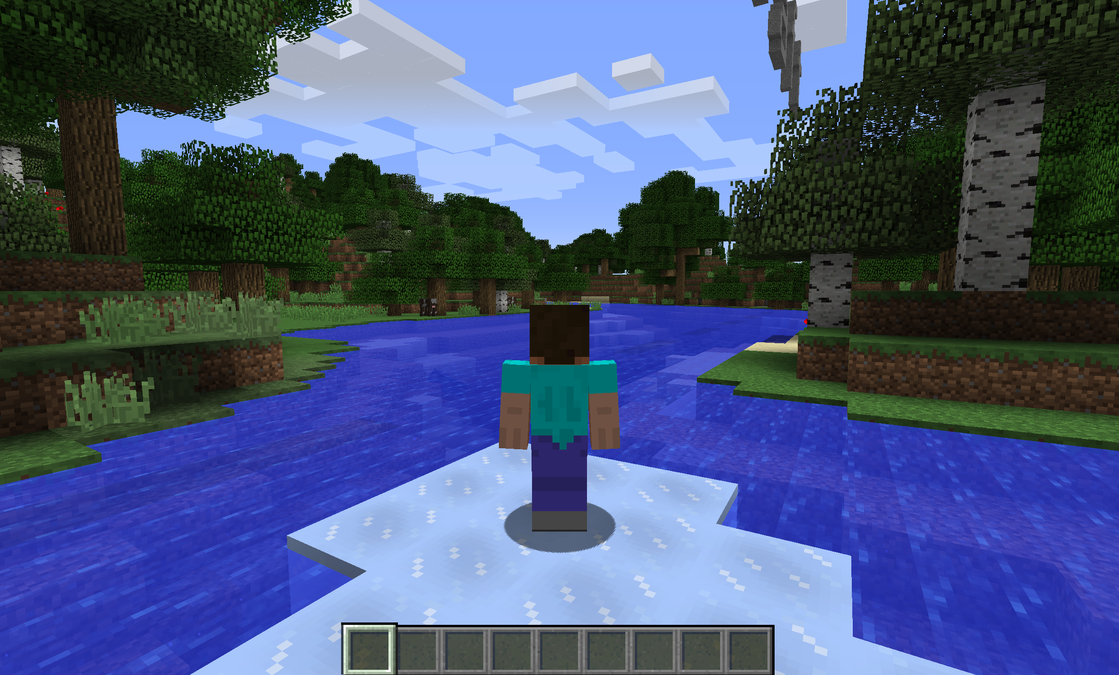
library(craft)
myid <- tail(getPlayerIds(),1)
elsafy(myid)

Slide 15
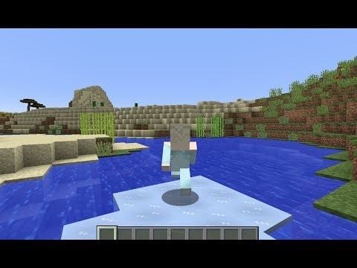
Interacting with players in-game

Slide 16
Interacting with players via chat
Send a message: chatPost()
Players can also chat (press T), which allows us to interact
Get recent messages: getchatPosts()

Slide 17
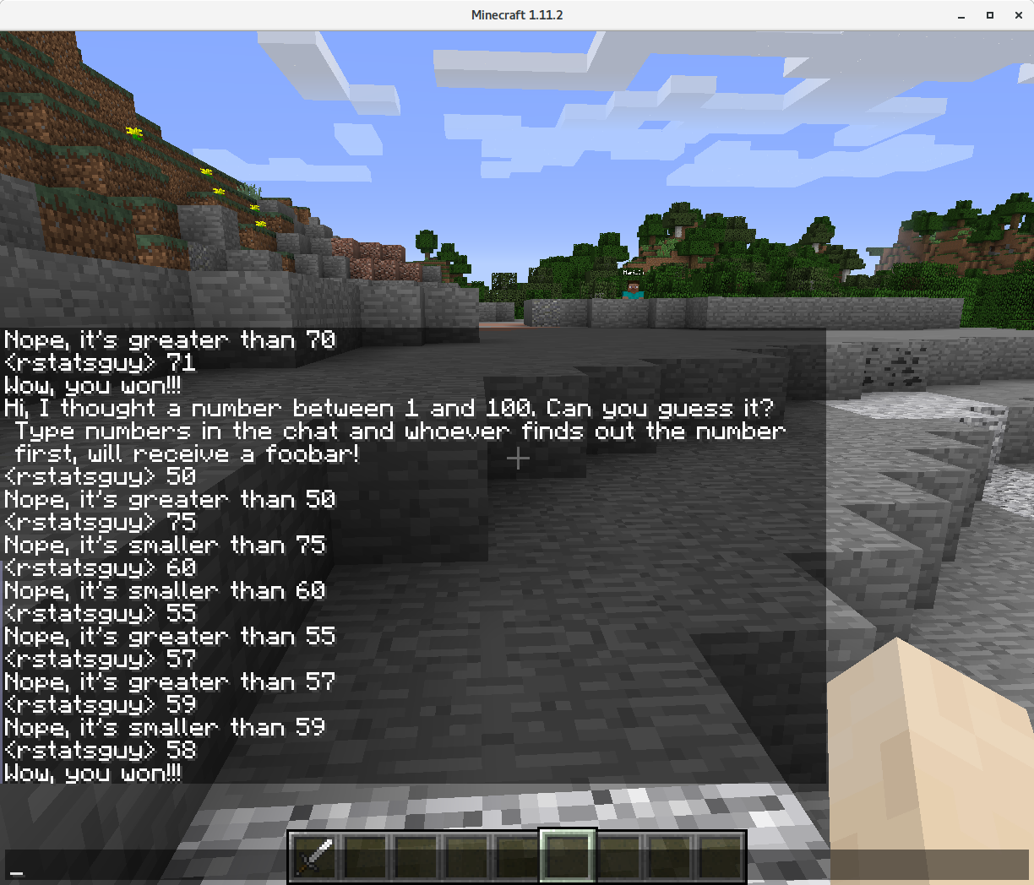
chatPost('Hi, I thought a number between 1 and 100.’)
msg <- getChatPosts()

Slide 18
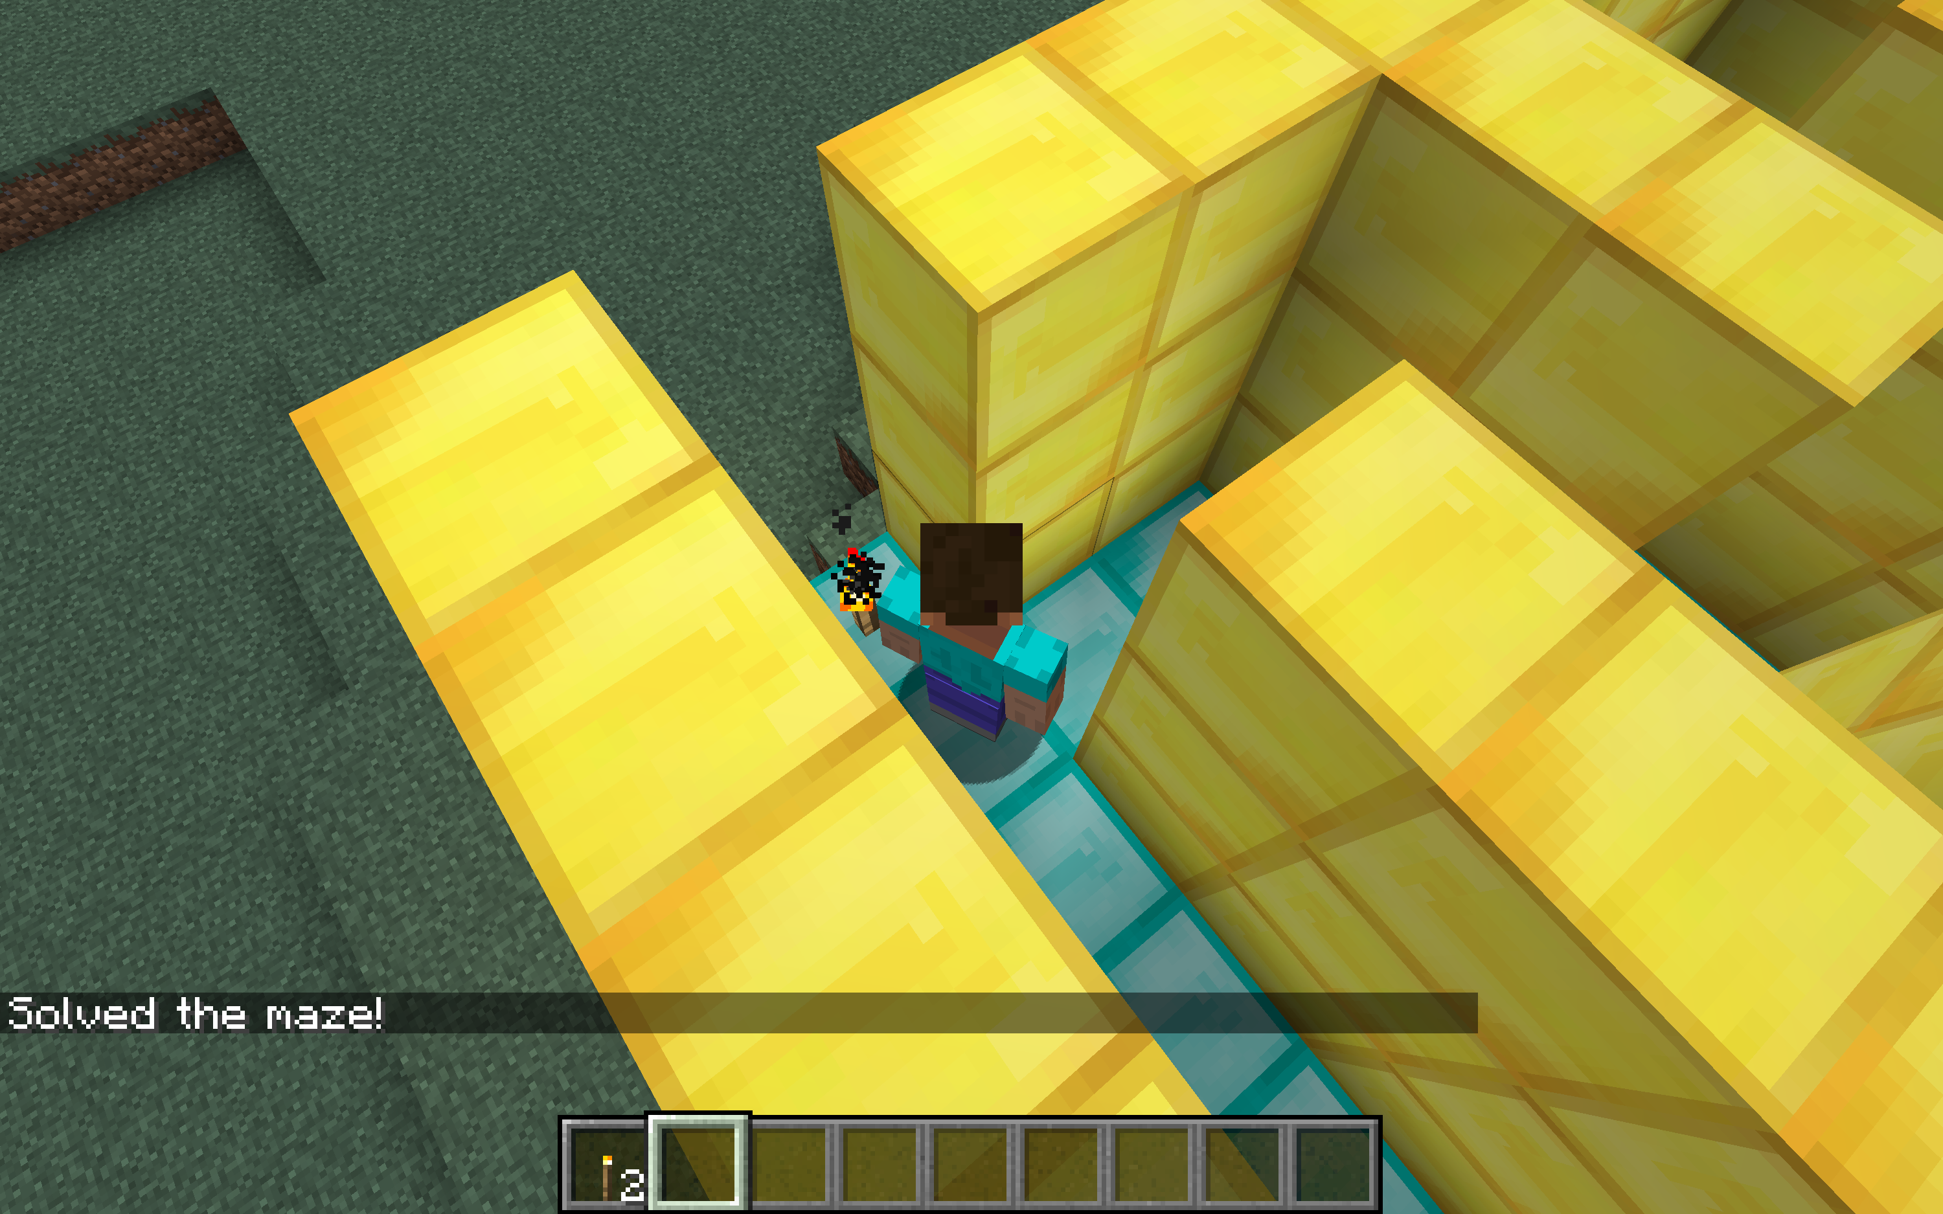
Maze Solving

Slide 19
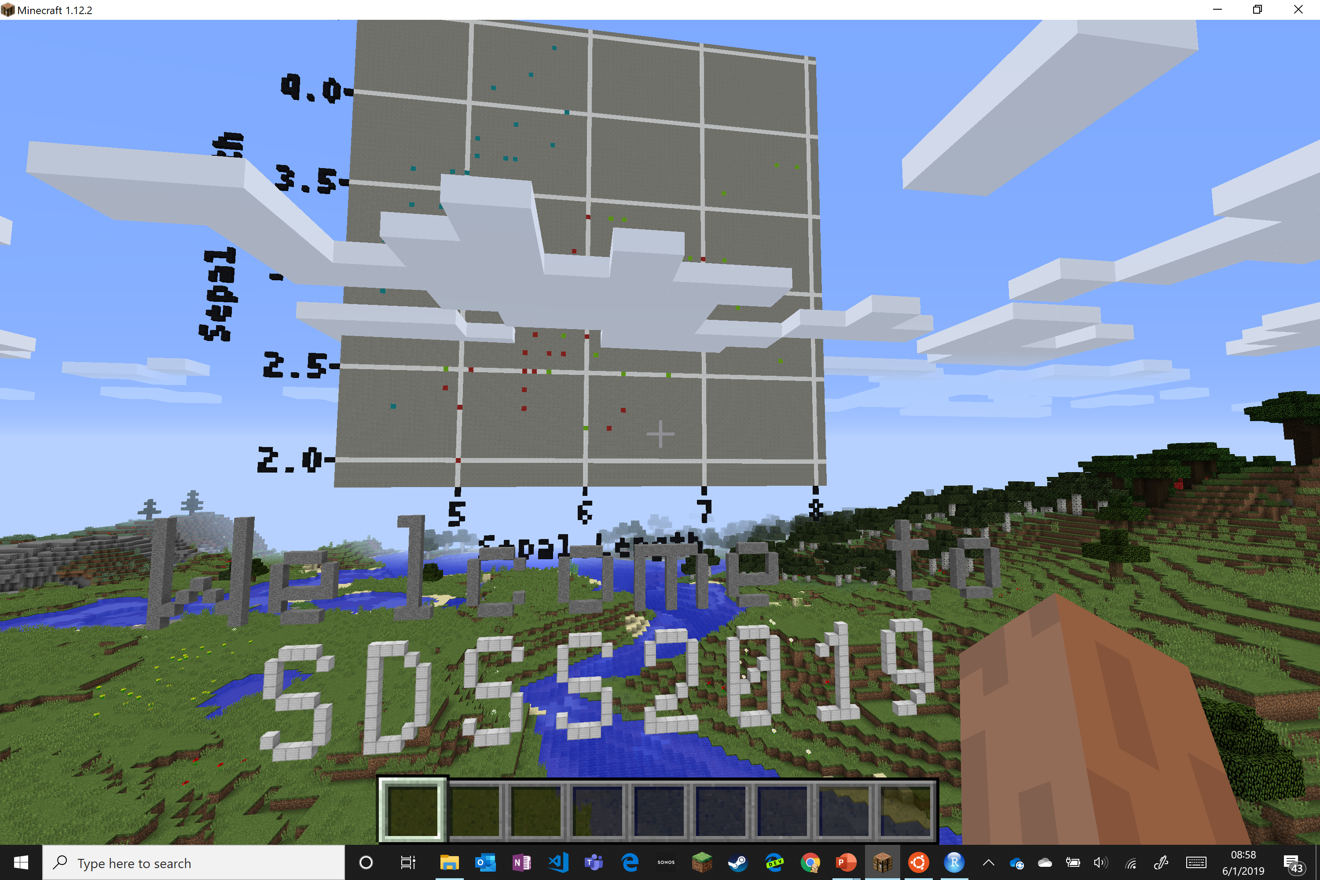
Scatterplots

Slide 20
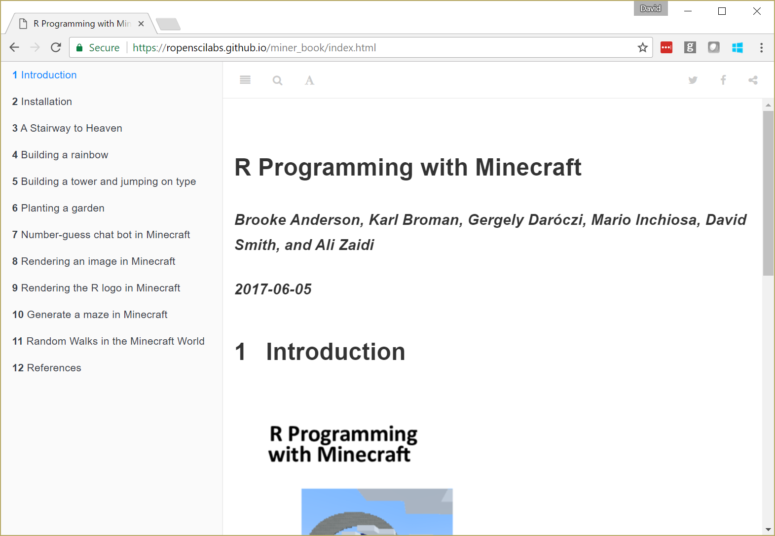

Slide 21
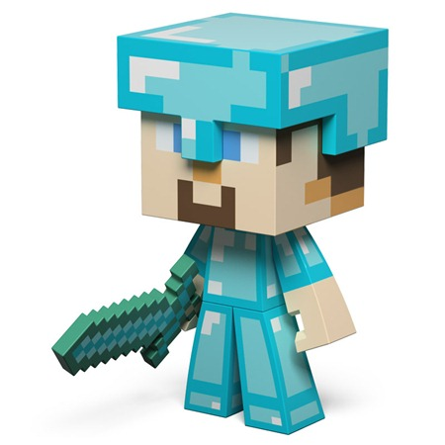
Resources
miner package:
github.com/ropenscilabs/miner
“R Programming with Minecraft”:
ropenscilabs.github.io/miner_book
Blog posts (search Minecraft):
blog.revolutionanalytics.com
The miner team:
  Brooke Anderson
  Karl Broman
  Gergely Daróczi
  Mario Inchiosa
  David Smith
  Ali Zaidi
Join my server: 13.78.135.40

