Slide 1
Intertwining Data Ethics in Intro Stats
Brianna Heggeseth, Ph.D.
Macalester College
Notes:
Thank you for staying this evening, during typical dinner time.
Miles talked about the entire curriculum and specifically gave examples about how to knit ethics into an advanced seminar, I’m going to talk about incorporating ethics into Intro Stats.
Start our students on their journey in statistics and data science with a moral compass to guide their way.
I hope that by the end, you’ll be empowered to teach student how to use their moral/ethical compass in and remind them to use it regularly throughout their journal. I’ll talk about ways I did this some key data examples, small group discussions, and a few readings. This is just one way to do this, and I’ll share my reflections as well as some of my students’ reflections.

Slide 2
Where I’ve been
Greetings from Williams College
Great Adventures Ahead!
Notes:
To give you some context about the environment in which I’ve been teaching….Here are some postcards from my journey
I spent 5 years teaching at Williams College and recently switch to Macalester College. Both of these places have around 2000 undergraduates (no grad students), both elite liberal arts institutions which require students to take classes across the disciplines to graduate.
Up until two year ago, I had never really talked about ethics in a class. But when I taught Senior Seminar at Williams on Data Mining in Spring 2018, I had finally gotten around to reading Weapons of Math Destruction by cathy o’neil so I assigned them read it throughout the semester since we were discussing many predictive models ----To be clear, I was really nervous about incorporating ethics into my classroom. I felt unprepared to lead discussions, I was worried about setting At the end, seniors wished they had had exposure to issues in Intro
Transitioned to Macalester last fall and taught Intro, incorporating Ethics

Slide 3
Where I’ve been
Williams College
2000 undergrads
Math/Stat Dept
1st Ethics Attempt:
Data Mining Senior Seminar
- Bit nervous to start
- Seniors had great feedback
Love, me
To:
Future self
Great Adventures Ahead!
Notes:
To give you some context about the environment in which I’ve been teaching….
I spent 5 years teaching at Williams College and recently switch to Macalester College. Both of these places have around 2000 undergraduates (no grad students), both elite liberal arts institutions which require students to take classes across the disciplines to graduate.
Up until two year ago, I had never really talked about ethics in a class. But when I taught Senior Seminar at Williams on Data Mining in Spring 2018, I had finally gotten around to reading Weapons of Math Destruction by cathy o’neil so I assigned them read it throughout the semester since we were discussing many predictive models ----To be clear, I was really nervous about incorporating ethics into my classroom. I felt unprepared to lead discussions, I was worried about setting At the end, seniors wished they had had exposure to issues in Intro
Transitioned to Macalester last fall and taught Intro, incorporating Ethics

Slide 4
Where I’ve been
Greetings from Williams College
Macalester College
2200 undergrads
Math/Stat/CS Dept
2nd Ethics Attempt:
Intro Stats
A few case studies
Small group discussions with prompts
Bring up early, often
Love, me
Great Adventures Ahead!
To:
Future Self
Notes:
To give you some context about the environment in which I’ve been teaching….
I spent 5 years teaching at Williams College and recently switch to Macalester College. Both of these places have around 2000 undergraduates (no grad students), both elite liberal arts institutions which require students to take classes across the disciplines to graduate.
Up until two year ago, I had never really talked about ethics in a class. But when I taught Senior Seminar at Williams on Data Mining in Spring 2018, I had finally gotten around to reading Weapons of Math Destruction by cathy o’neil so I assigned them read it throughout the semester since we were discussing many predictive models ----To be clear, I was really nervous about incorporating ethics into my classroom. I felt unprepared to lead discussions, I was worried about setting At the end, seniors wished they had had exposure to issues in Intro
Transitioned to Macalester last fall and taught Intro, incorporating Ethics

Slide 5
What is Data Ethics?
The thought and practice related to value concepts
such as justice, equality, fairness, honesty,
respect, rights, entitlements and care
with respect to the data generation and surveillance,
data sharing, trading, and protection,
and to what ends data are employed.
- Rob Kitchin in “The Data Revolution: Big Data, Open Data, Data Infrastructures and Their Consequences”
Notes:
Think about and what you are doing…

Slide 6
What is Data Ethics?
The thought and practice related to value concepts
such as justice, equality, fairness, honesty,
respect, rights, entitlements and care
with respect to the data generation and surveillance,
data sharing, trading, and protection,
and to what ends data are employed.
(awareness)
(action)
- Rob Kitchin in “The Data Revolution: Big Data, Open Data, Data Infrastructures and Their Consequences”
Notes:
Awareness of how these concepts are related to data and what you are doing about it to maintain justice, equality, etc. … both are vital
If you don’t have awareness, you can’t do anything about it.

Slide 7
What is Data Ethics?
The thought and practice related to value concepts
such as justice, equality, fairness, honesty,
respect, rights, entitlements and care
with respect to the data generation and surveillance,
data sharing, trading, and protection,
and to what ends data are employed.
(awareness)
(action)
data collection
data privacy
data analysis/modeling/prediction
- Rob Kitchin in “The Data Revolution: Big Data, Open Data, Data Infrastructures and Their Consequences”
Notes:
How you collect data
How you keep the data private and secure
How you use the data (analysis, visualization, modeling, prediction)

Slide 8
Why teach Data Ethics?
“As a statistician, it is easy to be immersed in the numbers churned up by the data and that tantalizing implications from their interpretation.
But behind every data point there is a human story,
there is a family, and there is suffering.”
– Dr. Nicholas Jewell (Chapter 1 in Statistics for Epidemiology)
Notes:
It is easy to get caught in the numbers….we aren’t typically interacting with the subjects in our data. It is easy to forget.
My PhD advisor includes these two sentences in the first chapter of his Stats for Epi to preface the introductory material. He has a routine (and recommends his students) of watching a movie, Wit (starring Emma Thompson) which covers a person diagnosed with cancer going through a clinical trial, to stay in tune with the human element.

Slide 9
What I learned back in the day…
History and Regulation of Human Subject Protections
  Historical Unethical Studies: Nuremberg Trials, Tuskegee Study
  Belmont Report -> U.S. Regulation
    1) Respect for persons; 2) Beneficence; and 3) Justice
Data Privacy is Important
  Work with de-identified or synthetic data
In an advanced consulting course or during research…
Notes:
Really important… foundation of ethical study design.
But the focus is on study design, which an introductory student may not be doing right away.
How does that apply to what students are doing in Intro?

Slide 10
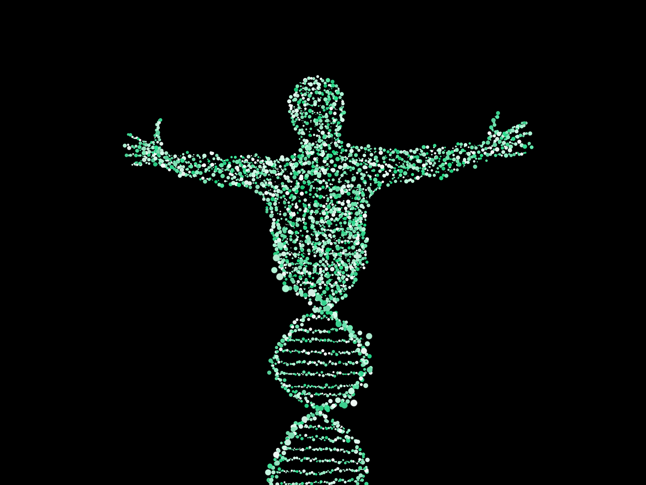


New forms of data
Notes:
So much data and new forms of data… our devices, from Fitbits to cell phones and computers to 23 and Me
Ethical issues are clearly present but the regulation is lagging behind…
Many students are aware of their data being used but not necessarily how it is being traded behind the scene.
Data is a commodity that is driving much of the business on the internet. From recommendation systems on Amazon to ads on Google.
These types of data are not always collected from a well-designed study but rather through a terms of service. While the principles are still relevant, these new forms of data present new ethical challenges.

Slide 11
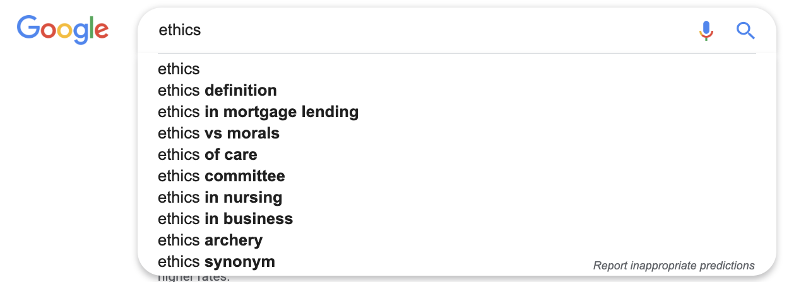
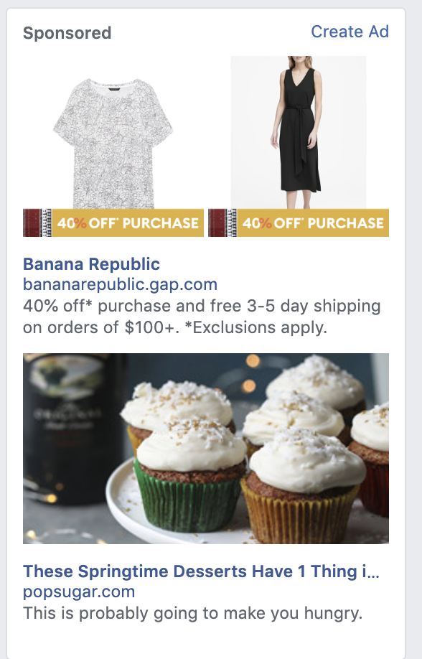
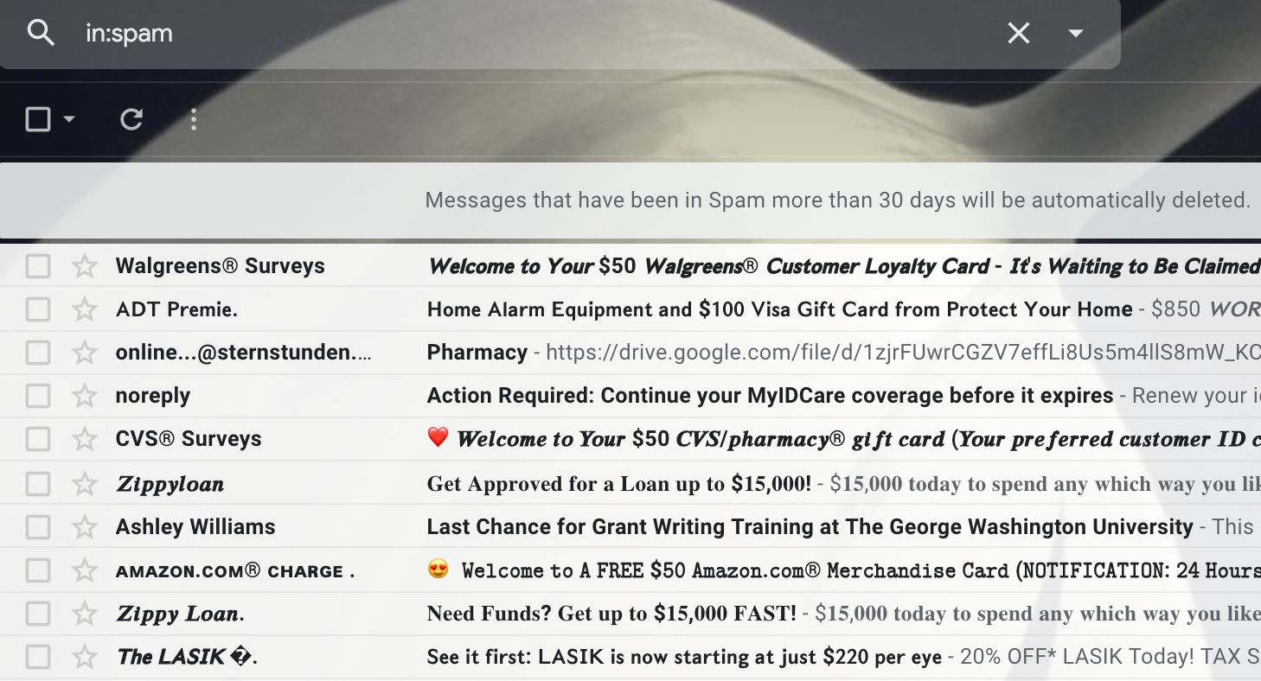
Models are everywhere
Notes:
We interact with models all of the time.
Text prediction
Spam detection
Suggested Ads/Recommendation systems
Resume filtering
Credit Scoring

Slide 12
Models are not objective
Notes:
“Algorithmic Bias”: describes systematic and repeatable errors in a computer system that create unfair outcomes, such as privileging one arbitrary group of users over others.
This applies to any and all statistical methods that are based on an estimation or optimization based on data.
In the last 3 years, all of these books have come out. All of them providing a different perspective on algorithmic bias.
I’ve read three and will be reading the rest soon…

Slide 13
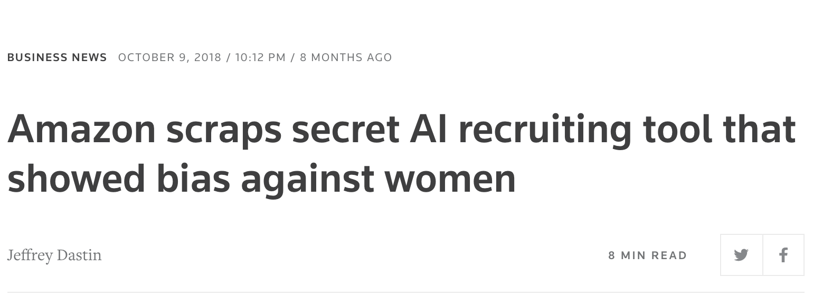
Models have real consequences
Source: Rutgers
Source: ProPublica, “Machine Bias” on recidivism models

Slide 14
Why in Intro Stats?
Increase data literacy among everyone
  “[W]e want our students to be good ‘statistical citizens,’ understanding statistics well enough to be able to consume the information that they are inundated with on a daily basis, think critically about it, and make good decisions based on that information”
Prepare future statisticians/data scientists/research scientists
  “Regardless of where a person is involved in the chain of statistical information, there will be a need for a basic understanding of the concepts and language, a level of reasoning (the abilities to question, compare, and explain) and a level of statistical thinking (applying the ideas to new problems and identifying questions of your own).”
From “Statistical Literacy as a Goal for Introductory Statistics Courses” in Journal of Statistics Education, 2017

Slide 15
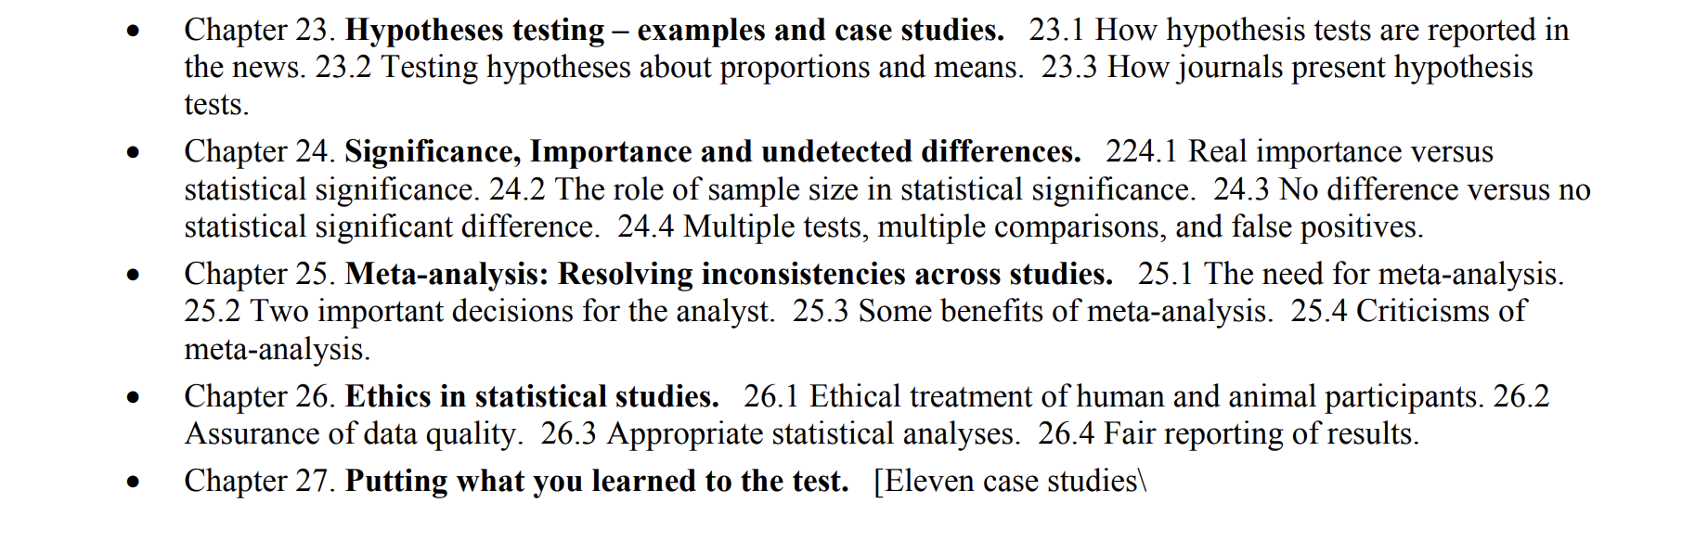
Existing Intro Texts
"Seeing Through Statistics" 4th Edition by Jessica Utts

Slide 16
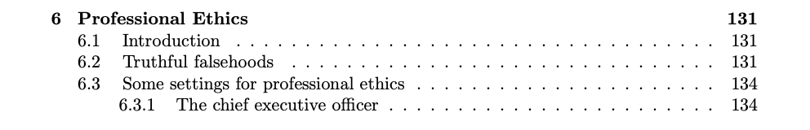
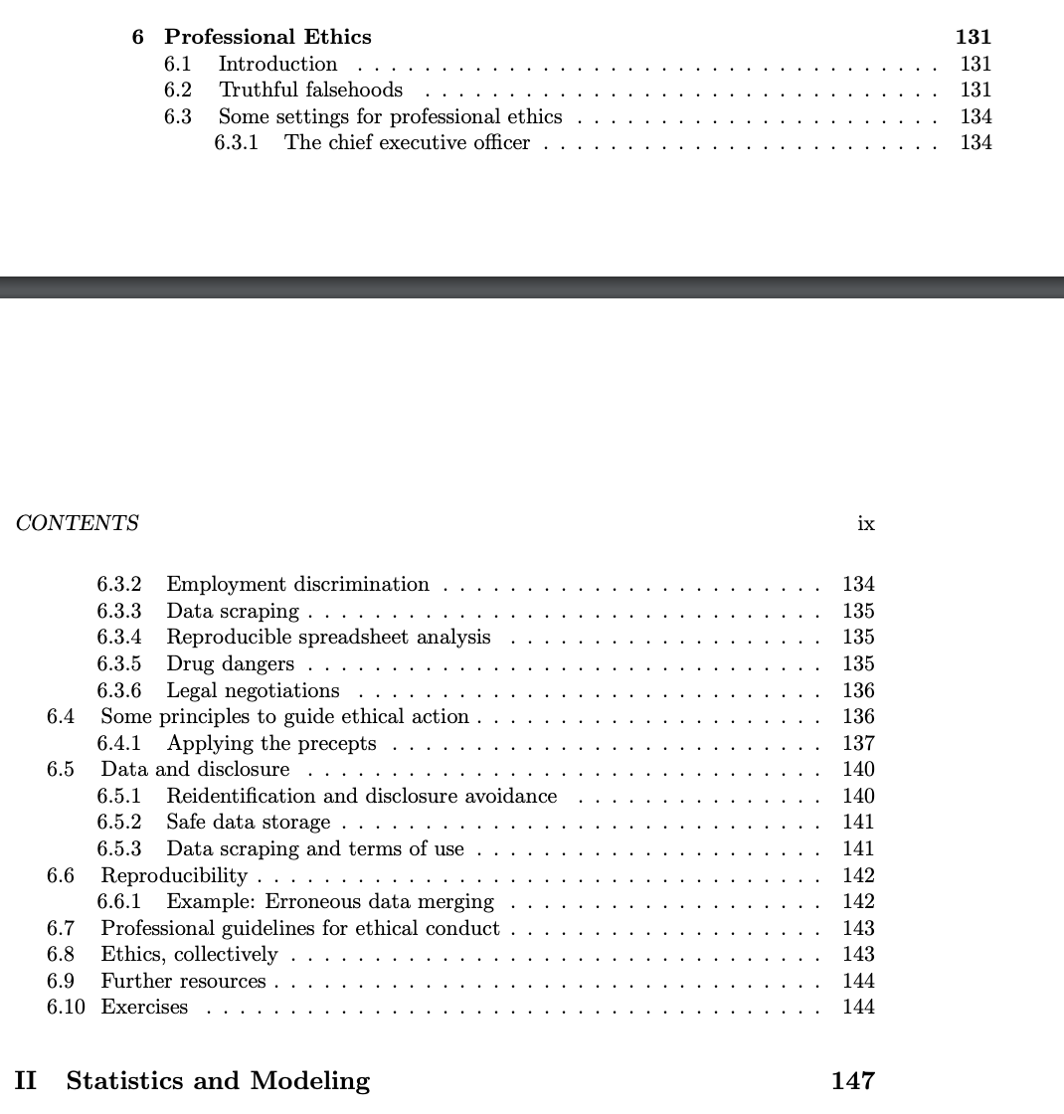
Existing Intro Texts
“Modern Data Science with R” by Baumer, Kaplan, Horton

Slide 17
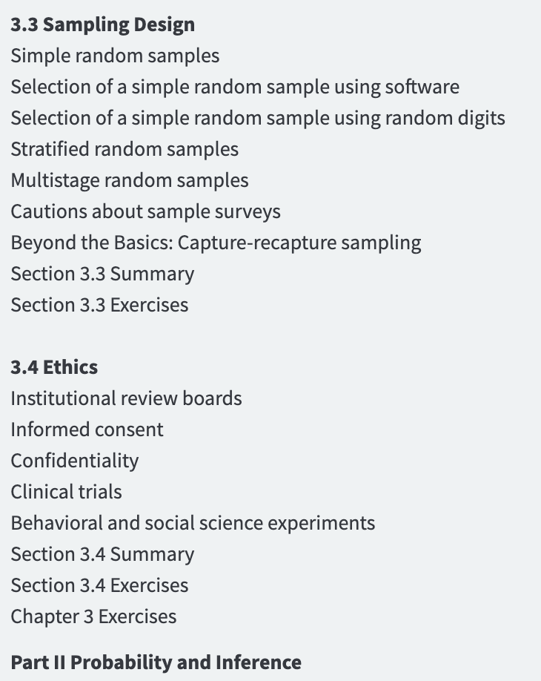
Existing Intro Texts
“Introduction to the Practice of Statistics” by Moore, McCabe, Craig

Slide 18
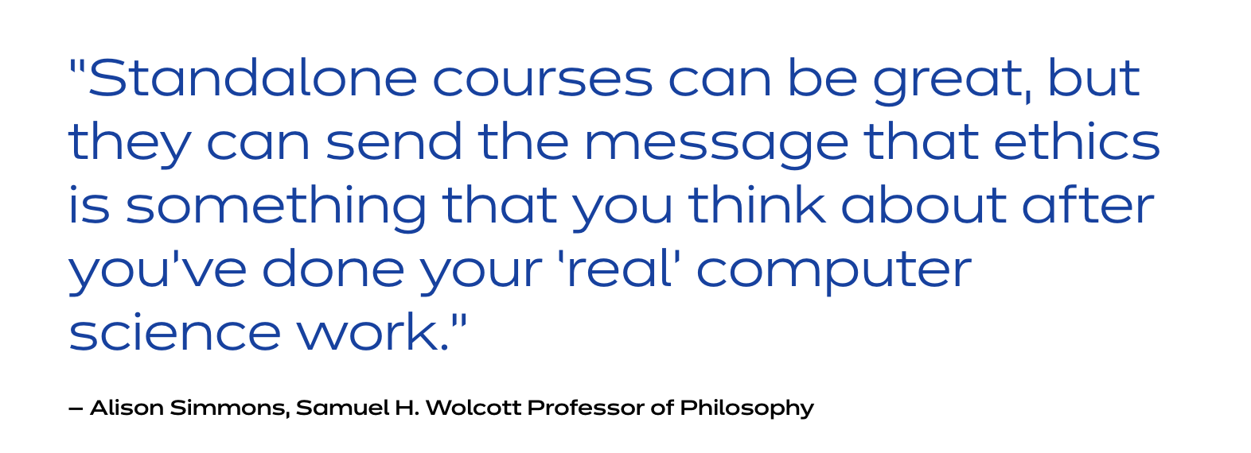
Why not a separate class or one day of class?

Slide 19
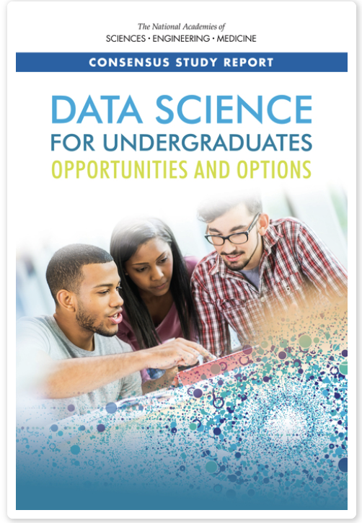
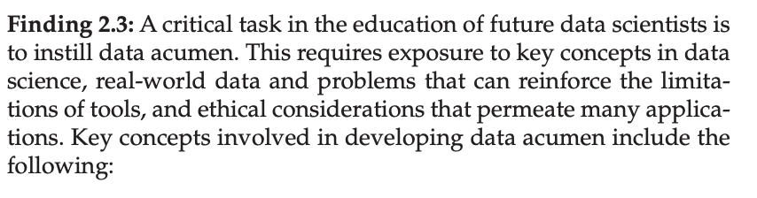
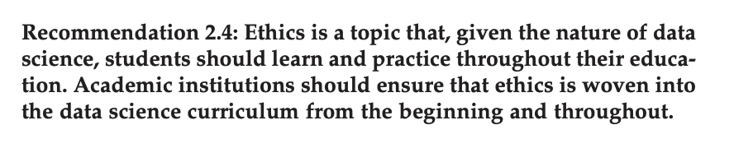
Why not a separate class or one day of class?

Slide 20
Resistance
+ My responses now
Already too many topics to cover – What do we have to we cut?
I’m not qualified to teach ethics…
Students can take an ethics course in philosophy dept…
Sprinkle it in with existing topics
Not teaching Kant or Utilitarianism but increasing awareness
We model good analysis by stopping to think about these issues

Slide 21
Macalester Intro Class
Data Collection and Quality
Visualizing Data
Regression Models
Random Variability
Randomness and Probability
Statistical Inference
https://bcheggeseth.github.io/Math155Notes/ (Class Notes)
Focus on Modeling
Real data examples throughout

Slide 22
One way to do it
Bring it up on Day One
  Defining data and data context (W’s)
Use real data and talk real choices and consequences
  Small group discussions about a real data set
Reinforce when talking about sampling and biases
  Who is in the sample and who’s not? Impact?
Models selection and algorithmic bias
  Choices in variables and their impact
Consequences of errors
  Residuals/Prediction Errors, Decision Making (Hypothesis Testing)

Slide 23
Data Examples
Data: Police Stops/Reported Crimes (San Francisco: data.sfgov.org)
Statistics Topic: Visualization, Data Context (Who, What, Where, When…)
Ethics Discussion Prompts:
  Who is in this data set and who is not?
  What would the implications be if we used this data to predict where future crimes would be?

Slide 24
Data Examples
Data: House Prices (Iowa House Prices at Kaggle.com or SaratogaHouses in mosaicData)
Statistics Topic: Linear Regression, Residual Analysis
Ethics Discussion Prompts:
  Are the errors systematically different for different subsets?
  Check for discriminatory predictions using variables not included in model
  How might a price prediction model (Zillow, Redfin) impact the process of buying a house for an individual?

Slide 25
Data Examples
Data: House Prices (Iowa House Prices at Kaggle.com or SaratogaHouses in mosaicData)
Statistics Topic: Linear Regression, Model Selection
Ethics Discussion Prompts:
  What variables should you used to predict price? Neighborhood?
  What if a variable is predictive of price because of past racial relining practices?

Slide 26
My Reflection
Spent less class time on ethics than I had wanted – sprinkled it in and had one day of a major “ethics discussion” on a reading from WMD
Wanted to have incorporated an ethical questions into every homework – not quite
Tried to keep data context and real human consequences present in class discussions – almost always
“Models are opinions embedded in mathematics” – Cathy O’Neil

Slide 27
Student Feedback
Name 2-3 things you learned or who you grew in this class.
I learned all about creating, evaluating, and interpreting models, in addition to the ethics and strategy surrounding the data collection used as inputs. I also learned how to conduct independent research of my own in R, which is something I plan on continuing to do in the future.
I learned the danger of creating a model around limited data and how all models are wrong and that it can be especially problematic if models are wrong in non random random ways that lead to sub populations being undercounted or misrepresented. I additionally came to understand that the idea of statistically significant is not purely mathematical. There are aspects of it which are more qualitative which must be taken into account when building a model.
I learned how to spot ethical problems within a model (such as examining the sample population and seeing how statisticians applied results from the model to a larger population) and to think critically about whether certain variables are useful in certain models.

Slide 28
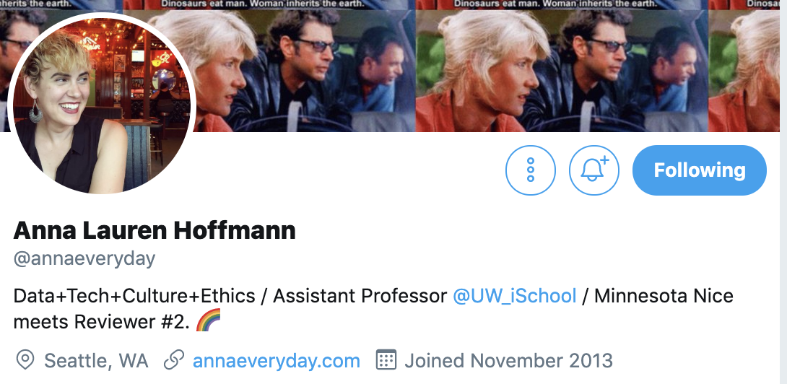
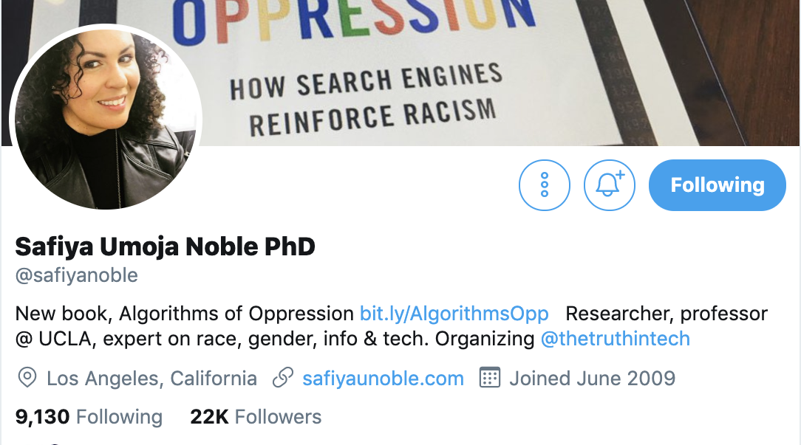
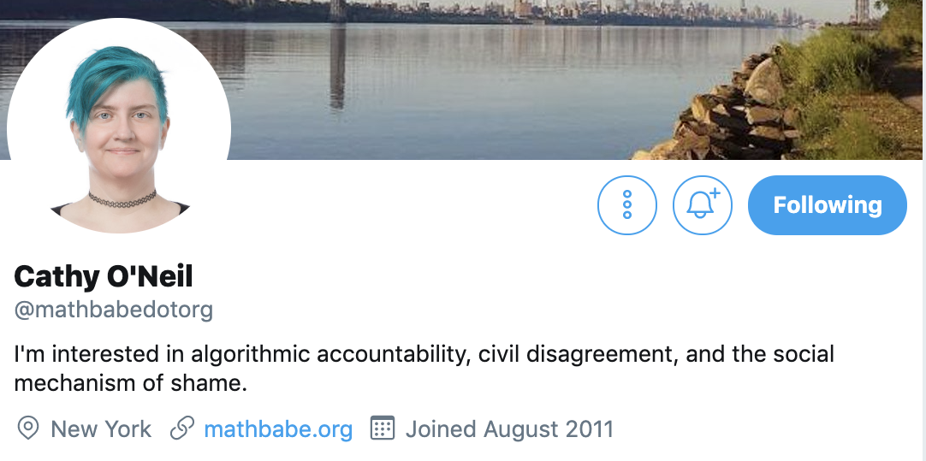
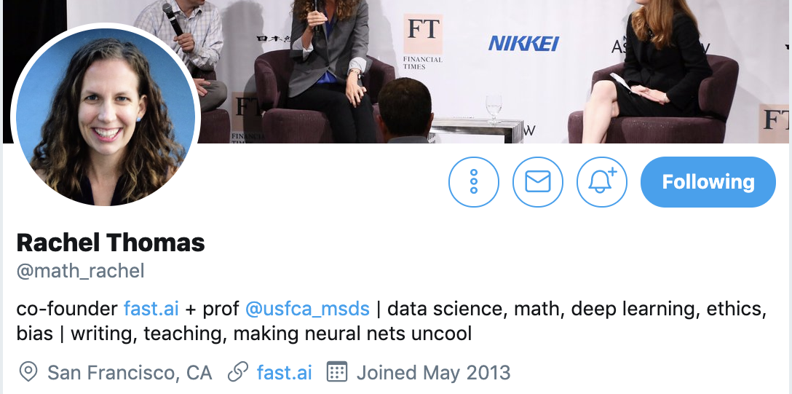
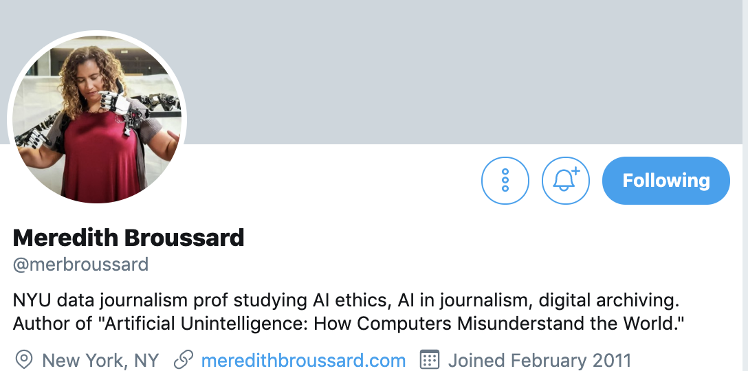
People to Follow

Slide 29
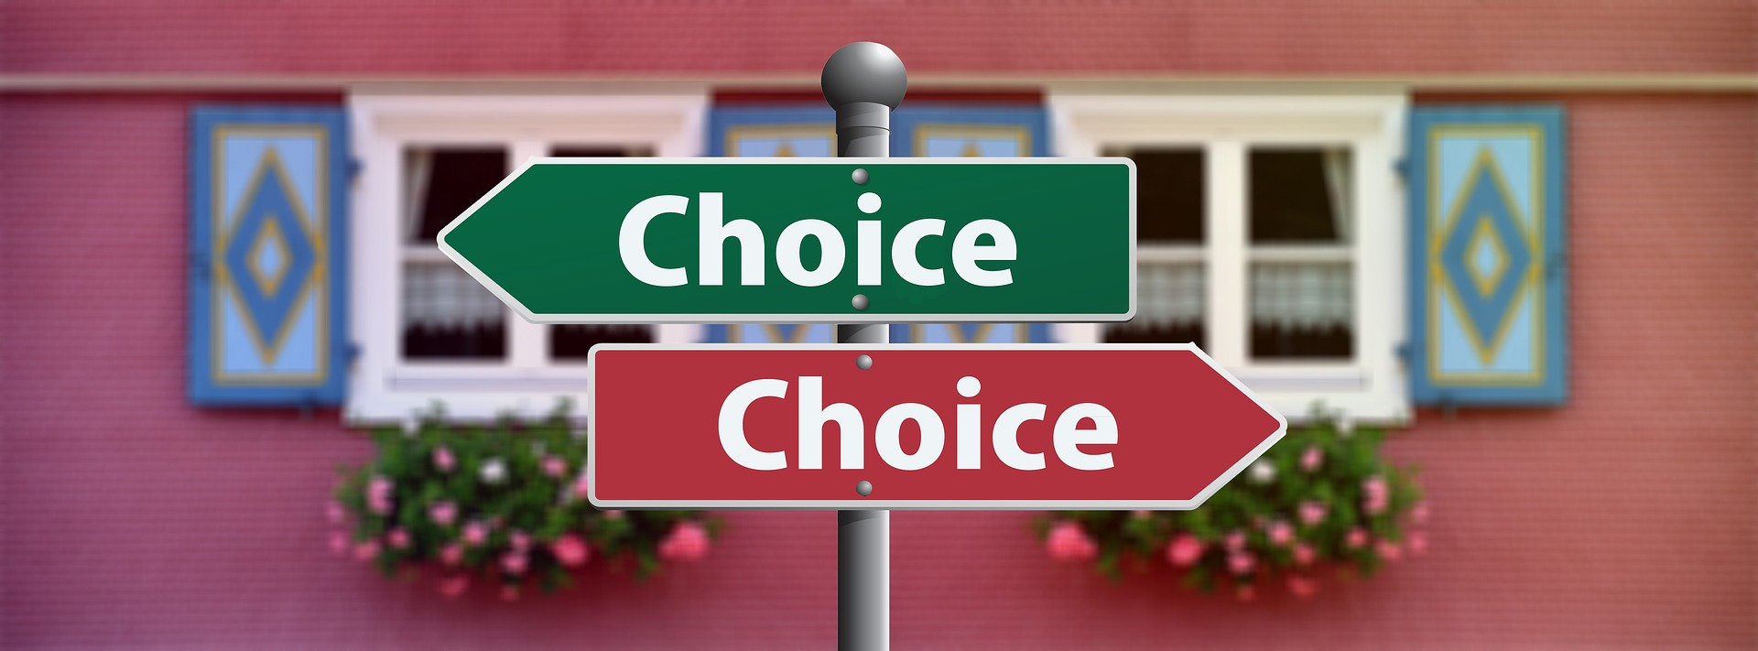
Teach/Use that Moral Compass
Early and Often!
Contact me
Email: bheggese@macalester.edu
Twitter: @bcheggeseth
Github: bcheggeseth

