Slide 1




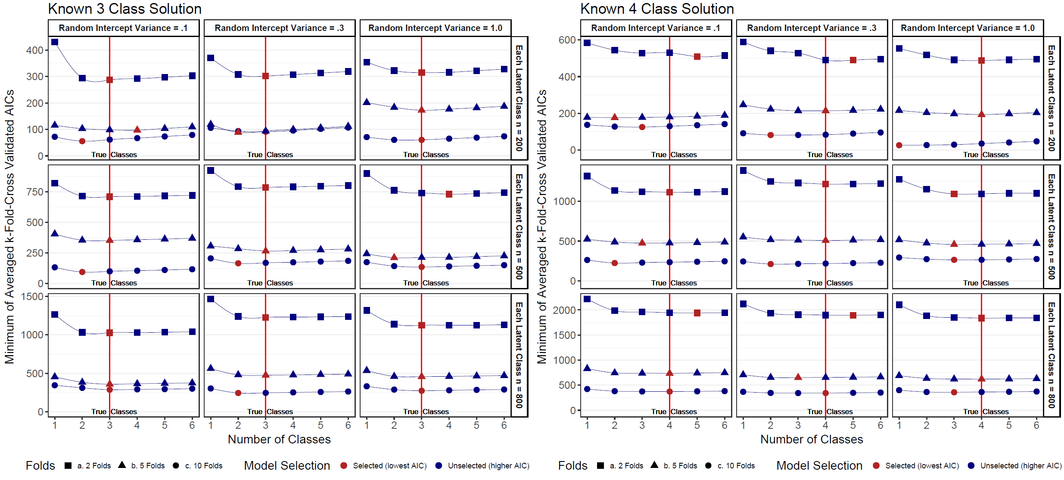
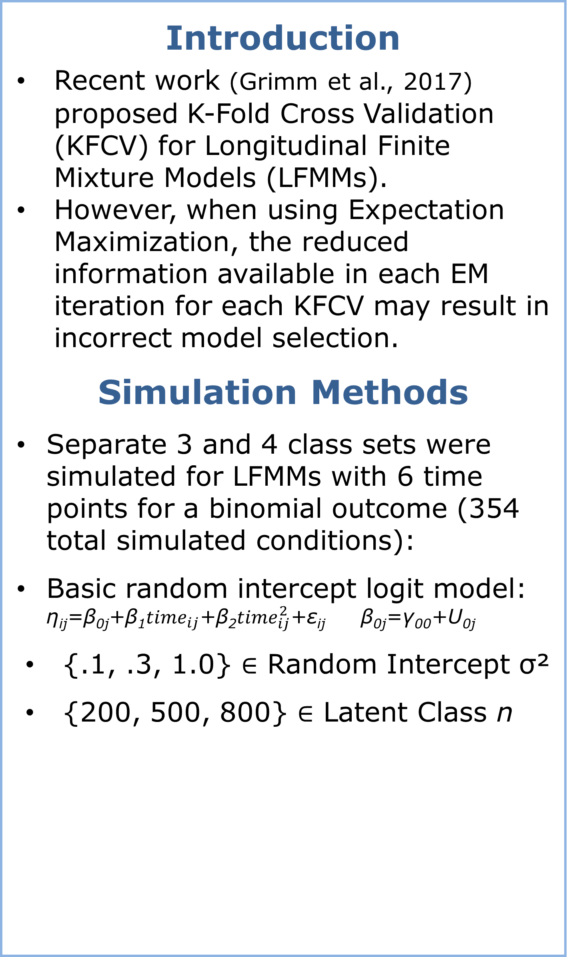
Performance of K-Fold Cross Validation for Binary Longitudinal Finite Mixture Models:
A Simulation and Cautionary Assessment
Thom Taylor, PhD
Nicklaus Children’s Research Institute, Miami, FL
VA Palo Alto Health Care System, Palo Alto, CA
Introduction
Recent work (Grimm et al., 2017) proposed K-Fold Cross Validation (KFCV) for Longitudinal Finite Mixture Models (LFMMs).
However, when using Expectation Maximization, the reduced information available in each EM iteration for each KFCV may result in incorrect model selection.
Simulation Methods
Separate 3 and 4 class sets were simulated for LFMMs with 6 time points for a binomial outcome (354 total simulated conditions):
Basic random intercept logit model: η_{ij}=β_{0j}+β₁${time}_{ij}$+β₂${time}_{ij}^{2}$+ε_{ij} β_{0j}=γ₀₀+U_{0j}
  {.1, .3, 1.0} ∈ Random Intercept σ²
  {200, 500, 800} ∈ Latent Class n
Results & Conclusions
70% of known 3 class simulations had the lowest AIC (best fit) while only 41% of known 4 class solutions had the lowest AIC (best fit), p = .06.
KFCV may not always be appropriate in EM-based LFMMs, particularly if there is greater unobserved heterogeneity in the available data.
3 Class Model Simulation Parameters |  |  |  | 4 Class Model Simulation Parameters
Class | β_{0j} | β₁ | β₂ | Class | β_{0j} | β₁ | β₂
1 | -3 | 3 | 0.05 | 1 | 3 | -2 | 0
2 | 0 | -0.5 | -0.1 | 2 | 0 | -0.01 | -0.01
3 | -5 | 0.2 | 0.1 | 3 | -5 | 3 | 0
 |  |  |  | 4 | -8 | 0 | 0.6

Slide 2
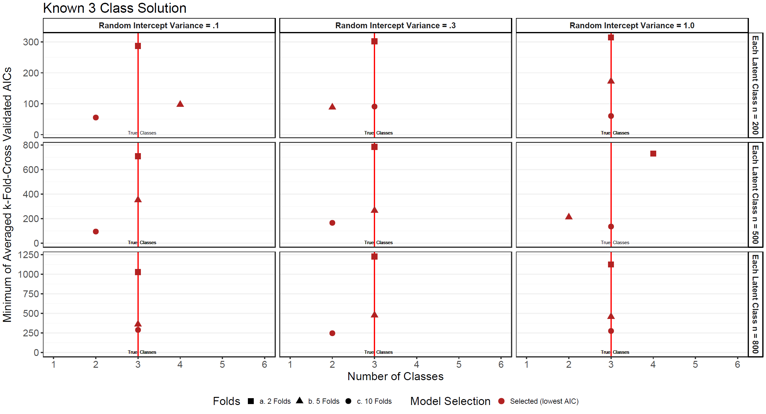
Performance of K-Fold Cross Validation for Binary Longitudinal Finite Mixture Models:
A Simulation and Cautionary Assessment
Thom Taylor, PhD
Nicklaus Children’s Research Institute, Miami, FL
VA Palo Alto Health Care System, Palo Alto, CA
Introduction
Recent work (Grimm et al., 2017) proposed K-Fold Cross Validation (KFCV) for Longitudinal Finite Mixture Models (LFMMs).
However, when using Expectation Maximization, the reduced information available in each EM iteration for each KFCV may result in incorrect model selection.
Simulation Methods
Separate 3 and 4 class sets were simulated for LFMMs with 6 time points for a binomial outcome (354 total simulated conditions):
Basic random intercept logit model: η_{ij}=β_{0j}+β₁${time}_{ij}$+β₂${time}_{ij}^{2}$+ε_{ij} β_{0j}=γ₀₀+U_{0j}
  {.1, .3, 1.0} ∈ Random Intercept σ²
  {200, 500, 800} ∈ Latent Class n
Results & Conclusions
70% of known 3 class simulations had the lowest AIC (best fit) while only 41% of known 4 class solutions had the lowest AIC (best fit), p = .06.
KFCV may not always be appropriate in EM-based LFMMs, particularly if there is greater unobserved heterogeneity in the available data.
3 Class Model Simulation Parameters |  |  |  | 4 Class Model Simulation Parameters
Class | β_{0j} | β₁ | β₂ | Class | β_{0j} | β₁ | β₂
1 | -3 | 3 | 0.05 | 1 | 3 | -2 | 0
2 | 0 | -0.5 | -0.1 | 2 | 0 | -0.01 | -0.01
3 | -5 | 0.2 | 0.1 | 3 | -5 | 3 | 0
 |  |  |  | 4 | -8 | 0 | 0.6

Slide 3
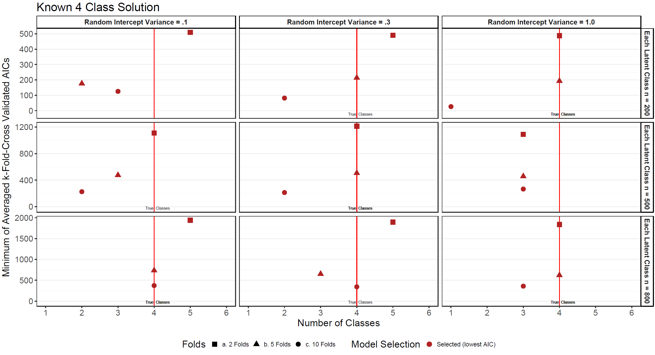
Performance of K-Fold Cross Validation for Binary Longitudinal Finite Mixture Models:
A Simulation and Cautionary Assessment
Thom Taylor, PhD
Nicklaus Children’s Research Institute, Miami, FL
VA Palo Alto Health Care System, Palo Alto, CA
Introduction
Recent work (Grimm et al., 2017) proposed K-Fold Cross Validation (KFCV) for Longitudinal Finite Mixture Models (LFMMs).
However, when using Expectation Maximization, the reduced information available in each EM iteration for each KFCV may result in incorrect model selection.
Simulation Methods
Separate 3 and 4 class sets were simulated for LFMMs with 6 time points for a binomial outcome (354 total simulated conditions):
Basic random intercept logit model: η_{ij}=β_{0j}+β₁${time}_{ij}$+β₂${time}_{ij}^{2}$+ε_{ij} β_{0j}=γ₀₀+U_{0j}
  {.1, .3, 1.0} ∈ Random Intercept σ²
  {200, 500, 800} ∈ Latent Class n
Results & Conclusions
70% of known 3 class simulations had the lowest AIC (best fit) while only 41% of known 4 class solutions had the lowest AIC (best fit), p = .06.
KFCV may not always be appropriate in EM-based LFMMs, particularly if there is greater unobserved heterogeneity in the available data.
3 Class Model Simulation Parameters |  |  |  | 4 Class Model Simulation Parameters
Class | β_{0j} | β₁ | β₂ | Class | β_{0j} | β₁ | β₂
1 | -3 | 3 | 0.05 | 1 | 3 | -2 | 0
2 | 0 | -0.5 | -0.1 | 2 | 0 | -0.01 | -0.01
3 | -5 | 0.2 | 0.1 | 3 | -5 | 3 | 0
 |  |  |  | 4 | -8 | 0 | 0.6

Slide 4

Performance of K-Fold Cross Validation for Binary Longitudinal Finite Mixture Models:
A Simulation and Cautionary Assessment
Thom Taylor, PhD
Nicklaus Children’s Research Institute, Miami, FL
VA Palo Alto Health Care System, Palo Alto, CA
Introduction
Recent work (Grimm et al., 2017) proposed K-Fold Cross Validation (KFCV) for Longitudinal Finite Mixture Models (LFMMs).
However, when using Expectation Maximization, the reduced information available in each EM iteration for each KFCV may result in incorrect model selection.
Simulation Methods
Separate 3 and 4 class sets were simulated for LFMMs with 6 time points for a binomial outcome (354 total simulated conditions):
Basic random intercept logit model: η_{ij}=β_{0j}+β₁${time}_{ij}$+β₂${time}_{ij}^{2}$+ε_{ij} β_{0j}=γ₀₀+U_{0j}
  {.1, .3, 1.0} ∈ Random Intercept σ²
  {200, 500, 800} ∈ Latent Class n
Results & Conclusions
70% of known 3 class simulations had the lowest AIC (best fit) while only 41% of known 4 class solutions had the lowest AIC (best fit), p = .06.
KFCV may not always be appropriate in EM-based LFMMs, particularly if there is greater unobserved heterogeneity in the available data.
3 Class Model Simulation Parameters |  |  |  | 4 Class Model Simulation Parameters
Class | β_{0j} | β₁ | β₂ | Class | β_{0j} | β₁ | β₂
1 | -3 | 3 | 0.05 | 1 | 3 | -2 | 0
2 | 0 | -0.5 | -0.1 | 2 | 0 | -0.01 | -0.01
3 | -5 | 0.2 | 0.1 | 3 | -5 | 3 | 0
 |  |  |  | 4 | -8 | 0 | 0.6

