Slide 1
Predicting the Sale Price of Homes in Ames,Iowa
Matea Milojkovic, Chad Morton, Anna Romanova, and William Thacker
Winthrop University

Slide 2
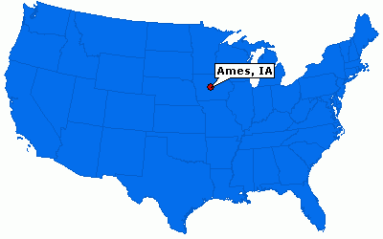
Who, When, Where
Data set: Ames, Iowa home sales 2006 – 2010
Population: 66,000
Size: 24 sq. miles

Slide 3
The Challenge
Challenge: Predict home sale prices from home features
Training Set: 1,490 homes sold with 80 variables
  Size and Number of Rooms
  Lot Size and Shape
  Basement Size and Features
  Exterior Materials and Quality
  Garage Types
  Location
  Number of Kitchens

Slide 4
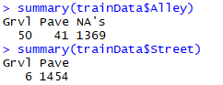
Feature Engineering and Transformations
Created New Variables
  Sale Age = Year Sold – Year Built
  Years Since Remodeling = Year Sold – Year Remodeled
  Total Bathrooms = Full Baths + (Half Baths * 0.5)
  logSalePrice = log(SalePrice)
Variable Elimination

Slide 5
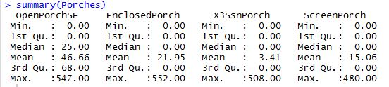


Feature Engineering and Transformations (continued…)
Reorder factors and reduce levels
  Create binary variables: Porch, Deck, Fireplace, Fence
  Reordered factors based on frequencies and business logic

Slide 6

Three Approaches for Dimensionality Reduction
Approach One
  Random Forest reduced number of variables by 30%
  Build_model() algorithm gives best model using all possible regressions approach
Approach Two
  Use all 29 variables directly into build_model()
Approach Three
  Lasso Regression

Slide 7
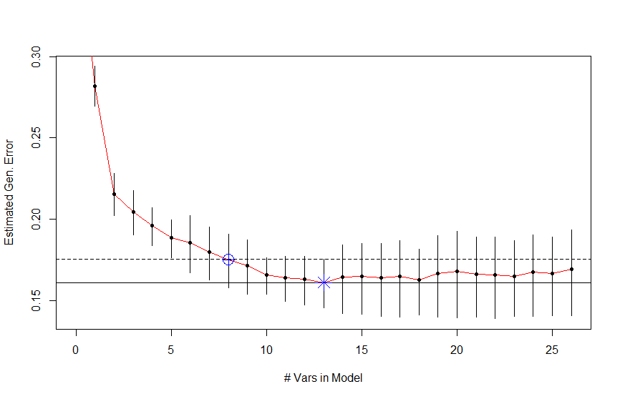
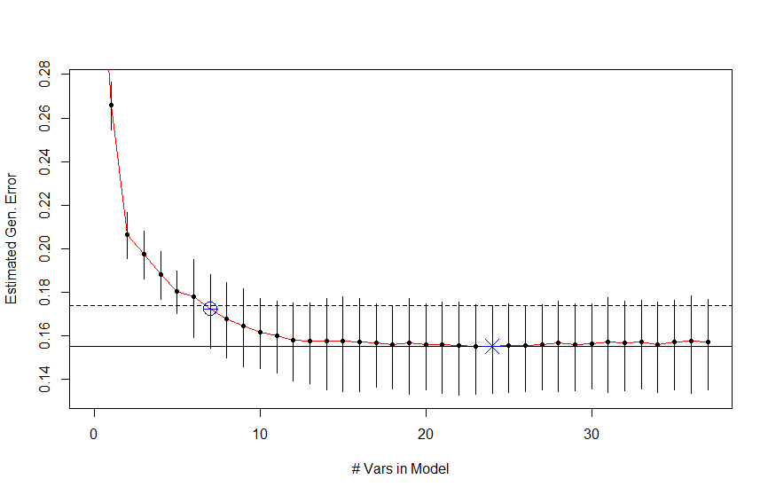
Build_Model() Graphs
Approach One
Approach Two

Slide 8


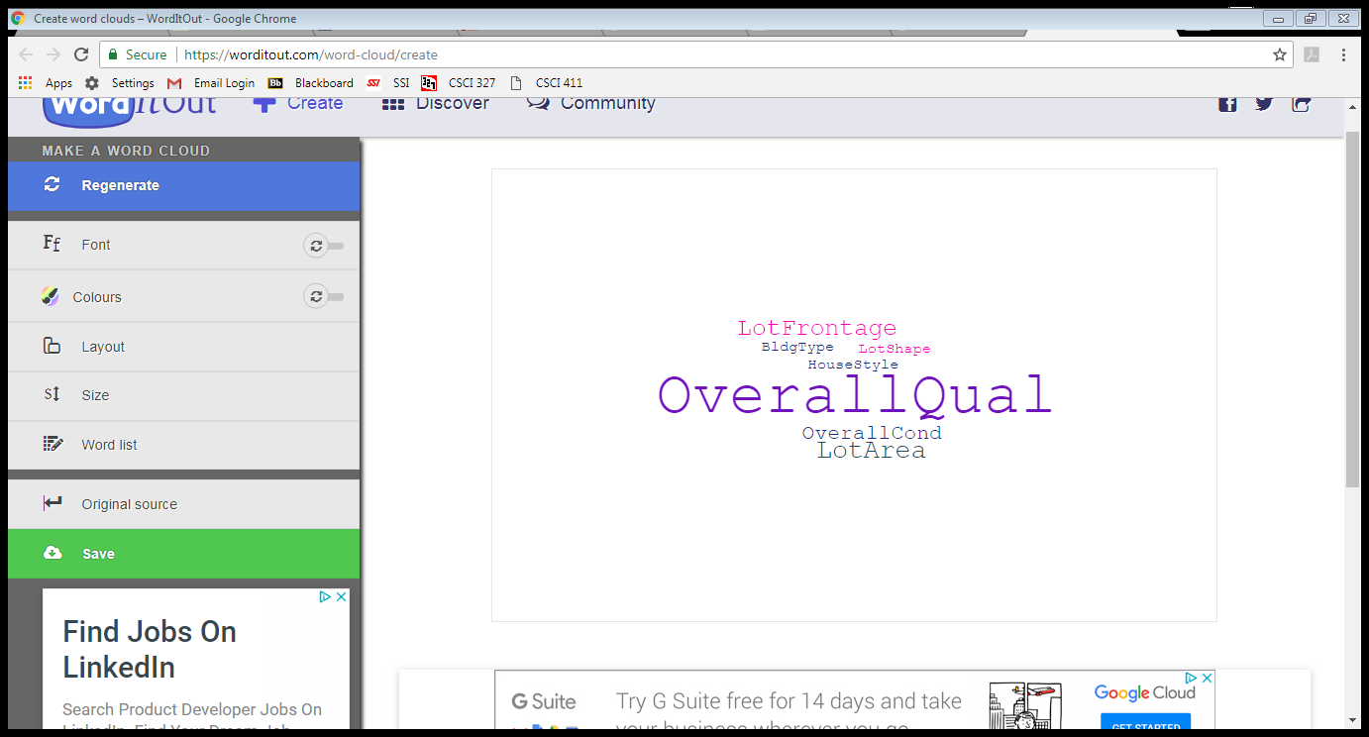
Predictor Recommendations
Approach One
Approach Two
Approach Three

Slide 9
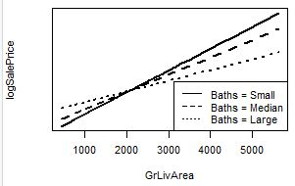
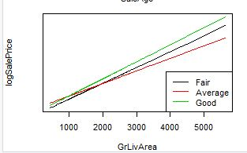
Second Order Interactions
Interactions:
  Ground Living Area * Number of Baths
  Sale Age * Years Since Remodeling
  Overall Quality * Ground Living Area

Slide 10
Results
Model | Root Mean Square Error (RMSE)
LM1 | 0.1460
RF1 | 0.1300
LM2 | 0.14676
RF2 | 0.1317
Lasso Regression | 0.1505

Slide 11
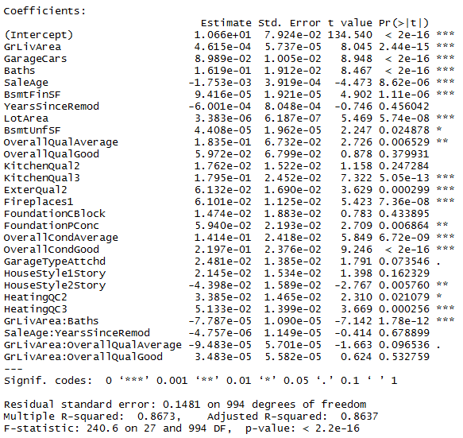

Best Model
Random Forest with Second Order Interactions
  RMSE on log scale: 0.1300
  RMSE on original, dollar scale: $30,530.49

Slide 12
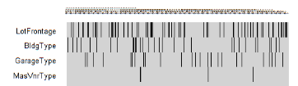
Future Work
Impute missing values
  Amelia package in R imputes missing data via multiple imputation and expectation-maximization with bootstrapping
Reduce dimensionality by mapping data set onto a lower dimension based on distances

Slide 13
QUESTIONS?

