Slide 1

Mapping rates of inpatient hospitalizations related to mental disorders in the state of Missouri: a conditional autoregressive model with zip code-level data
Daphne Lew, MPH,¹ Steven Rigdon, PhD¹
¹ Department of Epidemiology and Biostatistics, College for Public Health and Social Justice, Saint Louis University
Symposium on Data Science and Statistics, May 17, 2018, Reston, VA
Slide 1 of 9

Slide 2
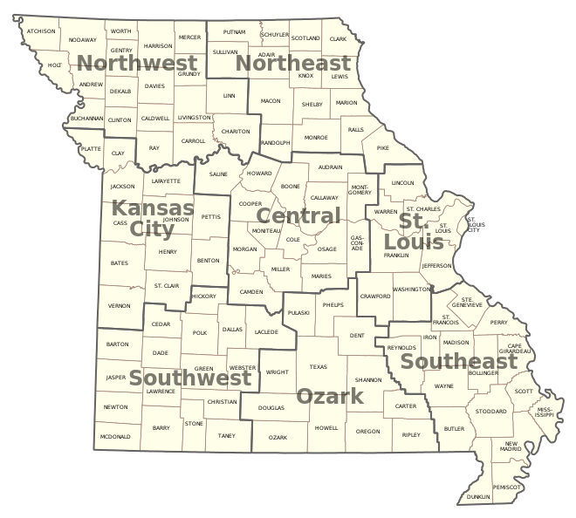
Burden of Mental Illness in the US and Missouri
Mapping rates of inpatient hospitalizations related to mental disorders in the state of Missouri: a conditional autoregressive model with zip code-level data
Lew, D., Rigdon, S.
44.7 million American adults were estimated to have experienced any past year mental illness in 2016 (NIMH, 2017)
Nearly one-third of all inpatient hospitalizations in the US involve at least one mental disorder or substance use disorder (Heslin, Elixhauser, & Steiner, 2015)
Missouri (MO) ranks 36 and 40 out of all 50 states on measures of adult mental health and access to mental health services, respectively (Mental Health America, 2018)
In 2017, 18% of MO adults experienced any past-year mental illness and the suicide rate reached an all-time high of 18.6 per 100,000 population (MO Department of Mental Health, 2017)
Figure 1: Map of regions in the state of Missouri; area circled in red is known as the “bootheel”
Symposium on Data Science and Statistics, May 17, 2018, Reston, VA
Slide 2 of 9

Slide 3
Mapping rates of inpatient hospitalizations related to mental disorders in the state of Missouri: a conditional autoregressive model with zip code-level data
Lew, D., Rigdon, S.
Spatial Distribution of Mental Health Disorders
Prior research has shown evidence that mental health outcomes are not spatially random
  Hot spots of schizophrenia diagnoses identified in the country of Grenada (Moreno et al., 2008)
  Clustering of suicides and suicide attempts examined in Australia (Too et al., 2017) and Ohio, USA (Fontanella et al., 2017)
  Spatial clustering of heroin-related drug poisoning deaths identified throughout the US (Stewart et al., 2017)
No existing research has examined potential geographic clustering of mental health related hospitalizations
Missouri Department of Mental Health has generated maps of mental health outcomes at county level, but not at finer geographic units
Symposium on Data Science and Statistics, May 17, 2018, Reston, VA
Slide 3 of 9

Slide 4
Mapping rates of inpatient hospitalizations related to mental disorders in the state of Missouri: a conditional autoregressive model with zip code-level data
Lew, D., Rigdon, S.
Study Aims
Develop a Bayesian hierarchical model that accounts for spatial correlation within zip codes and data that has been subject to administrative censoring
Use this model to predict rates of inpatient hospitalizations associated with mental health disorders throughout the state of MO
Asses three possible covariates as predictors of hospitalization rates (percent of population with no health insurance, percent of families receiving food stamps, and percent vacant housing)
Assess inpatient hospitalization rates for evidence of spatial clustering
Symposium on Data Science and Statistics, May 17, 2018, Reston, VA
Slide 4 of 9

Slide 5
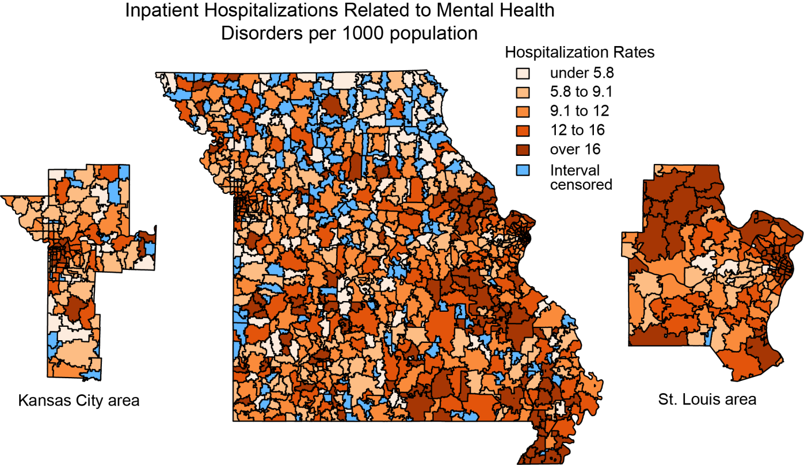
Mapping rates of inpatient hospitalizations related to mental disorders in the state of Missouri: a conditional autoregressive model with zip code-level data
Lew, D., Rigdon, S.
Data Source
Missouri Information for Community Assessment 2014 data pertaining to inpatient hospitalizations attributed to any mental disorders for all zip codes in MO (n = 1,019)
  Number of hospitalizations in the zip code was censored for confidentiality reasons if it was between 1 and 4
American Community Survey 2010-2014 five-year estimates for zip code level demographic data
US Census Bureau TIGER/LINE shapefiles for all zip codes in MO
Figure 2: Map of inpatient hospitalizations attributed to mental health disorders per 1000 individuals in the population; zip codes with interval-censored data are highlighted in blue
Symposium on Data Science and Statistics, May 17, 2018, Reston, VA
Slide 5 of 9

Slide 6
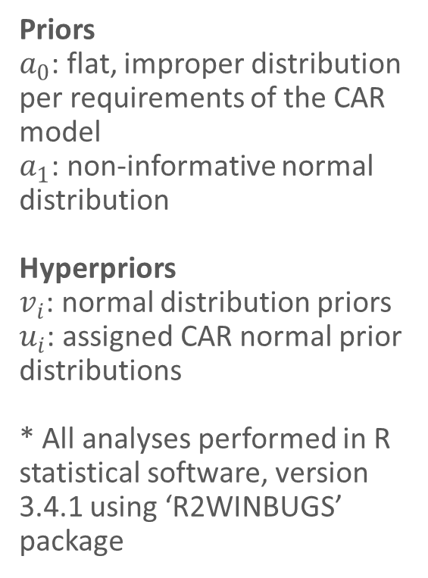
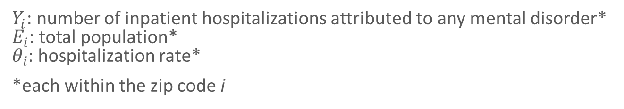
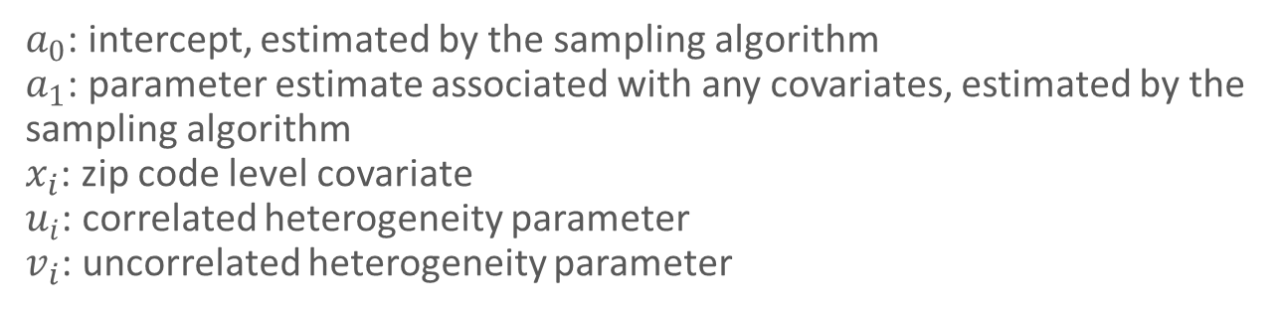
Mapping rates of inpatient hospitalizations related to mental disorders in the state of Missouri: a conditional autoregressive model with zip code-level data
Lew, D., Rigdon, S.
Model Specification
$$Y_{i} \sim Poisson\left(E_{i}θ_{i}\right), i=1, 2,…, 1019$$
Priors
$a_{0}$: flat, improper distribution per requirements of the CAR model
$a_{1}$: non-informative normal distribution
Hyperpriors
$v_{i}$: normal distribution priors
$u_{i}$: assigned CAR normal prior distributions
* All analyses performed in R statistical software, version 3.4.1 using ‘R2WINBUGS’ package
$Y_{i}$: number of inpatient hospitalizations attributed to any mental disorder*
$E_{i}$: total population*
$θ_{i}$: hospitalization rate*
*each within the zip code i
$$θ_{i}=\exp\left(a_{0}+ a_{1}x_{i}+ u_{i}+v_{i}\right), i=1, 2, …, 1019$$
$a_{0}$: intercept, estimated by the sampling algorithm
$a_{1}$: parameter estimate associated with any covariates, estimated by the sampling algorithm
$x_{i}$: zip code level covariate
$u_{i}$: correlated heterogeneity parameter
$v_{i}$: uncorrelated heterogeneity parameter
Symposium on Data Science and Statistics, May 17, 2018, Reston, VA
Slide 6 of 9

Slide 7
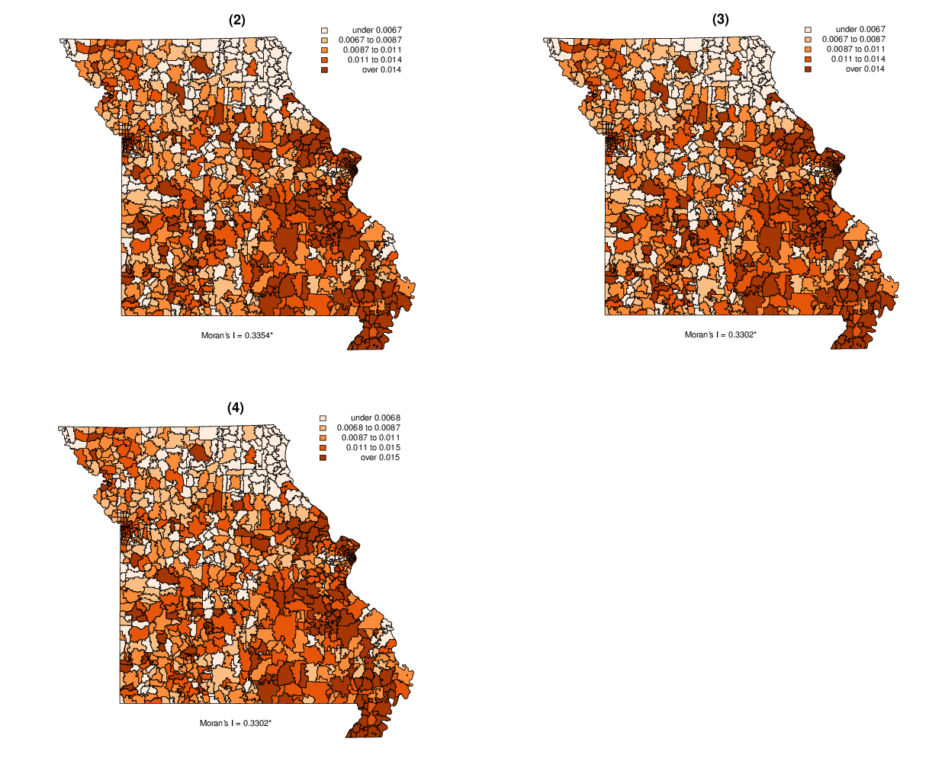
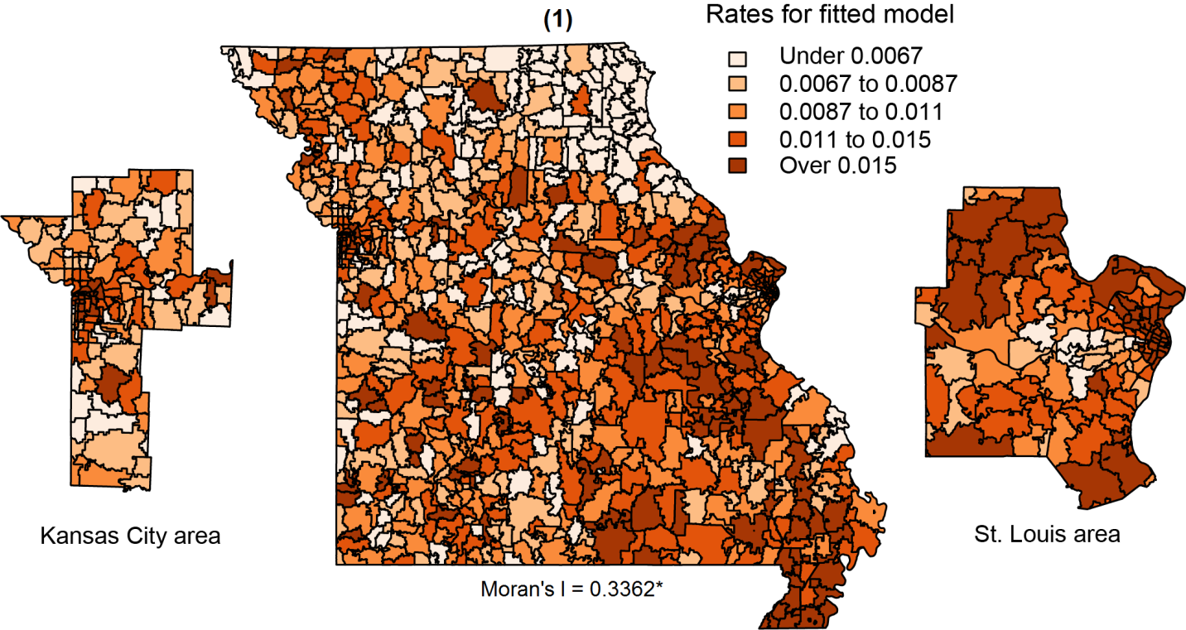
Mapping rates of inpatient hospitalizations related to mental disorders in the state of Missouri: a conditional autoregressive model with zip code-level data
Lew, D., Rigdon, S.
Results
Cluster of low hospitalization rates in the northeast corner of the state
Clusters of high hospitalization rates in and around the St. Louis region, the Kansas City area, and in the “bootheel” region of the state
Figure 3: Thematic maps of estimated hospitalization rate in each of the 4 models: (1) no covariates, (2) percent of population with no health insurance; (3) percent of households receiving food stamps; (4) percent vacant housing; * statistically significant at α = 0.05
Symposium on Data Science and Statistics, May 17, 2018, Reston, VA
Slide 7 of 9

Slide 8
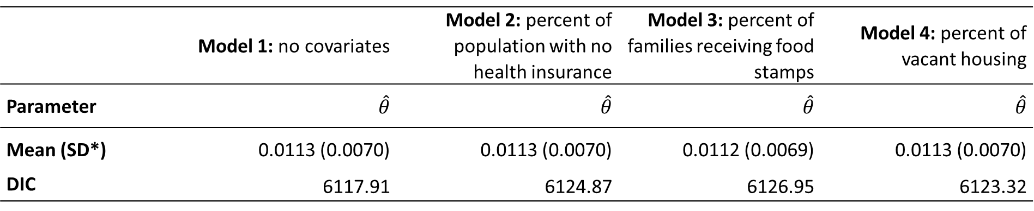
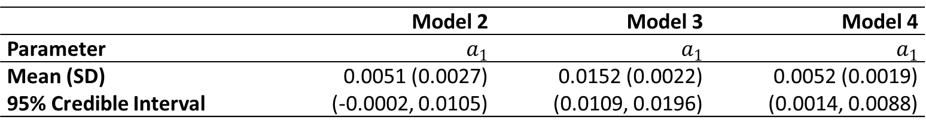
Mapping rates of inpatient hospitalizations related to mental disorders in the state of Missouri: a conditional autoregressive model with zip code-level data
Lew, D., Rigdon, S.
Results
Table 1: Average estimated rate of hospitalizations attributed to mental disorders throughout all zip codes and associated DIC for four different models; * SD: standard deviation
 | Model 1: no covariates | Model 2: percent of population with no health insurance | Model 3: percent of families receiving food stamps | Model 4: percent of vacant housing
Parameter | $\hat{θ}$ | $\hat{θ}$ | $\hat{θ}$ | $\hat{θ}$
Mean (SD*) | 0.0113 (0.0070) | 0.0113 (0.0070) | 0.0112 (0.0069) | 0.0113 (0.0070)
DIC | 6117.91 | 6124.87 | 6126.95 | 6123.32
Table 2: Posterior mean, standard deviation, and credible interval for parameter estimates associated with covariates included in models two through four
 | Model 2 | Model 3 | Model 4
Parameter | $a_{1}$ | $a_{1}$ | $a_{1}$
Mean (SD) | 0.0051 (0.0027) | 0.0152 (0.0022) | 0.0052 (0.0019)
95% Credible Interval | (-0.0002, 0.0105) | (0.0109, 0.0196) | (0.0014, 0.0088)
Symposium on Data Science and Statistics, May 17, 2018, Reston, VA
Slide 8 of 9

Slide 9
Mapping rates of inpatient hospitalizations related to mental disorders in the state of Missouri: a conditional autoregressive model with zip code-level data
Lew, D., Rigdon, S.
Main Findings and Implications
Mental health related inpatient hospitalizations exhibit significant spatial clustering within zip codes in the state of MO
Percent of families receiving food stamps and percent of vacant housing were significantly associated with hospitalization rates
Future work should examine other factors that lead to this geographic clustering of mental health related inpatient hospitalizations
These findings can help inform placement of future mental health services and individual interventions
Symposium on Data Science and Statistics, May 17, 2018, Reston, VA
Slide 9 of 9

