Slide 1
Visualizing BLS data in Google Public Data Explorer
Christopher Morris
Senior Economist
Productivity Program
U.S. Bureau of Labor Statistics

Slide 2
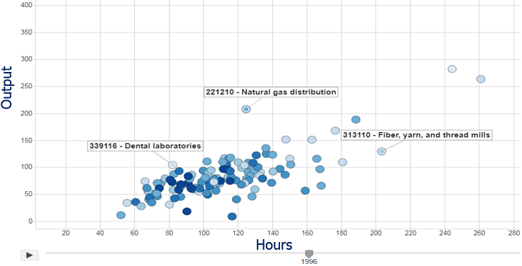
What is Google Public Data?
A directory of dynamic dashboards created by government agencies and other organizations that the public can explore free of charge.

Slide 3
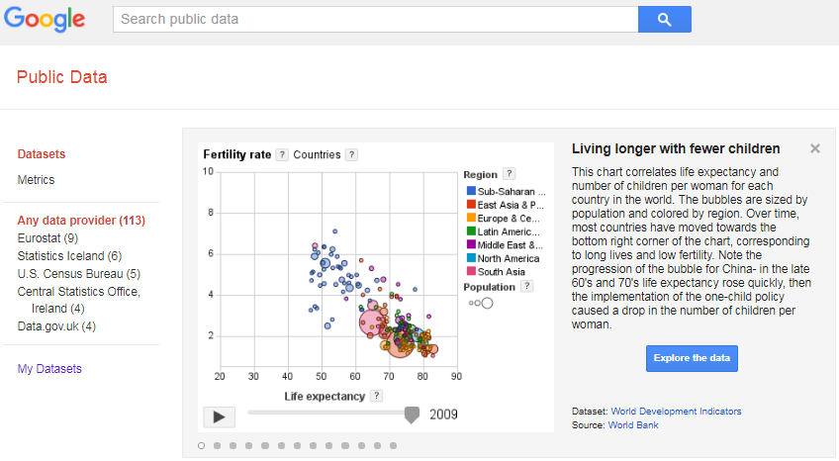
Google Public Data Directory
Dashboards can be searched for by data provider, dataset name, or metric.

Slide 4
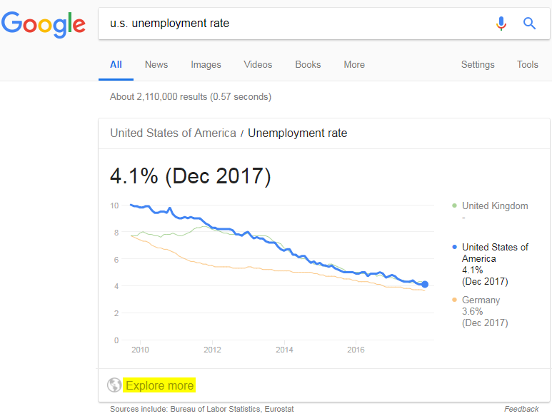
Google Public Data in the Search Engine
A search for ‘u.s. unemployment rate’, returns BLS data.
Link to interactive dashboard

Slide 5
BLS Unemployment Rate Visualizations
Line Chart
U.S. unemployment rate, 1948-2018
Bar Chart
Unemployment rates by state, 1990-2018
Map Visualization
Virginia unemployment rate by county, 1990-2018

Slide 6

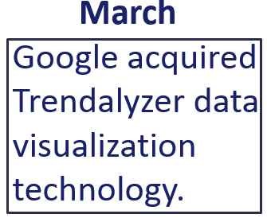
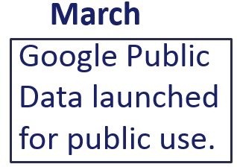
History of Google Public Data
Google built collaborative partnerships with statistical agencies to create dashboards.

Slide 7
BLS Dashboards (publicly available)
Dashboard Name | BLS Program Source Data | BLS Measures
*Unemployment in the U.S. | - Current Population Survey (CPS) - Local Area Unemployment Statistics (LAUS) | Employment, Labor force, Unemployment, Unemployment rate
Consumer Price Index (CPI) in the U.S. | - Consumer Price Index | Consumer Price Index, Inflation (month-over-month), Inflation (year-over-year)
Producer Price Index (PPI) | - Producer Price Index | Producer Price Index, Inflation (month-over-month), Inflation (year-over-year)
Wage Statistics for the U.S. | - Current Employment Statistics (CES): National, State and Area | Earnings, Employment, Hours Worked
* Indexed in Google’s public data directory and integrated into Google’s Search Engine.
NOTE: Resource limitations prevented the conversion of additional datasets.

Slide 8
Reviving Google Public Data at BLS
BLS Innovation Competition:
The Commissioners Office announced an innovation competition. The winner would get 3 months away from their normal duties to work on their project.
Winner:
My proposal to convert more BLS datasets into Google dashboards, starting with the Productivity Program, was selected.

Slide 9
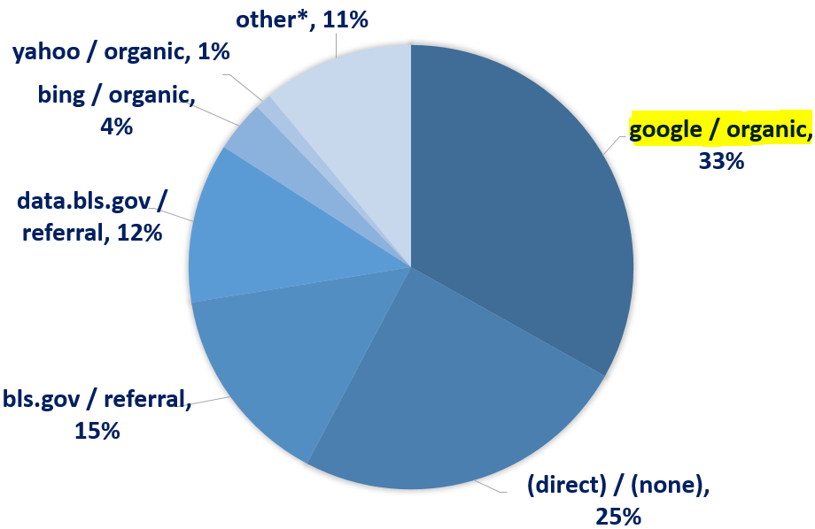
Why did you choose Google Public Data?
Sources of BLS customer acquisition (metric = Users),
January 01, 2018 - April 30, 2018
1/3 of BLS users were acquired from a Google search.
*Note: The 'other' category contains thousands of sources that individually comprise less than 1% of total sessions.
Source: Google Analytics

Slide 10
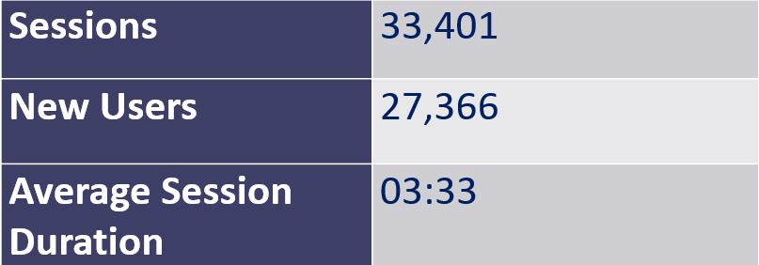
Google Analytics: Jan 2018 – Apr 2018
BLS Unemployment Dashboard Traffic
*Approximately 7,000 new users per month

Slide 11
Productivity Dashboards
Dashboard Name | Time Scale | BLS Program | BLS Measure Categories*
Labor and Multifactor Productivity By Industry | Annual | Industry Productivity Studies (IPS) | Capital, Employment, Intermediate Purchases, Labor, Multifactor, Output, Unit Labor Costs
Labor Productivity and Costs | Quarterly | Major Sector Productivity (MSP) | Employment, Labor, Non Labor, Output, Profits, Unit Labor Costs
Labor and Multifactor Productivity By Sector | Annual | Major Sector Productivity (MSP) | Capital, Employment, Energy, Labor, Materials, Multifactor, Non Labor, Output, Profits, Services, Unit Labor Costs
* There are too many measures to list them individually, so the categories are listed instead.
Example: Industry Productivity Dashboard
https://www.google.com/publicdata/explore?ds=eq6uotl7je1d2_

Slide 12
Productivity Visualizations
-Major Sector Productivity (Quarterly)
Productivity slowdown
-Major Sector Productivity (Annual)
Capital factor shares
-Industry Productivity (Annual)
Declining labor share of income
Notes:
Declining Labor Share of Income
This chart compares the value of production and labor compensation cost in 128 six digit industries according to the North American Industry Classification System. The bubbles are sized by number of employees and select industries are labeled. Over time, 75% of industries had a larger increase in the value of production relative to labor compensation, which indicates that a growing share of income was going to factors of production other than employee compensation like capital (e.g. machinery, computers, and software), and intermediate purchases (purchased materials, services and energy that go into producing a final product). Note: The start and end years may vary for some industries.

Slide 13
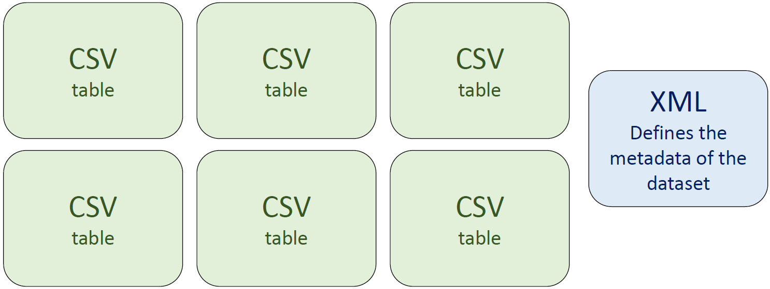
How were the dashboards created?
Google
Dashboard
Productivity Programs:
- SAS transposes publicly available productivity data from long to wide format and subsets the datasets by sector and industry.
- Python generates the XML metadata file.

Slide 14
Future Work
Integrate more BLS datasets into the Google Public Data directory:
Consumer Prices Index (CPI)
Producer Price Index (PPI)
Current Employment statistics (CES)

Slide 15
Questions?
CONTACT INFORMATION:
Christopher Morris
(202) 691-5030
morris.christopher@bls.gov

