Slide 1
Experiences with AI, Expert Knowledge and Data Analysis
IBM T. J. Watson Research Center
Octavian Udrea
May 16, 2018
Featuring work in collaboration with:
Shirin Sohrabi, Anton Riabov, Mark Feblowitz, Michael Katz, Deepak Turaga, Daby Sow, Nagui Halim, Horst Samulowitz, Claudio Martinez, Ilbin Lee and others

Slide 2
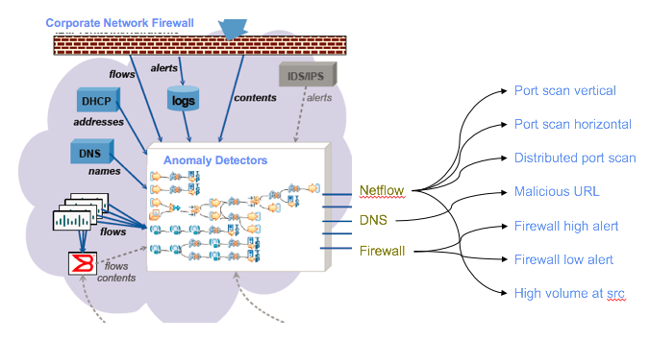
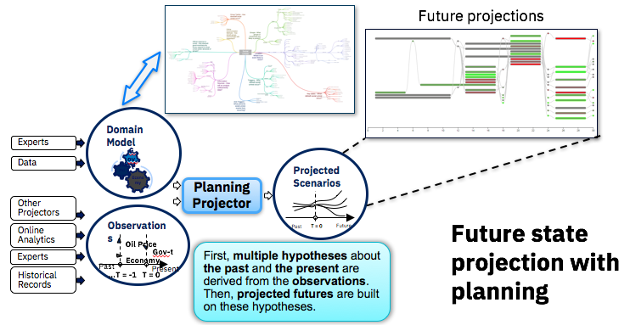
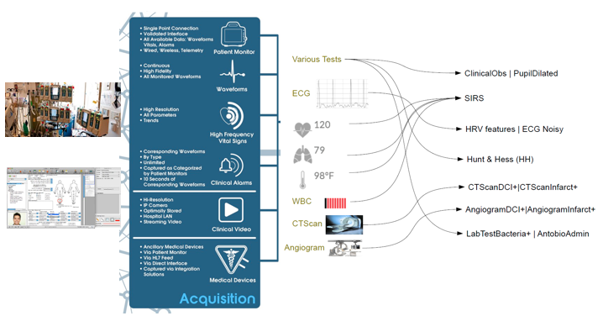
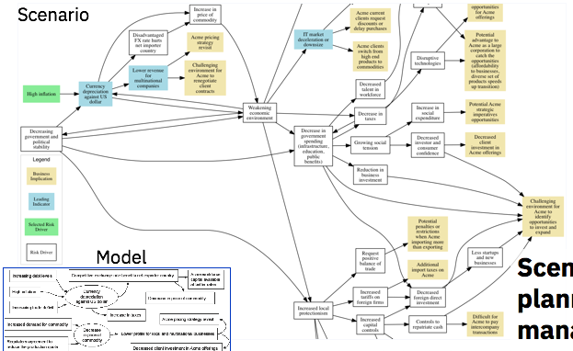
Motivation
v
[Hypothesis exploration for malware detection, AAAI 2013]
[State projection via AI planning, AAAI 2017]
v
[Automated large-scale data analysis, ICAPS 2015]
[Scenario planning for enterprise risk management, AAAI 2018]

Slide 3
Challenges
Observations:
  Are not raw data (e.g., spike in network activity vs data packet)
  Are not reliable (i.e., can me missing, noisy, or inconsistent)
  Are indicative of a state of an entity (but we are not sure of the states)
Models
  Can be partially learned, can be bootstrapped with expert knowledge
  Practically guaranteed to be incomplete and often inconsistent
  Rarely consumable

Slide 4
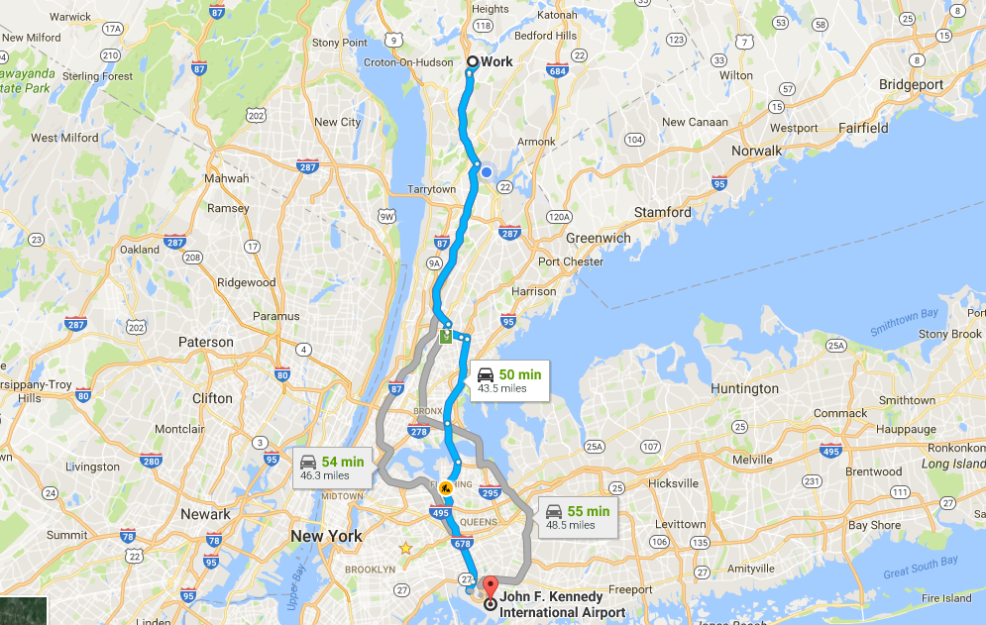
Brief introduction to AI planning

Slide 5
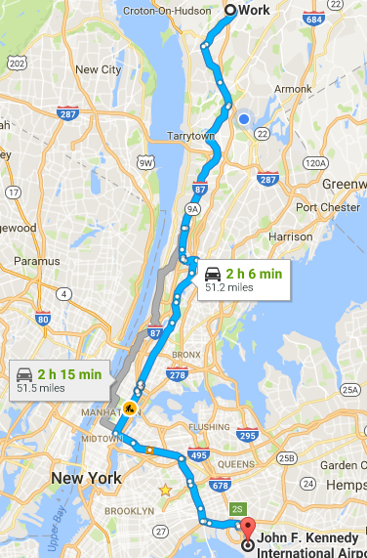
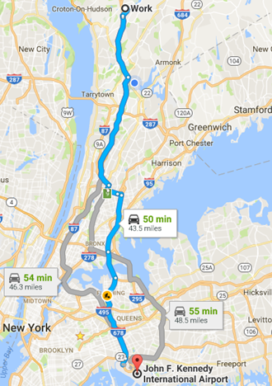
High quality (diverse) plans
VS.

Slide 6
Relevant AI planning background
Traditional AI planning:
  Given: facts, initial state, actions, goals
  Output: plan
Plan recognition:
  Given: facts, initial state, actions, observations, a set of possible goals
  Output: goals or the plans
Plan recognition translated to planning:
  Given: facts, initial state, actions, observations, (partial) set of possible goals
  Intermediate step: transform the plan recognition problem into a planning problem
  Output: goals or plans

Slide 7
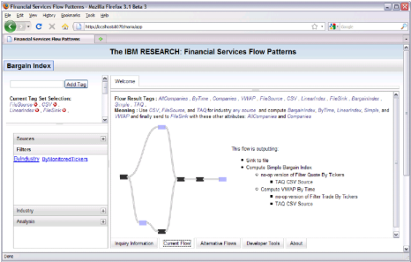











IBM Automated Analytics Composer
Goal Refinement
Guidance
Composer
AI planning based composition and deployment engine
Business Analyst
Processing Goals
(as tags)
Automatically
Composed
Application Flow
Results
Generated Pig or Jaql
Generated SPL
Results
Apache Hadoop
(with Pig or Jaql scripting)
Other
Platforms
(via plug-ins)
IBM InfoSphere Streams

Slide 8



























IBM Automated Analytics Composer
Components & Composition Patterns
Goal Refinement
Guidance
Composer
AI planning based composition and deployment engine
Business Analyst
Processing Goals
(as tags)
Automatically
Composed
Application Flow
Trend
Periodicity
Results
Trade
Data
BargainIndex
Trend
Generated Pig or Jaql
Generated SPL
Results
Apache Hadoop
(with Pig or Jaql scripting)
Other
Platforms
(via plug-ins)
IBM InfoSphere Streams

Slide 9
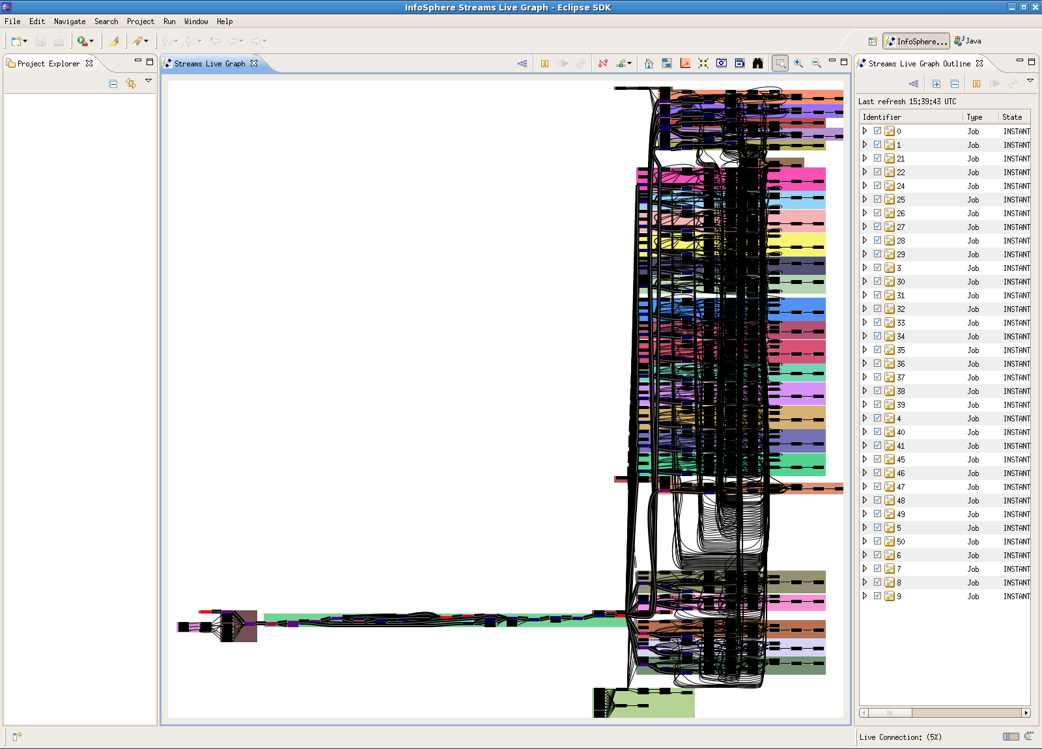
Complexity of automatically composed applications

Slide 10
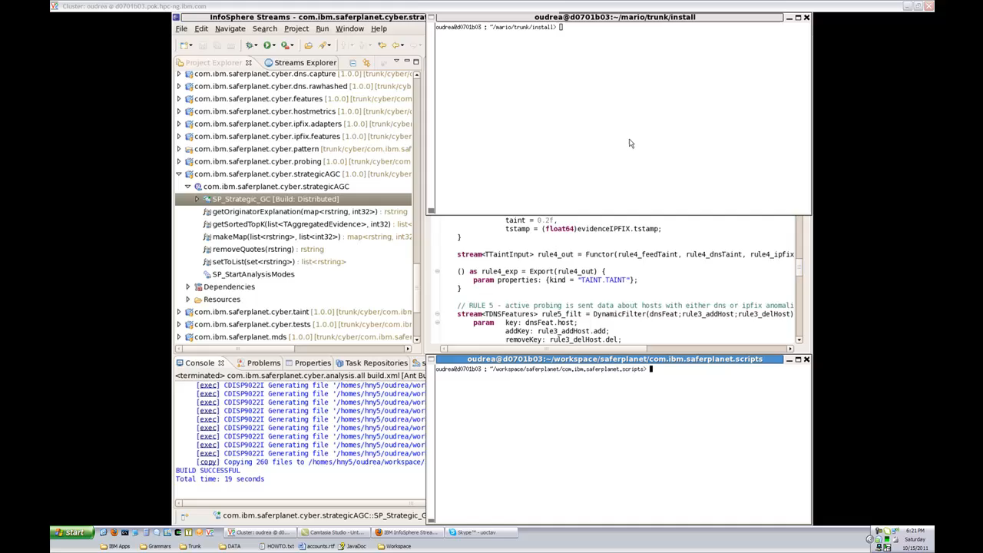
The first baby steps: learning to adapt analysis to data

Slide 11
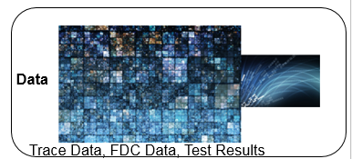

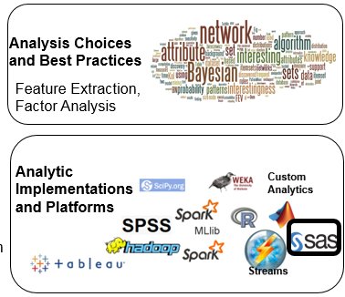
Analytic automation via Scout and CADS
Cognitive Assistant for Data Science (CADS)
Business Analyst
Analytic Scout
Performance evaluation on benchmark datasets
Machine learning to automatically determine best choice of model for supervised analysis
SOFIA Analytic Repository
Pre-processing
Source Connectors
Alignment
First of their kind applications for automatic analytic selection and benchmarking
Couple AI, Machine learning, and Large-scale systems to realize cognitive applications
Algorithm Implementations and Metadata
Composer
AI planning based composition and deployment engine
Sinks, visualization
Data Mining
Meta-learning, Ensemble Methods
Compute Cluster / Cloud

Slide 12
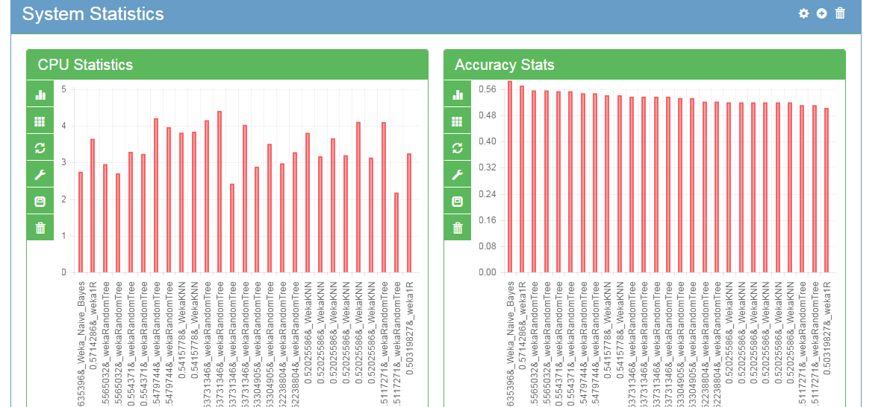
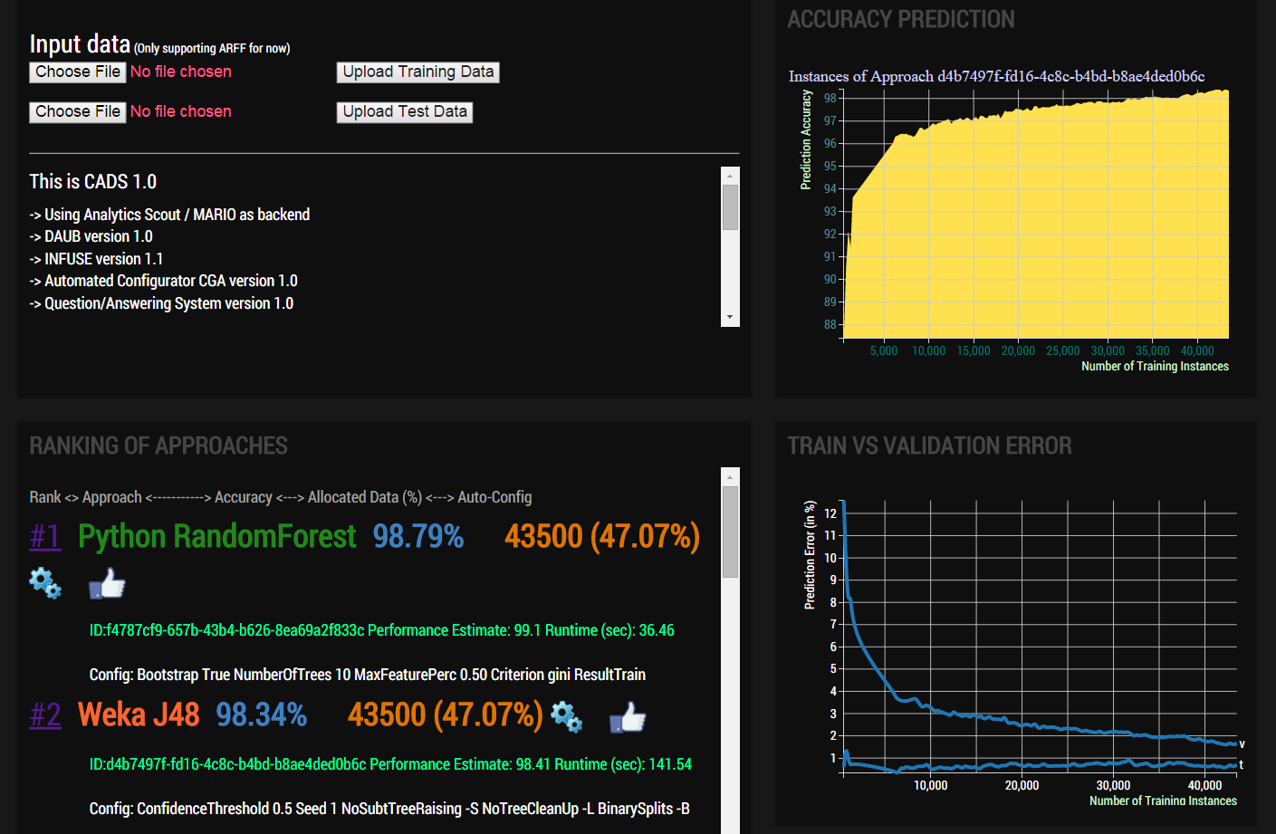
Analytic automation via CADS and Scout
Overcome “analytic decision overload”
Enable viewing and interaction with analysis choices in an online fashion
Allow rapid insights from data to answer key questions

Slide 13
Can we use expert models to reason about real world entities?
Yes, but since models and observations are unreliable, we can only create a hypothesis -- a theory describing possible threats in the world
Threats are be materialized by a series of actions
  …in cybersecurity, actions by an adversary
  …in healthcare, actions by a condition/disease
  …in news analysis, actions by people/groups (with or without previous intent)
All actions can be observable in principle, we may only be able to observe a subset
The investigator wants to prevent undesirable situations by
  Inferring plans or methods from observations
  Acting to prevent undesirable situations
  Proactively acquire knowledge in ambiguous situations

Slide 14
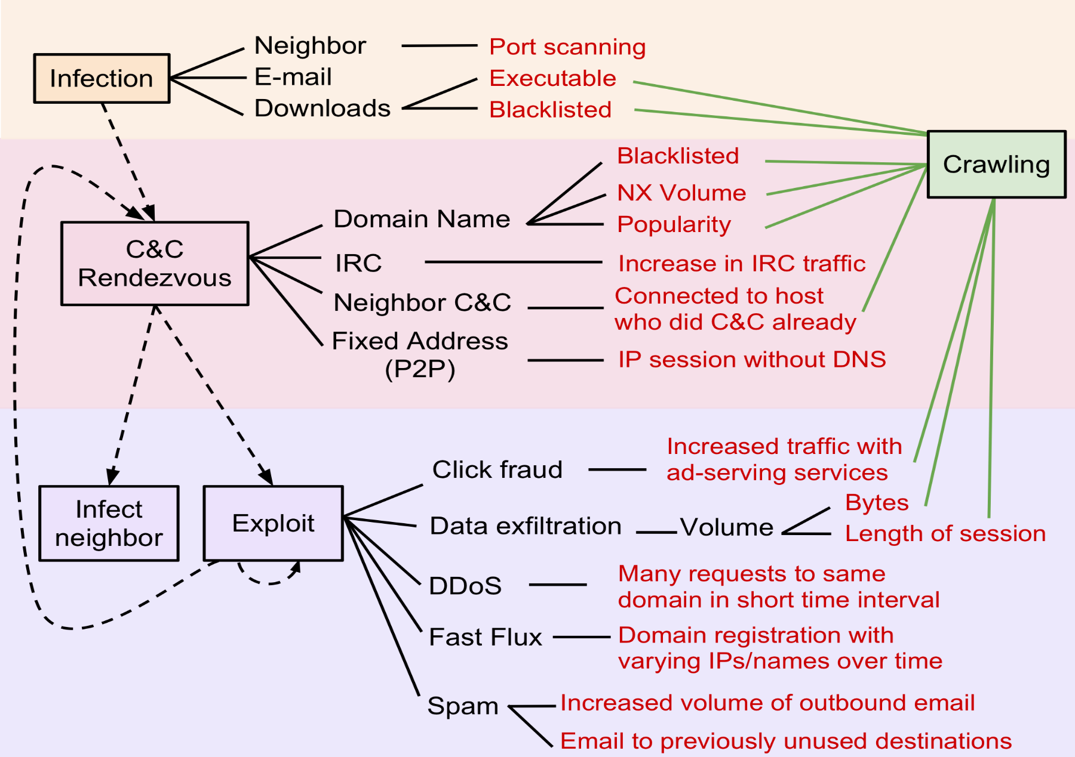
Expert-derived malware state transition model

Slide 15
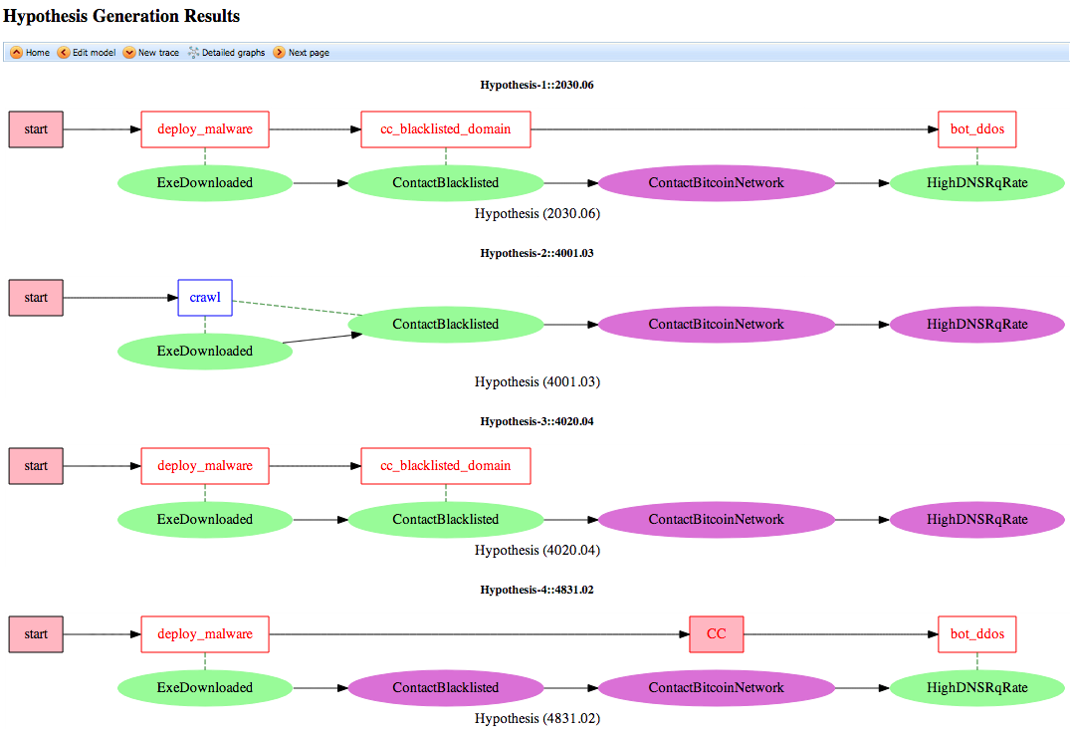
1
2
More plausible
Unexplained observation
3
Unobserved behavior
4

Slide 16
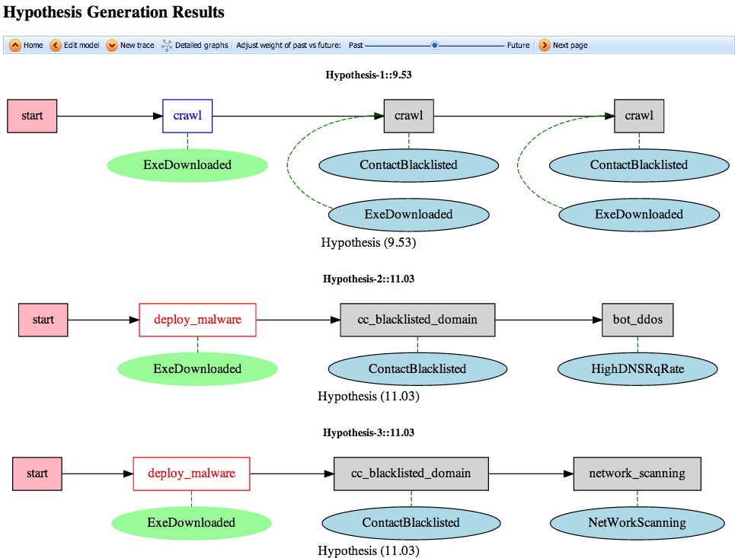

Slide 17
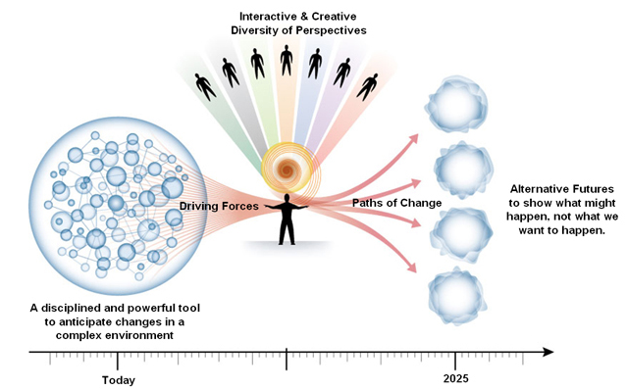
Scenario Planning for Enterprise Risk Management
Alternative Futures
To show what might happen, with the purpose to make better decisions
Main forces:
Economic environment
Technology
Currency
Social order/unrest
Corruption
Natural disaster
Market disruptors
Government Stability
Source: https://blog.itcilo.org/learning-about-scenario-planning-and-thinking/

Slide 18
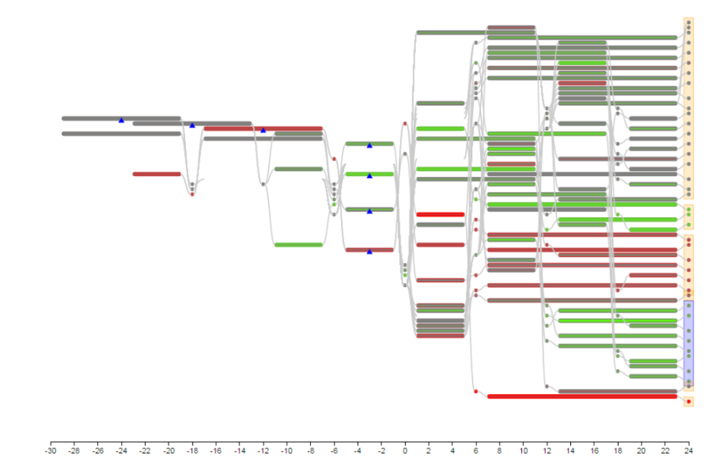
IBM Research has been developing Machine Foresight capabilities
Multiple, diverse future evolutions
Generate alternative scenarios
    “what could happen”
Generate explainable future trajectories
What-If Analysis
Learn from qualitative and quantitative knowledge
Leverage Traditional Prediction/Forecasting Methods
  “what’s likely to happen”
Current events
Possible futures, grouped by similarity
Alternative Future Scenarios

Slide 19


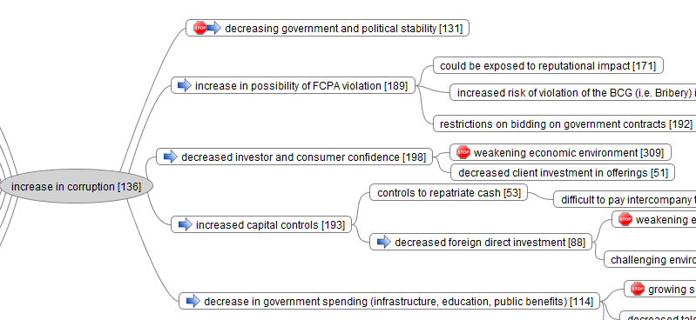
IBM’s Chief Risk Officer (CRO) SPA Project
Rolled out globally
Support in Local Languages
Listen to profiled news and social media
60+
1590
Local news sources
100+ countries
Watson APIs are integrated - i.e. Language Translator Service
9500+
    Keywords covers broader risk subject areas
Built-in risk driver models
Details
SPA is currently an engagement asset – product discussion underway
It takes up to 8 hours to set up a new domain with known sources and models
New types of live sources (text, audio, video) can be added as extensions
Users saw value in a system identifying possible alternative scenarios, providing largely unbiased input to scenario planning process
Automated assistance for creating risk driver models is being developed
Results
  Generating plausible scenarios
  80% of scenarios have IBM relevant results
  Increased risk awareness and unbiased foresight
  Confirmation that SPA saves time and adds value
23
SPA is customized by country through a profile which has the capability to create scenarios based on user profile’s responses

Slide 20
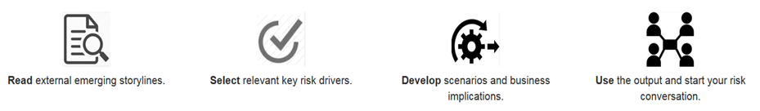
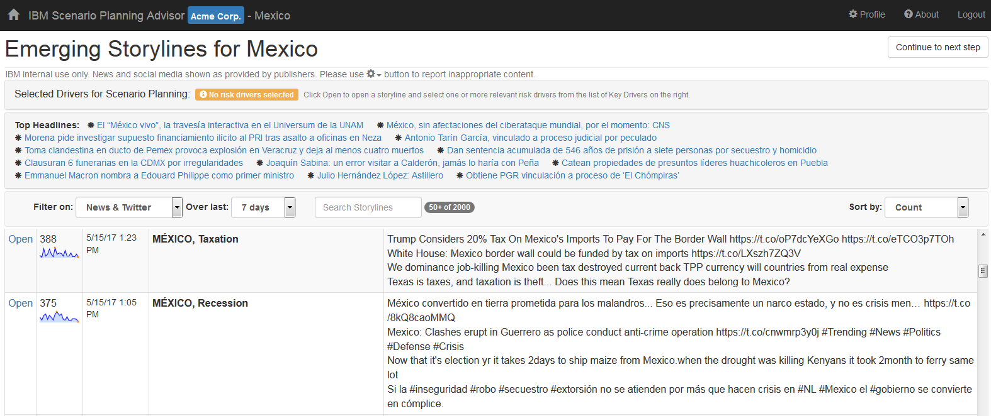
Technology support for Scenario Planning
Scenario for demo only, created using a dummy company ‘ACME’

Slide 21
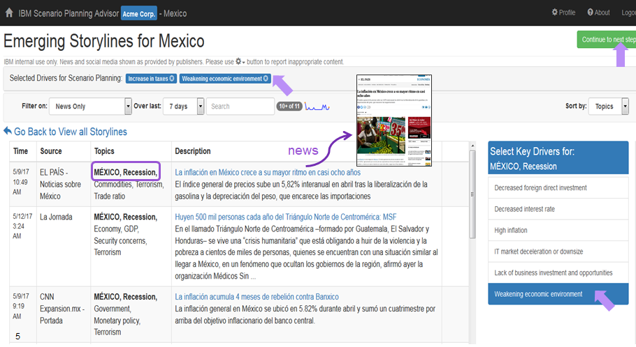
Technology support for Scenario Planning
Scenario for demo only, created using a dummy company ‘ACME’

Slide 22
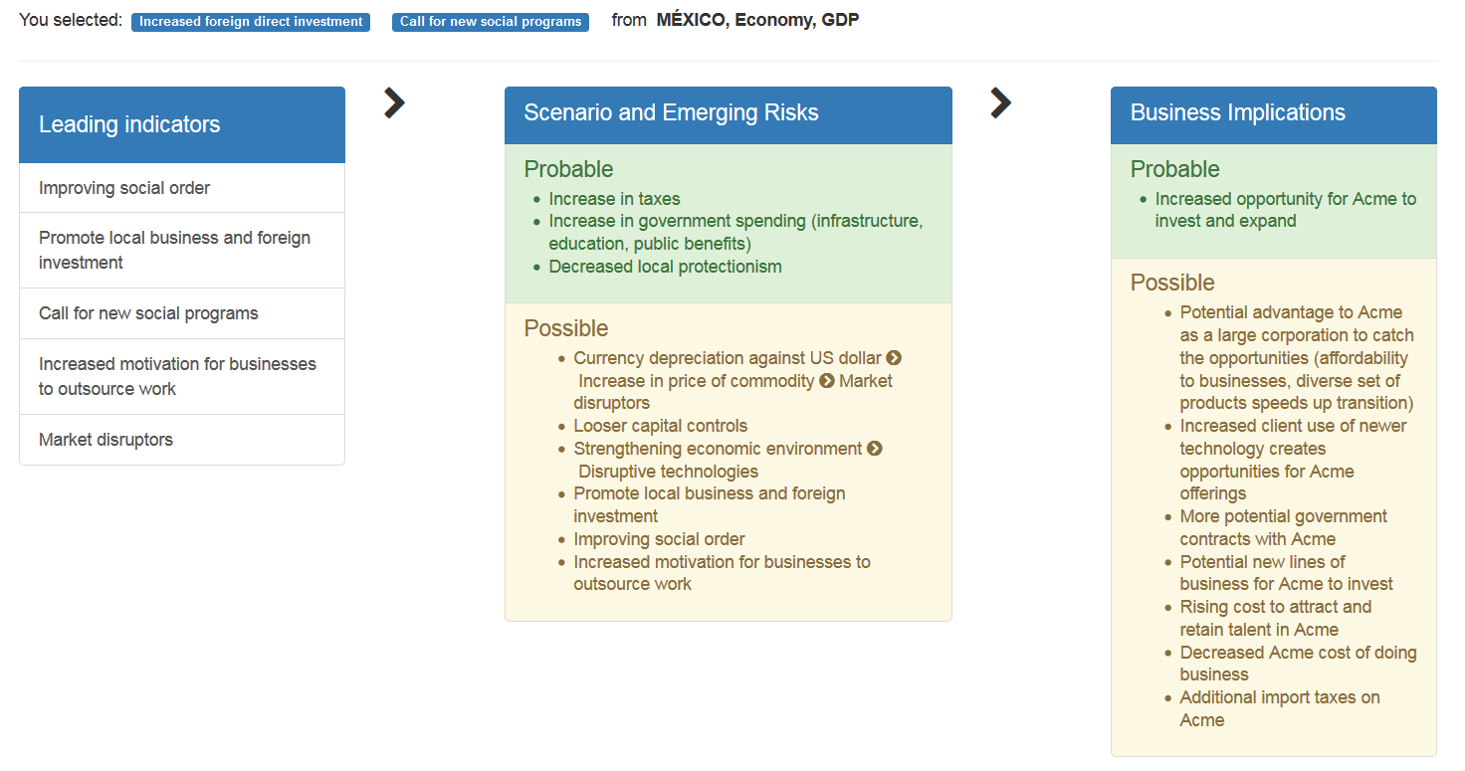
Technology support for Scenario Planning

Slide 23
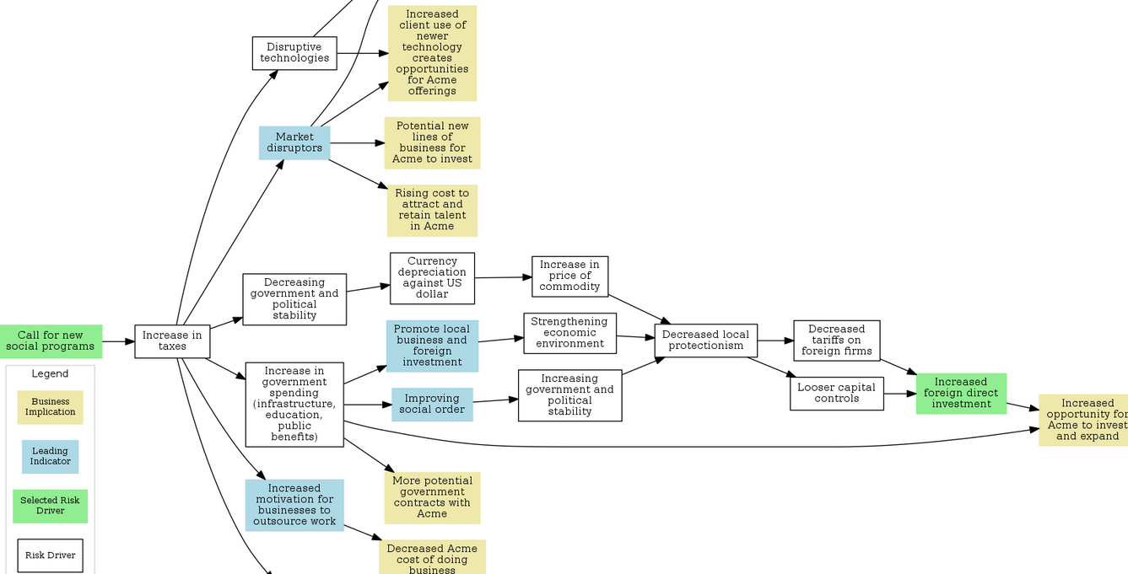
Technology support for Scenario Planning

Slide 24
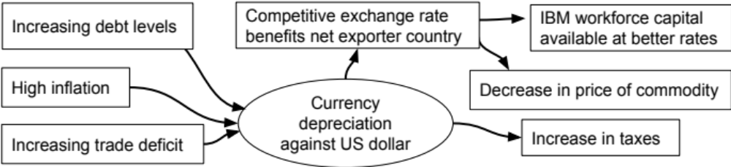
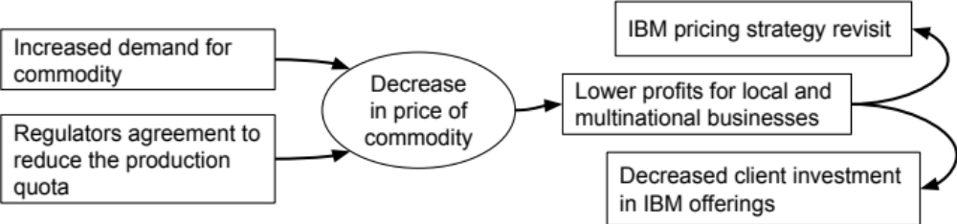
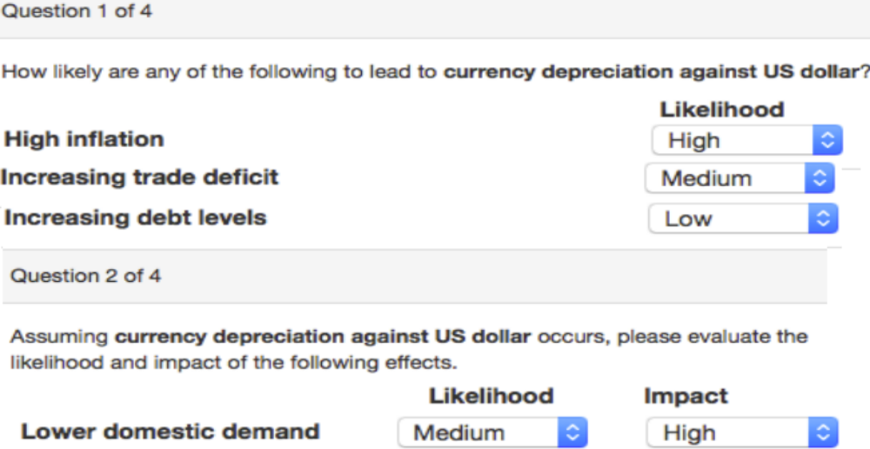
Capturing the Domain Knowledge
Notes:
Most AI planning system assume domain description is given in PDDL. However,
Domain expert may not have any AI planning background
Domain expert may already be comfortable with another tool
Mind Maps: represent concepts and their relationship in a simple graphical form.
Knowledge elication and engineering is a challenge.
To help them .. The casues, effects, → cascade, connected together, and when put them together we get a huge graph,
We work with different countries, they have different likelihood/impact/, and for example, here. This will result in different scnarios for different teams/countries.
Capturing Domain Knowledge. The Mind Maps and The Customizations components store knowledge about risk drivers and business implications elicited from the domain experts and the local country experts correspondingly. While the reasoning engine in SPA supports a rich representation of risk drivers as actions in Planning Domain Description Language (PDDL) [2], the knowl- edge representation used by domain experts is drastically simplified, to prevent conflicts and reduce overheads in knowledge elicitation and maintenance. The do- main experts use Mind Maps created in FreeMind [1] to capture directed graphs of risk drivers and business implications, with edges having hidden semantics of pairwise cause and effect. The Customizations are elicited using generated questionnaires that request country-specific likelihood and impact for selected cause and effect pairs. Due to Customizations, the same observations may generate different scenarios in different countries.

Slide 25
Computing scenarios
Formulate a planning problem
  Translate the given set of Mind Maps and their customization into a planning problem
      Lifted: one general set of actions with different possible grounding defined in the problem file for each transition in the Mind Maps
      Grounded: (partially) grounded planning task
  Add a set of explain and discard actions per each observation
  Ensure all observations are considered, whether explained or discarded
  Ensure at least one goal is satisfied
Compute a set of top-quality plans using top-k planning [Riabov+ SPARK’14, Sohrabi+ ECAI’16, Katz+ ICAPS’18]
Cluster the plans to create 3-6 scenarios
Compute the leading indicators
Compute the probable/possible predicates
Notes:
we would define one general and “lifted” set
of actions in the domain file, defining problem files based
on the given Mind Maps. As a generic grounding algorithm
may take a substantial amount of time, we also experiment
with creating directly a (partially) grounded planning task.

Slide 26
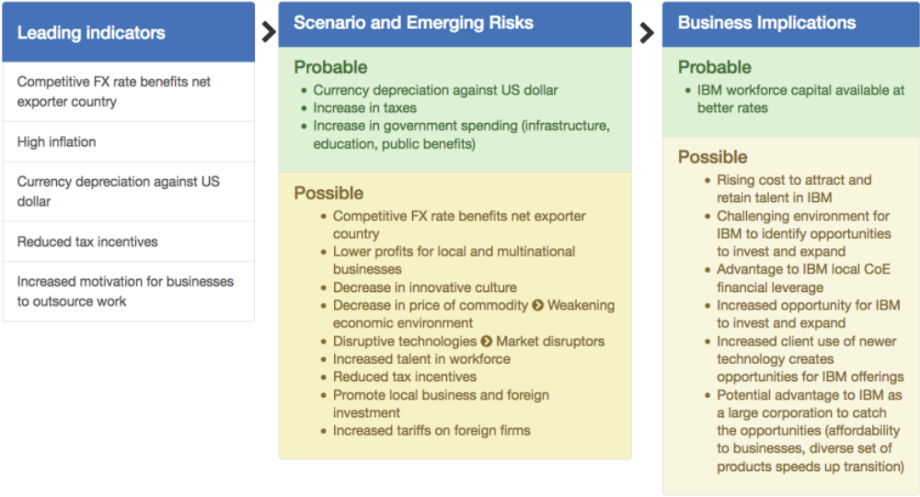
Example: generated scenario
Scenario is a generated summary of a cluster of
high-quality plans generated by a top-k planner
Notes:
This is a path through the MindMaps graph. We present both text and graphically.
This is the screen shot of the tool, this is just one.
Leading indicators, early and discreminary.

Slide 27
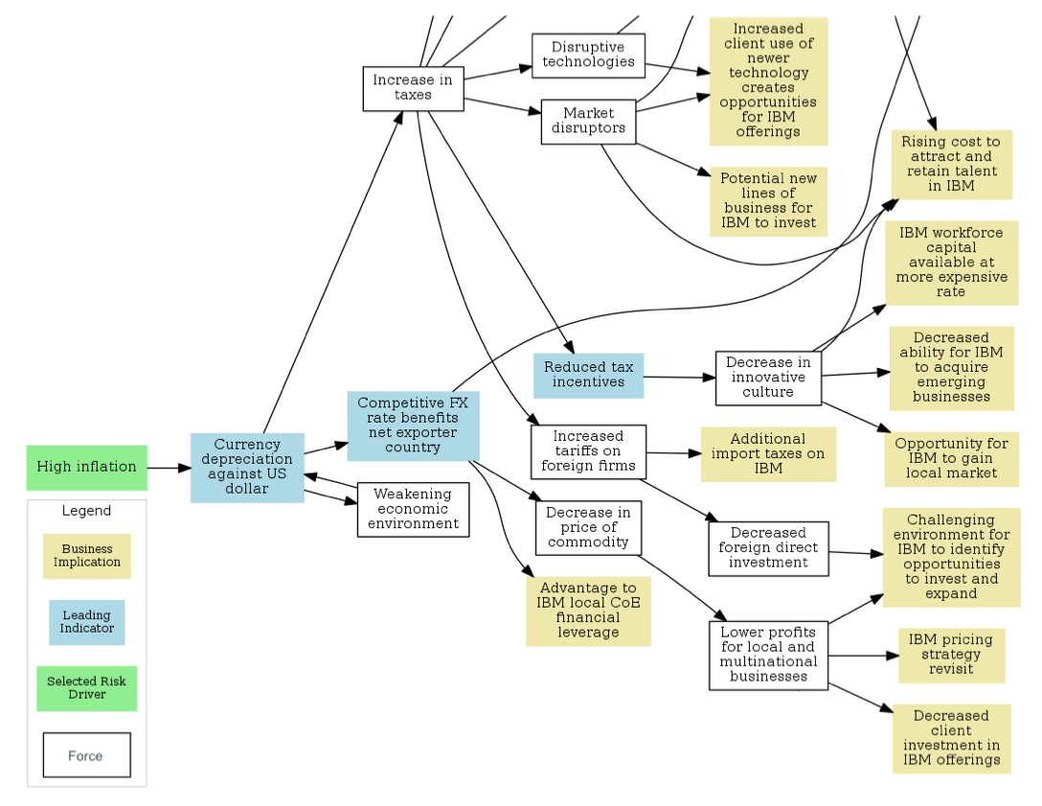
Example: Explanation Graph for a Scenarios
The same cluster of high-quality plans
shown as a graph

Slide 28
Domain expertise and learning from data
Domain expertise is a great way to bootstrap – reduces bias, democratizes access to expertise
Difficult to scale efficiently – allowing local customization helps
Learning such models from data (e.g., news, articles, event databases) is difficult:
  Articles/events are instances, but we need a general causal relationship
  Text at this level is difficult to parse, even for experts (they often do not agree)
  Difficult to differentiate opinions from facts
  Cannot learn models for very rare occurrences

Slide 29
References
  Related publications: Shirin Sohrabi, Anton Riabov, Michael Katz, Octavian Udrea et al.
    [AAAI 18] An AI Planning Solution to Scenario Generation for Enterprise Risk Management
    [AAAI 2017] State projection via AI planning
    [IJCAI 2016] Plan Recognition as Planning Revisited
    [SPARK 2014, ECAI 16] New Algorithms for The Top-K Planning Problem
    [ICAC 2013] Big Data Exploration Via Automated Orchestration of Analytic Workflows
    [AAAI 2013] Hypothesis Exploration for Malware Detection Using Planning
    [Shvo+ PAIR’17] An AI Planning-Based Approach to the Multi-Agent Plan Recognition Problem (Preliminary Report)
    [Sohrabi+ KEPS’14] Knowledge Engineering for Planning-Based Hypothesis Generation

Slide 30
BACKUP

Slide 31
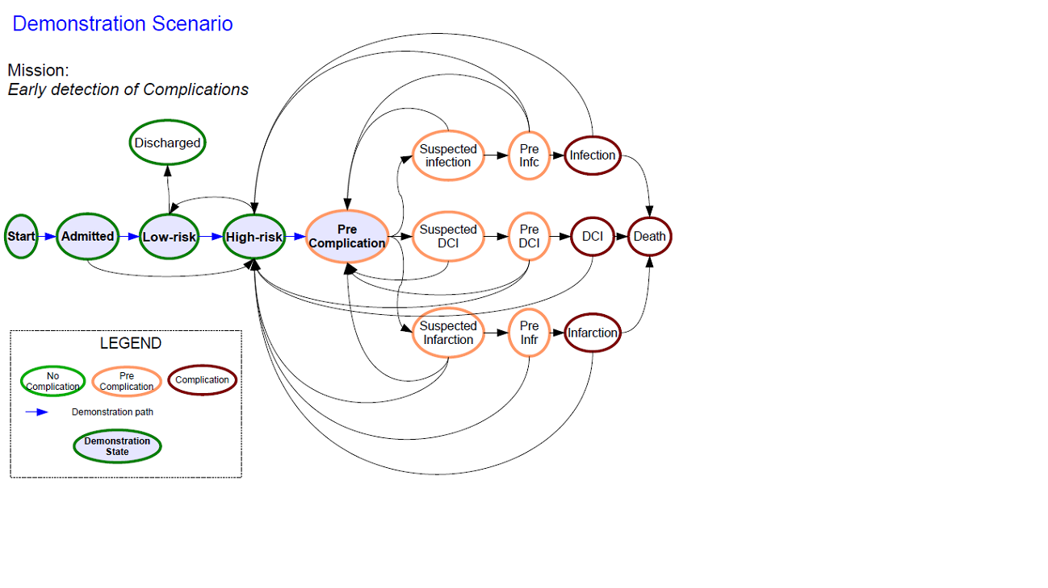
LTS++ models in Critical Care
LABTESTBACTERIA+ | SIRS3 | SIRS4
HH3 | HH4 | LABTEST- | SIRS2|SIRS3 | SIRS4|HRVL| LEADFIXED|ANTIBIOADMIN
Analytic Observation
Test Observation
Intervention Observation

Slide 32
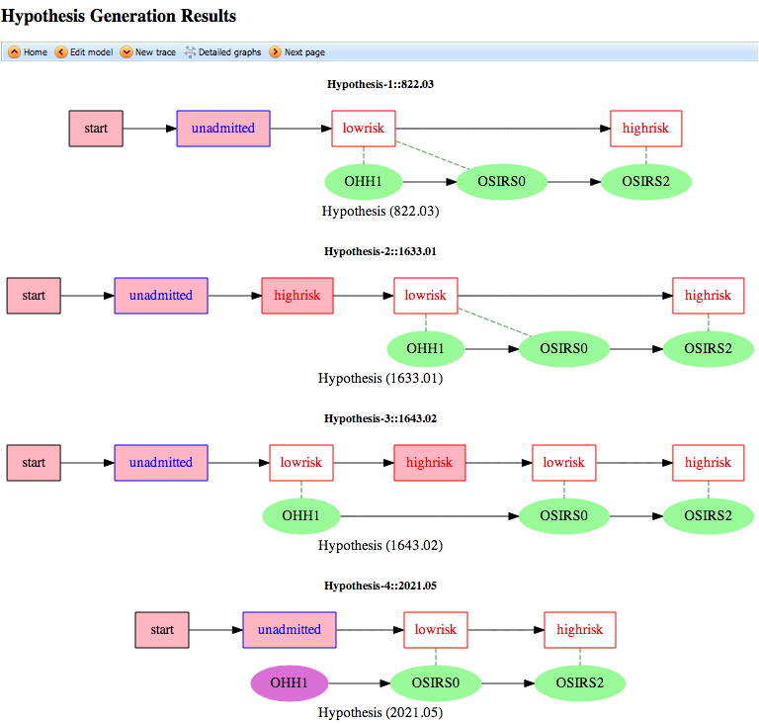
Generated hypotheses for the critical care application
Both OHH1 and SIRS0 are explained by lowrisk
Each hypothesis is shown as sequence of states matched to observed event sequence
1
State Transition Diagram
2
OHH1|OHH2|OSIRS0
OHH3|OSIRS2|OHRVL
Unobserved behavior
low risk
high risk
3
start
unadmitted
4
Less plausible hypothesis
Unexplained observation

Slide 33
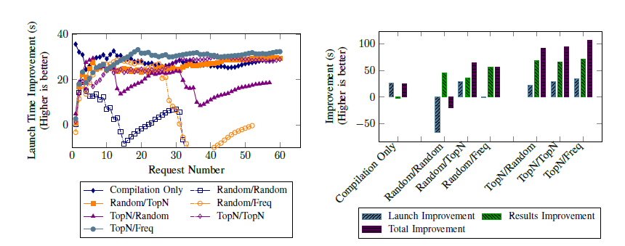
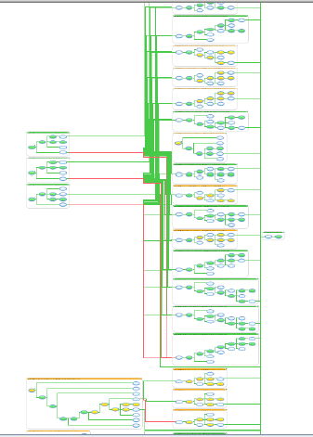
Speculative Execution in IBM Streams and Apache Pig
Improvement over time
Average improvement

Slide 34
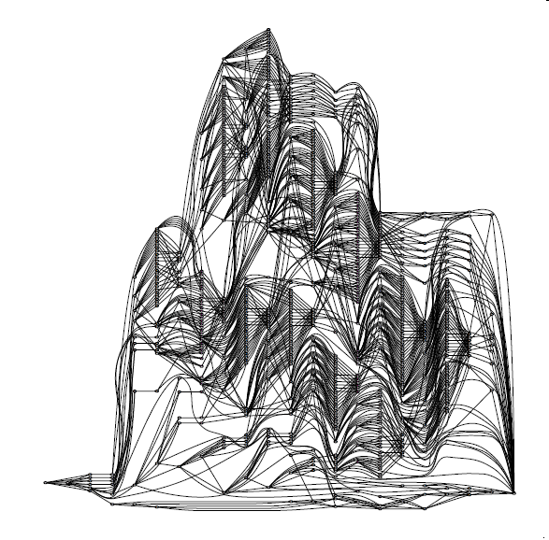
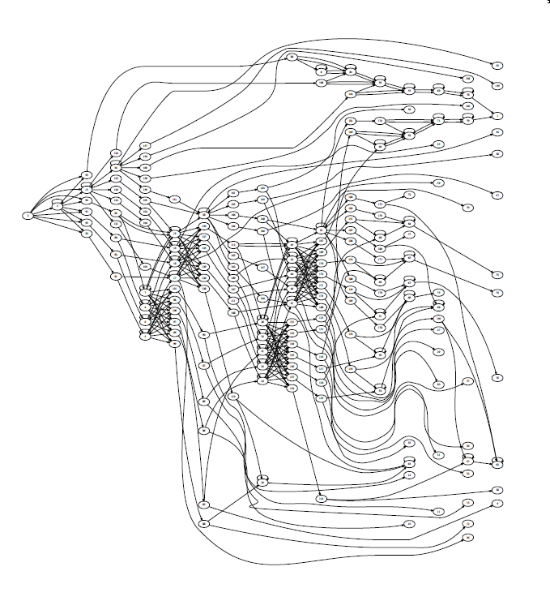
Search Space: Malware Detection LTS++ Model, 5 Observations
Eppstein’s algorithm: 713 nodes, 1664 edges
K* algorithm: 187 nodes, 405 edges

