Slide 1
Classification Trees for Privacy in Sample Surveys
Rolando A. Rodríguez
Michael H. Freiman
Jerome P. Reiter
Amy D. Lauger
Symposium for Data Science and Statistics
May 18, 2018
Any views expressed are those of the author and not necessarily those of the U.S. Census Bureau.
Notes:
Jerry = Duke & Census

Slide 2
The American Community Survey (ACS)
The ACS is the Census Bureau’s largest demographic survey
Collects a wealth of information about households and people
  Household characteristics (relationships, mortgage/rent, utilities)
  Person characteristics (age, sex, ancestry, schooling, occupation)
  Over 35 topic areas
ACS is the basis for the distribution of ~$675 billion in federal funds annually
Notes:
Used for many non-government purposes

Slide 3
Usefulness and privacy in the ACS
We are required to release estimates from the ACS
We are required to protect the identities and attributes of respondents in the ACS
ACS yearly data releases include:
  1-year and 5-year microdata and tables
  On the order of 10 billion estimates produced per year
Current ACS privacy practices include:
  Swapping, coarsening, and censoring for microdata
  Coarsening and suppression for tables

Slide 4
Users need to account for privacy protection
Privacy algorithms usually add bias and/or variance to estimators
We often keep certain parameters of the algorithms secret
Data users can’t account for the effect of such ‘private’ algorithms
We are researching methods to add transparency
New methods need to give at least as much privacy

Slide 5
Enter synthetic data
We use distributional draws to generate new ACS records
The theory accounts for added variance via multiple-imputation
Models can augment survey data with administrative records

Slide 6
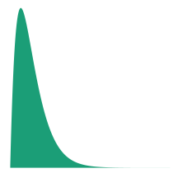

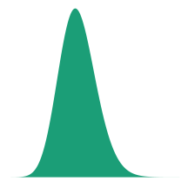



How synthetic data works
Prior distribution
Posterior distribution
Data likelihood
Posterior predictive draws
Multiple data releases
Notes:
Natural phenomenon under Bayesian stats
If we simulate values, low probability of complete match

Slide 7
Choosing models for the ACS
We want to generate new values for all records and all variables
  Majority of variables in ACS are categorical
  We have dimensionality woes, so conditional models helpful
Stakeholders prefer models that they can understand
The models must reasonably work within synthetic data framework
  ‘Proper’ posterior draws can be hard to obtain
  Other methods can be useful with adaptations to fit the framework
Notes:
“Likelihood is more subjective than the prior”

Slide 8
Classification trees are good models to try
Trees can identify important relationships automatically
We can easily fit trees conditionally on previous trees
The logical flow of a tree is easy to visualize
We can use bootstrapping on the trees leaves for synthetic data

Slide 9
Tree-based synthesis: grow the tree
🏠
🏠
🏠
🏠
🏠
🏠
The only test set of interest is the data itself, so we train the tree on entire data
🏰
🏢
🏠
🏠
🏠
🏠
🏨
🏰
🏢
🏠
🏠
🏠
🏠
🏨🏨 +
🏠
🏠
🏠
🏠
🏠
🏠
🏠
🏠
🏠
🏠
🏰
🏢
🏢
🏠
🏠
🏠
🏠
🏰
💲
💲💲
💲💲
💲💲💲+
🏠
🏠
🏠
🏠
🏠
🏰
🏰
🏠
🏠
🏠
🏠
🏠
🏢
🏢
🏠
🏠
🏠
🏠

Slide 10
Tree-based synthesis: grow the tree
🏠
🏠
🏠
🏠
🏠
🏠
🏰
🏢
🏠
🏠
🏠
🏠
🏨
🏰
🏢
🏠
🏠
🏠
🏠
🏨🏨 +
🏠
🏠
🏠
🏠
🏠
🏠
🏠
🏠
🏠
🏠
🏰
🏢
🏢
🏠
🏠
🏠
🏠
🏰
💲
💲💲
💲💲
💲💲💲+
🏠
🏠
🏠
🏠
🏠
🏰
🏰
🏠
🏠
🏠
🏢
Only previously synthesized features (predictors) available to a given tree
🏠
🏠
🏢
🏠
🏠
🏠
🏠

Slide 11
Tree-based synthesis: grow the tree
🏠
🏠
🏠
🏠
🏠
🏠
🏰
🏢
🏠
🏠
🏠
🏠
🏨
🏰
🏢
🏠
🏠
🏠
🏠
🏨🏨 +
🏠
🏠
🏠
🏠
🏠
🏠
🏠
🏠
🏠
🏠
🏰
🏢
🏢
🏠
🏠
🏠
🏠
🏰
💲
💲💲
💲💲
💲💲💲+
🏠
🏠
🏠
🏠
🏠
🏰
🏰
🏠
🏠
🏠
🏠
🏠
🏢
We limit minimal split/leaf size to:
Avoid overfitting
Allow plausible synthesis
🏢
🏠
🏠
🏠
🏠

Slide 12
Tree-based synthesis: use leaves for synthesis
🏠
🏠
🏠
🏠
🏠
🏠
🏰
🏢
🏠
🏠
🏠
🏠
🏨
🏰
🏢
🏠
🏠
🏠
🏠
🏨🏨 +
🏠
🏠
🏠
🏠
🏠
🏠
🏠
🏠
🏠
🏠
🏰
🏢
🏢
🏠
🏠
🏠
🏠
🏰
💲
💲💲
💲💲
💲💲💲+
🏠
🏠
🏠
🏠
🏠
🏰
🏰
🏠
🏠
🏠
🏠
🏠
🏢
🏢
🏠
🏠
🏠
🏠

Slide 13
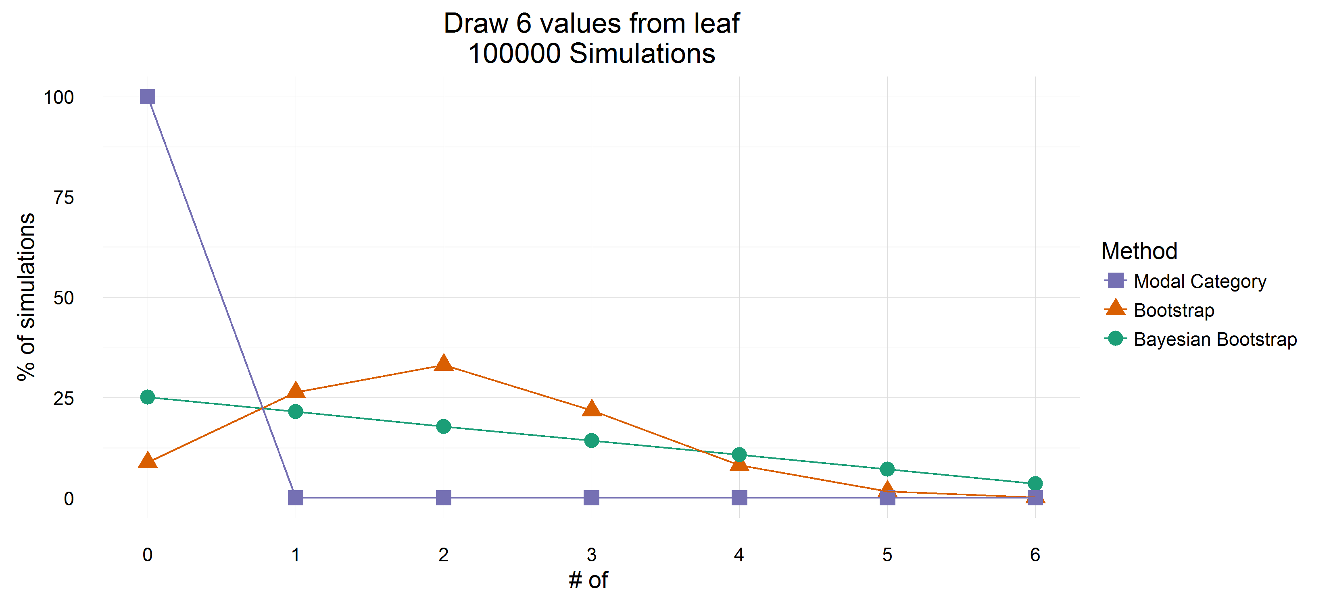
Tree-based synthesis: use leaves for synthesis
🏠
🏠
🏠
🏠
🏠
🏠
🏰
🏢
🏠
🏠
🏠
🏠
🏰
🏢
🏠
🏠
🏠
🏠
🏠
🏠
🏰
🏢
🏰
🏰
🏰
🏢
🏢
(🏨🏨 +, 💲💲💲+)

Slide 14
Current results for ACS tabulations are promising
We assess a variety of estimates on several metrics
  Internal microdata cross-tabulations
  Unweighted production tables
  Common analyses such as regressions
Results are generally good, but certain metrics highlight potential issues
Problems in tree fits are relatively tractable
  Trees may not always split in ways that support the tables
  Limitations in tree depth can cause issues
Notes:
Unweighted b/c we don’t synthesize weights
Note this is a pretty hard metric NOT to fail on

Slide 15
What about privacy?
We can analyze risk against specific external databases
  How certain are links between records?
  How much do statistics change?
How can we protect against attacks in general?
Need to define privacy in a computable way

Slide 16
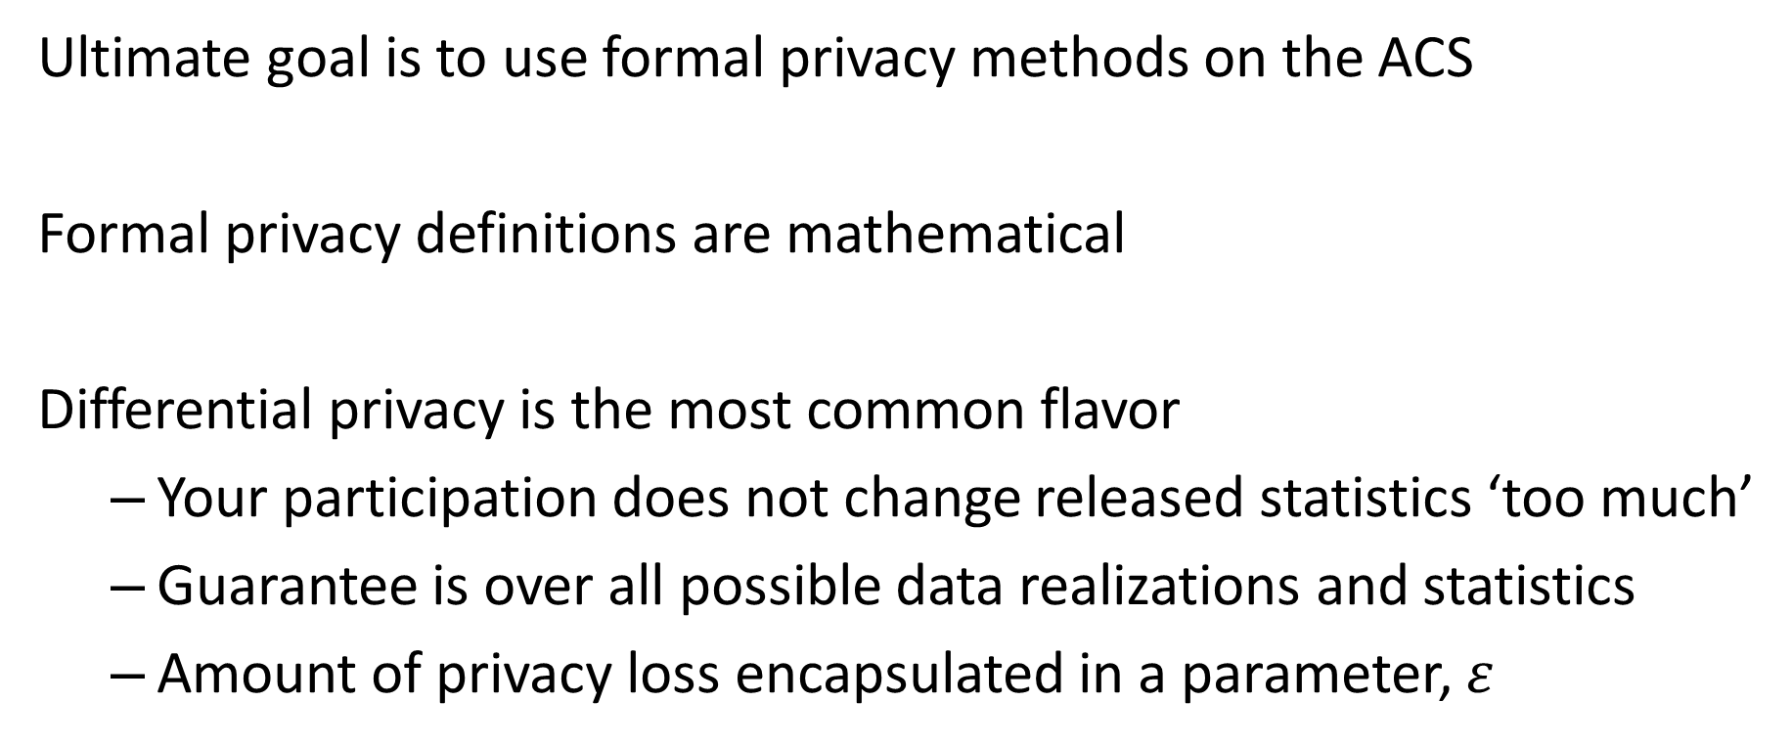
Quantifiable privacy requires formal definitions
Ultimate goal is to use formal privacy methods on the ACS
Formal privacy definitions are mathematical
Differential privacy is the most common flavor
  Your participation does not change released statistics ‘too much’
  Guarantee is over all possible data realizations and statistics
  Amount of privacy loss encapsulated in a parameter, $ε$
Notes:
Mathematical reads “computable’

Slide 17
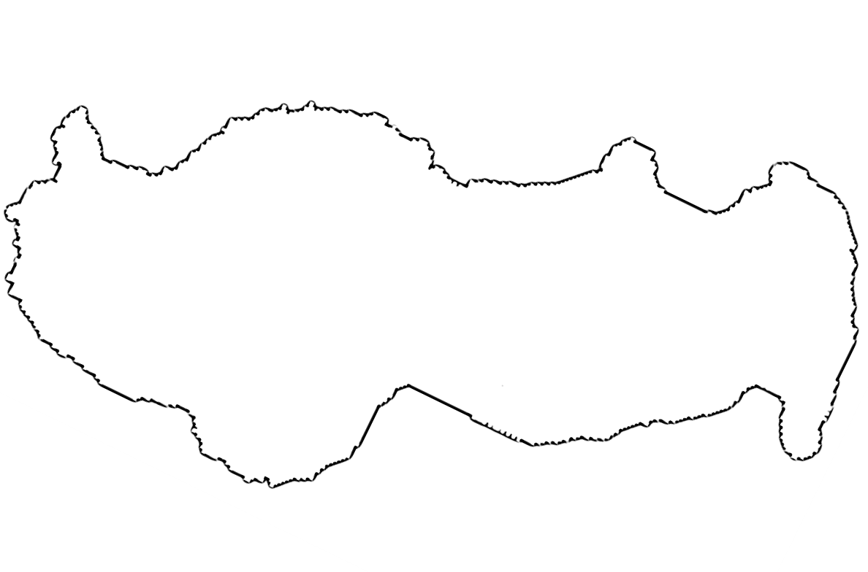
A simple example of differential privacy
 | 🚗 | 🚉 | 🚶 | 🚲 | 🚢
👩 | 700 | 5 | 1 | 0 | 0
👨 | 800 | 4 | 0 | 0 | 1

Slide 18
A simple example of differential privacy
ε = 0.1 | 🚗 | 🚉 | 🚶 | 🚲 | 🚢
👩 | 700 | 5 | 1 | 0 | 0
👨 | 800 | 4 | 0 | 0 | 1

Slide 19
A simple example of differential privacy
ε = 0.1 | 🚗 | 🚉 | 🚶 | 🚲 | 🚢
👩 | 712 | 5 | 4 | 3 | 1
👨 | 783 | 23 | 23 | 3 | 1

Slide 20
A simple example of differential privacy
ε = 0.1 | 🚗 | 🚉 | 🚶 | 🚲 | 🚢
👩 | 805 | 1 | 8 | 17 | 4
👨 | 692 | 14 | 3 | 1 | 3

Slide 21
A simple example of differential privacy
ε = 0.1 | 🚗 | 🚉 | 🚶 | 🚲 | 🚢
👩 | 796 | -9 | 15 | -7 | 16
👨 | 712 | 5 | 12 | -5 | 6

Slide 22
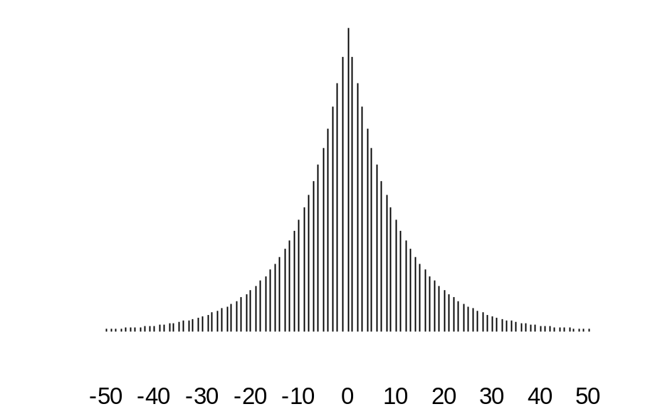
A simple example of differential privacy
ε = 0.1 | 🚗 | 🚉 | 🚶 | 🚲 | 🚢
👩 | 700 | 5 | 1 | 0 | 0
👨 | 800 | 4 | 0 | 0 | 1

Slide 23
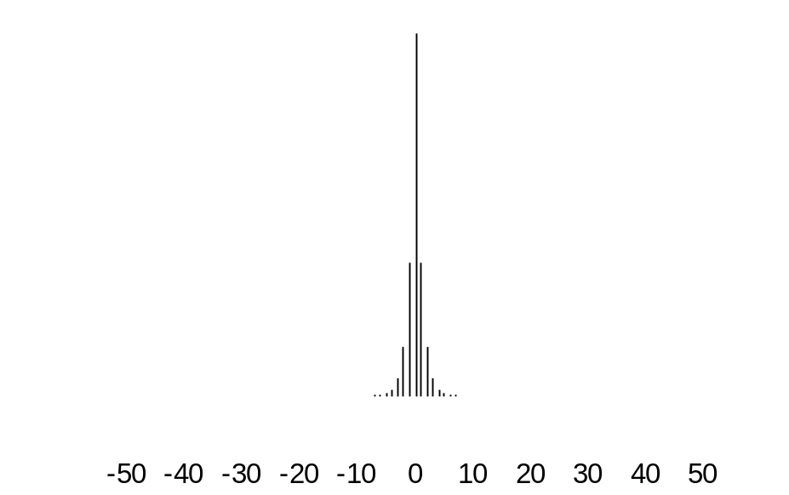
A simple example of differential privacy
ε = 1 | 🚗 | 🚉 | 🚶 | 🚲 | 🚢
👩 | 700 | 5 | 1 | 0 | 0
👨 | 800 | 4 | 0 | 0 | 1

Slide 24
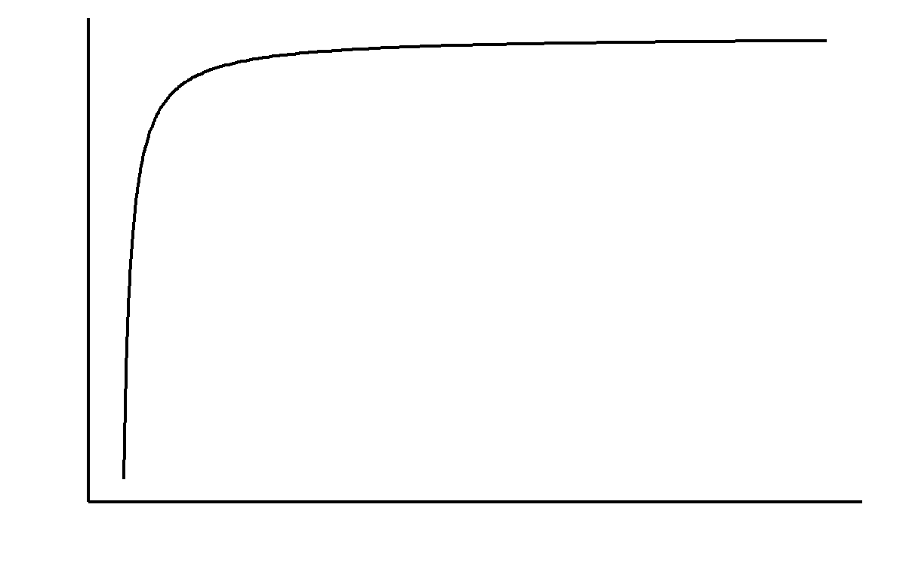
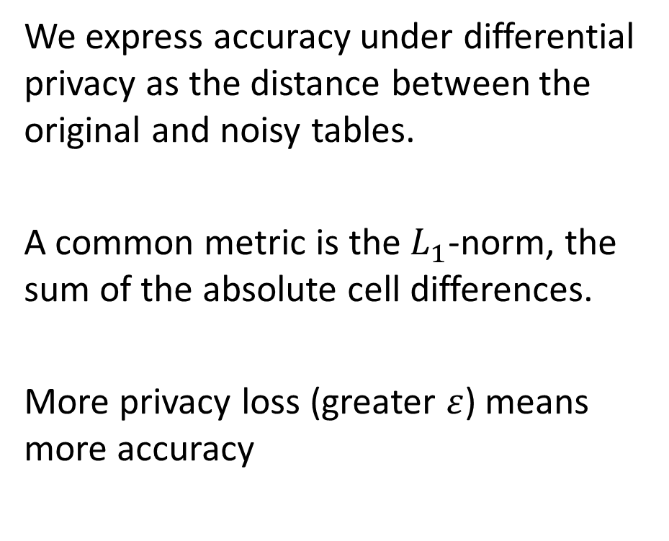

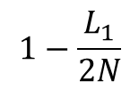
Now we can discuss a privacy tradeoff
We express accuracy under differential privacy as the distance between the original and noisy tables.
A common metric is the $L_{1}$-norm, the sum of the absolute cell differences.
More privacy loss (greater $ε$) means more accuracy
$$1−\frac{L_{1}}{2N}$$
$$ε$$

Slide 25
Formal privacy can be hard for sample surveys
Detailed surveys are blessed (cursed) by dimensionality
  Total # of cells increases exponentially with # of variables
  Tables of small populations will tend to be sparse
  Rounding negative counts can lead to large marginal bias
Data releases can contain summaries that are ‘harder’ to protect
  How many people live with a person with property P?
  What is the median age of said persons?
Surveys are weighted
  How do we define ‘your participation’?
  How do we report accurate standard errors?

Slide 26
The path forward
Continue to improve synthetic data methods for the ACS
Research ways in which formal privacy might be viable for ACS
Use administrative records where possible
Thank you!
rolando.a.rodriguez@census.gov

