Slide 1
Insights into Reshoring from Big Data Visualization of Social Media Posts
Symposium on Data Science and Statistics
May 19, 2018
Megan Eileen Moore,
North Carolina State University
Lori Fay Rothenberg,
North Carolina State University
Notes:
Megan Moore email: memccar4@ncsu.edu

Slide 2
Introduction
Offshoring is manufacturing in foreign countries, nearshoring is manufacturing in neighboring countries, and reshoring is the act of reintroducing domestic manufacturing
Notes:
Introduction
Currently, one of the hot topics in purchasing and supply management research is the location decision for manufacturing, which includes reshoring, offshoring, outsourcing, and nearshoring (Knight & Tate, 2016). In general, there has been a global decline in offshoring and outsourcing practices (Margulescu & Margulescu, 2014), and an increase in reshoring practices (Moradlou and Backhouse, 2017). This has prompted numerous studies on reshoring (e.g., Moradlou and Backhouse, 2017; Gylling, Heikkila, Jussial, & Saarinen, 2015).

Slide 3
Definitions of Reshoring
Reshoring can be defined as “a strategy that returns manufacturing to its home country” (Maronde et al., 2015, p. 80).
Tate, Ellram, Schoenherr, and Petersen (2014) define reshoring as “the relocation of manufacturing facilities from traditional offshore locations to more attractive offshore locations, or even home to the United States” (p.381).
The Reshoring Initiative (2017) defines reshoring as “the practice of bringing manufacturing and services back to the U.S. from overseas” (p. What is reshoring?”).
Notes:
Researchers of reshoring studies vary in their terms for and definitions of reshoring. For example, the terms reshoring (e.g., Ellram, Tate & Petersen, 2013; Gray, Skowronski, Esenduran, & Rungtusanatham, 2013; Tate, 2014), onshoring (Kazmer, 2014), backshoring (Arlbjorn & Mikkelsen, 2014), back-reshoring (Fratocchi et al., 2016), nearshoring (Ellram, et al., 2014) and foreign direct investment (Reshoring Initiative, 2017) are a few of the terms being used for the phenomenon of reshoring. The definitions for reshoring are also different. For example, Tate, Ellram, Schoenherr, and Petersen (2014) define reshoring as “the relocation of manufacturing facilities from traditional offshore locations to more attractive offshore locations, or even home to the United States” (p.381). In contrast, the Reshoring Initiative (2017) defines reshoring as “the practice of bringing manufacturing and services back to the U.S. from overseas” (p. What is reshoring?”). Researchers are not the only ones interested in reshoring and the different definitions.

Slide 4
Terminology
Reshoring (e.g., Ellram, Tate & Petersen, 2013; Gray, Skowronski, Esenduran, & Rungtusanatham, 2013; Tate, 2014), onshoring (Kazmer, 2014)
Backshoring (Arlbjorn & Mikkelsen, 2014)
Back-reshoring (Fratocchi et al., 2016)
Nearshoring (Ellram, et al., 2014)
Foreign direct investment (Reshoring Initiative, 2017)
Notes:
Reshoring related discussions are occurring in the popular press and across the political spectrum (Grappi, Romani, & Bagozzi, 2015). In addition, companies and the general public are interested in reshoring as seen in trade articles and the popular press (Moore, 2016). In the realm of politics, currently the U.S. Senate is considering bills on the federal regulation of Made in the USA and Made in America labeling of products (Friedman, 2017). Individual states are leveraging different labeling standards for these terms, and there are conflicting interpretations of the Federal Trade Commission’s labeling standard (Friedman, 2017). Manufacturers will be affected by these labeling standards, since retailers already are sourcing products that are Made in the USA. This will create a retail pull from manufacturing for Made in the USA (Reshoring Initiative, 2017; Kunz, Karpova, & Garner, 2016; Ellis, 2014). Companies sometimes refer to reshoring as Made in the USA or American Manufacturing (Moore, 2016). In a quantitative study of reshoring reasons, over a third of textile companies stated that the image/brand of reshoring was a factor in their reshoring efforts (Moore, 2016). In addition to understanding industry and government reactions toward reshoring, it is important to understand the general public’s reactions to reshoring.
Voters made it clear in the recent elections that bringing manufacturing back to the U.S. should be a priority for politicians. Prior to the elections, companies had stated that one of the reasons they are reshoring is the availability of government incentives (Reshoring Initiative, 2017). If the general public becomes disinterested in reshoring, this could affect politicians’ support for reshoring. Without government incentives, companies may not reshore as much business or as quickly as they might otherwise. The government, companies and the general public are all discussing reshoring.
One way to study the attitudes and opinions of politicians, companies and the general public is through the analysis of interactions on social media. Interactions on social media have been analyzed in marketing and management studies (e.g., Mangold & Faulds, 2009; Malhotra, 2015), but far fewer analyses of social media interactions were found in the supply chain management literature. The supply chain management studies were either written as conceptual in nature (e.g., Fisher et al., 2014; Sigala, 2013), centered on the development of a mathematical model describing the effect of social media (Choi, 2017), or focused on using a self-reported survey methodology (Ramanathan, 2017). Only one supply chain management study was found where actual social media posts were studied. Chae (2015) studied tweets about supply chains and found different audiences were engaging in different types of discussions.

Slide 5
Methodology and Search Parameters
IBM Watson Analytics for Social MediaTM (WASM)
IBM Watson AnalyticsTM
  English only language selected
  Topics - Reshoring, Made in the USA, American manufacturing, Onshoring, Backshoring, and American made
  Context terms -manufacturing, manufacture, made, produce, production, source, and sourcing
  Excluded celebrity hashtag events
  January 1, 2017 to March 31, 2017
Notes:
Research Methodology
IBM Watson Analytics for Social MediaTM (WASM) is a software tool used for collecting, analyzing, and visualizing social media data. The first step in using WASM is to define the search parameters. Topics are the keywords and themes are subtopics and related words. Lists of inclusion terms, exclusion terms, and context terms can be applied to the topics of interest. WASM permits retrieval and analysis of social media posts in seven languages: Arabic, English, French, German, Italian, Portuguese, and Spanish. For this study, English was the only language selected.
There are seven sources of data for IBM Watson Analytics for Social MediaTM : Twitter, Forums, Reviews, Facebook, Videos, Blogs, and News. All information retrieved from these sources are public posts on social media. WASM selects a random sample of 10% of the Tweets on Twitter that contain the topics of interest. Forums are public message boards and forums. Reviews are various review sites. The Facebook functionality is in beta form. WASM pulls data from Facebook pages of the top 10 industries and requested pages. Videos are comments posted to video sites. Blogs are web pages or sites regularly updated with informal posts and subsequent comments. News are major news sites and news wires.
For the purpose of this study, the Topics used for searching IBM Watson Analytics for Social MediaTM were Reshoring, Made in the USA, American manufacturing, Onshoring, Backshoring, and American made. The context terms used were manufacturing, manufacture, made, produce, production, source, and sourcing. Due to a celebrity hashtag event, the terms #bestfanarmy, #lovatics, and #iheartawards were excluded as these were not relevant to the Topics. The Themes used for the research were the same as the Topics in order to ensure that the specific wording was maintained throughout the entire processes of data collection, analysis and visualization. In the current study, “reshoring” is the term used to encompass the results of the searches.
Due to a potentially large amount of data, the dates for the current study were limited to January 1, 2017 to March 31, 2017. This time encompasses the first quarter of 2017. It should be noted that in American politics, this time period was a transition between President Barack Obama and President Donald Trump.
In addition to using IBM Watson Analytics for Social MediaTM (WASM), the current study used IBM Watson AnalyticsTM software. IBM Watson AnalyticsTM is a data analysis and visualization tool that uses artificial intelligence for suggestions of additional lines of inquiry. This was leveraged in order to further explore the data retrieved from WASM.

Slide 6
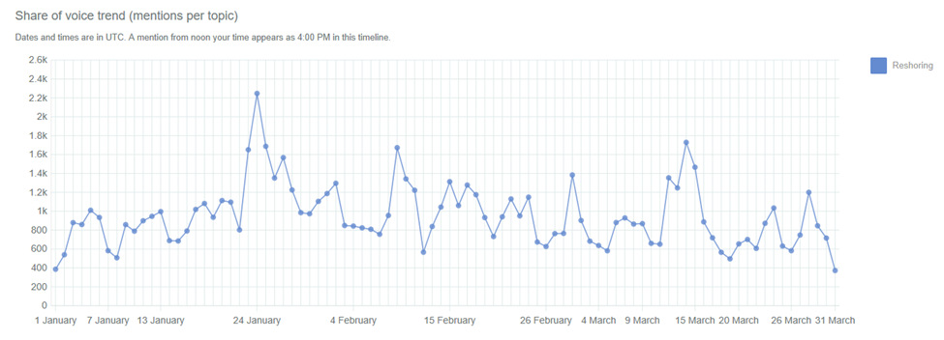
Figure 1. Mentions per topic over time from January 1, 2017 to March 31, 2017
Notes:
Analysis and Results
4.1 Context
4.1.1 Time Analysis
Figure 1 illustrates the mentions of reshoring related topics over time for the period January 1, 2017 to March 31, 2017. Mentions are references to Topics within posts. The number of mentions of reshoring are relatively stable over time, except for a salient spike on January 24, 2017. This was the first Tuesday after the Inauguration of President Donald Trump. On Monday, January 23, 2017 President Trump announced that the United States would leave the Trans-Pacific Partnership. A portion of the spike may be due to this event.

Slide 7
Table 1. Number of Mentions and Percentage of Total Mentions based on Source
Source | Number of Mentions | Percentage of Total
Videos | 23,528 | 27.57%
Forums | 18,752 | 21.97%
News | 16,787 | 19.67%
Twitter | 11,497 | 13.47%
Blogs | 10,141 | 11.88%
Reviews | 3,924 | 4.60%
Facebook pages | 718 | 0.84%
Total | 85,347
Notes:
4.1.2 Source Type Analyses
The number of mentions varied across source types. Table 1 shows the number and percentage of mentions. Videos and Forums combined accounted for 49.54% of the total mentions across sources. Reviews at 4.60% and Facebook a 0.84% had the fewest mentions.

Slide 8
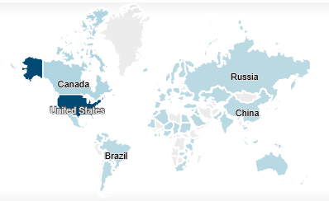
Figure 2. Geographical map of the Social Media posters of reshoring related topics
Notes:
4.1.3 Geography Analyses
Using the search parameters specified for WASM, there were 78,815 total documents with 85,347 total mentions for the reshoring related Topics for the period of January 1, 2017 to March 31, 2017. Documents are posts. Mentions are references to the topics within posts. Most of these mentions of reshoring related topics came from the United States, totaling 12,360 mentions. Additionally, there were high numbers of mentions from Canada, Brazil, Russia, and China. In total, roughly 140 countries had reshoring related posts. The map in Figure 2 depicts reshoring related social media authorship from countries around the world. The darker shading indicates a higher geographic concentration of authors. There were some countries where there were no authors of reshoring related content on social media. The use of topics such as Made in the USA probably contributed to the high number of authors in the United States.

Slide 9
Table 2. Author Country and Unique Author Count for Countries with 10+ Authors
Author Country | Unique Author Count
Argentina | 18
Australia | 97
Brazil | 42
Canada | 420
Egypt | 10
France | 37
Georgia | 25
Germany | 33
Iceland | 21
India | 31
Puerto Rico | 10
Russia | 10
Singapore | 16
South Africa | 23
Spain | 13
Sweden | 17
Switzerland | 10
Tanzania | 10
Thailand | 13
United Kingdom | 226
United States | 8197
Blank | 31925
Indonesia | 15
Ireland | 16
Italy | 26
Jamaica | 10
Japan | 31
Malaysia | 17
Mexico | 49
Nepal | 26
Netherlands | 39
New Zealand | 10
Nigeria | 16
Philippines | 15
Notes:
The total number of unique authors by author country are presented in Table 2 for countries with 10 or more unique authors. Of the roughly 140 countries with unique authors, only 34 had 10 or more unique authors. The results based on unique authors had a similar distribution to the results of total mentions by country. The United States has the highest number of unique authors at 8,179. This is likely due to the inclusion of American and USA specific search term parameters.

Slide 10
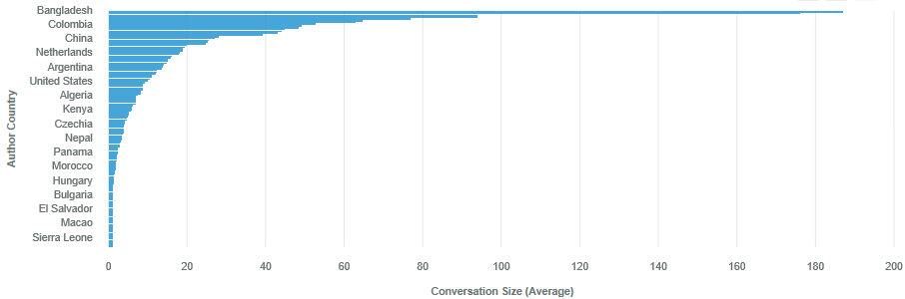
Figure 3. Image from IBM Watson AnalyticsTM of "How do the values of Conversation Size compare by Author Country?".
Notes:
These results suggest that the reshoring phenomena is discussed globally. This agrees with studies conducted on reshoring in the United States (Ellram et al., 2013), the United Kingdom (Bailey & De Propris, 2014), Spain (Martinez-Mora & Merino, 2014), Germany (Kinkel, 2012), and Northern Europe (Gylling et al., 2015).
According to a 2014 study by Margulescu & Margulescu, “reshoring is predominantly an American phenomenon” (p. 91). This is due to the fact that European companies were less apt to offshore in the 80’s and 90’s (Margulescu & Margulescu, 2014). Therefore, there was less of a need for European companies to practice reshoring (Margulescu & Margulescu, 2014). European reshoring prospects have been limited due to inflexible and expensive labor markets and a prevalence of family firms (Margulescu & Margulescu, 2014).
Figure 3 shows of the analysis of conversation size by author country. Conversation size is defined as the overall total posts within a particular conversation thread. From the bar chart in Figure 3, it is observed that reshoring related posts in Bangladesh create very large sized conversations on social media. Reshoring related posts in Columbia, China, Netherlands, Argentina, and the United States have the next largest conversation sizes.

Slide 11
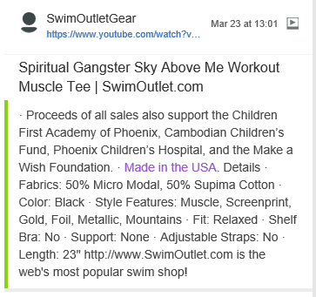
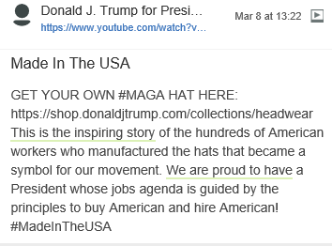
Figures 4 and 5. Images of video posts regarding reshoring on Social Media.
Notes:
4.2 Content
4.2.1 Activity in social media
Participation of companies and individuals were identified through account types. Companies had the highest average number of posts at 19.91. The media had 13.97 posts on average and individuals had 2.18 posts on average. Other organizations had 1.28 posts on average. An analysis of author influence scores showed that companies or causes were the most influential. The author influence score is based on the number of posts and the number of people responding to those posts.
The most influential authors for the video source were users named Donald J. Trump for President, SwimOutletGear, and Trailers 123.com. The topic of reshoring was used for both political cause, such as the election, and for company advertisements. The most influential video was posted by Donald J. Trump for President. This had one video posted with 393 engagements during the time period of January 1, 20017 to March 31, 2017. Engagements are a count of the author’s post, the responses, and author’s response to the responses. Figure 4 is the verbal part of the video post.
Many social media users were companies posting about Made in the USA as a product attribute. For example, the SwimOutletGear posted 385 videos during the searched time period. Of these 385 videos, zero had active engagements. Figure 5 is one example of the many companies that are posting Made in the USA as a product attribute.

Slide 12
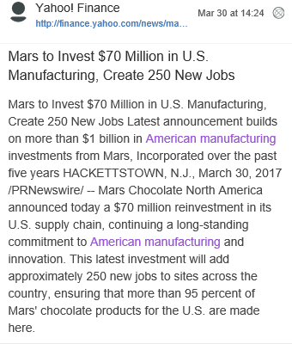
Figure 6. Image of an example of news posts regarding reshoring on Social Media.
Notes:
Likewise, the reshoring related topics were found throughout the popular press. There were 19 news organizations that had 50 to 170 posts about reshoring related topics. Examples of these news organizations included Mil Tech, The Outdoor Wire, Yahoo! Finance, The Washington Post, Business Insider, and Business Wire. An example of one of the 112 postings from Yahoo!Finance pertaining to reshoring is Figure 6.

Slide 13
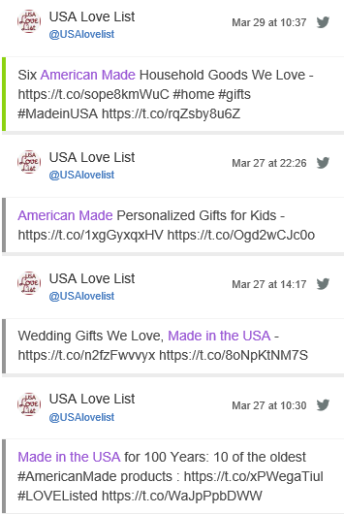
Figure 7. Image of an example of Twitter posts regarding reshoring on Social Media.
Notes:
In addition to political, company and news posts, there were social media posts from individuals promoting Made in the USA products. For example, the Twitter account USA Love List was the second most influential twitter author. This account had over 14,800 followers. During the time period of January 1, 2017 to May 31, 2017, this user posted 102 tweets with 63 engagements. Figure 7 is examples of the Twitter posts from USA Love List.

Slide 14
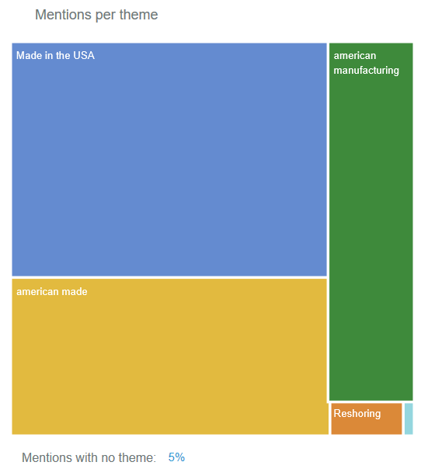
Figure 8. Mentions per theme Made in the USA, American Made, American Manufacturing, Reshoring, and Onshoring
Notes:
4.2.2 Theme Analyses
The same terminology was used for both Topics and Themes when searching WASM. Figure 8 and Table 3 show the total mentions by theme. Almost half (47.74%) of the Topics and Themes mentioned were Made in the USA. American Made was 30.34% of the mentions. Reshoring was only 1.52%, and Onshoring was only 0.23% of the total reshoring related mentions on social media between January 1, 2017 and March 31, 2017. There seems to be a preference among social media users for the terms Made in the USA and American Made. Among the terms found in the academic literature, Reshoring was the favorite on social media.

Slide 15
Table 3. Number of Mentions and Percentage of Total by Topic/Theme
Topic/Theme | Number of Mentions | Percentage of Total
Made in the USA | 39,035 | 47.74%
American Made | 25,897 | 30.34%
American Manufacturing | 15,741 | 18.44%
Reshoring | 1,295 | 1.52%
Onshoring | 193 | 0.23%
Other (possibly Backshoring) | 3,186 | 3.73%
Total | 85,347
Notes:
According to WASM, 5% of the mentions do not match any of the themes. In Table 3, this other category was more accurately calculated as 3.37%. When mentions contain Themes or Topics but not context terms, the mention is classified as Other. In this case, Backshoring is not listed on the WASM theme output. Backshoring may or may not be a part of the 3.37% of unaccounted for mentions

Slide 16
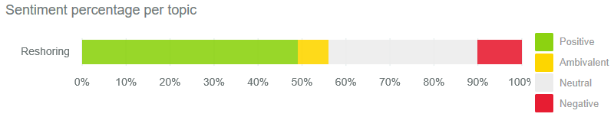
Figure 9. Sentiment of reshoring on Social Media as categorized by WASM as positive, ambivalent, neutral, and negative
Notes:
4.2.3 Sentiment Analyses
WASM uses textual emotion detection and artificial intelligence to determine the sentiment of the Social Media posts (Gundecha, 2016). WASM leverages training, featuring selection, diverse classifiers, lexicon/word detection, emoticons, emoji, and slang to attempt to determine the sentiment (Gundecha, 2016). Figure 9 and Table 4 display the results of the Sentiment analysis for the current study. Mentions are categorized as positive, ambivalent, neutral, and negative. Almost half (49.11%) of the total mentions of reshoring related terms were positive. Only 6.90% of the total mentions were classified as ambivalent by WASM. For the dates, January 1, 2017 to March 31, 2017, 33.90% of the Social Media posts were neutral. Only 10.08% of the total Social Media mentions of reshoring related terms were classified as negative.

Slide 17
Table 4. Number of Mentions and Percentage of Total based on Sentiment Type
Sentiment Type | Number of Mentions | Percentage of Total
Positive | 41,915 | 49.11%
Ambivalent | 5,893 | 6.90%
Neutral | 28,934 | 33.90%
Negative | 8,605 | 10.08%
Total | 85,347
Notes:
There has been little research into the sentiments associated with reshoring. According to a 2015 study by Grappi et al., the sentiments of gratitude, righteous anger, and ethnocentrism impacted consumers’ willingness to pay for reshored products. In their study, as companies reshored, consumers were positive about the reshoring decision, wanted to reward reshoring companies, and perceived reshoring actions from those companies as benevolently motivated (Grappi et al., 2015).

Slide 18
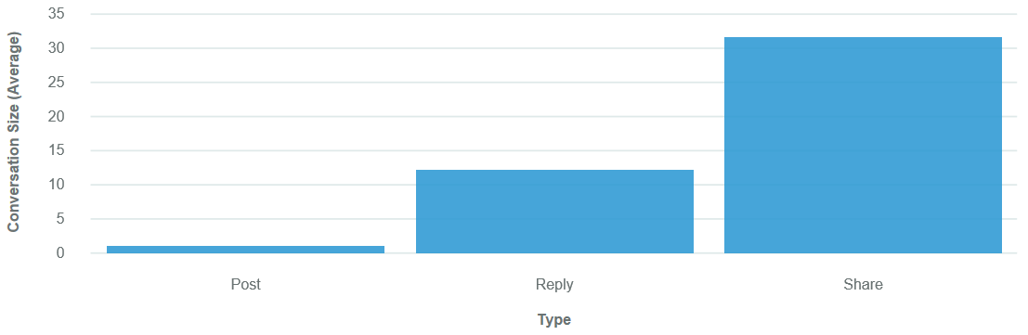
Figure 10. Image from IBM Watson AnalyticsTM of "How do the values of Conversion Size compare by Type".
Notes:
4.2.4 Author Engagement Analyses
Figure 10 is an image from IBM Watson AnalyticsTM of conversation size compared to type. The types are posts, replies and shares. Unique posts occurred the least, while shares and replies occurred more frequently. The conversation size by type is 31.65 for shares, 12.24 for replies, and 0.99 for posts. For every one post of reshoring related material, there is an average of 31 shares and an average of 12 replies. This implies that social media users are more apt to share reshoring related materials, rather than post or reply to reshoring related material.

Slide 19
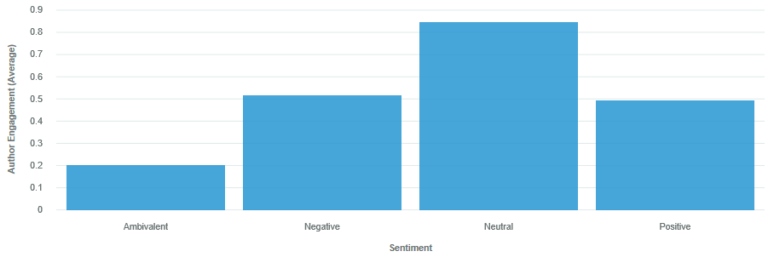
Figure 11. Image from IBM Watson AnalyticsTM of "How do the values of Author Engagement compare by Sentiment?"
Notes:
An image from IBM Watson AnalyticsTM of the classification of Author Engagement by Sentiment is presented in Figure 11. Author engagement is calculated by counting the number of times people post or respond to an author and the number of times the authors responds to them. Based on Figure 11, posts with a neutral sentiment with regards to reshoring had the highest average for author engagement. Posts with negative and positive sentiment had the next highest averages, with negative being slightly higher. Those with ambivalent sentiment had the lowest average level of author engagement. The number of positive mentions, in Figure 9, was the highest among the sentiments, but author engagement with positive mentions were third in Figure 11. One inference could be made that there were many mentions with a positive sentiment by users who were not as actively engaged. There were fewer neutral and negative sentiment mentions, however, these users had a higher average engagement.

Slide 20
Key Findings
Discussions about U.S. reshoring activities are taking place in 140 countries
The term ‘reshoring’ is rarely used in social media posts
In 2018, the ubiquitous discussion about reshoring related topics makes it approachable to most audiences
This study offers an example of the application of big data visualization to answer questions that are being considered in industry and academia
Notes:
Insights into Reshoring from Big Data Visualization of Social Media Posts (304618)
*Megan Eileen Moore, North Carolina State University
Lori Fay Rothenberg, North Carolina State University
Keywords: Data Visualization, Reshoring, Made in the USA, American manufacturing, Onshoring
Data visualization is a powerful tool for conveying information in an easy to understand format. One potential application of data visualization is in the topic of reshoring, which is the act of reintroducing domestic manufacturing. Reshoring, American manufacturing, and Made in the USA are hot topics in academia, industry, and popular press. These topics are relevant in 2018, as location decisions of where to manufacture affect the supply chain, total costs of production, and consumer perceptions. Big data are being produced on social media can be analyzed using data visualization in order to lead the way in a more thoughtful discussion about the reshoring phenomenon. The purpose of this study was to apply data visualization techniques to social media posts and responses on the topic of reshoring to describe the discussions occurring between individuals, companies, and government officials. IBM Watson Analytics for Social MediaTM was used to collect the social media posts, and IBM Watson AnalyticsTM as well as IBM Watson Analytics for Social MediaTM were used to analyze the big data produced by social media posts. The search parameters were set to include terms used in the popular press as well as those used in the academic literature. The data were analyzed using context and content. The context data are visualized using time, source type, and geographic analyses, and the content data are visualized by activity in social media, theme, sentiment, and author engagement analyses.
Among the key findings were (1) discussions about U.S. reshoring activities are taking place in 140 countries and (2) the term ‘reshoring’ is rarely used in social media posts. In 2018, the ubiquitous discussion about reshoring related topics makes it approachable to most audiences. This study offers an example of the application of big data visualization to answer questions that are being considered in industry and academia.

Slide 21
References
Arlbjorn, J. & Mikkelsen, O. (2014), Backshoring manufacturing: Notes on an important but under-researched theme., Journal of Purchasing & Supply Chain Management, 20, 60-62.
Bailey, D., & De Propris, L. (2014). Manufacturing reshoring and its limits: The UK automotive case. Cambridge Journal of Regions, Economy and Society, 7(3), 379-395.
Ellis, K. (2014). Made in USA gains, but china still key. WWD: Women's Wear Daily, 207(117), 1-1.
Ellram, L., Tate, W. & Petersen, K. (2013), Offshoring and reshoring: An update on the manufacturing location decision, Journal of Supply Chain Management, 49(2), 14-22.
Fratocchi, L., Ancarani, A., Barbieri, P., Di Mauro, C., Nassimbeni, G., Sartor, M. & Zanoni, A. (2016). Motivations of manufacturing reshoring: an interpretative framework. International Journal of Physical Distribution & Logistics Management, 46 (2),98-127.
Friedman, A. (2017, May 6). Senate Committee Advances American-Made Products Act. Sourcing Journal,
Grappi, S., Romani, S., & Bagozzi, R. P. (2015). Consumer stakeholder responses to reshoring strategies. Journal of the Academy of Marketing Science, 43(4), 453-471.
Gray, J., Skowronski, K., Esenduran, G. & Rungtusanatham, M. (2013), The reshoring phenomenon: What supply chain academics ought to know and should do, Journal of Supply Chain Management, 49(2), 27-33.
Gundecha, P. (2016). IBM Watson just got more accurate at detecting emotions. Retrieved April 27, 2017, from https://www.ibm.com/blogs/bluemix/2016/10/watson-has-more-accurate-emotion-detection/
Gylling, M., Heikkila, J., Jussial, K. & Saarinen, M. (2015), Making decisions on offshore outsourcing and backshoring: A case study in the bicycle industry, International Journal of Production Economics, 162, 92-100.

Slide 22
References continued
Kazmer, D. O. (2014). Manufacturing outsourcing, onshoring, and global equilibrium. Business Horizons, 57(4), 463-472.
Knight, L., & Tate, W. (2016). Editorial from the incoming editors: Setting out. Journal of Purchasing & Supply Management, 22(2), 69-71.
Kinkel, S. (2012). Trends in production relocation and backshoring activities: Changing patterns in the course of the global economic crisis. International Journal of Operations & Production Management, 32(6), 696-720.
Kunz, G. I., Karpova, E. &Garner, M. B. (2016), Going global: The textile and apparel industry (3rd ed.). New York, NY: Fairchild Books.
Malhotra, N. (2015). Essentials of marketing research: A hands-on orientation. Boston, MA: Pearson Education.
Mangold, W. G., & Faulds, D. J. (2009). Social media: The new hybrid element of the promotion mix. Business horizons, 52(4), 357-365.
Margulescu, S., & Margulescu, E. (2014). Reshoring in manufacturing and services. Global Economic Observer, 2(1), 90-95.
Martinez-Mora, C. & Merino, F. (2014). Offshoring in the Spanish footwear industry: A return journey? Journal of Purchasing and Supply Management, 20(4), 225-237.
Maronde, U., Stambaugh, J., Martin, L. & Wilson, P. (2015). The effect of reshoring on purchase behaviour Journal of Marketing Development and Competitiveness, 9(2),80-92.
Moore, M. E. (2016). Evaluation of the Reshoring of Sourcing and Manufacturing Strategies in the Textile and Apparel Industries. (Master’s thesis). North Carolina State University, Raleigh. Retrieved from http://www.lib.ncsu.edu/resolver/1840.20/33268
Reshoring Initiative. (2017), available at: http://www.reshorenow.org/ (accessed 24 April 2017).
Tate, W., Ellram, L., Schoenherr, T. & Petersen, K. (2014). Global competitive conditions driving the manufacturing location decision, Business Horizons, 57,381-390.
Tate, W. L. (2014). Offshoring and reshoring: U.S. insights and research challenges. Journal of Purchasing and Supply Management, 20(1), 66-68.

