Slide 1
Sensemaking and Five Problems With Data Science
2018 Symposium on Data Science & Statistics
May 16 – 19, 2018 Reston Virginia
Michael Latta
Coastal Carolina University
YTMBA Research & Consulting

Slide 2
Yanny OR Laurel

Slide 3
In Tukey’s (1962) work done for the Army Research Office titled, “The Future of Data Analysis,” John Tukey foreshadowed the emergence of Data Science.
“For a long time I thought I was a statistician, interested in inferences from the particular to the general. But as I have watched mathematical statistics evolve, I have had cause to wonder and doubt… I have come to feel that my central interest is in data analysis… Data analysis, and the parts of statistics which adhere to it, must…take on the characteristics of science rather than those of mathematics… data analysis is intrinsically an empirical science…

Slide 4
Questions Surrounding Data Science
How important is Data Science?
What skills do Data Scientists have?
Is it a Science, or an Art, a Craft, or something else?
Was George Box correct that, “All models are wrong, but some are useful.”?
Are we just doing “Cookbookery and Mathmatistry” as Box also said?
Is it the case that, as Richard Browne says, ‘… a result that is truthful and useful to the client is often preferable to one that would charm our major professor, but leave the client confused?”
What do statisticians say they are?

Slide 5
What are the SDSS Symposium with Topic Areas and Tracks?
Machine Learning
Data Visualization
Data Science
Computational Statistics
Computing Science
Applications

Slide 6
Foundations of this Talk
1954
How to Lie with Statistics Darrell Huff
1980
Applied Management Science
Rick Hesse & Gene Woolsey
1996
Against the Gods: The Remarkable Story of Risk Peter Bernstein
2009
The Devil’s Delusion David Berlinski
2013
Data Science for Business Foster Provost & Tom Fawcett
2017
Errors, Blunders, and Lies
David Salsburg
2017
Sensemaking: The Power of the Humanities in the Age of the Algorithm
Christian Madsbjerg

Slide 7
Who Is the American Statistician?
Or, Is It Data Scientist?

Slide 8
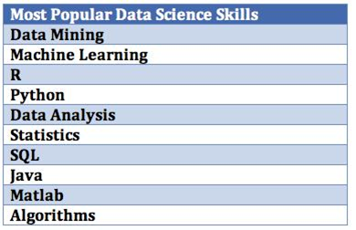
Ferris Jumah’s
Top Ten Skills Listed by Data Scientists on LinkedIn

Slide 9
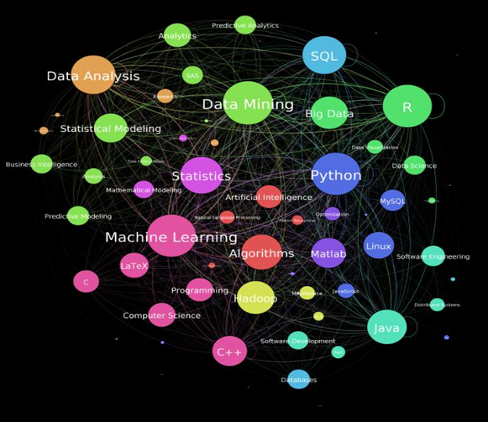
Ferris Jumah’s Network of Data Scientist Skills
The Data Science Skills Network, September 3, 2014

Slide 10
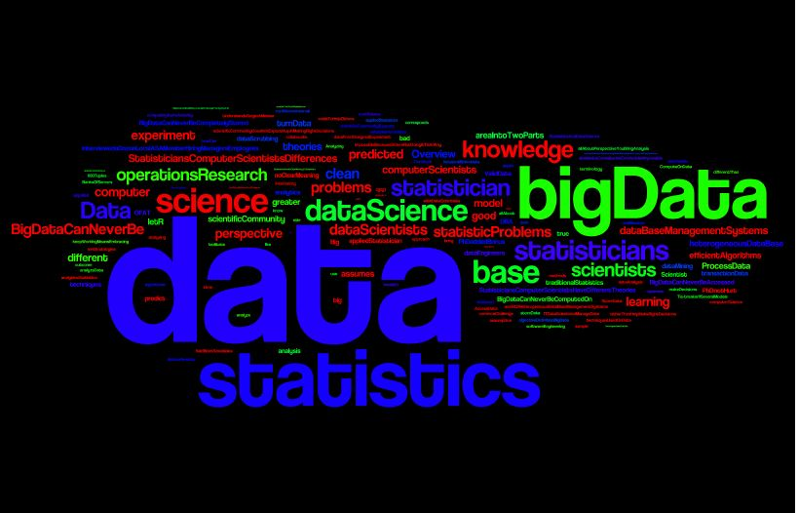

Slide 11
Five Problems With Big Data - From a speech by Nate Silver at the HP Big Data Conference in Boston, August 2015
Where to put it
Big bias
False positives
Big Complexity
That’s not what I was looking for….

Slide 12
Where to Put It
The more data companies have the more complex the problems of managing it can become
  - Do you buy hardware?
  - Do you store it in the cloud?
  - How often will you need to access it?
  - Can you deal with latency?

Slide 13
Big Bias
It’s possible to make statistics say whatever you want
The more data you have, the more wiggle room there can be to sway the stats
You may have a conclusion in search of an analysis
Beware of spurious correlations

Slide 14
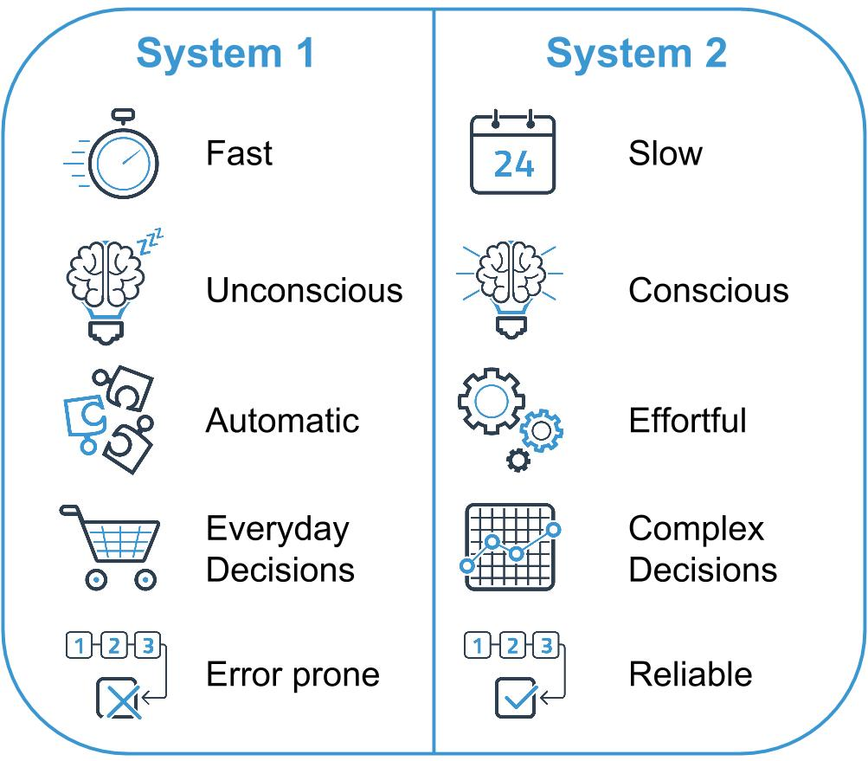
Thinking, Fast & Slow
Daniel Kahneman

Slide 15
False Positives
Daniel Kahneman “Thinking, Fast and Slow”
The point of Thinking Fast vs. Thinking Slow is that sometimes people rush decisions based on a subset of data (thinking fast)
A better practice is to “think slow” to really explore and rationalize data
With big data, thinking fast (not analyzing the data fully) can lead to false positives

Slide 16
Big Complexity
Extracting the “signal from the noise”
This is the problem of finding the needle in the haystack
The more data you have, sometimes the harder it can be to find true value from the data

Slide 17
That’s not what I was looking for…
Imagine Google Maps giving you directions and suggesting an alternate, “faster” route
You take it only to find that it’s a dirt road under construction
Sometimes big data systems think they have found a shortcut, but in reality, it’s not exactly what the user was looking for

Slide 18
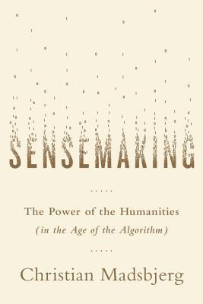
In 1993, Karl Weick introduced the concept of Sensemaking in organizational decision making to account for failures in data-driven decision making.
Network: @Hyatt_Meetings
Password: sdss2018
https://sensanalytics.com/

Slide 19
The Five Principles of Sensemaking
Culture – not individuals
Thick Data – not just thin data
The Savannah – not the zoo
Creativity – not manufacturing
The North Star – not the GPS

Slide 20
Sensemaking is the ability or attempt to make sense of an ambiguous situation. More exactly, sensemaking is the process of creating situational awareness and understanding in situations of high complexity or uncertainty in order to make sound decisions.

Slide 21

Google Flu Trends Success?
In 2008, Google researchers wanted to use search terms to predict outbreaks of flu sooner than data from the CDC
‘Nowcasting’ was invented and used generating results that were published in Nature
Google queries were faster than the CDC data by two weeks

Slide 22

Google Flu Failure
But, in 2009 Google Nowcasting completely missed the H1N1 pandemic and overestimated outbreaks in 2012-2013
Correlation without causation led to overestimates because search terms such as ‘chicken soup’ created a warning
The moral to the story is Big Data will never be neutral

Slide 23

Sensemaking Defined By
Jeff Jonas 2013
Sensemaking is about helping companies make sense of messy external business data
This messy external data exists with uncertainty in an unknown and ever changing world such as social media
Sensemaking is needed to gain understanding about risk management, customer segments, social circles, and investigations

Slide 24


