Slide 1
Approaches to Investigating Multimorbidity
Cynthia S. Crowson, PhD
SDSS
May 19, 2018
Notes:
I’d like to thank the organizers for the opportunity to present my work today.

Slide 2
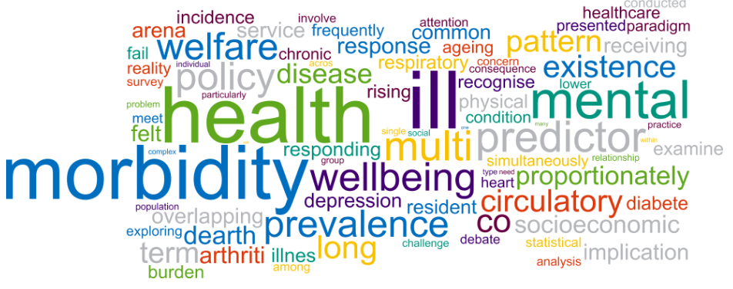
Definition
Multimorbidity is the occurrence of 2+ chronic conditions
  Growing global health concern
  Elderly and low socioeconomic status
  Single disease model no longer adequate
www.researchperspectives.org
Notes:
Multimorbidity is the occurrence of 2 or more chronic conditions. It is a growing health concern due to the aging of the population, and it primarily affects the elderly and those with low socioeconomic status.

Slide 3

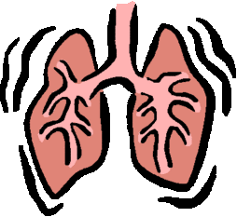

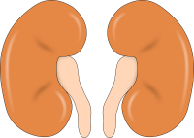

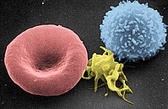
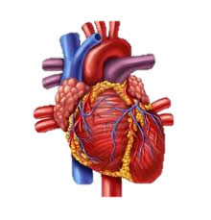


Ageing Process
Ageing
Multi-system loss of function or reserve
Single morbidity
Accelerated Incidence of Multi-morbidity
Adverse Outcomes: frailty, disability, poor quality of life, hospitalization, mortality
Notes:
The process of ageing begins at the cellular level with changes such as oxidative stress, inflammation and mitochondrial dysfunction. This leads to multi-system loss of function or reserve. The first clinical manifestation of ageing is often a single morbidity. This is then followed by an accelerated incidence of multi-morbidity, which leads to adverse outcomes, such as frailty, disability, poor quality of life, hospitalization and death.

Slide 4
Research questions
How common is multimorbidity?
Which conditions co-occur more often than expected?
How does multimorbidity develop over time?
How do multimorbidity patterns influence outcomes?
Notes:
Relevant research questions related to multimorbidity include….
Research is needed into
how multimorbidity develops (including the extent to which many disorders are driven by one cause, or whether they occur independently),
its associations with a range of outcomes (including quality of life, functional status, health-service use, quality of care, and mortality)
how preventable these outcomes are
how to intervene to minimize them
how best to organize health care to address the needs of people with multimorbidity

Slide 5
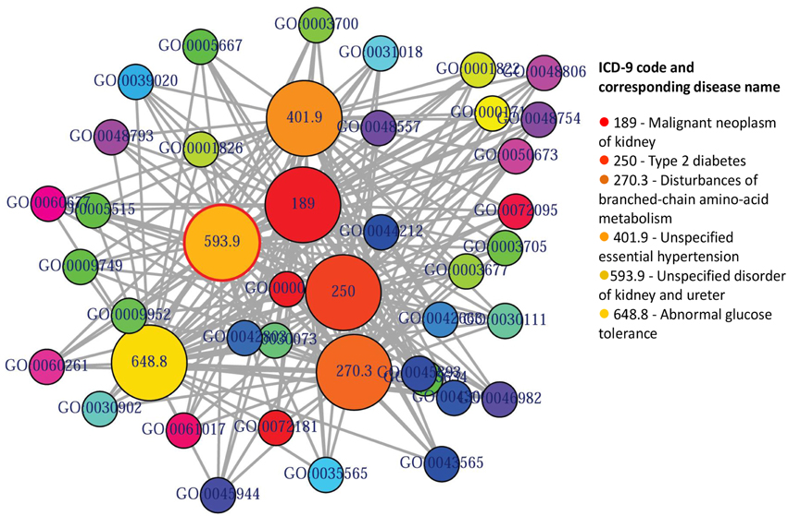
Issues
Large number of conditions of interest
Complex inter-relationships

Slide 6
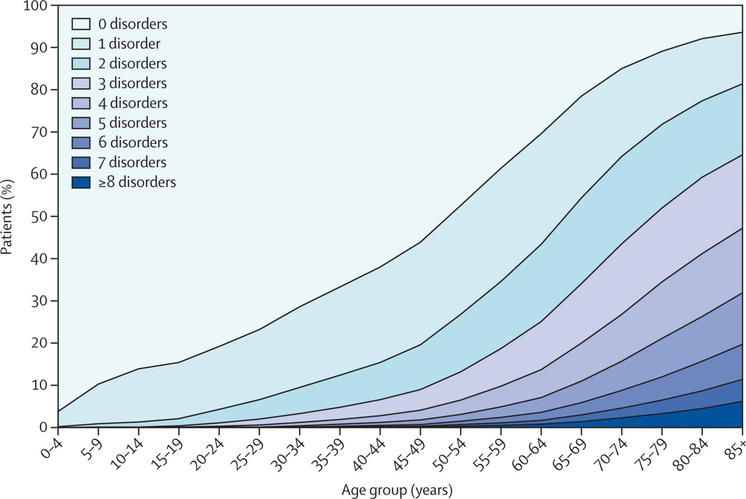
Prevalent number of conditions
Barnett K et al. Lancet 2012; 380:37-43

Slide 7
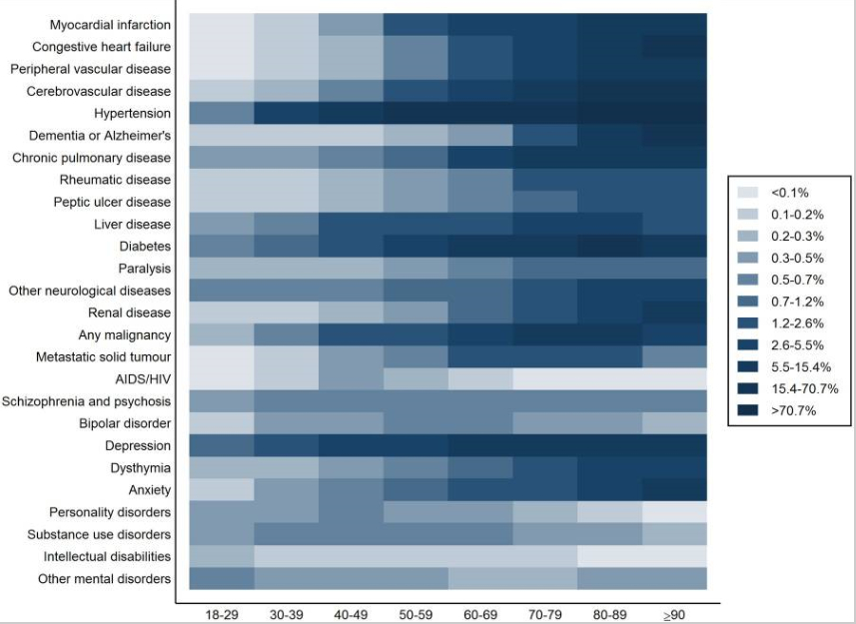
Prevalence of individual conditions
Lenzi J et al. BMJ Open 2016:6:e012812

Slide 8
Approaches to identify patterns of multimorbidity
Cross-sectional
  Dyads and triads
  Unsupervised learning
    Principle components/factor analysis
    Clustering
    Topic models
Longitudinal
  Trajectory analyses
  Multi-state models
Notes:
Unsupervised learning techniques

Slide 9

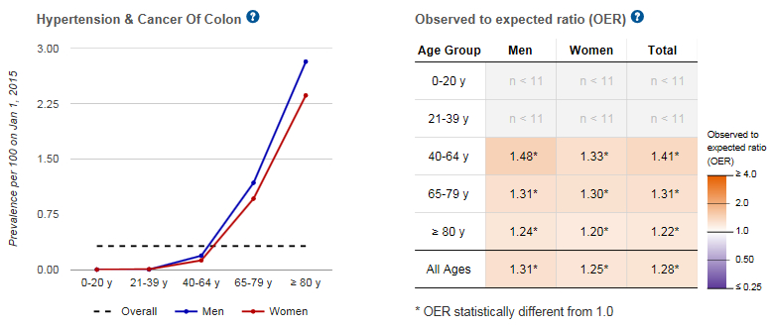
Dyads
Rochester Epidemiology Project: Data Exploration Portal
www.rochesterproject.org/portal/

Slide 10
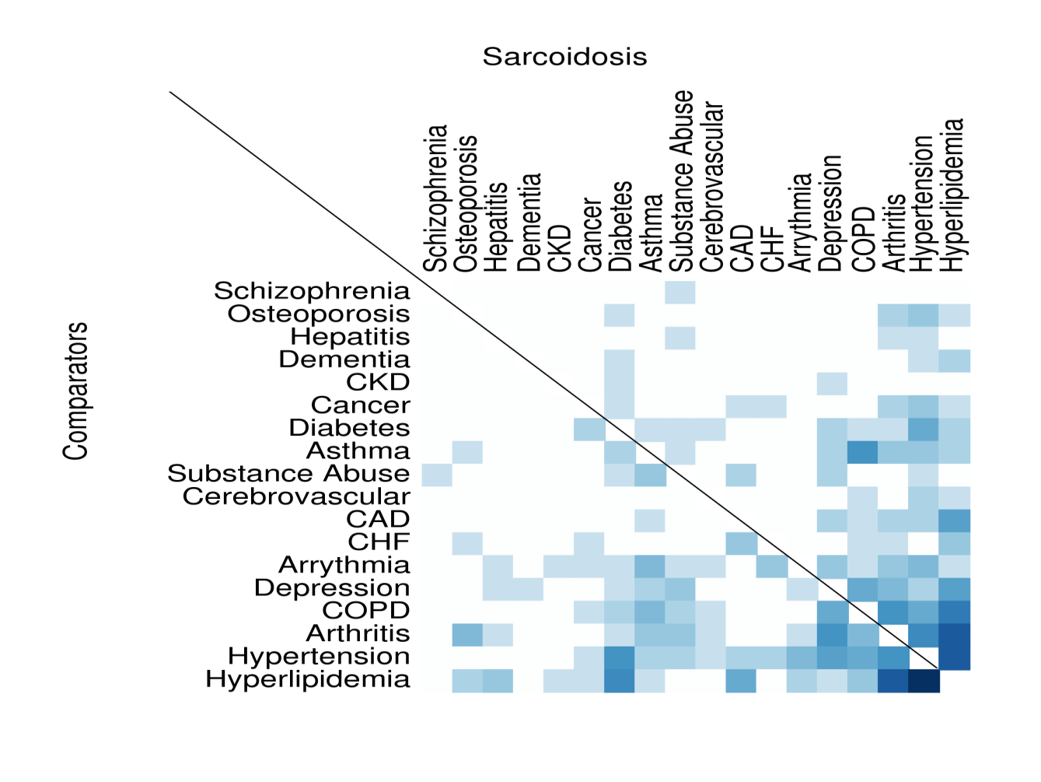
Dyads in cases and controls
Ungprasert P et al. Mayo Clinic Proc 2017;92:1791-9
Notes:
We also used these models to study multi-morbidity in a cohort of patients with sarcoidosis. This paper was recently published in Mayo Clinic Proceedings. We looked at a pre-defined set of moribidites and this plot show how common these conditions were in patients with sarcoidosis and comparators. Perhaps the combination of hyperlipidemia and hypertension is a bit more common in the comparators than in the sarcoidosis patients because this dark blue box may be a bit darker than the one for cases on the other side of the line. We didn’t find any statistical differences in these combinations of 2 morbidities at time or any of the combinations of morbidities.

Slide 11
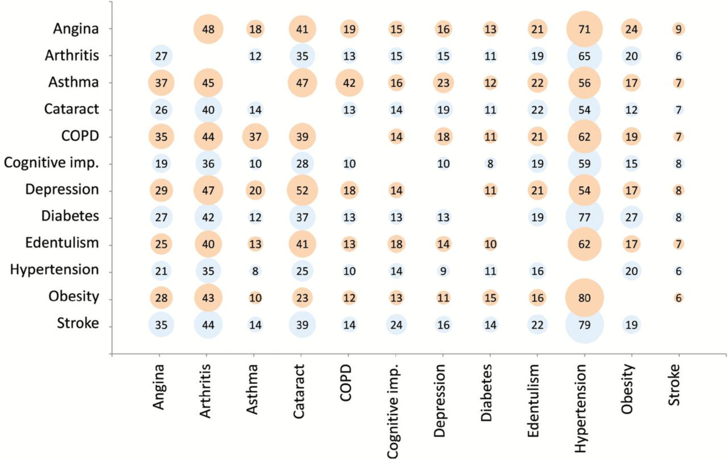
Dyads
Garin N et al. J Gerontol A Biol Sci Med Sci. 2015;71(2):205-214
Notes:
Figure 2. Comorbidity prevalence using overall pooled data. For country-wise information see Supplementary Appendix . To interpret the graph, choose one condition in the left column and then from the total patients with this condition check the percentage of those who have one of the co-occurring conditions from the list below.

Slide 12
Principal Components and Clustering
Principal Components Analysis
  Looks to find a low-dimensional representation of the observations or features that explain a good fraction of the variance
Clustering
  Looks to find homogeneous subgroups among the observations or features
James G, Witten D, Hastie T, Tibshirani R. An Introduction to Statistical Learning

Slide 13
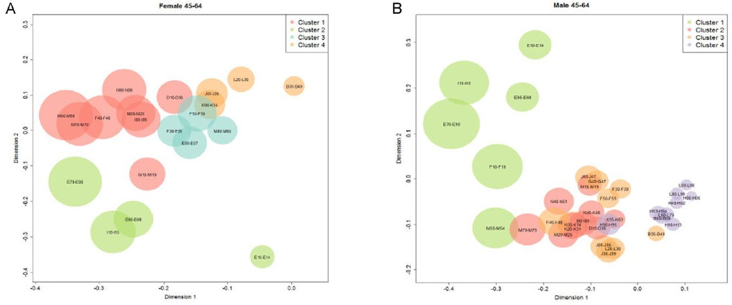
Principal Components and Clustering
Roso-Llorach A et al. BMJ Open 2018;8:e018986

Slide 14
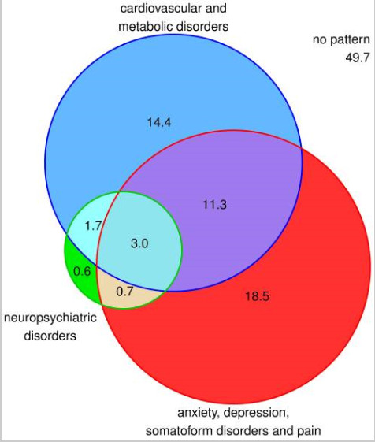
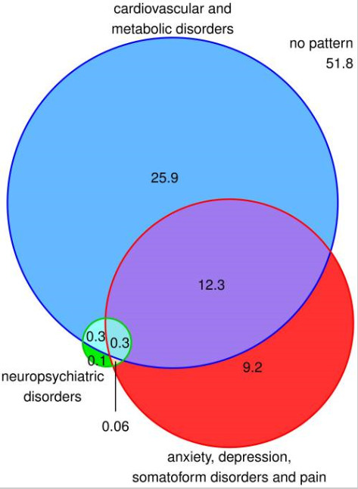
Venn Diagrams
male
female
Schäfer I et al. PLoS ONE 2010

Slide 15
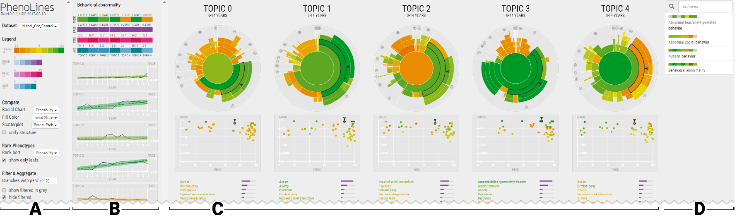
Topic Models
Machine learning approach for modeling discrete admixtures, first popularized for extracting themes from document collections
Glueck M et al. IEEE Trans Vis Comput Graph 2018; 24:371-81
Notes:
PhenoLines facilitates the visual analysis of topics that describe disease symptoms, in support of topic model optimization and characterization. Hierarchical relationships, temporal trends, correlated measures, and rank-ordered lists enable for comparisons within and between topics. The interface includes (A) Settings Panel, (B) Detail Panel, (C) Topics Panel, and (D) Search Panel.

Slide 16
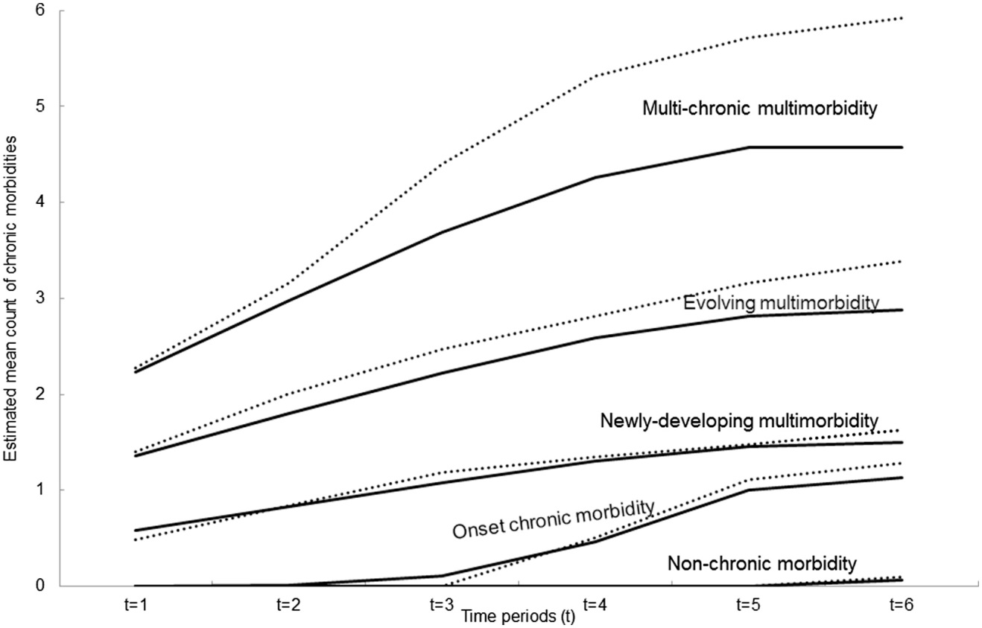
Multimorbidity Trajectories
Latent class growth analysis
  Cluster patients into distinct pathways
Strauss V et al. J Clin Epi 2014; 67:1163-71
Notes:
Clusters of chronic multimorbidity trajectories over time in Consultations in Primary Care Archive (CiPCA; solid lines) and North Staffordshire Osteoarthritis Project (NorStOP; dotted lines). The solid lines represent the estimated mean curves of multimorbidity profiles for the five clusters based on CiPCA. The dotted lines represent the mean of observed morbidity counts at each time point of NorStOP participants assigned to each of the clusters. “Non-chronic morbidity” cluster included people who did not have any chronic morbidity; “Onset chronic morbidity” cluster included those who developed a first chronic morbidity; “Newly-developing multimorbidity” cluster included those who developed multimorbidity lately; “Evolving multimorbidity” cluster included those who progressed from one chronic morbidity to multimorbidity; “Multi-chronic multimorbidity” cluster included those who started with multimorbidity and developed further morbidities.

Slide 17
Multi-state models
Can be used to estimate:
  Time in each state
  Probability of transitioning from one state to another
  Covariate effects on transitions
Illness
Health
Death
Notes:
That leads us to multi-state models.
Here the picture is a bit more complex than in the simple competing risk case. The most common model is the illness-death model. In addition to the competing risk, of death, these models can also estimate the risk of death after illness. And they can allow patients to go back and forth between health and illness, if that makes sense. Death is called an absorbing state, because once you enter that state, you cannot come back out.
These models can be used to estimate the time in each state. The states are the health, illness and death. And we can estimate the probability of transitioning from one state to another.
We can also look at covariate effects. So maybe age is important in going from health to death, but once you’ve had the illness, age is not as important as how long you have been living with the disease. so we can look at covariate effects on each transition.

Slide 18
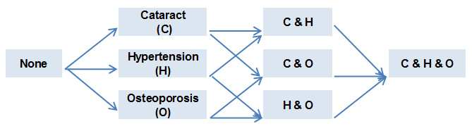

Multi-state model: example
Death
Notes:
This is an example of looking at 3 different morbidities in patients with rheumatoid arthritis. So people can start in any of these states when they are diagnosed with rheumatoid arthritis. They may have none of the 3, just cataract, just hypertension or just osteoporosis, they may have any combination of 2 of these or they may have all 3.
They can start in any state and then they can develop more morbidities over time. Also, they can go to death from any of the states, but that’s a lot of arrows, so I just drew some of them or it just gets too messy.

Slide 19
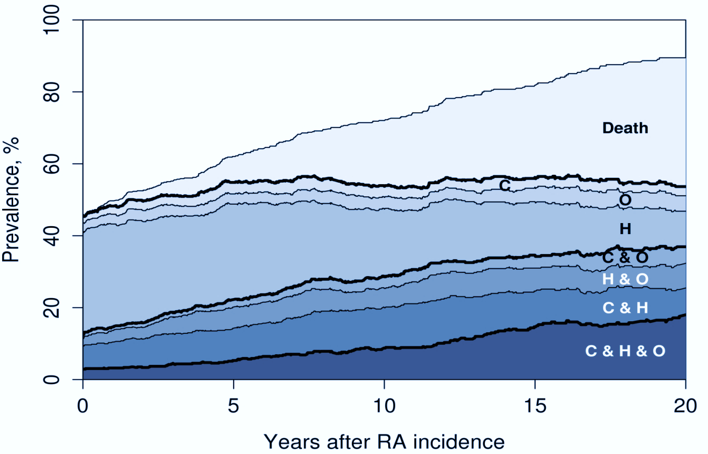
Multi-state model: RA morbidity
Notes:
We also did a longitudinal analysis of these morbidities on the RA disease duration time scale. In the longitudinal analysis, these are now mutually exclusive groups. At the RA diagnosis, we can see very few patients have all 3 and over time the proportion with all 3 increases quite a bit. At the beginning, many of them have just hypertension. About 10-12% of patients have 2 conditions at RA diagnosis and another 30 % have just 1 of the 3 and no one has died at the beginning and the rest of the patients at time 0 do not have any of the 3.
On the other side of the figure we have close to 20% have all 3, many have died, few have nothing. The proportion with hypertension alone has decreased quite a bit.
This shows the capabilities of the models.

Slide 20
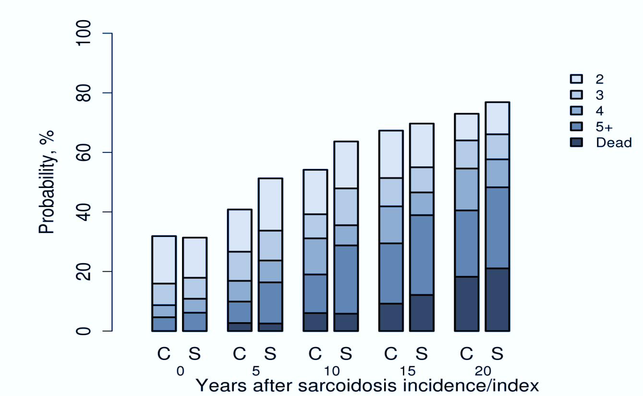
Multi-state model: sarcoidosis
Ungprasert P et al. Mayo Clinic Proc 2017 Nov.
Notes:
However, when we look at the proportion of patients who developed 2, 3, 4 or 5 or more of these morbidities over time, we see that the patients with sarcoidosis and comparators are similar at the baseline and then over time the patients with sarcoidosis develop slightly more morbidities over time. By 20 years, the proportion who have died looks a bit bigger in the sarcoidosis group, but also the proportion with 5 or more is a bit bigger in the sarcoidosis group. The increases are minimal, but they did reach statistical significance.

Slide 21
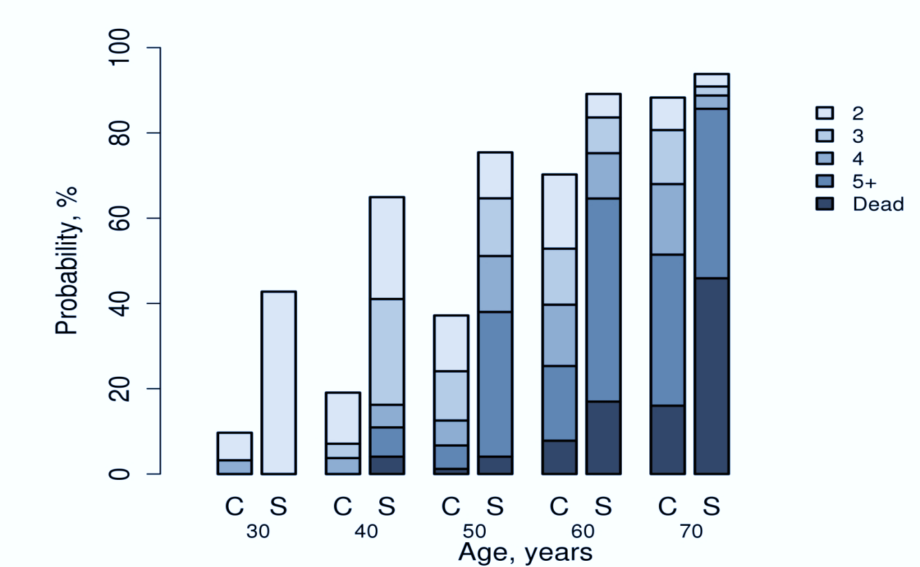
Multi-state model: sarcoidosis
Ungprasert P et al. Mayo Clinic Proc 2017 Nov.
Notes:
The differences are more apparent when we look at them on an age scale. Here we see patients with sarcoidosis have higher rates of morbidity at age 30 than comparators and this continues throughout the entire age range.
So I think these models will be very useful and can provide new insights into how morbidities accumulate in patients with chronic diseases.

Slide 22
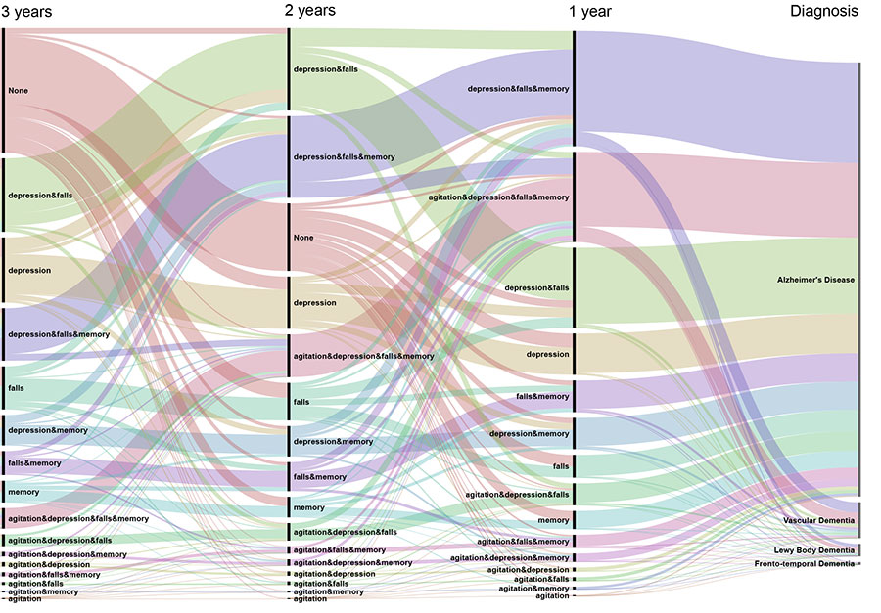
Alluvial flow diagram
https://www.optumlabs.com/blog/blog.entry.html/2017/11/03/uncovering_hiddenpa-4WHZ.html

Slide 23
Summary
Multimorbidity patterns are complex
Difficult to compare between studies due to differences in
  Spectrum of diseases studied
  Methods used
Further research needs
  Longitudinal patterns of morbidity development
  Graphical representations

Slide 24


