Slide 1
Robust Surrogate Ridge Estimators for Linear Regression Model based on an M-estimator
Osama Abdelaziz Hussein
Department of statistics
Alexandria University, Egypt

Slide 2
THE PROBLEM
One of important issues in the big data is the analytic approach to learn from data for optimal decision. The most frequently used analytic approach is regression analysis .
Large datasets involved in big data analytics contain thousands of correlated variables and many of them contaminated by “outliers” .

Slide 3
The classical Least Squares estimators have optimal properties if the Gauss-Markov assumptions were satisfied. The problems of Multicollinearity and outliers make the OLS estimates less efficient , specially when both problems are presented in the data simultaneously.

Slide 4
Several techniques are available in the literature which deals with the problem of multicollinearity and outliers in the data independently.
However, very few techniques were presented for the problem of multicollinearity and outliers simultaneously, specially for high dimensional data.

Slide 5

Consider the classical linear regression model
Y = X β + ε (1.1)
The OLS estimator of β and its variance-covariance matrix is given by
$\hat{β}$ = ($X^{′}$X$)^{−1}X^{′}$Y
Cov($\hat{β}$) = $σ^{2}$ ($X^{′}$X$)^{−1}$

Slide 6
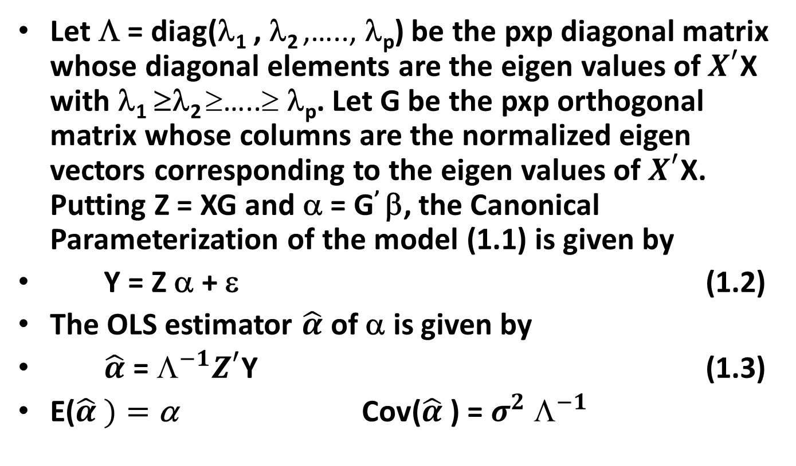
The Canonical Parameterization of the model (1.1)
Let Λ = diag(λ₁ , λ₂ ,….., λ_{p}) be the pxp diagonal matrix whose diagonal elements are the eigen values of $X^{′}$X with λ₁ ≥λ₂ ≥…..≥ λ_{p}. Let G be the pxp orthogonal matrix whose columns are the normalized eigen vectors corresponding to the eigen values of $X^{′}$X. Putting Z = XG and α = G’ β, the Canonical Parameterization of the model (1.1) is given by
Y = Z α + ε (1.2)
The OLS estimator $\hat{α}$ of α is given by
$\hat{α}$ = $☹^{−1}Z^{′}$Y (1.3)
E($\hat{α} )=$α Cov($\hat{α}$) = $σ^{2}$ $☹^{−1}$

Slide 7

The multicolinearity problem
If $X^{′}$X is ill-conditioned some of its eigen values will be close to zero This implies that some of the components of the OLS estimator $\hat{β}$ will have large magnitudes and large variances and its mean square error will be inflated.

Slide 8
The outliers problem
The deviations from the hypothesized distribution of the errors and the existence of “influential observations” in the direction of Y (outliers) and/or the direction of X (high leverages) make the OLS estimators drastically less efficient and less stable, (Huber 1964).
Moreover high leverages can cause multcollinearity.

Slide 9
The structure and properties of "good" statistical procedures presented by Davies (2002) can be used to evaluate the learning algorithm for prediction in linear models.
Assumptions: The procedure should work with minimal assumptions about the data to which it is applied.
Signal and Noise model: The model generating the data should reflect the reality of the exiting of different types of deviations from the assumptions.
Robustness: This means that minor changes in the data should result in minor changes in the results of the procedure.
Efficiency: Asymptotic optimality of the statistical methods used.
Calculability: The procedure should be fast in execution even with very large and very high dimension data sets.

Slide 10
In this study
we present two new estimators one called Surrogate Ridge M-estimator (SRME) as a robust estimator which combats the problem of simultaneous occurrence of multicollinearity and outliers in y-direction,
The other called Surrogate Ridge MM-estimator (SRMME) as a robust estimator which combats the problem of simultaneous occurrence of multicollinearity and outliers in Y and X directions.

Slide 11
A simulation study is presented to illustrate the performance of the newly proposed estimators. Results of the study showed that the method of Latent Root– M based Regression and the proposed estimators are more efficient in rectifying both problems simultaneously.

Slide 12
1-RIDGE REGRESSION
Despite more modern approaches such as the lasso (Tibshirani 1996), least angle regression (LARS) (Efron et al. 2004), and boosting (Bühlmann 2006), ridge regression (RR) continues to be useful in many situations , (Maronna 2011), specially for high dimensional data

Slide 13
Hoerl and Kennard (1970,a,b) introduced the ridge regression estimator as a biased estimation method with smaller mean square errors than those of the OLS estimators.

Slide 14
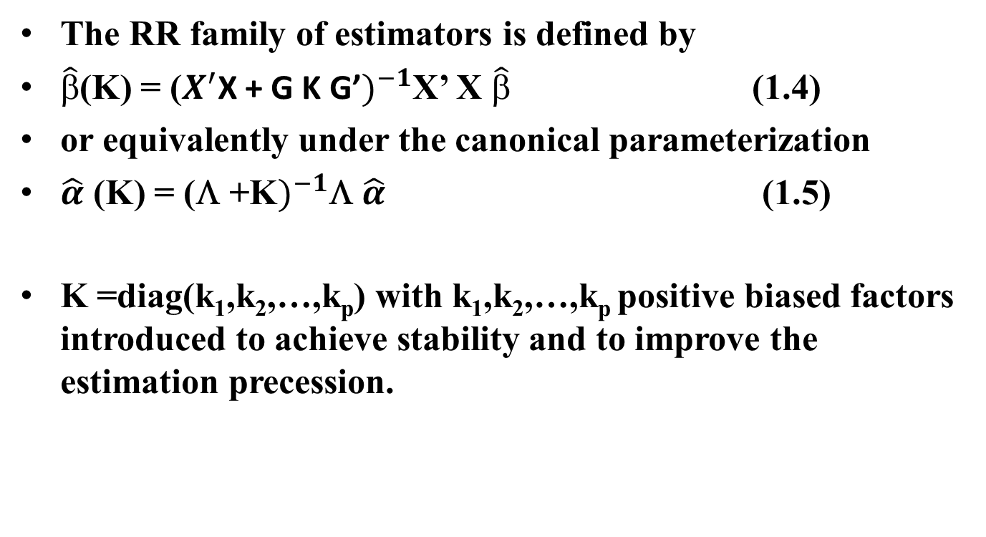
The RR family of estimators is defined by
$\hat{β}$(K) = ($X^{′}$X + G K G’$)^{−1}$X’ X $\hat{β}$ (1.4)
or equivalently under the canonical parameterization
$\hat{α}$ (K) = (Λ +K$)^{−1}$Λ $\hat{α}$ (1.5)
K =diag(k₁,k₂,…,k_{p}) with k₁,k₂,…,k_{p} positive biased factors introduced to achieve stability and to improve the estimation precession.

Slide 15
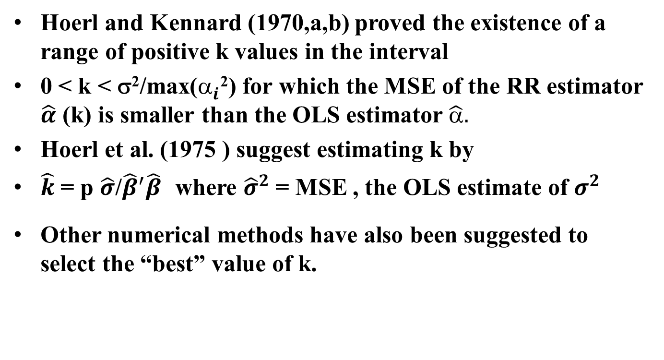
Hoerl and Kennard (1970,a,b) proved the existence of a range of positive k values in the interval
0 < k < σ²/max($_{i}^{}$²) for which the MSE of the RR estimator $\hat{α}$ (k) is smaller than the OLS estimator $\hat{α}.$
Hoerl et al. (1975 ) suggest estimating k by
$\hat{k}$ = p $\hat{σ}$/${\hat{β}}^{′}\hat{β}$ where ${\hat{σ}}^{2}$ = MSE , the OLS estimate of $σ^{2}$
Other numerical methods have also been suggested to select the “best” value of k.

Slide 16
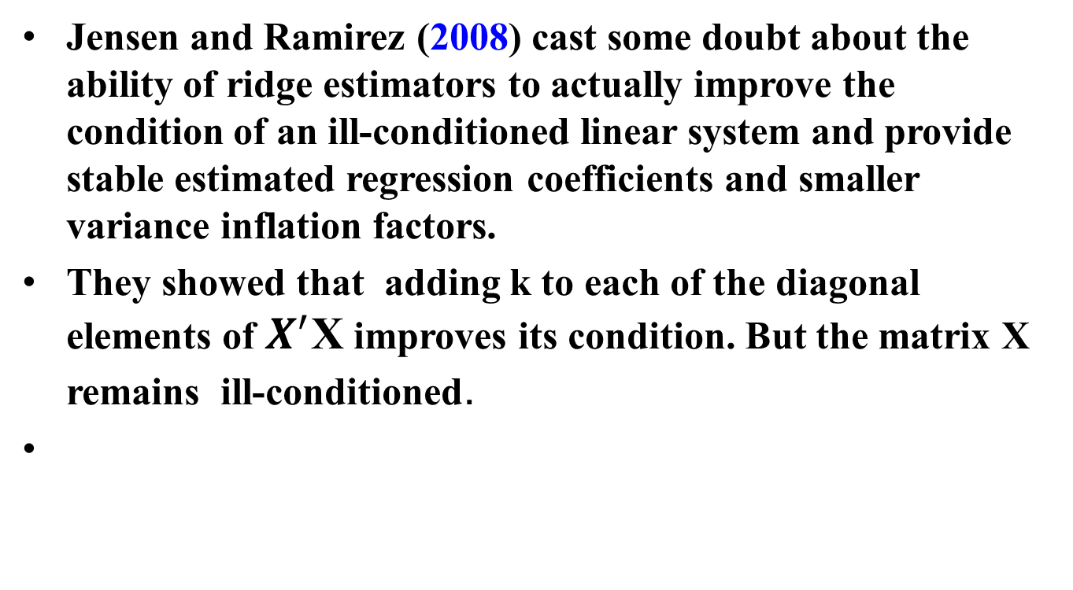
2-Surrogate Ridge Estimator SRE
Jensen and Ramirez (2008) cast some doubt about the ability of ridge estimators to actually improve the condition of an ill-conditioned linear system and provide stable estimated regression coefficients and smaller variance inflation factors.
They showed that adding k to each of the diagonal elements of $X^{′}$X improves its condition. But the matrix X remains ill-conditioned.

Slide 17
Jensen and Ramirez (2008) propose replacing the ill-conditioned regression model (1.1) by the surrogate but less ill-conditioned model Y = X_{k} β +ε (2.1)
where X_{k} = U (D +k I_{p}) V^{t}
The matrices U and V are obtained from the singular-value decomposition of X = U D V^{t} with U^{t}U = V^{t}V = I_{p}
D² = Λ

Slide 18
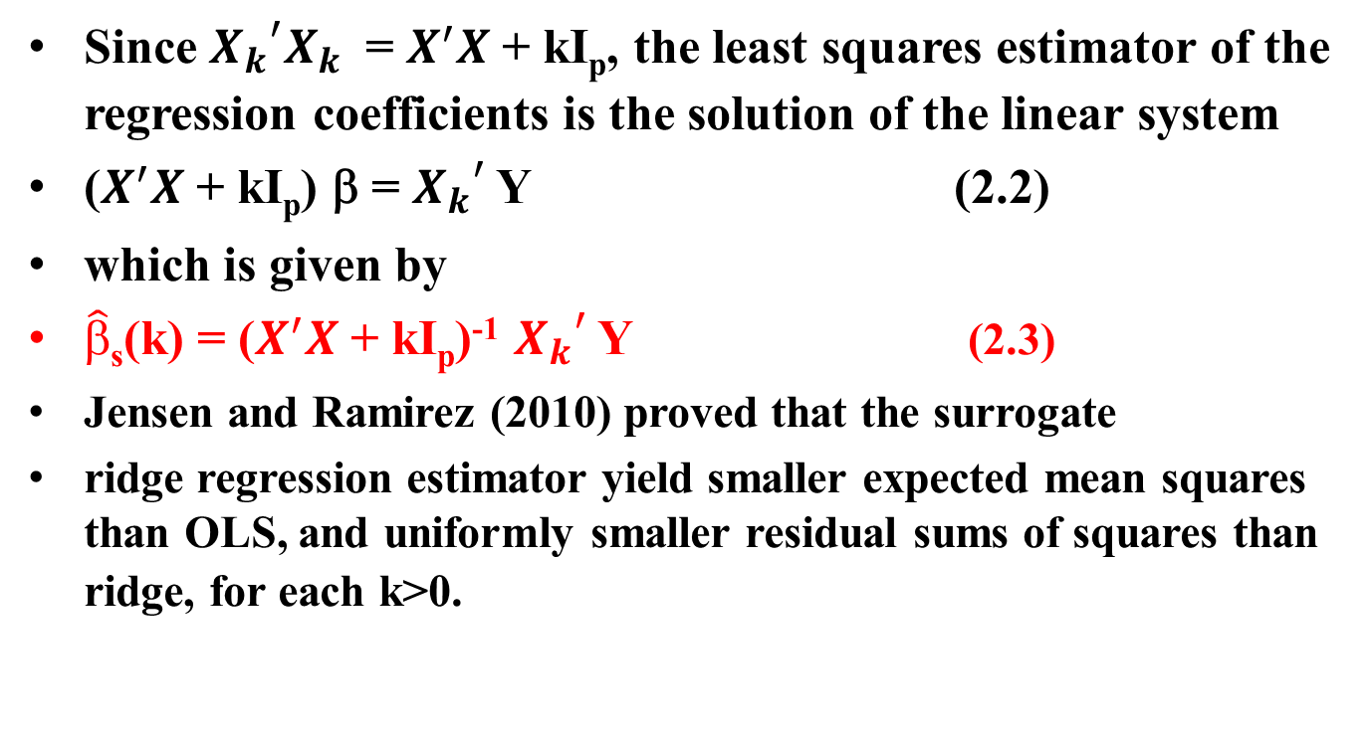
Since ${{X_{k}}_{}^{′}X}_{k}$ = $X^{′}X$ + kI_{p}, the least squares estimator of the regression coefficients is the solution of the linear system
($X^{′}X$ + kI_{p}) β = ${X_{k}}_{}^{′}$ Y (2.2)
which is given by
$\hat{β}$_{s}(k) = ($X^{′}X$ + kI_{p})⁻¹ ${X_{k}}_{}^{′}$ Y (2.3)
Jensen and Ramirez (2010) proved that the surrogate
ridge regression estimator yield smaller expected mean squares than OLS, and uniformly smaller residual sums of squares than ridge, for each k>0.

Slide 19
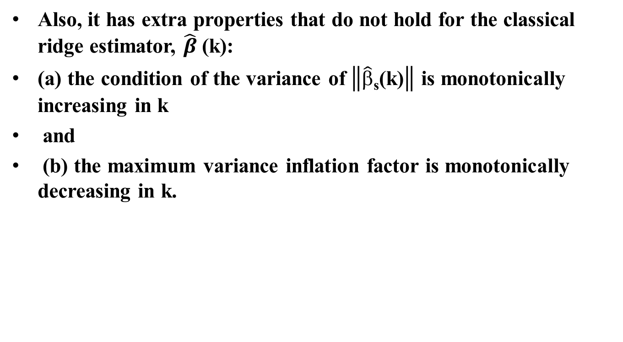
Also, it has extra properties that do not hold for the classical ridge estimator, $\hat{β}$(k):
(a) the condition of the variance of $\left\|\hat{β}\text{s}\text{(}\text{k}\text{)}\right\|$ is monotonically increasing in k
and
(b) the maximum variance inflation factor is monotonically decreasing in k.

Slide 20
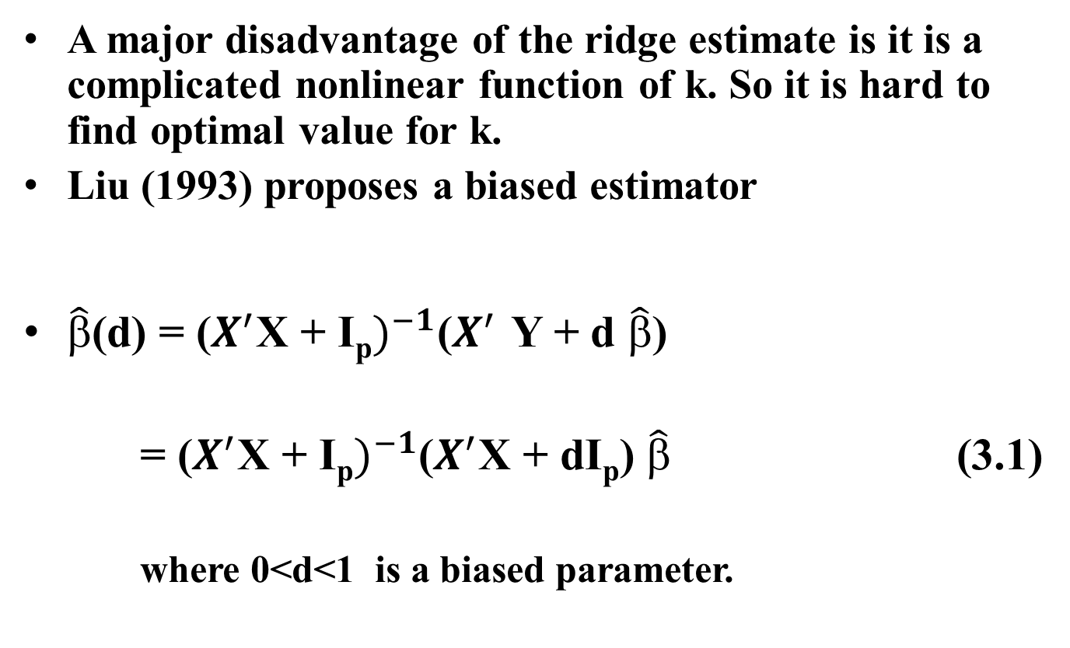
3-LIU ESTIMATOR LE
A major disadvantage of the ridge estimate is it is a complicated nonlinear function of k. So it is hard to find optimal value for k.
Liu (1993) proposes a biased estimator
$\hat{β}$(d) = ($X^{′}$X + I_{p}$)^{−1}$($X^{′}$ Y + d $\hat{β}$)
    = ($X^{′}$X + I_{p}$)^{−1}$($X^{′}$X + dI_{p}) $\hat{β}$ (3.1)
    where 0<d<1 is a biased parameter.

Slide 21
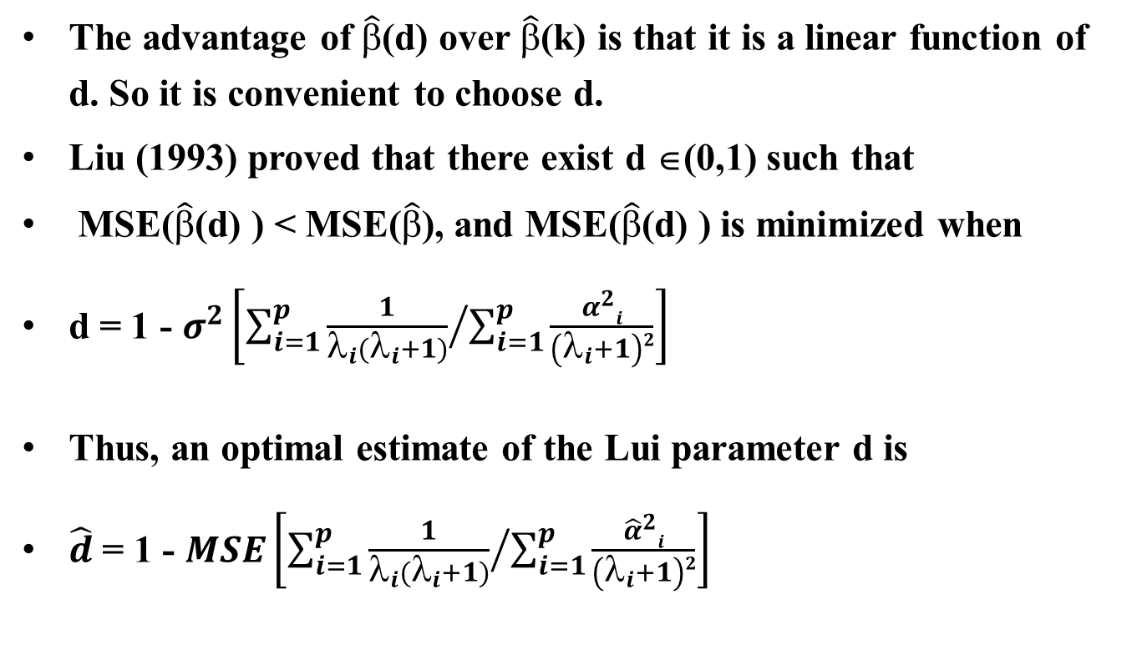
The advantage of $\hat{β}$(d) over $\hat{β}$(k) is that it is a linear function of d. So it is convenient to choose d.
Liu (1993) proved that there exist d ∈(0,1) such that
MSE($\hat{β}$(d) ) < MSE($\hat{β}$), and MSE($\hat{β}$(d) ) is minimized when
d = 1 - $σ^{2}\left[\sum_{i=1}^{p}{{\frac{1}{λ_{i}(λ_{i}+1)}}/{\sum_{i=1}^{p}{\frac{α^{2}i}{\left(λ_{i}+1\right)2}}}}\right]$
Thus, an optimal estimate of the Lui parameter d is
$\hat{d}$ = 1 - $MSE\left[\sum_{i=1}^{p}{{\frac{1}{λ_{i}(λ_{i}+1)}}/{\sum_{i=1}^{p}{\frac{{\hat{α}}^{2}i}{\left(λ_{i}+1\right)2}}}}\right]$

Slide 22
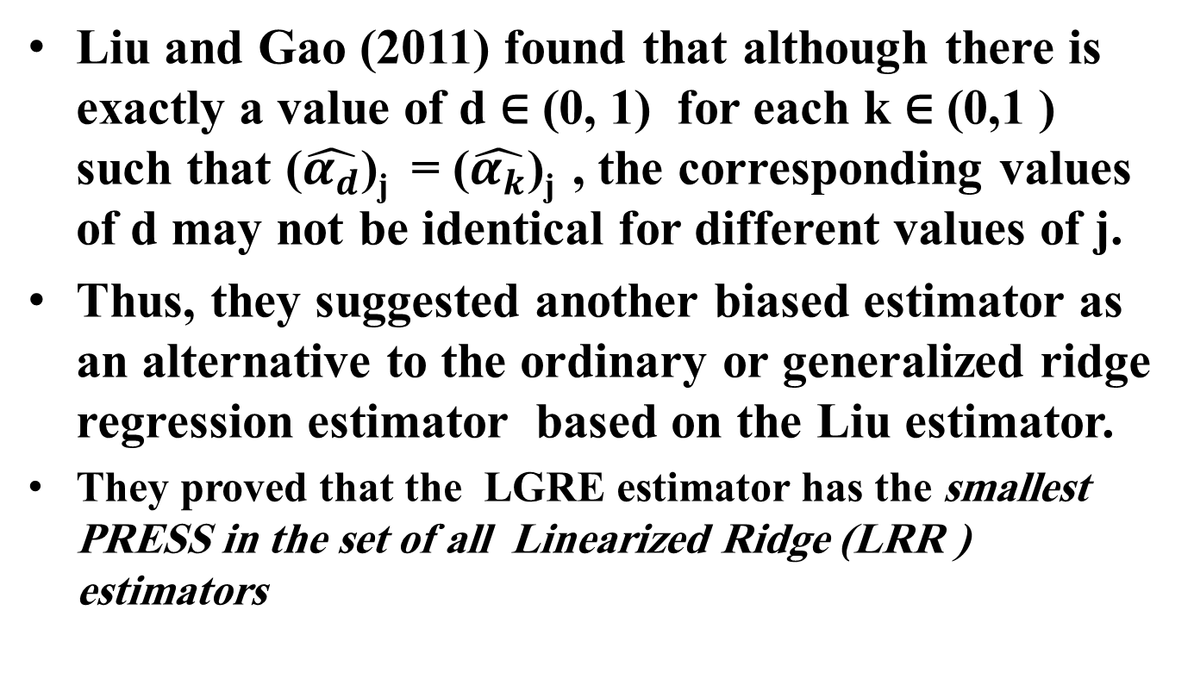
4 - LINEARIZED GENERALIZED REDGE ESTIMATOR LGRE
Liu and Gao (2011) found that although there is exactly a value of d ∈ (0, 1) for each k ∈ (0,1 ) such that ($\hat{α_{d}}$)_{j} = ($\hat{α_{k}}$)_{j} , the corresponding values of d may not be identical for different values of j.
Thus, they suggested another biased estimator as an alternative to the ordinary or generalized ridge regression estimator based on the Liu estimator.
They proved that the LGRE estimator has the smallest PRESS in the set of all Linearized Ridge (LRR ) estimators

Slide 23
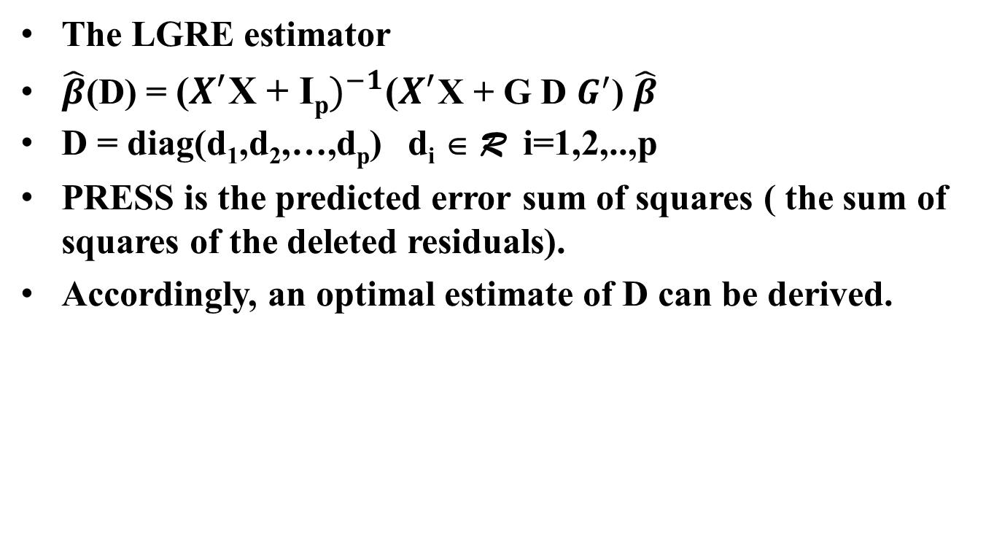
The LGRE estimator
$\hat{β}$(D) = ($X^{′}$X + I_{p}$)^{−1}$($X^{′}$X + G D $G^{′}$) $\hat{β}$
D = diag(d₁,d₂,…,d_{p}) d_{i} ∈ R i=1,2,..,p
PRESS is the predicted error sum of squares ( the sum of squares of the deleted residuals).
Accordingly, an optimal estimate of D can be derived.

Slide 24
5- LATENT ROOT ESTIMATOR (LRE)
To overcome some of the limitations of RR and other biased estimation techniques, the latent root regression (LRE) was developed Webster et al. (1974). The major advantage of LRE is that it not only identifies the singularities present in X, but also determines the predictive value of the singularities and appropriately adjusts the OLS estimates for the predictive singularities.

Slide 25
ROBUST ESTIMATORS
Robust statistical regression estimators are developed to have high “asymptotic” relative efficiency when some of the assumptions of the theoretical model are violated. Typically, the assumption of normality of the error term and the assumption of no influential observations, either in the direction of Y (outliers) or the direction of X (high leverages).

Slide 26
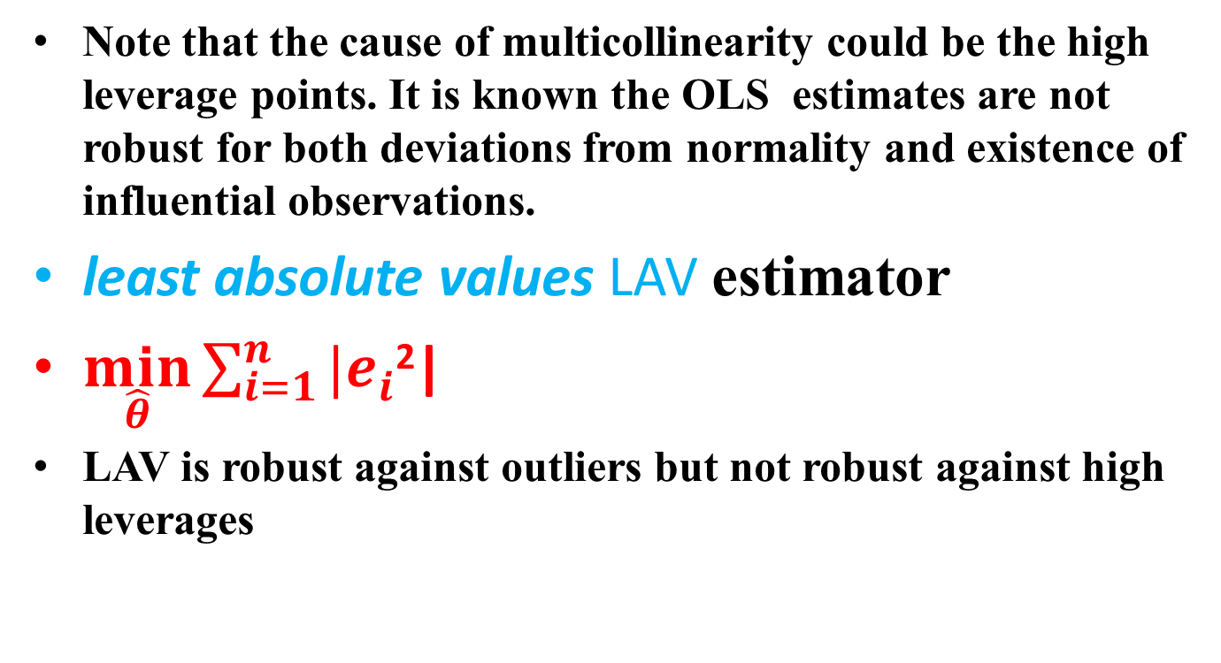
Note that the cause of multicollinearity could be the high leverage points. It is known the OLS estimates are not robust for both deviations from normality and existence of influential observations.
least absolute values LAV estimator
$\min_{\hat{θ}}{\sum_{i=1}^{n}{|e_{i}^{}}}$²|
LAV is robust against outliers but not robust against high leverages

Slide 27
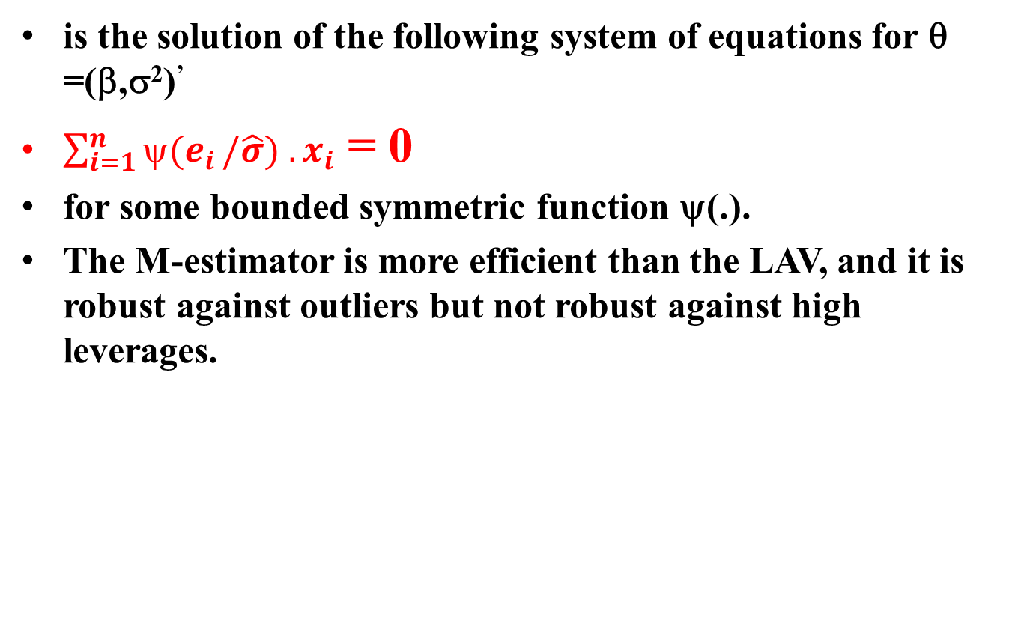
The M-estimators
is the solution of the following system of equations for θ =(β,σ²)’
$\sum_{i=1}^{n}{ψ(e_{i}}/\hat{σ}) . x_{i}$ = 0
for some bounded symmetric function ψ(.).
The M-estimator is more efficient than the LAV, and it is robust against outliers but not robust against high leverages.

Slide 28
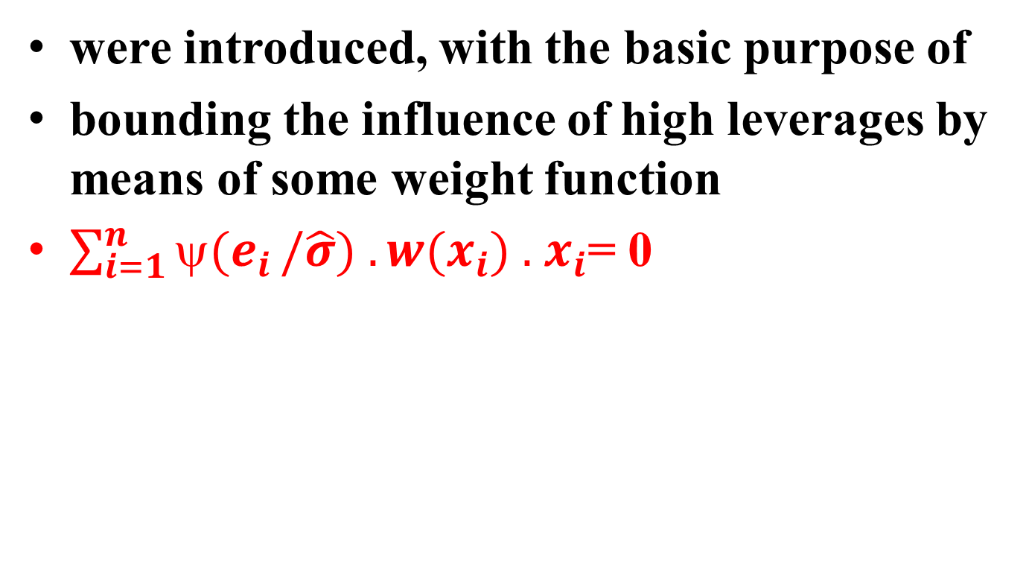
The Generalized M-estimator (GM)
were introduced, with the basic purpose of
bounding the influence of high leverages by means of some weight function
$\sum_{i=1}^{n}{ψ(e_{i}}/\hat{σ}) . {w(x}_{i}) .$ $x_{i}$= 0

Slide 29
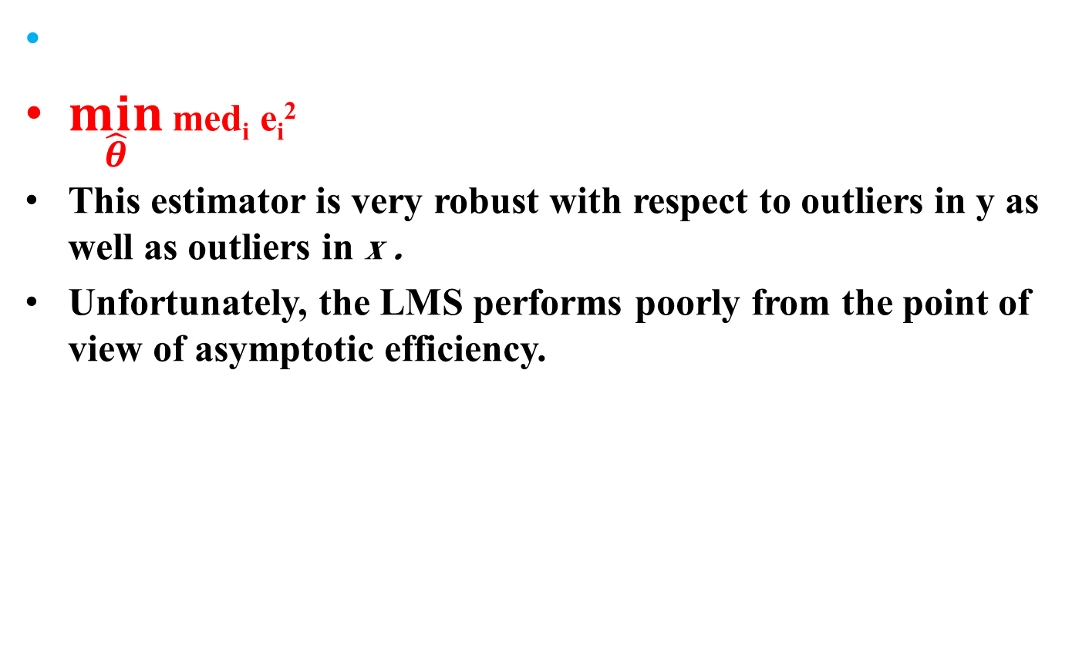
Least Median of Squares LMS
$\min_{\hat{θ}}$ med_{i} e_{i}²
This estimator is very robust with respect to outliers in y as well as outliers in x .
Unfortunately, the LMS performs poorly from the point of view of asymptotic efficiency.

Slide 30
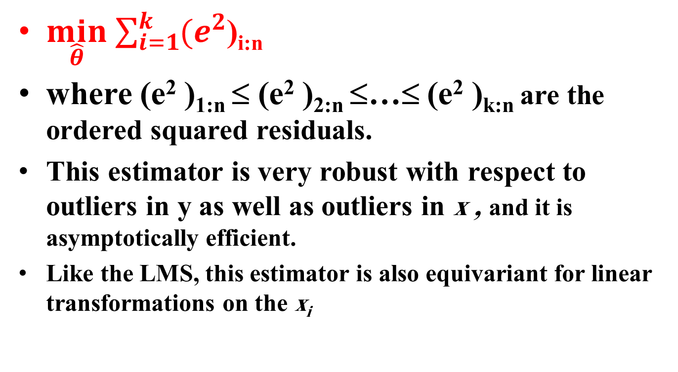
least trimmed squares (LTS)
$\min_{\hat{θ}}$ $\sum_{i=1}^{k}{(e_{}^{2}}$)_{i:n}
where (e² )_{1:n} ≤ (e² )_{2:n} ≤…≤ (e² )_{k:n} are the ordered squared residuals.
This estimator is very robust with respect to outliers in y as well as outliers in x , and it is asymptotically efficient.
Like the LMS, this estimator is also equivariant for linear transformations on the x_{i}

Slide 31
MM-estimator
The MM-estimators are highly efficient when the errors have a normal distribution and their breakdown-point is 0.5.
The MM-estimates are defined by a three-stage procedure.
In the first stage an initial regression estimate T₀ of β₀ is computed which is consistent with high breakdown-point but not necessarily efficient.

Slide 32
In the second stage compute the residuals of the initial estimate, then compute M-estimate of the errors scale s(e(T₀)) is computed using residuals based on the initial estimate.
Finally, in the third stage an M-estimate of the regression parameters based on a proper redescending psi-function is computed.
The MM-estimator and GM-estimator are robust
in both Y and X-direction.

Slide 33
ROBUST RIDGE ESTIMATORS
Silvapulle (1991) proposed a ridge M-estimator (RME) as a robust estimator by shrinking the M- estimator (ME) and robustify the biasing parameter (k) of Hoerl and Kennard (1970a,b).
Arslan and Billor (2000) proposed a Liu M-estimator (LME) as a robust estimator by shrinking the M- estimator (ME) and robustify the biasing parameter (d) of Liu (1993).

Slide 34
Habshah and Lau (2009) proposed a method called Latent Root – M based Regression (LRMB). They employed the weight of the M-estimator in the weighted correlation matrix.

Slide 35
Maronna, R (2011) proposed a ridge-regression estimate based on repeated M estimation (MM estimation) . The MM estimator can be fast and efficiently computed for high dimensional data.
Jadhav and Kashid (2016) proposed a linearized ridge M-estimator (LRME) as a robust estimator by shrinking the M- estimator (ME) and robustify the biasing parameter (D) of Gao and Liu (2011).

Slide 36
The new Robust Surrogate Ridge Estimator RSRE
All the previous robust ridge estimators use M-estimator for the regression parameters, then use the usual ridge estimator with optimal estimated biased parameter as a function of the robust estimates.
The surrogated regression model has the form of a linear model Y = X_{kM} β +ε
where X_{kM} = U (D +k_{M} I_{p}) V^{t}
The matrices U and V are obtained from the singular-value decomposition of X = U D V^{t} with U^{t}U = V^{t}V = I_{p}
D² = Λ

Slide 37
Thus, the M-estimation procedure can be applied directly and get efficient estimators for the regression parameters and the biased parameter at the same time.
This estimator are less affected by outliers (in the direction of Y).
The simulation study shows that it has smaller MSE than some robust ridge estimators in the study.

Slide 38
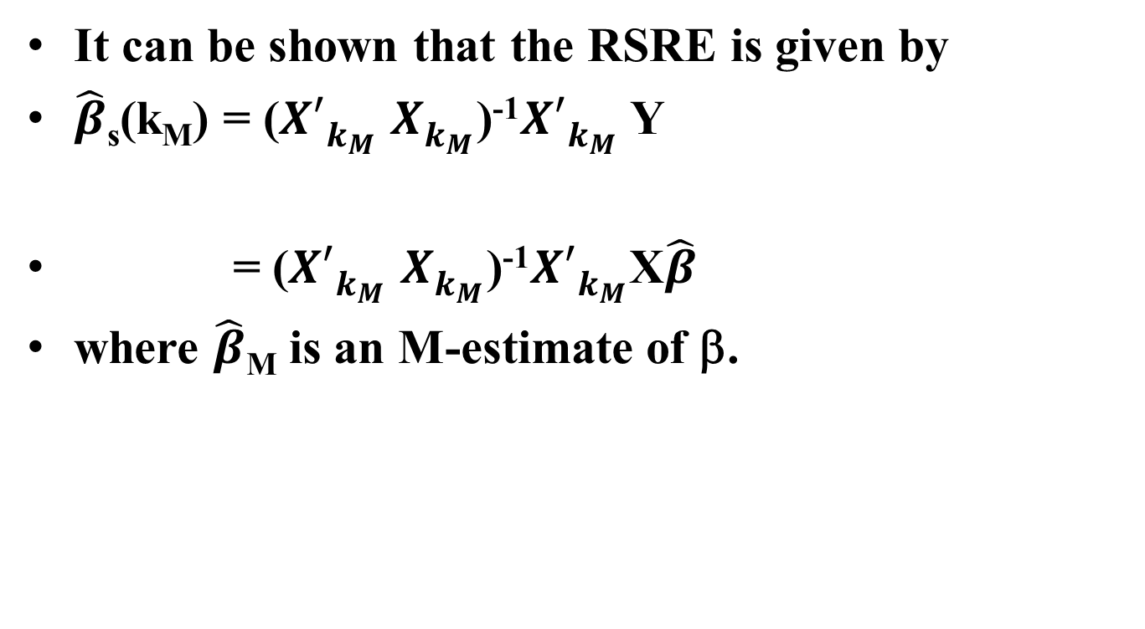
It can be shown that the RSRE is given by
$\hat{β}$_{s}(k_{M}) = (${X′}_{k_{M}}^{}$ $X_{k_{M}}^{}$)⁻¹${X′}_{k_{M}}^{}$ Y
= (${X′}_{k_{M}}^{}$ $X_{k_{M}}^{}$)⁻¹${X′}_{k_{M}}^{}$X$\hat{β}$
where $\hat{β}$_{M} is an M-estimate of β.

Slide 39
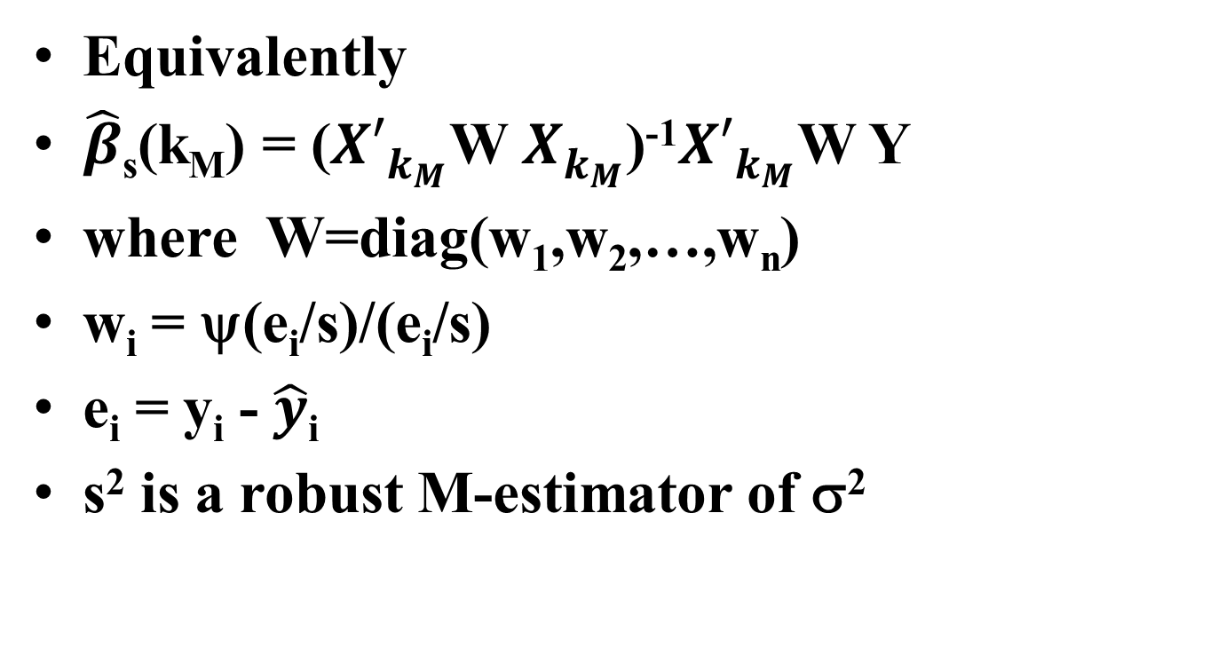
Equivalently
$\hat{β}$_{s}(k_{M}) = (${X′}_{k_{M}}^{}$W $X_{k_{M}}^{}$)⁻¹${X′}_{k_{M}}^{}$W Y
where W=diag(w₁,w₂,…,w_{n})
w_{i} = ψ(e_{i}/s)/(e_{i}/s)
e_{i} = y_{i} - $\hat{y}$_{i}
s² is a robust M-estimator of σ²

Slide 40
The choice of the objective function ψ , the initial estimates for σ² and thus the estimate of the “optimal” biased parameter k_{M} will be studied by simulation.

Slide 41
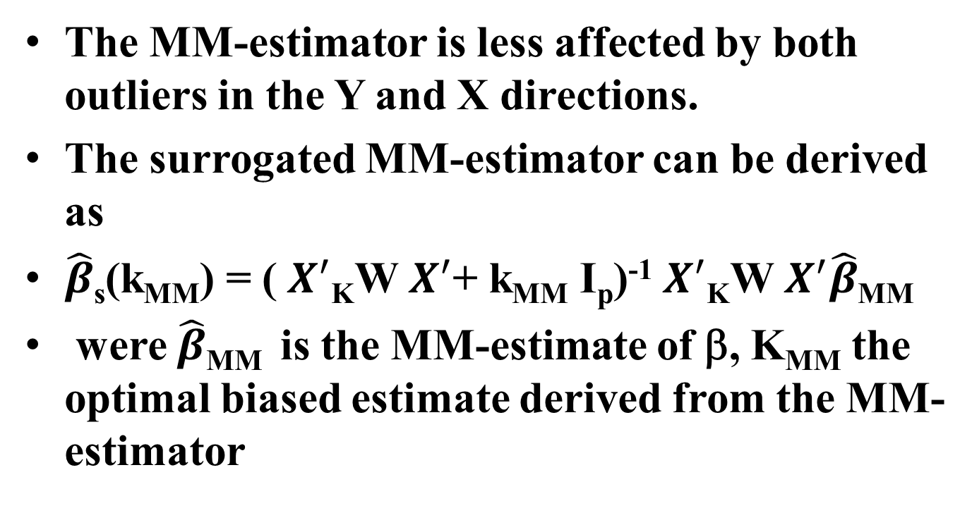
SURROGATE MM-ESTIMATOR
The MM-estimator is less affected by both outliers in the Y and X directions.
The surrogated MM-estimator can be derived as
$\hat{β}$_{s}(k_{MM}) = ( $X^{′}$_{K}W $X^{′}$+ k_{MM} I_{p})⁻¹ $X^{′}$_{K}W $X^{′}\hat{β}$_{MM}
were $\hat{β}$_{MM} is the MM-estimate of β, K_{MM} the optimal biased estimate derived from the MM-estimator

Slide 42
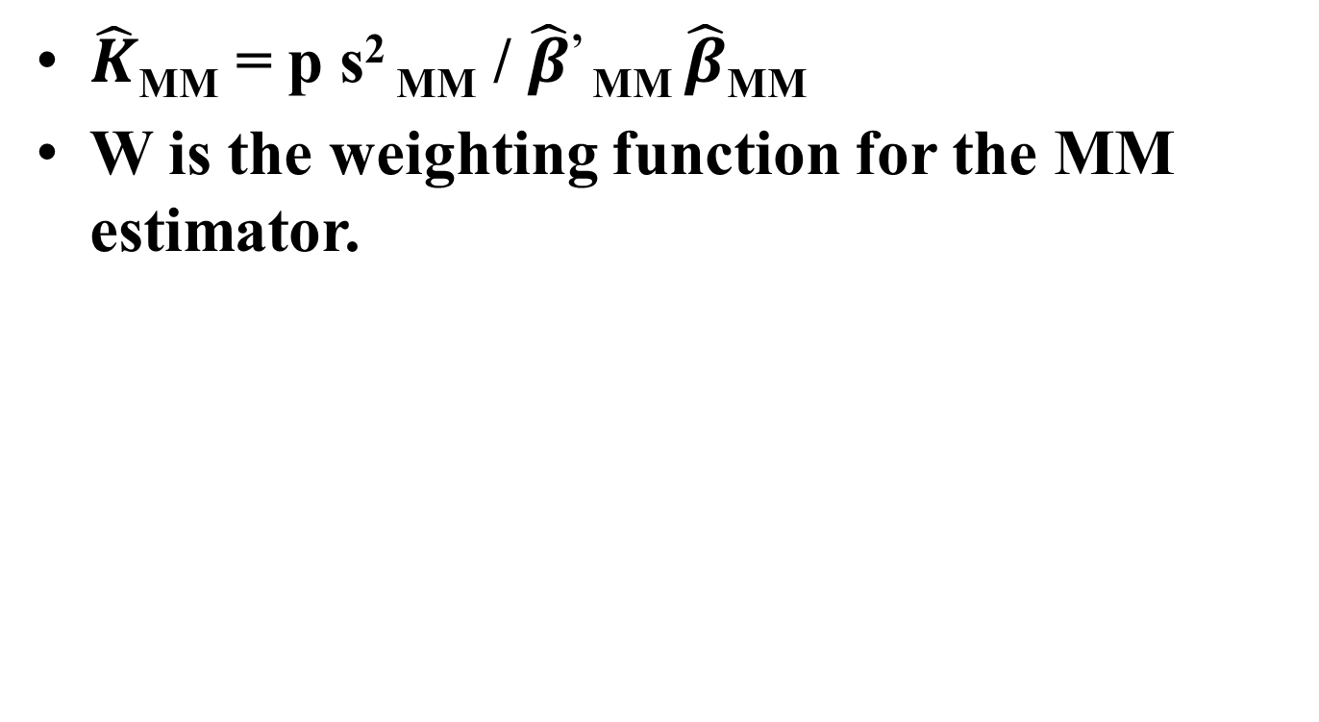
$\hat{K}$_{MM} = p s² _{MM} / $\hat{β}$’ _{MM} $\hat{β}$_{MM}
W is the weighting function for the MM estimator.

Slide 43
The robust surrogated MM-estimator
ANOTHER ALGORITHM
Define the surrogated ridge model:
Y = X_{kM} β +ε
where X_{kM} = U (D +k_{MM} I_{p}) V^{t}
Step 1: find an initial estimate of β with high breakdown point (e.g. LAV) and a corresponding initial estimate of K_{MM} (K₀= p s²/ β₀^{t} β₀)), s² is the estimate of σ² using the initial estimator procedure.

Slide 44
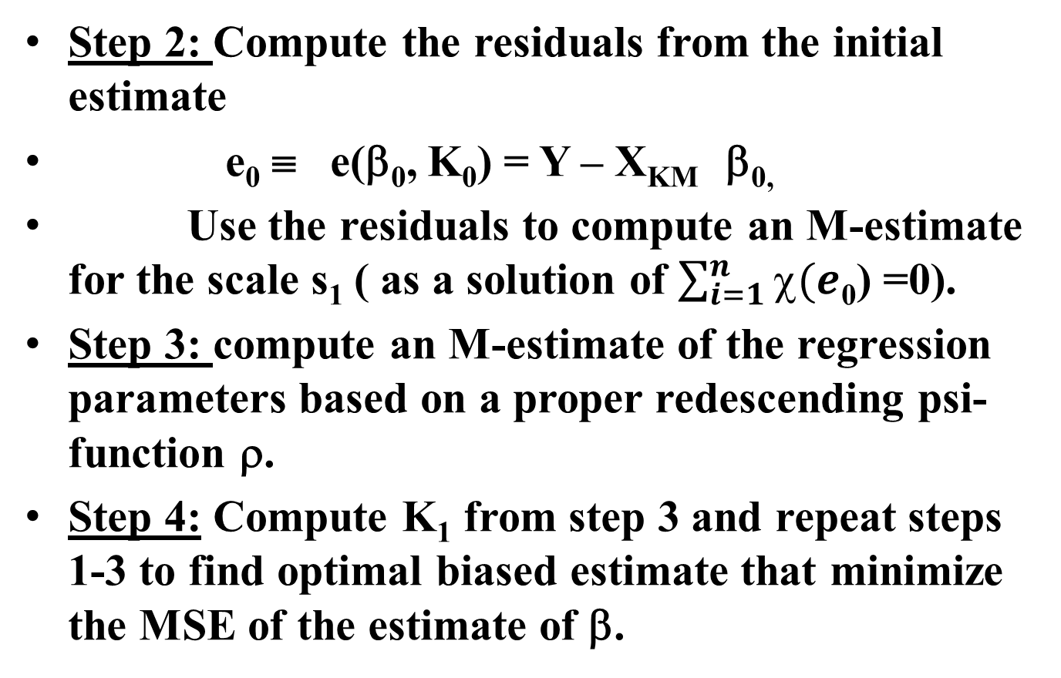
Step 2: Compute the residuals from the initial estimate
e₀ ≡ e(β₀, K₀) = Y – X_{KM} β_{0,}
Use the residuals to compute an M-estimate for the scale s₁ ( as a solution of $\sum_{i=1}^{n}{χ(e}$₀) =0).
Step 3: compute an M-estimate of the regression parameters based on a proper redescending psi-function ρ.
Step 4: Compute K₁ from step 3 and repeat steps 1-3 to find optimal biased estimate that minimize the MSE of the estimate of β.

Slide 45
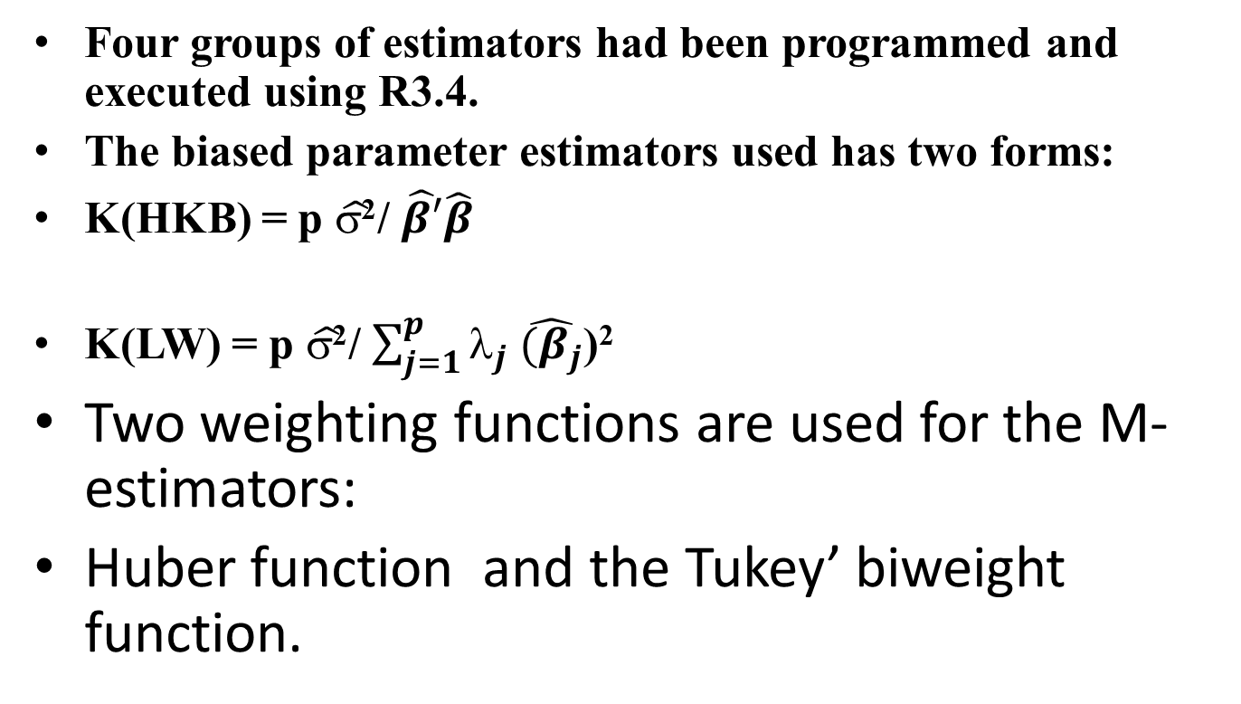
SIMULATION DESIGN
Four groups of estimators had been programmed and executed using R3.4.
The biased parameter estimators used has two forms:
K(HKB) = p $\hat{σ\text{2}}$/ $\hat{β′}\hat{β}$
K(LW) = p $\hat{σ\text{2}}$/ $\sum_{j=1}^{p}{λ_{j}}$ $\hat{{(β}_{j}}$)²
Two weighting functions are used for the M-estimators:
Huber function and the Tukey’ biweight function.

Slide 46
GROUP 1:
Robust Biased estimators to overcome the problems of mlticollinearity and outliers ( in the direction of Y) simultaneously:
(all estimators based on two forms of the M-estimators)
1-Robust Ridge estimators (Silvapull 1991).
2-Robust Liu estimators (Arslan and Billor 2000).
3-Robust latent roots estimators (Habshah and Lau 2009).
4- Robust linearized ridge estimators (Jadhav and Kashid 2016).
5- Robust surrogated ridge estimators (Hussien 2018)

Slide 47
GROUP 2
Biased estimators to overcome the problems of mlticollinearity only
(Estimators use two forms of biased parameter estimates, when applicable).
1- Ridge estimator. (Hoerl and Kennard 1970 …)
2- Liu estimator. (Liu 1993)
3-Linearized generalized ridge estimator. (Liu and Gao
2011).
4-Latent roots estimator. (Webster et al. 1974).
5- Surrogate ridge estimator. (Jensen and Ramirez 2008).

Slide 48
GROUP 3
Control Group
1-Huber M-estimator.
2- Tukey Biwieght M-estimator.
3- Ordinary Least squares estimators.

Slide 49
SIMULATION SENARIOS
For each simulation scenario we generate n datasets as y_{i} = β_{o} + β₁x_{i1} + β₂ x_{i2} + ε_{i}
The independent variables were generated as
x_{ij} = (1-r² )^{0.5} z_{ij} + r z_{i(p+1)} i=1,2,…,n j=1,..,p
(p=2) z_{ij} ∼N(0,1). McDonald and Galarneau (1975)

Slide 50
r = 0.0 , 0.5 , 0.95 , 0.99 correlation coefficients.
n = 26, 50 , 100 sample sizes.
number of iterations = 5000.
The comparison depend on both the biased and MSE of the estimators

Slide 51
SIMULATION RESULTS
Case1: Normal errors, no outliers or multicollinearity
The MSE for all estimators in group 1 and group 2 are not significantly different from the MSE of the OLS estimates for all sample sizes.
But, the Robust surrogated estimators SRM are slightly better.

Slide 52
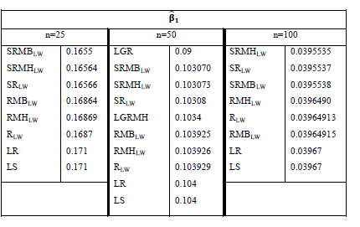

Slide 53
Case 2: Contaminated Normal , t (3) or Caushy errors, no multicollinearity.
Theoretically, the M-estimators are more efficient than the OLS in all cases of heavy tailed distributions. The robust latent roots estimators have the smallest MSE for most of the cases.
The new SRM estimator has the smallest MSE for the contaminated normal error for n=25 and 50 only and contamination proportion > 0.05.

Slide 54
CASE 3: NORMAL ERRORS, NO OUTLIERS AND DIFFERENT DEGREES OF multicollinearity
If r = 0.5 Liu estimator LE has smaller MSE than all other estimators.
If r = 0.95 and r=0.99 the latent root estimator LR outperforms all other estimators. This is due to the inflation of the average MSE for those estimators.

Slide 55
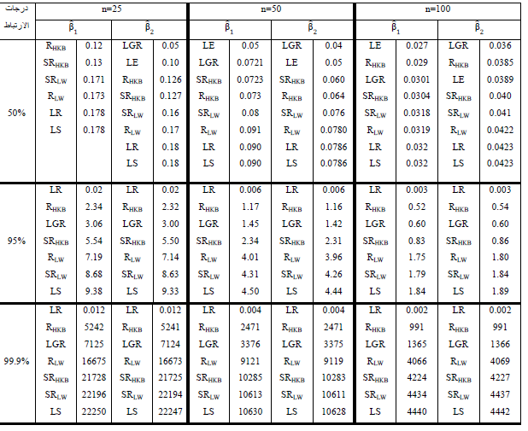

Slide 56
CASE 4: contaminated normal errors and r=0.95 , r=0.99 multicollinearity
The robust latent roots estimators LRM and the robust linearized generalized ridge estimators LGRM outperform all other robust biased estimators for all sample sixes and all percentages of contaminations.
The LRM estimators are less affected by higher percentage of contaminations. Its MSE decreases for larger sample sizes.

Slide 57
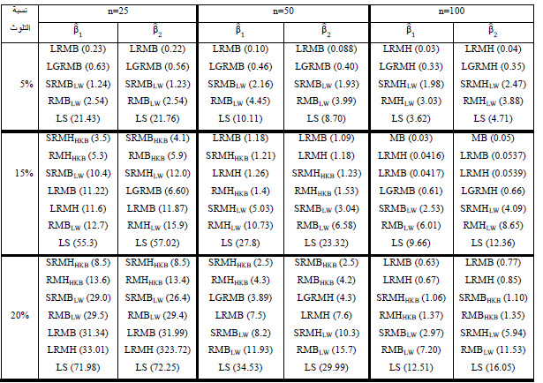
r =0.95

Slide 58
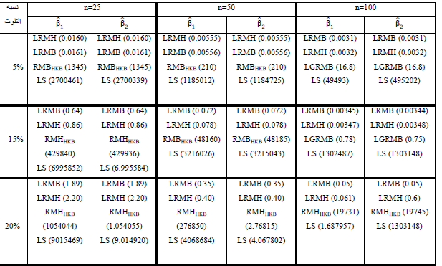
r = 0.99

Slide 59
CASE 5: t(3) or Cauchy errors and r=0.5 , r=0.95 , r=0.99 multicollinearity
For r =0.50 the linearized generalized ridge estimators LGRM have the smallest MSE for all sample sizes. The new estimators appears third in this case.
For r=0.95 and r=0.99 the robust latent roots estimators LRM have have the smallest MSE for all sample sizes.

Slide 60
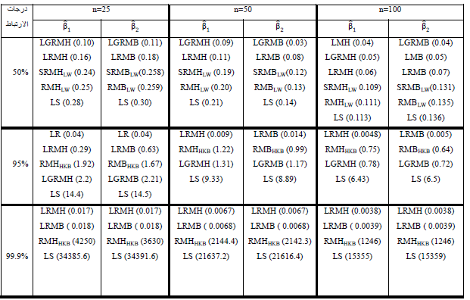

Slide 61
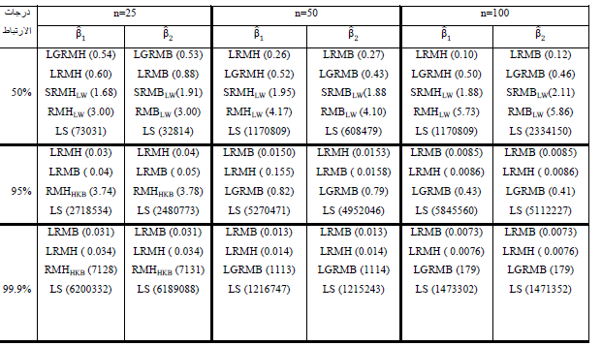

Slide 62
Conclusions
Use the biased estimators if r > 0.50.
For small sample sizes use the robust surrogated estimators.
Use the robust latent roots estimator for large samples only since it removes the latent vectors with high correlations.
Use the robust surrogate ridge estimators for cases of outliers (heavy tailed) and
0.5 ≤r ≤ 0.95

Slide 63
Use the robust latent roots and the linearized generalized ridge estimators for heavy tailed errors and r > 0.95.

Slide 64
Future studies:
Evaluate the properties of the robust MM- surrogate ridge estimators by simulation. It is less affected by high leverage points.
Evaluate the properties of a robust LTS- surrogate ridge estimators by simulation. It is less affected by high leverage points.
Diagnostic procedures for simultaneous detection of multicollinearty and outliers in high dimensional big data sets.

Slide 65
REFERENCES
Arkin, R. G., & Montgomery, D. C. (1980). Augmented robust estimators. Technometrics, 22(3), 333-341.
Arslan, O., & Billor, N. (1996). Robust ridge regression estimation based on the GM-estimators. Journal of Mathematical and Computational Science, 9(1), 1-9.
Arslan, O., & Billor, N. (2000). Robust Liu estimator for regression based on an M-estimator. Journal of Applied Statistics, 27(1), 39-47.
Coakley, C. W., & Hettmansperger, T. P. (1993). A bounded influence, high breakdown, efficient regression estimator. Journal of the American Statistical Association, 88(423), 872-880.
Gao, F., & Liu, X. Q. (2011). Linearized ridge regression estimator under the mean squared error criterion in a linear regression model. Communications in Statistics-Simulation and Computation, 40(9), 1434-1443.
Habshah, M., & Lau, U. H. (2009). The performance of latent root-M based regression. Journal of Mathematics and Statistics, 5(1), 1-9.

Slide 66
Habshah,M.,&Mohamed,A.M.(2014). The Performance of Robust Latent Root Regression Based on MM and modified GM estimators. WSEAS TRANSACTIONS on MATHEMATICS,13,916-924.
Hampel, F. R., Ronchetti, E. M., Rousseeuw, P. J., & Stahel, W. A. (1986). Robust statistics: the approach based on influence functions. New York: John Wiley & Sons.
Hocking, R. R. (1976). The analysis and selection of variables in linear regression. Biometrics, 32(1), 1-49.
Hoerl, A. E., & Kennard, R. W. (1970a). Ridge regression: Biased estimation for nonorthogonal problems. Technometrics, 12(1), 55-67.
Hoerl, A. E., & Kennard, R. W. (1970b). Ridge regression: applications to nonorthogonal problems. Technometrics, 12(1), 69-82.
Hoerl, A. E., Kennard, R. W., & Baldwin, K. F. (1975). Ridge regression: some simulations. Communications in Statistics-Theory and Methods, 4(2), 105-123.
Jadhav, N. H., & Kashid, D. N. (2016). Robust Linearized Ridge M-estimator for Linear Regression Model. Communications in Statistics-Simulation and Computation, 45(3)1001-1024.
Jensen, D. R., & Ramirez, D. E. (2008). Anomalies in the foundations of ridge regression. International Statistical Review, 76(1), 89-105.

Slide 67
Lawless, J. F., & Wang, P. (1976). A simulation study of ridge and other regression estimators. Communications in Statistics-Theory and Methods,5,307-323.
Liu,K.J. (1993). A new class of biased estimate in linear regression. Communications in Statistics-Theory and Methods, 22(2), 393-402.
Liu, X. Q., & Gao, F. (2011). Linearized ridge regression estimator in linear regression. Communications in Statistics-Theory and Methods, 40(12), 2182-2192.
Rousseeuw, P. J., & Leroy, A. M. (1987). Robust regression and outlier detection .New York: John Wiley & Sons.
Sharma, S., & James, W. L. (1981). Latent root regression: An alternate procedure for estimating parameters in the presence of multicollinearity. Journal of Marketing Research, 18(2) 154-161.
Silvapulle, M. J. (1991). Robust ridge regression based on an M- estimator. Australian Journal of Statistics, 33(3), 319-333.
Webster, J. T., Gunst, R. F., & Mason, R. L. (1974). Latent root regression analysis. Technometrics, 16(4), 513-522.

Slide 68
Yohai, V. J. (1987). High breakdown-point and high efficiency robust estimates for regression. The Annals of Statistics,15, 642-656.
McDonald and Galarneau (1975). A Monte Carlo Evaluation of Some Ridge-Type Estimators. Journal of the American Statistical Association, 70,407-416.
Marrona, R. A. (2011). Robust Ridge Regression for High-Dimensional Data. Technometrics, 53(1),44-53.
Davies, P. L. (2002). "Statistical Procedures and Robust Statistics," Tech. Report, University of Dortmund, Germany.

