Slide 1



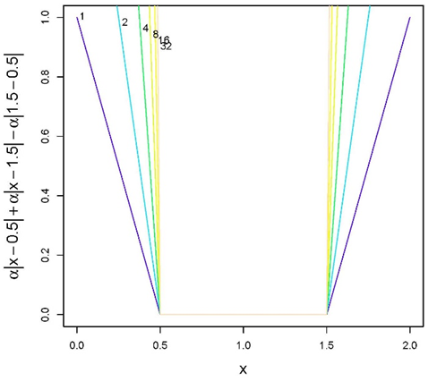
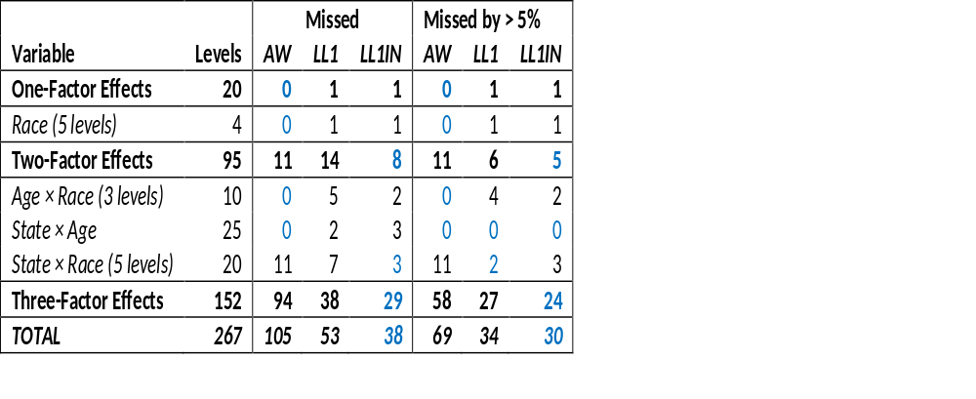
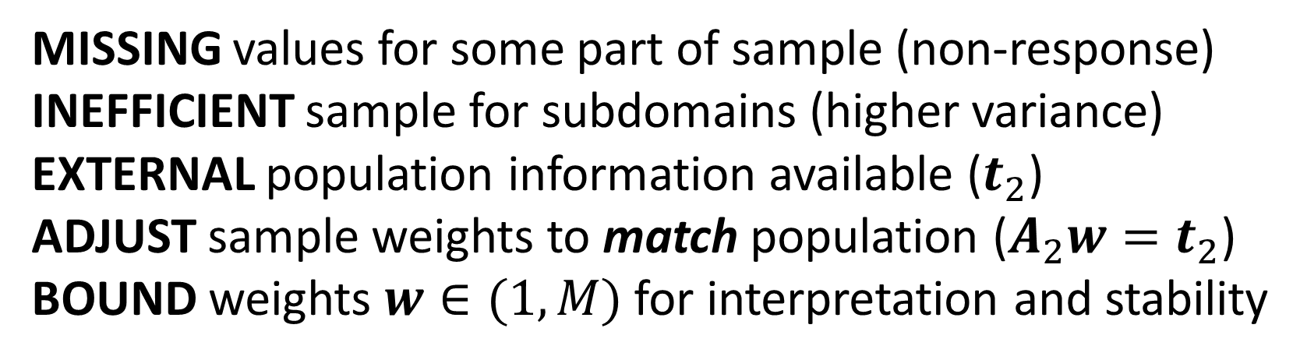
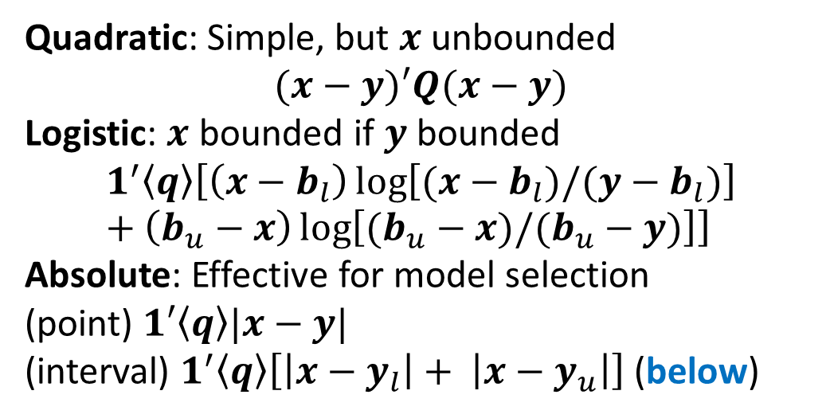
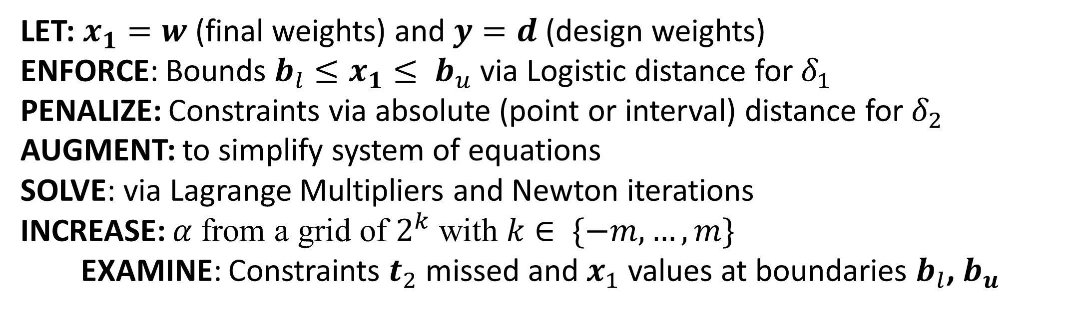
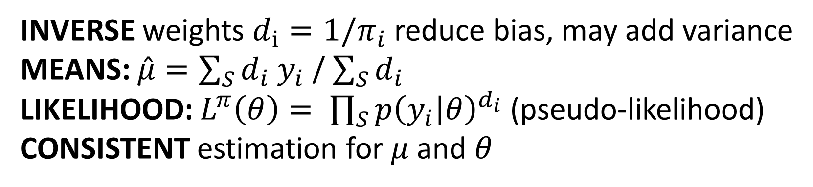
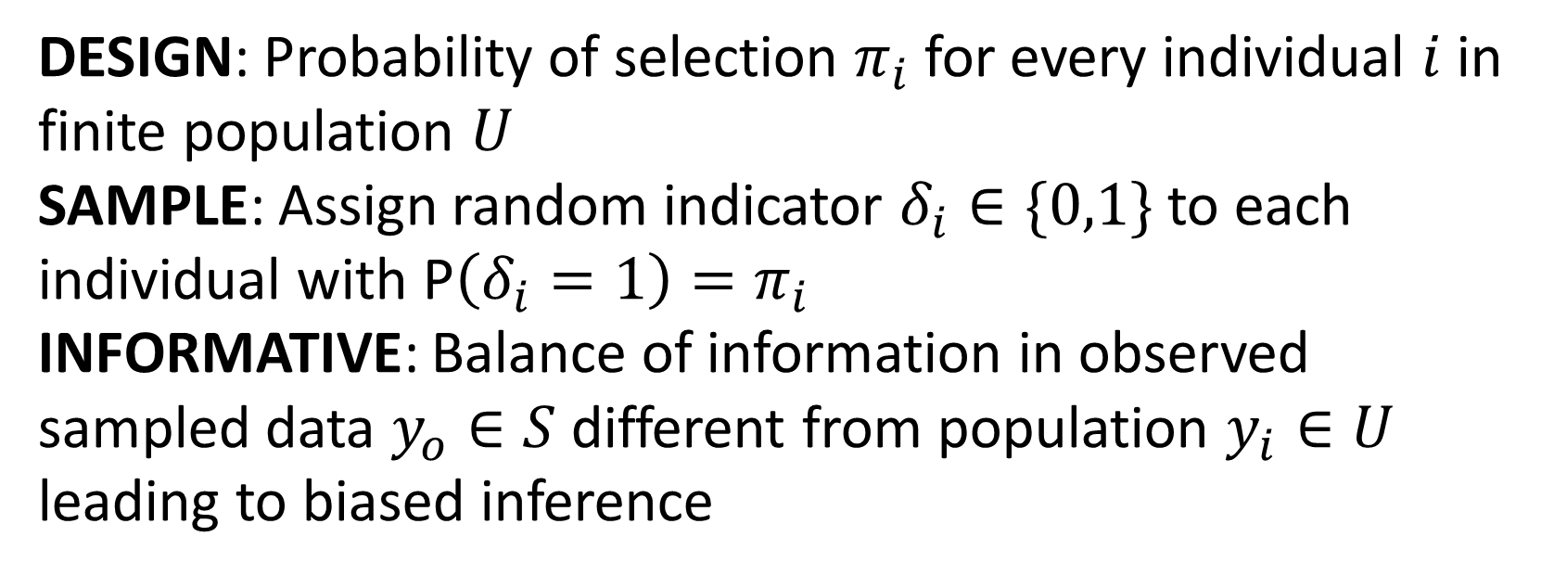
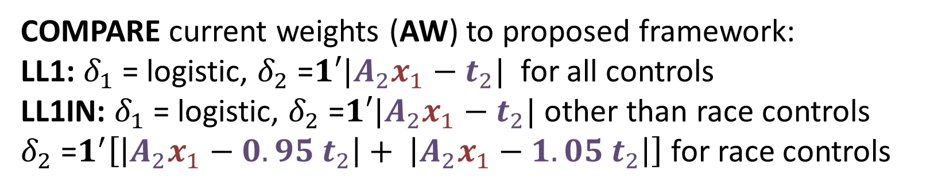


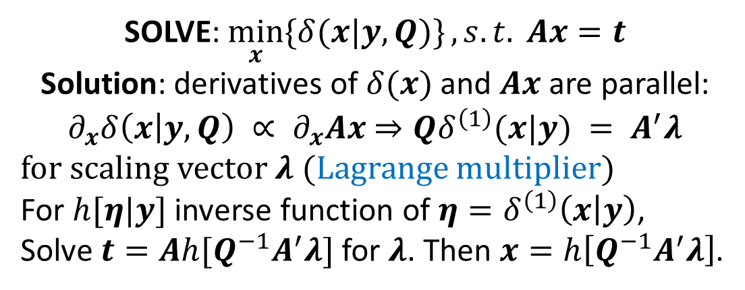
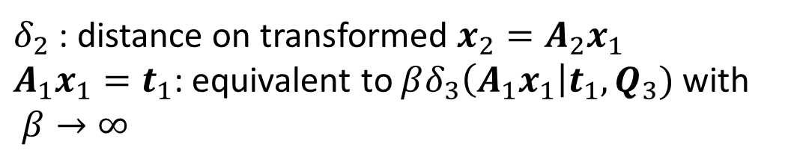
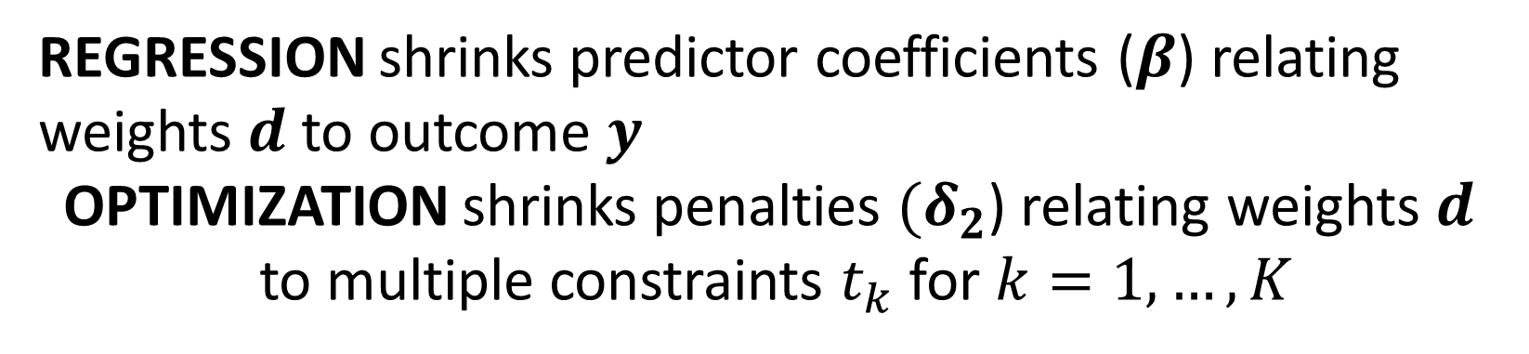

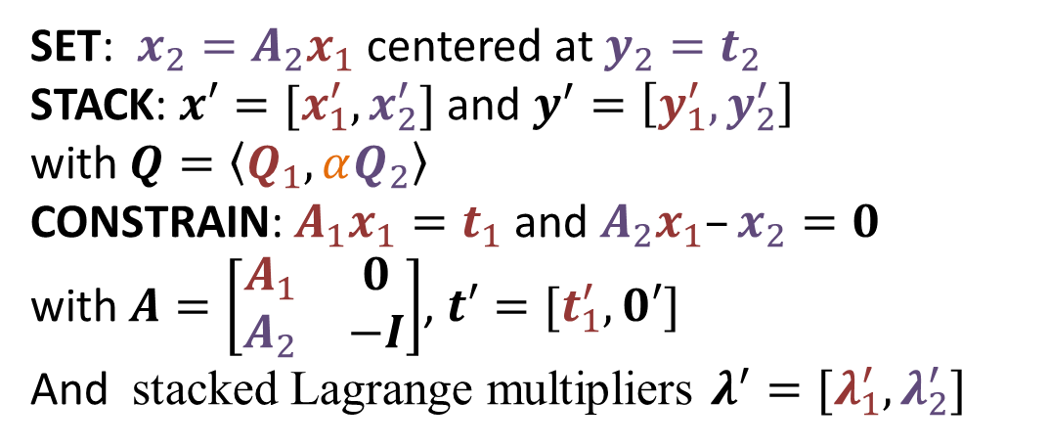
Optimization of Sampling Weights under Large Number of Conflicting Constraints
Matt Williams (Matthew.Williams@samhsa.hhs.gov) & Terrance Savitsky (Savitsky.Terrance@bls.gov)
Substance Abuse and Mental Health Services Administration & Bureau of Labor Statistics
PROBLEM STATEMENT
APPLICATION
SURVEY SAMPLING
OPTIMIZATION TOOLS
NATIONAL SURVEY ON DRUG USE AND HEALTH (NSDUH), 2014
DESIGN: Probability of selection $π_{i}$for every individual $i$ in finite population $U$
SAMPLE: Assign random indicator $δ_{i}∈\{0,1\}$ to each individual with P$\left(δ_{i}=1\right)=π_{i}$
INFORMATIVE: Balance of information in observed sampled data $y_{o}∈S$different from population $y_{i}∈U$ leading to biased inference
GOAL: Solve for $x_{1}$closest to $y_{1}$via ‘distance’ subject to constraints
$$\min_{x_{1}}\left\{δ_{1}\left(x_{1} | y_{1}, Q_{1}\right)+αδ_{2}\left(A_{2}x_{1} | t_{2}, Q_{2}\right)\right\}, s.t. A_{1}x_{1}=t_{1}$$
DISTANCES $δ_{1}$
PENALTIES $δ_{2}$
PRIMARY SOURCE for illicit drug use, alcohol use, substance use disorders (SUDs), and mental health issues for the civilian, non-institutionalized population of the United States
STATE BASED sample of 67,500 interview per year with 5 sampling stages
SIXTEEN WEIGHT COMPONENTS, including a final adjustment to Census population totals (post-stratification)
ADJUSTMENTS modelled separately in each of 9 Census Divisions
CONTROLS: State, Quarter, Age group, Race, Gender, and Hispanicity
Quadratic: Simple, but $x$ unbounded
$$(x−y)′Q(x−y)$$
Logistic: $x$ bounded if $y$ bounded
$$1^{′}〈q〉\left[\left(x−b_{l}\right)\log\left[(x−b_{l})/(y−b_{l})\right]+\left(b_{u}−x\right)\log\left[(b_{u}−x)/(b_{u}−y)\right]\right]$$
Absolute: Effective for model selection
(point) $1′〈q〉|x−y|$
(interval) $1^{′}〈q〉\left[\left|x−y_{l}\right|+ \left|x−y_{u}\right|\right]$ (below)
$δ_{2}$ : distance on transformed $x_{2}=A_{2}x_{1}$
$A_{1}x_{1}=t_{1}$: equivalent to $βδ_{3}\left(A_{1}x_{1}\right|t_{1}, Q_{3})$ with $β→∞$
USE OF WEIGHTS
AUGMENTATION
INVERSE weights $d_{i}=1/π_{i}$ reduce bias, may add variance
MEANS: $\hat{μ}=\sum_{S}{d_{i} y_{i}}$ / $\sum_{S}{d_{i}}$
LIKELIHOOD: $L^{π}\left(θ\right)= \prod_{S}{p{\left(y_{i} | θ\right)}^{d_{i}}}$ (pseudo-likelihood)
CONSISTENT estimation for $μ$ and $θ$
SET: $x_{2}=A_{2}x_{1}$ centered at $y_{2}=t_{2}$
STACK: $x′=[x_{1}^{′}, x_{2}^{′}]$ and $y^{′}=\left[y_{1}^{′}, y_{2}^{′}\right]$
with $Q=〈Q_{1}, αQ_{2}〉$
CONSTRAIN: $A_{1}x_{1}=t_{1}$ and $A_{2}x_{1}–x_{2}=0$
with $A=\left[\begin{matrix}A_{1} & 0 \\ A_{2} & −I\end{matrix}\right]$, $t′=[t_{1}^{′}, 0′]$
And stacked Lagrange multipliers $λ^{′}=[λ_{1}^{′}, λ_{2}^{′}]$
NEW ENGLAND (n = 5500, K = 267)
COMPARE current weights (AW) to proposed framework:
LL1: $δ_{1}$ = logistic, $δ_{2}$ =$1′|A_{2}x_{1}−t_{2}|$ for all controls
LL1IN: $δ_{1}$ = logistic, $δ_{2}$ =$1′|A_{2}x_{1}−t_{2}|$ other than race controls
$δ_{2}$ =$1^{′}\left[\left|A_{2}x_{1}−{0.95 t}_{2}\right|+ \left|A_{2}x_{1}−{1.05 t}_{2}\right|\right]$ for race controls
WEIGHT ADJUSTMENT
MISSING values for some part of sample (non-response)
INEFFICIENT sample for subdomains (higher variance)
EXTERNAL population information available ($t_{2}$)
ADJUST sample weights to match population ($A_{2}w=t_{2}$)
BOUND weights $w∈(1,M)$for interpretation and stability
Lagrange Multipliers
SOLVE: $\min_{x}{\{δ(x|y,Q)\}}, s.t. Ax=t$
Solution: derivatives of $δ(x)$ and $Ax$ are parallel: $∂_{x}δ\left(x | y,Q\right) ∝ ∂_{x}Ax$ $⇒Qδ^{\left(1\right)}(x|y) = A^{′}λ$
for scaling vector $λ$ (Lagrange multiplier)
For $h[η|y]$ inverse function of $η=δ^{\left(1\right)}\left(x | y\right)$,
Solve $t=Ah[Q^{−1}A^{′}λ]$ for $λ$. Then $x=h\left[Q^{−1}A^{′}λ\right]$.
CHALLENGE: TOO many controls and TOO many bounds on the weights.
IMPLEMENTATION FRAMEWORK
LET: $x_{1}=w$ (final weights) and $y=d$ (design weights)
ENFORCE: Bounds $b_{l}≤x_{1}≤ b_{u}$ via Logistic distance for $δ_{1}$
PENALIZE: Constraints via absolute (point or interval) distance for $δ_{2}$
AUGMENT: to simplify system of equations
SOLVE: via Lagrange Multipliers and Newton iterations
INCREASE: $α \text{from} \text{a} \text{grid} \text{of} 2^{k} \text{with} k∈ \{−m, …, m\}$
EXAMINE: Constraints $t_{2}$ missed and $x_{1}$ values at boundaries $b_{l}$, $b_{u}$
AW: Forces one-factor effects, missing higher level effects. LL1: Balances sizes of effects (larger states and race groups) leading to more controls achieved. LL1IN: Loosens restrictions on unachievable controls (small race groups for certain states) leading to more controls achieved.
REGRESSION vs. OPTIMIZATION
REGRESSION shrinks predictor coefficients ($β$) relating weights $d$ to outcome $y$
OPTIMIZATION shrinks penalties $(δ_{2}$) relating weights $d$ to multiple constraints $t_{k}$ for $k=1, …, K$
SPEED and SCALING UP
AW: several hours including manual intervention. LL1 and LL1IN: 30sec.
Quadratic Programming (not shown): > 4 hours and 2 GB RAM.
Other Datasets: LL1 and LL1IN 15min & 1GB for n = 100,000 and K = 200.

