Slide 1

From Statistics to Data Science Startup: Transformation within a Large Research Organization
Symposium on Data Science and Statistics
May 19, 2018
Gayle S. Bieler, Director
Center for Data Science
RTI International
Notes:
Hello everyone, I’m Gayle Bieler, and I’m so happy to talk to you all today.
I’ve had many adventures in my 30 years at RTI International, but by far the most challenging and fulfilling has been building the Center for Data Science for the past 6 years. I was trained in traditional statistics, but I soon discovered that I had a bent toward the unconventional. At RTI, I learned to have an open mind, that the things that are unfamiliar at first are the very things that may soon prove fascinating. You just don’t know what you don’t know—you need to be prepared to change and grow and take right turns during the course of your career. That was an invaluable lesson.
But I’ll start in the beginning, with RTI itself. Most of you have hopefully heard of us, our HQ are in RTP, NC. We have the great fortune of being housed in a brand new state of the art building called Horizon—filled with natural light, it’s a modern environment designed for collaboration. It’s a big moment for our organization.

Slide 2


RTI International
RTI International is an independent, nonprofit research institute dedicated to improving the human condition.
We combine scientific rigor and technical expertise in social and laboratory sciences, engineering, and international development to deliver solutions to the critical needs of clients worldwide.
Notes:
What is RTI? Since our founding in 1958, we’ve grown into one of the world’s leading non-profit research institutes by remaining focused on our mission to improve the human condition.
We deliver independent, objective, and scientifically rigorous res, dev, and tech services to support projects around the world.
In today’s parlance, I guess you could call us Science for Good.
We’re large and global:
5000 staff, representing 250 degree fields, and…at any given time, ~3,000 ongoing projects with over 1,000 clients around the world.
I always say our major emphasis is on public health and wellness, as well as social and justice policy.
Our clients include US government, state and local governments, academia, foundations, global NGOs, and commercial companies.

Slide 3

RTI Services and Capabilities
Statistics and Data Science
Ensuring the quality, validity, and reliability of data from research studies of all types.
Turning data into actionable insights.
Data Science
Survey statistics
Biostatistics
Environmental statistics
Notes:
RTI has always been a data-centric organization, and statistics is at the core of RTI’s work. So it’s been a logical extension to apply data science to every practice area, extending our boundaries into areas like computational social science, computational epidemiology, public health informatics, bioinformatics, and others.
The Center for Data Science is situated in the organization among RTI’s statisticians. That was an important choice, because we could have been situated almost anywhere in the org—among the computer scientists, in the corporate groups, or in any of the domain research groups.
Where we are says a few things:
First, we are committed to analytic rigor. Data science is many things, but putting analytic excellence at the top emphasizes its mathematical underpinnings. For the type of work that RTI does, that’s important.
Second, we’re agnostic to application discipline. With 5000 people, our data scientists have the opportunity to work across literally dozens of research domains and find their own unique interests over time. For a team of unbelievably curious and entrepreneurial people, that’s a plus.

Slide 4

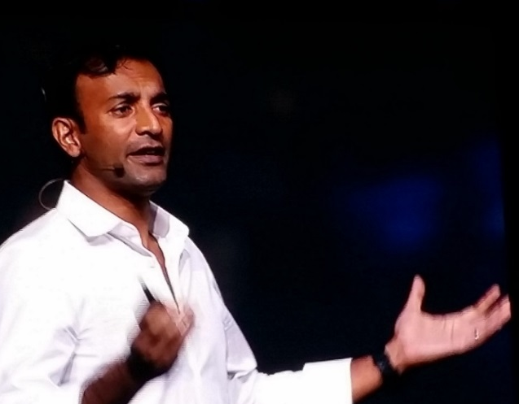
A Transformation
Persistent feeling that we could use data not exclusively for acquiring knowledge but for informing action and decision-making
Solve thorny problems
Work directly with everyday people
Evolve quickly through iteration
Understand and respond to human need
DJ Patil, former US
Chief Data Scientist
Make government work better for all of us
We can do this!
Notes:
I was really inspired by the Obama Administration, by their commitment to science and data, and the initiatives going on at the Office of Science and Technology Policy, at 18F, the Presidents Innovation Fellows, and the USDS. Government was becoming more data-driven than a lot of companies!
And I had this growing feeling that we could use data not only for acquiring knowledge but also for informing action and decision-making
And then DJ Patil entered the scene (as the first US Chief Data Scientist): his message and approach—to solve thorny problems, work directly with and for everyday people, evolve quickly through iteration, understand and respond to human need, and making gov’t work better for all of us….
I was in.
I remember thinking: we can do this!
THIS is the trend I’m going to talk about today—it’s data science for social good, from my own perspective and experience.

Slide 5
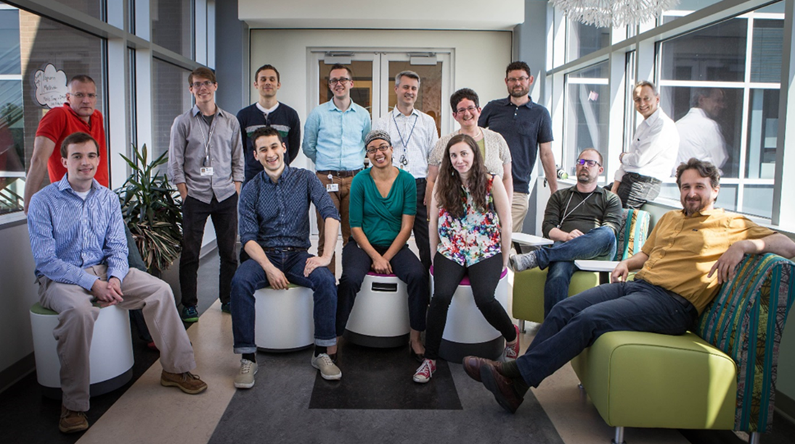
2014: RTI Center for Data Science
Data science is a team sport
We have a vibrant team with a compelling
social mission…Data for Good
Notes:
Fast forward through a lot of hard work over a couple year period…
And in 2014: RTI establishes the Center for Data Science. Which meant me, another statistician, and a couple of new hires from the NC State Institute for Advanced Analytics. Thank you NC State!
We are now 4 years old, with 22 people. We’re growing and thriving.

Slide 6


Choose Your Leader Well
The most important decision you’ll make!
Choose a Servant Leader
Puts people first, impact second, themselves last
Knows the business & loves data science
Removes obstacles
Advocates for staff
Creates atmosphere
of opportunity
Learns from and admits mistakes
Raises leaders
Has a higher calling,
a mission, sets lofty goals
Notes:
So, what have been some of the most important factors in our success, what’s most important to me as a leader?
Some of these we committed to early on, some of them evolved (and continue to evolve) through practice and experimentation.
I would say that choosing your leader is the most important decision you’ll make. My advice is to choose what is called a servant leader.
Servant leadership (Robert Greenleaf, 1970) is a leadership philosophy. It effectively turns the power pyramid upside down; instead of people working to serve the leader, the leader exists to serve the people.
What does that mean to me? It means someone who…puts people first, impact second, themselves last.
Higher calling, sets lofty goals:
Example: One of my early ambitions was to get involved with the White House data initiatives. This was my dream. Wouldn’t it be great if…and, lo and behold, just a few months later, through some cleverness, timing, and a little chutzpah, we did it! We joined President Obama’s Data-Driven Justice Initiative led out of the OSTP (pictured here is a few of us at the WH).
This type of leadership is something staff can feel. It’s palpable. Being a data science leader is hard work. It’s not something you can delegate or do executively. But the hands-on work pays off in spades.

Slide 7

Mission and Vision
RTI’s mission…to improve the human condition
Our Center’s mission…to positively impact
society through data science for social good
My Vision…
Create a vibrant data science team that is a hub of innovation and collaboration, where people can thrive and be at their natural best while doing meaningful work to improve the world.
We solve important national problems, improve our local communities, and transform scientific research
Notes:
And to be a great leader, I believe that having a compelling mission and vision is important.
As I’ve mentioned, at RTI we’re committed to our company’s mission…to do work that improves the human condition.
And the growing trend of Data Science for Social Good resonates with our team ... this is our cause.
I’ve always envisioned a vibrant data sci team that is a hub of innovation and collaboration, where ppl can thrive and be at their natural best, while doing meaningful work to improve the world.
And in four years, we’ve come a long way: we’ve grown, we’ve solved national and int’l problems, improved our local communities, published our work, presented at conferences, universities, government agencies, and at the White House. We’ve created open source tools and applications, become thought leaders in areas like data-driven justice, and appeared in local and national media.

Slide 8


Live your team values. We are committed to…
Continuous learning and innovation…
Data science needs to learn from itself
Data science is a team sport
Team vs. group culture
Human-centered design…
Engage with stakeholders and end-users to deliver value
Seek feedback and adapt design through rapid prototyping
Create products that people use
Notes:
I’ve learned that developing and living your team values is also important. Beyond mission, vision, impact, or what we do, people care about how it feels to work here. It’s the culture.
3 themes that emerged:
1. Data science needs to learn from itself. We need to share knowledge with one another. Continuous learning and innovation are paramount.
2. Data science is a "team" sport: you hear it a lot. The operative word here is team, and that means two things to us:
First, all of us, as data scientists, can only solve problems by knowing first where the problems ARE, and that requires engaging with people deeply connected to the problem space.
Second, we strive to be a team, not just a group: which means we elevate one another, we go out of our way to help one another, we mentor and develop one another, we collaborate on projects together.
Finally, we’re committed to human-centered design and rapid prototyping. These are some of the hallmarks of our success. Both really important when creating data products; allows us to create “products that people use.” Our staff believe in this approach and are committed to it.

Slide 9
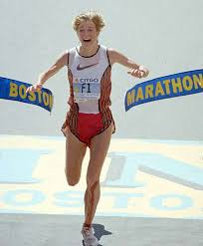


Team Composition: Evolution
We raise leaders!
…is not who you need at 22
Who you need at 2…
We’ve evolved…
from dashboards to deep learning
from prototypes to fully deployed products
…we practice tip-to-tail data science
Notes:
Team composition is a major consideration for any data sci team, and something that is both specific to your business and organization, and that must keep evolving. No perfect solution, and it’s not static.
For example, who you need at 2…is not who you need at 22…
At 2 we needed the ignition, the sprinters. They don’t typically last long, and that’s OK.
At 22 we need the marathoners—we’re more stable now; we need creative, dedicated, and humble people in it for the long haul. Patient, team-oriented, and with a growth mindset
We’ve gone through it all: dazzling, wrong, useful, and spectacular: remember, as George Box says: all models are wrong, but some are useful. And I’d add, when you get it right, some models can change the world. This also pertains to team composition.
Along with our staff, our work has evolved… from dashboards to deep learning…from prototypes to fully deployed products.
I am most proud of the fact that we raise leaders and that we practice tip-to-tail data science.

Slide 10
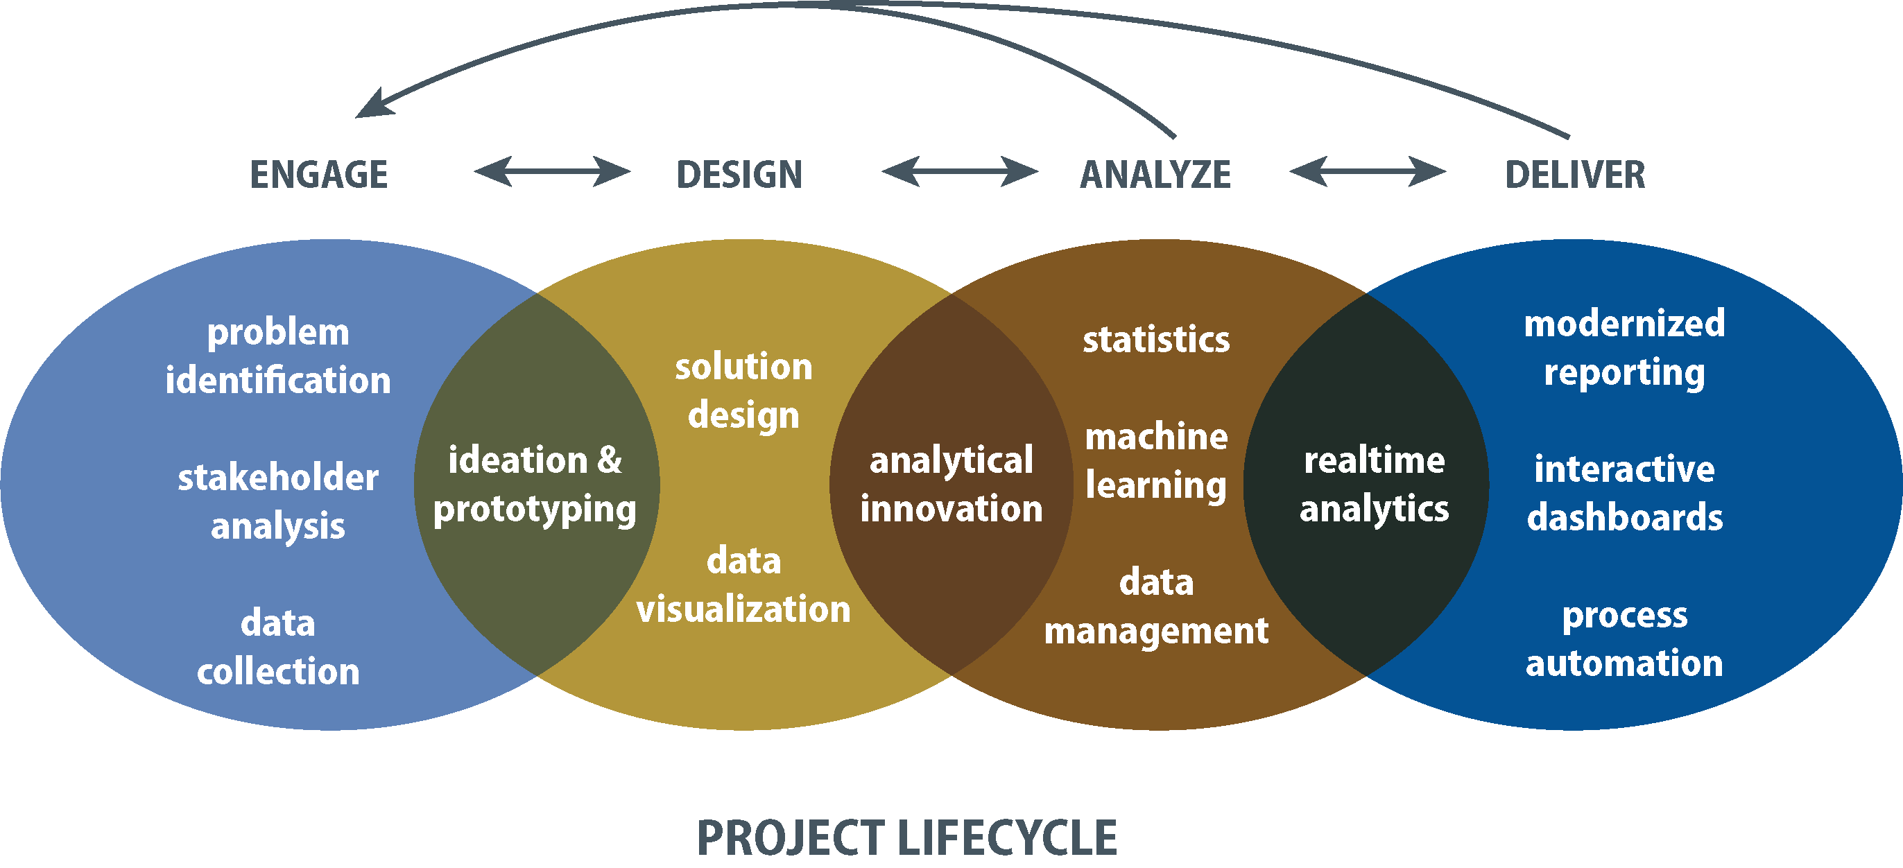
Tip to Tail Data Science
Notes:
So, What is Tip-to-Tail Data Science? To us, it’s data science that is deeply connected to the project lifecycle.
We consider data science to be about problem-solving:
So our approach starts with client engagement and continues through solution design, advanced analytics, and modern reporting.
It is a process that requires many skillsets
Done right, it starts way before the “analyze” part. It starts with engagement, with defining the problem, the solution, and iterates between stages. And keeps returning to engagement.
To do this kind of data science, our technical skills have to include all aspects of advanced analytics, plus software engineering and visual design.
My philosophy is this: If you really want a single team than can create something special, with impact, you need these varied skillsets under one roof, working as a team, with a common cause.
Data scientists: analytical work. They come in many different varieties, always look for humble
Software developers and data engineers: form the backbone of a data science team…important if you have a product orientation
Visual designers: give life to your visual work.
Backgrounds in various other fields is important at a place like RTI—it effectively means you speak multiple languages, which is important when working collaboratively across the organization.

Slide 11
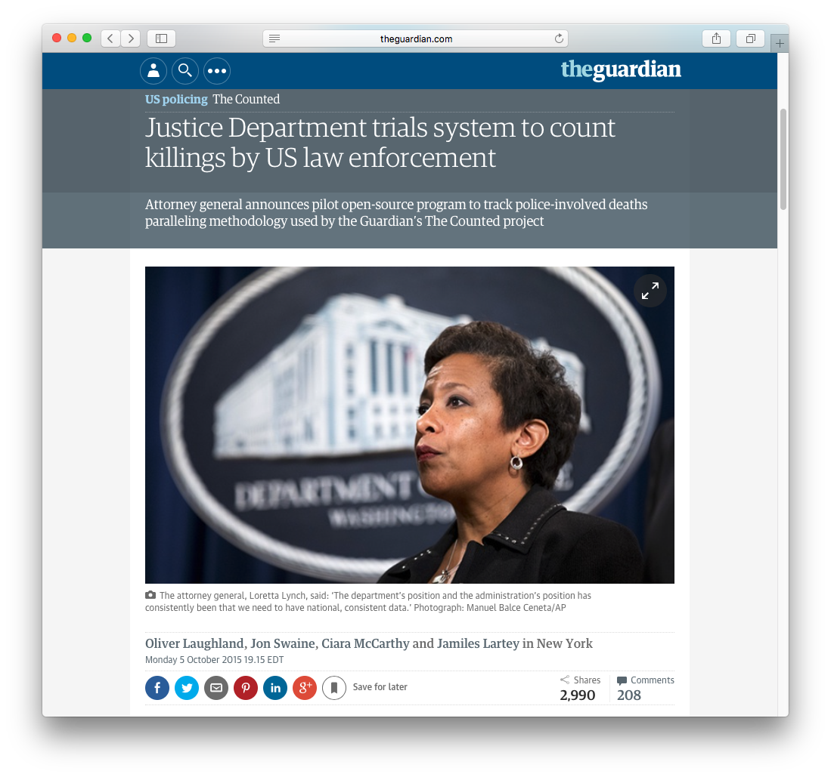
Identifying Arrest-Related Deaths: The Problem
President Obama, in response to his Task Force on 21st Century Policing, March 2, 2015:
“Right now, we do not have a good sense, and local communities do not have a good sense, of how frequently there may be interactions with police and community members that result in
a death”.
Notes:
I’ll talk about one project that is emblematic of our mission. There’s my favorite AG, Loretta Lynch.
My favorite examples are from the public safety and social justice realm. This is partly due to my own interests, and the fact that these topics make for great stories. And frankly, I don’t know what could be more important in this world than good governance and social justice.
This project is one of the reasons I say the federal government is becoming more data-driven than a lot of companies.
On Aug 9, 2014: 18 year-old Michael Brown, a suspect in a convenience store robbery, was shot by police in Ferguson, Missouri. Protests of police brutality continued in Ferguson for more than a week. We began yet another episode in the nationwide debate about race and policing. This time, there were calls for better official data on police killings.
March, 2015: Pres Obama said, in response to his Task Force on 21st Century Policing, …“Right now, we do not have a good sense…”
October, 2015: AG Loretta Lynch and Bureau of Justice Statistics announced the start of a pilot program to change that. BJS wanted to create a more robust version of their earlier program to count arrest-related deaths—from 2003 to 2011, they were publishing annual data provided voluntarily by the 18,000 US law enforcement agencies. It was intended to be a Census of all deaths.
So what is an arrest-related death? The term “arrest-related” encompasses the range of circumstances pertaining to a death, including those that occur from the process of apprehension to detention. So the event causing the death can occur before, during, or after arrest, and it is all manner of deaths, not just police shootings.
Law enforcement homicides
Other homicides
Accidents
Suicides
Deaths due to natural causes
October 5, 2015
http://www.theguardian.com/us-news/2015/oct/05/justice-department-trials-system-count-killings-us-law-enforcement-the-counted
As the FBI, Justice Department, the Administration’s Task Force on 21st Century Policing, and lawmakers have called for a need to have “national, consistent data” to track people killed in the process of arrest by US law enforcement, the Bureau of Justice Statistics has quietly launched a count it hopes will be comprehensive.

Slide 12
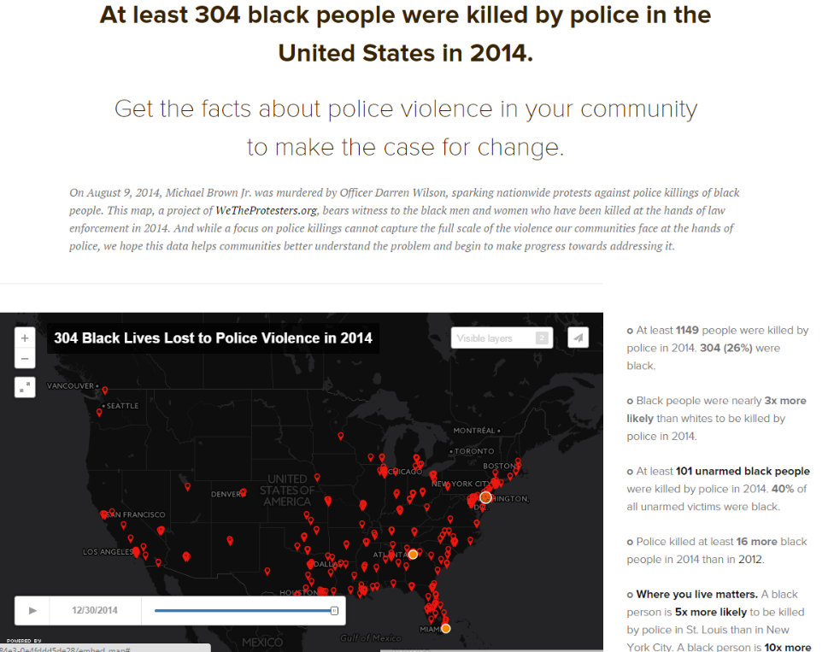
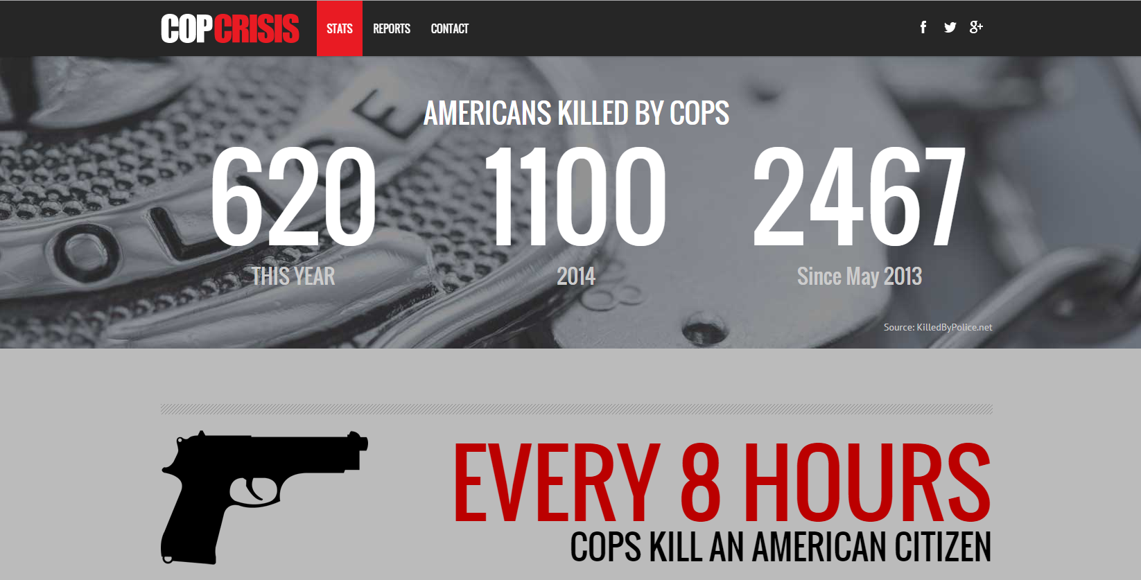
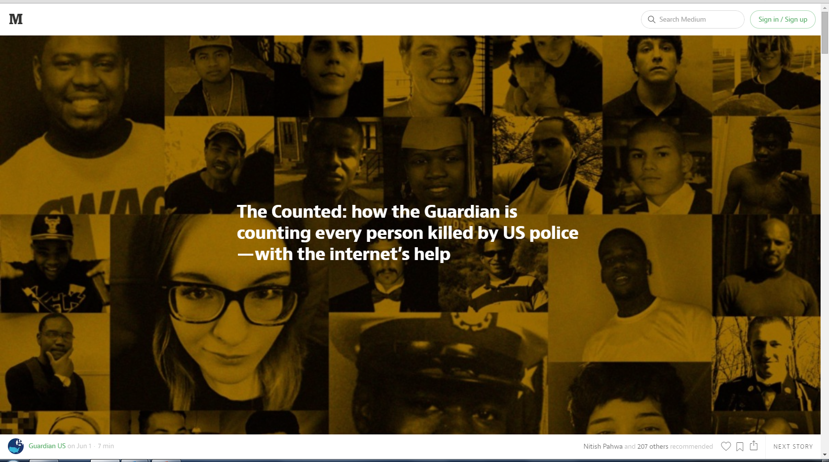
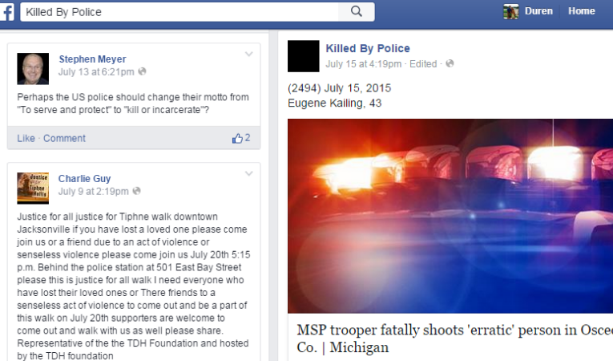
Crowd-Sourced Lists
Notes:
By 2014, crowdsourced lists were doing a better job than the federal government’s voluntary approach.
The Guardian: “The Counted”
Washington Post: “Fatal Force”
CopCrisis
FB page: “Killed by Police”
BJS did a coverage assessment study: Capture-Recapture analysis, using their data and the FBI’s data (ARD and Supplementary Homicide Reports). Overlap between the two sources of data
Showed that their program was seriously underestimating the number of arrest-related deaths.
Slightly less bad in 2011 when BJS started using Google searches.
So they knew they could do better
Enter RTI in 2015: We were asked to design a single official way to count arrest-related deaths that so far had eluded the government. DOJ was looking for an accurate, national, and consistent approach to data collection.
The idea was to use a hybrid approach to data collection starting in 2015:
Phase 1: review online media reports of potential officer-involved deaths
Phase 2: follow-up law enforcement agency survey to verify facts about the incidents, confirm identified deaths, and to find others missed in media reports.
BTW, this unconventional approach to problem-solving in the federal government is likely to represent the future. This is a trend I see and one of the very significant takeaways from this project.

Slide 13
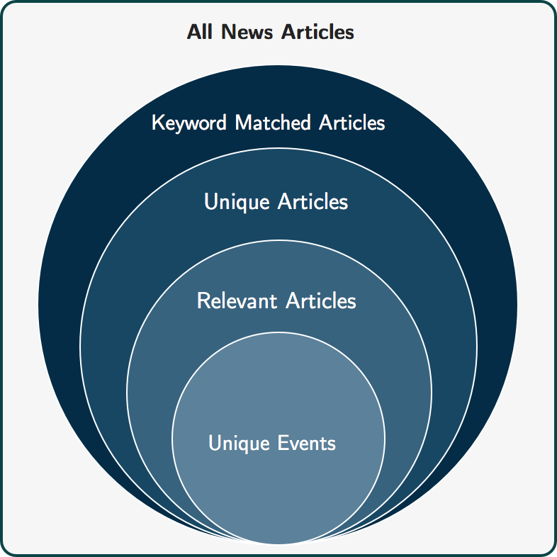
Using Open Information Sources to Estimate Arrest-Related Deaths
1,200,000 articles / month
140,000 articles / month
8,750 articles / month
99% reduction
135 unique events / month
Notes:
When this project first started, there were no data scientists on it. Just our criminologists and social scientists.
And they soon ran into a big problem:
Media alerts revealed that there were many relevant news stories to review (>1,000,000 monthly)
Many human coders, many huge Excel spreadsheets, and one big headache.
I still remember Duren Banks, the RTI PD, calling us one day:
“Hey, is there any way to reduce the number of articles we have to read? We’re swamped in news articles over here.”
No way they could do this project relying on humans alone.
Many potential news articles to review. Many human coders, many spreadsheets.
The data science problem: can we reduce human labor without reducing the number of individuals identified?
Solution:
Using open source software in Python, our data scientists developed an automated coding and classification pipeline of online media data that uses text analytics and machine learning techniques to identify potential cases that can be subsequently be verified by human coders to form a comprehensive and timely count of arrest-related deaths.
In our solution, determining a potential arrest related death is the result of processing news articles through a successive set of filters. We refer to this set of article filtering processes as the pipeline.
It starts with the universe of all news articles and ends with unique events.

Slide 14
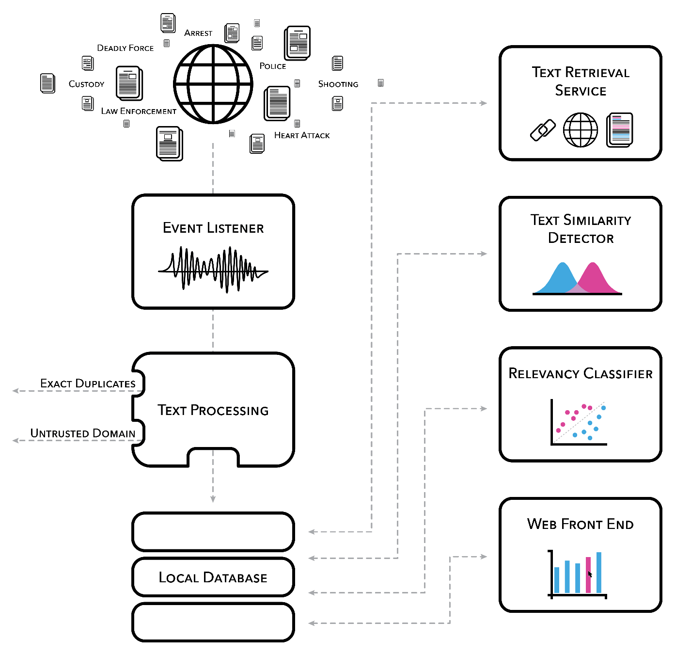
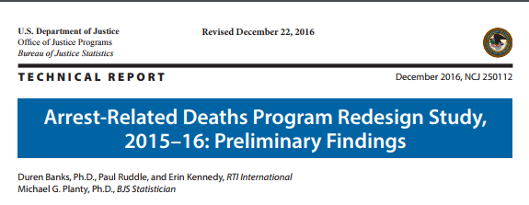




Media Alert Coding and Classification Pipeline, Results, Impact
Notes:
Here’s a more technical view of the pipeline.
From the data science perspective, this project weaves data and analytic pipelines together in creative ways. Aside from impact, this is what data scientists get excited about—creating products and processes that people use.
The initial step of the pipeline (the Event Listener) collects news articles from media monitoring services, where the articles collected have a title or text that contains a word from a list of primary search terms (such as shot, standoff, use of force) and other terms indicating law enforcement involvement (such as police, officer, arrest, or custody).
The Event Listener brings in 1.2M articles / month.
Again, the data science problem: can we reduce human labor without reducing the number of individuals identified?
Many potential news stories to review
Many coders, many spreadsheets
Text Processing:
The articles are deduplicated, a process that removes articles that have significant overlap in the article title or text.
Removes duplicates and articles from untrustworthy or duplicative sources: no national news outlets, no Wikipedia, no Reddit, no Breitbart.
Down to 515,000 articles/month
Text Similarity Detector: uses document similarity measures to eliminate similar articles, based on text and titles
Uses TFIDF Cosine Similarity on article titles longer than 40 characters and removes articles above similarity threshold.
Uses TFIDF Cosine Similarity on article text and removes articles above similarity threshold.
Uses the set of named entities and the Jaccard similarity to remove articles above the similarity threshold.
Also looks for those with similar named entities: proper nouns
Down to 140,000 articles/month
Relevancy Classifier: Machine learning component
After duplicate articles are removed, the remaining articles are run through a relevancy classifier — a machine learning model that predicts whether the article describes an arrest related death.
Ensemble model (logistic regression, decision tree classifiers, and a neural network)
The classifier efficiently filters out articles it is confident are irrelevant. However, a large number of articles are not eliminated by the machine learning model, and they may or may not be about arrest related deaths; the model is less certain about their relevancy.
A human coder makes the final determination of whether all remaining articles meet our definition of an arrest related death, and then links multiple articles to a specific decedent, all through a user-friendly web interface. Once the unambiguously irrelevant articles are discarded by the classifier, we’re down to about 8,700 articles a month that need to be reviewed. The volume of news articles is reduced by 99.2% from the initial stage.
The web interface was a feature that most delighted our coders—made it so easy to do their job. Not only fewer articles, but no more spreadsheets!
In the 2015-16 Re-design Study, between the media review and the follow-up survey, we estimated 1,900 arrest-related deaths occurred from June 2015 through May 2016, far outpacing the previous methodology. In Dec 2016, BJS published the report, which can be found on their website.
The system is currently being expanded to other police-related outcomes. These new domains provide an opportunity to improve on the existing system as well as evaluate performance gains from newer deep learning based approaches for classification.
My staff are grateful for all of the open source technologies and specifically the Python libraries that made this type of project possible.
Why is this project important:
The methodology standardizes data collection, so that the Justice Department no longer needs to rely on voluntary reporting by local law enforcement. Our system, as reported in The Guardian, is the most comprehensive official effort so far to accurately record the number of deaths at the hands of American law enforcement and provide the “national, consistent data” described by the US AG.
Bigger Picture:
As I mentioned, this hybrid approach to problem-solving is likely to represent the future (at least in the applied research business that we’re in). Solutions can range anywhere from the traditional on one end (what we think of as primary data collection for research purposes) to the unorthodox (however you define it—found data, digital exhaust, machine learning, AI) on the other end, to every combination of the two approaches in between. There can potentially be many workable solutions to any given problem.
And no, this is not something we could have done 30 years ago…societal problems may remain the same, but the solutions are re-invented.
Received Lots of Media Attention
This project has been featured in numerous media outlets, including The Guardian, fivethirtyeight.com (who also included it among the Best Data Stories of 2016), and others (e.g. The Measure of Everyday Life podcast).
October 5, 2015
Justice Department trials system to count killings by US law enforcement
http://www.theguardian.com/us-news/2015/oct/05/justice-department-trials-system-count-killings-us-law-enforcement-the-counted
Dec 13, 2015
US government database hopes to tell 'whole story' of police killings after year of Guardian count
http://www.theguardian.com/us-news/2015/dec/13/justice-department-database-police-killings-counted-statistics
Dec 15, 2016
Killings by US police logged at twice the previous rate under new federal program
https://www.theguardian.com/us-news/2016/dec/15/us-police-killings-department-of-justice-program
Dec 15, 2016
The Government Finally Has A Realistic Estimate Of Killings By Police
https://fivethirtyeight.com/features/the-government-finally-has-a-realistic-estimate-of-killings-by-police/
Dec 29, 2016
The Best and Worst Data Stories of 2016 (Trudeau Prize for Governance)
https://fivethirtyeight.com/features/the-best-and-worst-data-stories-of-2016/
July 26, 2017
Artificial Intelligence and Arrest-Related Deaths
http://measureradio.libsyn.com/artificial-intelligence-and-arrest-related-deaths

Slide 15

Remember…Attitude is Key
Many challenges to creating something new in a rapidly moving field, from scratch, in a traditional organization
Embrace ambiguity
Magnify every success
Learn as we go… Experiment!
Expect bumps in the road
Success is not final, failure is not fatal.
It is the courage to continue that counts.
…Winston Churchill
Notes:
Finally, I’ll leave you with this thought: Attitude is key.
Many challenges…What could possibly go wrong? Turns out just about everything. It’s a bit like living in a fishbowl.
I’ve learned to:
Embrace Ambiguity: The best things in life don’t have 12-point plans. I’ve learned that ambiguity and uncertainty are a little exciting; it means that anything is possible.
Learn as we go: I heard someone recently say that a data science organization is like an idea factory—some in opposition to one another, and some very strong opinions. We need to give voice to those ideas, prioritize them, and experiment.
Magnify every success! People need to hear about what you’re doing.
Expect bumps in the road: Pres Obama once said that “Nothing in life that’s worth anything is easy”. I believe that’s true. Just get up and try again!

