Slide 1

Pushing Beyond the Borders:
Bridging Higher Ed and Communities Through the Anchor Dashboard
Alan M. Delmerico, PhD
William F. Wieczorek, PhD
SUNY Buffalo State
Institute for Community Health Promotion
Paper presented at the Annual Meeting of the American Association of Geographers, New Orleans, LA, 4/11/18

Slide 2
Anchor Overview
Anchor Mission
  A commitment to intentionally apply an institution’s place-based economic power and human capital in partnership with community to mutually benefit the long-term well-being of both.

Slide 3
Anchor Overview
What is an anchor?
  Eds and Meds
    Capacity to benefit neighboring communities
    Alignment of resources and business operations with mission
The Anchor Institution Community Benefit Dashboard
  Understand the breadth of influence an institution has on its surrounding community
    Institutional and community oriented measures
  Which mechanisms contribute to the improvement and vibrancy in their communities?

Slide 4



Anchor Overview
History
  Initiated following the release of the 2013 report The Anchor Dashboard by the Democracy Collaborative
  With funding from the Annie E. Casey Foundation
    More info at: anchors.democracycollaborative.org
  SUNY Buffalo State
    Formally involved since 2014
    Institution has long maintained an orientation toward working beyond our campus borders

Slide 5
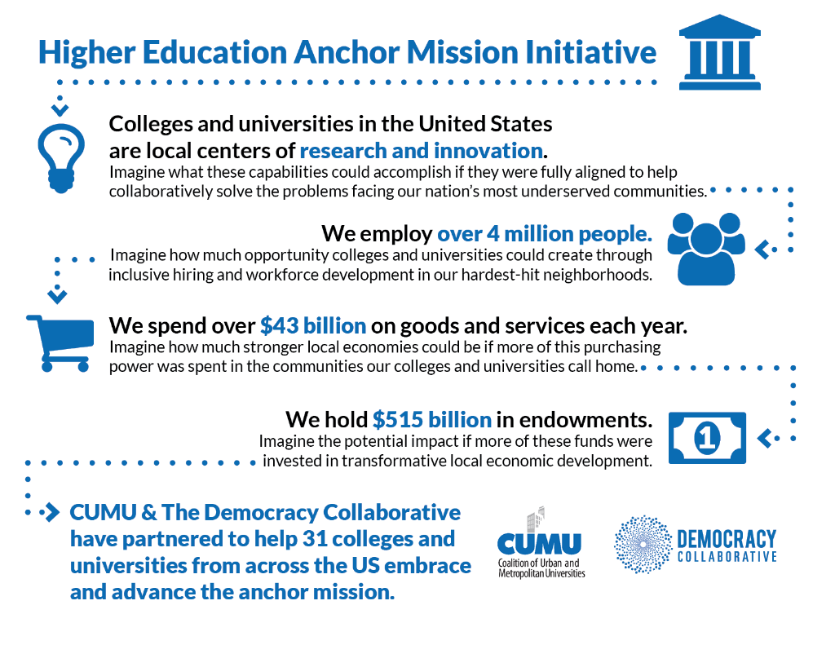
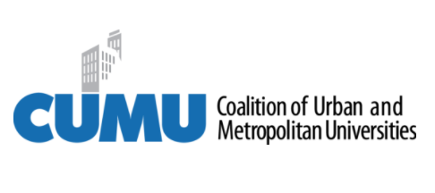






Anchor Overview
Anchor Learning Cohort
  Six institutions to collaborate, develop shared metrics
  Coalition of Urban and Metropolitan Universities (CUMU)
    New partnership in 2018 with CUMU members invited to join the Higher Education Anchor Mission Initiative (25+ announced 4/10/18)
  Carnegie Classification
    Alignment and extension to Community Engagement Classification
Notes:
Very diverse additions: Johns Hopkins, Georgetown, University of Chicago, IUPUI, CSU Los Angeles, York in Canada, etc.

Slide 6
Buffalo State Background
As an institution
  Dynamic evolution reflects broader changes in Buffalo
    Buffalo Normal School->State Teacher’s College (1871-1928)-> Expansion into liberal arts and joining SUNY (1948)
  In 2018
    125 acre urban campus, ~10,000 undergraduate and 2,000 graduate students, >50% minority
    Substantial commuter population from local communities but increasing recruiting and enrollment from NYC
Notes:
Buffalo as a model of struggling post-industrial cities looking to redefine itself. Still highly segregated with uneven development and prosperity…disparity in who has benefitted

Slide 7
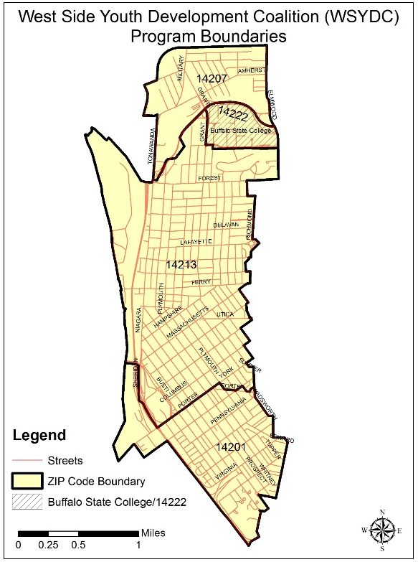
Buffalo State Background
West Side of Buffalo, our neighborhood:
  ~40,000 people, highly diverse
  Starting point: Italian immigrant origins -> Puerto Ricans -> refuge population (Somali, Iraqi, Burmese, etc.)
  Crime, drugs (underage drinking, heroin, prescription drugs, etc.), generational gang affiliation, graffiti, abandoned properties, high poverty, low performing schools, etc.
  Vibrant and diverse, strong entrepreneurship, LGBT community, many Buff State students
Notes:
Highly plural, lots of change over last decade, many new immigrants, many persistent problems.

Slide 8
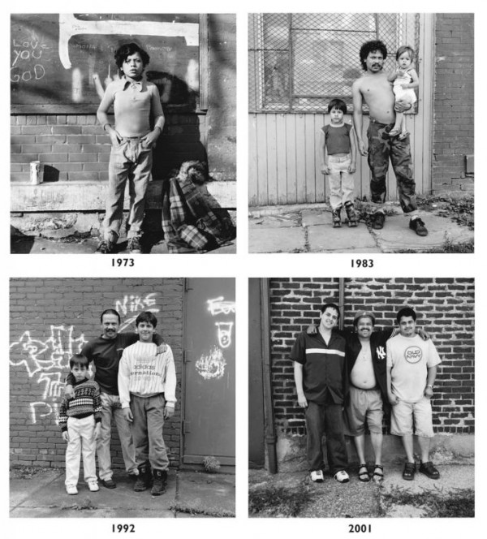
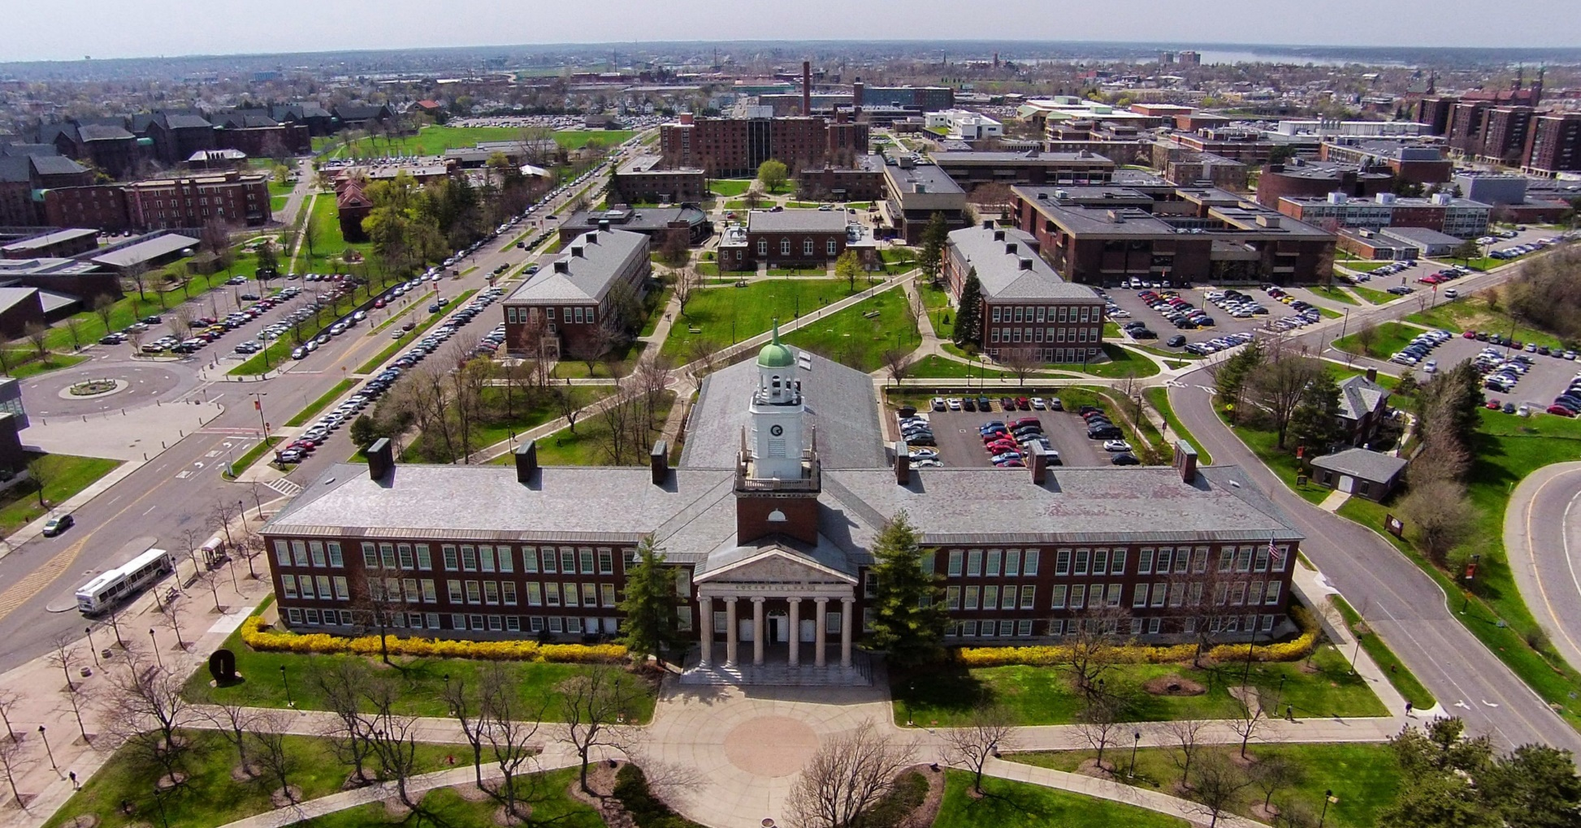
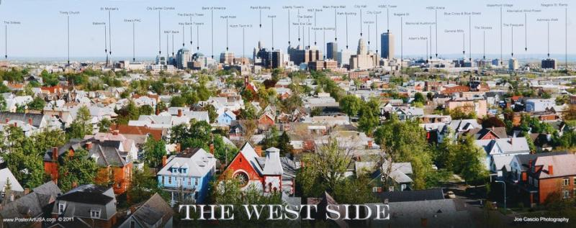

Slide 9
Anchor Institution Role
Utilize all resources to help solve your communities’ most pressing problems (poverty, poor health outcomes, crime, education, etc.)
Redefine role (especially state/public schools) as collaborative community problem solving solutions
  Applied sciences education
  Training
  Investment
  Hiring
  Faculty
  Students
  Purchasing
Universally applicable to all aspects of IHE
  Biology, public health, education, geography vs. physics
  Art (Milton Rogovin)
Notes:
Equitable! Purposeful direction of effort to a community (hiring purchasing, etc.). Not static, so solutions may not yet be present, i.e. procurement of goods not presently produced locally…but could they be? Work with local producer to adapt production to meet needs of institution.

Slide 10
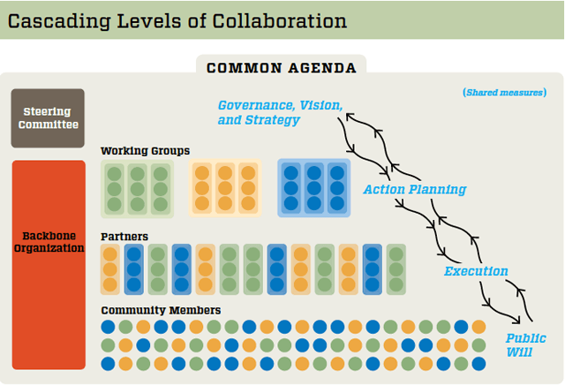
Collective Impact
Mechanism of action
  Collective impact approach – 5 pillars
    Common agenda
    Common measurement
    Mutually reinforced activities
    Communication
    Backbone organization (a natural role of the Anchor Institution)

Slide 11
West Side Youth Development Coalition
Begun in 2009 around violence prevention but has taken on a broad orientation toward community health (breastfeeding, parenting, opioid px, etc.)
  Birth to young adulthood
Diverse funding
  Drug Free Communities grant, multiple state funded projects around substance use prevention
Led by Buffalo State
  Serving as the backbone organization
    Scientific, technical and collaborative horsepower
  Evidence-based agenda setting
  Capacity for communication

Slide 12
Measurement
The Dashboard has five main categories:
  Anchor Mission Alignment
  Economic Development
  Education
  Health, Safety & Environment
  Community Building
Three sets of measures at two levels:
  Institutional Effort and Impact
  Community Outcomes

Slide 13
Results Based Accountability
Two parts: Performance and Population Accountability
Natural alignment with anchor dashboard
  Especially the performance (institutional effort and effect)
  Community Outcomes = Population Accountability
What you can manage directly
  Focus on contribution, not attribution
  Longer term lag for joint contribution outcomes
Friedman, M. (2005). Trying hard is not good enough. Trafford on Demand Pub.

Slide 14
Scale and Other Challenges
What can we expect our impact to be in a complex system?
  Scale -> West Side vs. City of Buffalo vs. WNY region
    Inherently geographic consideration
Measurement challenges
  What is the right amount of local procurement?
Community engagement -> college kids as problem
Data infrastructure of institution
Uneven faculty and student engagement in applied learning

Slide 15
Why the anchor?
Helps to justify our existence
  Answer to “Why Society Should Care About & Fund IHEs Like Ours?”
  Changing rules of higher education
    Staying relevant
    Lots of competition
    Staying useful / good value for students
    Major issues for public IHE – especially mid-level public schools
  Why do we exist and why should the public invest tax dollars?
    Lack of support for “traditional” legacy knowledge
    Changing needs of society
    Knowledge is still central

Slide 16
Why This Matters for Geographers
Inherently about place
  Dynamic interrelationship between IHE and it’s environment across many domains
  Answer the question: how best can IHEs impact their neighborhoods?
    And at what scale?
Geographers are primed to play a central role in leading this effort at IHEs
  Understanding of place, scale, interaction, etc.
  Skillset for quantitative assessment of environment and interaction

