Slide 1
Using found data - a cautionary tale
David A. Johannsen, David J. Marchette, Matt Hackman, Roger Lamb
Naval Surface Warfare Center
Acknowledgment: This work funded in part by the NSWC Naval Innovative Science and Engineering (NISE) program.
Distribution Statement A:
Approved for public release: distribution unlimited
Notes:
Distribution Statements (statements updated 9/30/2013)
Distribution A: Approved for public release; distribution is unlimited.
Distribution B: Distribution authorized to U.S. Government agencies (reason) (date of determination). Other requests for this document shall be referred to (controlling DoD office).
Distribution C: Distribution authorized to U.S. Government agencies and their contractors (reason) (date of determination). Other requests for this document shall be referred to (controlling DoD office).
Distribution D: Distribution authorized to Department of Defense and U.S. DoD contractors only (reason) (date of determination). Other requests for this document shall be referred to (controlling DoD office).
Distribution E: Distribution authorized DoD Components only (reason) (date of determination). Other requests for this document shall be referred to (controlling DoD office).
Distribution F: Further dissemination only as directed by (controlling office)(date of determination) or higher DoD authority.

Slide 2
Statement of the problem
Objective: Provide an alternative to signature-based malware detection systems.
Approach: Develop and train machine learning based software, using datasets featuring a wide array of malware and benign system and application files. This model will distinguish malicious files based off unique characteristics recognized while performing feature selection during training.

Slide 3
History - Kaggle data experiment
Kaggle* released a set of malware data.
This dataset consisted of a byte-dump of 10K pieces of malware.
Each program was assigned a “family”, one of 9 distinct families of malware. The task was to classify a new piece of malware according to family.
This was a large and interesting set of data to test out algorithms for malware analysis.
* https://www.kaggle.com/c/malware-classification

Slide 4
History - Kaggle data experiment
Analogy from text processing suggests an approach:
  Bag-of-words uses word-count histograms (or variations on this theme).
  Very good performance can be obtained with this simple model.
  We utilized “byte-count” histograms to obtain a baseline estimate of performance. The idea was to use this as a starting point for developing better classifiers.
  Hypothesis: a malware “family” starts with an initial code-base and modifies the code, therefore the byte-counts should be fairly similar within families.
    Word-count would seem to be a better feature, but there are a number of problems with this, so we started with bytes, thinking we’d then move to more sophisticated features.
This is a “fuzzy” matching rather than a signature – but it does have a “signature” flavor – the signature of byte distributions (or, if we expand to words, machine instruction distribution).

Slide 5
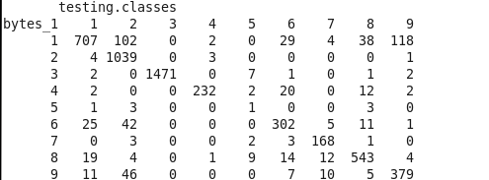
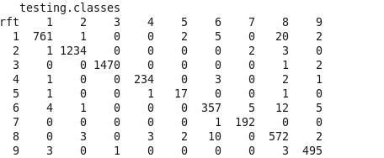
History - Kaggle results
9-NN
Random Forest
Error: 0.109
Error: 0.019
98% correct classification! Very impressive results!
Does this simplistic approach work for the more interesting problem of malware detection?

Slide 6
Criticisms
“Byte” is not the right resolution (word length).
  Analogy is using phonemes instead of words.
Byte counts can be manipulated.
  So can signatures.
Ordering lost.
  This was only meant as a starting point.
  Words, more general n-grams could be used.
    Preliminary results did not show significant improvement in performance.
  ML technique is general – can add domain-specific features.
In the Benign vs Malicious problem how well will this work with completely new attacks (not sharing code)?
  Signatures have the same problem (possibly worse).
  Perhaps new attacks share machine instruction patterns?
  There is reason to believe that the ML approach would be at least somewhat robust, as compared to signatures.

Slide 7
Program for Malicious/Benign
Start with (normalized) byte-count histograms to get a baseline.
Investigate larger words to determine optimal word size.
Select features using standard feature selection methods.
Utilize domain experts to enrich feature space.
Build classifier based on optimal features.

Slide 8
Classifiers used
Primarily used two very common algorithms:
  k-nearest neighbor classifier, and
  random forest classifier.
Also experimented with several neural network architectures, but the random forest classifier was superior.
  Random forests are essentially “best in breed”*.
*Fernandez-Delgado et al, “Do we need hundreds of classifiers to solve real world classification problems?”, JMLR, 15, 2014, 3133-3181.

Slide 9
Benign vs Malware Datasets
Datasets used:
  CAS (benign, mixed OS(?), 84 files)
  Dionaea (honeypot, malicious, mixed OS(?), 21 files)
  CAS (malicious, mixed-OS(?), 42 files)
  CAS (malicious, Linux, 3239 files)
  Malicia (malicious, Windows, 11368 files)
  VXHeaven (malicious, mixed-OS(?), 20113 files)
  CAS (suspicious, mixed-OS(?), 1057 files)
  Kaggle (Windows, malicious, 10868 files)
  Windows Applications (benign, 17 files)
  Windows System (benign, 2 Windows 7 Enterprise systems, 4089 & 984 files)
  Linux System (benign, 2 systems, 1507 & 2082 files).
There are more than 55,000 executables in the training data.

Slide 10
Benign vs Malware Datasets
Data divided (by uniform sampling of indices) into “training” and “test” sets.
Each set partitioned into four classes:
  Linux benign
  Linux malicious
  Windows benign
  Windows malicious
Excluded executables for which target OS was unknown or for which the character (benign/malicious) was unknown.
Random forest achieved better than 99.5% correct classification in distinguishing Windows from Linux (using like character).

Slide 11
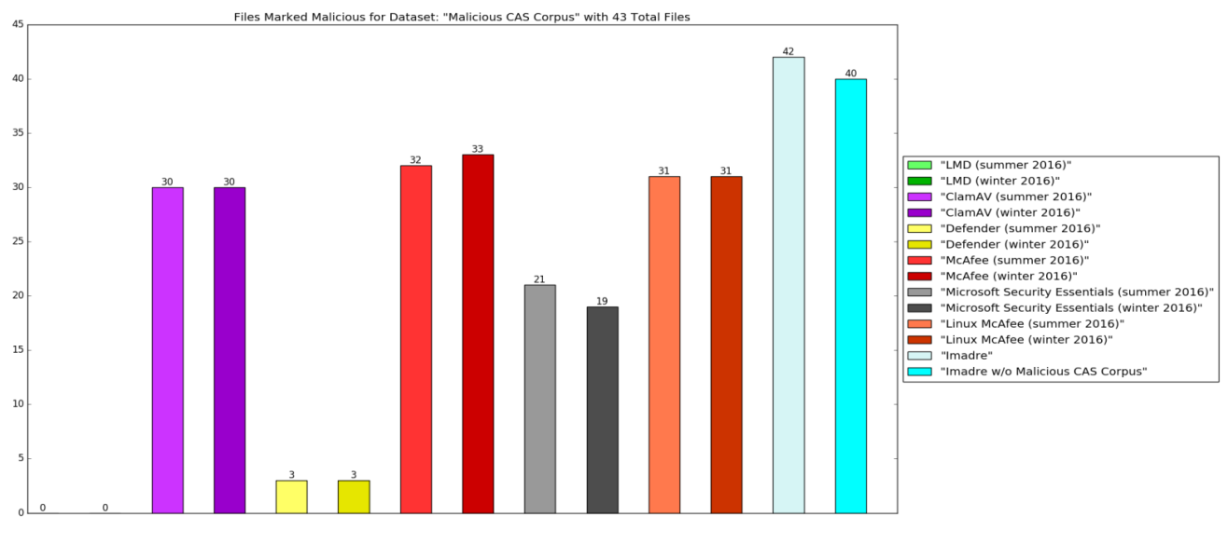
Benign vs Malware Performance
Performance (compared with signature-based methods):

Slide 12
Benign vs Malware Performance
Performance (by OS):
  Windows: approximately 99% correct classification.
  Linux: approximately 98% correct classification.
Classification Task | Random Forest Classifier | Nearest Neighbor Classifier (Euclidean distance) | Nearest Neighbor Classifier (Hellinger distance)
Benign vs. Malicious (using only Windows software) | 99.431% | 98.888% | 99.418%
Benign vs. Malicious (using only Linux software) | 98.272% | 93.718% | 96.417%
Benign vs. Malicious (using both Windows and Linux software) | 98.902% | 99.164% | 99.654%

Slide 13
Too good to be true
Now consider classification performance on excluded data (for which OS was not unambiguously known).
Pooled OS Benign vs Malicious classifier:
  ~49% correct classification on CAS and honeypot datasets – chance;
  ~63% correct classification on VX Heaven dataset;
  ~87% correct classification on Kaggle dataset.
Evidence that the training data does not adequately cover the parameter space.

Slide 14
What is going on?
Easily distinguish between datasets.
In fact,
  can tell apart the two Windows 7 systems with 95% accuracy;
  can tell apart the two Linux systems with 99% accuracy.
Classifier Error Rate | Linux Benign | Linux Malicious | Windows Malicious | Windows Benign (App) | Windows Benign (Sys)
Linux Benign | --- | 1.432% | 0.093% | 0.00% | 0.250%
Linux Malicious | 1.432% | --- | 0.465% | 0.552% | 0.791%
Windows Malicious | 0.093% | 0.465% | --- | 0.088% | 0.569%
Windows Benign (App) | 0.000% | 0.552% | 0.088% | --- | 0.389%
Windows Benign (Sys) | 0.250% | 0.791% | 0.569% | 0.389% | ---

Slide 15
What is going on?
But can’t distinguish between test and training datasets.
Classifier Error Rate | Linux Benign (Train) | Windows Malicious (Train) | Linux Benign (Test) | Windows Malicious (Test)
Linux Benign (Train) | --- | 0.093% | 50.763% | 0.109%
Windows Malicious (Train) | 0.093% | --- | 0.109% | 49.525%
Linux Benign (Test) | 50.763% | 0.109% | 0.00% | 0.093%
Windows Malicious (Test) | 0.109% | 49.525% | 0.093% | 0.00%

Slide 16
What is going on?
Random labels – Are we memorizing or worse?
  Assigning random labels resulted in “coin toss” classifier performance – so something is being classified.
Robustness:
  Classification performance does not degrade appreciably when “important bytes” are discarded.
Can only conclude classifier is learning the “shape” of the histograms.

Slide 17
Robustness
Changing 0s.
  Number of zero bytes is an obvious difference between benign and malicious files.
  “Corrupt” ever more zero bytes of both benign and malicious and compute classifier performance.
  No significant degradation of classifier performance.
Using beginning/end bytes only.
  Classification accuracy improves rapidly using only initial bytes. Classifier accuracy is 96% using only initial 128 bytes.
    Analogous to a signature based method.
  Omitting initial bytes did not adversely affect classifier performance.
  Classification is 85% accurate using only final 400 bytes (Windows benign files are much more likely to have a significant number of terminal zero bytes than malware).

Slide 18
Interlude I - The Tank Parable*
Several years ago an attempt was made to build an algorithm to determine whether an image contained a (camouflaged) tank, or not.
Data was collected, a neural network was built, and it was nearly perfect! It got excellent results on a set of withheld data!
Unfortunately, when it was tested on an entirely new set of data, it was no better than chance.
Upon further analysis it was discovered that the training data with tanks was taken on a cloudy day while the non-tank training data was taken on a clear day.
The classifier was essentially a “cloudy day” detector!
See, for example: https://neil.fraser.name/writing/tank/

Slide 19
Interlude II - The Illusion of Progress
David Hand*:
… the extra accuracy of the more sophisticated approaches, beyond that attained by simple models, is achieved from “minor” aspects of the distributions and classification problems.
… the data points in the design set are not, in fact, randomly drawn from the same distribution as the data points to which the classifier will be applied.
… when constructing classification rules, various other assumptions and choices are often made which may not be appropriate and which may give misleading impressions of future classifier performance.
Hand, “Classifier technology and the illusion of progress”, Statistical Science, 21, 2006, 1-14.

Slide 20
Possible Explanations
Maybe the bad results on new data are due to drift.
  As Hand says, the training data may not be from the same distribution as future data.
We are in R²⁵⁶, where “all the data is on the corners” and other consequences of high dimensional data.
Are we detecting some artifact of the way a given data set was collected?
Are we detecting something about the OS version under which the code was compiled? The language/compiler used?
Is it a packing problem – are we detecting whether the files have been packed with a particular packing algorithm, the equivalent of a cloudy day detector?
Is there a 32- vs 64-bit issue?

Slide 21
Summary
Excellent performance within a given data collection.
  Better than signature based.
  Very robust to “mucking about” with the data.
We have evidence that it isn’t really keying on what we need it to key on.
  Poor performance across data collections.
  Excellent ability to tell collection sets apart:
    Two different collections of malware.
    Two different collections of benign (both Windows 7).
What is needed is a much better designed experiment, and we are not situated to be able to do this without collaboration.

Slide 22
Conclusions
We do not believe that byte-counts adequately characterize malicious vs benign in spite of the apparent performance.
Expanding to larger word-size isn’t the answer until we can be confident that the features are truly indicative of the maliciousness of the file.
Domain knowledge is needed to inform the feature selection methodology, and this knowledge has led to signature based methods.
While our approach was better than signature-based approaches on the data we had, it is unknown how much of this is a result of:
  the byte-equivalent of the “cloudy day” detector,
  a bias in the data collection.

Slide 23
Conclusions
Relying on ‘found data’ is not without peril. One needs a dataset representative of the data the algorithm is going to be used with.
  This means extensive examples of malware as well as representative examples of benign files.
  Getting representative data, without teaming with an anti-virus company or organization, is a challenge.
Relying solely on the algorithms to select the features such as byte counts, word counts, etc. is also unlikely to work.
  We need to unpack, possibly decompile, and utilize knowledge of how executables are organized in a given OS.

Slide 24
Questions?

