Slide 1
Modeling Topics in Survey Interviewer Notes
Wendy Martinez
Terrance Savitsky
US Bureau of Labor Statistics
SDSS 2018
The views expressed are those of the authors and do not necessarily reflect policies of the U.S. Bureau of Labor Statistics.

Slide 2
Origin
Graduate courses in
  Computational statistics
  Exploratory data analysis
Other Ed Wegman students
  Jeffrey Solka – finite mixture models
  Angel Martinez – text analysis
Builds on prior work with Lucilla Tan

Slide 3
Major Points of Analysis
Use two data sources
  Sample unit behavior
  Text describing reason for refusal
Use two types of text encodings
  Term-document matrix
  Bigram proximity matrices
Cluster text using
  Model-based clustering
  Bayes clustering
Find important concerns in clusters using classification trees
  Cluster IDs are ‘class labels’
  Coded behaviors are ‘features’

Slide 4
Background – CE
Data source:
  The Consumer Expenditure Interview Survey (CE) – provides information on the buying habits of America’s consumers, including data on expenditures, income, and demographics.
  For more details about the Consumer Expenditure program: http://www.bls.gov/cex
GOAL: Associate a sample unit’s sentiment (doorstep concerns from Contact History Instrument) regarding the survey with the reasons for non-response (Survey Instrument – SI)
Notes:
“How does a contacted sample units initial sentiment towards the survey request (as captured by the CHI doorstep concerns) associate with the units propensity to participate in the survey?”
We did not focus on performing a response propensity analysis (other research with the same data had already shown there to be an association). Our objective was to determine if the information contained in interviewer note fields in the survey instrument may corroborate that the CHI doorstep concern themes/sentiment applied to characterize the sample units were appropriate.

Slide 5
Study Sample
Wave 1 sample units from CE collection April 2012 through March 2014
18,031 distinct sample units
25% were non-respondents
  30% of these refused for Other reasons
Reasons not captured by codes in SI
Only know reason through text analysis
Notes:
Face-to-face contact was made. Some kind of personal interaction was done.
75% response rate – over the period. So, data set was 25% of units who were nonrespondents. Out of these nonrespondents, some had different reasons for refusing, some of which was captured with radio buttons and some with text (REASON_S)
Approximately 29% of nonrespondents refused for other reasons.

Slide 6
Data Sources – 2 Instruments
Attempts to contact sample unit
Final outcome
Data Source 2:
Contact History Instrument (CHI)
doorstep concerns
Attempt to contact sample unit member
Contact made
Interview conducted
Non-response/
Refusal
Unable to contact
Data Source 1
Survey Instrument (SI)
“Other” reasons

Slide 7
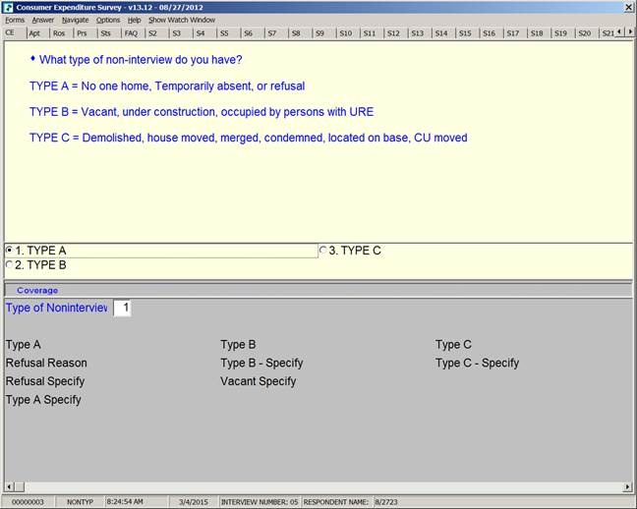
Survey Nonresponse Inputs
Data Source 1 (SI)
Page in Survey Instrument

Slide 8
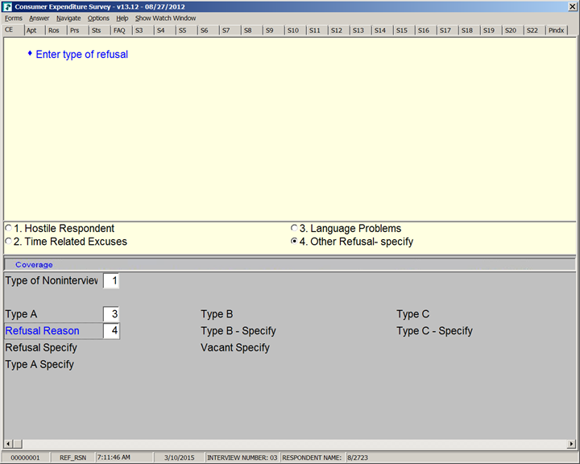
“Other Refusal” Reason – A Document
Data Source 1 (SI)
Page in Survey Instrument
Unstructured text field

Slide 9
Examples of text documents from Data Source 1
"DOESNT DO SURVEYS". SOMEWHAT HOSTILE
"Its voluntary; I just dont want to do it."
"Special family situation"
"VOLUNTARY NO THANKS"
"just not interested"
"makes it a policy not to do such things"
100% Day
roomates and dont want bothered
old lady said dsnt wnt to participate
999999999999999999999999999999999999999999999
?? Im closing this case for another FR
ALREADY DNE OTHER SURVEYS TOO INVASIVE
ANTI GOV
ATTORNEY TOLD THEM THEY DIDNT HAVE TO DO IT
AVOIDANCE
AVOIDANCE, SILENT REFUSAL
Absolutely will not answer questions

Slide 10
Highest Frequency Words
Refusal Corpus (SI)
Most frequent words in the text narrative
Highest Frequency (1 – 10) | Highest Frequency (11 – 20)
privacy | doesn
refusal | door
avoidance | government
silent | health
issues | voluntary
survey | concerns
participate | personal
refused | gov
not | govt
anti | family

Slide 11
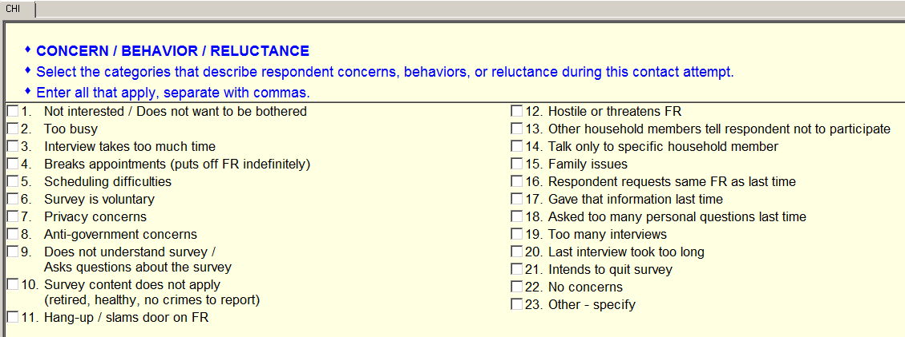
Door
“Doorstep concern” indicators from
Data Source 2 (CHI)
Interviewers report observations of sample unit reactions to the survey request.
Associate concern codes with refusal reasons
CHI revised after 2013 data collections – fewer items.

Slide 12
Process the Text
Used MATLAB and R
Text narrative from a non-responding sample unit is a “document.”
Preprocessed text
  Removed special characters and stop words
  Converted to lower case
Size of corpus
  1,283 documents (n)
  760 unique words (p)

Slide 13
Exploratory Process
Encode documents using raw frequencies
  TDM – Term-document Matrix
  BPM – Bigram Proximity Matrix
Reduce dimensionality–ISOMAP – nonlinear approach
  Chose d = 4
  Used cosine distance
Conduct cluster analysis
  Model-based Clustering
  Bayes Clustering
Associate clusters of interviewer notes (refusal reasons) with doorstep concerns
Notes:
Pre-processed the data
760 words
1283 documents or text fields
Analysis is iterative process
Tried different approaches for clustering and reducing the dimensionality
Extract knowledge

Slide 14
Encode the Text – TDM
The most common approach is the bag of words or term-document matrix (TDM).
The rows correspond to words.
The columns correspond to documents.
The (i,j) -th entry in the matrix is the number of times the i -th word appears in the j -th document.
These are the raw frequencies.

Slide 15
Encode the Text – BPM
TDM – each document coded as a vector
Bigram Proximity Matrix (BPM) – each document coded as a matrix
The rows and columns in BPM_{k} (k-th document) correspond to words.
The (i,j) -th entry in the matrix BPM_{k} is the number of times the i -th word appears before the j -th word.
BPM_{k} is reshaped as a row in the data matrix.

Slide 16
The Data
Interviewer note in survey instrument is a document.
Recall the size of corpus:
  1,283 documents (n)
  760 unique words (p)
Size of data matrix using TDM is 1,283 x 760
Size of data matrix using BPM encoding is 1,283 x 579,121
  The BPM uses the period for all end of sentence punctuation.
  The period is counted as a word.

Slide 17
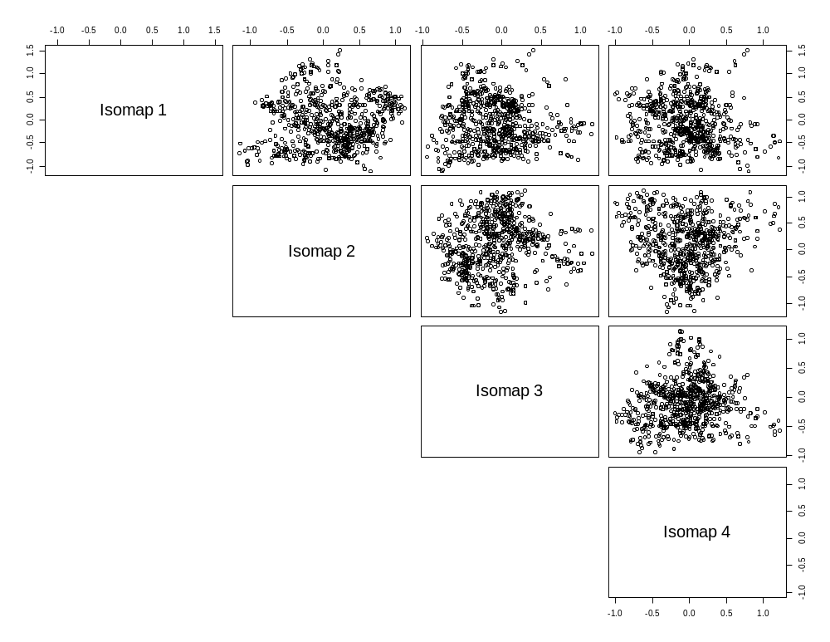
ISOMAP Dimensions for TDM Encoding
ISOMAP–estimates of geodesic distance used with classical multi-dimensional scaling
Each point is a document in an ISOMAP embedding.
Clustered these data.

Slide 18
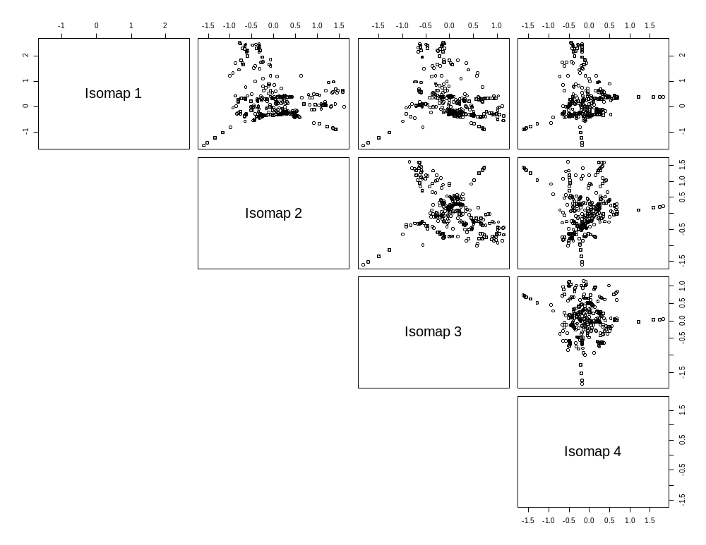
ISOMAP Dimensions for BPM Encoding
See a little more structure with this embedding.
Clustered these data.
Around 15 clusters found.

Slide 19
Cluster Analysis
Model-Based Clustering:
  Estimate a probability density function for cluster structure
  Model is finite sum (mixture) of multivariate Gaussians
  Each term is a cluster – very flexible structure
  Provides estimate of number of groups
Bayes Clustering:
  Limit of a Dirichlet process (DP) model as the noise variance contracts on zero
  Converts posterior distribution to penalized optimization
  Use Carlinski-Harabaz statistic to select penalty parameter (in turn determines number of clusters)
  Connects DP to k-means

Slide 20
Connect Clusters with Concerns
Cluster ID for each narrative of non-response
Construct classification trees
  Use cluster IDs (SI) as class labels
  Use doorstep concerns (CHI) as features
  Variable chosen to ‘best’ split into subsets
  Indication of ‘importance’
Feature/Predictor
Contact History:
Doorstep concern codes
Class/Response
Survey Instrument:
Cluster ID for text narrative

Slide 21
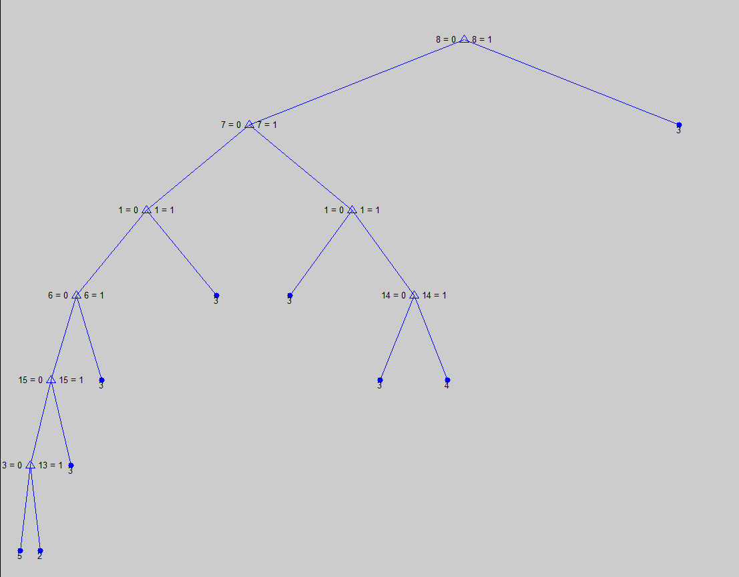
Model-Based Clustering using TDM Data Matrix
Anti-government
Privacy
Not interested
Voluntary
Classification Tree: using Cluster IDs from ISOMAP – Model based clustering as response variables and doorstep concern codes as predictors.

Slide 22
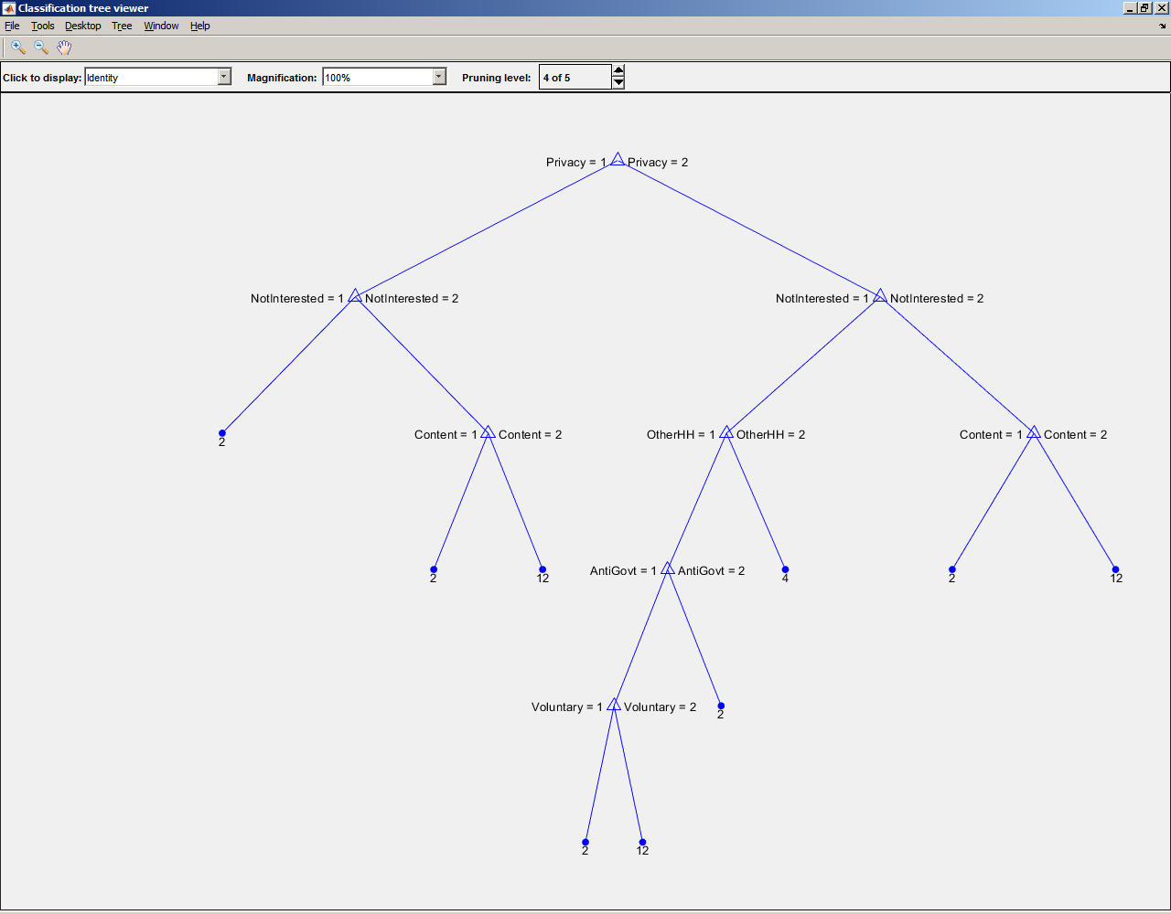
Model-Based Clustering using BPM Data Matrix
Privacy
Not interested
Content
Anti-government
Voluntary

Slide 23
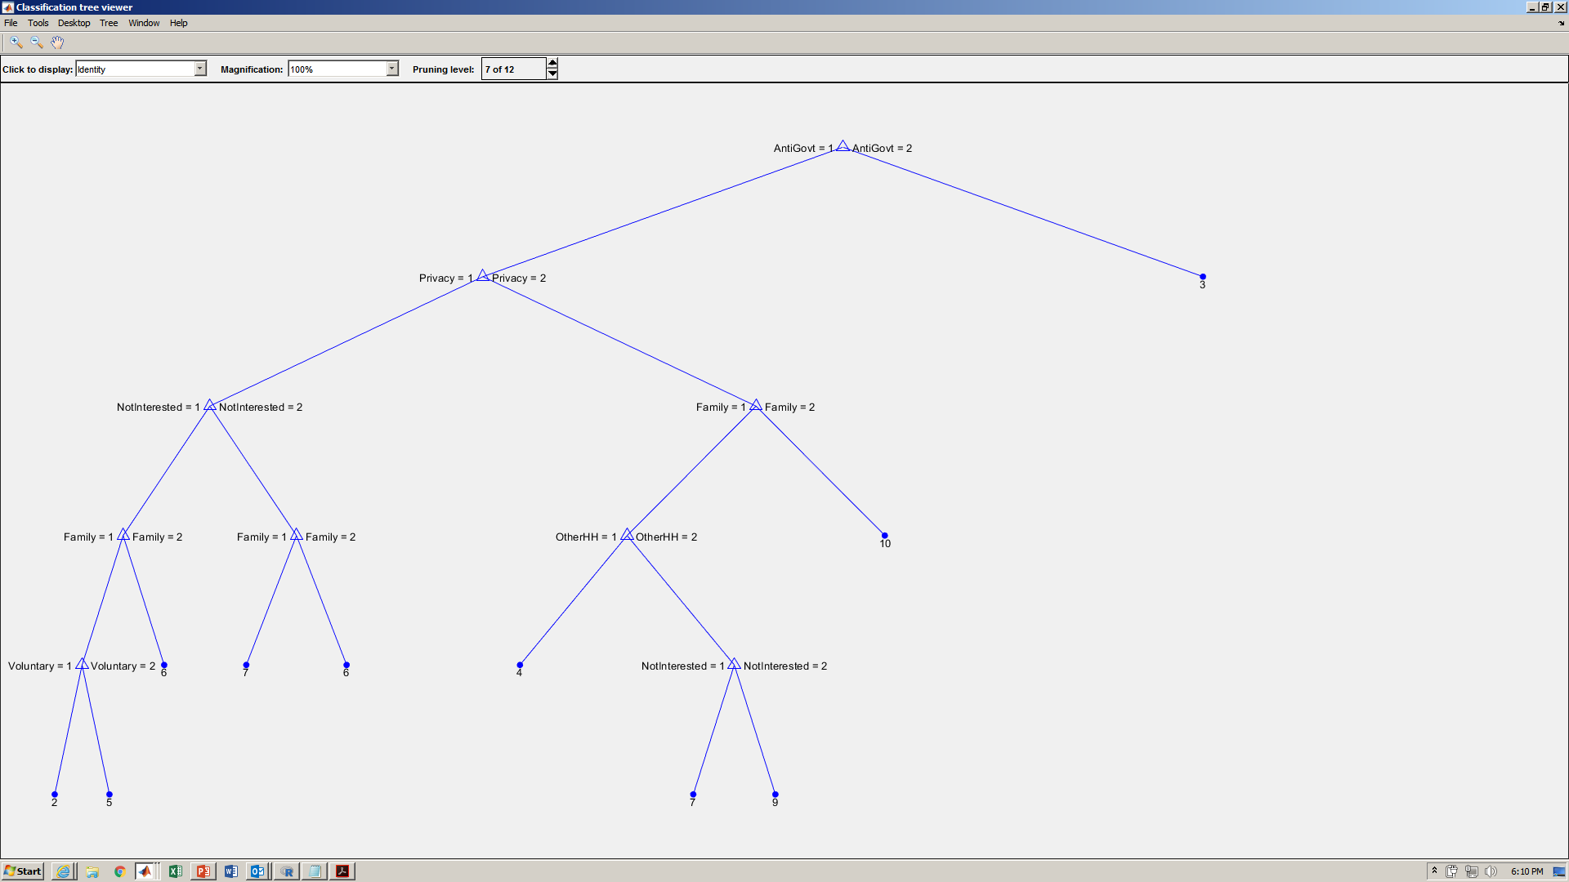
Bayes Clustering using TDM Data Matrix
Anti-government
Privacy
Not interested
Family

Slide 24
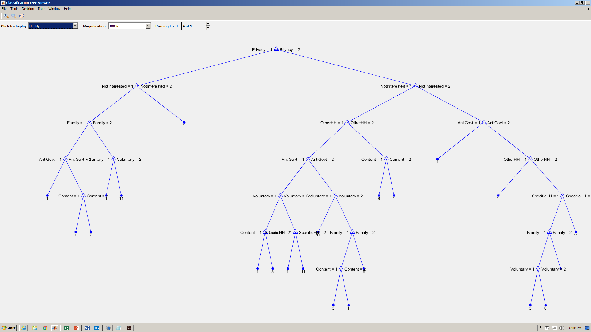
Bayes Clustering using BPM Data Matrix
Privacy
Not interested
Family
Anti-government
Content

Slide 25
Recap
Used two types of encodings
  Term-document matrix
  Bigram proximity matrices – captures some word order
Explored two types of cluster approaches – both estimate number of clusters
Model-based clustering
  Flexible clusters
  Not appropriate for high-dimensional data
Bayes clustering
  Similar to k-means clustering – looks for spherical clusters
  Can be used with high-dimensional data
Associated clusters with sample unit behavior

Slide 26
Discussion
Compare cluster approaches – MBC and Bayes
  Similar estimates on the number of clusters ~ 15
  Same major concerns – Privacy, anti-government, not interested, voluntary
  Bayes – different concern – Family
Compare encodings – TDM and BPM
  Some similar concerns
  BPM uncovered different concern – Survey content

Slide 27
Application
Important reasons for nonresponse are not captured by the existing codes – enhance the survey instrument.
Missing these reasons could adversely affect non-response bias analyses.
Understand refusal reasons and sentiment to better tailor information about the usefulness of government statistics and measures taken for privacy protection.
Use information from text, doorstep concerns, and other variables to estimate propensity to respond.

Slide 28
References
Breiman, L., J. Friedman, R. Olshen, and C. Stone. 1984. Classification and Regression Trees. Boca Raton, FL: CRC Press.
Solka, J. 1995. Matching Model Information Content to Data Information, PhD Dissertation, George Mason University.
Tenenbaum, de Silva, & Langford. 2000. “A global geometric framework for nonlinear dimensionality reduction,” Science, 290:2318-2323.
Martinez, A., 2002. A Framework for the Representation of Semantics, PhD Dissertation, George Mason University.
Fraley & Raftery, 2002. “Model-based clustering, discriminant analysis, and density estimation: MCLUST,” Journal of the American Statistical Association, 97:611-631.
MBC: https://www.stat.Washington,edu/rafter/Research/mbc.html
Martinez W. and L. Tan, “Categorizing sentiment using unstructured text,” Joint Statistical Meetings, 2015.
Savitsky, T.D. 2016. “Scalable Approximate Bayesian Inference for Outlier Detection under Informative Sampling,” Journal of Machine Learning Research, 17:1-49.

Slide 29
Wendy Martinez Bureau of Labor Statistics Office of Survey Methods Research 202-691-7400 martinez.wendy@bls.gov

Slide 30
Limitations
Limited access to interviewer notes due to PII concerns
  No access to interviewers case level notes
  No access to doorstep concern item “other-specify” description
Clustering method assigns a sample unit to membership in 1 unique cluster, but more than one doorstep concerns may be observed for a sample unit member
Text box for entering reason in SI is too small (usability perspective) resulting in short documents

Slide 31
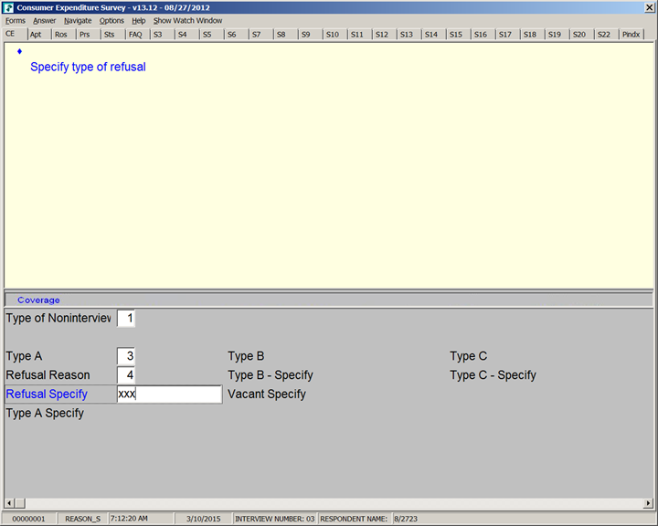
Box for Text Narrative

