Slide 1
Fast track innovations in estimation and analytics for large national health surveys
January, 2020
Steven B. Cohen Ph.D.
RTI International is a registered trademark and a trade name of Research Triangle Institute.
www.rti.org

Slide 2
Agenda
Overview
Challenge at hand
Enhancements to health care survey analytics
Accelerating estimation and imputation processes
Future Efforts

Slide 3

Development of fast track estimation processes that:
improve the timeliness and efficiency of estimation tasks to facilitate the production of preliminary analytical files to clients
satisfy specified levels of accuracy that ensure
data integrity
permit the user to focus energy on higher-order thinking and problem resolution
Yield more accurate, timely and cost efficient final analytical files to clients

Slide 4

Accelerating the MEPS Imputation Processes
Development of Fast Track MEPS Analytic Files
MEPS Application: The Medical Expenditure Panel Survey (MEPS)
is an annual national survey that collects data on health care use, expenditures, sources of payment, and insurance coverage for the
U.S. civilian noninstitutionalized population. It is sponsored by the Agency for Healthcare Research and Quality (AHRQ).
Focused on imputation of medical expenditures and associated sources of payment associated with office based physician visits – responsible for ~30 percent of overall expenditures
For physician office-based visits, approximately 50% of the expenditure data are either completely missing or partially missing.

Slide 5
MEPS Expenditure Imputation
Imputation is required for the following source
of payment variables – a vector of payments
Family
Medicare
Medicaid
Private Insurance
Veterans/Champva
Tricare
Other Federal
State & Local Goverment
Workers Compensation
Other Private
Other Public
Other Insurance
Overall Payment

Slide 6

Fast-Track Imputation Procedures
The first phase required an initial using conventional imputation methods, such as the weighted sequential hot deck.
Models were fit to identify the most salient factors associated with expenditures for physician office visits.
Newly imputed MEPS expenditure data were compared with the final MEPS analytic files via summary statistics and source of payment distributions.

Slide 7
Determination of predictors
Models were fit to identify the most salient factors associated
with expenditures for physician office visits. These serve as important imputation class variables/factors in prediction models
Initial explanatory variables in model specification based on previous studies and association with the outcome, which include:
whether surgery was performed, medical services-EEG, EKG, LABTEST, MRI, mammography, anesthesia in addition to age, sex, race/ethnicity, region, insurance coverage, Medicare, Medicaid, HMO, Tricare/ChampVA, and perceived health status.

Slide 8

Building the prototype
Levels of permissible variation in expenditures and sources of payment were initially determined based on the observed differentials in estimates between actual 2007 and 2008 MEPS data.
The adjusted newly imputed 2009 data was also compared to the prior year 2008 actual data on overall expenditures and sources of payment to inform specifications for levels of permissible variations over time.
The process was repeated for 2010-2013 MEPS data, using AI and ML techniques to incorporate the prior knowledge acquired in improving the imputation procedures.

Slide 9

Diagnostics
The diagnostic criteria included:
statistical tests to assess the convergence in the expenditure estimates between the fast track and existing MEPS imputed estimates;
statistical tests to assess the convergence in the estimated medical expenditure distributions and their concentration between the fast track and existing MEPS imputed estimates;
assessments of the alignment of statistically significant measures in analytic models predicting medical expenditures

Slide 10
Means and Standard Errors of the Medical Expenditures for Physician Office Visits by Existing Data and Weighted Sequential Hot-Deck Imputed Data, 2011-2012 MEPS
2012 weighted means

Slide 11
Means and SEs of Medical Expenditures for Physician Office Visits by Existing Data, 2012 MEPS
2012 weighted means
2012 Weighted Mean
2012 Weighted Mean Standard Error
2012 table 1 Weighted Mean
2012 table 2 Weighted Mean
2012 table 3 Weighted Mean

Slide 12
Means and SEs of Medical Expenditures for Physician Office Visits by Existing Data, 2012 MEPS
2012 weighted means
with SE
2012 table 1 Weighted Mean
2012 table 2 Weighted Mean
2012 table 3 Weighted Mean
2012 Weighted Mean
2012 Weighted Mean Standard Error

Slide 13
Means and SEs of the Medical Expenditures for Physician Office Visits
by Existing Data and Weighted Sequential Hot-Deck Imputed Data-1st Pass, 2012 MEPS
with
2012 table 1 weighted means
2012 Weighted Mean
2012 Weighted Mean Standard Error
2012 table 1 Weighted Mean
2012 table 2 Weighted Mean
2012 table 3 Weighted Mean

Slide 14
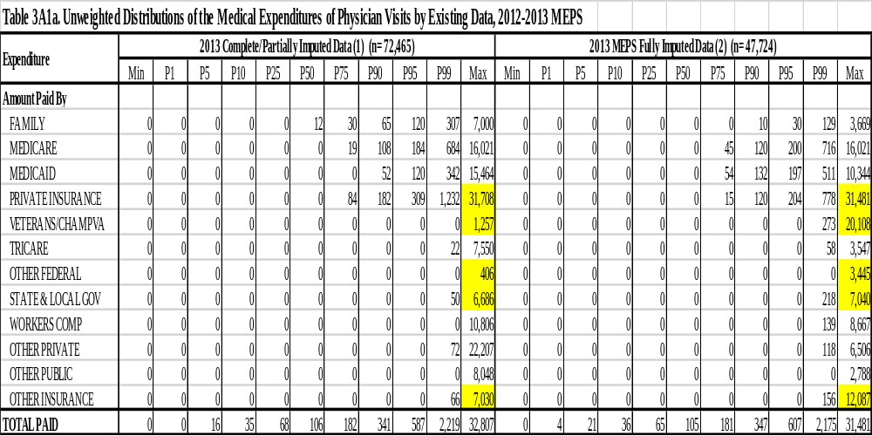
Unweighted Distributions of the Medical Expenditures of Physician Visits by Existing Data, 2012-2013 MEPS

Slide 15
Signal from Prior Year
Expenditure | 2012 Complete/Partially Imputed Data (n= 73,093) |  | 2012 MEPS Fully Imputed Data (n= 34,566) |  | 2011 Complete/Partially Imputed Data (n= 67,167) |  | 2011 MEPS Fully Imputed Data (n=33,985 )
 | Weighted |  | Weighted |  | Weighted |  | Weighted
 | Mean | SE Mean | Mean | SE Mean | Mean | SE Mean | Mean | SE Mean
Amount Paid By
FAMILY | 32.86 | 0.92 | 9.56 | 0.77 | 34.49 | 1.10 | 9.26 | 0.72

Slide 16
Means and SEs of Medical Expenditures for Physician Office Visits by Existing Data and Weighted Sequential Hot-Deck Imputed Data, 2nd Pass, 2011-2012 MEPS
with
2012 table 2 weighted means
2012 table 3 Weighted Mean

Slide 17
Predicting the most problematic fast track imputed cases
A model was also developed to predict the most divergent imputed cases that required further attention
Z(i) was specified as a weighted linear function of the differences between the actual and fast-track imputed values for the source of payment components from a prior year:
Z(i) = [W1xABS{(FAMILY$ DIF(i)} + W2xABS{(PRIVATE$ DIF(i)} + W3xABS{(VET$ DIF(i)} +…..………]

Slide 18
Predicting the most problematic fast track imputed cases
A prediction model for Z(i) was developed to distinguish the highest from the lowest values of Z(i) to be used for identifying imputed values most likely to be problematic
The model was specified as a function of the most salient factors associated with expenditures for physician office visits,
also including # of Dr. office visits, # of hospital discharges and veteran status.

Slide 19
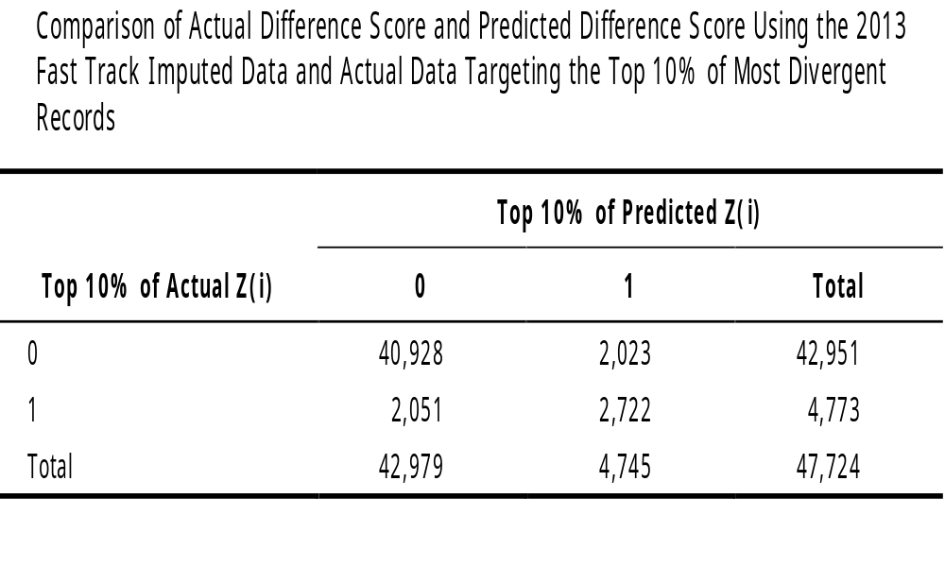
Predicting the most problematic fast track imputed cases

Slide 20
Means and SEs of Medical Expenditures for Physician Office Visits
by Existing Data and Weighted Sequential Hot-Deck Imputed Data, 2011-2012 MEPS
with
2012 table 3 weighted means
2012 Weighted Mean
2012 Weighted Mean Standard Error
2012 table 1 Weighted Mean
2012 table 2 Weighted Mean
2012 table 3 Weighted Mean

Slide 21
Expenditure distribution for office based medical provider visits – Final estimates 2012
(Ordered by magnitude of visit expense)
Office Visit Distribution in the US
$ Distribution

Slide 22
Expenditure distribution for office based medical provider visits – Fast track imputed estimates 2012
(Ordered by magnitude of visit expense)
Office Visit Distribution in the US
$ Distribution

Slide 23
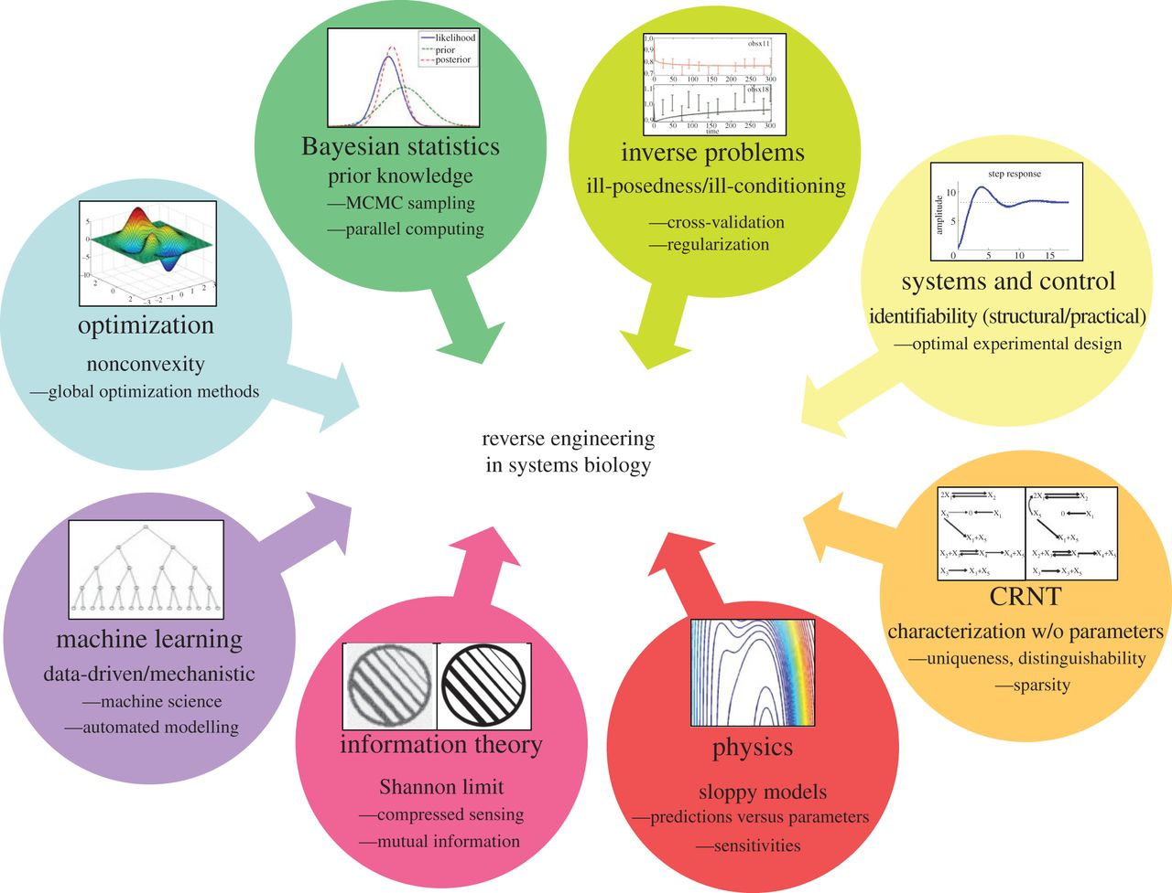
Reverse Engineering the Imputation Process
The Reverse Engineering toolbox: many tools can be applied to find the best model to explain a certain set of observed data.
Reverse Engineering of Complex Systems
Alejandro F. Villaverde, and Julio R. Banga J. R. Soc. Interface 2014;11:20130505

Slide 24
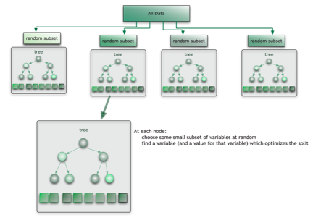
Hybrid Approach
To match the mixed imputation approach applied to the MEPS survey data we implemented a tri-mode approach
A randomized hot-deck was performed for highly similar rows using the variables associated with visit expenditure and insurance coverage.
A Multi-Output Random Forest Model was trained on the past 5 years of data. Payment breakouts were predicted using this trained model.
Rules for specific classes were automatically learned by by analyzing decision boundaries with full class coverage in the Random Forest. Rules automatically selected with an iterative test procedure.
The results of both approaches were directly combined into the final imputed dataset.

Slide 25
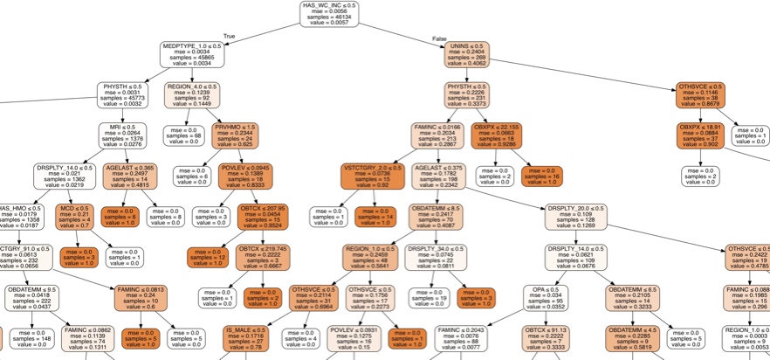
MEPS Random Forest Results

Slide 26
2014 Fast-track ML Imputation Results
: Person
-
Level Comparison of Percentage of the Total Expenditures and Mean
Ex
penditures among the Population Between Actual Office
-
Based Physician Visit Event Data
And AI/ML
Imputed Data (n=21,399), 2014 MEPS
Actual Data
AI Imputed Data
Percentile
Percent
SE Percent
Mean
SE Mean
Percent
SE Percent
Mean
SE Mean
Top 1%
21.66
1.42
27,906
1,234
21.68
1.46
27,621
1,209
Top 5%
43.92
1.27
11,327
383
43.69
1.25
11,213
390
Top 10%
57.46
1.07
7,413
213
57.19
1.06
7,339
212
Top 20%
72.95
0.74
4,704
115
72.77
0.75
4,670
113
Top 25%
78.14
0.62
4,032
96
77.99
0.62
4,004
94
Top 30%
82.26
0.50
3,538
83
82.12
0.51
3,514
80
Top 40%
88.33
0.37
2,849
63
88.23
0.38
2,831
62
Top 50%
92.51
0.24
2,387
54
92.42
0.24
2,373
53

Slide 27
2014 Fast-track ML Imputation Results
Logistic Regression Comparison for Individuals Likely to Be on the Top 5% of the Total Health Care Expenditure Distribution Using the MEPS Data Restricted to Office-Based Physician Provider Visits and AI/ML Imputed Data (n=21,399), 2014 MEPS
Measures | MEPS Actual Data (R²=0.1201) |  |  | ML Imputed Data (R²=0.1220)
 | Beta Coefficient | SE of Beta | Wald F P-Value | Beta Coefficient | SE of Beta | Wald F P-Value
Age | -0.0013 | 0.0045 | 0.7719 | -0.0008 | 0.0045 | 0.8494
Sex
Male | 0.0000 | 0.0000 | 0.0126 | 0.0000 | 0.0000 | 0.0619
Female | -0.2777 | 0.1103 |  | -0.2050 | 0.1092
Race/Ethnicity
Hispanic | 0.0000 | 0.0000 | 0.7521 | 0.0000 | 0.0000 | 0.6647
Non-Hispanic White | -0.0424 | 0.1424 |  | -0.0640 | 0.1494
Non-Hispanic Black | 0.1070 | 0.1685 |  | 0.1145 | 0.1761
Non-Hispanic Other | 0.0335 | 0.2231 |  | -0.0172 | 0.2211
Marital Status
Married | 0.7912 | 0.2640 | 0.0045 | 0.7559 | 0.2610 | 0.0050
Widowed | 1.2668 | 0.3508 |  | 1.2543 | 0.3473
Divorced/Separated | 1.1008 | 0.3132 |  | 1.0481 | 0.3082
Never Married | 0.8880 | 0.2720 |  | 0.8876 | 0.2753
Under 16 | 0.0000 | 0.0000 |  | 0.0000 | 0.0000
Family Size
One | 0.0000 | 0.0000 | 0.1440 | 0.0000 | 0.0000 | 0.2149
Two or more | 0.2414 | 0.1646 |  | 0.2077 | 0.1669
Region
Northeast | 0.0000 | 0.0000 | <0.0001 | 0.0000 | 0.0000 | <0.0001
Midwest | 0.5280 | 0.1568 |  | 0.4887 | 0.1580
South | -0.3967 | 0.1312 |  | -0.4679 | 0.1289
West | 0.0020 | 0.1466 |  | -0.0057 | 0.1361
Family Income Classification
Poor | 0.0000 | 0.0000 | 0.3635 | 0.0000 | 0.0000 | 0.1655
Near Poor | 0.1864 | 0.3322 |  | 0.1106 | 0.3381
Low Income | -0.0195 | 0.2046 |  | -0.1103 | 0.1957
Middle Income | 0.1956 | 0.1936 |  | 0.1852 | 0.1816
High Income | 0.3088 | 0.2076 |  | 0.3258 | 0.2049

Slide 28
2014 Fast-track ML Imputation Results (continued)
Logistic Regression Comparison for Individuals Likely to Be on the Top 5% of the Total Health Care Expenditure Distribution Using the MEPS Data Restricted to Office-Based Physician Provider Visits and AI/ML Imputed Data (n=21,399), 2014 MEPS
Measures | MEPS Actual (R²=0.1201) |  |  | ML Imputed Data (R²=0.1220)
 | Beta Coefficient | SE of Beta | Wald F P-Value | Beta Coefficient | SE of Beta | Wald F P-Value
Health Insurance Coverage
Any private | 0.3705 | 0.3416 | 0.5182 | 0.4464 | 0.3604 | 0.3963
Public only | 0.2610 | 0.3220 |  | 0.2975 | 0.3380
Uninsured | 0.0000 | 0.0000 |  | 0.0000 | 0.0000
Health Status
Excellent | 0.0000 | 0.0000 | 0.0085 | 0.0000 | 0.0000 | 0.0166
Very Good | 0.4055 | 0.1818 |  | 0.3352 | 0.1744
Good | 0.6591 | 0.1821 |  | 0.5906 | 0.1732
Fair | 0.5461 | 0.2336 |  | 0.5254 | 0.2293
Poor | 0.6753 | 0.3085 |  | 0.5391 | 0.3023
Limitation in Activity
Yes | 0.0763 | 0.1907 | 0.6896 | 0.1414 | 0.1965 | 0.4725
No | 0.0000 | 0.0000 |  | 0.0000 | 0.0000
Cancer
Yes | 0.5212 | 0.1610 | 0.0014 | 0.4998 | 0.1650 | 0.0028
No | 0.0000 | 0.0000 |  | 0.0000 | 0.0000
Heart Disease¹
Yes | -0.1347 | 0.1452 | 0.3546 | -0.2026 | 0.1586 | 0.2030
No | 0.0000 | 0.0000 |  | 0.0000 | 0.0000
High Blood Pressure
Yes | -0.2524 | 0.1312 | 0.0558 | -0.2704 | 0.1308 | 0.0400
No | 0.0000 | 0.0000 |  | 0.0000 | 0.0000
Inpatient Events | 0.0676 | 0.0725 | 0.3524 | 0.0631 | 0.0710 | 0.3753
Number of Prescribed Medicine Purchases | 0.0029 | 0.0022 | 0.1769 | 0.0037 | 0.0021 | 0.0714
Number of Ambulatory Visits | 0.1770 | 0.0075 | <0.0001 | 0.1795 | 0.0077 | <0.0001
MEPS = Medical Expenditure Panel Survey; n= Sample size; SE = standard error.

Slide 29
Fast Track Imputation Advances
Reduction in time realized for imputation processing:
Several months reduced to 2-3 weeks
potential for further reductions
Alignment with MEPS office-based physician visit medical expenditure estimates for:
overall office-based medical expenditures
largest sources of payments
estimated medical expenditure distributions and their concentration
statistically significant measures in analytic models predicting medical expenditures

Slide 30

Innovations in Estimation and Imputation
Success Metrics
Reduced time to produce preliminary and final client deliverables
Reduction in cost of
estimation and imputation
Longer term-cost reductions as multiple deliveries are reduced
Higher quality as measured by reductions in # of necessary data re-deliverables to clients.
Future Efforts
Predictive analytics to forecast future states

Slide 31
Machine learning innovations in estimation and analytics for large national health surveys
Thank you!
Steven B. Cohen, Ph.D.
scohen@rti.org

