Slide 1

Causal Inference Under Interference in Dynamic Therapy Group Studies
Bing Han¹, Susan Paddock², Lane Burgette¹
Dec 19, 2019
RAND Corporation
NORC at the University of Chicago
  Research was supported by the National Institute on Alcohol Abuse and Alcoholism of the National Institutes of Health (NIH) under Award Number R01AA019663 (PI: Paddock)

Slide 2
Motivating Question
Does attending more (versus fewer) sessions in a group therapy intervention improve patient outcomes?
Data collected from N=132 residential addiction treatment patients in group cognitive behavioral therapy (GCBT) to reduce depression symptoms
Unlike prior studies that established associations between level of session attendance and patient outcomes, we:
  Examine how the Rubin Causal Model can be applied to these data
  Explicitly define a causal treatment effect
  Reflect broader interest in individual and peer aspects of group therapy

Slide 3
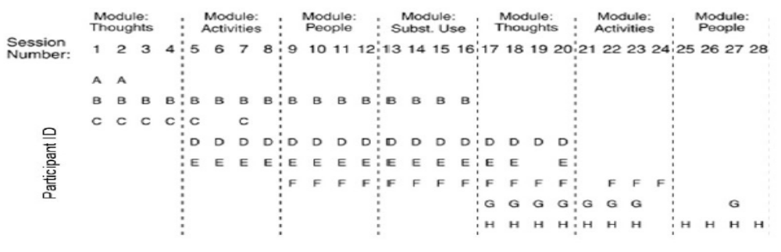
Open Enrollment: One Patient May Affect Others
Dynamic group: Membership changes over the course of the group
  e.g., Paddock et al., 2011; Bauer et al., 2013; Cafri et al., 2015
Attendance record, first 28 sessions
Group dynamic is important to consider; e.g., group cohesion is associated with retention and outcomes (Burlingame et al., 2011)

Slide 4
Rubin Causal Model: Introduction
z_{i}: Treatment status for patient i (z=0,1), (high versus low attendance)
Y_{i}(z_{i}): Potential outcome, or counterfactual, for patient i under treatment status z_{i}
Y_{i}(1) – Y_{i}(0): Effect of z_{i}=1 vs. z_{i}=0
Average causal effect can be identified as E[Y(1)] – E[Y(0)] under standard assumptions
Stable unit treatment value assumption (SUTVA): no interference among subjects
Under no interference, potential outcomes for person i, Y_{i}(1) and Y_{i}(0), are unaffected by the treatment statuses of others, z_{-i}

Slide 5
Challenges in defining a causal effect in GCBT
No interference is implausible for GCBT studies.
There are multiple versions of treatment -- and thus of potential outcomes -- under interference
What is a meaningful comparison of potential outcomes?
The structure of the CBT group – the attendance record, M
  is usually not fixed but random
  determines the treatment statuses, regardless of how they are defined

Slide 6
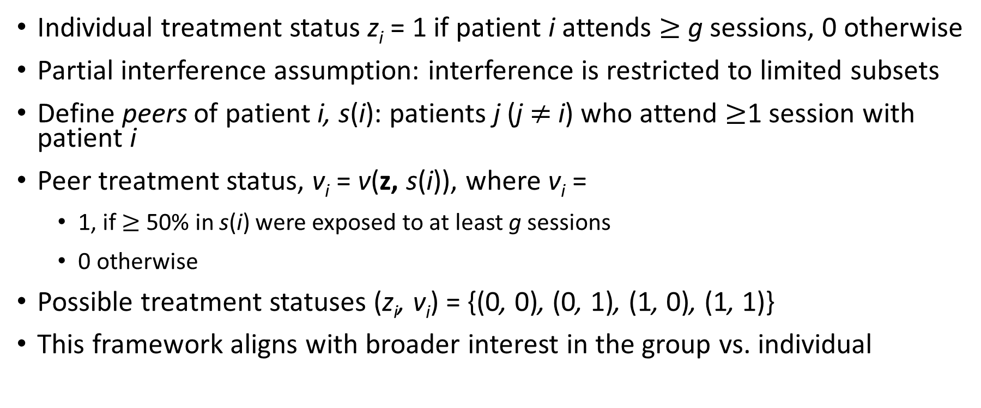
Reduce the Number of Potential Outcomes
Individual treatment status z_{i} = 1 if patient i attends $≥$ g sessions, 0 otherwise
Partial interference assumption: interference is restricted to limited subsets
Define peers of patient i, s(i): patients j (j $≠$ i) who attend $≥$1 session with patient i
Peer treatment status, v_{i} = v(z, s(i)), where v_{i} =
  1, if $≥$50% in s(i) were exposed to at least g sessions
  0 otherwise
Possible treatment statuses (z_{i}, v_{i}) = {(0, 0), (0, 1), (1, 0), (1, 1)}
This framework aligns with broader interest in the group vs. individual

Slide 7
Reduce the Number of Potential Outcomes
Examples where a v() function has been applied
In these prior studies, z is not fully determined by the structure governing interference. Structure can be regarded as fixed.
z, treatment status | Structure governing interference | Citation
Kindergarten retention | Schools | Hong & Raudenbush 2006
Community policing | Communities | Verbitsky-Savitz & Raudenbush 2012
Social/emotional curriculum | Schools | VanderWeele et al. 2013

Slide 8
Key Assumption*
For a hypothetical attendance record L and individual i,
Y_{i}(L) = Y_{i}(z_{i},v_{i}) + e_{i}(L)
Y_{i}(z, v), i = 1,…,N, under the same (z, v) are i.i.d.
E[e_{i}(L)] = 0 and e_{i}(L) independent of Y_{i}(z_{i}, v_{i})
Thus, E[Y_{i}(L)] = E[Y_{i}(z_{i}, v_{i})]
Use expectations of essential potential outcomes to obtain causal contrasts
Essential potential outcome, common to all with same (z,v)
Error term specific
to an attendance record
*Similar to a suggestion by Li et al. (2018), who focus primarily on fixed (vs. random) treatment statuses

Slide 9
Define Treatment Effects of Interest using Expectations of Essential Potential Outcomes
For z and v binary
Individual effects:
  E[Y(1,1)] - E[Y(0,1)]
  E[Y(1,0)] - E[Y(0,0)]
Peer effects:
  E[Y(1,1)] - E[Y(1,0)]
  E[Y(0,1)] - E[Y(0,0)]
Total effect:
  E[Y(1,1)] - E[Y(0,0)]
  Sum of a peer and an individual effect

Slide 10
Assumptions to Identify Causal Effects
Covariate score balancing
  { Y_{i}(z_{i},v_{i}), for all z_{i}, v_{i} } ⊥ M | (X_{i}, W_{i})
    where (X_{i}, W_{i}) represents individual- and peer-level covariates
Prognostic score balancing
  (X_{i}, W_{i}) ⊥ Y_{i}(0,0) | φ_{i}, and { Y_{i}(z_{i},v_{i}), for all z_{i}, v_{i} } ⊥ (X_{i}, W_{i}) | φ_{i}
where φ_{i} is the prognostic score, usually φ_{i} = E[Y_{i}(0,0) | X_{i}, W_{i} ]

Slide 11
Data
Outcome: Beck depression inventory (BDI-II) 6 months post-baseline
Observed treatment status (Z,V):
Mean number of sessions attended
defines Z and V:
  1-13 sessions (Z=0, or V=0)
  14-16 sessions (Z=1, or V=1)
Covariates:
  Individual-level: age, gender, baseline BDI-II
  Peer-level: Peer summaries of individual-level covariates
  Sensitivity analyses examined other covariates (race/ethnicity, marital status, etc.)
(Z, V) | n
(1,1) | 43
(1,0) | 19
(0,1) | 24
(0,0) | 46
total | 132

Slide 12
Analysis Modeling Approach
Estimating the prognostic score:
  Multiple membership random module effects (Hill & Goldstein 1988; Paddock & Savitsky, 2013)
Adjust for observed confounders via prognostic strata
  Hansen, 2008
  We also examined standard covariate adjustment, which yielded comparable results

Slide 13
Results
The average total effect of relatively high vs. low attendance is -9.5 points (se=2.9)
When peer attendance is low, the average treatment effect of high versus low individual attendance is -6.7 points (se=3.2)
However, when peer attendance is high, the individual effect is not significant (-2.2, se=3.1)
Peer effects are not statistically significant for either high or low individual treatment status.
  Peer effect is numerically high when individual attendance is low (-5.9, se=3.2)

Slide 14
Summary
Key novelty introduced by the GCBT study: Random structure governing interference also is used to define treatment status
Connections to causal inference in networks
Therapy group studies typically have this type of sample size in the group therapy arm - caution
Still, findings are interesting and the first we are aware of to examine the peer and individual causal effects in a group therapy setting

