Slide 1

Understanding Patients’ Feedback through Natural Language Processing and Machine Learning
Presented by:
  Yuhao Liu, MPA & MS
  Research Associate
  Center for Health Workforce Studies
  School of Public Health | University at Albany, SUNY
  yliu32@albany.edu
January 7th, 2020
International Conference on Health Policy Statistics
San Diego, California

Slide 2

Center for Health Workforce Studies
The Center for Health Workforce Studies (CHWS) was established in 1996.
Mission: To provide timely, accurate information and conduct policy-relevant research about the supply, demand, distribution, and the use of health workers.

Slide 3
Background and Purpose of Study
Understanding patients’ concerns and expectations regarding hospitals is crucially important for providers and administrators to improve service quality.
In the internet era, information required for such attempts has become more accessible and affordable, as a huge and increasing amount of unsolicited feedback is provided on crowd-sourced review websites (Yelp, TripAdvisor, Google Maps, etc.).
The purpose of this study is to better understand patients’ concerns and expectations by analyzing feedback data collected on the internet.

Slide 4
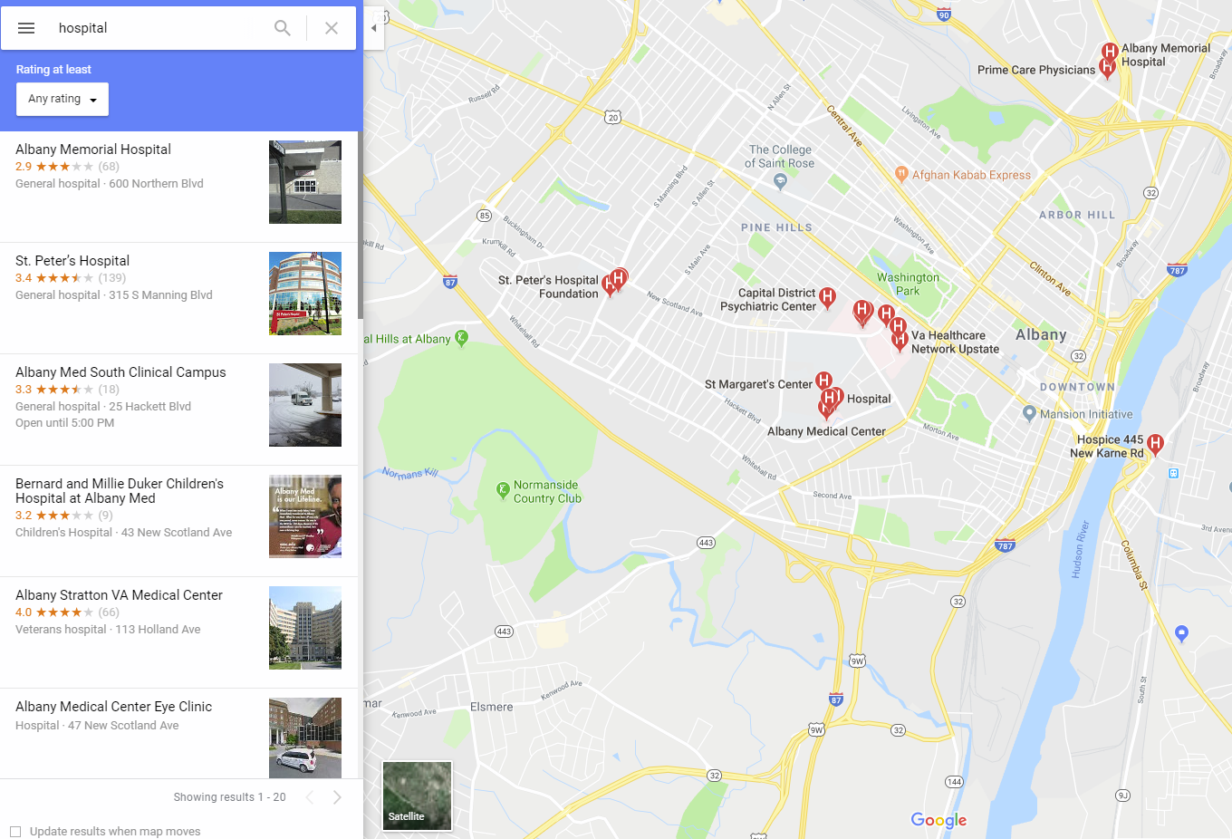
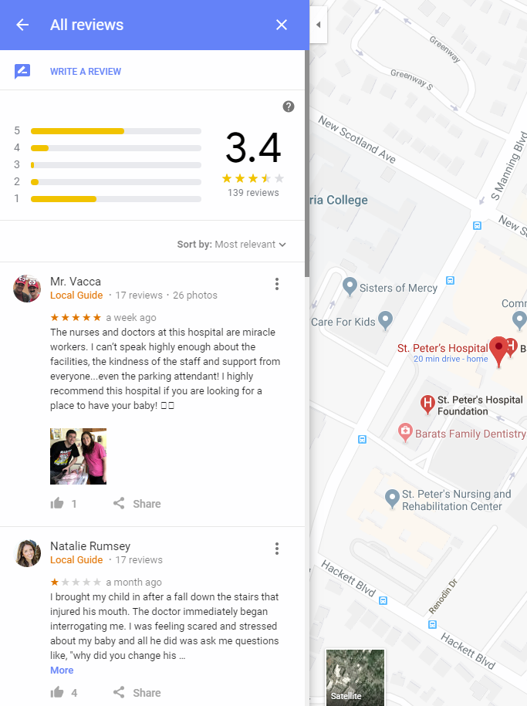
Data Source for Study

Slide 5
Data Source for Study
A list of all hospitals in U.S. was obtained from Data.gov
A web crawler was created to retrieve ratings and comments from Google Maps.
7,496 hospitals 6,735 can be found in Google Maps 5,888 of them have ratings and comments
Due to Google Maps API limitations, only the most recent 5 comments and ratings of each hospital were retrieved
They totally have 26,141 ratings and comments

Slide 6
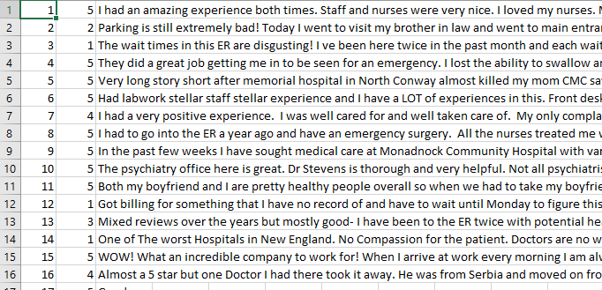
Data Set for Analysis

Slide 7
Methods
Classify as positive, neutral and negative
Identify most frequent two-gram terms
Text clustering analysis
Sentiment analysis

Slide 8
Classification of Ratings and Comments
Rating<=2 Negative rating and comment
Rating=3 Neutral rating and comment
Rating>=4 Positive rating and comment
N=26,141

Slide 9
Data Cleaning for Text Mining on Comments
Remove punctuation
Covert all letters to lower-case
Remove stop words (the, also, to, and)

Slide 10
Most Frequent Two-gram Terms
Positive comments Negative comments
highly recommend | 639
emergency room | 557
doctors (and) nurses | 499
great care | 478
excellent care | 451
nursing staff | 413
nurses doctors | 413
staff friendly | 392
good care | 381
recommend hospital | 373
hospital staff | 355
great experience | 341
best hospital | 322
make sure | 311
medical center | 306
staff great | 297
great staff | 290
taken care | 289
best care | 271
care received | 268
emergency room | 771
waiting room | 681
worst hospital | 470
sent home | 392
don(’t) know | 382
year old | 342
don(‘t) care | 300
family member | 300
went (to) er | 273
loved ones | 254
treated like | 254
blood pressure | 249
care (about/for) patients | 247
make sure | 245
feel like | 236
urgent care | 234
waited hours | 222
waste time | 216
worst experience | 208
customer service | 202

Slide 11
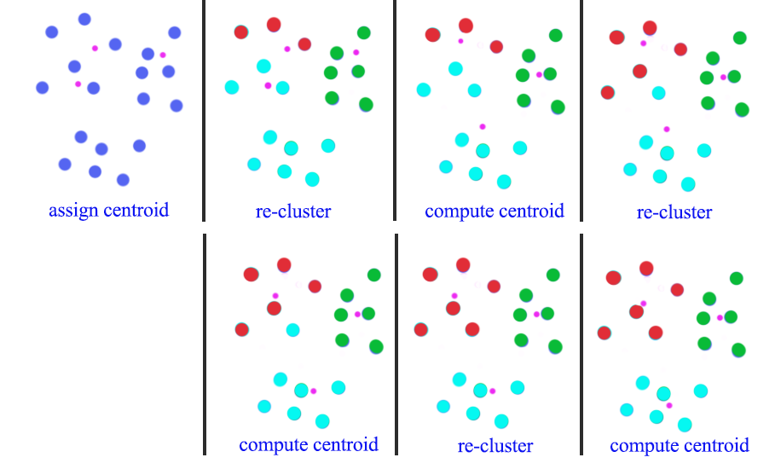
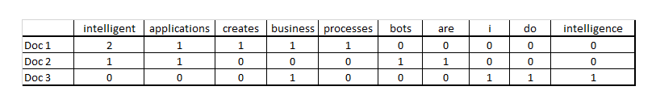
K-mean Clustering Analysis
Based on negative comments only
Remove words that exist in less than 10% of comments
Create term-document matrix as the dataset (from Darrin Bishop’s blog)
K-mean clustering algorithm (from Jonathan Hui’s blog)

Slide 12
Top Representative Words for Four Clusters
1st Cluster
insurance
billing
pay
department
bills
paid
collections
payment
received
company
2nd Cluster
wait
hour
seen
waited
minutes
appointment
long
30
finally
blood
3rd Cluster
family
mother
loved
mom
days
facility
member
surgery
ones
father
4th Cluster
bad
better
want
service
work
treated
terrible
really
unprofessional
daughter

Slide 13
Sentiment Analysis
Purpose: to fit a predictive model that classifies new comments into positive and negative groups in batch.
 |  | Accuracy Rate | Recall | Precision
Random Forrest | Trees=20 | 0.91 | 0.90 | 0.93
 | Trees=100 | 0.92 | 0.92 | 0.93
 | Trees=200 | 0.92 | 0.93 | 0.93
SVM |  | 0.95 | 0.94 | 0.96
Logistic Regression |  | 0.94 | 0.94 | 0.95
Accuracy rate, recall and precision are average values based on 10-fold cross validation.
Support vector machine has the best performance among all models here, and it identifies 95% cases correctly.

Slide 14
Key Findings and Implications: Hospital Administrators
Hospital administrators may wish to improve billing and payment processes, reduce waiting time, make facilities more accessible for aged patients and improve service quality.
Hospitals administrators may wish to make patients feel they are receiving excellent and friendly care from hospital staff.

Slide 15
Key Findings and Implications: Methods
Patient feedback on crowd-sourced review websites is readily available for analysis and can be informative.
Natural language processing algorithm and machine learning models can dramatically improve the efficiency of classifying patients’ feedback, as well as identifying their underlying meaning.

Slide 16



Questions?
For more information, please email me at: yliu32@albany.edu
Visit us at:
@CHWS_NY
@Centerforhealthworkforcestudies
www.linkedin.com/company/center-for-health-workforce-studies

