Slide 1
The Future Meets the Past:
Applying retrospective study design to improve prospective comparative effectiveness studies

Slide 2
Outline
Introduction to GeriPACT Study
  Population of Interest
  Research Question
  Challenges
  Construction of Comparable Control Cohort
  Results

Slide 3


Exemplar Comparative Effectiveness Study - GeriPACT
Patient-Aligned Care Teams (PACT) is a team-based model of care in which a team of health professionals, led by a provider, works collaboratively with the patient to provide for all of the patient's healthcare needs. – Usual Care
GeriPACT is a “Special Population PACT” that is tailored to provide comprehensive primary care for complex geriatric and high-risk Veterans
  Providers have geriatric expertise
  Interdisciplinary team includes pharmacist and social worker
  Smaller panel sizes (e.g. 2/3 size of usual PACT)
Notes:
GeripACT strives to optimize independence, quality of life and quality of care for Veterans who are particularly vulnerable due to multiple interacting cognitive, functional, psychosocial and medical challenges in the setting of advance age.

Slide 4
Exemplar Comparative Effectiveness Study - GeriPACT
Research Question: For high risk elderly Veterans, does transitioning to a patient care team specializing in geriatric care (GeriPACT) improve quality of care and patient experience compared to Veterans remaining in standard primary care (PACT)?
Challenge 1: GeriPACT is implemented nationally and randomization is infeasible.
Challenge 2: Desire to evaluate, on a national scale, outcomes not collected in the electronic medical record
Challenge 3: Patients who transition to GeriPACT may differ from those who remain in standard PACTs in ways that influence outcomes.
Notes:
3. unaccounted confounding

Slide 5
Exemplar Comparative Effectiveness Study
Our solution: Prospectively enroll newly transitioned GeriPACT patients and comparable PACT patients nationally identified by retrospective techniques to collect outcomes of interest.
Remainder of talk: Our implementation strategy and results.

Slide 6



Pre-Exposure
12-24 Mon
Prior BL
Exposure
0-12 Mon Prior BL
Patient Reported Outcomes
>=2 PACT visits –
No GeriPACT visits
Baseline
All Patients >=2 PACT visits – No GeriPACT visits
6 Mon
>=2 GeriPACT visits –
No PACT visits
12 Mon
18 Mon
Quarterly data pulls

Slide 7
Identifying the Cohort
57 VA medical centers with fully implemented GeriPACT programs in fiscal year 2016
Challenge – Comparable Control Group
  Identify PACT patients at the same 57 VA medical centers with similar characteristics as the GeriPACT patients that are willing to participate
  in longitudinal surveys
Notes:
Site’s GeriPACT visit count ≥ 500
At least one team at site had ≤ 800 unique patients per team at time of data pull
At least one team at site had social worker and pharmacist included

Slide 8

Creating a Pool for Control Matches
Retrospective strategy
Two stage matching PRIOR to Recruitment and Baseline Interview
Administrative data
  Exact matching
  Distance matching

Slide 9
Exact Matching
  Medical Center
  Sex
  Age within 5 years
  Race
  Presence of Advance Directive (yes/no)
  Dementia Diagnosis in Pre Exposure period (yes/no)
  Hospitalization in Prior Year (yes/no)
Drop any GeriPACT patients with less than 5 matches since expected recruitment rate was 1 in 5
Slight loss of generalizability outweighed by the internal validity accomplished
Notes:
Tuskeegee Alabama vs. Bay Pines Florida
Not all veterans are enrolled in VHA (~40%) and only about ~25% use in a given year
Internal Validity related to unaccounted confounding
Not matches – slightly older, Percentage wise more females, more nonwhites, more adv directive, more dementia,more at least one hosp in prev year (JFI similar) CAN score higher)

Slide 10
Exact Matching
Median Number of matches:
124 PACT patients per GeriPACT patient
Range 5 to 3,848

Slide 11

Distance Matching
  Age
  Count of hospitalizations
  CAN scores (prediction of hospitalization)
  JEN Frailty scores (predicts institutional care and home base care)
Using a Mahalanobis distance score, potential PACT patients were ranked and then grouped into priority groups according to strength of match
Max of 25, Min of 5 matches for each GeriPACT patient uploaded to tracking database

Slide 12
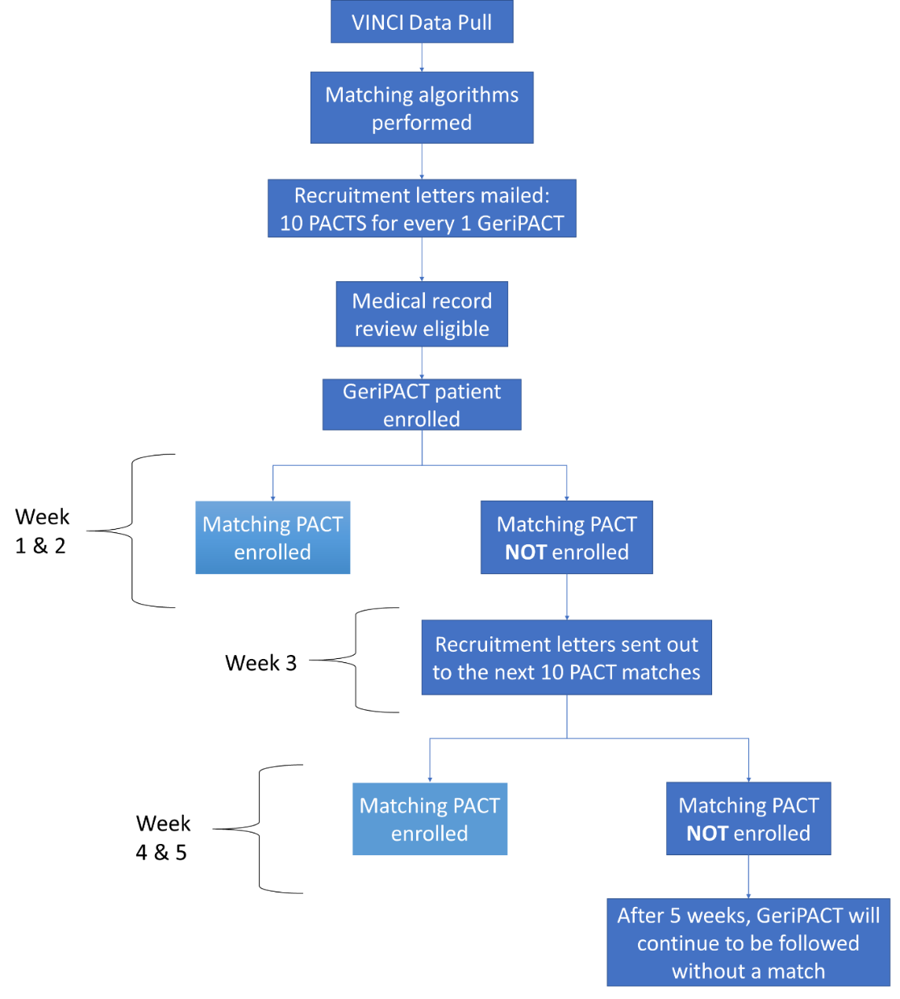

Slide 13
Results
First 218 GeriPACT patients – Study enrolled a suitable match for 207
Magnitude of Standardized Mean Difference
  Exact match variables 0
  Distance match variables 0.02 to 0.19
Notes:
In terms of Standardized Mean Difference <.1 is considered Excellent Balance and <.2 is considered suitable

Slide 14
Baseline measures collected via survey
 | GeriPACT N=207 | PACT N=207 | Standardized Mean Difference
TICS-M (cognition), mean (SD) | 30.7 (4.8) | 30.6 (5.5) | 0.16
Number of ADLs with help needed, mean (SD) | 1.3 (1.7) | 1.1 (1.5) | -0.19
Number of IADLs with help needed, mean (SD) | 1.5 (2.2) | 1.7 (2.0) | -0.22
Social Support, mean (SD) | 49.5 (9.8) | 50.94 (10.2) | 0.14
Good or OK Financial Security, N (%) | 142 (68.6%) | 162 (78.3%) | 0.21
Inadequate Health literacy, N(%) | 54 (26.1%) | 57(27.5%) | -0.002
Number of individuals in household, mean (SD) | 1.9 (0.9) | 2.0(0.9) | 0.10
Excellent baseline covariate balance on prospectively collected items not matched on – Evidence that matching on observed variables was successful!!!
Notes:
not used in matching

Slide 15
Limitations
Without randomization, unobserved confounding could still remain
Only data in the medical record can be used for matching

Slide 16
Conclusion
Pairing of retrospective study design with prospectively collected data allows for
Minimizing potential bias
Robust evaluation by including the patient perspective with patient reported measures
Which will allow for a richer understanding of programs and policy effectiveness

Slide 17
Conclusion
Coupling analytic strategies with careful design can strengthen the robustness of conclusions drawn from such a study
We encourage future studies to consider this approach

Slide 18
Paper currently under review with Health Services Research
Contact Info:
Valerie.Smith9@va.gov
Jennifer.Lindquist@va.gov

Slide 19
Additional slides follow

Slide 20
Difficulties in Comparative Effectiveness Studies
Cannot randomize patients
Retrospective approach
  Limited to available data /Areas of interest not available in administrative data –
  Lack of Patient Reported Outcomes
Prospective approach
  Observational data
  Causal inference
  Unintentional confounding – Potential problem with Internal validity
Notes:
Randomization not practical, or not ethical

Slide 21
Introduction to GeriPACT
GeriPACT is a “Special Population PACT” that is tailored to provide comprehensive primary care for complex geriatric and high-risk Veterans
The structure of GeriPACT differs from traditional PACT in 3 ways:
  Providers have geriatric expertise
  Emphasis on interdisciplinary team care (e.g. pharmacist and social worker)
  Smaller panel sizes (e.g. 2/3 size of usual PACT)
Notes:
No animations

Slide 22
Site Selections and Results (draft)
Define GeriPACT sites based on the following criteria using CDW RPCMM table and expert review from study clinicians and GE&C partners:
        Number of VAMCs
  Total VA sites (VAMCs, CBOCs)
  Clinic Stop Code = 350 appeared at site
  Site’s GeriPACT visit count ≥ 500
  At least one team at site had ≤ 800 unique patients per team at time of data pull
  At least one team at site had social worker
  and pharmacist included 57 eligible sites
Notes:
**57 needs to be updated

Slide 23
Considerations Or Lessons Learned
Exact matching – tradeoff internal validity and generalizability
Minimum number of matches
Length of time allowed to recruit a match

Slide 24
Exemplar Comparative Effectiveness Study
Blend of a retrospective case / control matching and prospective longitudinal surveys (baseline, 6, 12, and 18 month) to examine
Quality of Care
Patient Experience
PACT - Patient Aligned Care Teams (usual primary care)
GeriPACT – Primary care with specialty expertise in complex geriatric and high- risk Veterans
Notes:
GeripACT strives to optimize independence, quality of life and quality of care for Veterans who are particularly vulnerable due to multiple interacting cognitive, functional, psychosocial and medical challenges in the setting of advance age.
Provides geriatric expertise, multi discipline team including a pharmacist and social worker and smaller patient panel

Slide 25
Outcome Measures
Quality of Care
  Potentially Inappropriate Medications
  Presence of Advance Directive
  Frail Elderly Performance Measures
Patient Experience
  Patient Days at Home
  Patients Care Integration
  Self reported Health and Wellbeing

