Slide 1
Handling silently missing data in Medicare Advantage encounter data
Laura Hatfield, PhD
Associate Professor
Department of Health Care Policy
Harvard Medical School
ICHPS - San Diego, CA
January 7, 2020

Slide 2
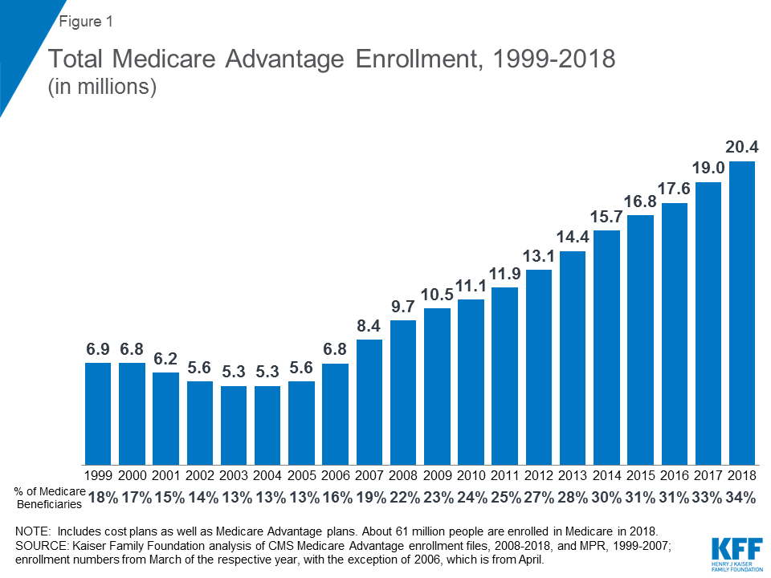

Slide 3
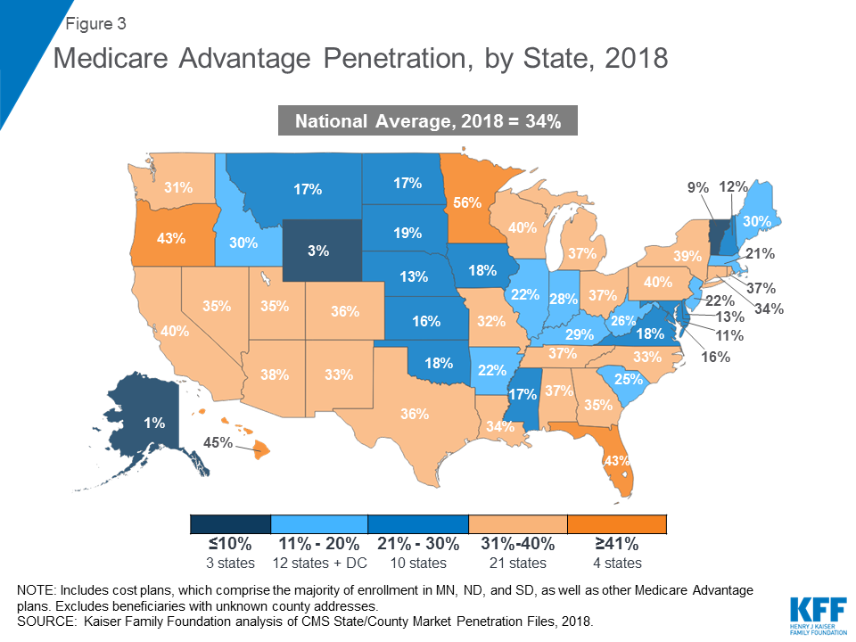

Slide 4




MA plans care about diagnosis codes
Risk-adjusted payments & bonuses
Health information
Fee-for-service payments
Diagnosis codes
Procedure codes
Quality data
Diagnosis codes
Procedure codes
Premiums

Slide 5
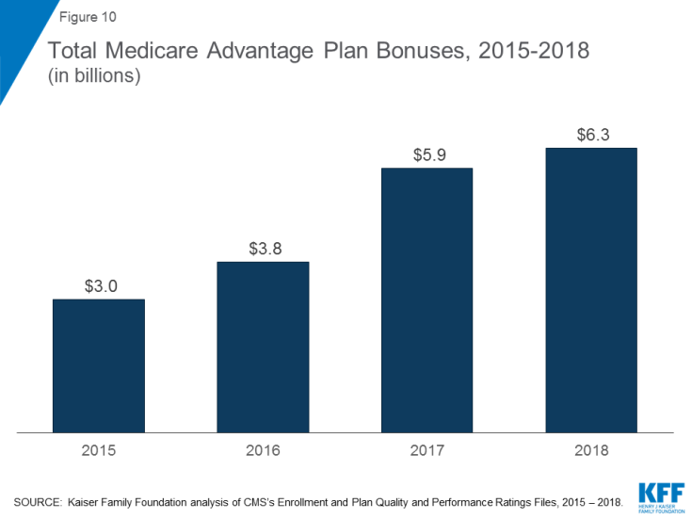

Slide 6
Technological limitations
Risk-adjusted payment incentive
Provider capacity
Plan capacity

Slide 7
Risk-adjustment is changing
(Transition period)
Risk Adjustment Payment System (RAPS)
Encounter Data System (EDS) submissions
Researcher access to EDS data
100% EDS risk adjustment
2012
2013
2014
2015
2016
2017
2018
2019
2020

Slide 8
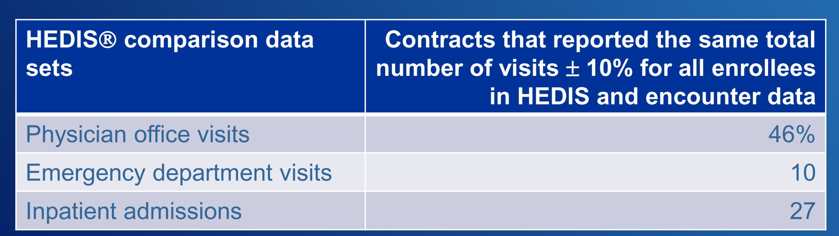
Encounter data quality may be poor
Source: MedPac analysis, 2018

Slide 9
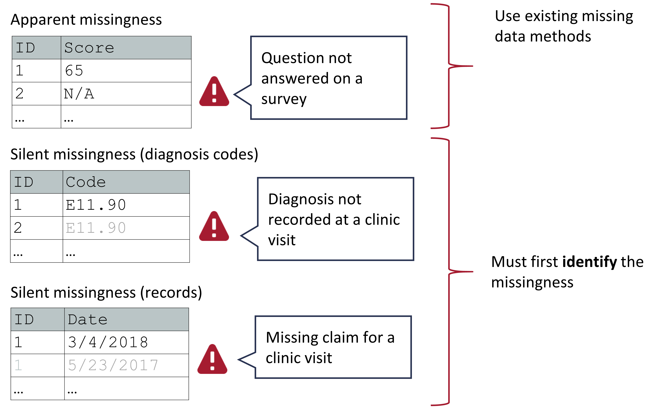

Slide 14



$$\operatorname{Pr}\left(Y=y\right)=\int{\int{\operatorname{Pr}\left(Y=y | X=x, R=r\right)\operatorname{Pr}\left(R=r \right|X=x)\operatorname{Pr}\left(X=x\right)dx dr}}$$
Distribution of the outcome, given other variables and the (random) missingness indicator
Distribution of the missingness indicator, given the other variables
Distribution of the other variables
$$Y$$
Outcome variable of interest, which is sometimes missing
$$R$$
Observation indicator variable, R=1 if outcome variable is observed, R=0 otherwise
$$X$$
Other variables related to missingness indicator or outcome variable

Slide 15
Filling in the missingness indicators
 |  | True Disease
 |  | Present | Absent
Diagnosis code | Present | True positive (R=1) | False positive (R=1) (upcoding?)
 | Absent | False negative (R=0) | True negative (R=?)

Slide 16
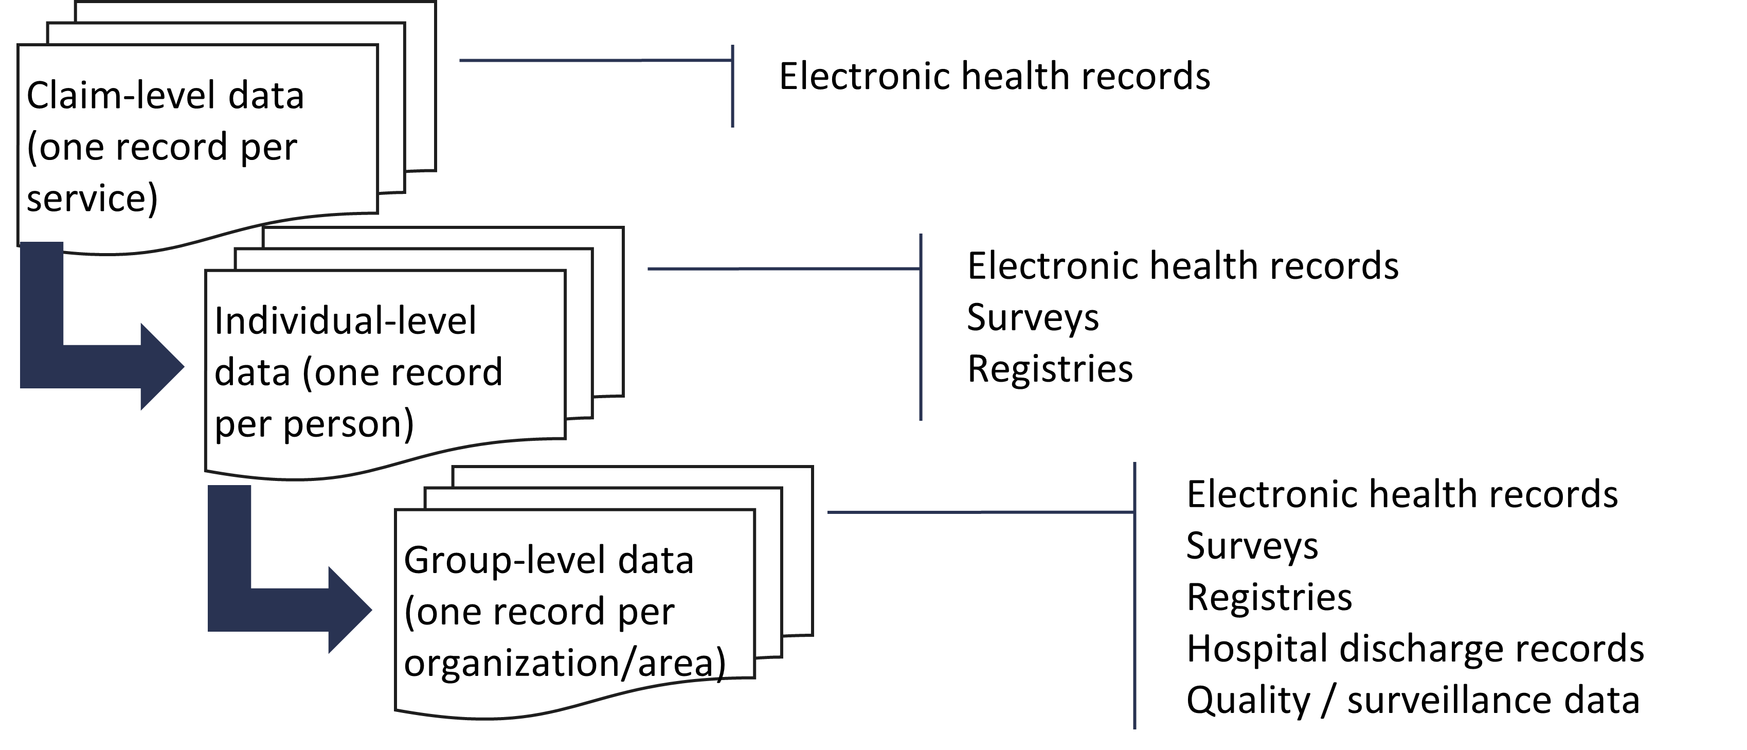
Auxiliary data sources

Slide 17



Thank you!
@laura_tastic @HPDSLab
www.HealthPolicyDataScience.org
hatfield@hcp.med.harvard.edu

