Slide 1
Borrowing Strength across Outcomes to Strengthen Impact Estimates:
A Hierarchical Bayesian Approach
Presentation at the International Conference on Health Policy Statistics
Charleston, SC
January 12, 2018
Lauren Vollmer • Mariel Finucane • Randy Brown
The contents of this presentation are solely the responsibility of the authors and do not necessarily represent the official views of the U.S. Department of Health and Human Services or any of its agencies.

Slide 2
Game Plan
Problem: Impact estimates are often based on samples that are too small to produce reliable estimates
Solution: Hierarchical Bayesian models borrow strength across related impact estimates
Today:
  The Comprehensive Primary Care Initiative
  Borrowing strength across:
    Regions
    Outcomes

Slide 3
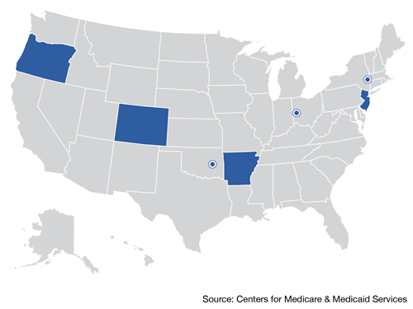
Case Study:
Comprehensive Primary Care (CPC) Initiative
CPC seeks to improve delivery of primary care by enhancing:
  Access and continuity of care
  Planned chronic and preventive care
  Risk-stratified care management
  Patient and caregiver engagement
  Coordination of care across the medical neighborhood
CPC provides:
  Money to support the changes (~$20/patient/month)
  Data feedback on practices’ and regions’ performance relative to peers
  A learning environment so that practices can learn from experts and each other
CMS/MPR is evaluating the effects of CPC on Medicare expenditures, quality of care, and patient outcomes:
  From ~500 CPC practices
  In 7 regions (states/metro areas) of the U.S.
  Serving 2.5 million patients (~500,000 Medicare)
  Compared to patients in propensity-score matched comparison practices, using traditional difference-in-differences
Notes:
We’ll showcase the advantages of this approach using a case study from Mathematica’s evaluation of CPC.

Slide 4
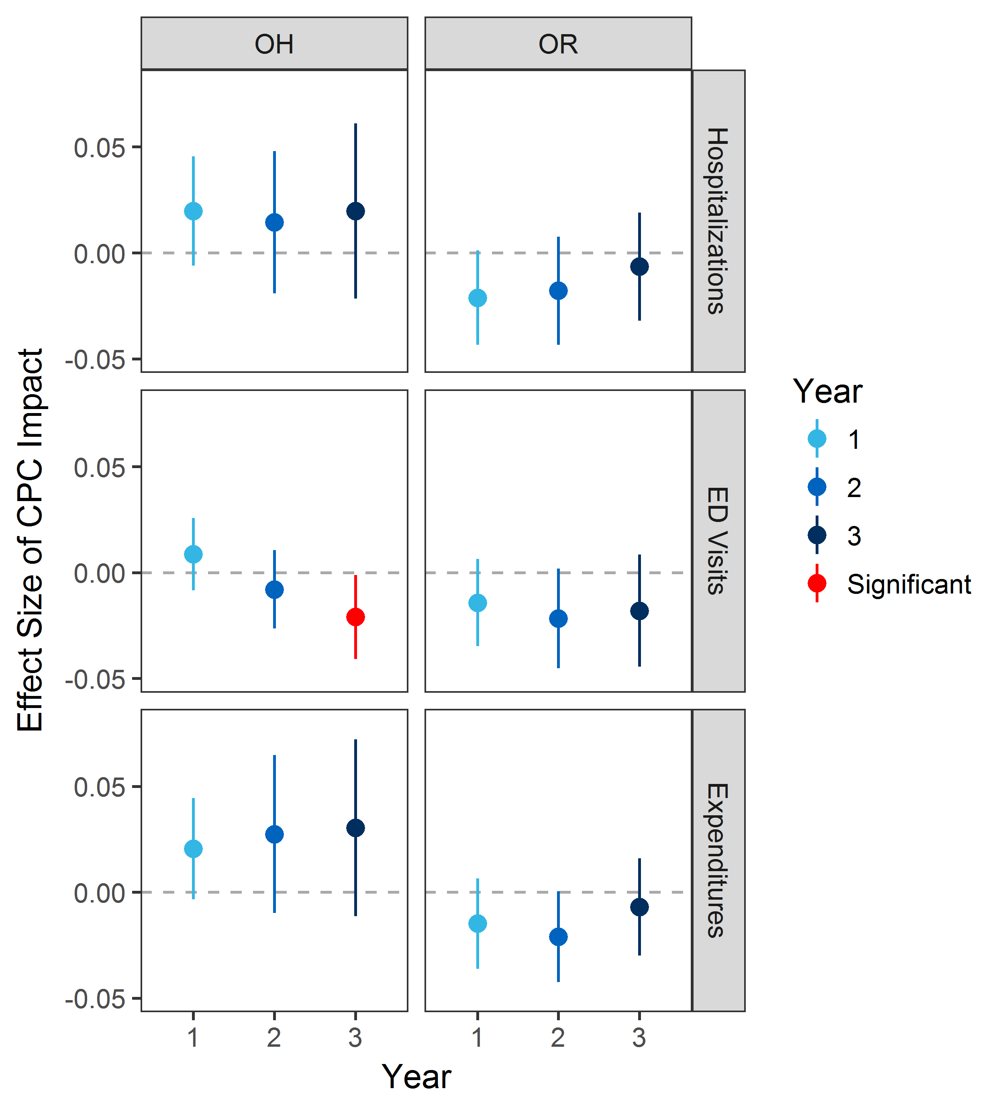
Borrowing Strength Across Outcomes
Frequentist Bayesian

Slide 5
Borrowing Strength Across Outcomes
Frequentist Bayesian

Slide 6
Borrowing Strength Across Outcomes
Frequentist Bayesian

Slide 7
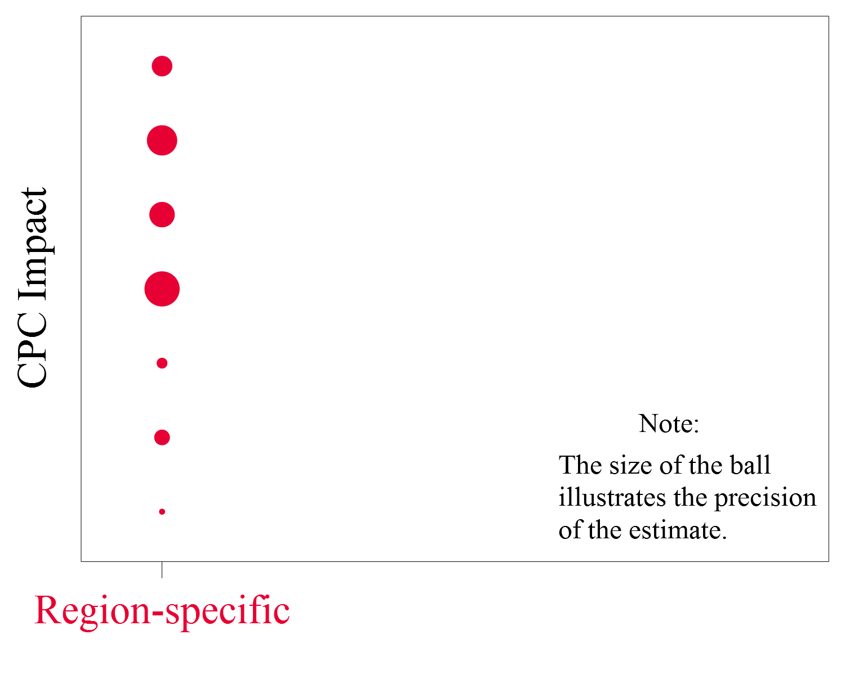
Borrowing Strength Across Regions

Slide 8
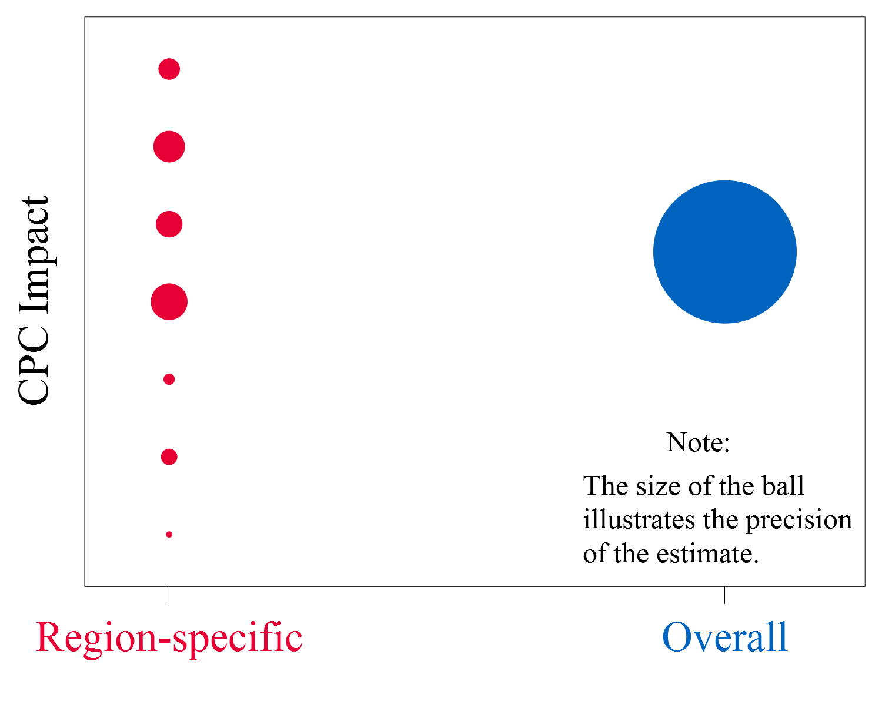
Borrowing Strength Across Regions

Slide 9
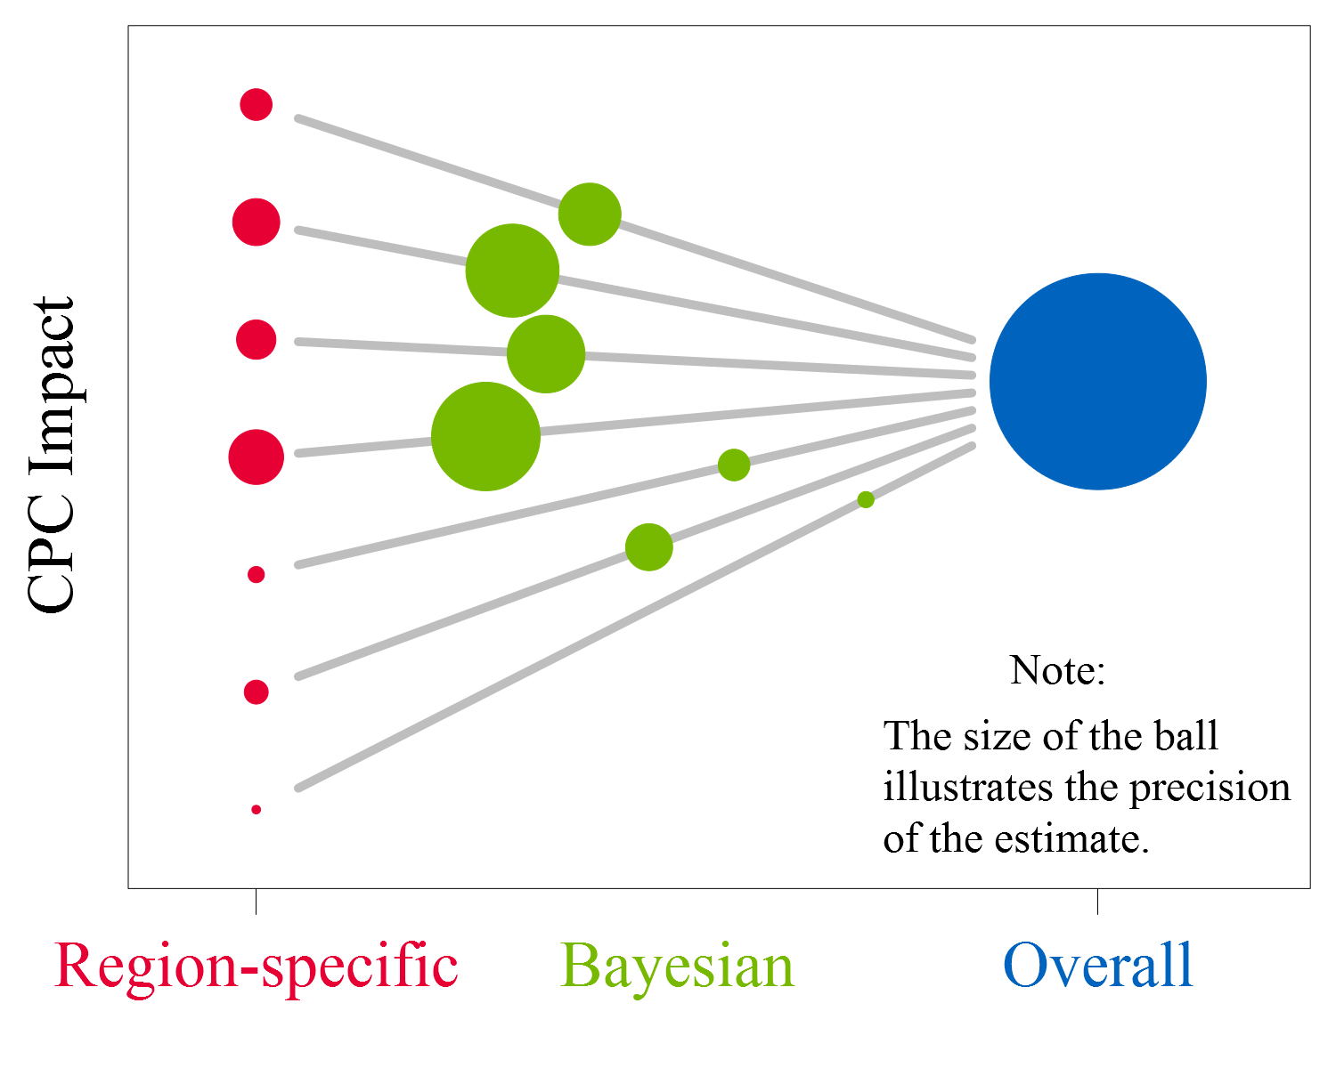
Borrowing Strength Across Regions

Slide 10
Borrowing Strength Across Outcomes
Outcome | Domain
Medicare expenditures | Medicare expenditures
Hospitalizations
Outpatient ED visits
Compliance with four diabetes measures | Quality of care process
Percentage of visits attributed to PCP
14-day follow-up to hospitalization
ACSC admissions | Quality of care outcome
30-day hospital readmission

Slide 11
Borrowing Strength Across Outcomes
Outcome | Domain
Medicare expenditures | Medicare expenditures
Hospitalizations
Outpatient ED visits
Compliance with four diabetes measures | Quality of care process
Percentage of visits attributed to PCP
14-day follow-up to hospitalization
ACSC admissions | Quality of care outcome
30-day hospital readmission

Slide 12
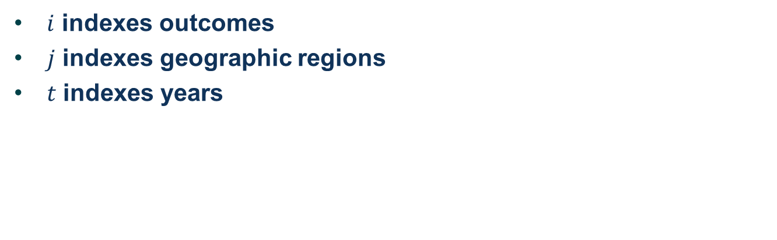
Bayesian Hierarchical Model
$$y_{ijt}=α+a_{i}+b_{j}+c_{t}+β_{i×j}+γ_{i×t}+δ_{j×t}+ ε_{ijt}$$
$i$ indexes outcomes
$j$ indexes geographic regions
$t$ indexes years

Slide 13
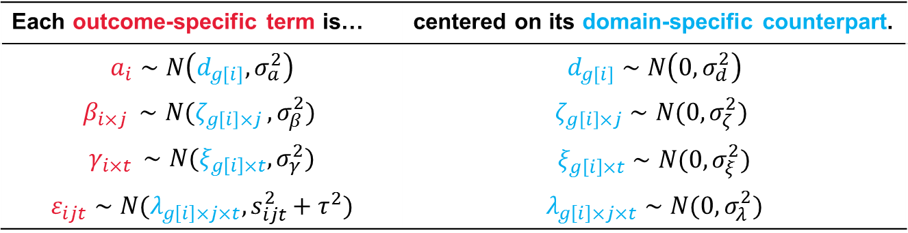
Bayesian Hierarchical Model
$$y_{ijt}=α+a_{i}+b_{j}+c_{t}+β_{i×j}+γ_{i×t}+δ_{j×t}+ ε_{ijt}$$
Each outcome-specific term is… | centered on its domain-specific counterpart.
$$a_{i}∼N\left(d_{g\left[i\right]}, σ_{a}^{2}\right)$$ | $$d_{g\left[i\right]}∼N\left(0, σ_{d}^{2}\right)$$
$$β_{i×j }∼N(ζ_{g\left[i\right]×j }, σ_{β}^{2})$$ | $$ζ_{g\left[i\right]×j}∼N(0, σ_{ζ}^{2})$$
$$γ_{i×t }∼N(ξ_{g\left[i\right]×t}, σ_{γ}^{2})$$ | $$ξ_{g\left[i\right]×t}∼N(0, σ_{ξ}^{2})$$
$$ε_{ijt}∼N(λ_{g\left[i\right]×j×t}, s_{ijt}^{2}+τ^{2})$$ | $$λ_{g\left[i\right]×j×t}∼N(0, σ_{λ}^{2})$$

Slide 14
Borrowing Strength Across Outcomes
Frequentist Bayesian

Slide 15
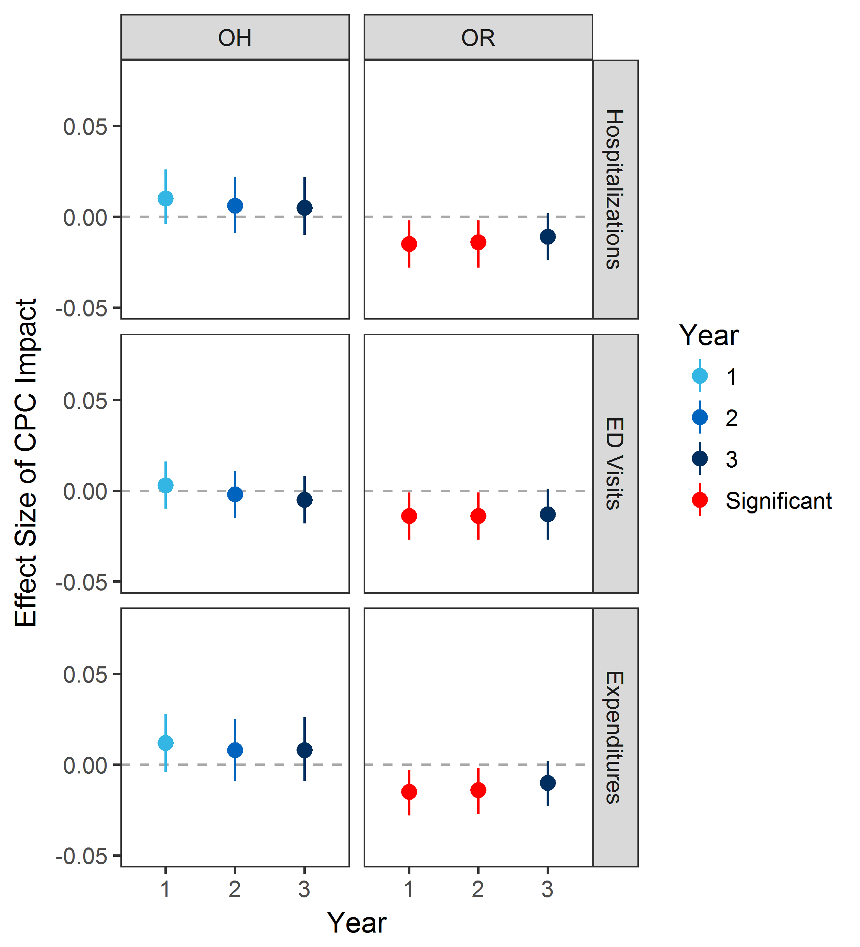
Borrowing Strength Across Outcomes
Frequentist Bayesian

Slide 16
Borrowing Strength Across Outcomes
Frequentist Bayesian

Slide 17
Borrowing Strength Across Outcomes
Frequentist Bayesian

Slide 18
Recall the Game Plan
Problem: Impact estimates are often based on samples that are too small to produce reliable estimates
Solution: Hierarchical Bayesian models borrow strength across related impact estimates
Today:
  The Comprehensive Primary Care Initiative
  Borrowing strength across regions and outcomes
    Why – correct for multiple comparisons, decrease false ☑ and ☒
    What – more precise, plausible, intuitive estimates

Slide 19
For More Information
Lauren Vollmer
  lvollmer@mathematica-mpr.com
Mariel Finucane
  mfinucane@mathematica-mpr.com

