Slide 1


Child labor and health: A systematic review
Kuimi BL, Oduro-Oppong N, Kaufman JS, Nazif-Munoz J.I., Nandi A.
Jan 12, 2018, ICHPS

Slide 2
Background
The abolition of child labor is one of the four categories of rights adopted in 1998 by the ILO Declaration on Fundamental Principles (Convention 2005; International Labour Office 2017).
Ending child labor in all its forms by 2025 is one of the targets of Sustainable Development Goal (Boothe 2016).
170 million children involved in child labor (Economic and Social Council 2016).

Slide 3
Background
Child labor might imposes physical and mental strain, which children are likely ill-equipped to handle (Fassa et al. 2000).
  Loss of developmental opportunities, which could adversely impact children into adulthood and over the life-course (Cigno and Rosati 2005).
  Time spent working severely constrains learning and playing time (Nishijima et al. 2015; Shendell et al. 2016).
However, it may be argued that work also has some positive effects:
  Children might learn adaptation strategies that increase their resilience (Blair 1992).
  Income from a working child may improve his nutritional status, and may confer health benefits to other family members as well (Genicot 2005).

Slide 4
Background
Previous review reported data mostly from High Income countries.
For the few in low- and middle-income countries (LMICs) :
  Health of street children who are quite distinct from child workers.
  Distributions and reasons for child labor.
  Missed education.
Thus, there remains a substantial lack of clarity concerning the overall relation between child labor and health, especially in LMICs.

Slide 5
Research Question
P | All children under 18 years in LMICs
I/E | Child labor, defined as paid or unpaid economic activity either for family or outside the home
C | Non-working children; different types of work, & prevalence or incidence of at least one of the health outcomes
O | Injuries, nutritional outcomes, and harmful workplace exposures
Notes:
Classification of the World Bank Data Catalogue
(e.g. anemia, malnutrition, wasting, stunting, weight-for height)
(e.g. chemical toxins, excessive heat/cold, physical risks such as working with heavy machinery without adequate protective measures)
These outcomes are most commonly hypothesized to be the immediate and the long-term effects of child labor (Parker 1997).

Slide 6
Objectives
This study aimed to synthesize the available knowledge, identify unexplored areas and discuss general limits of the published evidence.
  We follow a registered protocol and PRISMA guidelines (Moher et al. 2009).
  EMBASE, MEDLINE, Scopus, and Web of Science were searched for studies published between January 1996 and November 2017.
Notes:
The search strategy was designed with the help of a professional librarian to favour sensitivity over specificity in an effort to be as comprehensive as possible
Four indexing and abstracting services

Slide 7
Inclusion & exclusion criteria
Described the incidence or prevalence of health outcomes among working children.
Examined the association between child labor and outcomes by including an unexposed control group.
Studies were excluded if entirely qualitative, or if they only examined the prevalence of child work.
No restriction on language was applied.
Notes:
The reference lists of included studies were manually checked.

Slide 8
RESULTS

Slide 9
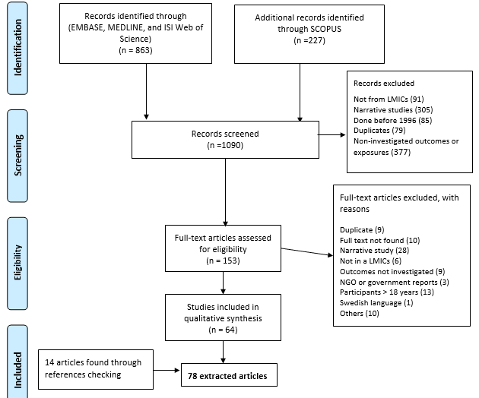
Flow chart
Notes:
Four indexing and abstracting services

Slide 10
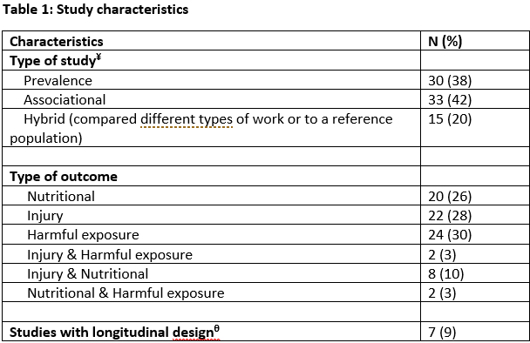
Notes:
¥ Studies only estimating the prevalence of at least one the health outcomes were classified as “Prevalence”;
those having a group of non-working children as control were classified as “Associational”;
finally, those comparing the association between child work and health outcomes across different types of work were classified as “Hybrid”.
^{Θ} Include 3 two-round surveys, 2 prospective, and 2 retrospective cohort studies.

Slide 11
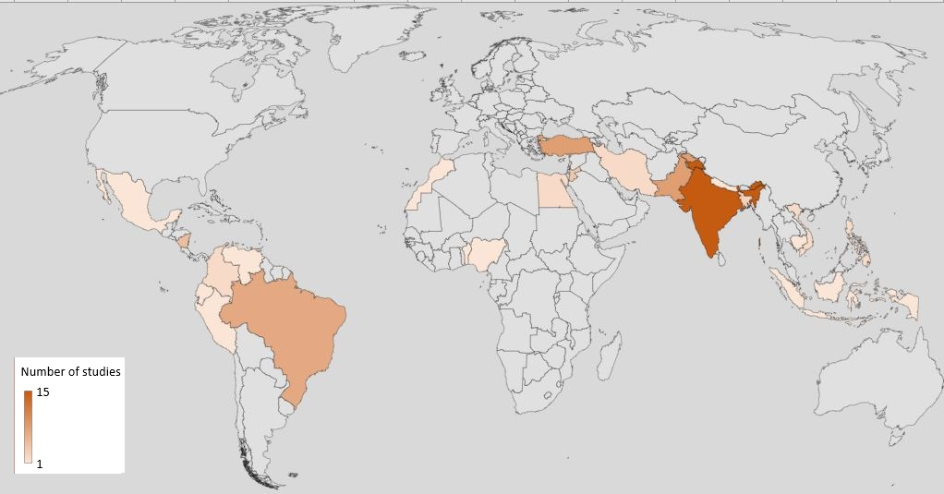
Notes:
*24 countries covered by studies conducted in a single country are represented.
Overall, the 78 studies included four cross-national studies.
Among these studies, (Bose-O'Reilly et al. 2008), (Pinzon-Rondon et al. 2009), and (Gargy et al. 2011) covered 9 countries (with Afghanistan and Zimbabwe being the countries not represented in this map)
and one study (Roggero et al. 2007) combined data from all developing countries.
Most studies were conducted in Asia and South America, with a fifth coming from India alone
India 15 ---- Turkey 8 ---- Pakistan 8 ---- Brazil 7

Slide 12
Nutritional Outcomes
On average, child workers had lower weight and height for age compared to non-working children .
The relation may be non-linear
  A study from rural Cambodia, found an inverse U-shaped association between the numbers of hours of labor and nutritional status (Kana et al. 2010).
  This suggests that health status improves if the working hours of children is shorter than the turning point ≈ 18 hrs/week.
Notes:
Generally, studies found associations between child labor and poorer nutritional status.
Few studies reported a relation between child labor and BMI (This might be the result of child labor affecting height and weight in the same direction and magnitude)
Working in non-sedentary sectors (e.g. agricultural, construction) was associated with lower height and weight, but not with differential BMI.
This might be the result of child labor affecting height and weight in the same direction and magnitude.

Slide 13
Injuries
Nonfatal injuries
A high prevalence of diverse types of injuries (fractures, burns, cuts, falls, sprains, and musculoskeletal pain).
Agricultural activities appear to be the most hazardous forms of child labor:
  Working children having 4-5 times higher prevalence of work-related injuries than those working in the non-agricultural sector.
Notes:
were observed among working children
Those working in manufacturing and domestic services had a higher prevalence of back pain
A prospective study among child laborers in rural communities in Bangladesh (Dalal et al. 2016) showed that younger age (<10 years) is associated with an increased incidence of injury-related illness.

Slide 14
Harmful exposures
In many case, the working environment was considered below the acceptable safety standards in terms of: ventilation, light, garbage disposal, temperature and level of noise.
2 studies in Nicaragua (Athanasiadou et al. 2008; Cuadra et al. 2007a) found that working children had 20-50 times higher serum levels of polybrominated diphenyl ethers (PBDEs) compared to non-working children.
PBDEs and lead are known to be associated with :
  thyroid hormone disruption
  memory impairment
  impaired neurobehavioral
Notes:
However, an overview of the extent of hazardous lead exposure in child laborers published in 2005, (Ide and Parker 2005) concluded that the potential magnitude of the hazard of lead exposure in child laborers is unclear

Slide 15
Harmful exposures
Working children had a lower Peak Expiratory Flow (PEFR) compared to non-working children.
  agricultural, construction and gem polishing sectors
A study in Dhaka, Bangladesh found that working in garbage dumping sites was associated with DNA damage (Gargy et al. 2011).

Slide 16
LIMITS
ORs as measures of association, even when the outcomes were common.
Sampling was done in a non-representative fashion.
Non report of the proportion of missing data.
Only 1/3 of studies having at least two groups adjusted for potential confounders.
Reverse causality : possibility that frail children might be less likely to find work at baseline.
Notes:
which exaggerates the relative risk (Rothman et al. 2008).
This might tend to underestimate the adverse effects of child labor observed, seriously limiting the causal interpretation of associations reported in these studies.

Slide 17
LIMITS
Many regions are severely understudied (China and sub-saharian Africa).
  Articles in English, Spanish, Portuguese, French and Turkish were included in our review.
There might also be a high likelihood of publication bias in this review.
Finally, other aspects of child labor were not captured in this review:
  children involved in illicit activities which may be considerably more hazardous
    prostitution
    drug trafficking.
Notes:
This imbalance needs to be explored, since no restriction in language was applied.
One possible explanation for the paucity of reports from China might be that few Chinese journals are indexed in databases such as PUBMED, EMBASE and Scopus (Fan et al. 2008; Xia et al. 2008)
Only three studies reported non-significant associations between child labor and health outcomes among all studies having a non-working control group.

Slide 18
CONCLUSION
The limited peer-reviewed work identified in LMICs and their poor qualities are clearly indication that more research with longitudinal quantitative measures is urgently needed.

Slide 19
THANK YOU!!

Slide 20
DISCUSSION
Working in non-sedentary sectors (e.g. agricultural, construction) was associated with lower height and weight, but not with differential BMI.
This might be the result of child labor affecting height and weight in the same direction and magnitude.

