Slide 1
PERFORMANCE OF DIFFERENT PROPENSITY SCORE METHODS IN SIMULATED COHORT STUDIES WITH TIME-TO-EVENT OUTCOMES
Susan Gruber
presented at the 2018 International Conference on Health Policy Statistics, Charleston, SC January 12, 2018

Slide 2
Study Team
U.S. Food and Drug Administration
  Christian Hampp Rima Izem
  Mark Levenson Yueqin Zhao
Kaiser Permanente, Northern California
  Laura Amsden Bruce Fireman (co-PI)
Sentinel Operations Center
  Katherine Freitas Susan Gruber (co-PI) Judith Maro
  Catherine Rogers Darren Toh Zilu Zhang
Brigham and Women's Hospital
  Jessica Franklin Joshua Gagne
  Sebastian Schneeweiss Richie Wyss
Kaiser Permanente, Washington
  Jennifer Nelson Robert Wellman

Slide 3
Overview
Propensity score (PS)-based methods are used for evaluating safety signals in FDA Sentinel’s distributed data network
  adjust for confounding
  privacy preserving
Project aims
  Better understand the strengths, weaknesses, and relative performance of PS-based methods in a Sentinel-like setting
  Inform potential uses and expansion of existing Sentinel toolkit
    Identify additional methods that performs well in a wide range of settings
    Develop complementary tools that work well in response to different challenges

Slide 4
Overview
We conducted a suite of simulation studies
  Observational claims data
  21 scenarios that pose varying challenges
  43 variants of PS-based methods
    Short term follow-up: estimate an odds ratio (OR) for binary outcomes
    Longer term follow-up with some right censoring: Estimate a hazard ratio (HR) for time-to-event outcomes
  Assessed how well each method did at estimating the treatment effect, and ability to detect a signal
Susan Gruber, ICHPS, 2018

Slide 5
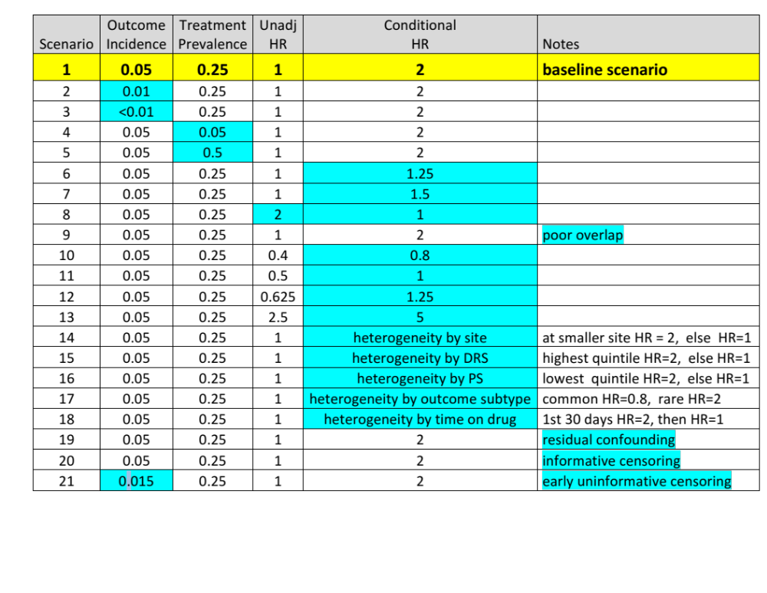
Scenarios

Slide 6
Data
Plasmode simulation
Patient-level covariates taken from real world data*
  15 strongest confounders (Bross’s formula)
  Realistic combinations of patient-level characteristics
  Correlations among covariates are preserved
  ~40,000 observations (33k at site 1, 7k at site 2)
Treatment and outcomes generated according to models defined by us
  Known confounders, known treatment effect
  Enables accurate assessment of ability to identify a signal and to estimate the magnitude of the treatment effect
*Aetna and Humana contributed data to this project that were originally
collected as part of Sentinel’s rivaroxaban surveillance

Slide 7
PS-based Methods
Variants of
  PS Regression
  1:1 Matching
  1:M variable ratio matching
  PS Stratification (10, 20, fine strata)
  Inverse probability of treatment weighted (IPTW)
  (and covariate adjusted regression as benchmark)
All methods used PS-based covariates, matched sets, strata, or weights with Cox regression
PSs were estimated using a correct logistic regression model
Assessed with respect to bias, variance, mean squared error, confidence interval coverage, rejection rate

Slide 8
Conditional and Marginal Hazard Ratios
Conditional HR_{c} describes how exposure to drug of interest multiplies an individual’s baseline hazard
Marginal HR_{m} is the hazard ratio averaged over all individuals in the population and all follow-up time
ATE: Average over entire study population
(1/2 frail, 1/2 healthy)
ATT: Average over treated population
(1/3 frail, 2/3 healthy)
frail
healthy
treated
comparator

Slide 9
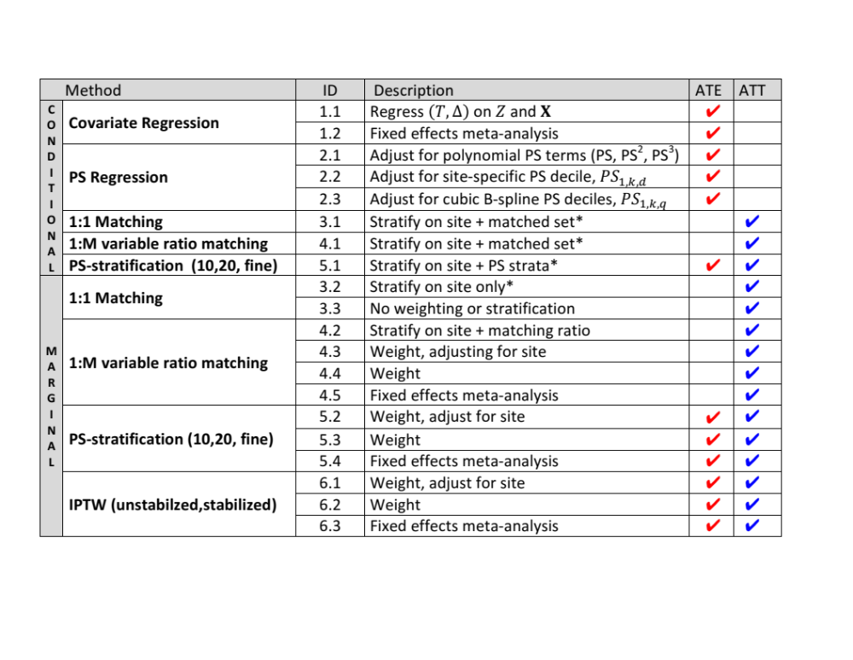
Methods
*in production use in Sentinel

Slide 10
When do these distinctions matter?
In many Sentinel-like scenarios the marginal HR is nearly the same as the conditional HR
  When the drug has no effect on safety outcomes HR_{m} = HR_{c}
  When incidence of the outcome is very low (<1%) during followup of interest HR_{m} ≈ HR_{c}
When the HR_{m} diverges from the HR_{c}, the HR_{m} is always closer to the null
Marginal HR: When does the ATE will diverge from the ATT?
  When the treated differ a lot from the comparators in ways related to the outcome and there is an effect of treatment
  When there is heterogeneity across subgroups in the conditional HR, especially across subgroups defined by strong predictors of treatment

Slide 11
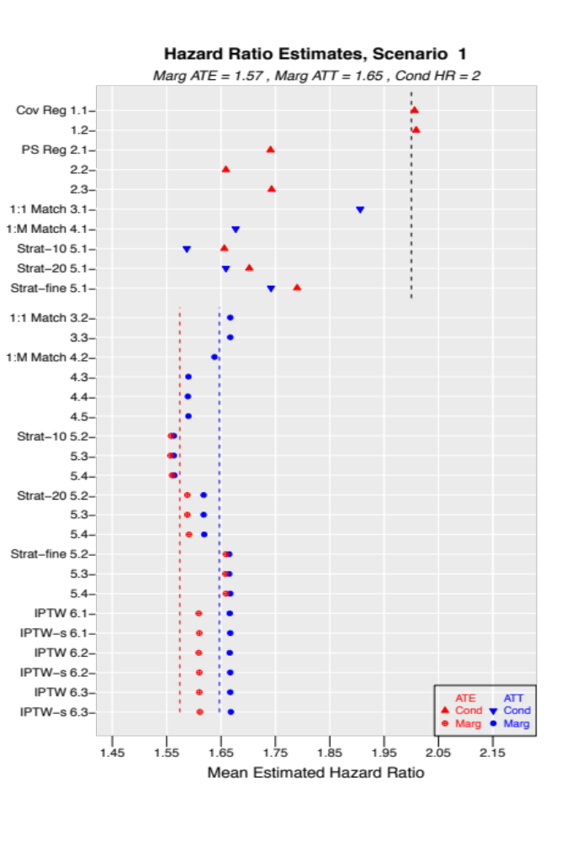
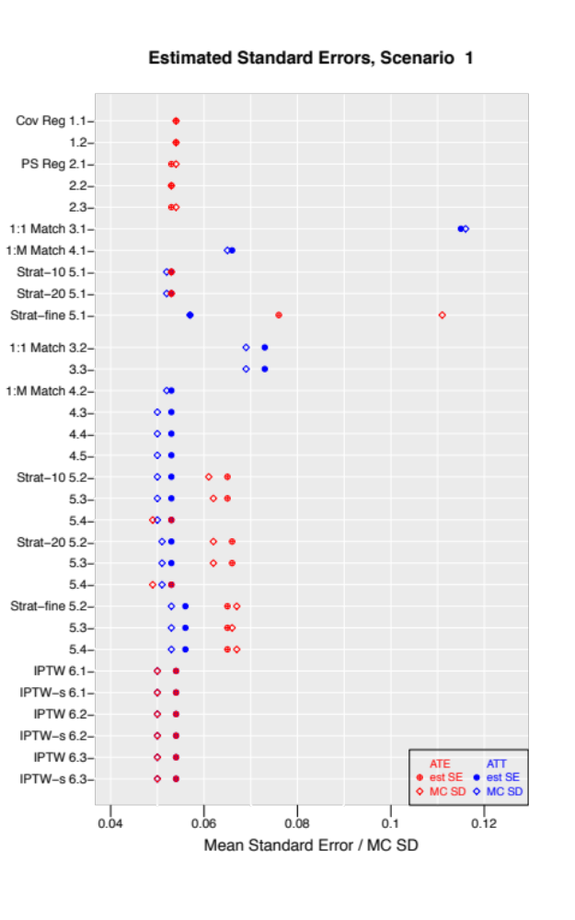
Results: Baseline Scenario (1000 replicates)

Slide 12
Results: Baseline Scenario (1000 replicates)
Conditional HR
  PS-based methods that estimate a conditional effect lie between HR_{m} (ATE) and HR_{c} on average
  1:1 matching gets closest to HR_{c} , but SEs are nearly double
Marginal HR
  ATE
    Least biased: PS stratification (10, 20) and IPTW
    SEs for IPTW are smaller than for PS stratification
  ATT
    Least biased: 1:1 matching, 1:M matching (stratified), PS stratification (fine), IPTW
    SEs are similar
SE estimates are reliable (sometimes slightly conservative)

Slide 13
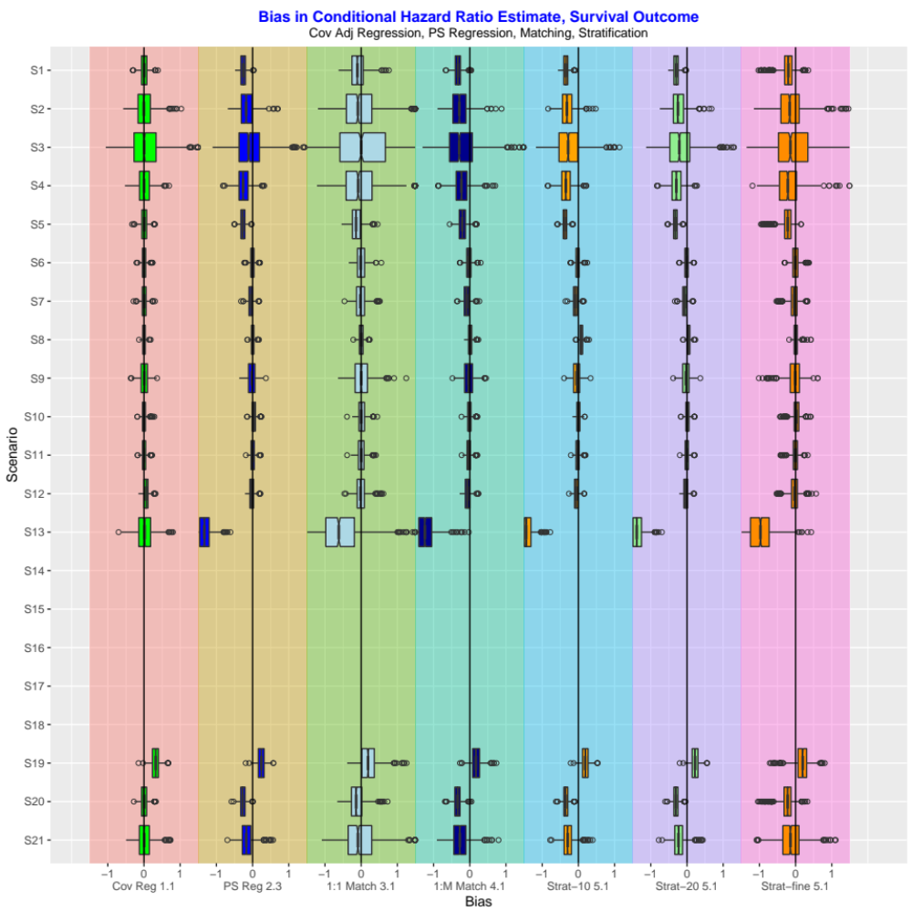
Bias in HR_{c} results (homogeneous effect scenarios)
Conditional HR is the same for everyone
Methods have similar performance across many scenarios (s5 – s12)
Cov adj regression is centered at 0, while other methods are sometimes biased.
Increasingly rare outcome (s1 – s3)
  SEs grow
  1:1 matching remains unbiased but has most variability. The estimate from any single analysis might be extreme
  PS regression and fine stratification have little bias
Poor overlap scenario 9 causes 1:1 matching and fine stratification to produce more outliers
Residual bias from unmeasured confounding (s19) and informative censoring (s20) is evident

Slide 14
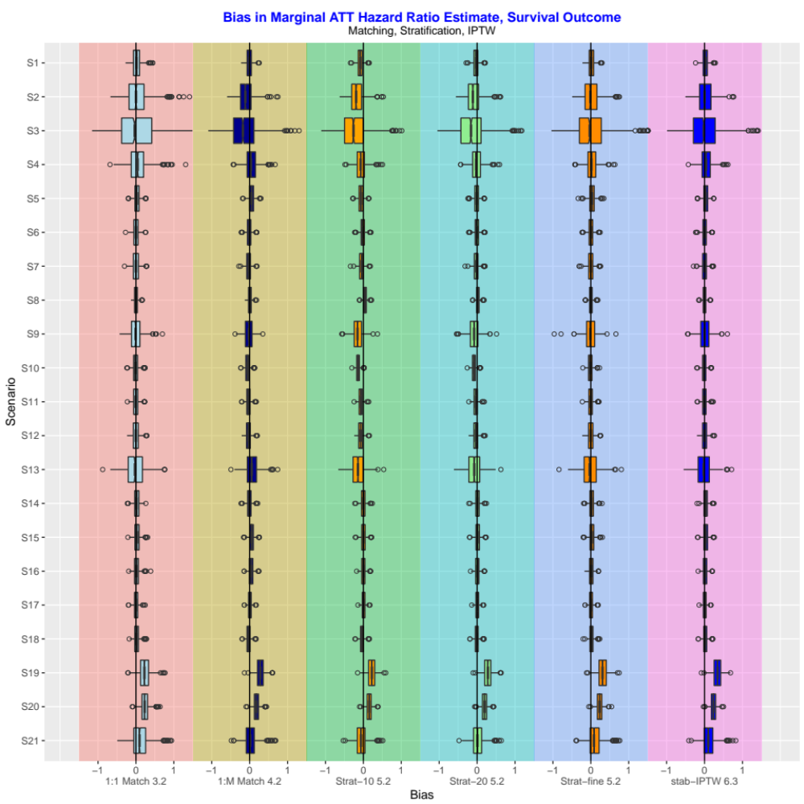
Bias in HR_{m} results in all scenarios (ATT)
At first glance, all methods do well across all scenarios
Increasingly rare outcome (s1 – s3)
  estimate from any single analysis may be extreme
  1:1 matching, fine stratification and IPTW were least biased
  1:M matching was biased
  PS stratification using 10 or 20 strata was biased (also true in s10-s13)
Problematic scenarios for HR_{c} (s9, s13) are not challenging for estimating HR_{m}
Residual bias from unmeasured confounding (s19) and informative censoring (s20) is evident

Slide 15
Final Thoughts
In many scenarios all methods performed well (under correct PS specification)
Which HR estimators performed best overall in our studies?
  IPTW estimators of the HR_{m} (ATT) did best overall
    IPTW estimators of the marginal ATE were vulnerable to poor overlap
  The 1:1 matched estimator of the HR_{m} (ATT) was as unbiased but was less precise.

Slide 16
Final Thoughts
Finer PS-stratification and flexible PS-regression did a good job of estimating the HR_{c} in scenarios without differential depletion of susceptibles*
  When there was depletion of susceptibles, these methods yielded HR estimates below their target HR_{c} but above the HR_{m} estimators.
Even though HR_{m} is closer to the null than HR_{c} when HR ≠ 1, in our scenarios (n= 40,000) the power to detect true safety signals (rejection rates) was similar when estimating a conditional or marginal effect
* individuals at high risk for the outcome

Slide 17
Extra slides

Slide 18
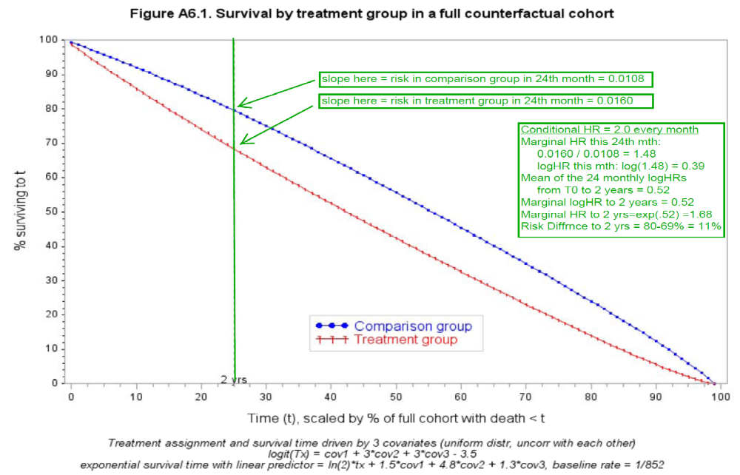
Figure A6.1 Survival by treatment group in a full counterfactual cohort
% surviving to t
Time (t), scaled by % of full cohort with death < t
Treatment assignment and survival time driven by 3 covariates (uniform distr, uncorr with each other)
logit(Tx) = cov1 + 3*cov2 + 3*cov3 – 3.5
exponential survival time with linear predictor = ln(2)*Tx + 1.5*cov1 + 4.8*cov2 + 1.3*cov3,
baseline rate = 1/852

Slide 19
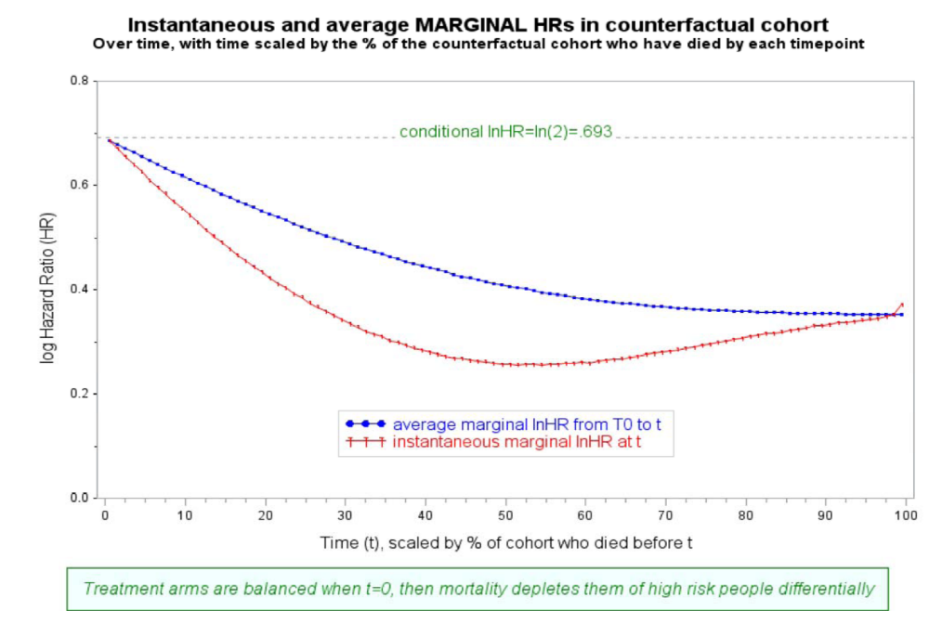
Figure A6.2
Figure A6.2 Instantaneous and average MARGINAL HRs in counterfactual cohort
over time, with time scaled by the % of the counterfactual cohort who have died by each time point
log Hazard Ratio (HR)
Time (t), scaled by % of cohort who died before t
Treatment arms are balanced when t=0, then outcome events deplete them differentially of high-risk people

