Slide 1
Best Practices for Benefit-Risk Evaluation to Ensure Effective and Transparent Decision-Making
Ten* Quantitative Recommendations for a Qualitative Benefit-Risk Evaluation
Gregory Levin, FDA/CDER/OTS/OB/DBIII

Slide 2
Disclaimer
This presentation reflects the views of the author and should not be construed to represent FDA’s views or policies.

Slide 3

Recommendation #1:
More rigorously plan the safety evaluation

Slide 4
More rigorous safety planning: A start
Categorization of adverse events according to seriousness of outcome and a priori knowledge about plausibility of drug effects
  Identify key potential risks
For key potential risks:
  Plan for ascertaining outcomes, e.g., via specific items in structured questionnaire (active) or groupings of voluntary responses to open-ended questions (passive)
  Plan for defining outcomes (e.g., groupings)
  Analysis plan with appropriate methods

Slide 5
Recommendation #2: Consider the expected precision in the evaluation of key potential risks in determining the size of the drug development program

Slide 6
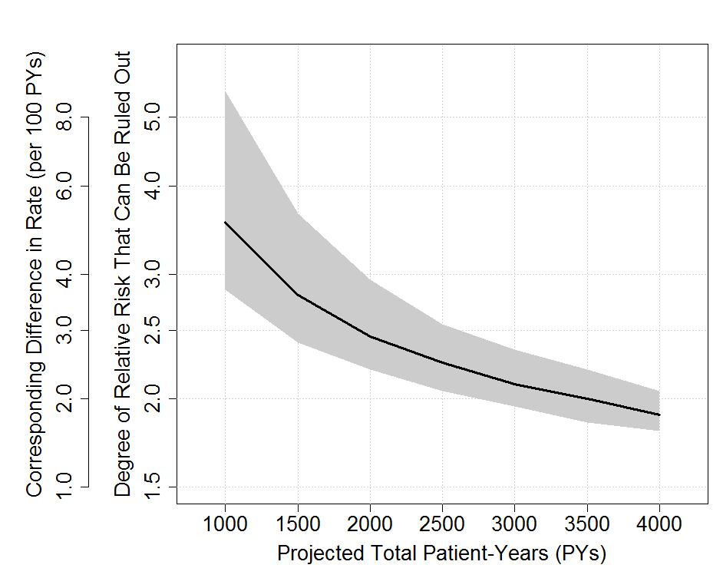
Example calculations to foster cross-disciplinary discussion
* Graph shows hazard ratios ruled out with 80% power with different total numbers of events (black line/grey area indicate expected/plausible range of observed events) given different total numbers of patient-years, 1:1 randomization, control event rate=2/100 PYs, equal rates on two arms

Slide 7
Recommendation #3: Include estimates of uncertainty around the comparison against the control in the safety evaluation

Slide 8
Importance of comparisons and uncertainty
Risk of AE: 4% on drug versus 2% on control
  What can we conclude?
Risk of AE: 4% on drug versus 2% on control (risk difference: 2%; 95% CI: -6%, +10%)
  What can we conclude?
Risk of AE: 4% on drug versus 2% on control (risk difference: 2%; 95% CI: 1.5%, 2.5%)
  What can we conclude?

Slide 9
Recommendation #4: Use metrics for safety summary measures that are appropriate for the study design

Slide 10
Use appropriate metrics
Consider parameter of interest (e.g., cumulative incidence proportion, incidence rate, hazard rate) and then choose appropriate method given the design
Example #1: time-to-event study, follow-up differs across patients, interest in cumulative incidence proportion
  Crude incidence proportions not appropriate!
  Use Kaplan-Meier estimates or alternatives instead
Example #2: integrated analysis of 6-month + 12-month studies, interest in cumulative incidence proportion
  Crude incidence proportions not appropriate!
  Use Kaplan-Meier estimates or alternatives instead

Slide 11
Recommendation #5: Present key benefit and risk results on the absolute difference scale

Slide 12
Present key results on absolute difference scale
Drug X prevents hip fracture (relative risk=0.5) and causes heart attacks (relative risk=2.0)
  Do the benefits outweigh the risks?
Drug X prevents hip fracture (control/drug rate=40/20, difference=20 events per 1000 patient-years) and causes heart attacks (control/drug rate=1/2, difference=1 event per 1000 patient-years)
  Do the benefits outweigh the risks?
Drug X prevents hip fracture (control/drug rate=20/10, difference=10 events per 1000 patient-years) and causes heart attacks (control/drug rate=15/30, difference=15 events per 1000 patient-years)
  Do the benefits outweigh the risks?

Slide 13
Recommendation #6: Consider analyses of integrated data from multiple studies where appropriate and use valid statistical methods

Slide 14
Appropriate integrated analyses
Study | Drug | Control
1 | 8/100 (8%) | 2/50 (4%)
2 | 10/200 (5%) | 4/100 (4%)
3 | 75/500 (15%) | 130/1000 (13%)
Percentage from crude pooling | 11.6% | 11.8%
Study-size adjusted percentage | 12.9% | 10.9%

Slide 15
Recommendation #7: Present key benefit and risk results side by side to facilitate cross-disciplinary discussions about benefit-risk

Slide 16
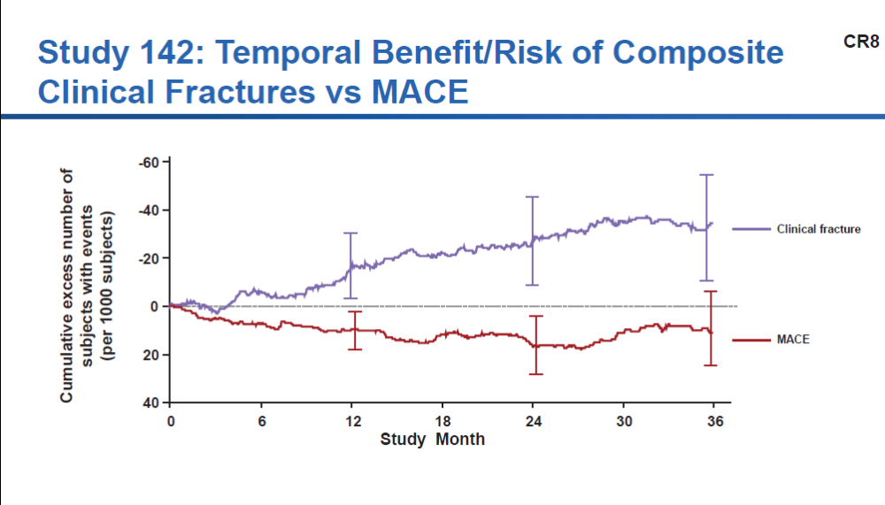
Present key benefit and risk results side by side
Source: Amgen 01/16/19 BRUDAC meeting presentation on romosozumab for treatment of postmenopausal osteoporosis in women at high risk for fracture

Slide 17
Recommendation #8: Attempt to translate drug effects on biomarkers to drug effects on clinical endpoints (direct measures of how patients function, feel, or survive)

Slide 18
Translate biomarker effects to clinical benefit
Example: volanesorsen for familial chylomicronemia syndrome
Benefit
  Large effect on biomarker (surrogate): triglycerides
  Uncertainty in magnitude of effect on clinical endpoint: pancreatitis
Risk
  Clear effect on biomarker: severe thrombocytopenia
  Uncertainty in magnitude of adverse effect on clinical endpoint: serious bleeding
FDA and Advisory Committee wrestled with uncertainty in benefits and risks on clinical endpoints
Implication for design stage: use clinical endpoints if potential for challenging benefit-risk evaluation

Slide 19
Recommendation #9:
Design clinical trials to provide information relevant to real-world treatment decisions

Slide 20
Designs relevant to real-world decisions
Choice of study population: representative of patients expected to take drug if approved
Choice of control group: receive treatment policy that is reasonable representation of standard of care
Choice of outcomes: direct measures of how patients function, feel, or survive
Choice of ancillary care: allow background/rescue/escape meds reflective of standard of care
Adherence: seek best real-world achievable levels of adherence to treatment
Estimand: treatment policy estimand is of interest
⇒ Goal: provide benefit-risk information relevant to actual treatment decisions and minimize extrapolation necessary to evaluate impact of potential regulatory decisions on public health

Slide 21
Acknowledgments
Office of Biostatistics Safety and Benefit-Risk Working Group (FDA/CDER/OTS/OB)

Slide 22
Thank you!

Slide 23
Backup Slides

Slide 24
Recommendation #10: Evaluate the treatment policy estimand as a key estimand in the analysis of important safety outcomes

Slide 25
Rationale for treatment policy estimand
Reason 1: helps identify delayed adverse effects (e.g., on outcomes with long latency periods like malignancy)
Reason 2: ensures adverse effects are not missed due to differences in types of patients discontinuing treatment on two arms
Note: reliable evaluation requires follow-up of patients who discontinue study treatment!

Slide 26
Rationale for treatment policy estimand
Drug doubles risk of infections while patients take it
Two subgroups:
  Healthier (75% of patients; infection rate: 1/100 PYs)
  Sicker (25% of patients; infection rate: 5/100 PYs)
Drug causes AEs and treatment discontinuation in sicker patients, random sample of placebo arm stops treatment
On-treatment (“while on treatment”) infection rates:
  Drug: 2*1 = 2.0
  Placebo: 1*0.75+5*0.25 = 2.0
On-study (“treatment policy”) infection rates:
  Drug: 2*1*0.75+5*0.25 = 2.75
  Placebo: 1*0.75+5*0.25 = 2.0

