Slide 1
Creating a Benefit-Risk Estimand from My Drug Program’s Efficacy and Safety Estimands
2019 ASA Biopharmaceutical Section
Regulatory-Industry Statistics Workshop
Washington, DC
Susan Duke, MS, MS
Office of Biostatistics, DBII
Center for Drug Evaluation and Research
US Food and Drug Administration

Slide 2
Disclaimer
This presentation reflects the views of the author, and should not be construed to represent FDA’s views or policies.

Slide 3
Acknowledgments
Thanks to these people for
  development of pulmonary estimand example and
  consideration of how to construct a benefit-risk estimand
    Cesar Torres, PhD - Mathematical Statistician, DBII
    Greg Levin, PhD - Deputy Director, DB III
    Yongman Kim, PhD - DBII Pulmonary Team Leader
    Dong-Hyun Ahn, PhD - Mathematical Statistician, DBII
    Rekha Jhamnani, MD - Pulmonary/Allergy Medical Officer
    Miya Paterniti, MD - Pulmonary/Allergy Team Leader

Slide 4
How to Make a Benefit-Risk Estimand?
Approach 1
  Primary Efficacy Estimand: ‘Benefit’
  and ‘Critical’ AESIs and any that emerged during confirmatory trials: ‘Risk’
  Estimand attributes
    Population
    Variable (Outcome)
    Population-level summary measure
    Handling of intercurrent events
  Nasal polyps example
Where does my drug development program sit on the Benefit Risk Matrix?
Approach 2
  What outcomes matter to patients?
Approach 3
  Weighting
Closing thoughts

Slide 5
Why a benefit-risk estimand?
Answering the wrong questions is bad science
Therefore, basing regulatory decisions on answers to the wrong questions is bad policy
~ Cesar Torres, previous presentation

Slide 6
Approach 1
Can we make a benefit-risk estimand?

Slide 7
Estimands
Estimands for the evaluation of efficacy endpoints are becoming more common
Estimands for the evaluation of safety endpoints not widely used (as of now)
Estimands for benefit-risk may not have been considered yet

Slide 8
Benefit-Risk Value Tree
Estimator
Endpoints
Benefits
Benefit-Risk Balance
Risks

Slide 9
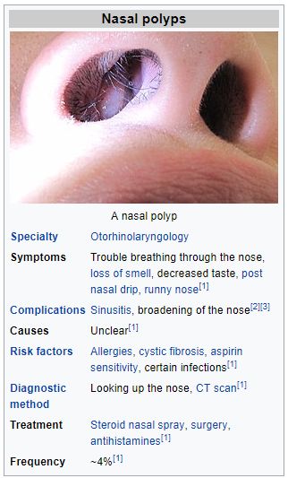
Example
Chronic rhinosinusitis with nasal polyposis
Unmet medical need – not well-controlled with steroid sprays, surgery, antihistamines
Systemic biologics are being developed that affect the metabolic pathway that forms nasal polyps
From Wikipedia

Slide 10
Nasal Polyps Efficacy Estimand
Population of interest: Adult patients with physician diagnosed nasal polyps for >12 months, who have large nasal polyps with chronic rhinosinusitis, and an inadequate response to standard of care therapy (which includes at least 8 weeks of intranasal CS and may include systemic CS and/or nasal polyp surgery), based on their actual treatment and receiving at least one dose of investigational or reference product
Endpoints of interest: Change from baseline in co-primary endpoints, average daily Nasal Congestion, and Nasal Polyp Score at Week 24 (for biologics) or Week 16 (for locally acting corticosteroids). Specific timing of visits is dependent on a drug's mechanism of action.
Population-level summary for the endpoint: Difference in variable means between active and placebo treatment groups
How potential intercurrent events are reflected:
  Rescue treatment: the patients who had rescue (surgery or systemic corticosteroid treatment (SCS for 3 or more days) would be considered treatment failures (composite strategy: intercurrent event is taken to be a component of the variable)
  Treatment discontinuation: the variables of interest (NC or NPS) values for the patients who did not have rescue are used regardless of whether or not treatment discontinuation occurs (treatment policy strategy: The value for the variable of interest is used regardless of whether or not the intercurrent event occurs)

Slide 11
Nasal Polyps Efficacy Estimator, Sensitivity Analysis
Estimator
Population-level summary for the endpoint: Difference in least squares variable means between active and placebo treatment groups employing ANCOVA.
How potential intercurrent events are reflected:
  Rescue treatment: worst score patient experienced prior to rescue imputed to Week 24 (or Week 16 for local corticosteroid medications) score
  Treatment discontinuation: patients' observed data post discontinuation is used and standard multiple imputation method is used to handle missing data assuming missing at random
Sensitivity analysis
Alternative analysis models: a) MMRM
Alternative estimands regarding intercurrent events:
  a) regardless of SCS rescue (using actual data for patients on SCS in the estimator) Alternative assumptions for missing data (imputation method):
  b) Missing not at random (delta-adjusting pattern imputation: a) Tipping point analysis) b) Missing not at random (control-based imputation)

Slide 12
Nasal Polyps Benefit-Risk Value Tree
Estimator
Endpoints
NPS difference in LS Means
Nasal Polyp Score
Benefits
Nasal Congestion Score
NC difference in LS Means
Benefit-Risk Balance
Risks

Slide 13
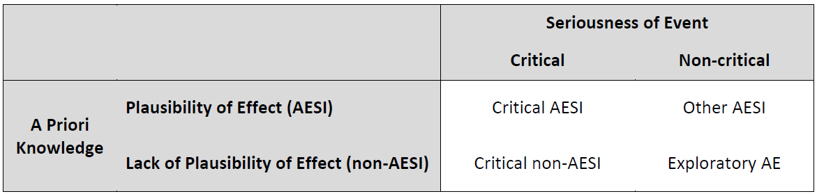
Safety Estimands for Nasal Polyps
Let’s suppose AESIs are: anaphylactic reactions, hypersensitivity, injection-site reaction (severe), infection (serious/severe), parasitic infection, opportunistic infection, drug-related hepatic disorder
Which are ‘critical’?
  anaphylactic reactions, hypersensitivity, injection-site reaction (severe), infection (serious/severe), drug-related hepatic disorder

Slide 14
Nasal Polyps Safety Estimand
Population of interest: Adult patients with physician diagnosed nasal polyps for >12 months, who have large nasal polyps with chronic rhinosinusitis, and an inadequate response to standard of care therapy (which includes at least 8 weeks of intranasal CS and may include systemic CS and/or nasal polyp surgery), based on their actual treatment and receiving at least one dose of investigational or reference product
Endpoints of interest: Whether or not patients had critical AESIs and critical non-AESIs discovered during confirmatory trials: anaphylactic reactions, hypersensitivity, injection-site reaction (severe), infection (serious/severe), drug-related hepatic disorder
Population-level summary for the endpoints: Difference in cumulative incidence through Week 24, between the two populations being compared
How potential intercurrent events are reflected: Treatment discontinuation, lack of treatment adherence, and use of alternative therapies will be ignored (treatment policy strategy: The value for the variable of interest is used regardless of whether or not the intercurrent event occurs)
Same as efficacy estimand / new for safety estimand

Slide 15
Nasal Polyps Safety Estimator, Sensitivity Analysis
Estimator
Population-level summary for the endpoint: Difference in cumulative incidence (risk difference) of the critical AEs noted between active and placebo treatment groups employing [what test statistic? How to account for different dropout rates between treatment arms?]
How potential intercurrent events are reflected: Treatment discontinuation, lack of treatment adherence, and use of alternative therapies: patients' observed data post discontinuation is used, and standard multiple imputation method is used to handle missing data assuming missing at random
Sensitivity analysis
Consider how often the AE occurred (hazard rate), ratio between rates (relative risk), AE duration and severity – are these important to the key medical questions for this drug, in this indication?

Slide 16
Nasal Polyps Benefit-Risk Value Tree
What if the actual incidence of potential risks is very low?
High benefit, low (known) risk
Endpoints
Estimator
Nasal Polyp Score
NPS difference in LS Means
Benefits
Nasal Congestion Score
NC difference in LS Means
Benefit-Risk Balance
Anaphylactic Reactions
Hypersensitivity
Risks
Risk Difference
Severe Injection Site Reaction
Known effect
Potential effect
Severe Infection
Hepatotoxicity
Is this the full picture for nasal polyps BR assessment?

Slide 17
Where is my drug on the Benefit Risk Matrix?
What level of BR Assessment is Warranted?
High Risk, Low Benefit
Easy decision for
non-approval
Sponsors typically stop development
High Risk, High Benefit
And/or more uncertainty
?
High
Risk
Low Risk, Low Benefit
And/or more uncertainty
?
Low Risk, High Benefit
Easy decision for approval
Especially with unmet medical need
Low
Example drug
for nasal polyps
Low
High
Benefit

Slide 18
Approach 2
Let’s now consider a different example…

Slide 19
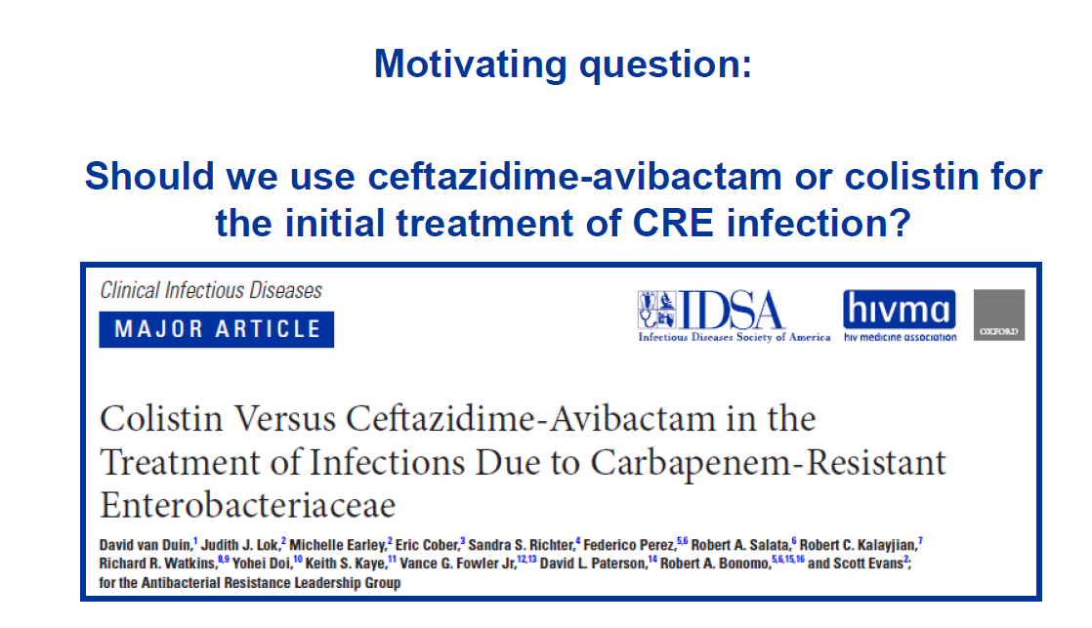
from Scott Evans

Slide 20
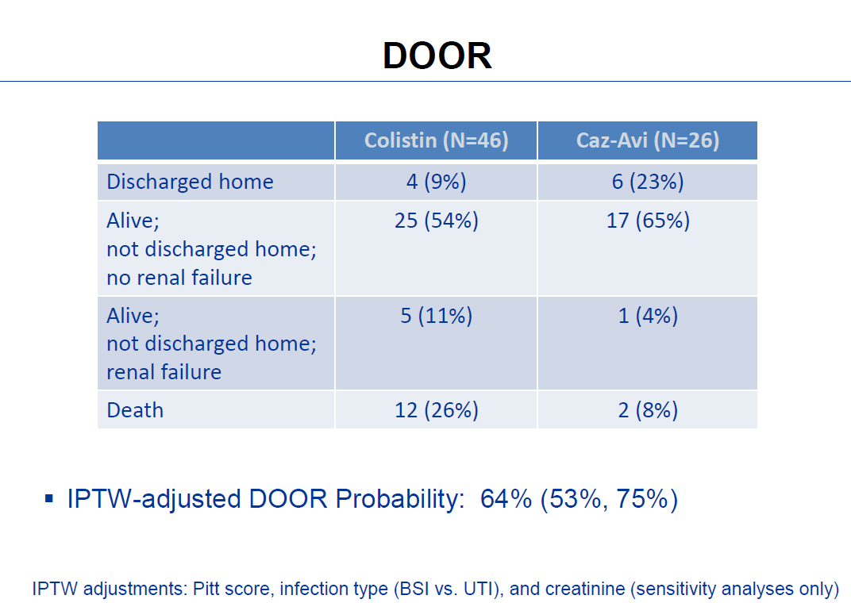
What categories make sense to assess an antibiotic for a resistant strain?
from Scott Evans

Slide 21
Approach 3
When does it make sense to use weighting?
Rare event with high morbidity and mortality in a relatively healthy population
Example:
  Natalizumab for MS
  Rare AE: PML, a brain infection with high neurological morbidity and mortality
PML: Progressive multifocal leukoencephalopathy

Slide 22
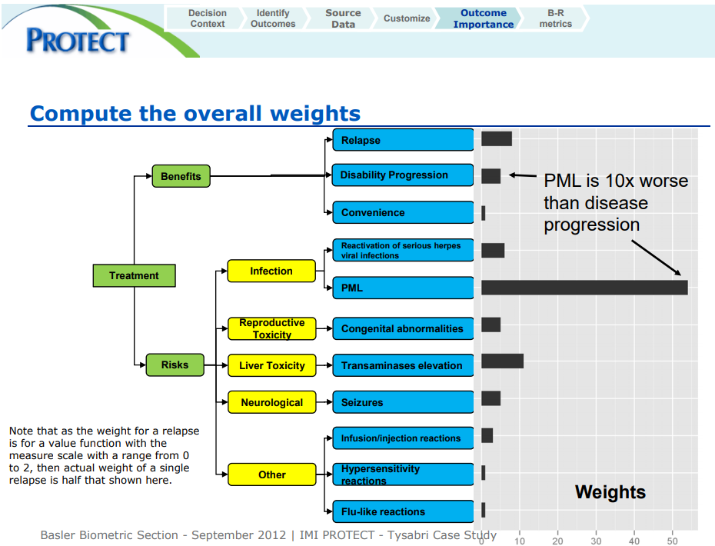
One element of BR Value Tree has much stronger weighting than any others
From Richard Nixon, 2012: http://bbs.ceb-institute.org/wp-content/uploads/2012/10/BBS2012-A-case-study-using-the-BRAT-framework-for-Benefit-Risk-Assessment.pdf

Slide 23
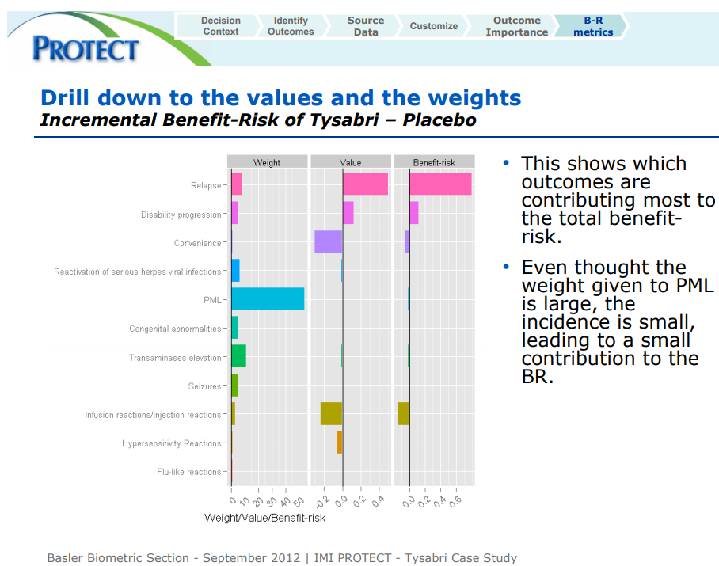
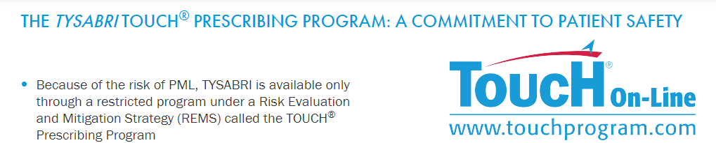
Incidence x Weight adds needed perspective
- Risk management
for this critical event
led to REMS for all patients
on natalizumab
- Did this BR assessment/
weighting affect the
regulatory outcome?

Slide 24
Closing Thoughts
Answering the wrong questions is bad science
Therefore, basing regulatory decisions on answers to the wrong questions is bad policy
What is the medical question for my drug’s benefit risk decision?
  What are the key medical benefit and risk questions for this drug?
  Where does this drug sit on the Benefit-Risk Matrix?
  How will this drug be assessed for benefit-risk in the submission?
    Prior to confirmatory trial initiation: does the study design and data to be collected match with the program level benefit-risk assessment for the submission?
    Is the planned BR assessment described in the protocol and SAP?
Consider which approach best fits your drug’s situation
  Estimands for BR planning
  Patient-level assessment is better than summarizing benefits and risks separately
  Is weighting relevant to the key medical questions?
  Benefit-risk assessment is young. What’s on the horizon?

