Slide 1
CBER Experiences with Historical Controls and Real World Evidence in Biologic Licensing Applications
Elizabeth Teeple, Ph.D.
Office of Biostatistics and Epidemiology
Vaccine Evaluation Branch
Center for Biologics Evaluation and Research

Slide 2
Disclosure
This presentation reflects my own views on the discussion topics and should not be taken as FDA position or policies.

Slide 3
Outline
CBER background
Issues and examples
  Historical Controls
  Real World Data
Conclusions

Slide 4
Biologics and CBER
Blood products
  Also blood devices, certain recombinant proteins, certain in vitro diagnostics
Cellular, tissue and gene therapies
Vaccines
  Also allergenics, probiotics, fecal transplant

Slide 5
RWE and CBER Products
Blood products, cell and gene therapies
  Rare diseases → small samples
  Blood products: immune deficiencies, exposure to snake venom or scorpion bite
Cell and gene: Single gene mutations, rare cancers
Vaccines
  Large (otherwise) healthy population
  If effective, low incidence of disease
Notes:
Both of these mean we need to augment data with sources other than RCT

Slide 6
Historical Controls
Rare disease: use external historical controls
No randomization to a concurrent comparator group
Applies in cases of serious disease when
  unmet medical need
  well-documented, highly predictable disease course that can be objectively measured and verified
  expected efficacy is large, self-evident, temporally related
FDA Draft Guidance. Rare Diseases: Common Issues in Drug Development Guidance for Industry, January 2019
Notes:
In the first category we are talking about today… make a case for using historical controls

Slide 7
Examples: Natural history
Primary Humoral Immunodeficiency
  IV or SC immune globulin product
  Efficacy endpoint based on historical standard: UCL 99% CI <1.0/subject-year
  Ascensiv, Xembify
Spinal Muscular Dystrophy (Zolgensma)
  Co-primary endpoint ability to sit without support >= 30 s. based on natural history
Notes:
PI: At increased risk for infections Use well understood natural history to define external responder rate

Slide 8
Examples: Historical control
Hereditary antithrombin deficient patients
Antithrombin for prevention of peri-operative and peri-partum thromboembolic events (ATryn)
Assessed by comparing incidence in ATryn-treated patients
  Two prospective, single-arm, open-label studies
Control plasma AT treated patients were collected retrospective chart review

Slide 9
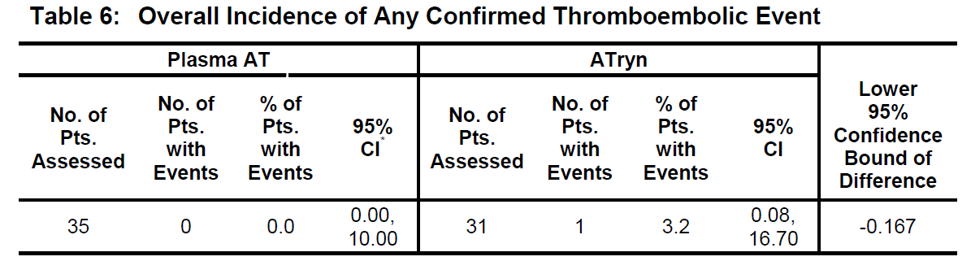
Examples: Historical control (contd.)
Result: Met pre-specified NI success criteria LCL 95% >= -20%

Slide 10
Using external historical controls
Clear limitations because not concurrent
  Time: changes in medical practice, population characteristics
  Study design: differences in diagnostic criteria, outcome measures, follow-up procedures.
Appropriate? Justify/methods
  Baseline covariate matching, propensity scores
  Meta analysis
  Bayesian

Slide 11
Postmarketing studies
Postmarketing requirements
  Effectiveness
  Safety
FDA study: Influenza and Guillain-Barre
Sentinel Initiative
Notes:
Switching gears – supplement with info not otherwise obtainable or needed to plan studies

Slide 12
Zostavax: Long-term effectiveness
2006: Approval for prevention of herpes zoster (HZ) (>60 years of age and older)
2011: extended to individuals 50-59 years of age
  PMC to study long-term effectiveness for reduction of risk for HZ and post-herpetic neuralgia (PHN)
  Based on electronic medical records from Kaiser Permanente Northern California 2007-14
  > 1.3 million individuals
Strength in study design:
  Prospective
  Pre-specified confounders
  Chart review to verify algorithm for outcome identification
  External validation with literature review
2018: long-term vaccine efficacy into labeling

Slide 13
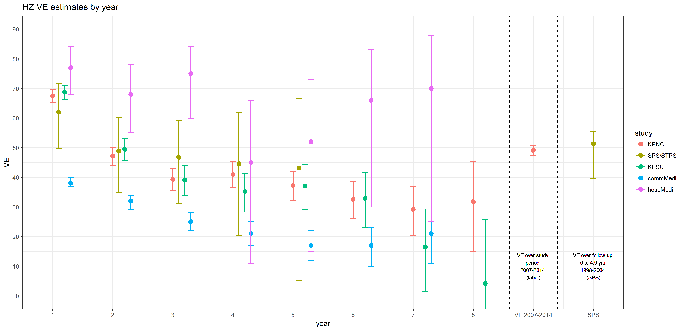
Zostavax: Long-term effectiveness

Slide 14
Rotarix: Safety
2008: Approved for prevention of rotavirus gastroenteritis in infants 6-24 weeks old
PMR observational study to assess the risk of safety events
  Intussusception (IS)
  Other pre-defined safety endpoints (e.g. Kawasaki disease)
Prospective, statistically powered and matched by age of first vaccination, gender and calendar quarter of vaccination
  Analyses based on two proprietary health care claims research databases
Low incidence of IS – high uncertainty
Notes:
Predesigned

Slide 15
Guillain-Barré Syndrome and Influenza Vaccination
Collaboration between FDA and CMS
Near real-time surveillance
  Sequential testing
  5-year historical cohort as comparison group
  To detect a potential 2.5-fold increased risk of GBS compared from the 5-year historical cohort (5 prior seasons 2012-2017)
  Results of the 2017-18 year did not show signals for a potential 2.5-fold increased risk of GBS in days 8-21 and 1-42 post-vaccination compared with the five prior historical seasons used as controls
Perez-Vilar et al., Vaccine, Vol. 37, Issue 29, 27 June 2019, 3856-3865 https://www.sciencedirect.com/science/article/pii/S0264410X19306656#b0130

Slide 16
Sentinel System
Sentinel Initiative was launched with the goals:
  Improving FDA’s capability to identify and evaluate safety issues in near real time
  Enhancing FDA’s ability to evaluate safety issues not easily evaluated from pre-market
After a pilot program, Sentinel System launched in 2016
  Exists as a collaboration of academic and data partners working under a common data structure
  Also collaborations
    CMS: effectiveness of influenza vaccines
    NHLBI: Transfusion Transmissible Infections Monitoring System
In CBER, Biologics Effectiveness and Safety (BEST) Initiative launched in 2017
  Expand Sentinel to provide access to EHR sources from over 20 million patients
Notes:
Started meaning full-scale after pilot program
Data partner = health care payers (Kaiser, BC, etc.)

Slide 17
Proposed Framework
Exploring the potential of RWD/RWE to support regulatory decisions (such as changes in labeling) about product effectiveness
  adding or modifying an indication, such as a change in dose, dose regimen, or route of administration;
  adding a new population; or
  adding comparative effectiveness or safety information.
The framework will include consideration of the following:
  Whether the RWD are fit for use
  Whether the trial or study design used to generate RWE can provide adequate scientific evidence to answer or help answer the regulatory question
  Whether the study conduct meets FDA regulatory requirements (e.g., for study monitoring and data collection)

Slide 18

FDA Framework Dec 2018
https://www.fda.gov/media/120060/download

Slide 19
RWD → Effectiveness RWE?
Real-World Data (RWD) are data relating to patient health status and/or the delivery of health care routinely collected from a variety of sources.
Real-World Evidence (RWE) is the clinical evidence about the usage and potential benefits or risks of a medical product derived from analysis of RWD.
The authors further suggested that “to establish a meaningful baseline, the FDA will need many sets of randomized clinical trials with prospectively designed, nonrandomized analyses to match the populations included in randomized clinical trials across a range of clinical questions, each investigated with a set of designs and methods following rigorous epidemiologic principles.”

Slide 20
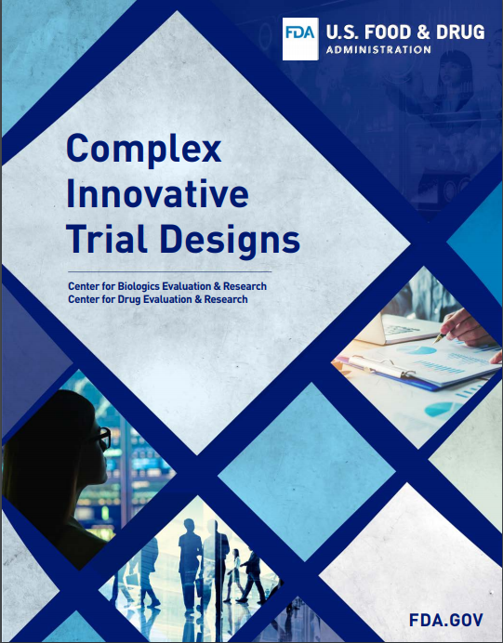
CID Pilot
Examples
Innovative use of external data
Formal incorporation of prior knowledge
Resources:
https://www.fda.gov/drugs/development-resources/complex-innovative-trial-designs-pilot-program
https://www.fda.gov/media/130897/download
Notes:
Draft guidance on interacting with FDA on CIDs

Slide 21
Acknowledgements
CBER/OBE
Shiowjen Lee, PhD
Richard Forshee, PhD
Telba Irony, PhD
Hector Izurieta, PhD
Jennifer Kirk, PhD
Tsai-Lien Lin, PhD
Silvia Perez-Vilar, PharmD, PhD
John Scott, PhD
Notes:
https://www.fda.gov/media/120060/download

